Slide 1
Co. Sligo
Contae Shligigh

Slide 2
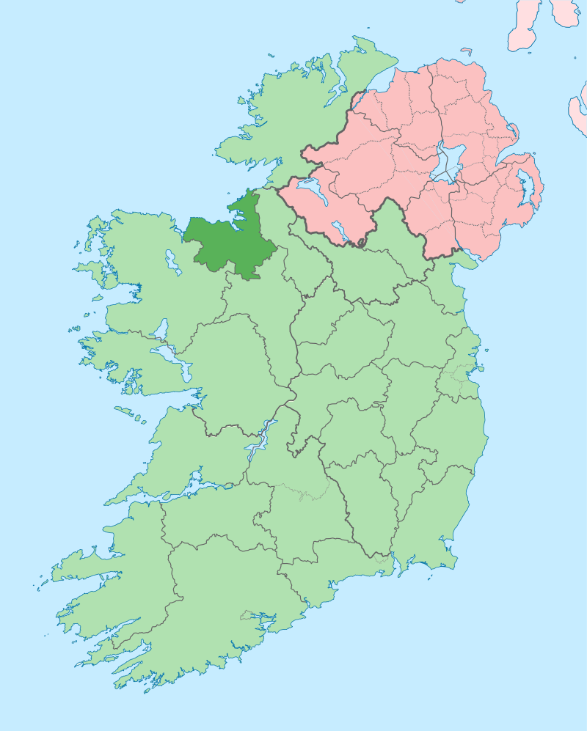
County Sligo is a county in the west of Ireland.
It is in the province of Connaught.
The Irish name ‘Sligeach’ means “abounding in shells”.
Sligo is known for Benbulben Moutain, one of Ireland’s most distinctive landmarks.
The poet William Butler Yeats spent much of his childhood in Sligo.

Slide 3
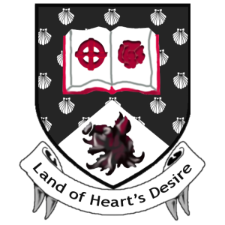
County Crest
The Celtic Cross refers to the Books of Ballymote and Lecan which are important historical manuscripts from Sligo.
The rose represents the poetry of W.B. Yeats.
The escallop shells refer to the origin of the word Sligeach "a place abounding in shells".
The boar's head refers to the "wild boar of Benbulben" in the Diarmuid and Gráinne myth.
The colour scheme of the crest incorporates the Sligo GAA colours of black and white.
Motto: “Land of Heart’s Desire” (Yeats)

Slide 4
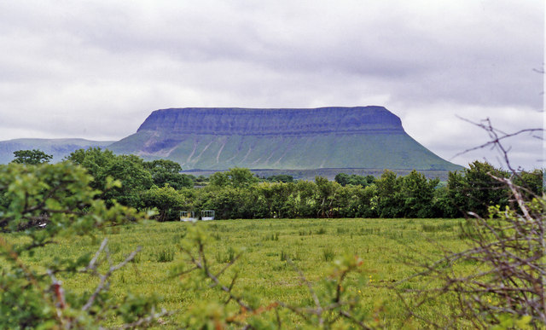
Benbulben
Benbulben is known as Co. Sligo’s ‘Table Mountain’ and is part of the Dartry Mountains.
It’s 526 metres high and it’s distinctive shape was formed by moving glaciers during the Ice Age.
Benbulbin is the setting for many Irish legends. One example is the story of the ‘Pursuit of Diarmuid and Gráinne’.
Benbulben Moutain

Slide 5
Benbulben
In this legend the warrior Diarmuid falls in love with Gráinne, the most beautiful woman in Ireland. However Gráinne is promised in marriage to Fionn mac Cumhaill.
Diarmuid and Gráinne run away together and are pursued all across Ireland by a very angry Fionn. They survive on the run for many years.
Benbulben Moutain
However one day in Benbulben they come across a wild boar, the only animal that can harm Diarmuid. The boar kills the warrior by piercing his heart with its tusk.
The mountain is said to be Diarmuid and Gráinne's resting place.

Slide 6
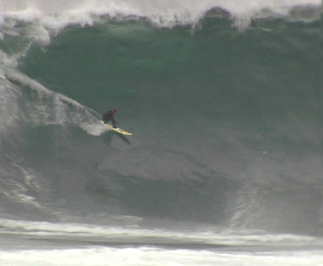
Surfing
Sligo is the self-proclaimed surfing capital of Ireland and there are surf spots all along the coast.
Mullaghmore in Co. Sligo regularly makes international headlines for it’s world-class waves.
The waves which can reach heights of 50 feet attract pro-surfers from all over the world.
Watch a clip of surfers in Mullaghmore here
Surfer in Mullaghmore

Slide 7
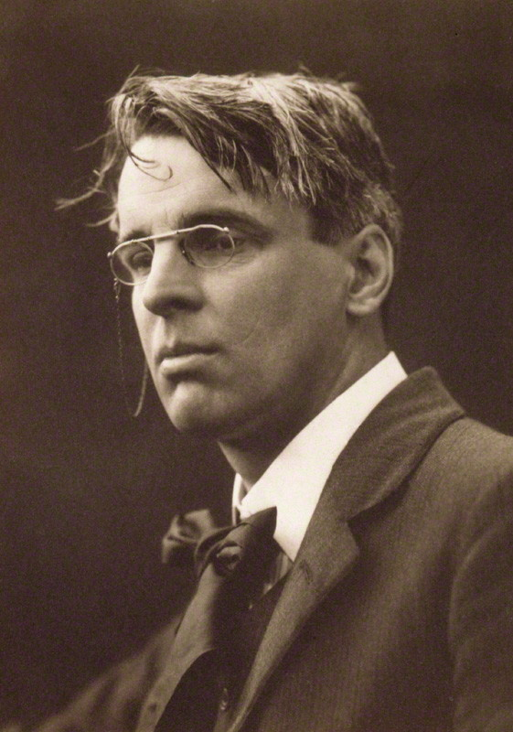
W.B. Yeats
W.B. Yeats is a famous Irish poet and playwright.
Although Yeats was born in Dublin it wasn’t long before his family relocated to Sligo.
Yeats came to regard Sligo as his childhood home and wrote a number of poems from inspiration he gathered from his surroundings.
It was the mountains, lakes and folklore of the place that moved him to write one of his most famous poems, The Lake Isle of Innisfree.
Yeats is buried in Drumcliff near Sligo.
W.B. Yeats (1865-1939)

Slide 8
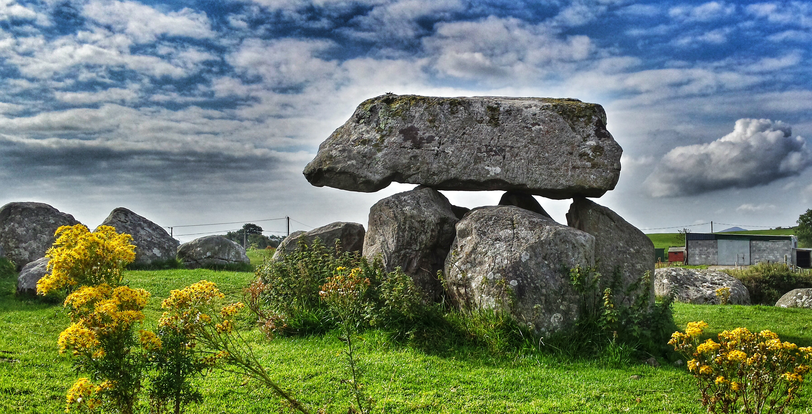
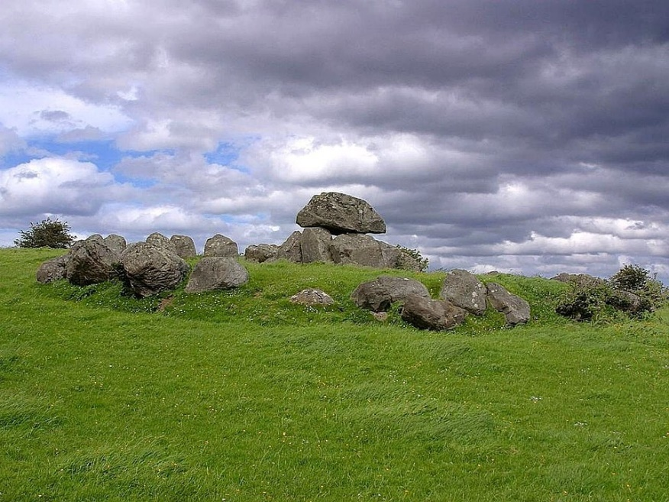
Carrowmore
Carrowmore is one of the four major passage tomb complexes in Ireland.
It is one of the largest complexes of megalithic tombs in Ireland and one of the oldest with tombs dating back to 3700 BC.
30 monuments survive in Carrowmore today.
The types of tomb found at Carrowmore are called Passage Tombs.
Carrowmore Passage Tombs

Slide 9
Quiz
Where is Ireland is Co. Sligo?
North
South
East
West

Slide 10
Quiz
What province is it in?
Leinster
Munster
Connaught
Ulster

Slide 11
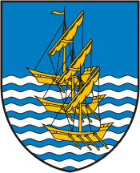
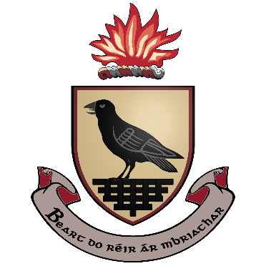
Quiz
Which of these is the county crest?

Slide 12
Quiz
Benbulben is also known as Co. Sligo’s…
Chair Mountain
Table Moutain
Bench Moutain

Slide 13
Quiz
Benbulben was formed during the…
Ice Age
Stone Age
Bronze Age

Slide 14
Quiz
‘Sligeach’ means abounding in…
seaweed
rocks
shells

Slide 15
Quiz
Which famous Irish poet is buried in Sligo?
Oscar Wilde
WB Yeats
Seamus Heaney

Slide 16
Quiz
The tombs at Carrowmore are called
Portal tombs
Passage tombs
Burial tombs

