Slide 1

Introduction to Shakespeare’s “Hamlet”

Slide 2
full title · The Tragedy of Hamlet, Prince of Denmark
Themes · jealousy, revenge, power, love, murder...and even moments of comedy.
time and place written · London, England, early seventeenth century (probably 1600–1602)
It is Shakespeare’s longest play
Disney’s “The Lion King” is based on it

Slide 3
Learning outcomes
Learners will:
Determine the introduction to the storyline of Hamlet.
Introduce themes pertaining to the events that take place at this time
Recognise the links between Shakespearean language and modern day English vocabulary.

Slide 4

Do you know what Twitter is?
Twitter is a website that enables users to send and read updates called "tweets“ to the people who subscribe to their Twitter account.

Slide 5
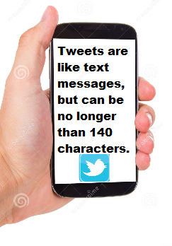

Slide 6

In this class, we are going to Tweet responses to the following scenario.
When indicated, you quickly write down your immediate response in the form of a tweet.

Slide 7

Ready???
Off we go......

Slide 8

You are away at college....it’s your final year. Everything is going well. Life is good!

Slide 9


Slide 10
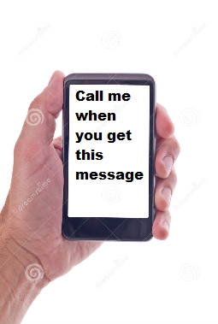
Monday night... 2am. Your mother sends you a text!

Slide 11

Half asleep, you ring her back. She is sobbing so hard, you can barely make out what she is saying. Eventually, she blurts out, “Your father is dead.”

Slide 13
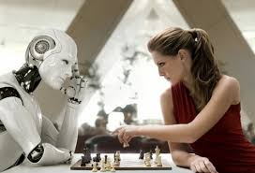
Unfortunately, this semester you have a lot of work to do, there’s constant reading, lots of assignments pending. When you tell university that your father has died, you are told you have to show evidence of illness, submit the death notice, and you still need to attend the onsite, or if you miss that you have to repeat the course...

Slide 14
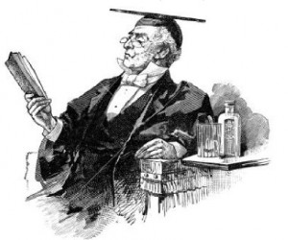
You have no choice..... You are forced to miss your Dad’s funeral

Slide 16
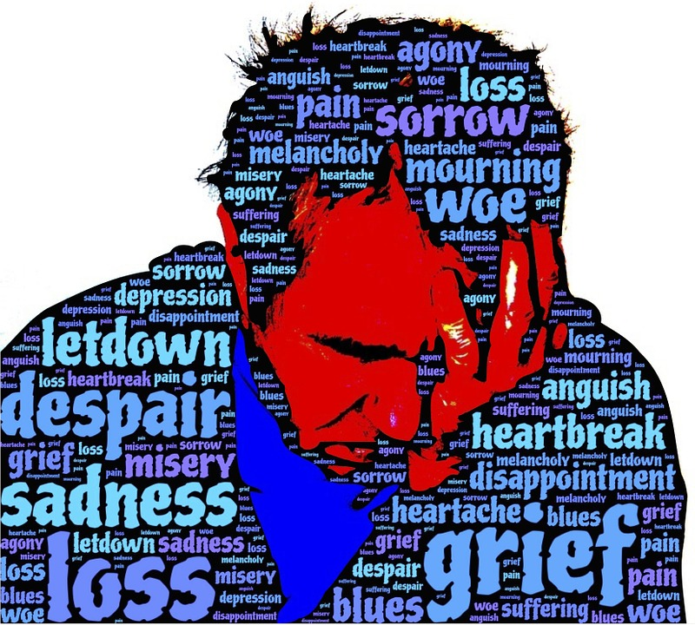
The semester’s over. You pass.... just about. It’s time to head home. It’s been 2 weeks since your father’s death, and you are just gutted.

Slide 17

So you load up the car and head home.....

Slide 18
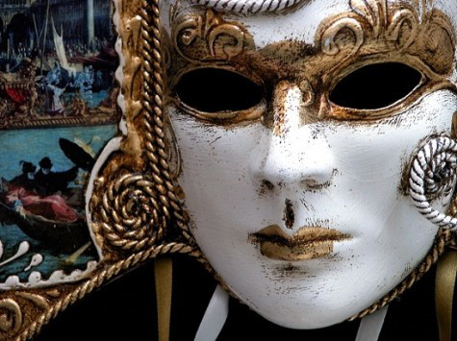
When you get home, you hug your mother for ages.... But you immediately sense a strange vibe from her... She’s not upset... Or maybe, it’s she’s not upset enough.......

Slide 19
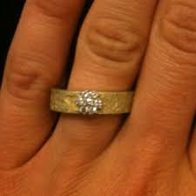
Then you notice she’s wearing a wedding ring on her finger..... A bright, shining, new, wedding ring.....

Slide 21
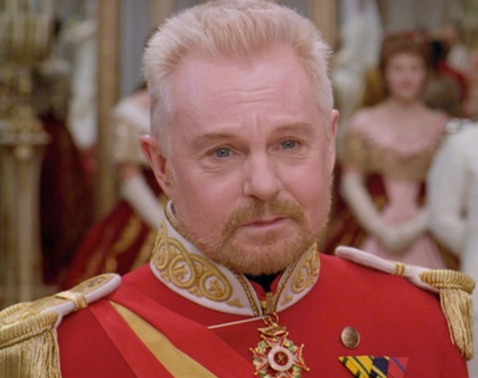
Mam tells you she has great news. She has remarried your father’s brother, Uncle Claudius.
You never liked Uncle Claudius. He was a smarmy git, and always appeared jealous of your Dad for taking over the family business. He always complained about his own job. He seemed to look at your Mam in a way that freaked you out.

Slide 23
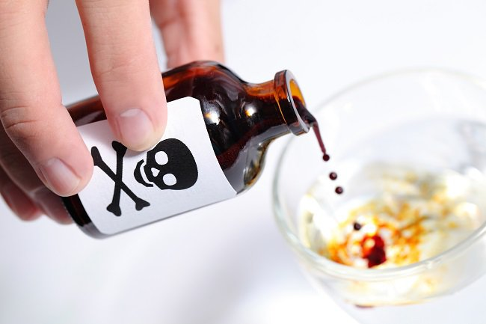
One night, your father’s ghost comes to you in a dream. He tells you he was murdered by your Uncle Claudius.

Slide 24
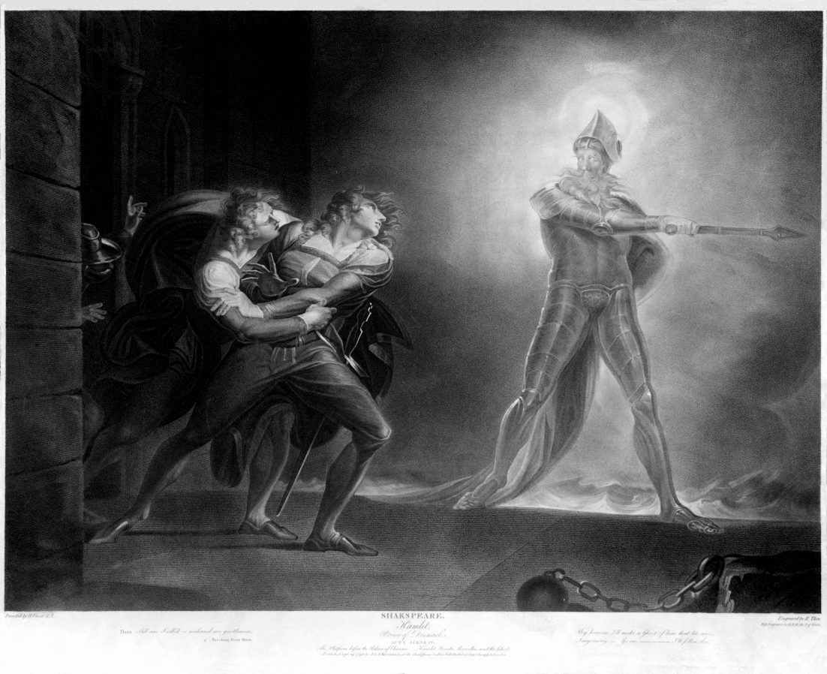
He wants you to avenge him.
Was the dream real???? Will you kill your uncle????

Slide 25


Slide 26
Webography
http://www.amodelrecommends.com/2011/04/18/shock-horror-the-no-gym-experiment/
http://www.ashireporter.org/HomeInspection/Articles/Social-Media-Writing-for-Your-Audience/2376
https://www.dreamstime.com/royalty-free-stock-photography-mobile-phone-blank-screen-hand-holding-white-front-view-isolated-white-background-image32845887
http://nepalnewslive.com/-9071.html
https://pixabay.com/en/photos/grief/
http://richmondsfblog.com/images/hamlet.jpg
http://shakespeare.mit.edu/hamlet/full.html
http://theaporetic.com/?p=4460
https://tagul.com/cloud/2
www.themexpert.com/blog/best-twitter-extension-for-joomla
https://thewhyaboutthis.com/tag/unrequited-love/
www.twitter.com
http://villains.wikia.com/wiki/King_Claudius
https://en.wikipedia.org/wiki/Hamlet

Slide 27
Learning outcomes
Learners will have:
Determined the introduction to the storyline of Hamlet.
Introduced themes relating to the events that take place at this time
Recognised the links between Shakespearean language and modern day English vocabulary.

