Slide 1
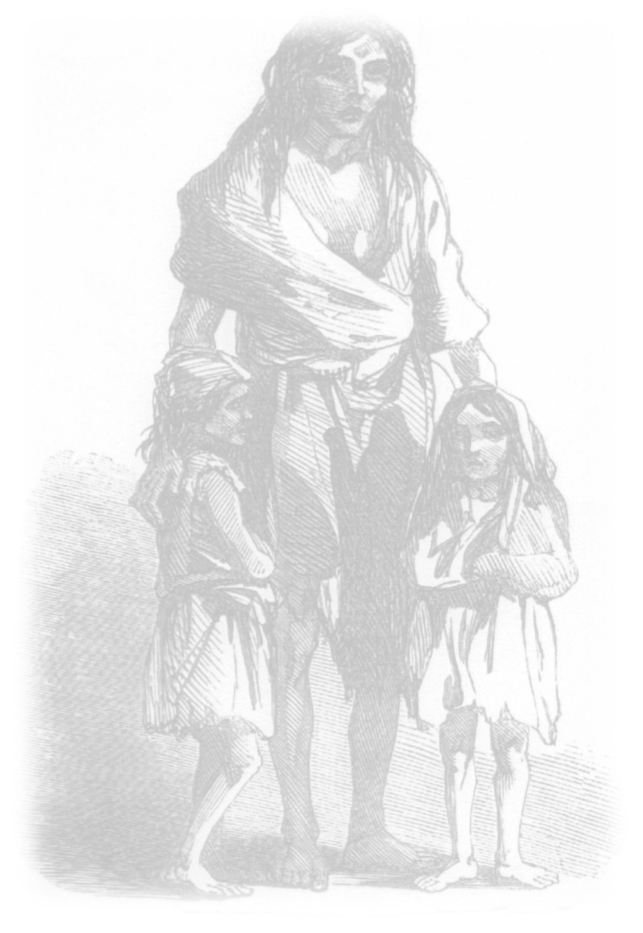

The Famine
An Gorta Mór
1845 - 1852

Slide 2
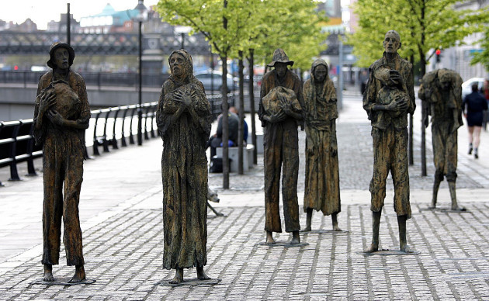
Famine
The Great Famine or an Gorta Mór was a time of mass starvation, disease and emigration in Ireland between 1845 and 1852.
During the Famine, approximately one million people died and a million more emigrated from Ireland. Before the Famine, Ireland’s population was estimated to be over 8.5 million. By the end of the Famine a quarter of the population had either died or emigrated.
Of the one million people who died, some died of starvation while others perished from hunger related diseases and fevers. A further one million people emigrated to Britain, the United States, Canada, Australia and elsewhere.
Famine Memorial on Custom House Quay, Dublin Sculptor Rowan Gillespie

Slide 3
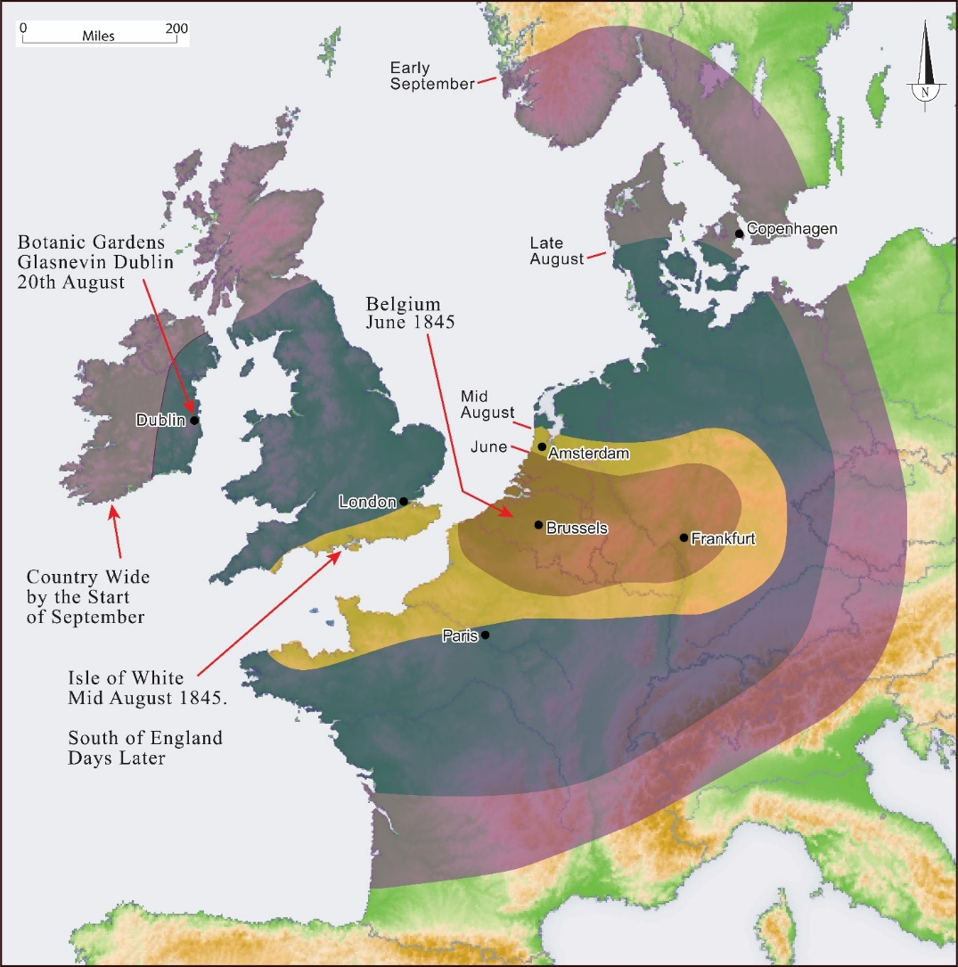
What caused the famine?
The potato was originally brought to Europe from South America by the Spanish. In 1845, about one third of the population was dependent on the potato as their main source of food. Potatoes can feed six times more people than most other crops.
The potato was vulnerable to disease because it is not a local species. In 1845 the crop was infected by Potato blight. This is a disease which causes potatoes to rot in the ground.
When the potato crop failed, the poorer people in Ireland were left with nothing to eat, neither could they afford to buy other types of food.
Spread of Blight across Europe

Slide 4
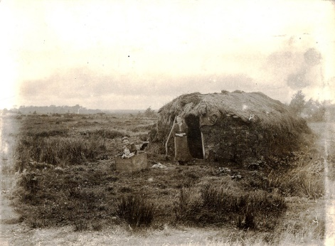
Rural Poor
Picture courtesy of Louth County Museum
When the potato blight struck in 1845, over two million people in Ireland were living in mud cabins, which were classified as fourth class houses. The Government put houses into four classes.
FIRST a solid house with more than five front windows
SECOND a solid house with up to five front windows
THIRD a cottage (often with thatch roof)
FOURTH a single room, built of organic material like sods, wood and so on (see picture right), some lived in even worse accommodation or had no dwelling at all.
Poor people were almost totally depended on the potato for food. They also used the potato to swap for other goods. When the potato crop failed due to blight, hunger and famine were inevitable.
Mud Cabins (c. 1880) Fourth Class House

Slide 5
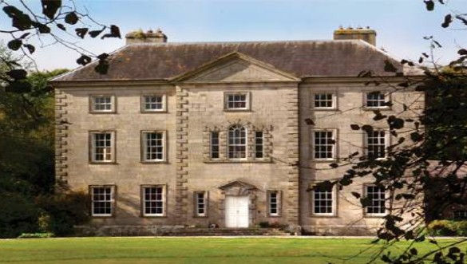
Landlords and Tenants
Around 80% of Irish people did not own the land they lived on. Instead it was owned by landlords, some of whom lived in England. Many landlords hired middlemen to collect the rent from their Irish tenants. The landlords who did not live in Ireland were known as absentee landlords because they were rarely in Ireland.
About one third of the Landlords were very good to their tenants and treated them fairly, doing all they could for the poor, but many landlords, middlemen and farmers treated the Irish Catholic tenants very poorly.
Landlord House First Class House

Slide 6
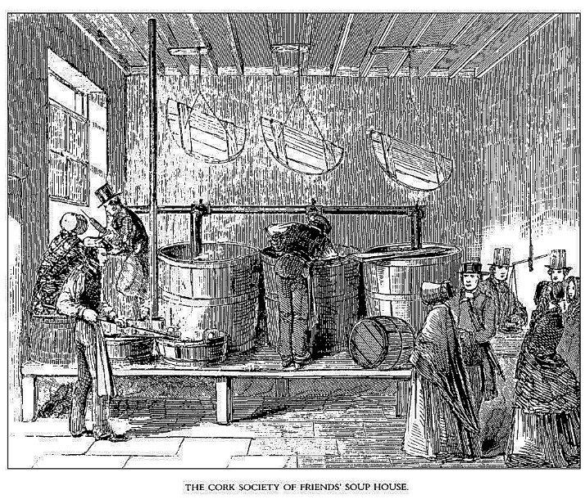
Local Responses
The situation got very serious in 1846. The first response was the setting up of Soup Kitchens to feed the poor by the Society of friends, (also known as Quakers or friends).
Many local landowners, clergy, police and others also tried to do what they could to help the starving.

Slide 7
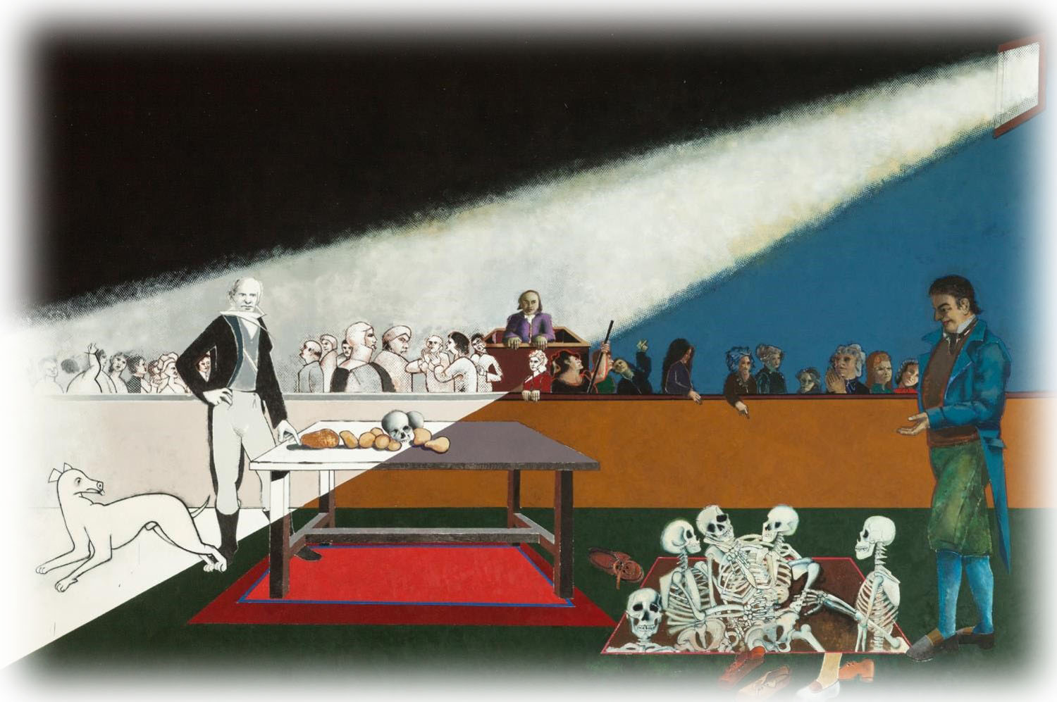
British Government Responses
The initial government response to the potato crop failure was quick and generally successful. The British Prime Minister, Robert Peel, purchased £100,000 worth of maize and cornmeal however it didn’t arrive in Ireland until February 1846 due to bad weather. The maize and cornmeal was very tough to eat and digest and was very unpopular.
A new Prime Minister, Lord John Russell, came into power in 1846. Russell believed that the government was not responsible for the crisis and was reluctant to intervene in its alleviation.
Sir Charles Wood, the Chancellor of the Exchequer and Charles Trevelyan, Assistant Secretary to the Treasury who were in charge of the administration of government relief, limited the government's food aid programme. Trevelyan believed that "the judgement of God sent the calamity to teach the Irish a lesson".
Black ’47

Slide 8
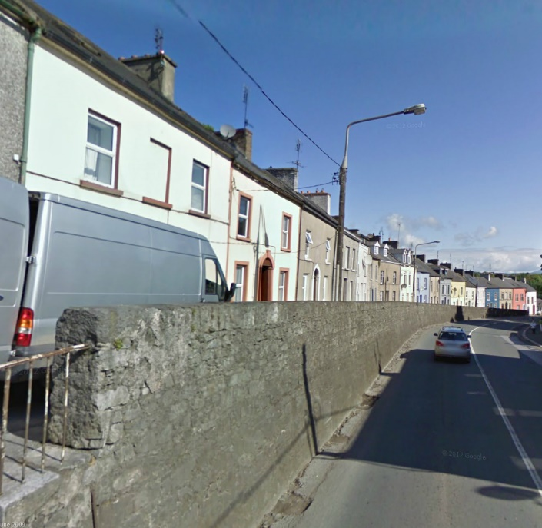
British Government Response
Eventually Russell's government did introduce a new programme of public works such as building roads, harbour piers, etc. By the end of December 1846 they employed half a million people. The starving poor, often entire families, had to work for 12 hour days. However, most of these people were too hungry, weak and feeble to work and so large numbers died on the works.
Road cutting Fermoy Co Cork

Slide 9
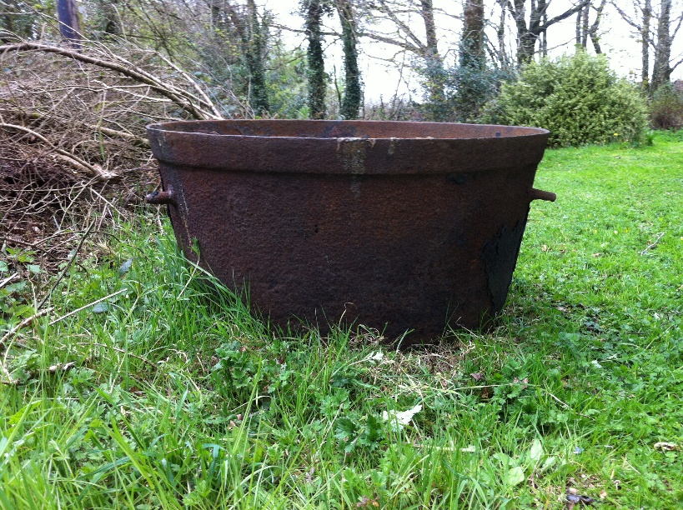
British Government Response
In January 1847, the government abandoned the public works programme, realising that it had failed. Instead they provided relief though outdoor direct relief in the form of soup kitchens which directly fed the poor. By the summer of 1847 it is estimated that over three million people were being fed.
However by the end of the summer, the Government decided to withdraw support for the system believing that it was costing too much and that the new potato crop was healthy (which it was not) and in general, people should be left to their own means.
Landlords/farmers were compelled to support the workhouses (which were set up before the Famine) and local relief schemes. They also became responsible for paying the rates for the poorer tenants. Some tried to get out of paying by evicting these poorer tenants. As a result hundreds of thousands of people were driven off the land.
Soup Kitchen Boiler

Slide 10
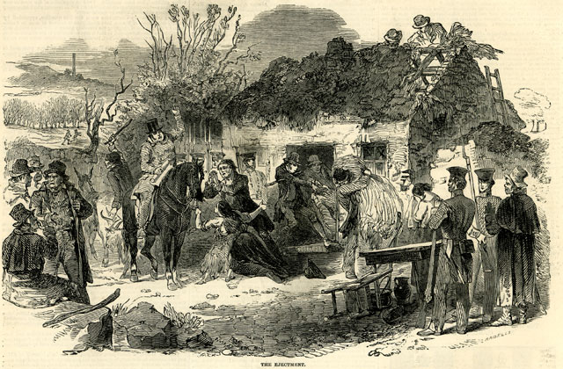
Land Evictions
Evictions were widespread as many poor people couldn’t afford to pay their rent. It is estimated that over half a million people were evicted from the land between 1847 and 1852. This meant that they had no means of producing their own food or raising their own animals and were forced to roam the countryside in search of food and work. Many dying on the ‘side of the road’.
Eviction
(London Illustrated news December 1848)

Slide 11
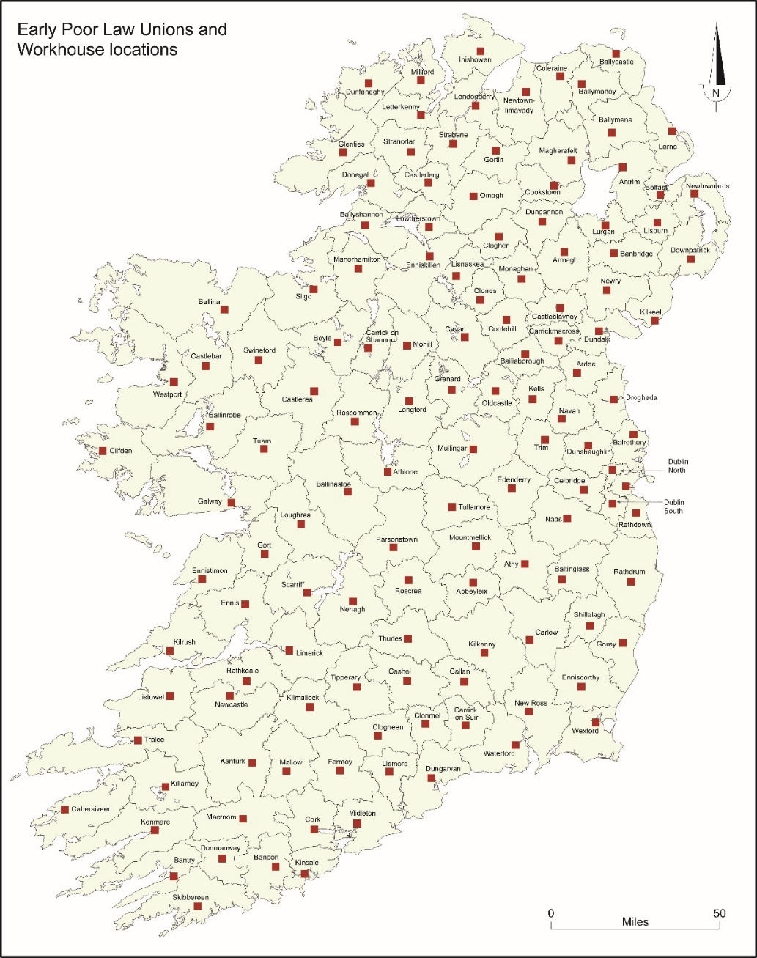
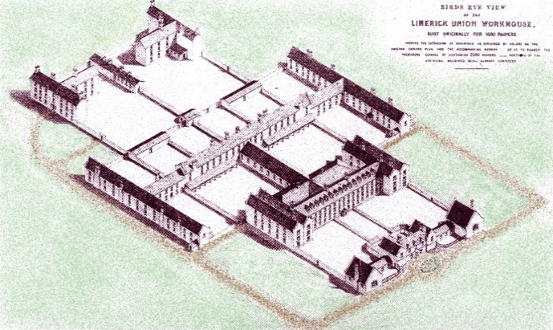
Poor Law Unions and Workhouses
Poor law union areas were set up in the 1830s to provide support for the destitute. At the centre was a Workhouse located close to a town which was positioned roughly in the middle of the Union. They were run by a locally elected board and depended on the local wealthy for support.
Over 130 poor law unions were set up before the famine. When the famine struck, the system became totally overwhelmed and couldn’t cope with the huge numbers looking for relief. Many workhouses set up extra auxiliary workhouses next to the main house but even these were unable to cope.
When a family entered a workhouse the men, women and children would be separated and put in different sections. Life in the workhouse was harsh and frequently cruel. There were many rules, the food was poor and disease was rampant.

Slide 12
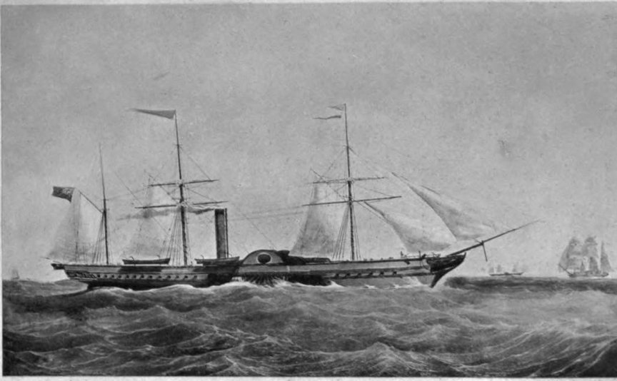
Irish Food Exports
Records show that during the Famine, large quantities of food were being exported from Ireland. Despite all this food production, the country could not produce enough to feed everyone, the loss of the potato was so great. The food that was available was beyond the reach of the poor, who couldn’t afford to purchase it.
Food was purchased abroad and shipped to Ireland. But not near enough to feed everyone.

Slide 13
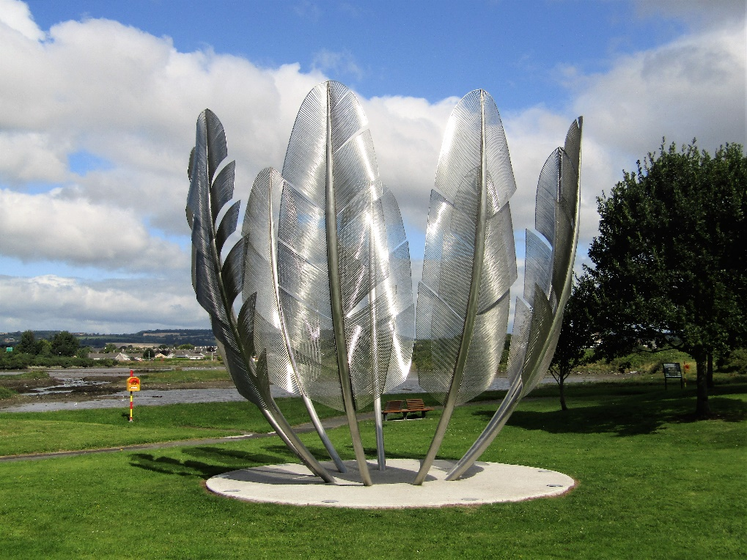
International Response
Large sums of money were donated by various people, charities and organisations around the world. Calcutta is credited with making the first donation of £14,000. Pope Pius IX and Russian Tsar Alexander II sent funds and Queen Victoria donated £2,000. U.S. President James K. Polk donated $50 and Congressman Abraham Lincoln donated $10.
Thousands of dollars were raised in the United States, including $170 collected from a group of Native American Choctaws in 1847. This is a remarkable donation due to the fact that it had only been 16 years since the Native American Choctaws faced famine themselves.
The British Relief Association raised money throughout England, America, and Australia. Their funding drive was benefited by a "Queen's Letter", a letter from Queen Victoria appealing for money to relieve the distress in Ireland. In total, they raised £171,533(£14.5 million current value).
Thank you monument
dedicated to the Choctaw
(Photo by John Crowley)

Slide 14
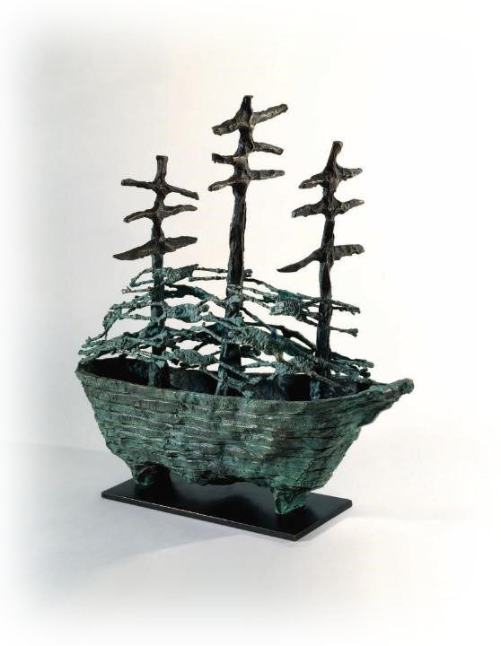
Emigration
A lot of people were left with no choice but to emigrate (if they could afford it). Irish migrants had to cross oceans on ships that were often in very poor condition (known as coffin ships) and many did not survive the journey.
During the Famine years, Irish people emigrated to the UK, Canada, the USA, and Australia as well as other parts of the world.
As the emigrants became established they often sent money home so that another member of their family could emigrate. It is estimated that over 2.5 million people had emigrated from Ireland by 1855.
The Famine marked a depopulation of Ireland. The population continued to fall until 1914 when it remained relatively unchanged until it started increasing again in the 1970s.
Famine Ship

Slide 15
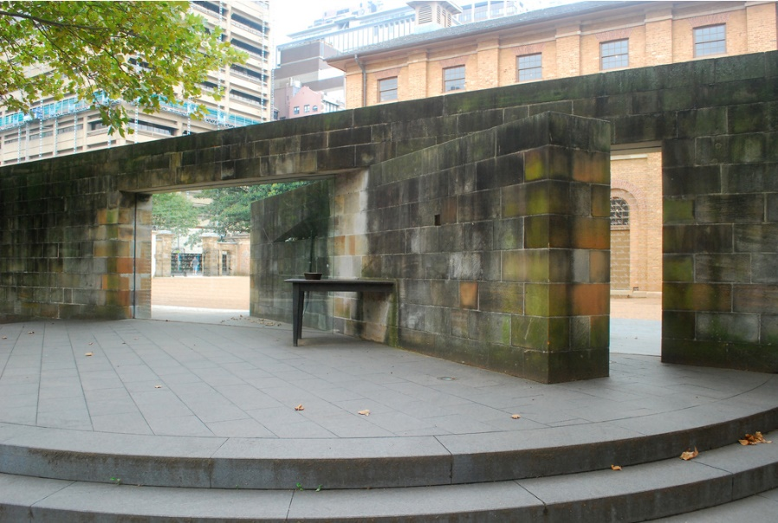
Memorials
The Irish Famine is remembered in many places throughout the world. The monuments include Famine sculptures at Custom House Quay in Dublin, the Irish Famine Memorial in New York and The Irish Famine Memorial Park in Boston.
There is also a Famine Walk from Doolough to Louisburgh in Mayo. This has been attended by Archbishop Desmond Tutu and the Choctaw Nation of Oklahoma.
Over two hundred sites in total have been established to remember An Gorta Mór
(The Great Hunger as the Famine is often referred to).
Hyde Park Barrack & Famine Monument in Sydney

Slide 16
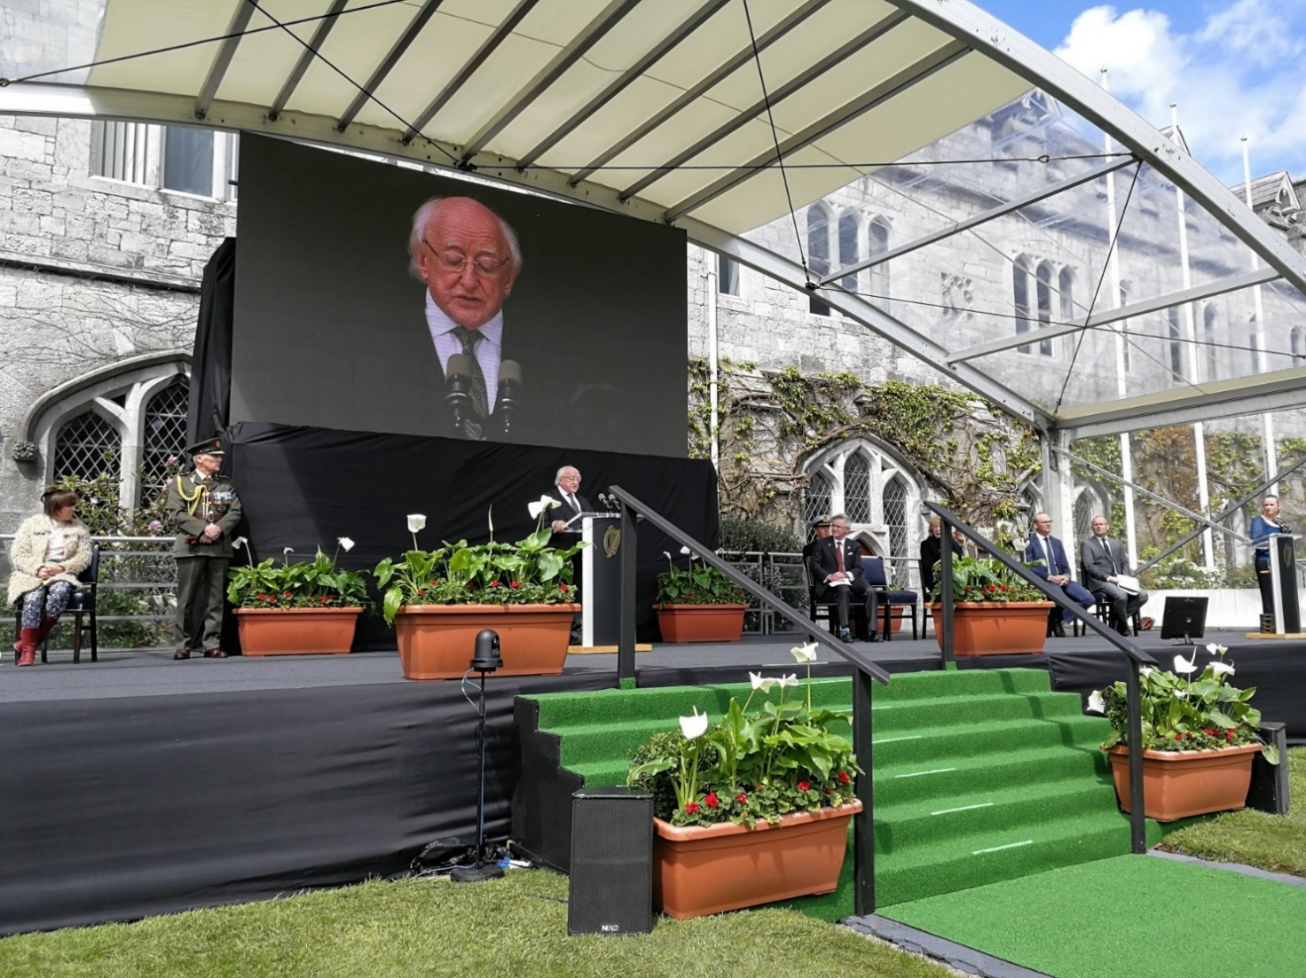
In Summary
It is often quoted that one million Irish people died and one million Irish people emigrated during the Famine however no one can be absolutely sure of the exact figures.
The (British) Government initially supported relief measures, importing food, setting up work schemes supporting the Poor Law Unions and Workhouses.
By late Summer 1847 Ireland was pretty much left to its own resources to sustain the population.
Across the world, new Irish communities became established, many of which trace their roots back to these tragic times.
Ireland has a reputation globally as a leader in helping those most in need around the world. As a nation we spend more than 800 million euro per annum on foreign aid.
Lest We Forget
President Higgins at the 2018 Famine Commemoration at University College Cork

