Slide 1

Red Warning in Ireland.
28 FEB – 2 MARCH 2018
Comparing the past to the present
Cold hard hitting questions
beauty AND THE BEAST

Slide 2
Comparing the past to the present

Slide 3
RED WARNING
IN IRELAND
Many reports compared the beast from the East to the big snow of 1982.
Watch the RTÉ Archive video to compare the economic disruption, damage and overall impact associated with the snowfall.

Slide 4
Big Snowfall Causes Chaos 1982 …
There was traffic chaos with roads impassable in places.
Some people were stuck in their cars to fend for themselves.
Train stations and airports were forced to close.
Electricity supplies were badly disrupted.
Closure of schools and workplaces occurred.
There were fuel and food shortages.
Extra pressure was put on the emergency services.
Impact on Birds
Fun in the Snow 1982

Slide 5
Task:
Compare the snowfall of 1982 to that of 2018 using
the Irish Newspaper Archive.
Note: The Irish Newspaper Archive is FREE to all schools.

Slide 6
Compare the Snowfall Chaos of 1982 to 2018
Snowfall of 1982
Snowfall of 2018

Slide 7
Cold hard hitting questions

Slide 8
Cold Hard Hitting Questions
Q1. What is the Polar Vortex?
Q2. What happens when the Polar Vortex weakens?
Q3. Explain the weather phenomenon called ‘Sudden Stratospheric Warming’?
Q4. What caused the abrupt jump in temperature high up in the stratosphere?
Q5. Describe the impact of ‘Sudden Stratospheric Warming’ on the jet stream.

Slide 9
Cold Hard Hitting Questions Answered.
Q1. What is the Polar Vortex?
The Polar Vortex is a circulation of winds high up in the stratosphere.
Source: Met Office - Weather
Notes:
https://www.youtube.com/watch?time_continue=29&v=XGPLHwARPSY

Slide 10
Cold Hard Hitting Questions Answered.
Q2. What happens when the Polar Vortex weakens?
When the polar vortex weakens…
The polar vortex can break down.
It can weaken the jet stream.
It can affect the weather at the surface of the Earth.
Source: Met Office - Weather
Notes:
https://www.youtube.com/watch?time_continue=29&v=XGPLHwARPSY

Slide 11
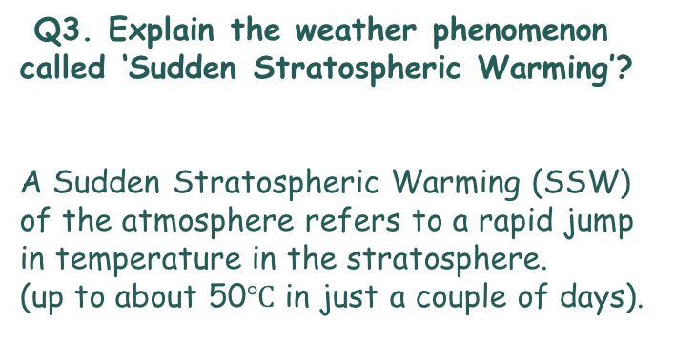
Cold Hard Hitting Questions Answered.
Q3. Explain the weather phenomenon called ‘Sudden Stratospheric Warming’?
A Sudden Stratospheric Warming (SSW) of the atmosphere refers to a rapid jump in temperature in the stratosphere.
(up to about 50$℃$ in just a couple of days).
Source: BBC Weather
Notes:
http://www.bbc.com/weather/feeds/20992173

Slide 12
Cold Hard Hitting Questions Answered.
Q4. What caused the abrupt jump in temperature high up in the stratosphere?
The abrupt jump in temperature happens when the polar vortex breaks down, air in the stratosphere starts to collapse in to the polar cap and compress. As the air compresses it warms, hence the stratospheric warming.
Source: BBC Weather
Notes:
http://www.bbc.com/weather/feeds/20992173

Slide 13
Cold Hard Hitting Questions Answered.
Q5. Describe the impact of ‘Sudden Stratospheric Warming’ on the jet stream.
Sudden Stratospheric Warming causes a weakening of the jet stream.
When the jet stream is strong it brings warm, wet winds from the Atlantic.
When the jet stream weakens, there is more chance for east or northeasterly winds to bring cold air from the arctic or near continent.
Source: BBC Weather
Notes:
http://www.bbc.com/weather/feeds/20992173

Slide 14
Extend your Knowledge.
Watch the videos by clicking on the images below.
Read the encyclopedia article from World Book Online.
Source: RTÉ Weather,
Met Office, BBC Weather

Slide 15
beauty AND THE BEAST

Slide 16
Beauty and the beast over Ireland
The beast from the east was further complicated by storm Emma.
Write down the characteristics of both in the table below.
Beast from the East | Storm Emma
Source: Windy.com

Slide 17
Beauty and the beast over Ireland
The beast from the east was further complicated by storm Emma.
Write down the characteristics of both in the table below.
Beast from the East | Storm Emma
Cold polar mass Sub-zero temperatures Icey conditions Heavy snow showers | Warmer moist air High winds
Source: Windy.com

Slide 18
What happened when these two met?
Beast from the East | Storm Emma
Cold polar mass Sub-zero temperatures Icey conditions Heavy snow showers | Warmer air mass Air containing moisture High strong winds Low Pressure
Source: Windy.com

Slide 19
What happened when these two met?
Beauty and Beast Conditions in Ireland
When the two masses met: The moisture was turned to snow with wind generating blizzard like conditions. Exceptional high accumulation of snow. High tides. Gale force winds Coastal flooding Freezing rain
Source: Windy.com

Slide 20
Project work

Slide 21
Project work
This weather event will go down in history.
Be part of history by uploading your weather recordings to www.scoilnet.ie/threads.
Note: Teachers can give each of their students an online class account for www.scoilnet.ie/threads. Students can then work away on their projects.

Slide 22
Project work
Reflect on the big snowfall of 2018 and 1982 by reading articles from the
Irish Newspaper Archive.
(Free access to schools)
www.scoilnet.ie/threads

