Slide 1
SPHE
Substance Abuse
Notes:
“Cocaine with 50 euro” image retrieved from: https://www.google.ie/url?sa=i&rct=j&q=&esrc=s&source=images&cd=&cad=rja&uact=8&ved=2ahUKEwjxnL2KxsHZAhXSLVAKHebYD-MQjRx6BAgAEAY&url=http%3A%2F%2Fmaxpixel.freegreatpicture.com%2FForeign-designed-Controlled-Dependent-Key-Certainly-1015719&psig=AOvVaw14m0qcHFAY5Xu1HR5IFKWq&ust=1519664158551585 on the 25th of February’2018.
”Pink Pills” retrieved from: https://www.google.ie/url?sa=i&rct=j&q=&esrc=s&source=images&cd=&cad=rja&uact=8&ved=2ahUKEwj1jNusxsHZAhUDZFAKHRCBA-QQjRx6BAgAEAY&url=http%3A%2F%2Fmaxpixel.freegreatpicture.com%2FCompressed-The-Dependence-Of-Fists-Womens-Drug-1875449&psig=AOvVaw14m0qcHFAY5Xu1HR5IFKWq&ust=1519664158551585 on the 25th of Februart’2018
“Cannabis smoke” image retrieved from: https://www.google.ie/url?sa=i&rct=j&q=&esrc=s&source=images&cd=&cad=rja&uact=8&ved=2ahUKEwjq-_PAxsHZAhXBKFAKHbMkB_IQjRx6BAgAEAY&url=https%3A%2F%2Fwww.flickr.com%2Fphotos%2Fcagrimmett%2F6307374507&psig=AOvVaw14m0qcHFAY5Xu1HR5IFKWq&ust=1519664158551585 on the 25th of Februart’2018

Slide 2
Learning Intentions
Brainstorm
Brainstorm why people use drugs
List
List some of the effects that drugs have on your body.
Sort
Sort the names of drugs into legal and illegal groups.
Describe
Describe what it means to be a drug addict
Devise
Devise a survey to gather information on drug awareness.
Notes:
“Target” image retrieved from: https://www.google.ie/url?sa=i&rct=j&q=&esrc=s&source=images&cd=&cad=rja&uact=8&ved=2ahUKEwjwipj89cjZAhVCLlAKHUIcBckQjRx6BAgAEAY&url=http%3A%2F%2Fpngimg.com%2Fdownload%2F27459&psig=AOvVaw2r_FPd-tdSwVtk3qaZzk1g&ust=1519918002514832 on the 28th of March’2018.

Slide 3
Which of the following are a drug?
❖ alcohol
❖ tobacco
❖ caffeine
❖ solvents
❖ over the counter drugs
❖ prescribed drugs
❖ illicit drugs

Slide 4
DEFINE:
DRUG
Notes:
“Brain graduate”: Retrieved from: https://www.google.ie/url?sa=i&rct=j&q=&esrc=s&source=images&cd=&cad=rja&uact=8&ved=2ahUKEwjR4eaRrcHZAhVHaFAKHSzyBvAQjRx6BAgAEAY&url=https%3A%2F%2Fpixabay.com%2Fen%2Fbrain-clever-thought-dear-hats-2799833%2F&psig=AOvVaw3XgTYvlmHQW3mTU8D_IhAD&ust=1519657820362976. on the 25th of February’ 2018.

Slide 5
THNK- PAIR-SHARE
Notes:
“Think Pair Share Drawing”: Retrieved from: https://www.google.ie/url?sa=i&rct=j&q=&esrc=s&source=images&cd=&cad=rja&uact=8&ved=2ahUKEwjUjorgr8HZAhWKblAKHWthAYEQjRx6BAgAEAY&url=https%3A%2F%2Fwww.flickr.com%2Fphotos%2Fotacke%2F10003586804&psig=AOvVaw0mtMdTIiUMPWPK3S1qrKlr&ust=1519658623006365 on the 25th of February’2018.

Slide 6
What is a drug?
Drug – Something which changes the body’s chemistry.
“A drug is a chemical substance that acts on the brain and nervous system, changing a person's mood, emotion or state of consciousness.”
Notes:
Definition retrieved from: https://www.hse.ie/eng/health/az/d/drug-misuse/facts-about-drug-misuse.html on the 25th of February’2018.
“Assortment of Drugs” image retrieved from: https://www.google.ie/url?sa=i&rct=j&q=&esrc=s&source=images&cd=&cad=rja&uact=8&ved=2ahUKEwie2_ryzcHZAhUQL1AKHQEnD9QQjRx6BAgAEAY&url=https%3A%2F%2Fpxhere.com%2Fen%2Fphoto%2F139487&psig=AOvVaw2g2G_-gw4Knu3UxcveOkbi&ust=1519666729503414 on the 25th of February’2018.

Slide 7
Why USE drugs?
Notes:
“Brain graduate”: Retrieved from: https://www.google.ie/url?sa=i&rct=j&q=&esrc=s&source=images&cd=&cad=rja&uact=8&ved=2ahUKEwjR4eaRrcHZAhVHaFAKHSzyBvAQjRx6BAgAEAY&url=https%3A%2F%2Fpixabay.com%2Fen%2Fbrain-clever-thought-dear-hats-2799833%2F&psig=AOvVaw3XgTYvlmHQW3mTU8D_IhAD&ust=1519657820362976. on the 25th of February’ 2018.

Slide 8
THNK- PAIR-SHARE
Notes:
“Think Pair Share Drawing”: Retrieved from: https://www.google.ie/url?sa=i&rct=j&q=&esrc=s&source=images&cd=&cad=rja&uact=8&ved=2ahUKEwjUjorgr8HZAhWKblAKHWthAYEQjRx6BAgAEAY&url=https%3A%2F%2Fwww.flickr.com%2Fphotos%2Fotacke%2F10003586804&psig=AOvVaw0mtMdTIiUMPWPK3S1qrKlr&ust=1519658623006365 on the 25th of February’2018.

Slide 9
Drug Use
Drug Misuse
Abuse
Dependence
Addiction
Notes:
Lets focus on the changes in the body and/or behaviour brought about through the use of these substances.
“Sad Face” image retrieved from: https://www.google.ie/url?sa=i&rct=j&q=&esrc=s&source=images&cd=&cad=rja&uact=8&ved=2ahUKEwj6j_zDz8HZAhUHKFAKHfgeBekQjRx6BAgAEAY&url=https%3A%2F%2Fcommons.wikimedia.org%2Fwiki%2FFile%3AAntu_face-sad.svg&psig=AOvVaw1UF1PrdA77vUQrI6ykrOvB&ust=1519667055596932 on the 25th of February’2018.

Slide 10
Drug USE
Experimental
Recreational
Harmful
Notes:
“Experimental” image retrieved from: https://www.google.ie/url?sa=i&rct=j&q=&esrc=s&source=images&cd=&cad=rja&uact=8&ved=2ahUKEwiT46OB0MHZAhVCb1AKHb8xDuoQjRx6BAgAEAY&url=https%3A%2F%2Fpixabay.com%2Fen%2Fprofessions-chemist-experiments-2065191%2F&psig=AOvVaw0H6LJJsuehk9QWEmyycUQn&ust=1519667294345144 on the 25th of February’2018.
“Recreational” image retrieved from: https://www.google.ie/url?sa=i&rct=j&q=&esrc=s&source=images&cd=&cad=rja&uact=8&ved=2ahUKEwievOum0cHZAhXCJFAKHUg3DOgQjRx6BAgAEAY&url=%2Furl%3Fsa%3Di%26rct%3Dj%26q%3D%26esrc%3Ds%26source%3Dimages%26cd%3D%26cad%3Drja%26uact%3D8%26ved%3D%26url%3Dhttp%253A%252F%252Fwww.misawa.af.mil%252FNews%252FArticle-Display%252FArticle%252F773498%252Falcohol-more-than-a-fun-night-out%252F%26psig%3DAOvVaw2ldnxpgFSREzgadJcaH8TS%26ust%3D1519667403593504&psig=AOvVaw2ldnxpgFSREzgadJcaH8TS&ust=1519667403593504 on the 25^{th February’2018.}
“Harmful drug” image; retrieved from: https://www.google.ie/url?sa=i&rct=j&q=&esrc=s&source=images&cd=&cad=rja&uact=8&ved=2ahUKEwjHwcqH0cHZAhUMYVAKHZDmAOUQjRx6BAgAEAY&url=http%3A%2F%2Fwww.airforcemedicine.af.mil%2FMedia-Center%2FDisplay%2FArticle%2F425702%2Fprescription-drug-abuse-dont-swallow-your-career%2F&psig=AOvVaw2ldnxpgFSREzgadJcaH8TS&ust=1519667403593504 on the 25th of February’2018.

Slide 11
Drug MISUSE
“Drug misuse is when a person regularly takes one or more drugs to change their mood, emotion or state of consciousness.”
Notes:
Definition retrieved from: https://www.hse.ie/eng/health/az/d/drug-misuse/facts-about-drug-misuse.html on the 25th of February’2018.
“Harmful drug” image; retrieved from: https://www.google.ie/url?sa=i&rct=j&q=&esrc=s&source=images&cd=&cad=rja&uact=8&ved=2ahUKEwjHwcqH0cHZAhUMYVAKHZDmAOUQjRx6BAgAEAY&url=http%3A%2F%2Fwww.airforcemedicine.af.mil%2FMedia-Center%2FDisplay%2FArticle%2F425702%2Fprescription-drug-abuse-dont-swallow-your-career%2F&psig=AOvVaw2ldnxpgFSREzgadJcaH8TS&ust=1519667403593504 on the 25th of February’2018.

Slide 12
ABUSE
Notes:
“Brain graduate”: Retrieved from: https://www.google.ie/url?sa=i&rct=j&q=&esrc=s&source=images&cd=&cad=rja&uact=8&ved=2ahUKEwjR4eaRrcHZAhVHaFAKHSzyBvAQjRx6BAgAEAY&url=https%3A%2F%2Fpixabay.com%2Fen%2Fbrain-clever-thought-dear-hats-2799833%2F&psig=AOvVaw3XgTYvlmHQW3mTU8D_IhAD&ust=1519657820362976. on the 25th of February’ 2018.

Slide 13
THNK- PAIR-SHARE
Notes:
“Think Pair Share Drawing”: Retrieved from: https://www.google.ie/url?sa=i&rct=j&q=&esrc=s&source=images&cd=&cad=rja&uact=8&ved=2ahUKEwjUjorgr8HZAhWKblAKHWthAYEQjRx6BAgAEAY&url=https%3A%2F%2Fwww.flickr.com%2Fphotos%2Fotacke%2F10003586804&psig=AOvVaw0mtMdTIiUMPWPK3S1qrKlr&ust=1519658623006365 on the 25th of February’2018.

Slide 14
Drug Abuse
This is when someone continuously misuses drugs (to change their mood, emotion or state of consciousness) leading to:
Inability to carry out their roles and responsibilities e.g. being a mother/father/son/daughter at home/school/work;
Physical harm e.g. drunk driving; overdose
Legal Problems e.g. drunk and disorderly; carrying illegal drugs
Relationship breakdowns e.g. arguments with boyfriend/ girlfriend; physical fights.
Notes:
“Handcuffed” image retrieved from: https://www.google.ie/url?sa=i&rct=j&q=&esrc=s&source=images&cd=&cad=rja&uact=8&ved=2ahUKEwi_l-DQysHZAhWSLVAKHf0_CNgQjRx6BAgAEAY&url=https%3A%2F%2Fpixabay.com%2Fen%2Fhands-handcuffs-the-dependence-of-1875444%2F&psig=AOvVaw14m0qcHFAY5Xu1HR5IFKWq&ust=1519664158551585 on the 25th of February’2018.

Slide 15
Drug Dependence
Dependence is a compulsion to continue taking a drug in order to feel good or to avoid feeling bad.
Notes:
“Handcuffed” image retrieved from: https://www.google.ie/url?sa=i&rct=j&q=&esrc=s&source=images&cd=&cad=rja&uact=8&ved=2ahUKEwi_l-DQysHZAhWSLVAKHf0_CNgQjRx6BAgAEAY&url=https%3A%2F%2Fpixabay.com%2Fen%2Fhands-handcuffs-the-dependence-of-1875444%2F&psig=AOvVaw14m0qcHFAY5Xu1HR5IFKWq&ust=1519664158551585 on the 25th of February’2018.

Slide 16
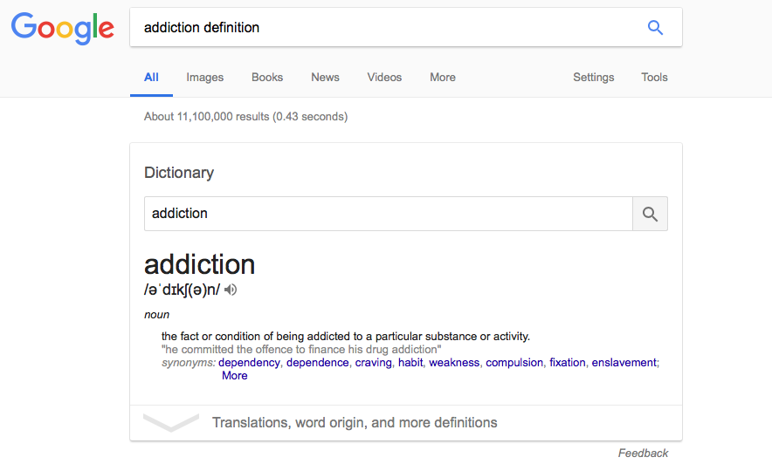
Addiction
Two types:
PHYSICAL
PSYCHOLOGICAL
Notes:
Physical addiction, when there are withdrawal symptoms, such as nausea, vomiting or cramping, if the supply of the drug is suddenly withdrawn.
Psychological addiction, when there is a psychological compulsion or need to regularly use a drug. If the drug is withdrawn, there are no physical symptoms but there may be psychological symptoms such as depression, anxiety and irritability.
Notes above retrieved from: https://www.hse.ie/eng/health/az/d/drug-misuse/facts-about-drug-misuse.html on the 25th of February’2018.
Screenshot image retrieved from google search on the 25th of February’2018.

Slide 17
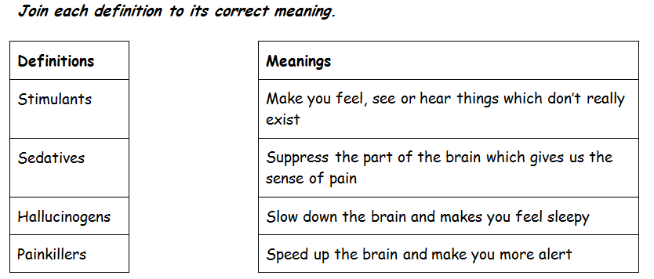
Types of drugs

Slide 18
Over to you…..
Notes:
“Uncle Sam” image retrieved from: https://www.google.ie/url?sa=i&rct=j&q=&esrc=s&source=images&cd=&cad=rja&uact=8&ved=2ahUKEwiqyeGX1sHZAhWGJVAKHWmuB9MQjRx6BAgAEAY&url=https%3A%2F%2Fpixabay.com%2Fen%2Fusa-uncle-sam-i-want-you-army-49909%2F&psig=AOvVaw2BOVbr9IpyC5zaB1ILpPLF&ust=1519668931646595 on the 25th of February’2018.

Slide 19
What is a drug?
Drug – Something which changes the body’s chemistry.
Would you add chocolate to our list of drugs?
Notes:
Have they included things like caffeine/coffee/tea or even alcohol or tobacco/cigarettes? Probably not. If so, suggest whether these should be added to ‘drugs?’

Slide 20
What is a drug?
Drug – Something which changes the body’s chemistry.
Can you be addicted to chocolate?
Notes:
Have they included things like caffeine/coffee/tea or even alcohol or tobacco/cigarettes? Probably not. If so, suggest whether these should be added to ‘drugs?’

Slide 21
What does addicted mean?
Addicted –
Can you be addicted to chocolate?
Notes:
Have they included things like caffeine/coffee/tea or even alcohol or tobacco/cigarettes? Probably not. If so, suggest whether these should be added to ‘drugs?’

Slide 22
What does addicted mean?
Addicted – When someone has to take a substance and are unable to stop taking it without feeling unwell.
Can you be addicted to chocolate?
Notes:
Have they included things like caffeine/coffee/tea or even alcohol or tobacco/cigarettes? Probably not. If so, suggest whether these should be added to ‘drugs?’

Slide 23
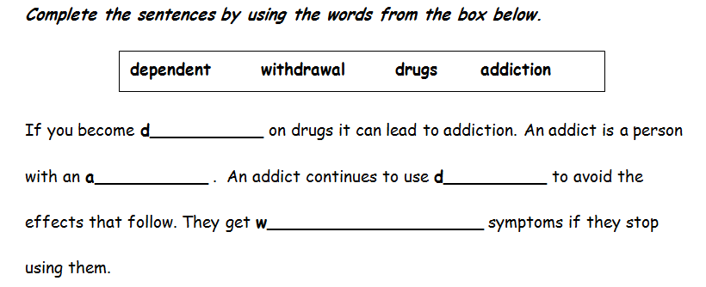
Drug addiction

Slide 24
Complete the table:
Legal drugs | Illegal drugs

Slide 25
Legal or Illegal?
Alcohol
Notes:
“Alcohol” image retrieved from: https://www.google.ie/url?sa=i&rct=j&q=&esrc=s&source=images&cd=&cad=rja&uact=8&ved=2ahUKEwiT5viFy8HZAhXSIlAKHSgiAPEQjRx6BAgAEAY&url=https%3A%2F%2Fpxhere.com%2Fen%2Fphoto%2F1050329&psig=AOvVaw38x1WrPm8cbJiBvbivQHeY&ust=1519665961480209 on the 25th of March’2018.

Slide 26
Legal or Illegal?
Cannabis
Notes:
”Cannabis” image retrieved from: https://www.google.ie/url?sa=i&rct=j&q=&esrc=s&source=images&cd=&cad=rja&uact=8&ved=2ahUKEwjoxODWy8HZAhUHZlAKHa9mCOYQjRx6BAgAEAY&url=https%3A%2F%2Fcommons.wikimedia.org%2Fwiki%2FFile%3AMarijuana_joint.jpg&psig=AOvVaw3bI5deov1XxN5EP-hU-O1S&ust=1519666125936949 on the 25th of February’2018.

Slide 27
Legal or Illegal?
Cocaine
Notes:
“Cocaine with 50 euro” image retrieved from: https://www.google.ie/url?sa=i&rct=j&q=&esrc=s&source=images&cd=&cad=rja&uact=8&ved=2ahUKEwjxnL2KxsHZAhXSLVAKHebYD-MQjRx6BAgAEAY&url=http%3A%2F%2Fmaxpixel.freegreatpicture.com%2FForeign-designed-Controlled-Dependent-Key-Certainly-1015719&psig=AOvVaw14m0qcHFAY5Xu1HR5IFKWq&ust=1519664158551585 on the 25th of February’2018.

Slide 28
Legal or Illegal?
Caffeine
Notes:
“Caffeine” image retrieved from: https://www.google.ie/url?sa=i&rct=j&q=&esrc=s&source=images&cd=&cad=rja&uact=8&ved=2ahUKEwiE9da2zMHZAhXPb1AKHd4wD8IQjRx6BAgAEAY&url=https%3A%2F%2Fpxhere.com%2Fen%2Fphoto%2F980930&psig=AOvVaw2_LfUO6If50paEPDW1FLnR&ust=1519666338675624 on the 25th of February’2018.

Slide 29
Legal or Illegal?
Steroids
Notes:
“Steroids” image retrieved from: https://www.google.ie/url?sa=i&rct=j&q=&esrc=s&source=images&cd=&cad=rja&uact=8&ved=2ahUKEwjq6IGTzcHZAhUPJlAKHUaqCP0QjRx6BAgAEAY&url=https%3A%2F%2Fpixabay.com%2Fen%2Finjection-medical-shot-syringe-519388%2F&psig=AOvVaw2pHsHWaxbWnYxZHFbV7aeB&ust=1519666531476747 on the 25th of February’2018.

Slide 30
Legal or Illegal?
Nicotine
(in tobacco)
Notes:
“Cigarettes” image retrieved from: https://www.google.ie/url?sa=i&rct=j&q=&esrc=s&source=images&cd=&cad=rja&uact=8&ved=2ahUKEwiz77H6yMHZAhUJPFAKHa7jDeoQjRx6BAgAEAY&url=http%3A%2F%2Fmaxpixel.freegreatpicture.com%2FSmoke-Habit-Addiction-Nicotine-Tobacco-Cigarettes-951983&psig=AOvVaw14m0qcHFAY5Xu1HR5IFKWq&ust=1519664158551585 on the 25th of February’2018.

Slide 31
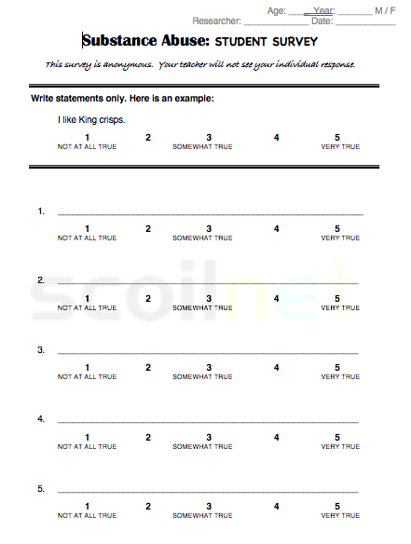
Over to you…..
Notes:
“Uncle Sam” image retrieved from: https://www.google.ie/url?sa=i&rct=j&q=&esrc=s&source=images&cd=&cad=rja&uact=8&ved=2ahUKEwiqyeGX1sHZAhWGJVAKHWmuB9MQjRx6BAgAEAY&url=https%3A%2F%2Fpixabay.com%2Fen%2Fusa-uncle-sam-i-want-you-army-49909%2F&psig=AOvVaw2BOVbr9IpyC5zaB1ILpPLF&ust=1519668931646595 on the 25th of February’2018.

Slide 32
End of Module Project:
Self Help Leaflet
Notes:
“Uncle Sam” image retrieved from: https://www.google.ie/url?sa=i&rct=j&q=&esrc=s&source=images&cd=&cad=rja&uact=8&ved=2ahUKEwiqyeGX1sHZAhWGJVAKHWmuB9MQjRx6BAgAEAY&url=https%3A%2F%2Fpixabay.com%2Fen%2Fusa-uncle-sam-i-want-you-army-49909%2F&psig=AOvVaw2BOVbr9IpyC5zaB1ILpPLF&ust=1519668931646595 on the 25th of February’2018.

Slide 33
