Slide 1

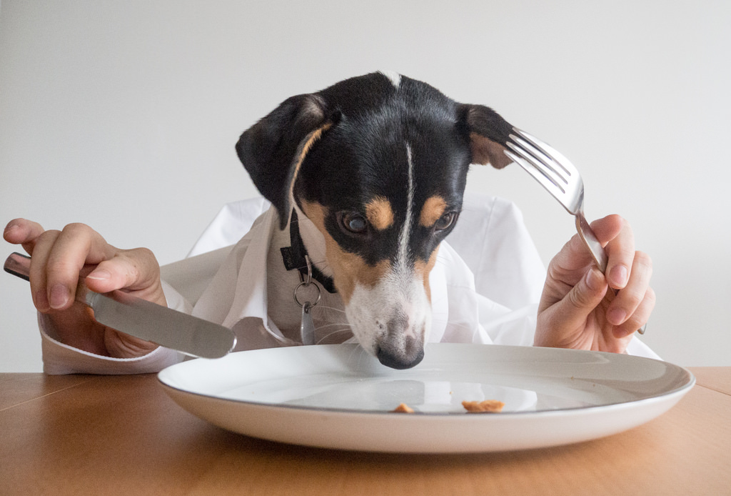
Caring for Dogs - Food
2.1 Label Foods as Healthy or Unhealthy for Dogs
Designed & created by Melanie McInerney
https://www.youtube.com/watch?v=8UdwmdRaAmk
Notes:
This has a youtube video about healthy foods and unhealthy foods for dogs. Our KEYWORD is HEALTHY & UNHEALTHY
Watch and then discuss the rest of the presentation.
Finally show students the work sheet – they can draw cut out pictures write their answers.
There is a separate PDF file to print out.

Slide 2
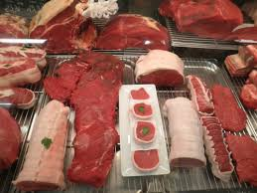
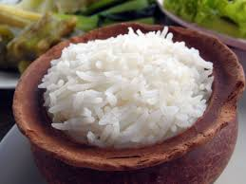
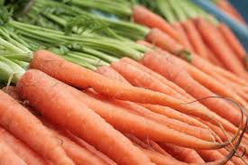
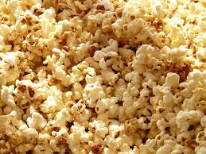
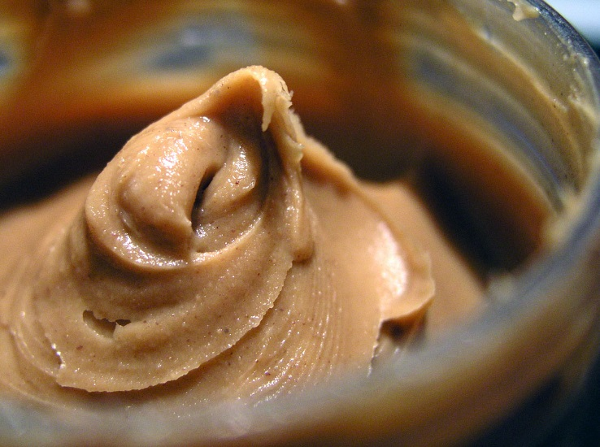
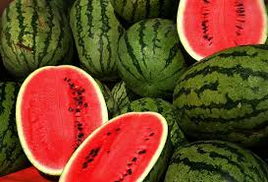
✓
✓
✓
Good for a Dog
✓
✓
✓
Designed & created by Melanie McInerney
Notes:
Begin with a discussion
What are these foods called?
Lets think about what we know already. Who has a dog?
What foods does your dog like to eat?
The animation will show that all these foods are good for dogs.

Slide 3
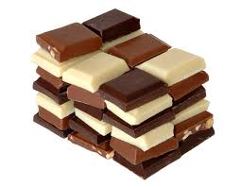
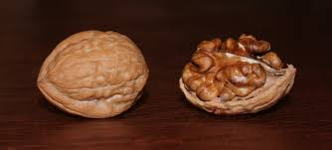
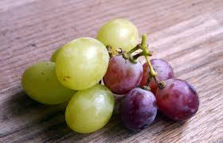
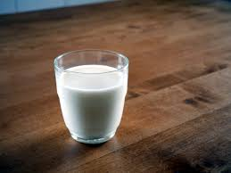
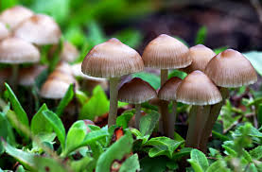
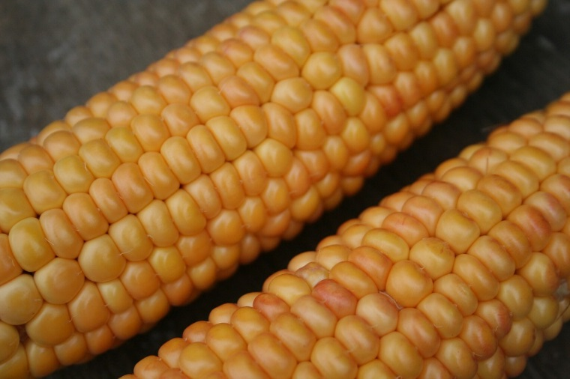
X
X
X
Bad for a Dog
X
X
X
Designed & created by Melanie McInerney
Notes:
Talk about these foods, name them
Ask students to notice which are good for them.
Click and show them that all these foods are bad for them!
Isn't it strange that pop corn is good for a dog but corn on the cob is bad? Etc.

Slide 4

Caring for Dogs - Food
2.1 label foods as healthy or unhealthy for dogs
Student Name: ______________________________________________
Now you decide!
Write/draw or stick the foods that are healthy and unhealthy for a dog in the space below!
Designed & created by Melanie McInerney
X
✓
________________________________________________________________________________________________
________________________________________________________________________________________________

Slide 5
These are the links for the image copyright.
https://pixabay.com/en/popcorn-corn-cinema-grains-sweet-52158/
https://commons.wikimedia.org/wiki/File:Glass_of_milk.jpg
https://commons.wikimedia.org/wiki/File:Watermelons.jpg
https://commons.wikimedia.org/wiki/File:PeanutButter.jpg
https://commons.wikimedia.org/wiki/File:Carrots.JPG
https://www.publicdomainpictures.net/view-image.php?image=105153&picture=bowl-of-rice
https://simple.wikipedia.org/wiki/Meat#/media/File:French_meat_0006.JPG
https://pixabay.com/en/corn-on-the-cob-corn-gold-orange-2784921/
https://commons.wikimedia.org/wiki/File:Baby_mushrooms.jpg
https://pxhere.com/en/photo/780269 grapes
https://commons.wikimedia.org/wiki/File:English_Walnuts.jpg
https://commons.wikimedia.org/wiki/File:Chocolate(bgFFF).jpg

