Slide 1
Example of Padlet Use for the Junior Cycle MFL Portfolio
MFL Teachers Community of Practice
22 March 2018 Meeting, CESC, Cork
V. David-McGonnell

Slide 2
What is Padlet?
A virtual board/wall
onto which you can add documents, texts,
pictures, videos, voice recordings, links…
A shared wall can be used for collaborative work
An individual wall can be used as a portfolio

Slide 3
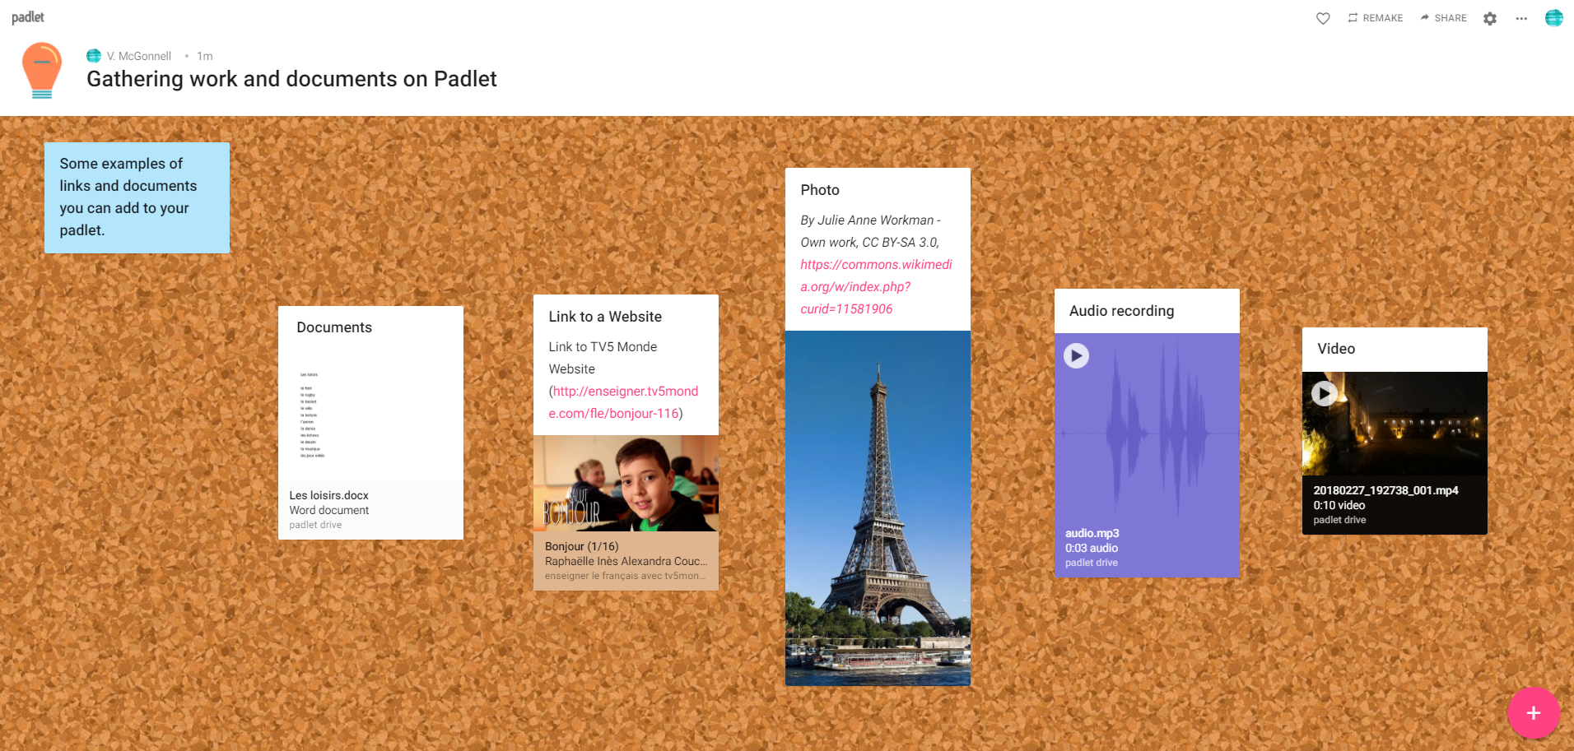
Examples of different items on a Padlet wall

Slide 4
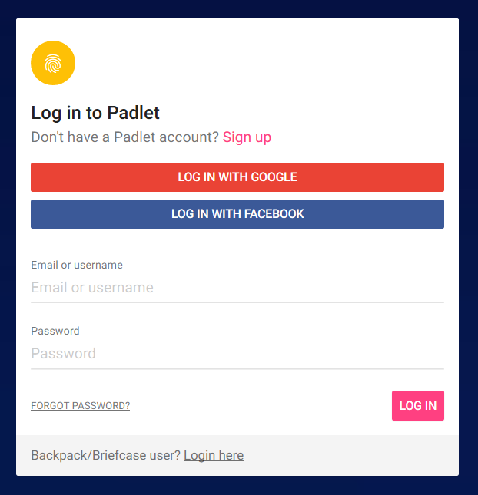
Creating a free Padlet Account
https://padlet.com/

Slide 5
Some advice to get started
Create a Padlet and show it to students.
Ask students to create an account at home,
and to write down their username and password.
In class, in the computer room, ask every student to log in and to follow your instructions step by step to create their own Padlet wall.

Slide 6
Creating a Padlet wall step by step

Slide 7
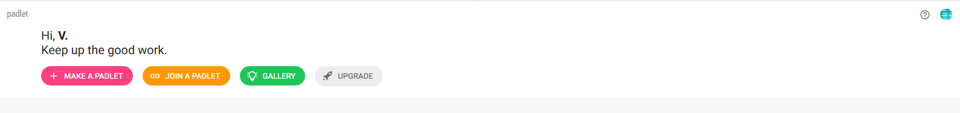
Creating a Padlet wall

Slide 8
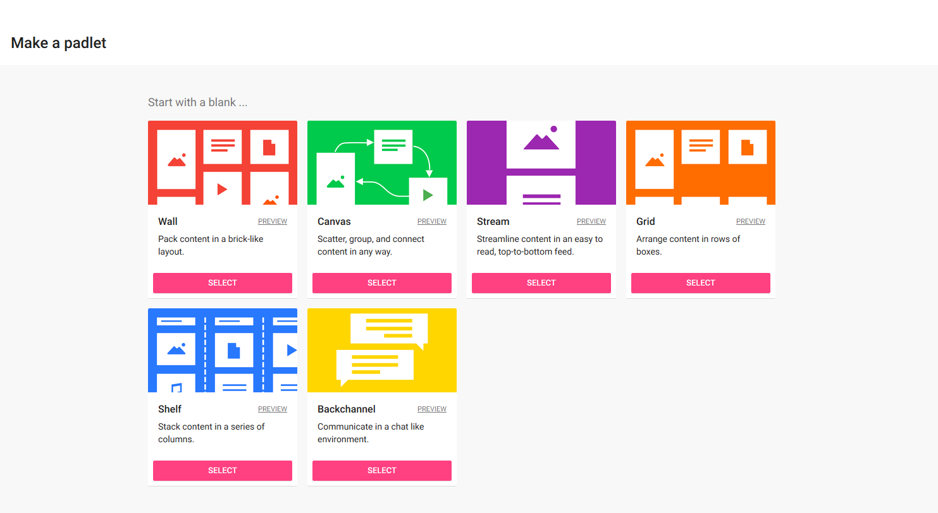
Choosing a format
N.B. Choosing the Canvas format enables you to connect your feedback to students’ work with an arrow on their Padlet.

Slide 9
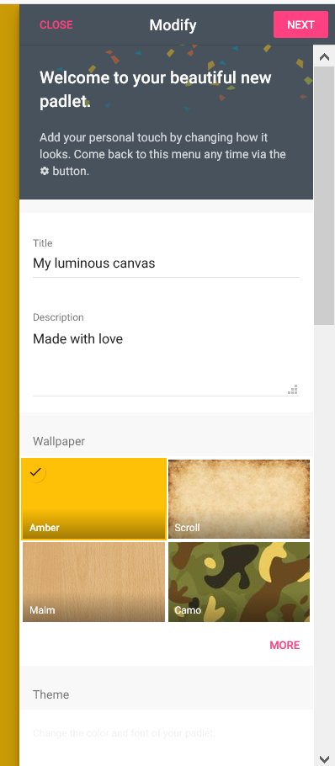
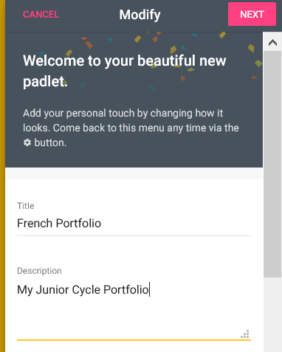
Choosing a Title and Description for your wall

Slide 10
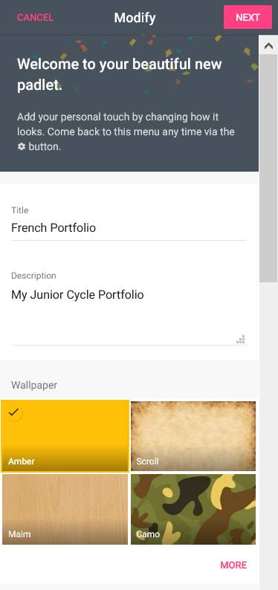
Choosing your wallpaper
2
1

Slide 11
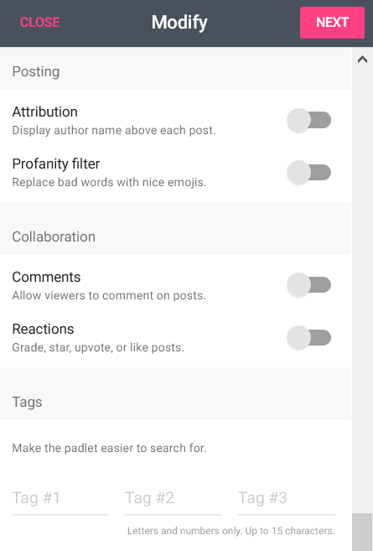
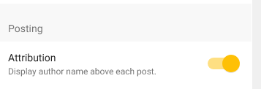
Scroll down
Enabling post attribution
3
1
2
N.B. Enabling post attribution will make it easier to distinguish between students’ work and your feedback on their Padlet portfolio.

Slide 12
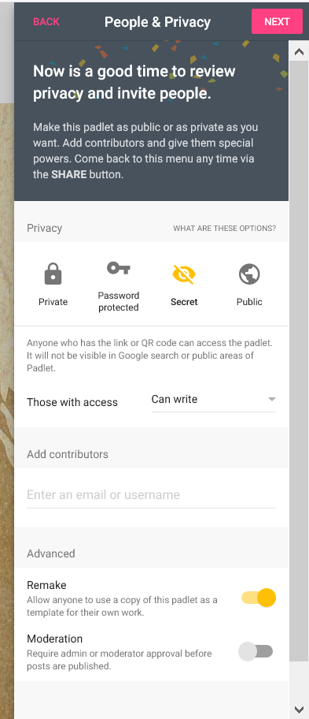
Making your Padlet wall secret
2
1
N.B. Choosing the Secret privacy option means that only people with the exact address can view the Padlet wall and write on it.
Teachers must collect these addresses in order to be able to write feedback.

Slide 13
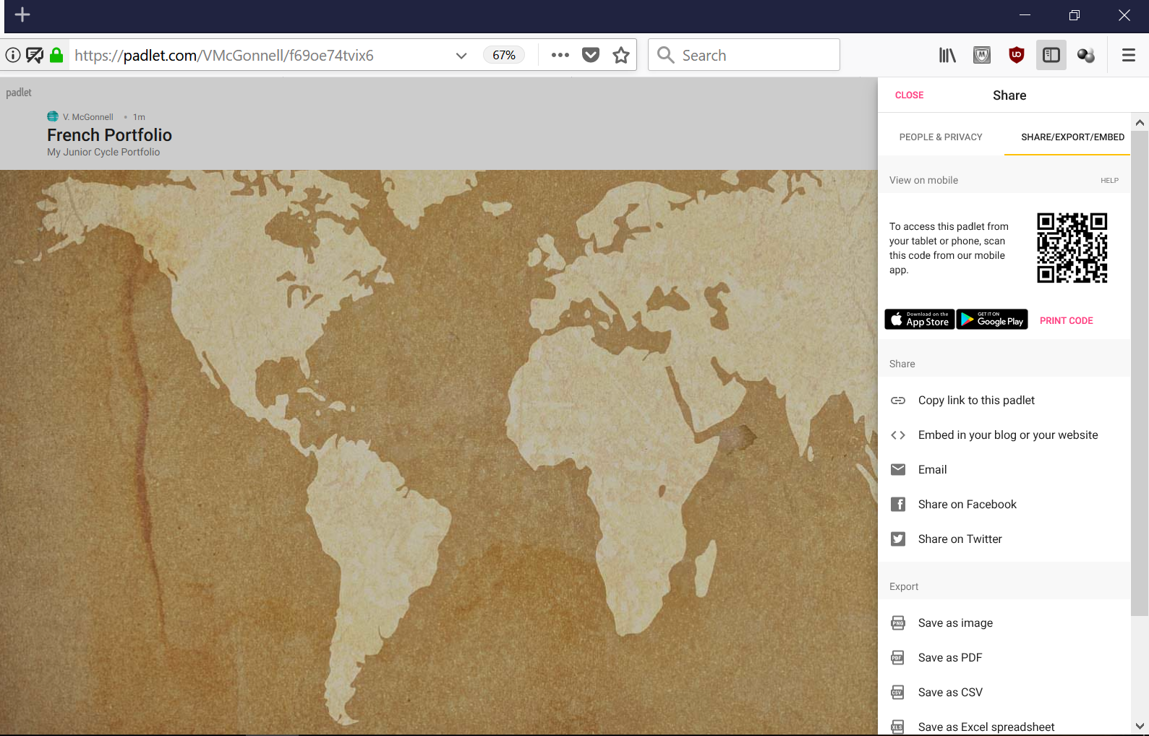
Copying and sharing the address of your Padlet wall
or

Slide 14
Collecting the addresses of your students’ Padlet portfolios

Slide 15
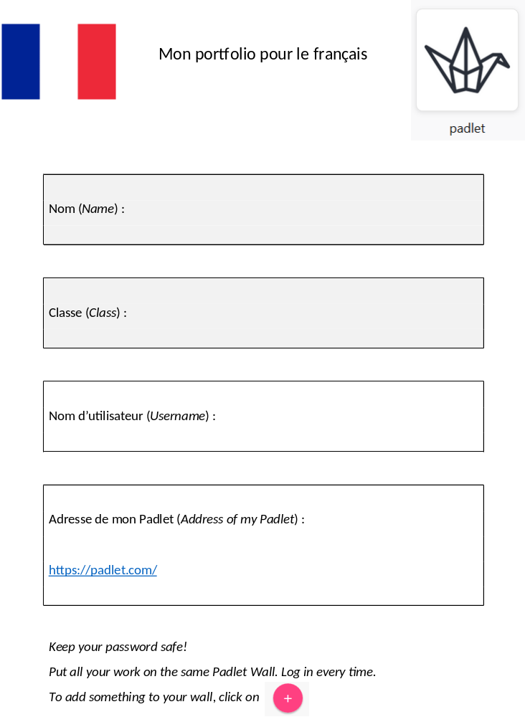
Example of a form which could be filled in by students of French:
N.B. Type a list of the addresses of your students’ Padlet walls so that you just have to click on the links to access them.

Slide 16
Posting items and feedback to a Padlet wall

Slide 17

Adding work and feedback to a portfolio
N.B. You must use Google Chrome, Firefox or the Padlet App

Slide 18
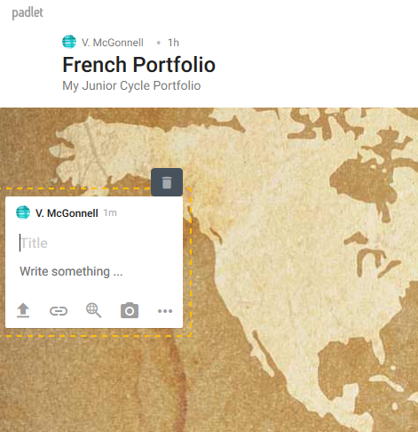
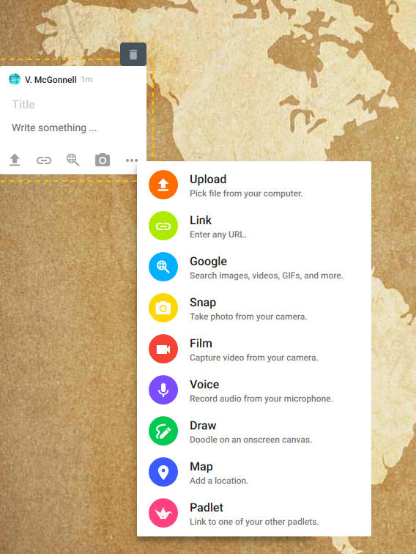

Slide 19
Saving a copy of your students’ Padlet portfolios

Slide 20
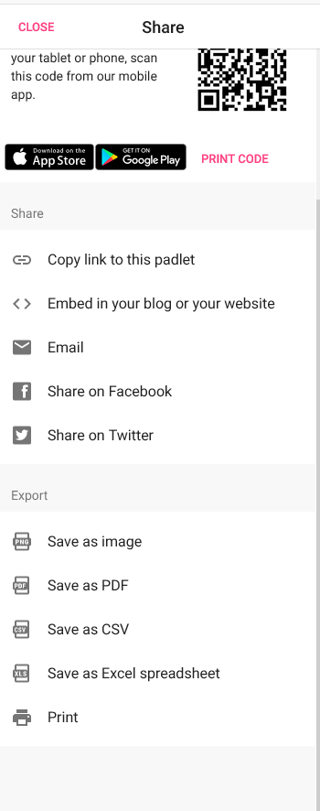
Saving and printing a portfolio
N.B. Portfolios can be printed regularly and kept in a file in school.

Slide 21
Some examples of Task Assignments which can be done on Padlet at home by First Year students

Slide 22
Task 1
Write a short text in the Target Language
to introduce yourself
Learning outcome:
1.17 write words and create short sentences using various media on every day topics with accuracy

Slide 23
Task 2
Find and add to your Padlet wall a picture of a famous person who is a native speaker of the Target Language
Learning outcome:
3.2 discover and use facts and figures related to the target countries such as statistical data, festivals, inventions, famous people

Slide 24
Task 3
Write a short presentation of that person in the Target Language
Learning outcomes:
1.19 create texts about aspects of their lives and topics that interest them such as family and friends, school, holidays, leisure activities, fashion, sport, celebrities
3.2 discover and use facts and figures related to the target countries such as statistical data, festivals, inventions, famous people

Slide 25
Task 4
Record yourself pretending you are asking for something in a shop in the Target Language
Learning outcome:
1.9 pronounce words accurately enough to be understood, with appropriate intonation

Slide 26
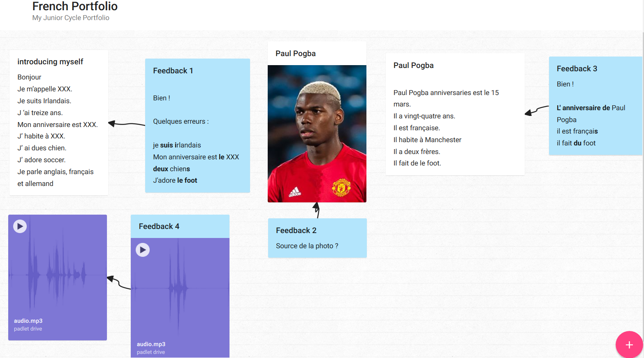
Example of French work, and written and oral feedback

Slide 27
Task 5
Record yourself talking about your family
in the Target Language
Learning outcomes:
1.9 pronounce words accurately enough to be understood, with appropriate intonation
1.10 convey simple descriptions, presentations or announcements on familiar topics

Slide 28
Task 6
Create a poster of a country/region
where the Target Language is an official language
and upload it to your Padlet wall
Learning outcome:
3.2 discover and use facts and figures related to the target countries such as statistical data, festivals, inventions, famous people

Slide 29
Task 7
Write about the differences you have noticed
between the Target Language
and other languages you know
Learning outcome:
2.5 compare grammar and vocabulary of the target language with that of other languages they know, making connections and distinctions as appropriate

Slide 30
Task 8
Start a Learning Log. Write about (1) what you have learnt in this subject so far, (2) how you learn
and (3) what you think you need to improve.
Learning outcomes:
2.6 identify, share and explain their preferred language-learning strategies
2.7 monitor and assess their own learning, using feedback they receive to reflect on what they need to improve and to set goals for improvement

