Slide 1
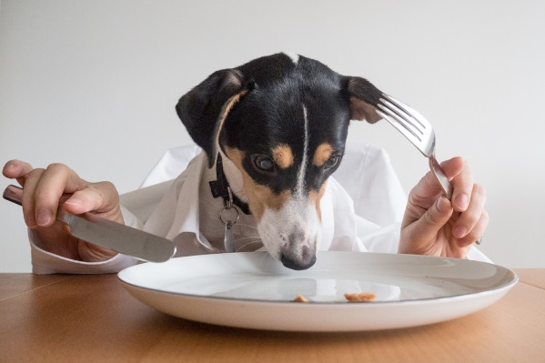

Student Name: _____________________________________________
Peanut Butter and Banana Dog Biscuit Recipe https://www.allrecipes.com/video/3637/peanut-butter-banana-dog-biscuits/
Look at the answers about what is healthy for a dog (Worksheet 2:1)
Can you see/write/tell your teacher two ingredients in this recipe that are healthy for a dog to eat?
1.________________________ 2._________________________
Next step is to make your own dog biscuits. The recipe is on the Scoilnet website, click here!
The PDF is named 2:5 make edible treats for dog.
Designed & created by Melanie McInerney for
Short Course – L2 Caring for animals - Food - 2.5 make edible treats for their ‘own’ dog
Notes:
If students have literacy issues perhaps read the questions and use PECS to Help the student answer the Qs
or write in their verbal answers for them.
Or write the answer and get them to stick this onto the line.

