Slide 1

The
Beatles

Slide 2
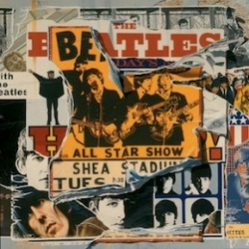
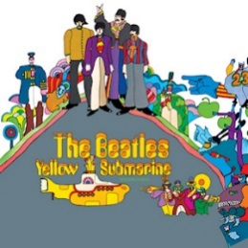
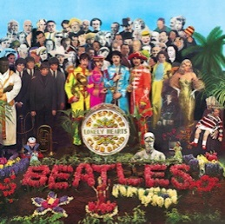
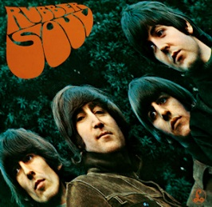
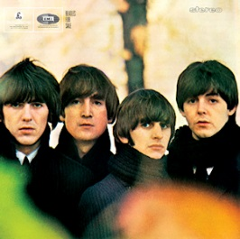
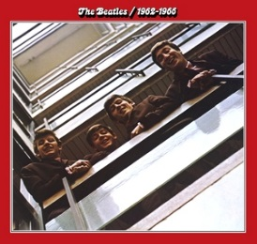
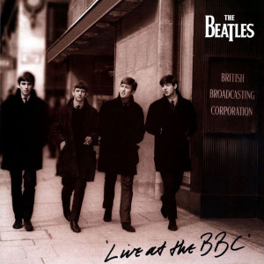
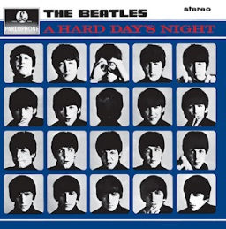
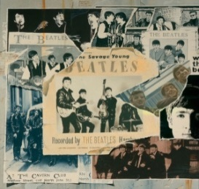
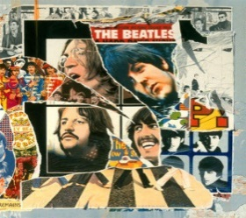
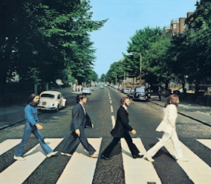
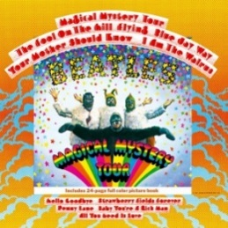
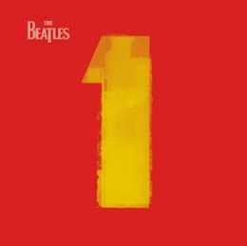
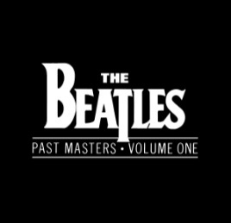
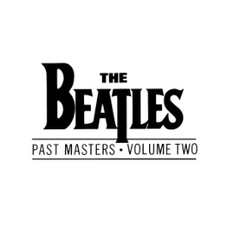
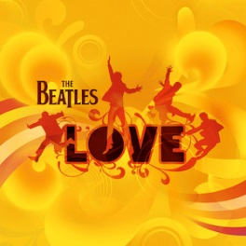
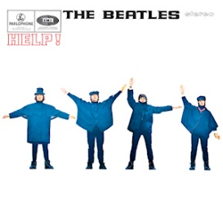
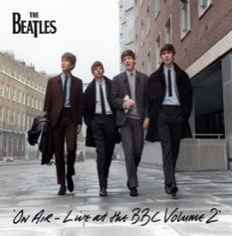
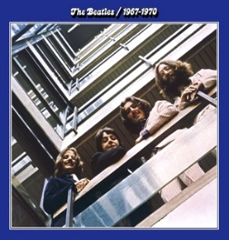
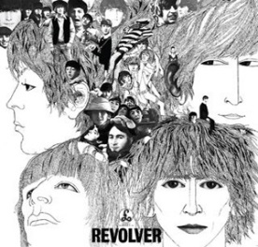
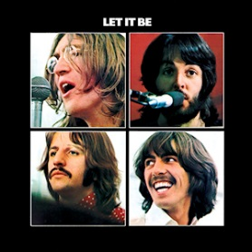
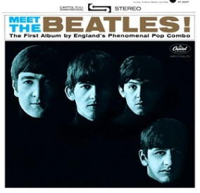
The Beatles
The Beatles were an English rock band from Liverpool formed in 1960. The Beatles are the best-selling band in
history, with estimated sales of over 800 million physical and digital albums worldwide. They have had more
number-one albums on the British charts and sold more singles in the UK and United States than any other act.
Throughout their career, the Beatles produced 23 studio albums, 5 live albums and 63 singles. The Beatles
broke up in 1970, however, their music left a mark on the years and decades that followed.
Can you name any of the albums below?

Slide 3
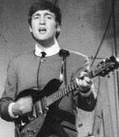
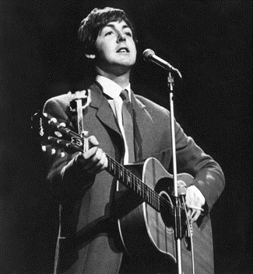
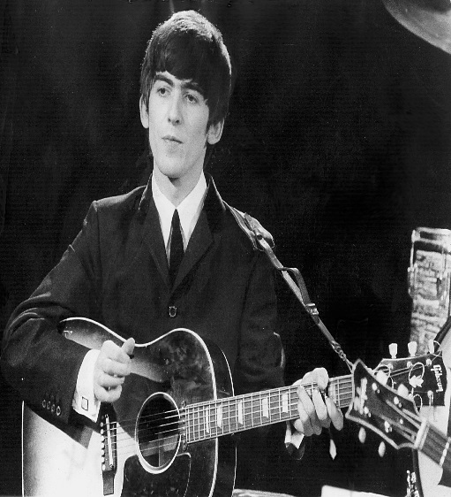
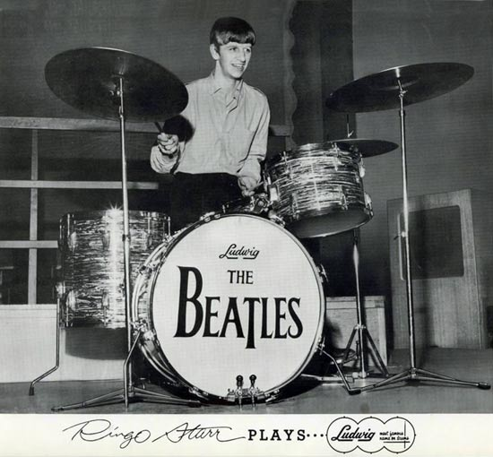
The Beatles
The Beatles had four main members and were given the nickname, “The Fab Four”.
They were
John Lennon,
Paul McCartney,
George Harrison
and Ringo Starr.
John Lennon
Paul McCartney
George Harrison
Ringo Starr

Slide 4
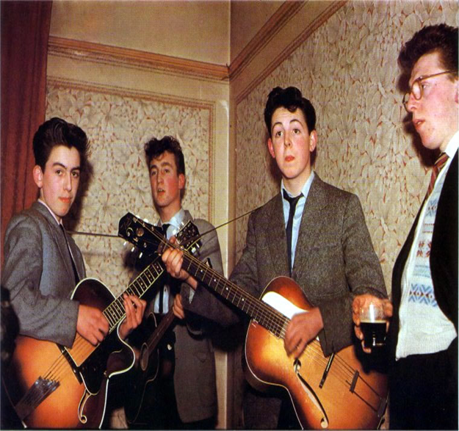
The Beatles
How it all began…
In 1956, John Lennon formed a band called The Quarrymen.
A year later, Paul McCartney joined the band. Paul suggested that his friend George Harrison should join in 1958. John Lennon wasn’t happy about this because George Harrison was only 14 years old at the time but he let him join regardless.
The band’s first recording was a version of the Buddy Holly song “That’ll Be the Day”.
The band had many members that came and went but by 1960, the only ones left were John, Paul and George.

Slide 5
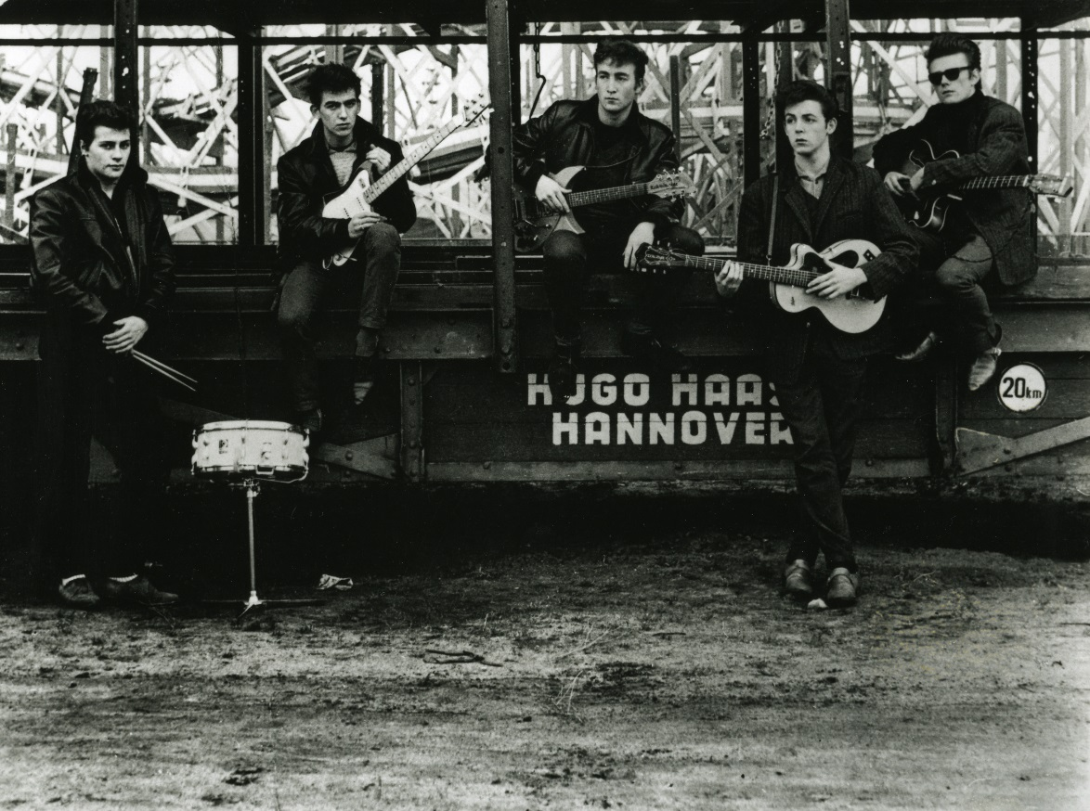
The Beatles
Hamburg
At this time, the Beatles could only play rock’n’roll at shows when they could find a drummer. In 1960, John Lennon asked his friend from art college Stu Sutcliffe to join the band. They also hired Pete Best to play the drums for them.
The Beatles’ manager organised for them to play in Hamburg, Germany for 3 months. They played in clubs and venues every night, often for six or seven hours at a time. They did this until 1962. When they returned to Liverpool, Stu Sutcliffe left the band to go to college in Germany. They were now a four-piece.

Slide 6
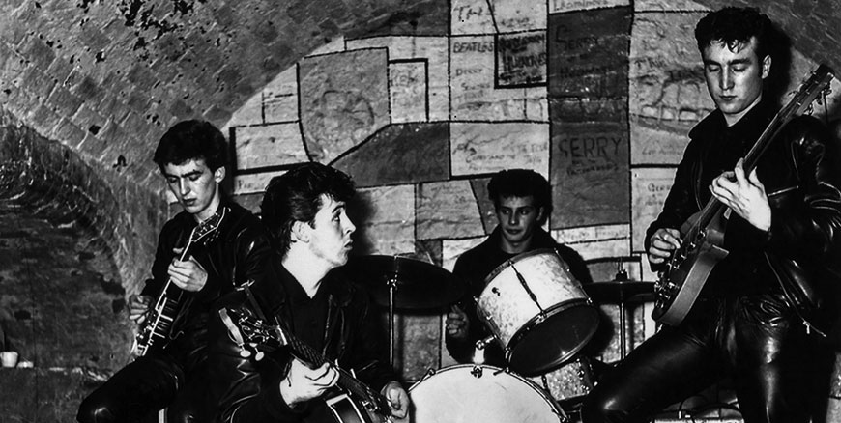
The Beatles
The Cavern
While playing at The Cavern Club in Liverpool, the Beatles were spotted by local record shop owner and music journalist Brian Epstein. He came to see them play on many occasions. Eventually he suggested that he become their manager.
In 1962, Brian Epstein arranged a record contract with Polydor records. During the recording of their debut album, the record producer George Martin, complained about Pete Best’s poor drumming skills. The Beatles looked for a replacement. They found one in Ringo Starr.

Slide 7

The Beatles
First Single
The Beatles released their first single “Love Me Do” in early October 1962. It reached No. 17 in the charts. Their first television appearance came a month later on the programme “People and Places”.
The Beatles’ manager wanted the band to look professional so he told them to dress in suits instead of jeans. He also told them to stop eating and smoking on stage!

Slide 8

The Beatles
First Number One Single
After “Love Me Do”, The Beatles released “Please Please Me” which was their first number one single in the UK charts.
The group had some success in England with their albums “Please Please Me” and “With The Beatles”.
When they sang their song "She Loves You" on Dick Clark's American Bandstand, the audience laughed at their hair cuts.

Slide 9
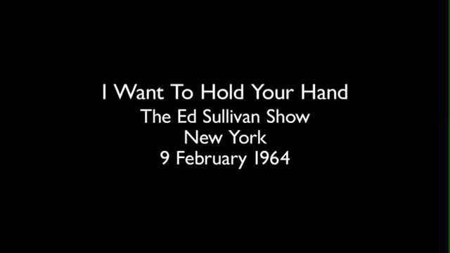
The Beatles
Beatlemania
Their big break came when Capitol Records gave the Beatles a US record deal after they appeared on Ed Sullivan's popular CBS network variety show in February 1964 (watched by an estimated 73 million people). They also had two number 1 albums in the UK the previous year.
It wasn’t unusual for the Beatles to be greeted by screaming fans at the cities they visited. When they played their music live, the people in the audience would scream as well. This became known as Beatlemania. The police in some cities had to use water hoses to control the crowds of people wanting to see the Beatles.

Slide 10
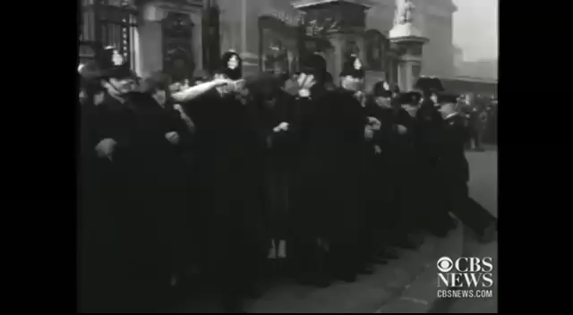
The Beatles
Beatlemania
The Beatles reached a level of popularity in the USA that even outshone their success in Britain. By April 1964, they held the first five places in the Billboard Hot 100 music charts. They had established Liverpool as the pop music capital of the world and the beat boom soon spread from the UK across to the USA.
That summer, they toured New Zealand and Australia, where their arrival in Adelaide was greeted by a crowd estimated at more than 300,000. The screams from the audiences were so loud that John, Paul, George and Ringo couldn’t hear each other’s instruments when they were playing concerts.

Slide 11
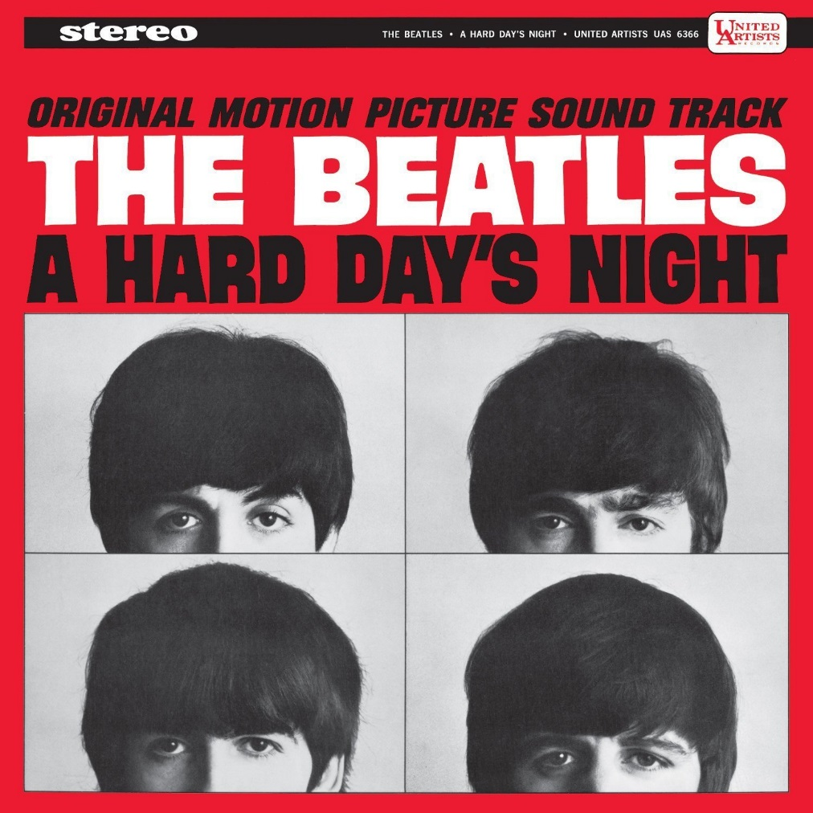
The Beatles
Movies
The Beatles decided that the next thing they would like to do is to star in their own film. A script was written especially for John, Paul, George and Ringo. They wrote an album to accompany the film called “A Hard Days Night”.
The film was a success and the Beatles went on to star in four other films; “Help!”, “Magical Mystery Tour”, “Yellow Submarine” and “Let it Be”.

Slide 12
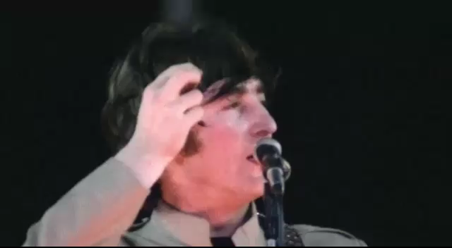
The Beatles
Stadium Concerts
The Beatles were becoming so popular that it was suggested that they play in a baseball stadium in New York so they could play to a larger audience. Before this, bands had only played in venues that could hold up to three or four thousand people.
In 1965, the Beatles played Shea Stadium, New York to an estimated audience of 55,000! No other band had played to such a large crowd before.
By 1966, the Beatles had become tired of touring around the world and playing live concerts. The screams from the crowd were so loud that they couldn’t hear themselves sing or play.
In August 1966, they played their last live concert in Candlestick Park, San Francisco. The show only lasted 33 minutes.

Slide 13
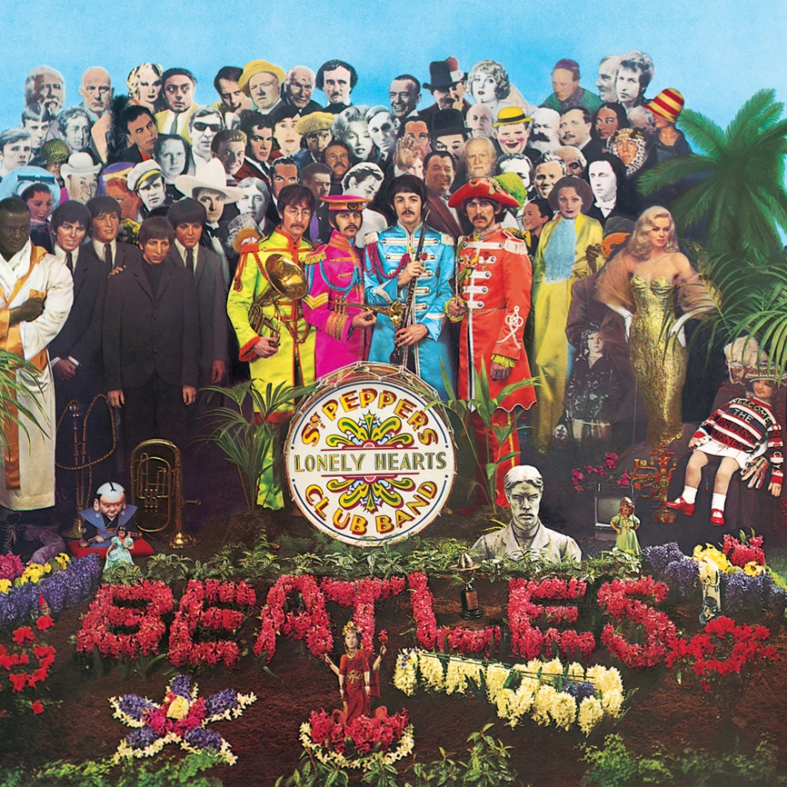
The Beatles
Famous Albums
After spending more than six years touring and playing live concerts, the Beatles now turned their focus to recording music and making albums. In 1967, the Beatles released “Sgt Pepper’s Lonely Hearts Club Band”. It is considered to be one of their best albums and its cover is one of the most recreated album covers ever.
The Beatles went on to release “The White Album”, “Let it Be” and “Abbey Road”. The Beatles were now to be considered among the best song writers in the world.

Slide 14
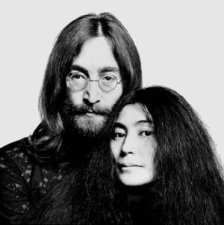
The Beatles
The Beginning of the End
John Lennon met Japanese artist Yoko Ono in 1966 at an art gallery in London. By 1968, John Lennon was seeing Yoko Ono on a regular basis. They were rarely apart.
The Beatles has a rule that only the four members of the Beatles were allowed in the studio while they were recording music. John broke this rule and allowed Yoko Ono to sit in on recordings. This caused tension within the group.
By 1969, each one of the Beatles lives were moving in a different direction and they didn’t agree on everything like they used to.

Slide 15
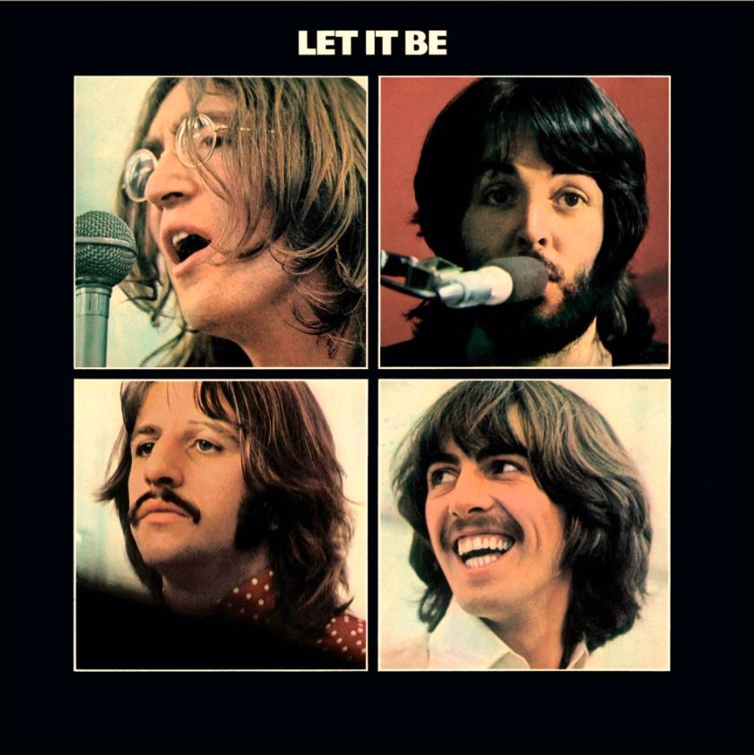
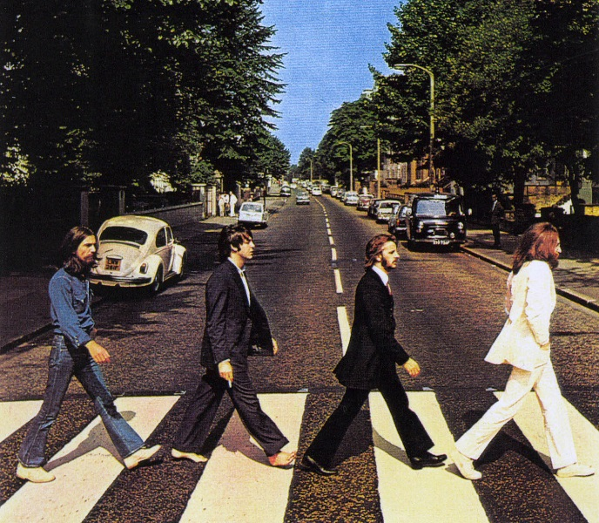
The Beatles
The Final Album
In 1969, the Beatles were supposed to make a film about how they wrote and recorded music. The film quickly became an unhappy experience for everyone because of the tension and arguing between the Beatles. The album “Let it Be” was recorded during this time.
The Beatles’ long time producer, George Martin, asked John, Paul, George and Ringo not to end on a sour note and convinced them to return to the studio to record one final album. In 1970, the Beatles released “Abbey Road” and announced to the world that they were breaking up.

Slide 16
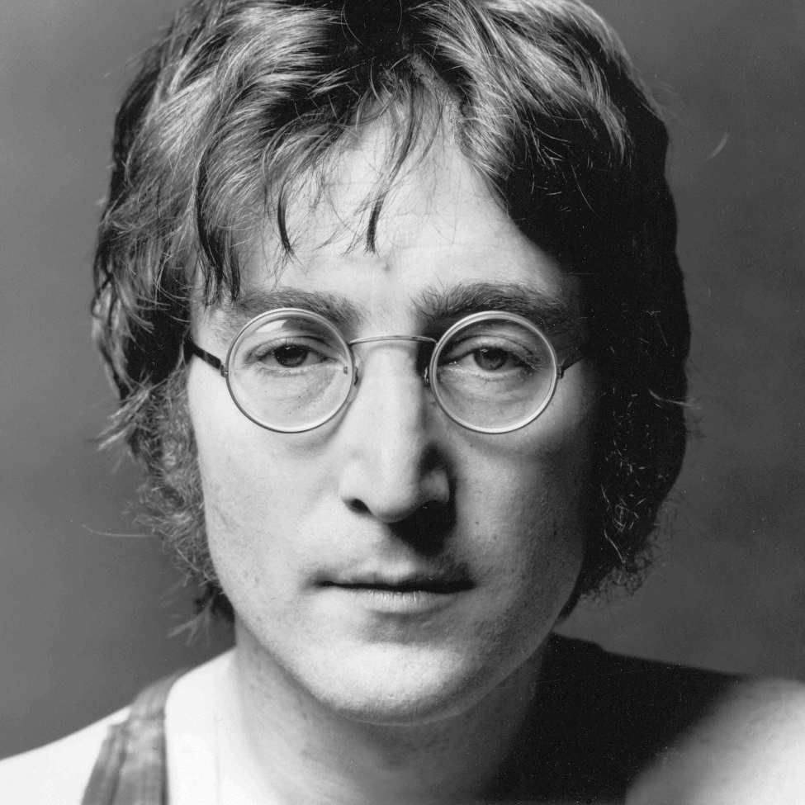
The Beatles
John Lennon
After the Beatles broke up, John Lennon embarked on a very successful solo career. He released seven albums between 1970 and 1980. Some of his most famous solo efforts include “Imagine”, “Give Peace a Chance”, “War is Over” and “Jealous Guy”.
In December 1980, John Lennon was shot in the back by a deranged fan. He was murdered outside of his apartment complex in New York. He died aged 40.
Although he was only active for 20 years, John Lennon’s music has stood the test of time and has influenced thousands of other artists.

Slide 17
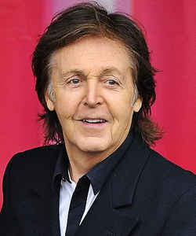
The Beatles
Paul McCartney
Paul formed the band Wings with his late wife Linda after the Beatles broke up. In 1973, Paul recorded the theme song to a James Bond film called “Live and Let Die”.
Paul’s band also recorded “Mull of Kintyre” which is still one of fastest selling UK singles of all time. In 1981, Wings disbanded due to disagreements.
Paul McCartney has performed since then as a solo artist. He has released many albums and has had hits throughout the 80’s, 90’s and into the 2000’s. His latest album was released in 2016.

Slide 18
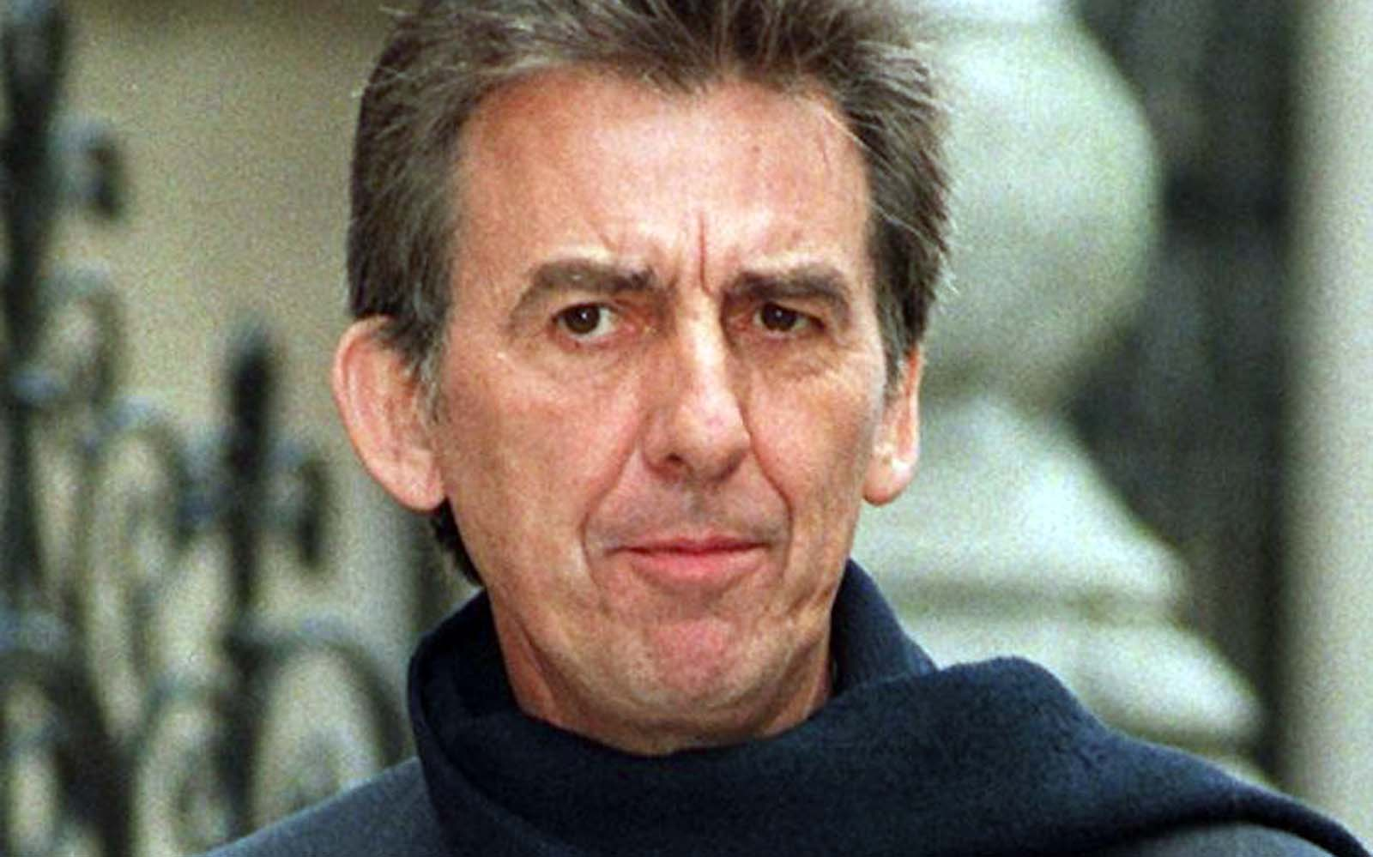
The Beatles
George Harrison
Before the Beatles broke up in 1970, George had already released two solo albums. In 1971, he released his album “All Things Must Pass” to great critical acclaim. The album included the hit single “My Sweet Lord”.
In 1988, Harrison formed the super group the Traveling Wilburys with Jeff Lynne, Roy Orbison, Bob Dylan and Tom Petty. Between 1988 and 1990 they produced hit songs such as “End of the Line” and “Handle with Care”.
On 29 November 2001, Harrison died from lung cancer at a friend's home in Los Angeles, aged 58.

Slide 19
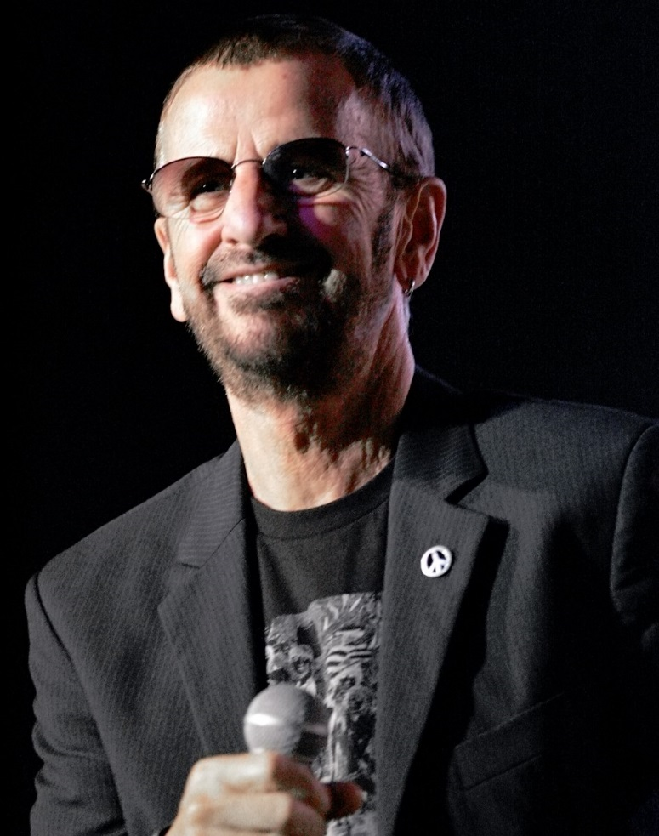
The Beatles
Ringo Starr
Following the break up of the Beatles, Ringo released two solo albums, the first reaching number 7 in the UK charts and number 22 in the US charts. He also played the drums on John Lennon’s and George Harrison’s solo albums.
Between 1984 and 1986, Ringo was the narrator for the popular children’s series “Thomas and Friends”. He also continued touring with his band Ringo Starr and His All-Starr Band.
In July 2017, on his 77th birthday, he released a new single entitled "Give More Love“. In September 2017 he released his nineteenth studio album of the same name. The album features appearances by Paul McCartney.

Slide 20
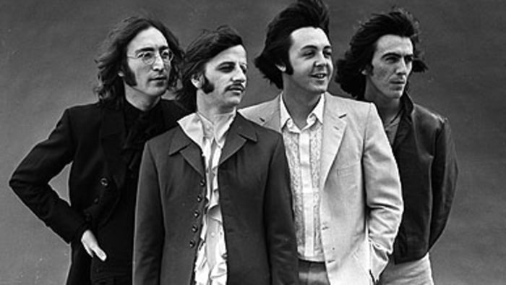
The Beatles
Legacy
In addition to the 23 albums released during the Beatles’ career, there have been more than 150 compilations, recorded interviews and videos issued. Hundreds of books have been written about their personal lives, music and influence on pop culture and rock music.
Their original record label, EMI and the Guinness Book of World Records estimate that more than one billion Beatles albums, singles and CDs have been sold worldwide.

