Slide 1


What is Music?
This Photo by Unknown Author is licensed under CC BY-NC-ND

Slide 2

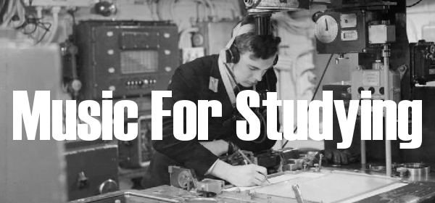
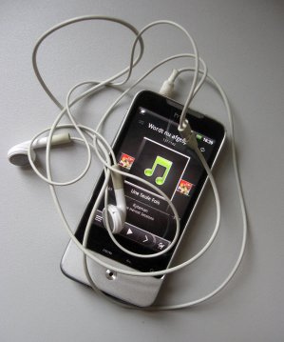
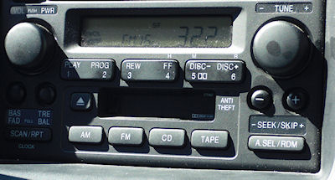

Music Is All Around Us
This Photo by Unknown Author is licensed under CC BY-ND
This Photo by Unknown Author is licensed under CC BY-NC-SA
To people in many cultures, music is completely intertwined into their way of life.
At your table, list all the places and situations that you can think of, where you are exposed to music of some kind.
This Photo by Unknown Author is licensed under CC BY-SA
This Photo by Unknown Author is licensed under CC BY-SA
This Photo by Unknown Author is licensed under CC BY-NC-ND
Notes:
Double click on sound icon to hear the clip

Slide 3
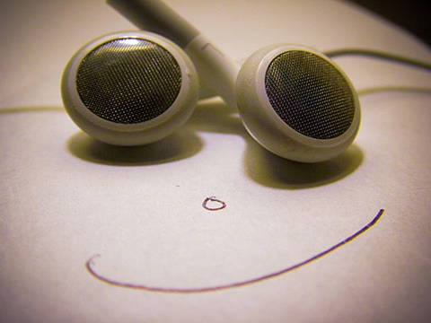
Music Affects Mood
Music can create a strong emotional response – and this is exploited in films / shops / advertising / gyms / shops etc.
It is also often the main reason we all listen to a particular style at a particular time – we like how it enhances our mood!
This Photo by Unknown Author is licensed under CC BY-SA

Slide 4
Match the Mood
Listen to the music on the YouTube clips on the next slide and match the moods below to the appropriate clip.
  CALM
  FEAR / SUSPENSE
  DRAMA AND ANTICIPATION
Notes:
Make sure to use the freeze screen option on the data projector remote before playing the clips on the next slide.

Slide 5
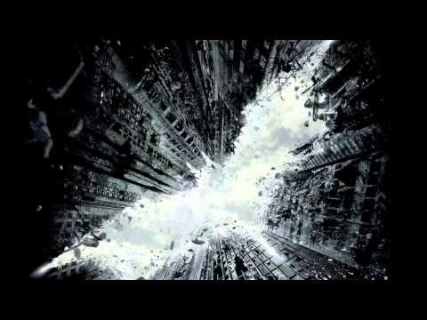


Notes:
Play these clips in whatever order you wish.

Slide 6
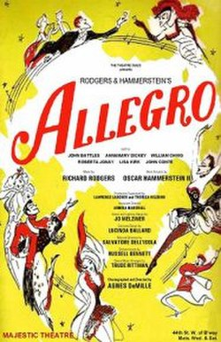
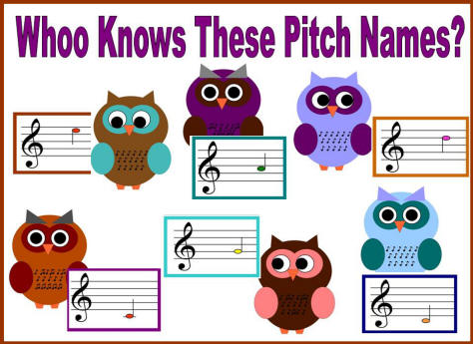
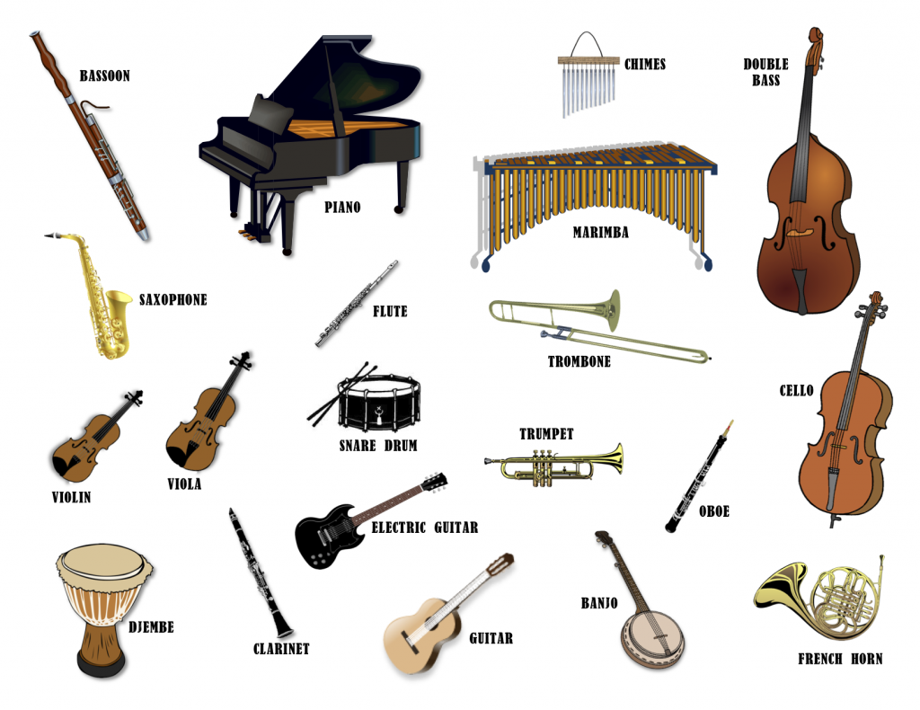

Try to work out why they make you feel a certain way
Speed (tempo): fast / slow
Pitch: High / low
Dynamics: Loud / soft
Timbre: Instrumental sound
This Photo by Unknown Author is licensed under CC BY-SA
This Photo by Unknown Author is licensed under CC BY
This Photo by Unknown Author is licensed under CC BY-SA
This Photo by Unknown Author is licensed under CC BY-NC-SA

Slide 7

Music has strong associations with MEMORY
Music is very powerful in triggering memories – we often remember significant times, places and people from our pasts when we hear certain songs or musical pieces.
This is especially true of the music you listen to during and after puberty – as a teenager, and this is also why compilations of music from the 80’s / 90’s / 00’s etc. sell so well!
What period of your life might you associate with the first clip on the next slide?
What memories are often evoked by older people hearing this clip?
This Photo by Unknown Author is licensed under CC BY-NC
Notes:
1. Make sure you select freeze screen on the data projector before playing the excerpts on the next slide.
2. Can you think of any songs you associate with people or events in your life?
3. You may have to help students with Excerpt 2: WWII song from Vera Lynn.

Slide 8
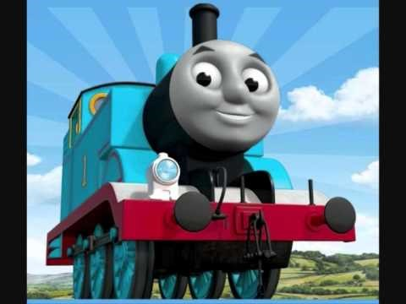

Excerpt 1
Excerpt 2

Slide 9

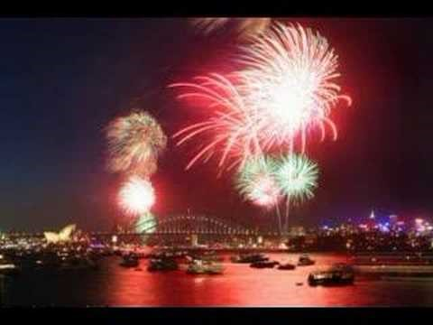
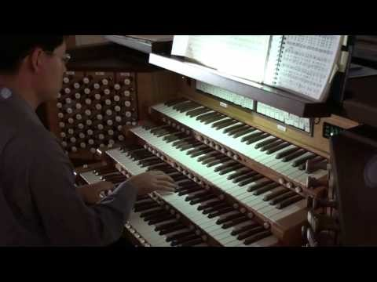

Music is an important part of many of our cultural RITUALS
Listen to the following extracts and identify which ritual / event we associate them with:
EXCERPT
1.
2.
3.
RITUAL / EVENT
1. New Year’s Eve
2. Wedding
3. Sporting Event
This Photo by Unknown Author is licensed under CC BY-SA

Slide 10


Music can help us to IDENTIFY things
This Photo by Unknown Author is licensed under CC BY
Products (used in advertising music and jingles)
Characters (used in films)
Place or location (used in films)
This Photo by Unknown Author is licensed under CC BY-NC-ND
Notes:
This is achieved through exploiting musical stereotypes we have all grown up with, and which have become part of our musical history, and also through repeatedly hearing the music.
Discuss the powerful associations we have with the music in these extracts:

Slide 11

Music can help to promote unity within a social group
Being a small part of a larger musical sound is a very powerful feeling indeed, and bonds participants together.
1
As everyone can sing, this is the most common medium used – e.g. congregational hymns in religious ceremonies; football chants
2
See if you can think of any more!
3
Notes:
Other possibilities:
audience participation at gigs; community singing / musical singalongs / pub singalongs / group karaoke etc.

Slide 12
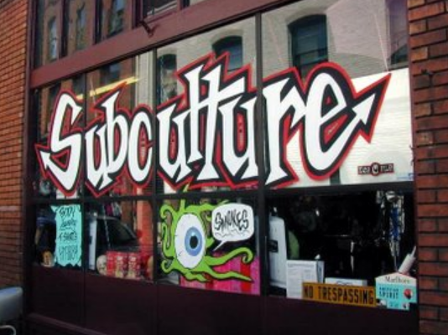
Sub-Cultures
A by-product of this is where music forms a vital part of a sub-culture (particularly for young people), where the group members listen to a similar style of music / follow a particular dress code etc. This is an important social function of music.
Can you think of any subcultures based on musical taste?
On the following slide are various pictures of people. On your sheet, see if you can identify what kind of music each person could be into, based purely on their style of dress!
This Photo by Unknown Author is licensed under CC BY-SA

Slide 13
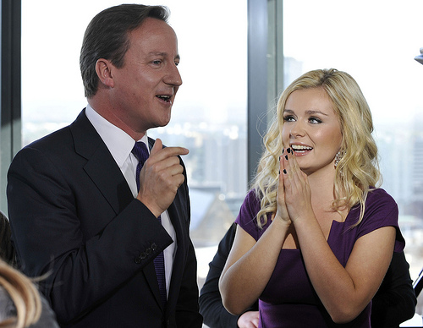
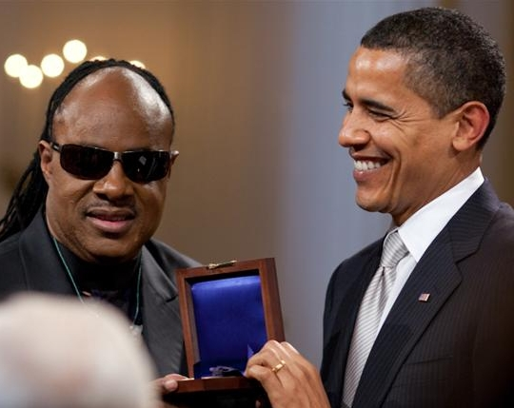
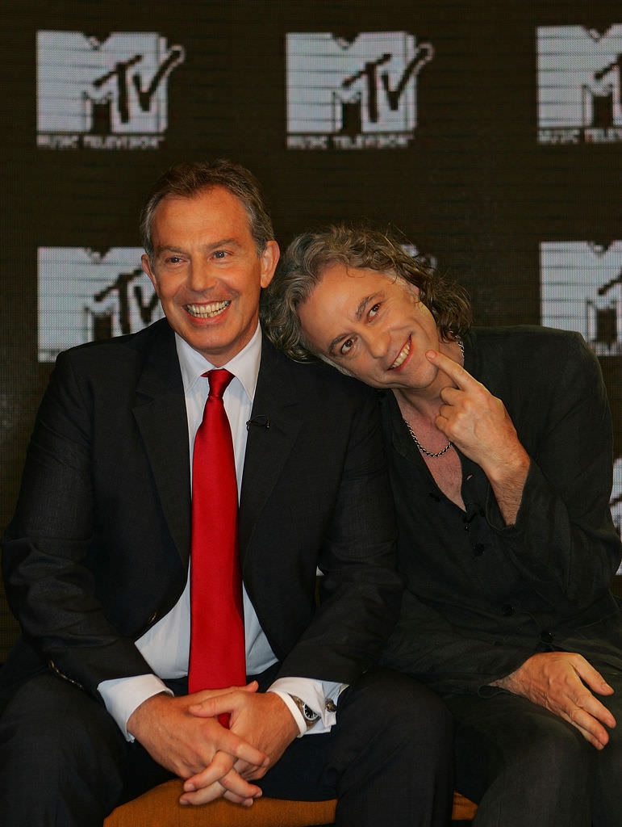
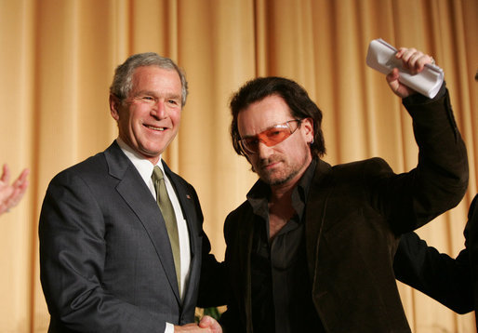
Music and Influence
As music is such a powerful and influential medium, it has been used throughout history by:
Politicians trying to influence people through music:
Musicians trying to influence through music and lyrics:
This Photo by Unknown Author is licensed under CC BY-NC-ND
This Photo by Unknown Author is licensed under CC BY-SA
This Photo by Unknown Author is licensed under CC BY-NC-SA
This Photo by Unknown Author is licensed under CC BY-SA
Notes:
How far do you think music has the power to influence people – and particularly young people?

Slide 14

Music is also Big Business!
Creativity and artistic expression aside, music is often produced first and foremost to MAKE MONEY!
Throughout history, composers have had to write music for certain occasions and functions as required by their patrons (employers). Nowadays, composers often make their living through commissions – where someone employs and pays them to write a certain piece of music for a certain effect!
Much music is also manufactured specifically to sell in large quantities
Notes:
What do you think of ‘manufactured pop’ such as that of Stock, Aitkin and Waterman in the 1980s, or programmes such as The X Factor, and Pop Idol

Slide 15
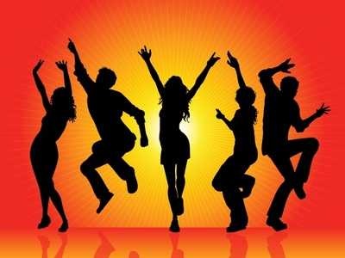
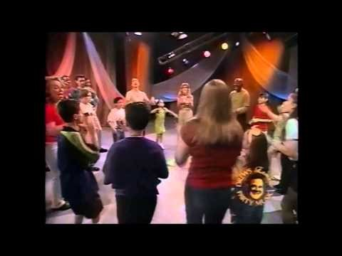
Music and Dancing
Moving our bodies to music must be as ancient as the human race itself! We have a natural physical response to music – whether it is nodding our heads, tapping our feet, moving our bodies, simulating playing instruments (air guitar?!) or full on dancing!
In modern society we often conduct our dancing in a fairly controlled way, and we certainly get more inhibitions about doing it publicly as we get older. Children often have no such inhibitions about dancing!
Look and listen to the following extract movement is taking place. How is the music affecting the movement?
This Photo by Unknown Author is licensed under CC BY-SA
Notes:
Where do people dance in our society now?
It is primarily RHYTHM that we respond to with movement. A steady beat is all it takes!

Slide 16

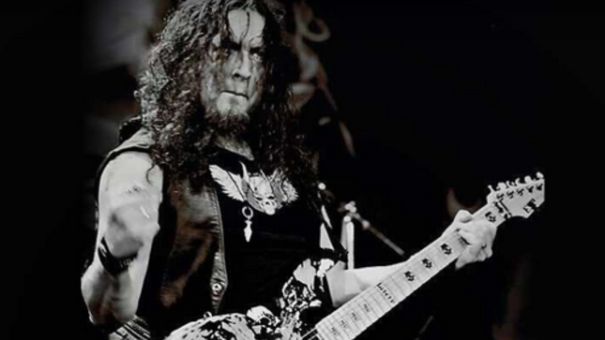
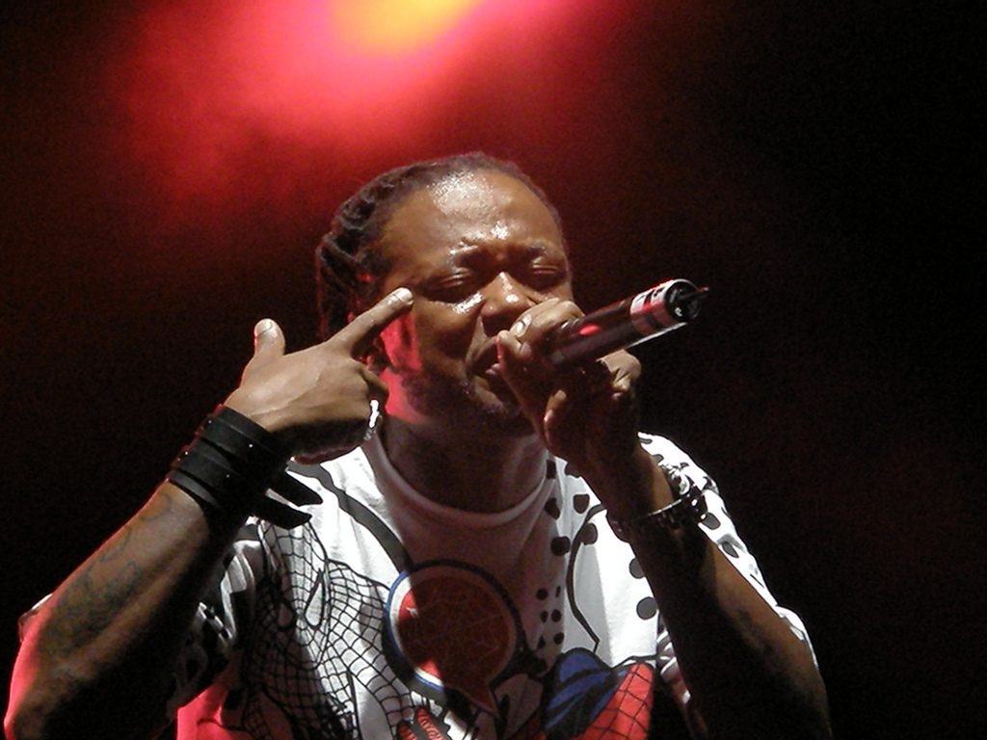
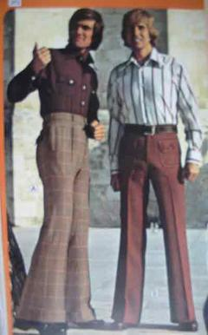
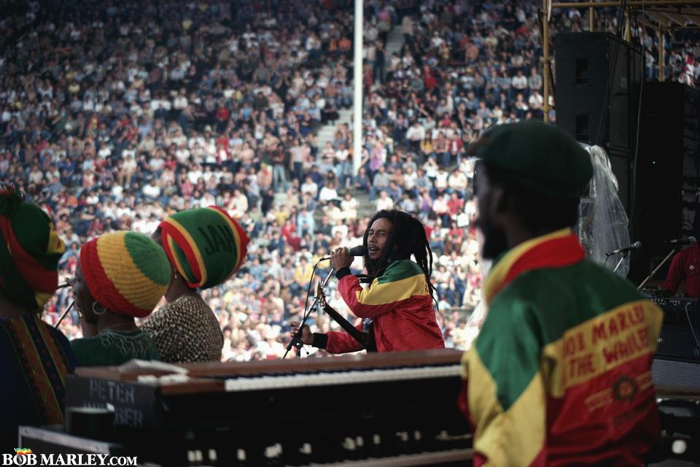
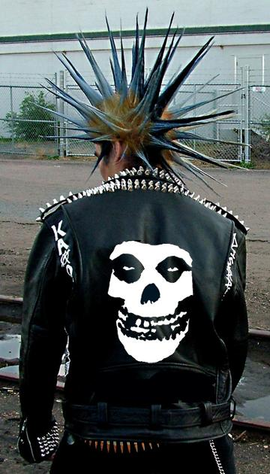
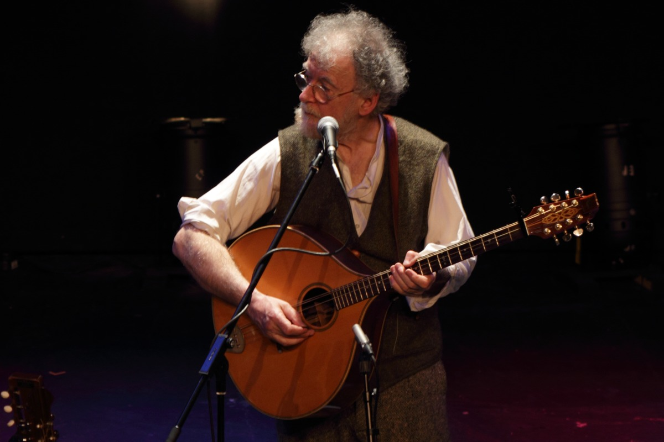

Picture A
Picture B
Picture C
Picture D
This Photo by Unknown Author is licensed under CC BY-SA
This Photo by Unknown Author is licensed under CC BY-NC-ND
This Photo by Unknown Author is licensed under CC BY-SA
This Photo by Unknown Author is licensed under CC BY-NC-ND
Picture E
Picture F
Picture G
Picture H
This Photo by Unknown Author is licensed under CC BY-NC-ND
This Photo by Unknown Author is licensed under CC BY-NC-SA
This Photo by Unknown Author is licensed under CC BY-SA
This Photo by Unknown Author is licensed under CC BY-NC-SA

Slide 17
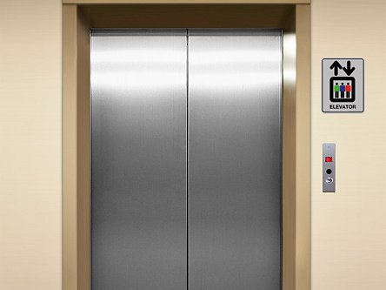
Music can used simply as a ‘silence filler’!
Write down any examples you can think of, where music is used as a background sound to avoid silence!
This Photo by Unknown Author is licensed under CC BY-ND
Notes:
The background picture should give you some ideas!

Slide 18
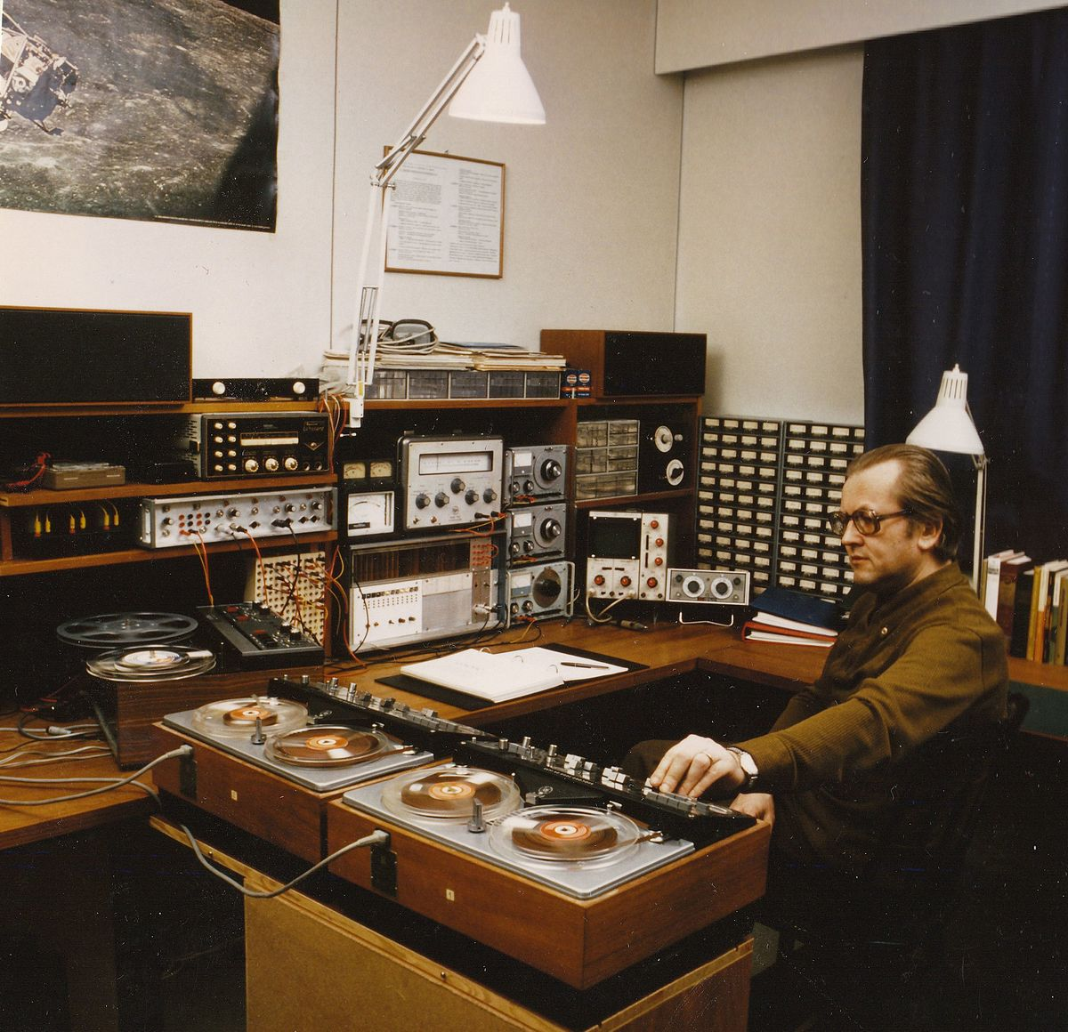
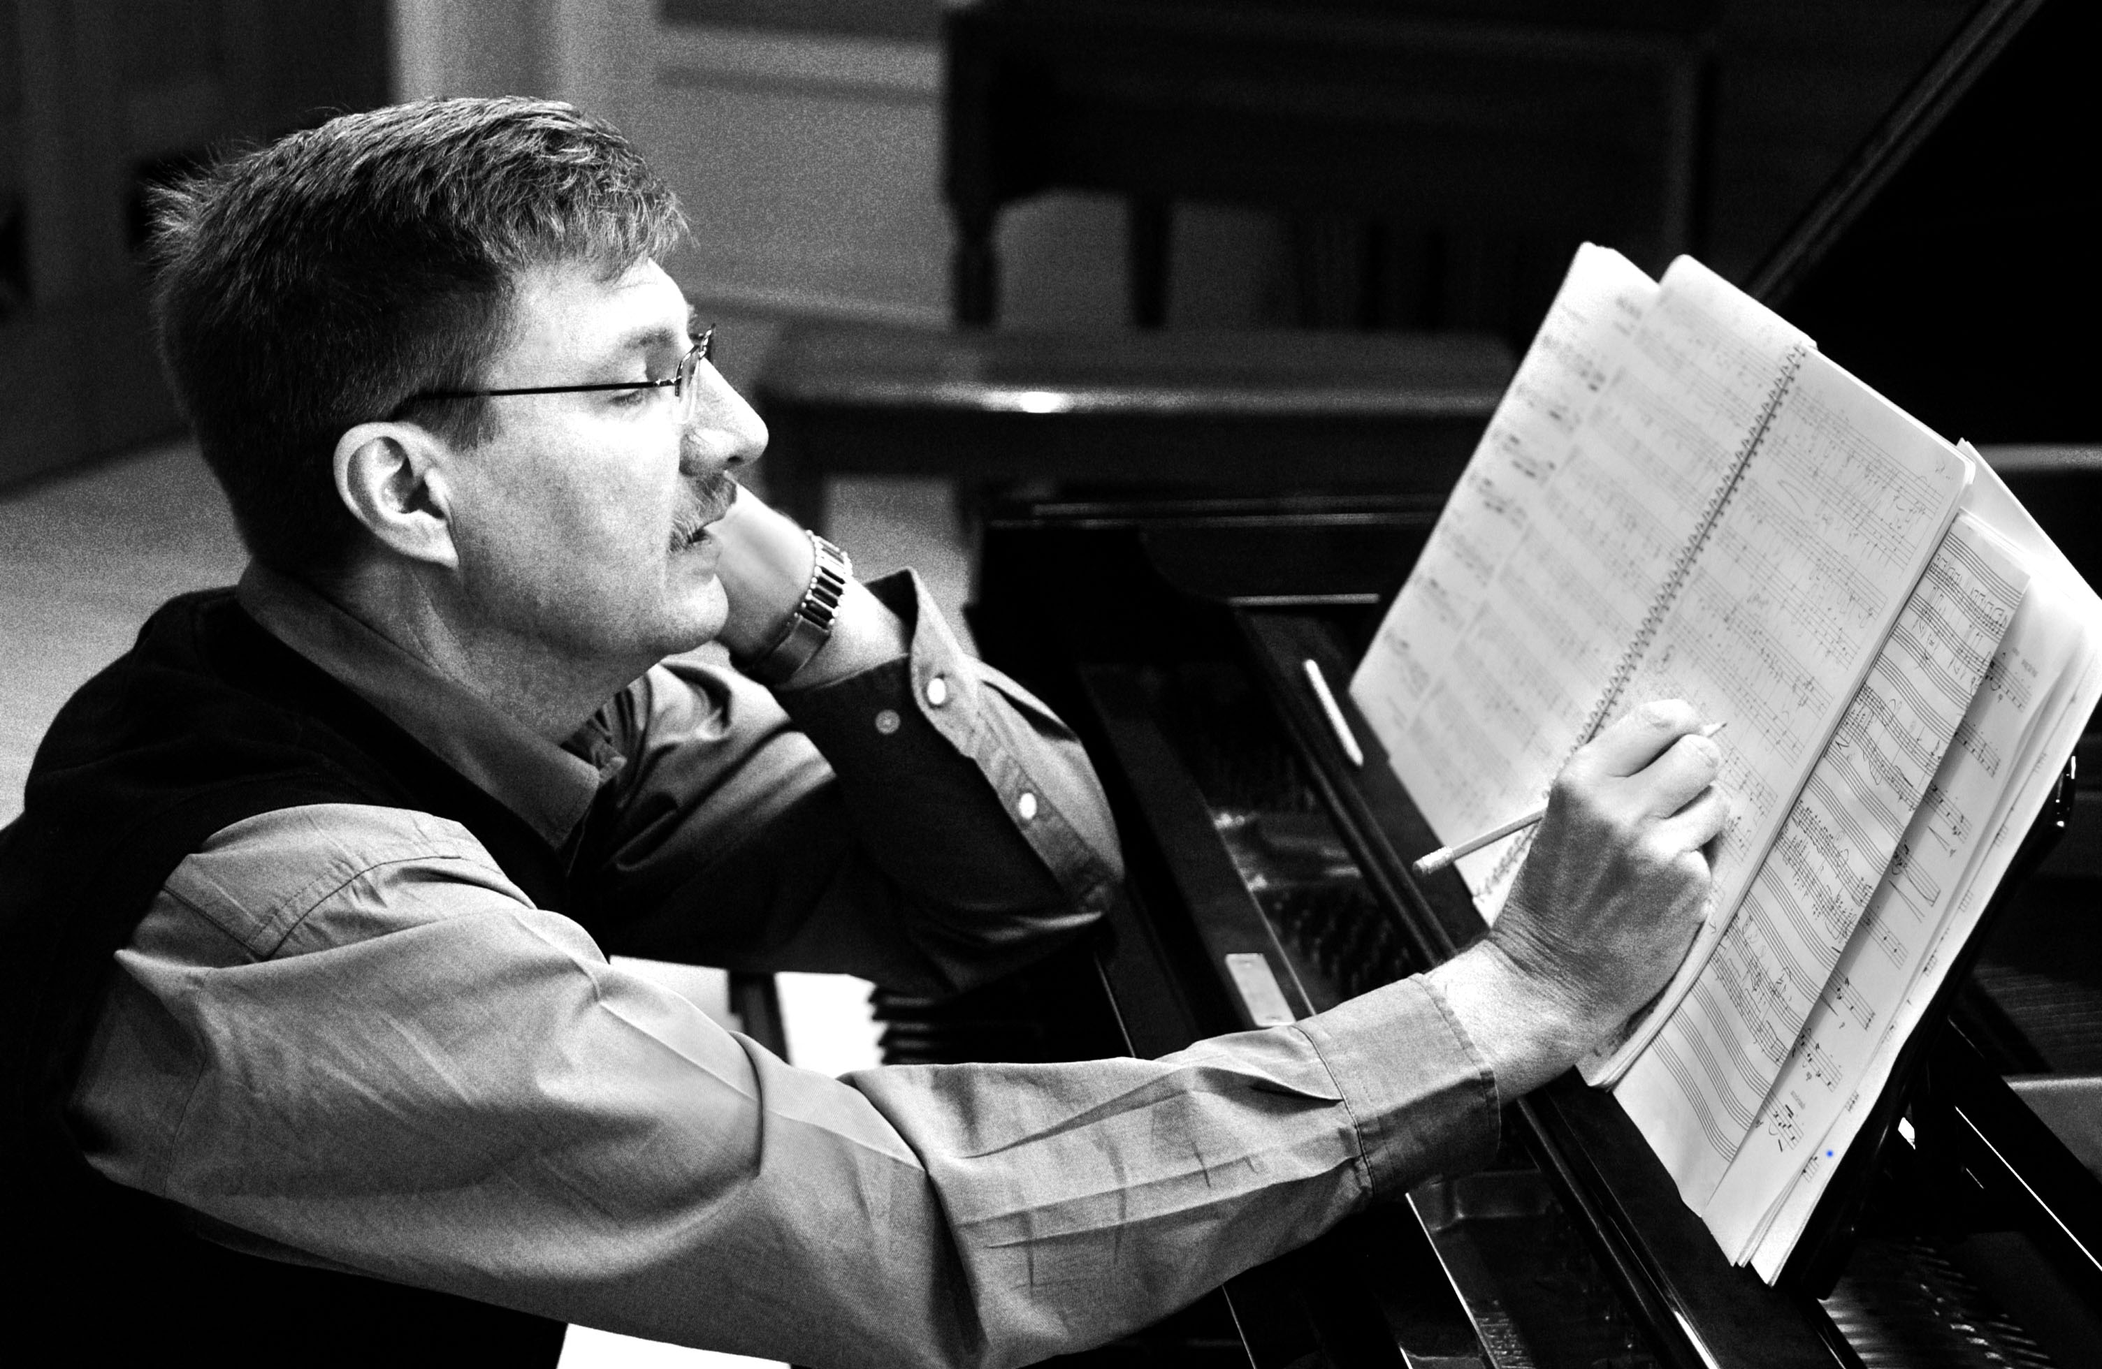
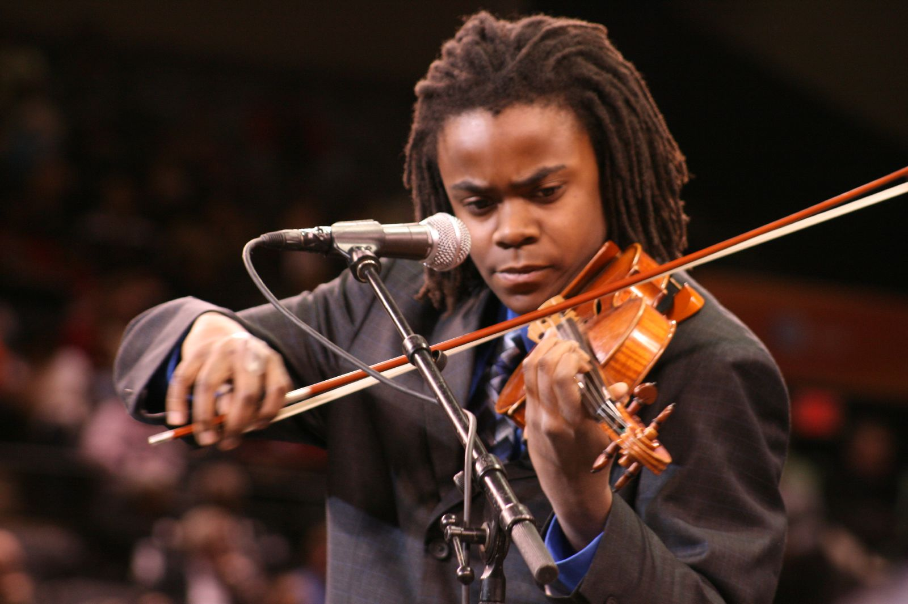
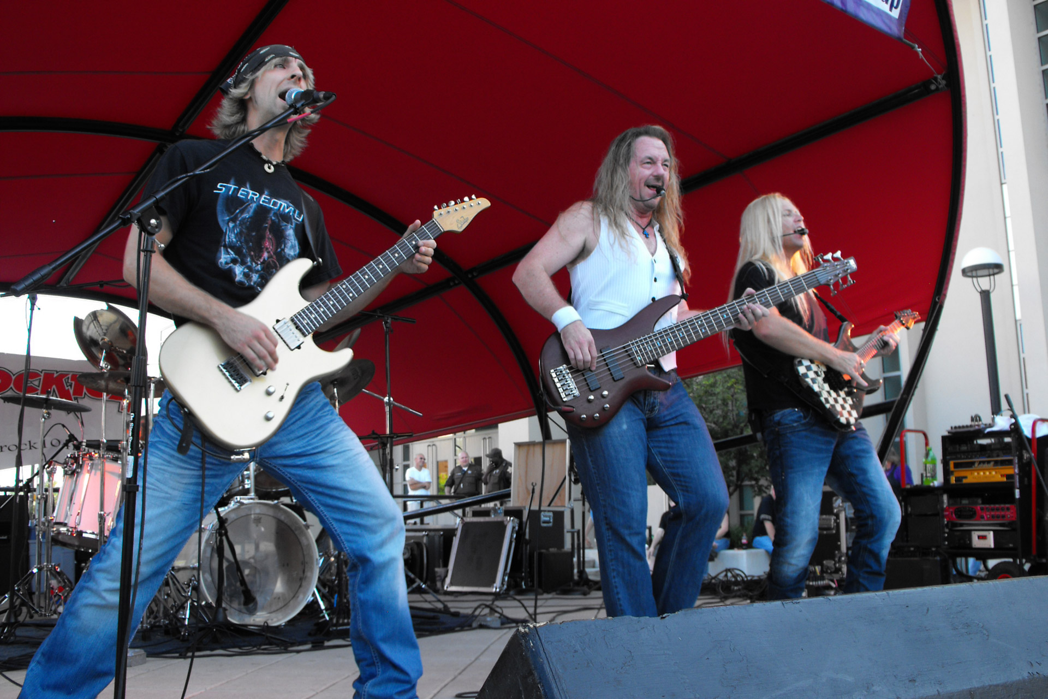
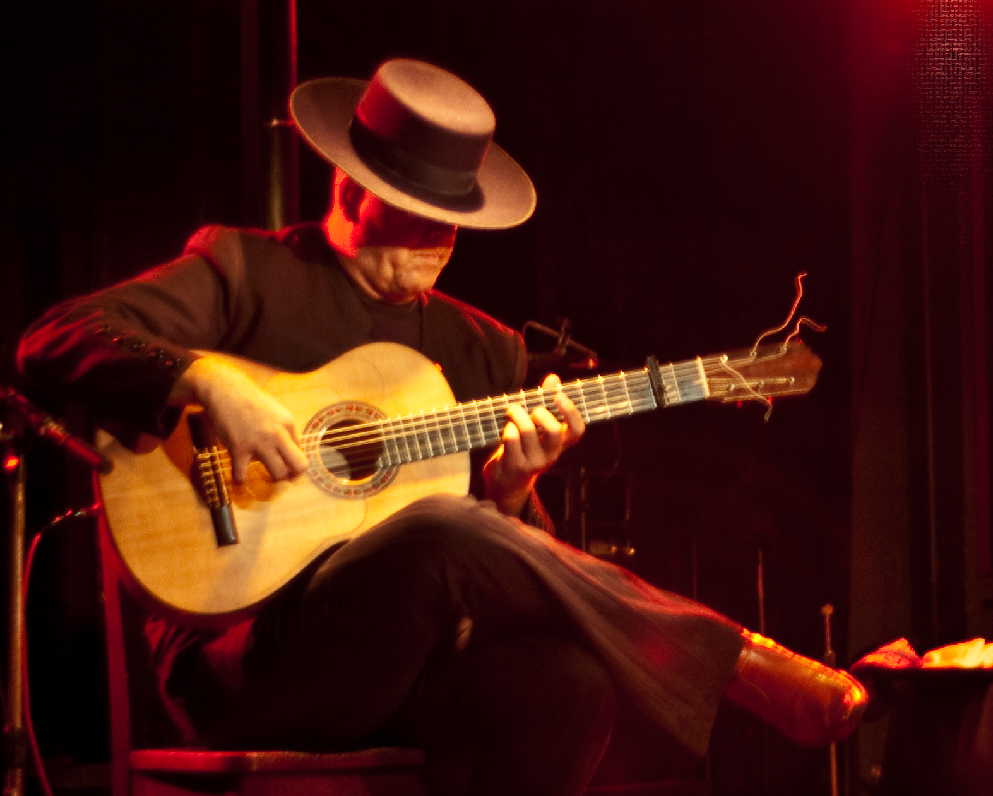
Music is also a form of self- expression and creativity!
For people who compose and write music….
For people who play a musical instrument or sing..
This Photo by Unknown Author is licensed under CC BY-SA
This Photo by Unknown Author is licensed under CC BY-SA
This Photo by Unknown Author is licensed under CC BY-SA
This Photo by Unknown Author is licensed under CC BY-SA

Slide 19

And Finally….
Can you come up with an effective ‘dictionary definition’ for what you think music actually is?
The Wikipedia definition includes the following:
‘Music is an art form whose medium is sound organised in time -
Common elements of music are pitch, rhythm, dynamics and the sonic qualities of timbre and texture. The creation, performance, significance and even the definition of music vary according to culture and social context.’
This Photo by Unknown Author is licensed under CC BY-NC-ND

Slide 20
How important is music in your life?

