Slide 1
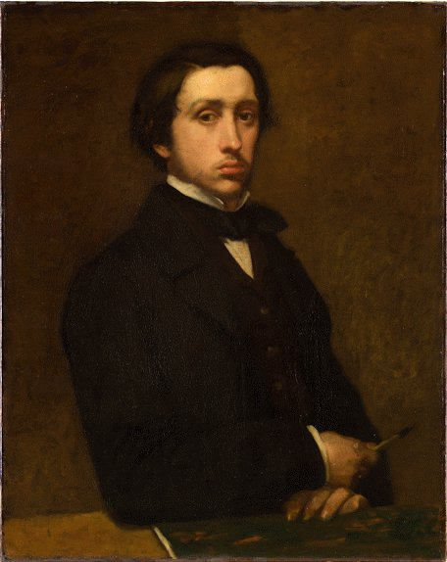

Edgar Degas (1834-1917)
Caroline Mc Corriston

Slide 2
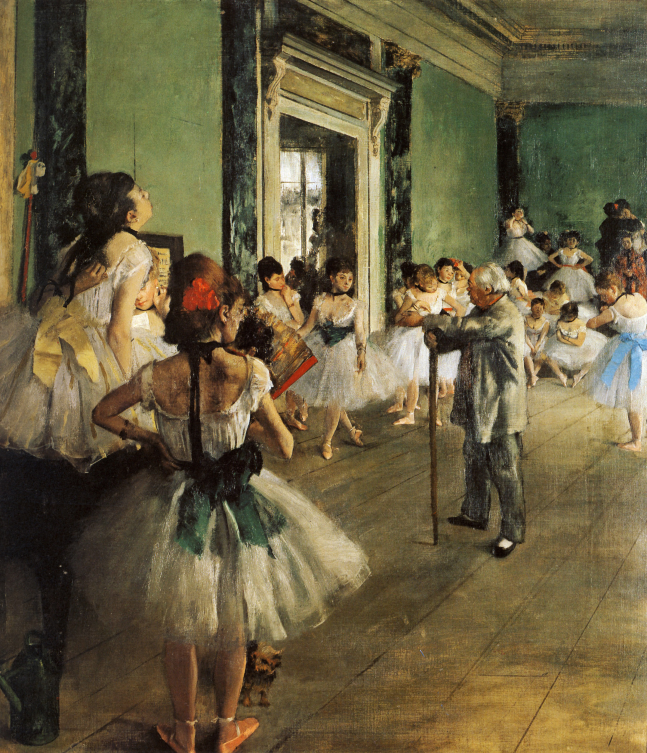
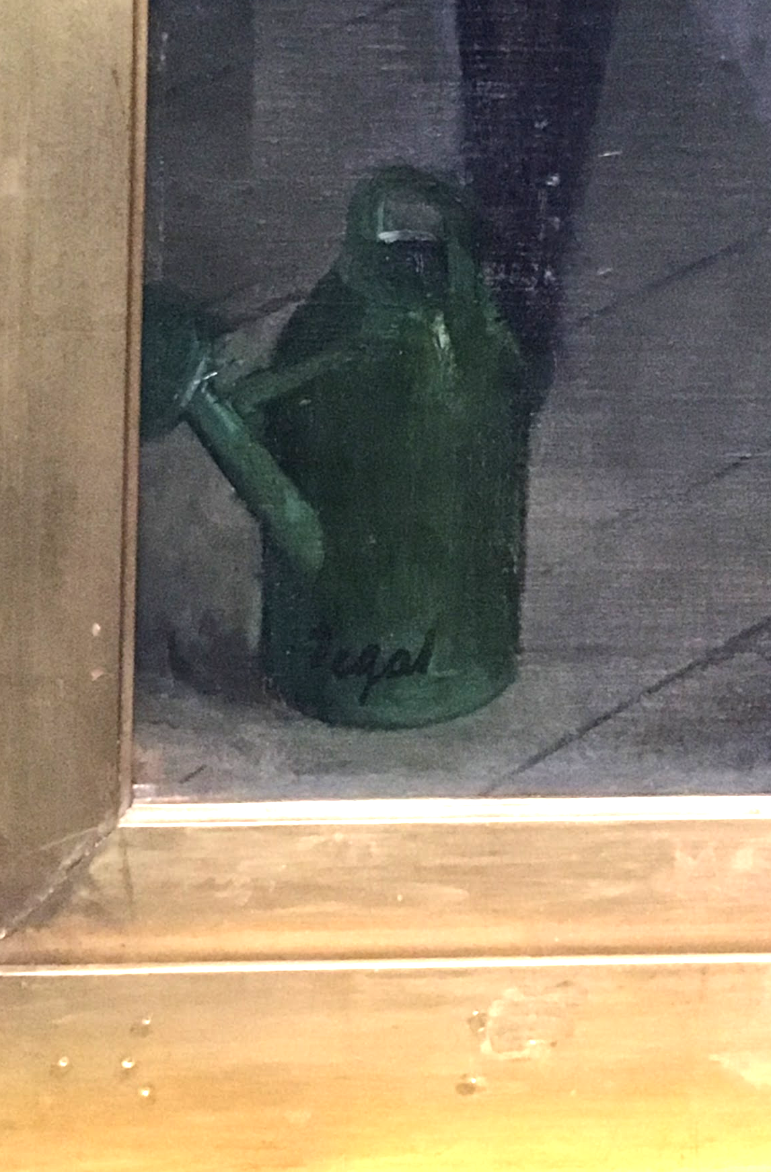
The Dancing Class, c. 1873-75
His signature on the watering can
Credit: Caroline Mc Corriston

Slide 3
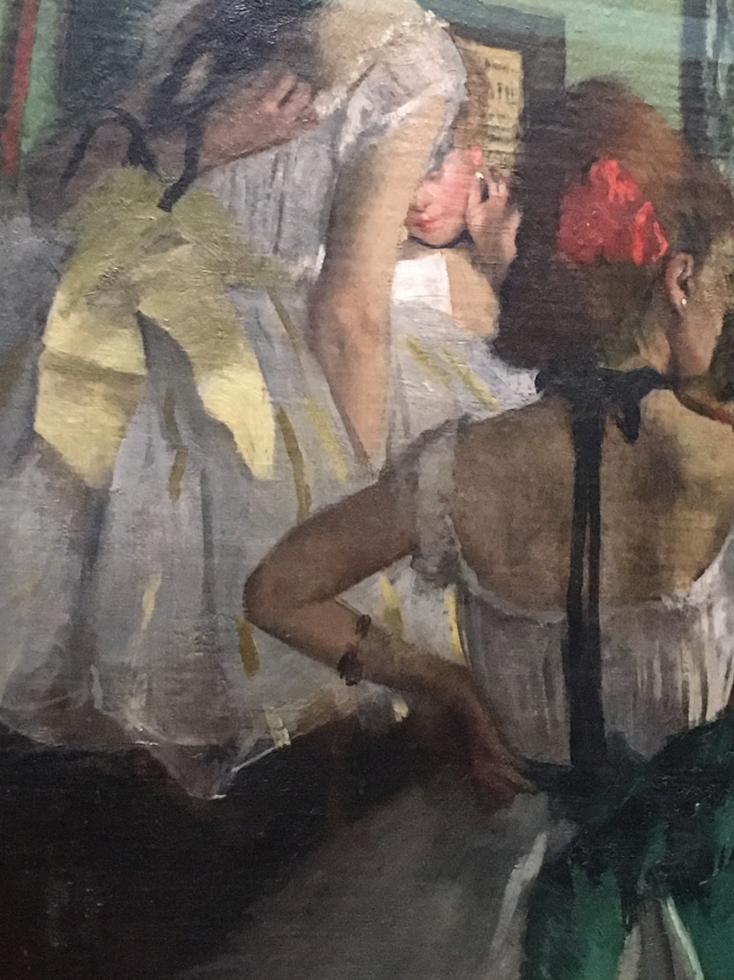
Details
Natural mannerisms: scratching back, hand on hip, fixing earring
Credit: Caroline Mc Corriston

Slide 4
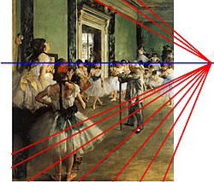
Composition

Slide 5
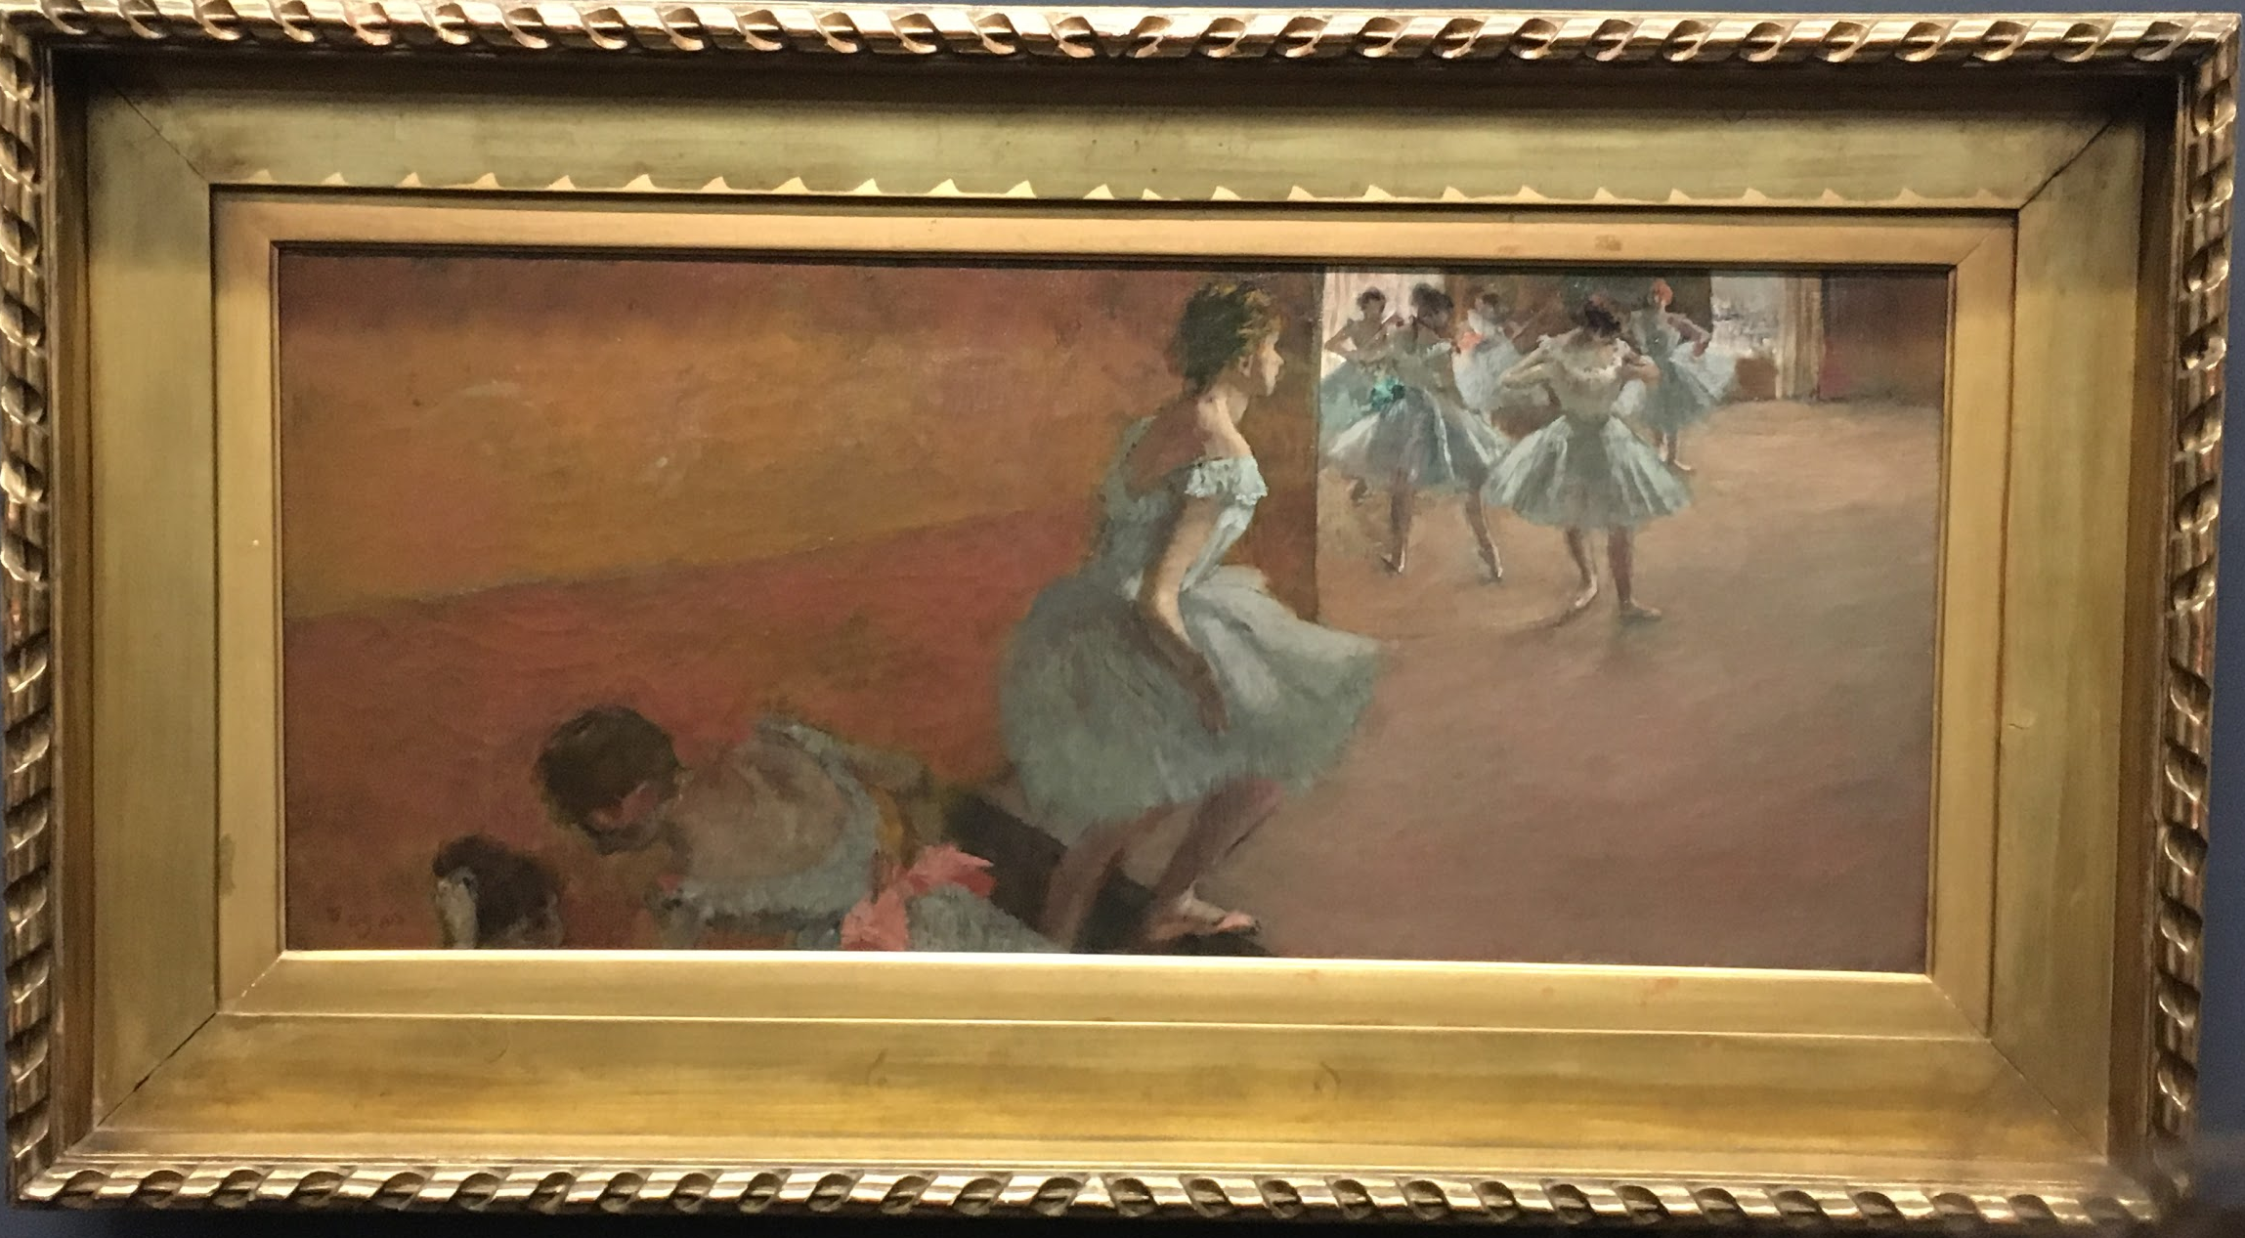
Credit: Caroline Mc Corriston

Slide 6
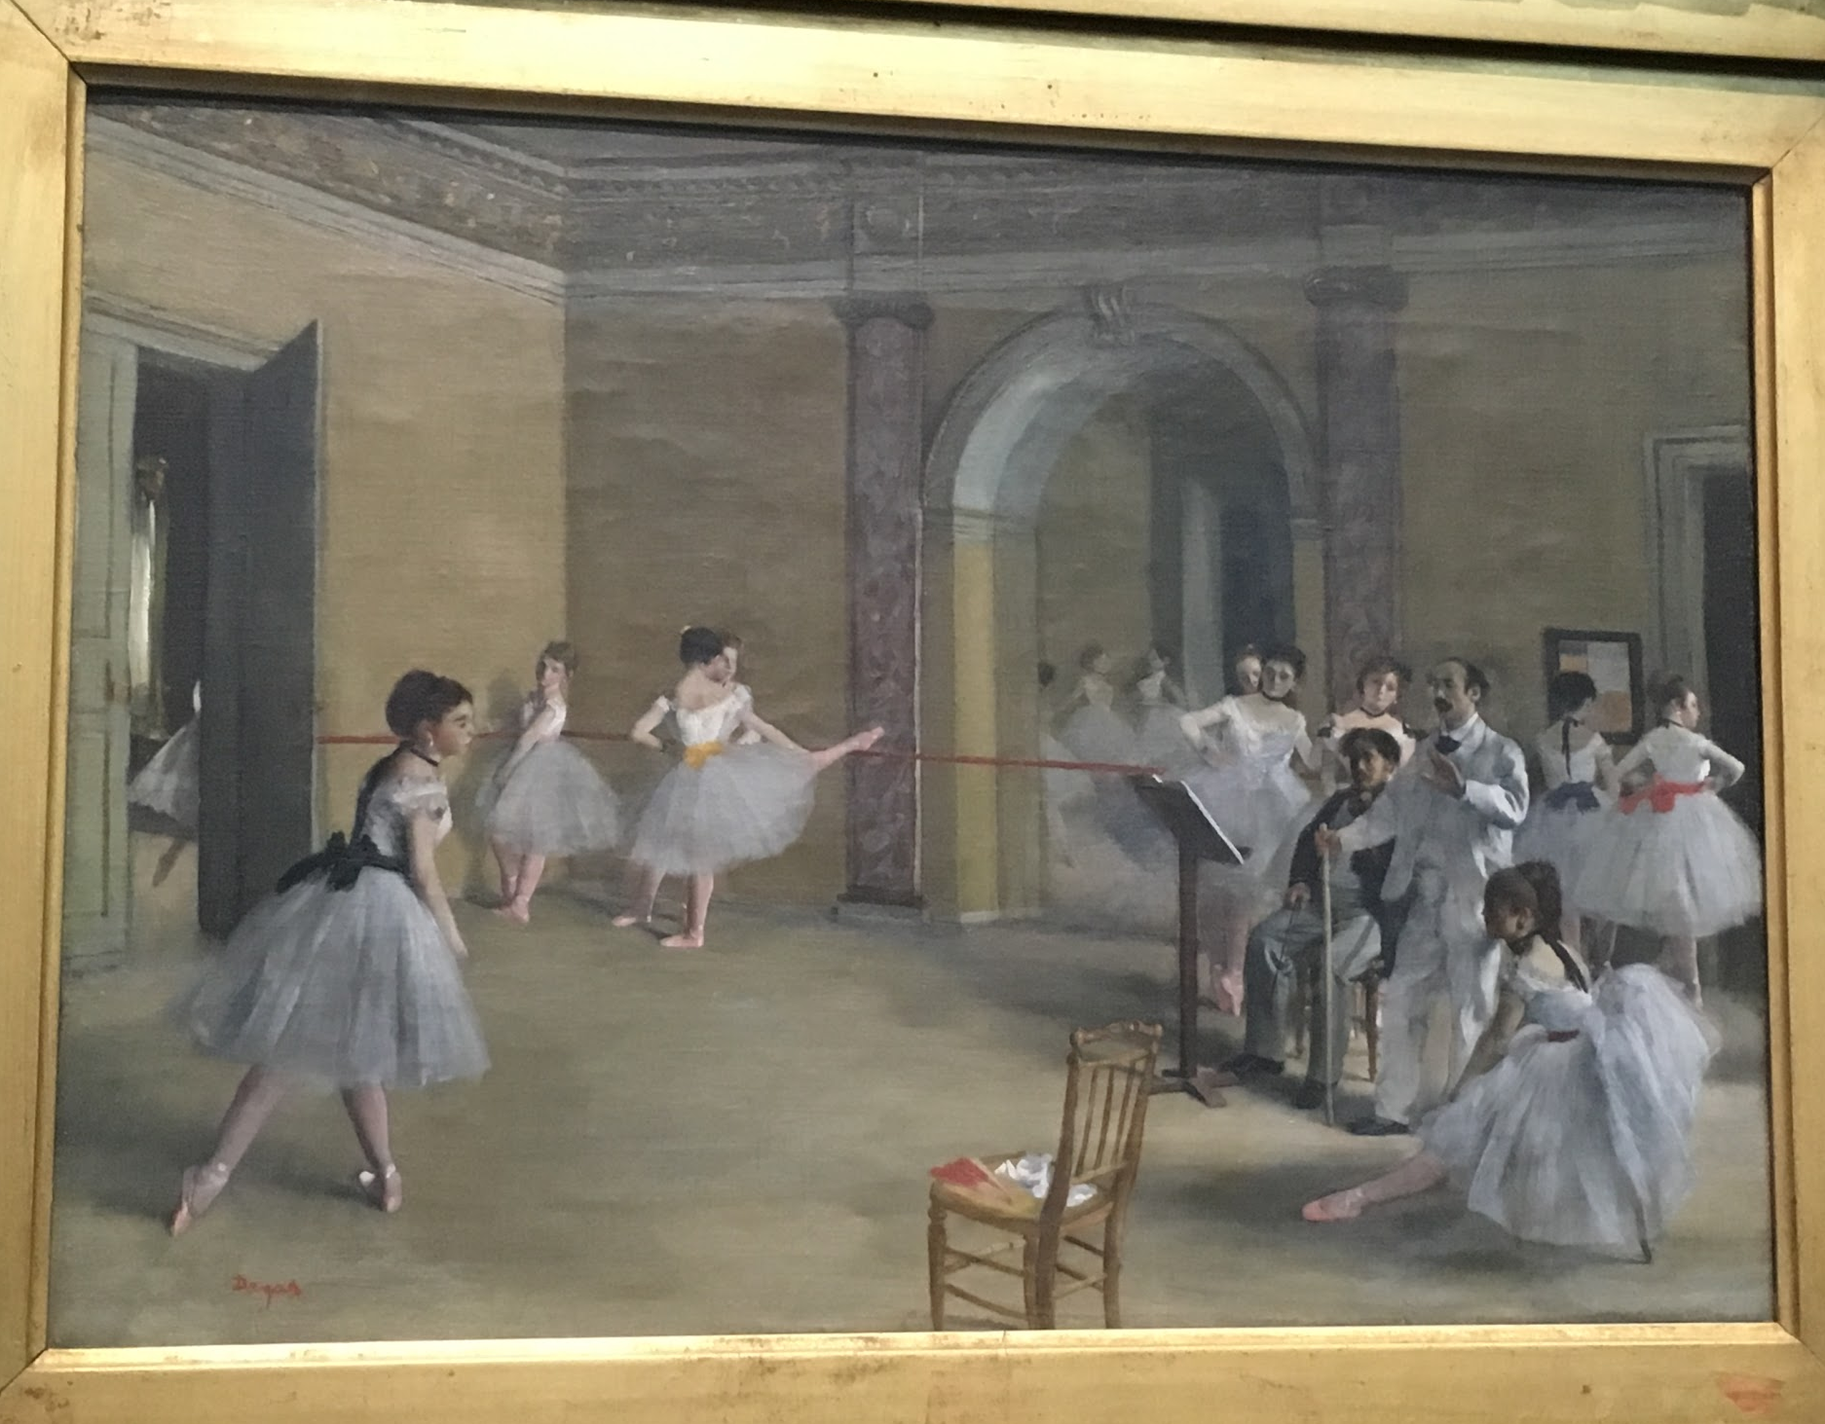
The Dance Foyer at The Opera, 1872
Credit: Caroline Mc Corriston

Slide 7
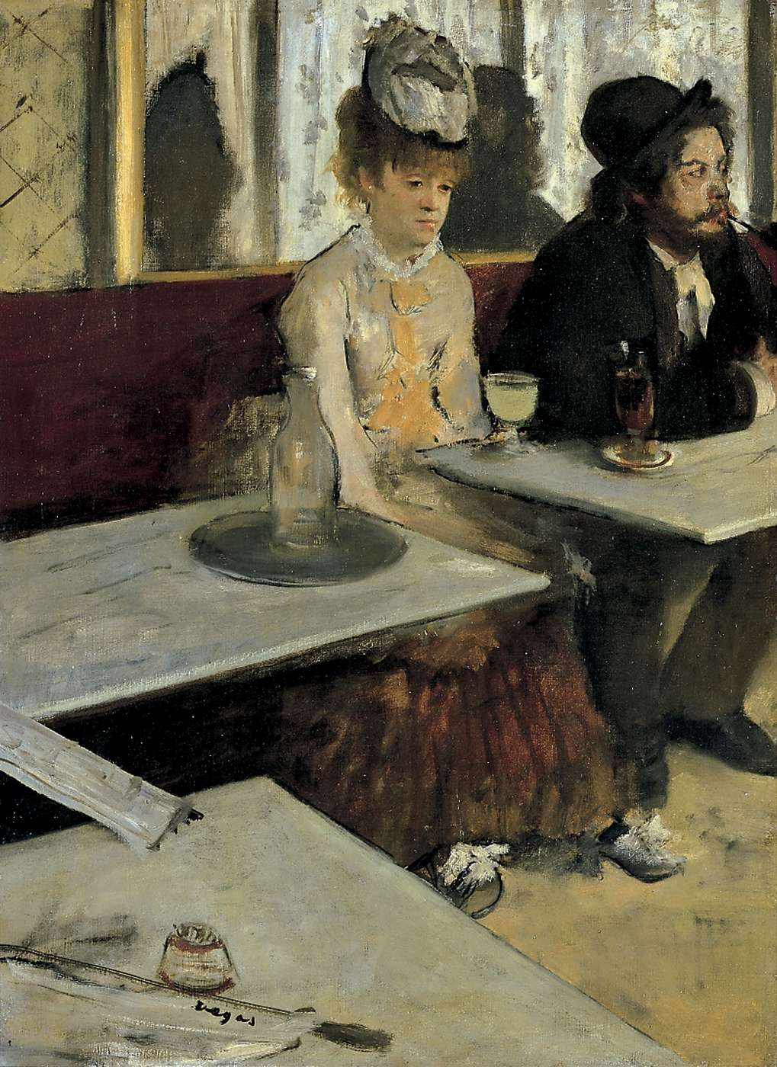
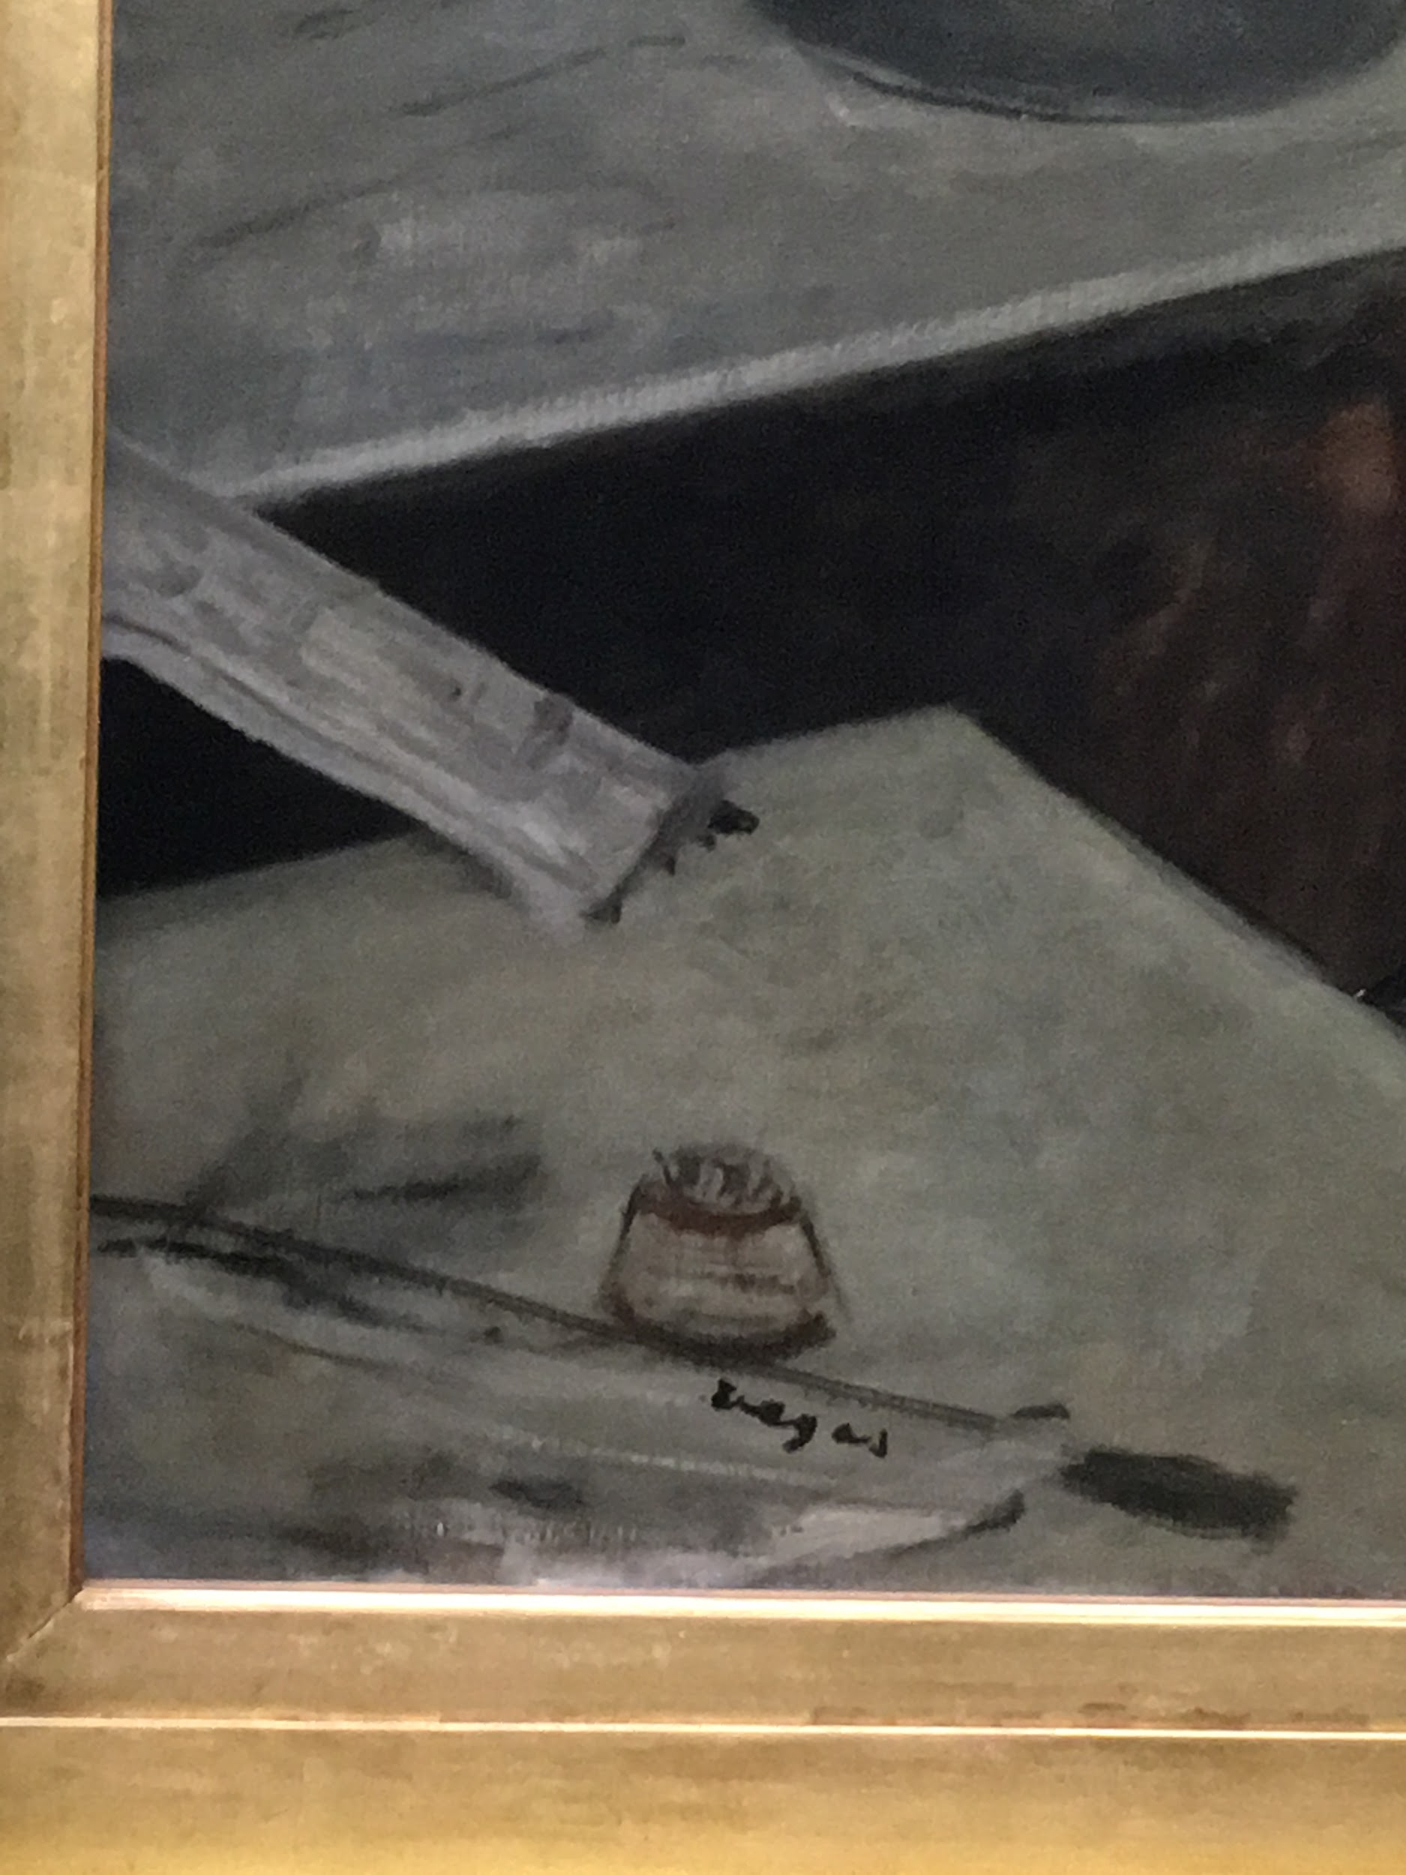
L’Absinthe, 1876
Signature
Credit: Caroline Mc Corriston

Slide 8
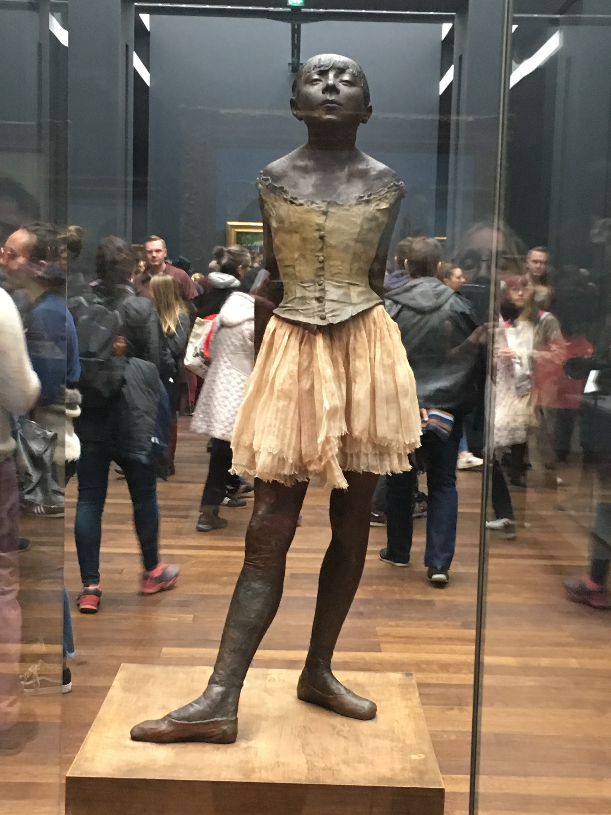
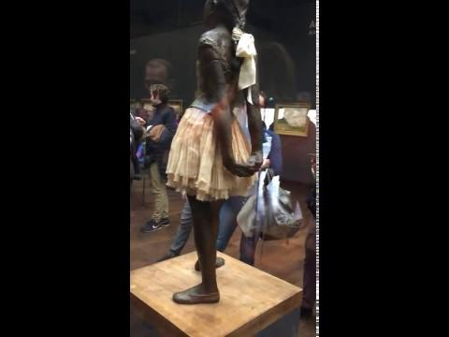
Sculptures
Credit: Caroline Mc Corriston

Slide 9
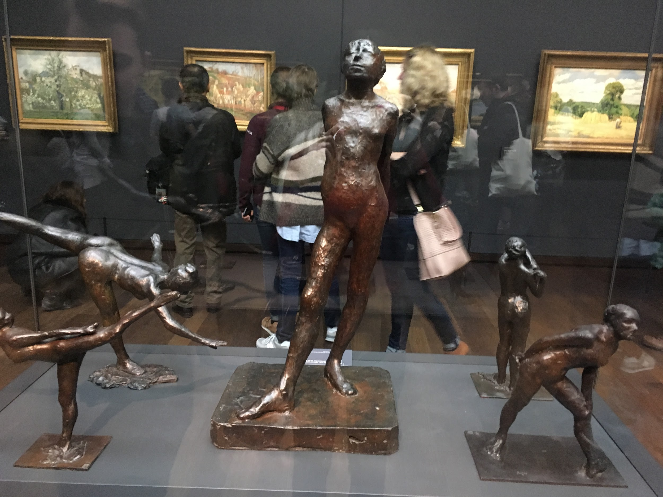
Credit: Caroline Mc Corriston

Slide 10
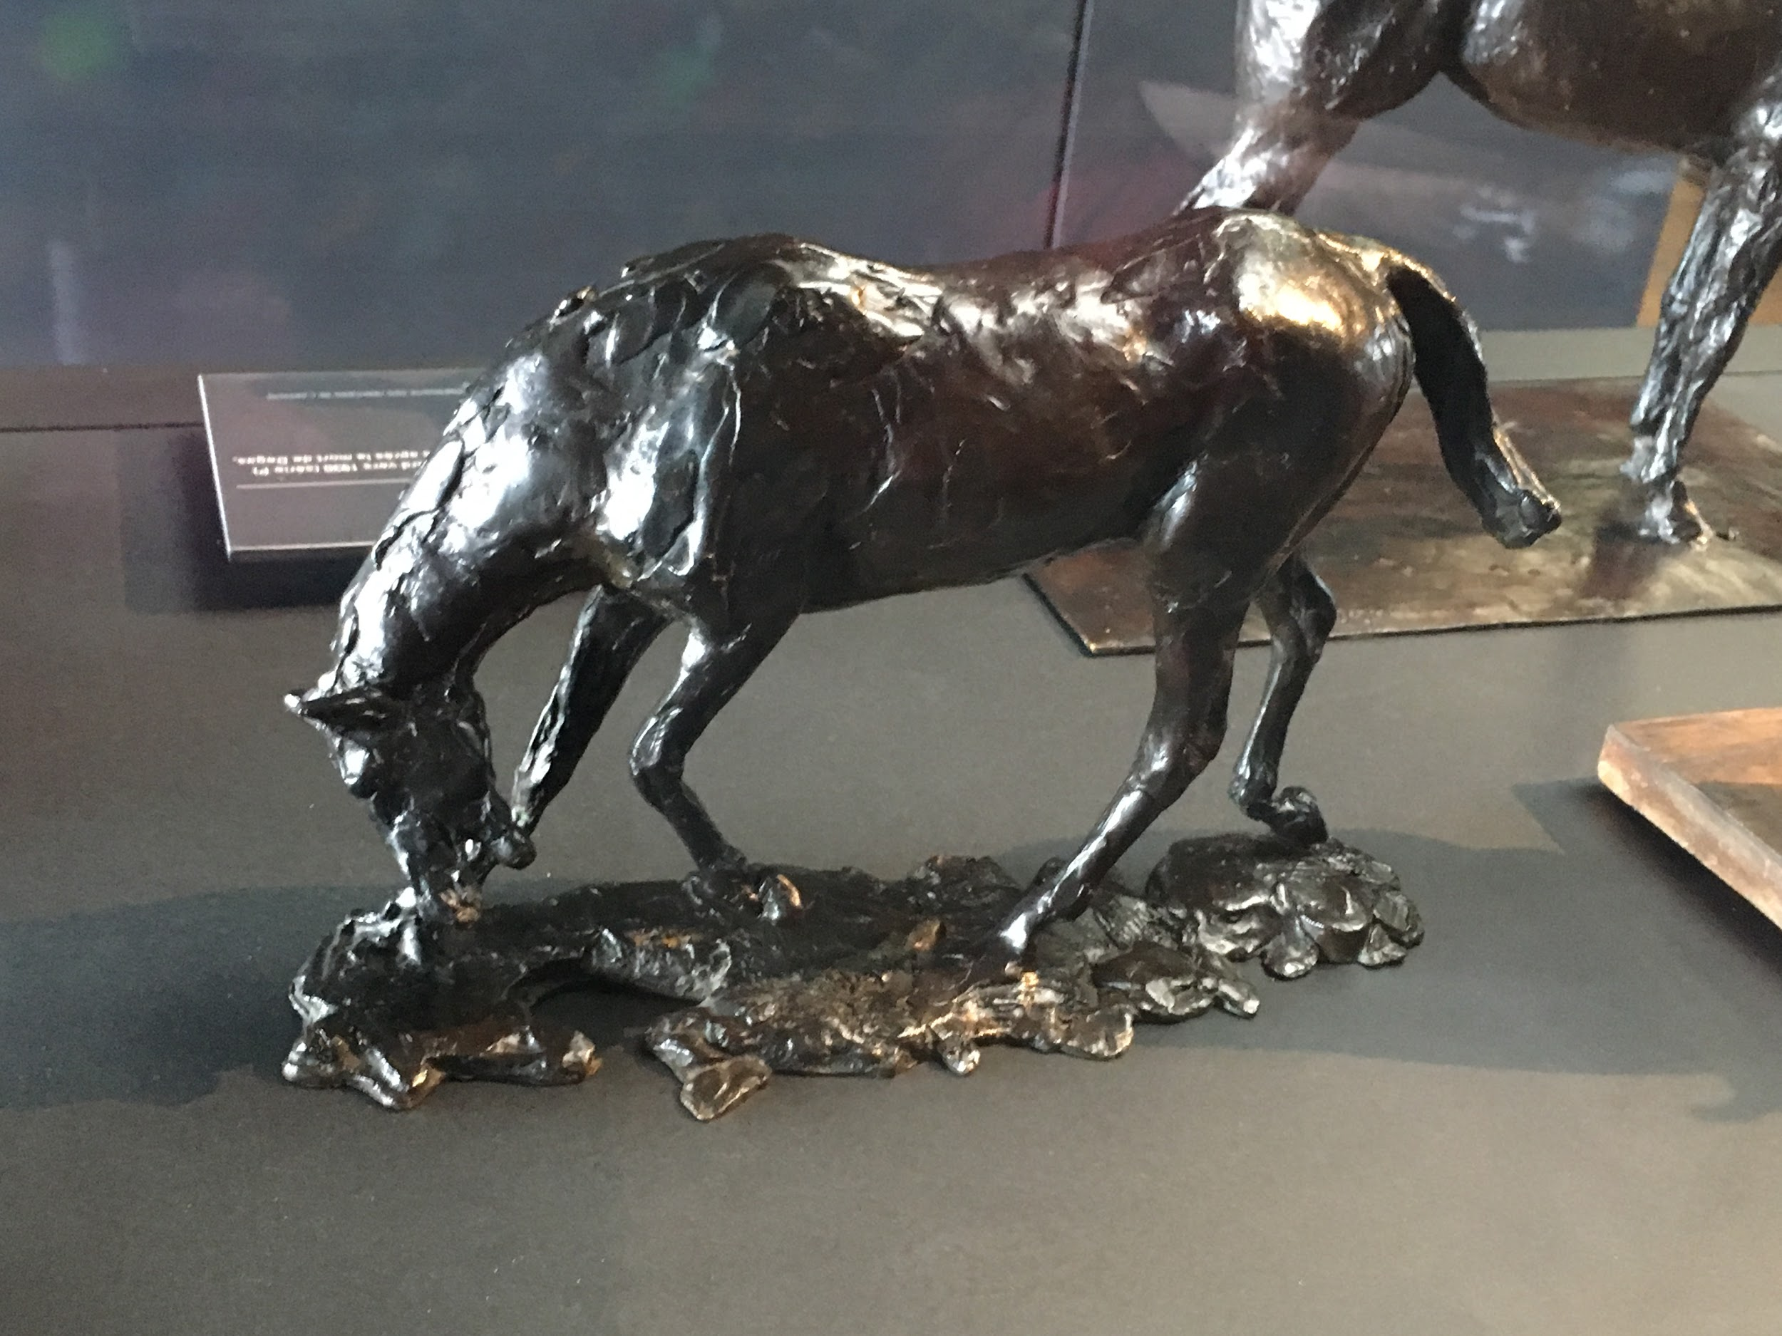
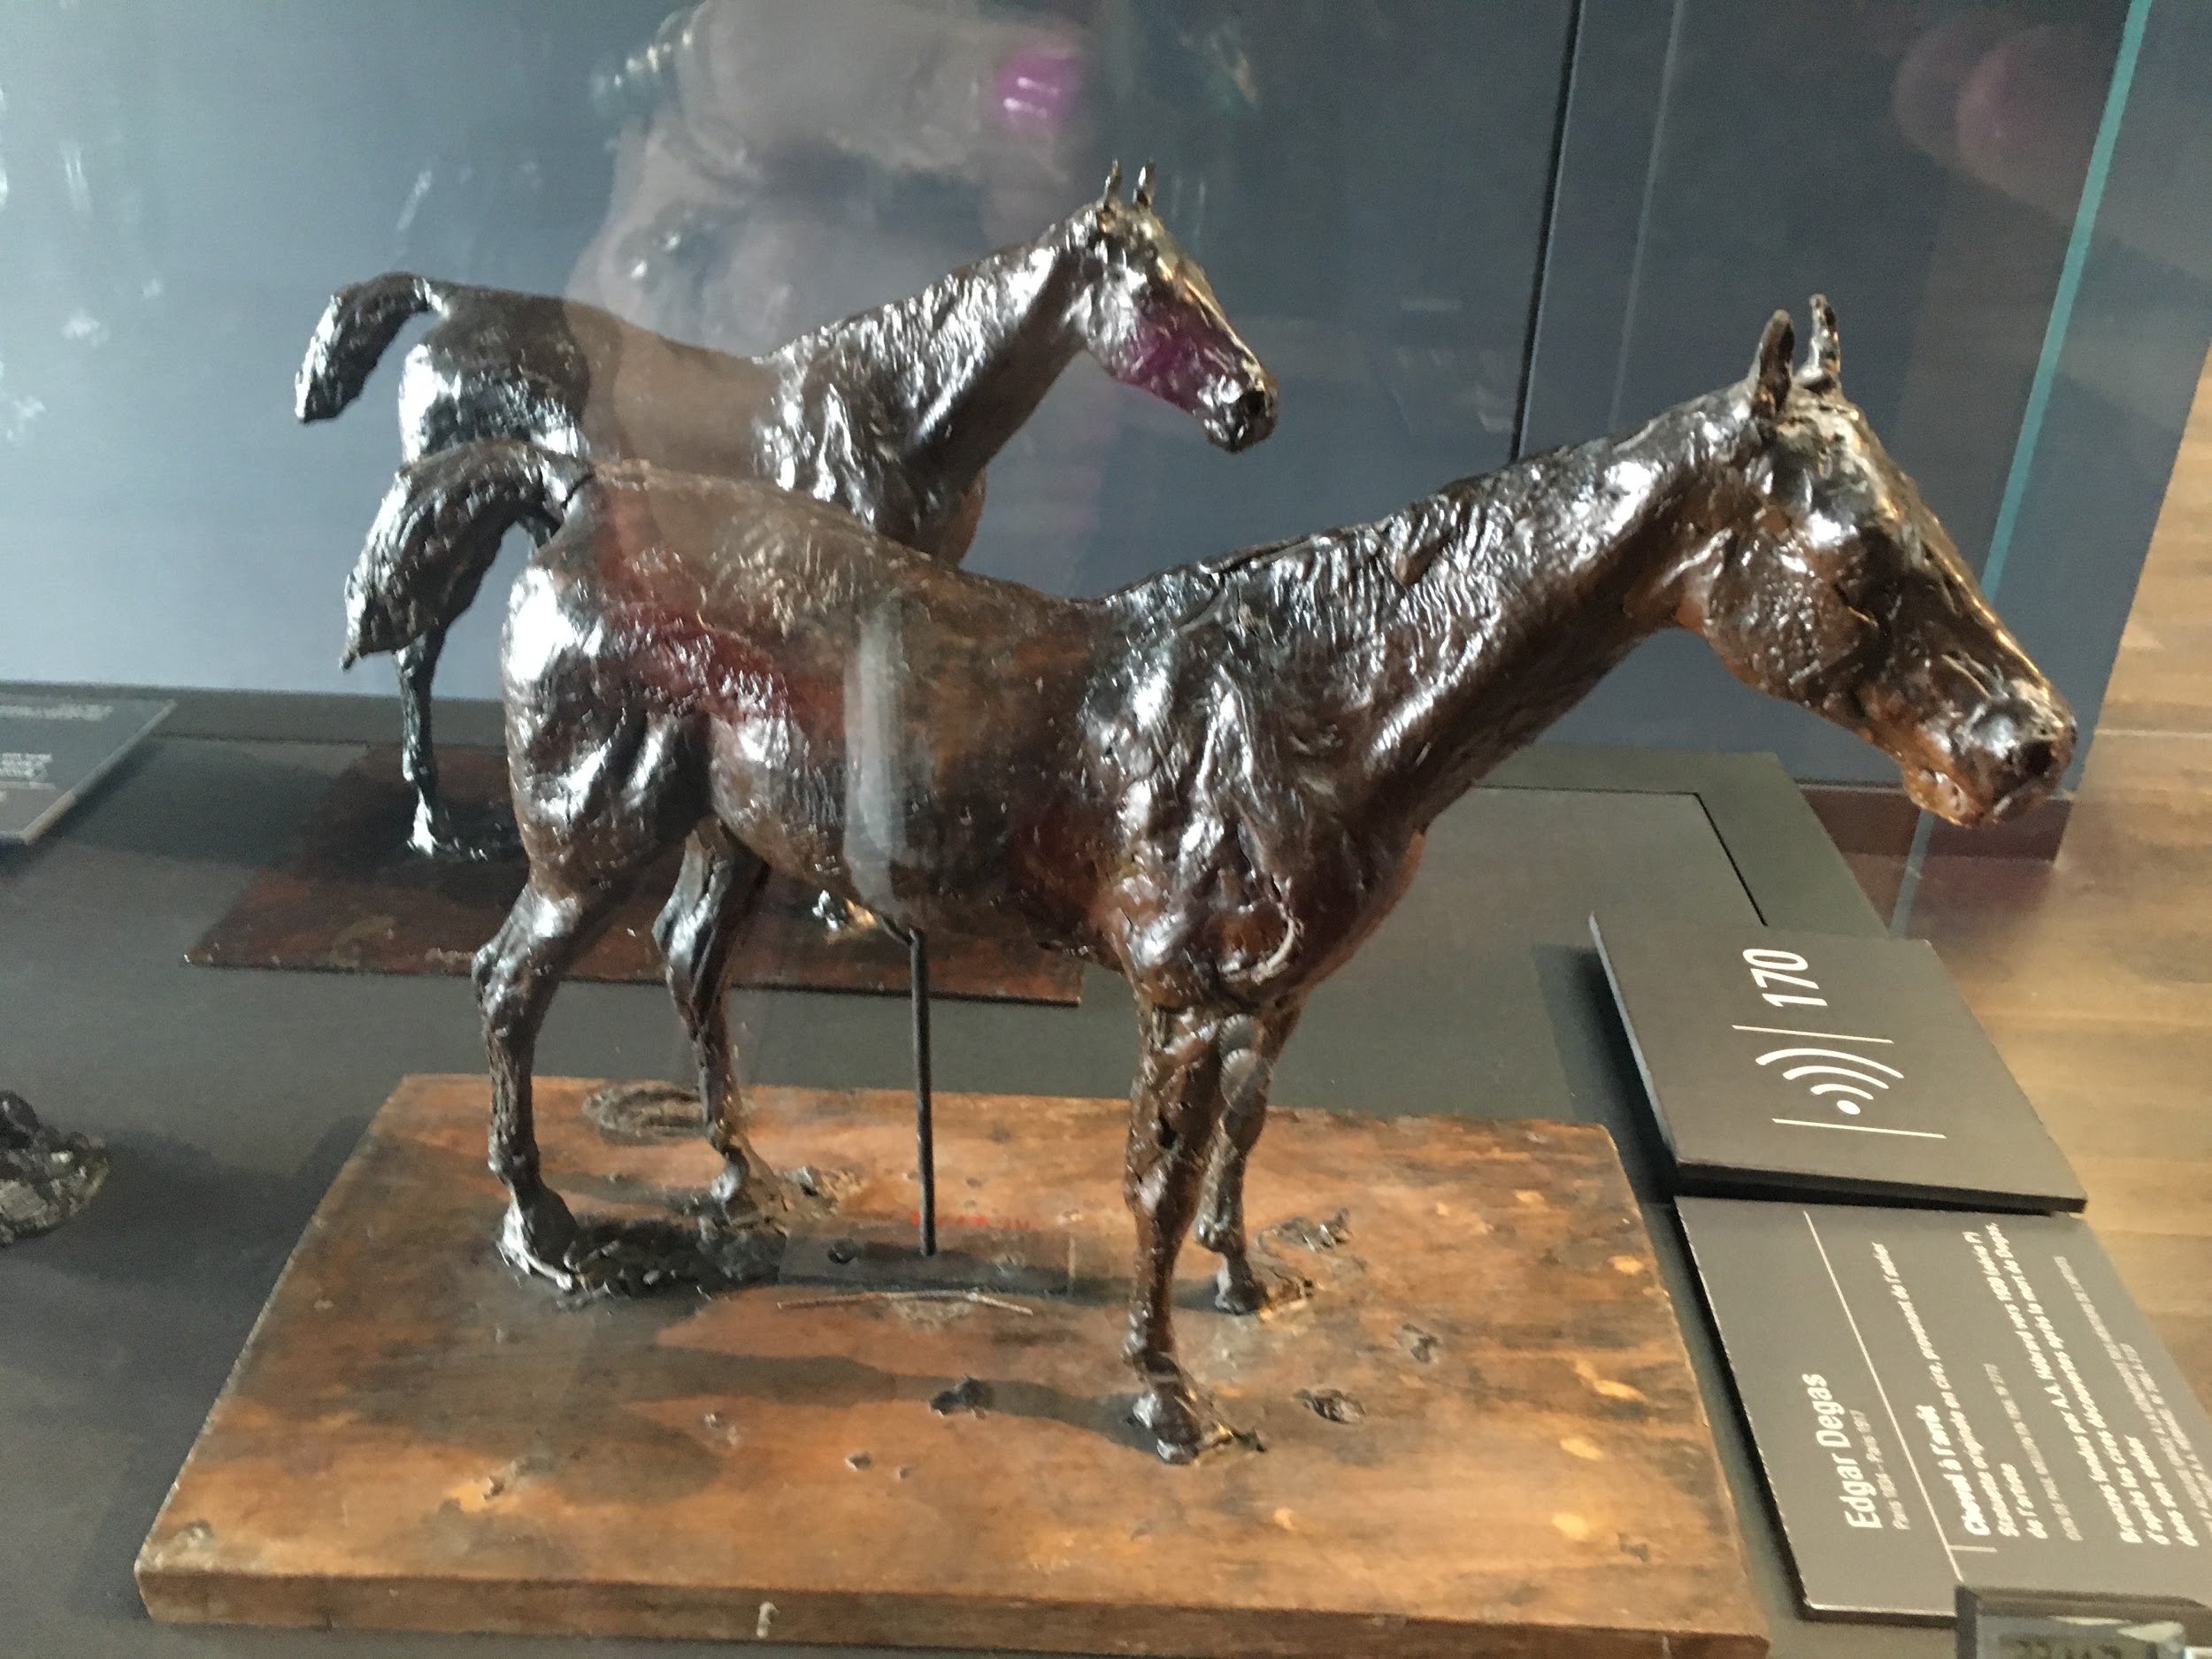
‘Horse has Stopped’
Credit: Caroline Mc Corriston
Credit: Caroline Mc Corriston

