Slide 1
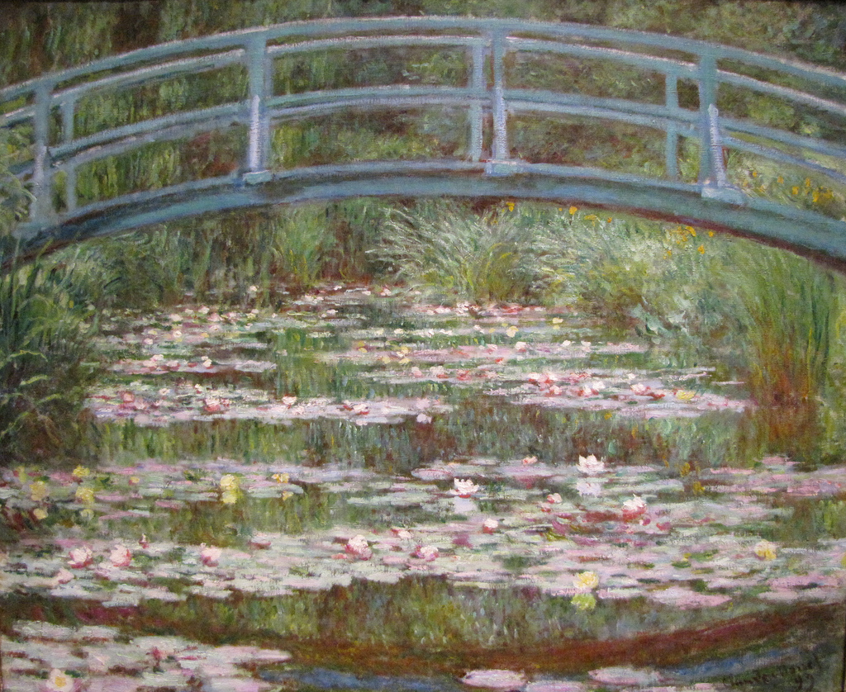

Impressionism
Caroline Mc Corriston

Slide 2
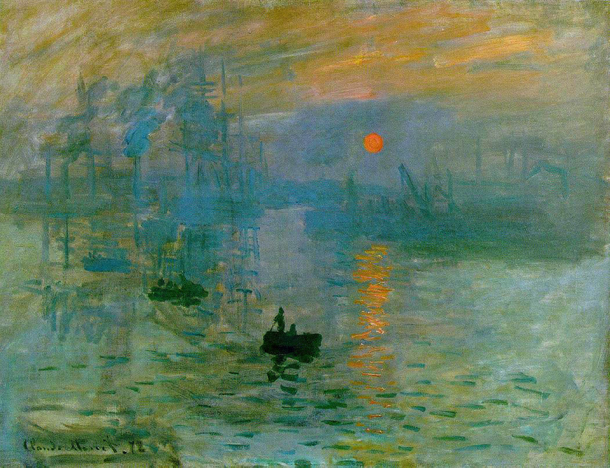
What was impressionism?
A style or movement in painting originating in France in the 1860s.
The name of the movement comes from Monet’s painting, ‘Impression Sunrise’
It was originally meant in a negative way but the group adopted it and used as their title in exhibitions.

Slide 3
What was impressionism?
The movement was influenced by realism and the work of Manet.
The group was made up of Claude Monet, Edgar Degas, Camille Pissarro and Pierre Auguste Renoir.
They regularly met up to discuss art and other matters in the popular Café Guerbois.
Although the artists associated with impressionism are seen as a group, their styles varied greatly, particularly later in their careers.

Slide 4
What was impressionism?
The first meeting of what was to become the Impressionist Group of painters occurred in 1859 when Monet and Pissarro met while attending the Académie Suisse, an art school in paris.
Their first exhibition took place on 15 April, 1874. They called themselves the Anonymous Society of Painters, Sculptors and Engravers.
Society was shocked by their paintings and the work was ridiculed and rejected.
The artists who are now known as the impressionists had 7/8 more exhibitions and their work grew gradually more popular and began to be new accepted style.

Slide 5
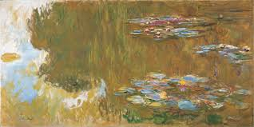
Characteristics of Impressionism
Impressionist paintings tend to have small thin brushstrokes with an emphasis on accuracy of colour over precision.
Light is an important factor and how it is captured is key to an impressionist work.

Slide 6
Impressionist Exhibitions
As a result of the rejection of their works by the Salon, the impressionists decided to form their own society of art in 1873.
They also held their own independent exhibitions, giving them the freedom to practice their own style and choose whatever subject matter pleased them.
This broke the control the Salon had over art, ushering a new era, with the control placed firmly in the hands of the artists themselves.

Slide 7
Support from Durand- Ruel
The art collector Durand-Ruel was crucial to the eventual success of the movement.
He supported the artist from the beginning and bought their work when he could.

Slide 8
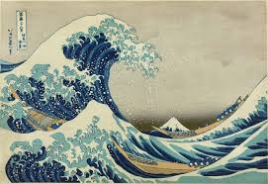
Influences
Japanese Prints: Many Impressionists collected and admired these woodcuts because of their vibrant colour and unusual compositions.
They also admired the simplicity of line and flat colour.

Slide 9
Influences
Scientific Discoveries- at this time scientists had discovered that light, which consists of energy particles, travels in straight lines and also that vision is caused by light rays hitting the eye.
This discovery heightened the artist’s interests on the effects of light on colour.
Impressionists often painted on a white primed canvas to create brighter tones in their paintings. Previously artists had used browns, greens and ochres.
They noticed colours opposite each other on the colour wheel created strong contrasts when placed side by side.

Slide 10
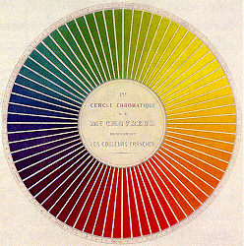
The scientist Chevreul explained that complementary colours (e.g. red and green) when painted side by side looked more vivid. Through their use of optical mixing the impressionists adopted some of Chevreul’s discoveries.

Slide 11
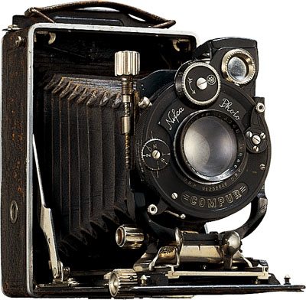
Influences
Industrial Revolution:
Invention of the Camera-
Artists were no longer needed to make records of families, state occasions etc. The camera was a more accurate instrument than the eye of the artist. Artists were not free to experiment with different techniques and styles.
They were also interested in accidental compositions caught by the camera, with objects and figures caught off by the boundaries of the picture space.

Slide 12
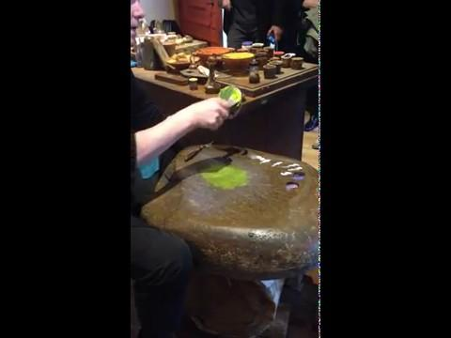
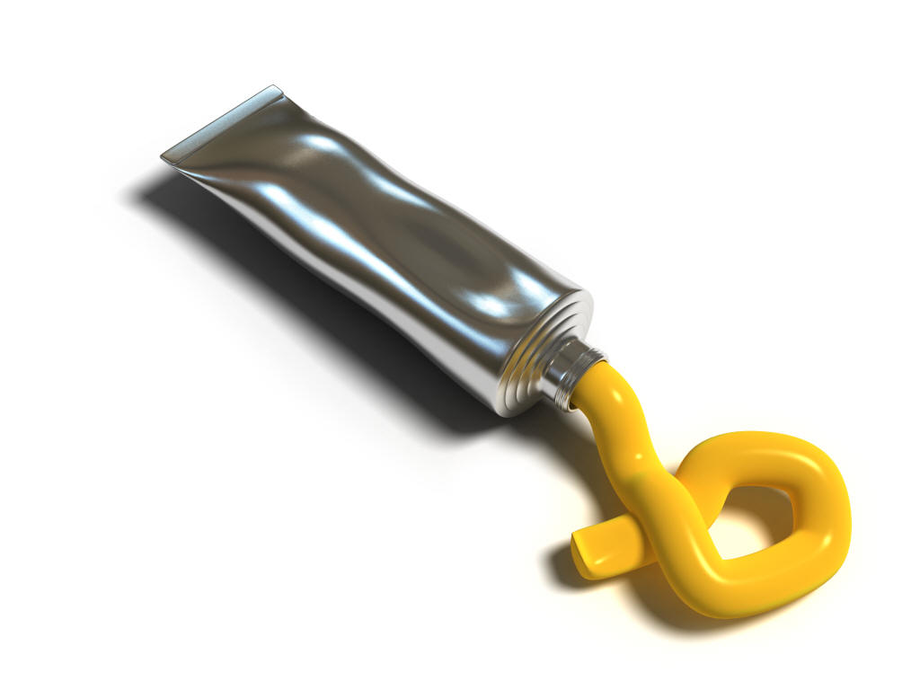
Influences
Development of Metal Oil Paint Tubes-
Invention of paint tubes- Plein Air was now much easier, encouraged people to attempt to paint natural light outdoors.
re-enactment of this process, Rembrandt van Rijn’s house, Amsterdam, C17

Slide 13
Techniques
Short, thick, loose brushstrokes of paint are applied quickly to capture the essence of the subject, rather than its details. The paint is often applied impasto.
Colours are applied side by side with as little mixing as possible, creating a vibrant surface. The optical mixing of colours occurs in the eyes of the viewers.
Tones of colour to create the illusion of form and volume.
Grays and dark tones are created by mixing complementary colours. In pure impressionism the use of black is totally avoided.

Slide 14
Techniques
Wet paint is placed onto wet paint without waiting for the layers to dry produced softer edges and created greater intensity of colour.
Close attention is paid to light and reflection of colour from object to object.
In paintings made en plein air (outdoors) shadows are boldly painted with the blue of the sky giving a sense of freshness and openness that was not captured in painting previously (blue shadows on snow influenced this).

Slide 15
Subject Matter
Contemporary life was seen as the most valid subject matter.
Impressionist artists such as Renoir and Degas were interested in the hustle and bustle of everyday life, wishing to capture fleeting moments of pleasure and enjoyment.
Impressionist artists such as Monet explored the effects of light and atmosphere on the countryside, working en plein air to capture a moment in time.

Slide 16
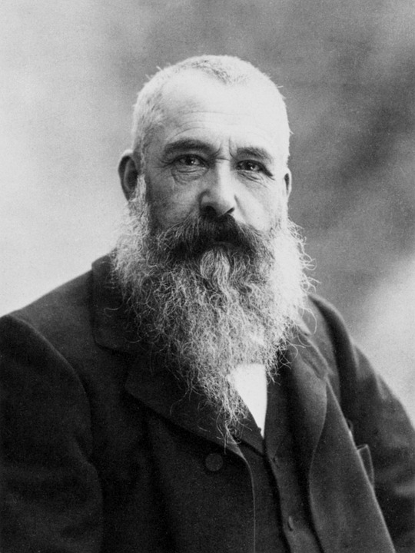
Claude Monet
Claude Monet was seen as the Father of Impressionism and was the most consistent practitioner of the movements philosophies.

Slide 17
Bibliography
Fahey, T and Geoghegan- Treacy, S. (2011). Art. Folens, Dublin.
Ni Chárthaigh, Á. (2000). Less Stress More Success, Art History revision for leaving Cert. Gill & Macmillan, Dublin.
Ni Chárthaigh, Á. (2011). Less Stress More Success, Art History revision for leaving Cert. Gill & Macmillan, Dublin.
Ni Chárthaigh, Á and O’ Sullivan, A. (2011). Appreciating Art. Gill & Macmillan, Dublin.
Ni Chárthaigh, Á and O’ Sullivan, A. (2017). Appreciating Art. Gill & Macmillan, Dublin.
Ó hAodha, S. (2014). Art Works. The Educational Company of Ireland, Dublin.

