Slide 1

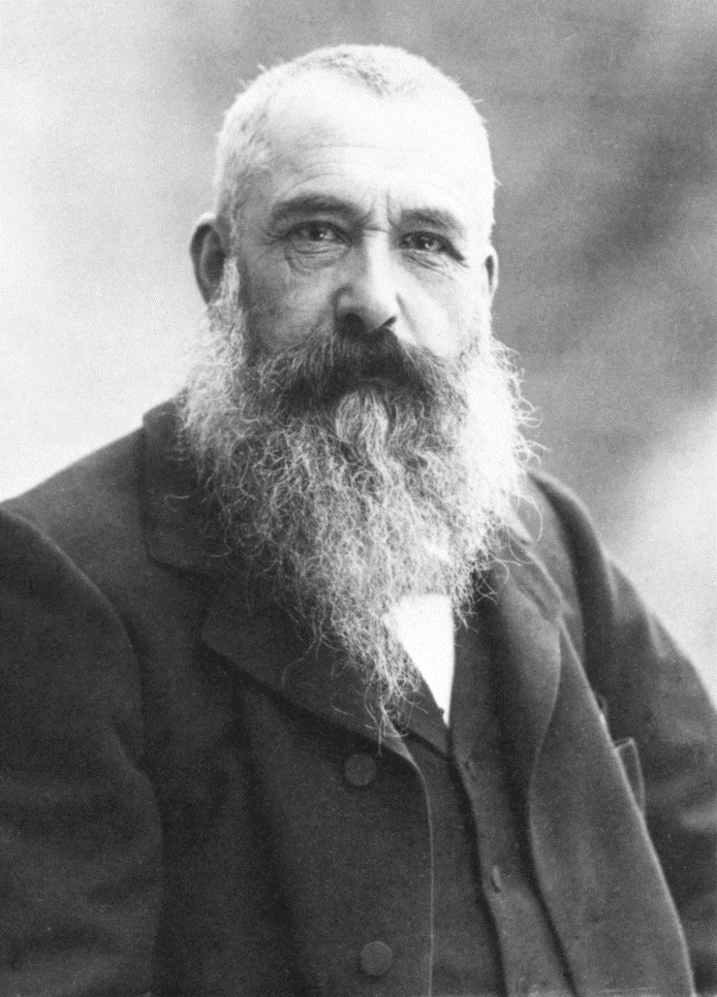
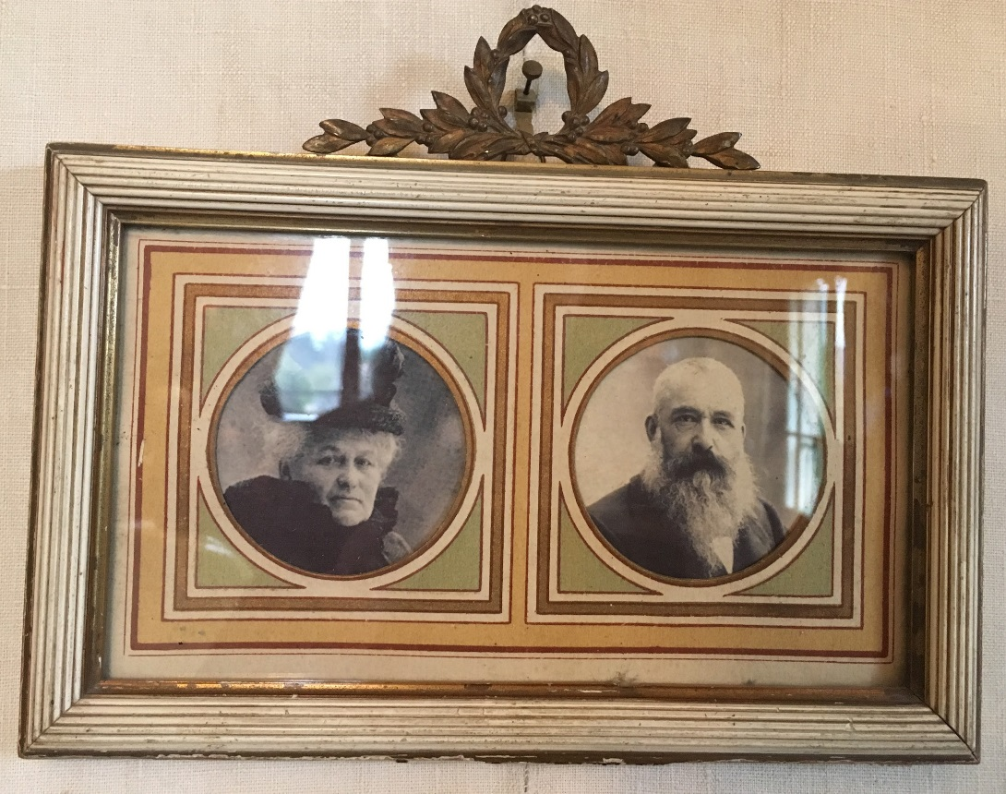
Claude Monet, (1840-1926)
Credit: Caroline Mc Corriston
Caroline Mc Corriston

Slide 2
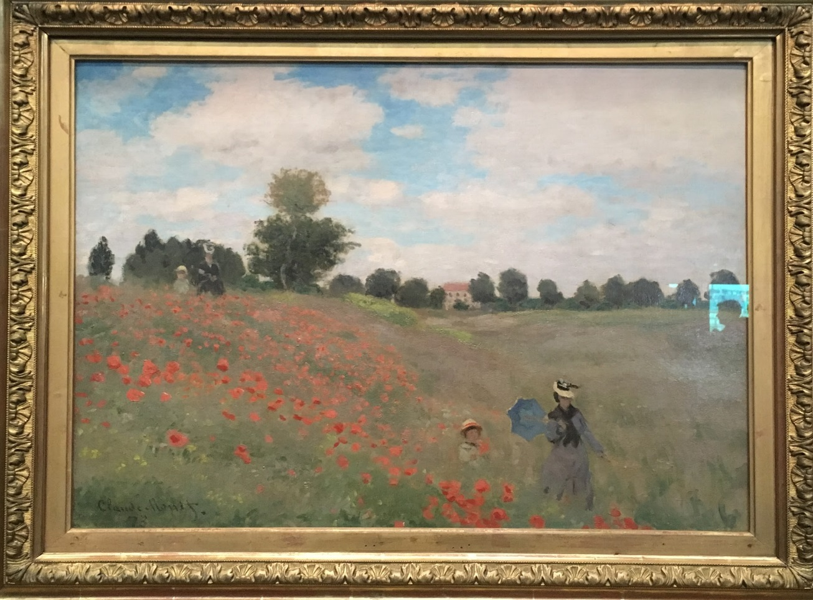
Monet’s wife and son walking through a poppy field. It was shown at the first Impressionist Exhibition.
Photo taken by: Caroline Mc Corriston

Slide 3
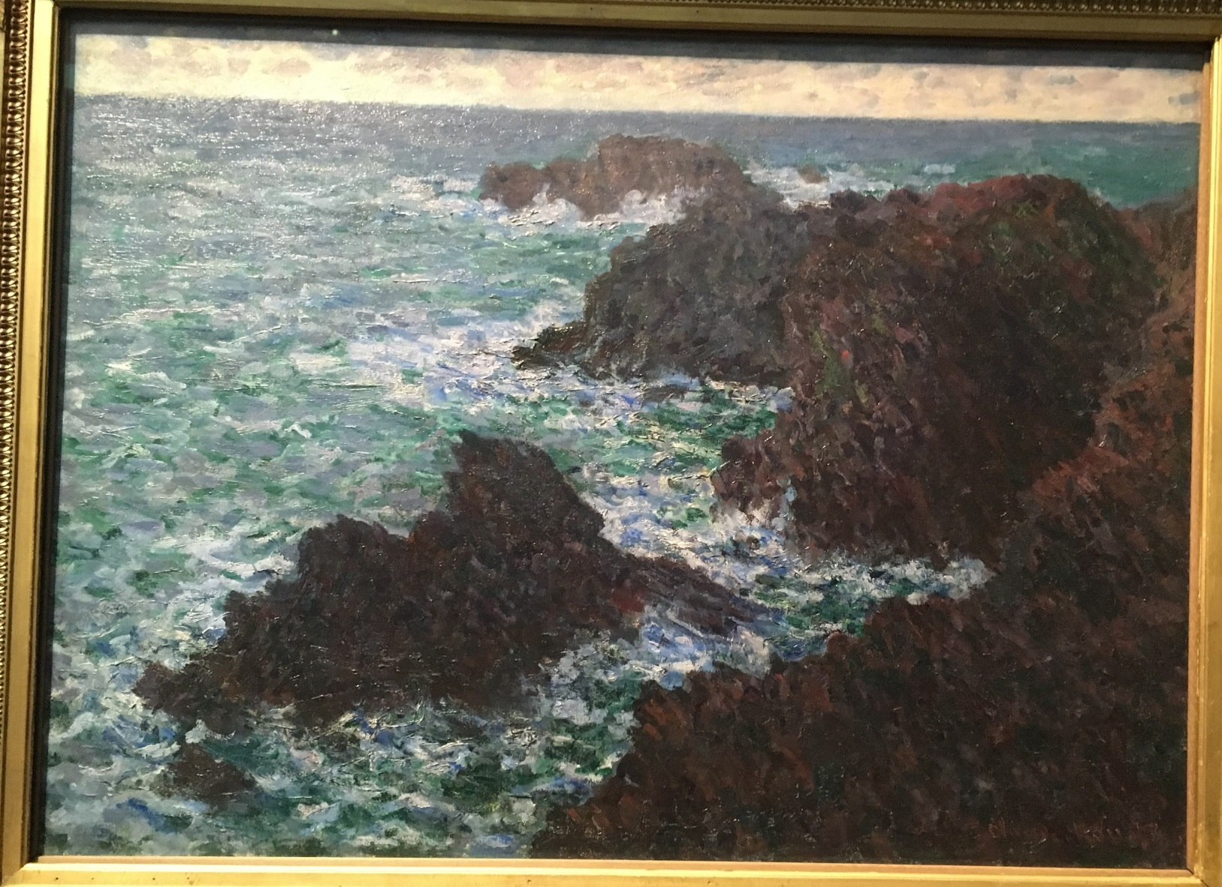
The Rocks of Belle Ile (Rough Sea)
Photo taken by: Caroline Mc Corriston

Slide 4
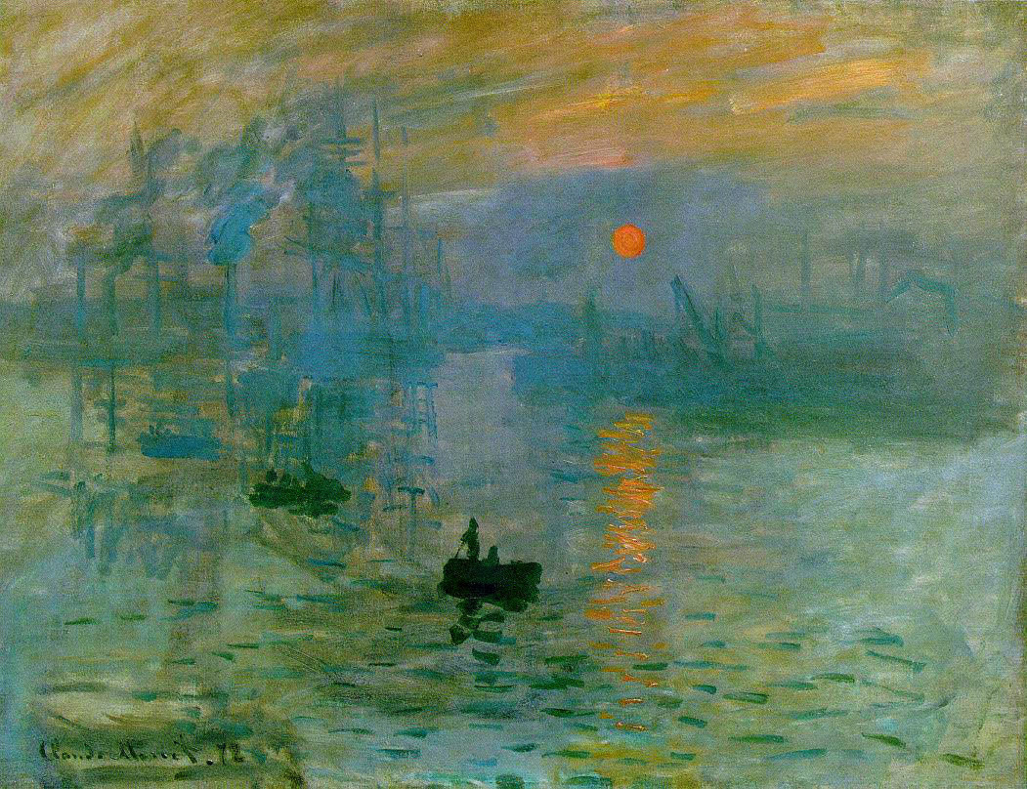
Impression Sunrise

Slide 5
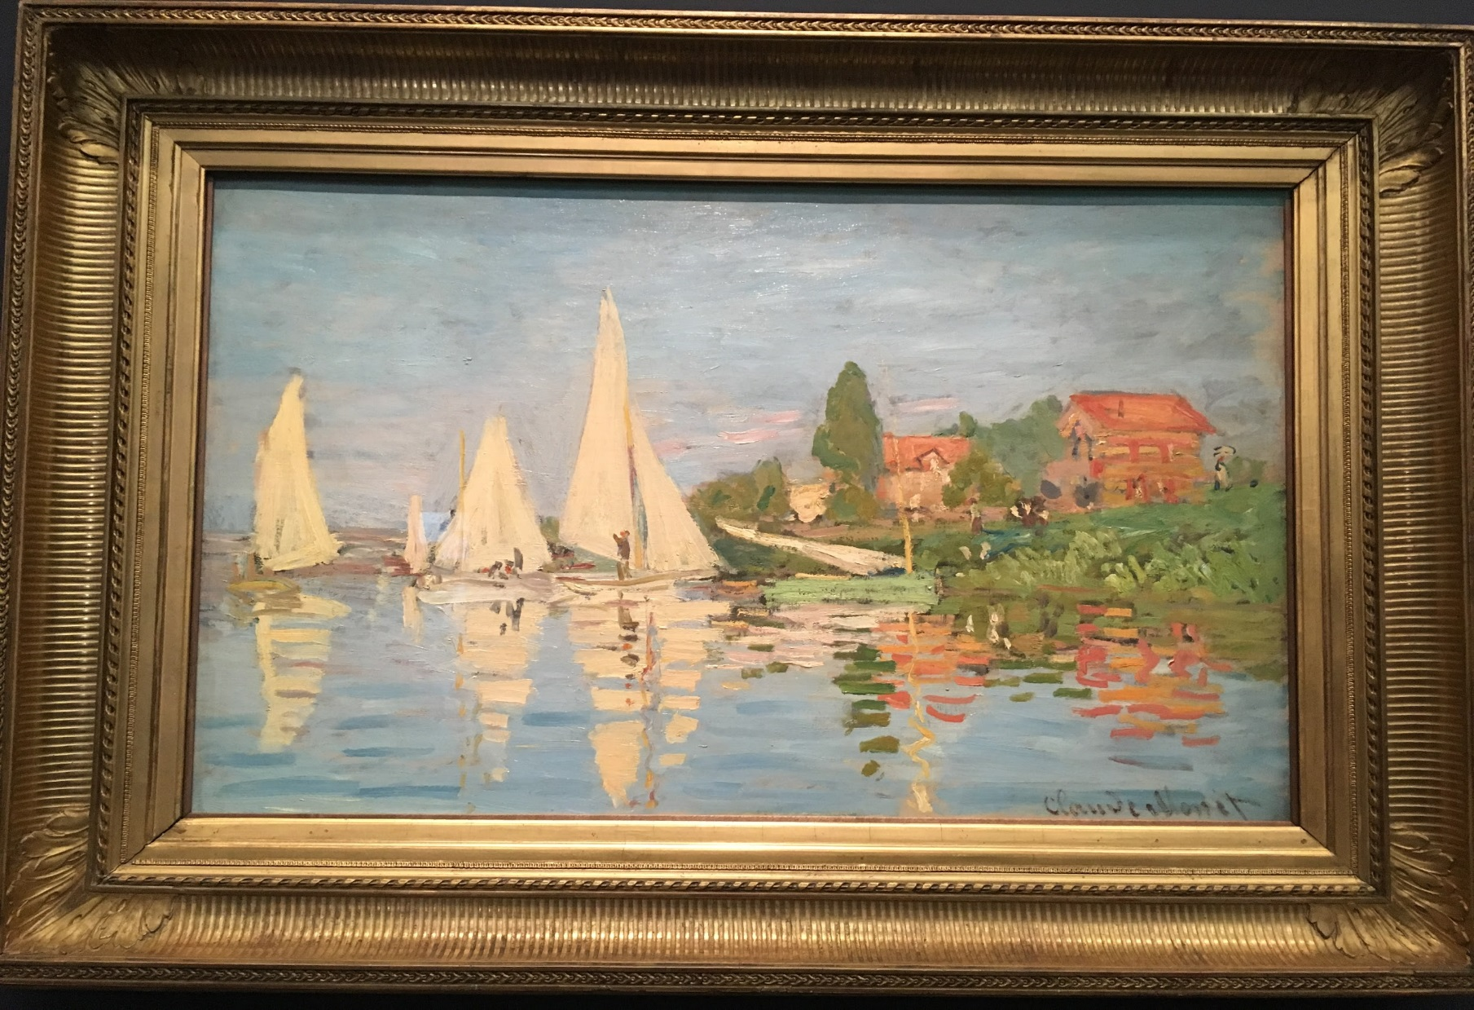
‘Regatta at Argenteuil
Photo taken by: Caroline Mc Corriston

Slide 6
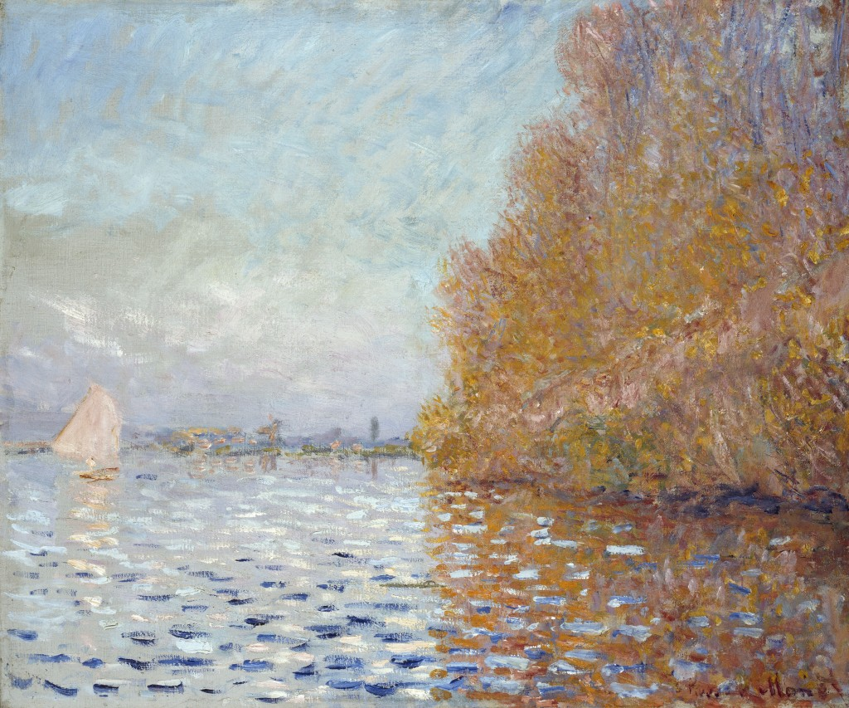
‘Argenteuil Basin with a Single Sailboat’, 1874

Slide 7
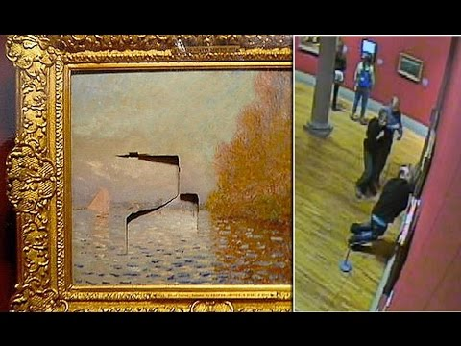
2014 attack on Monet Painting
https://www.youtube.com/watch?time_continue=1&v=F-rrF8grCcg
Notes:
https://www.youtube.com/watch?time_continue=1&v=F-rrF8grCcg

Slide 8
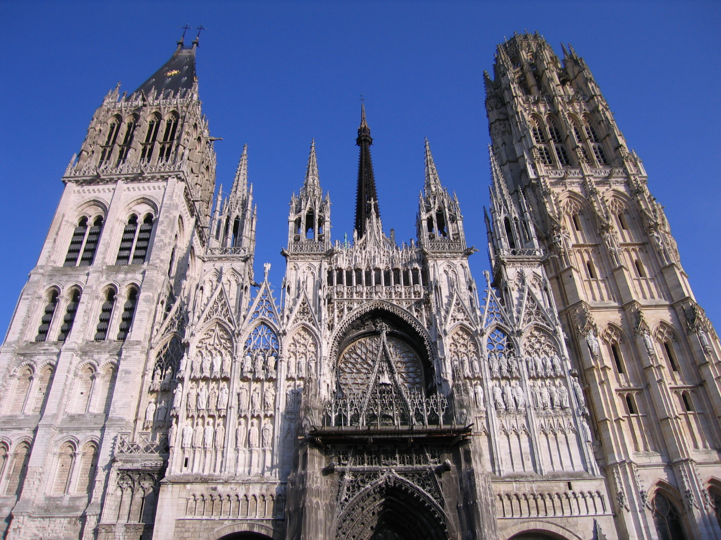

Slide 9
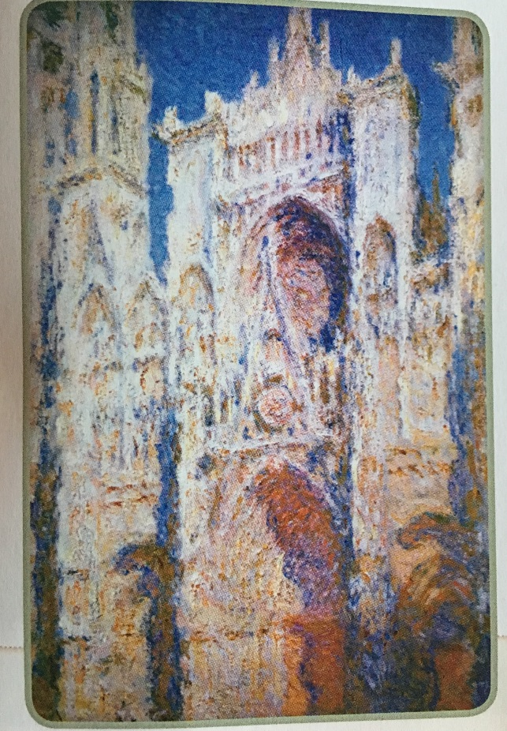
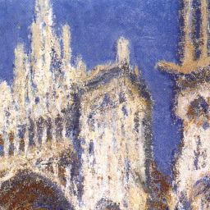
‘Rouen Cathedral, Blue Harmony, Morning Sunlight’, oil on canvas, 1894

Slide 10
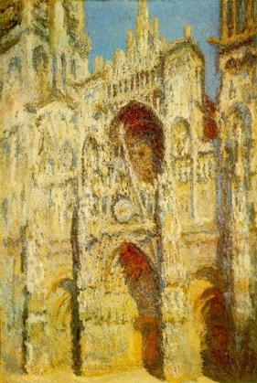
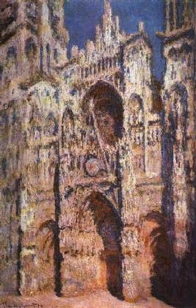
Rouen Cathedral, the West Portal and Saint-Romain Tower, Full Sunlight, Harmony in Blue and Gold)
Rouen Cathedral: Full Sunlight. 1894

Slide 11
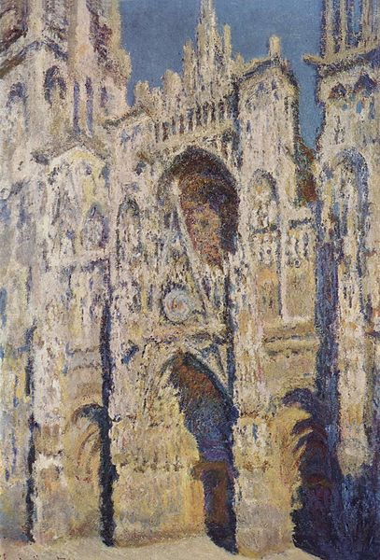
The Cathedral of Rouen. The Portal and the tower Saint-Romain, full sun

Slide 12
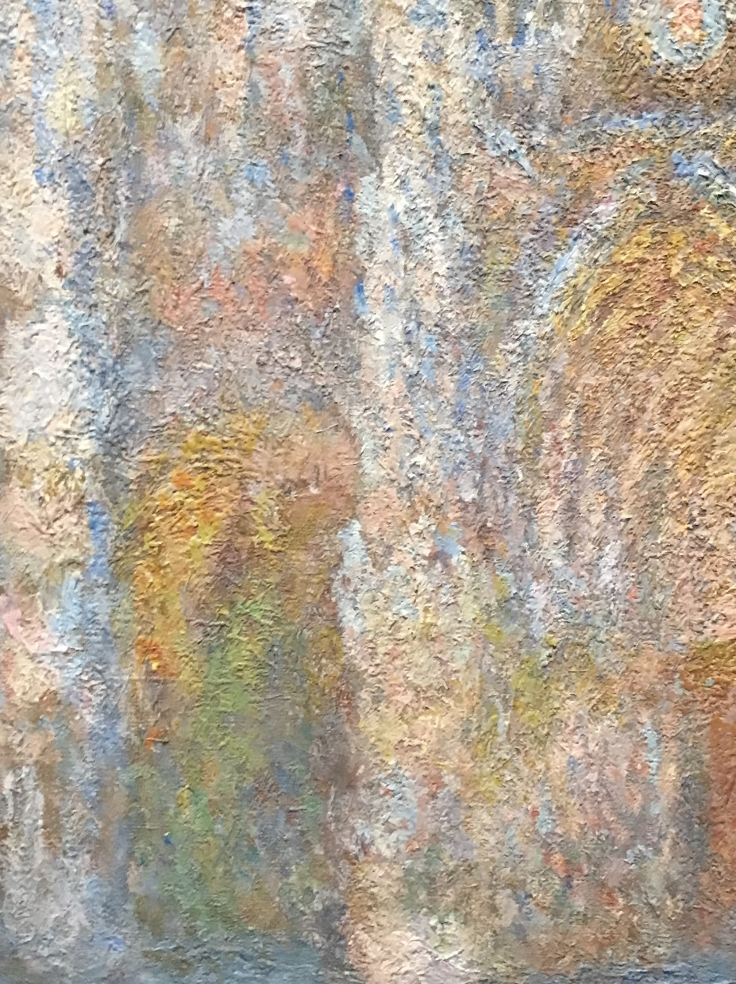
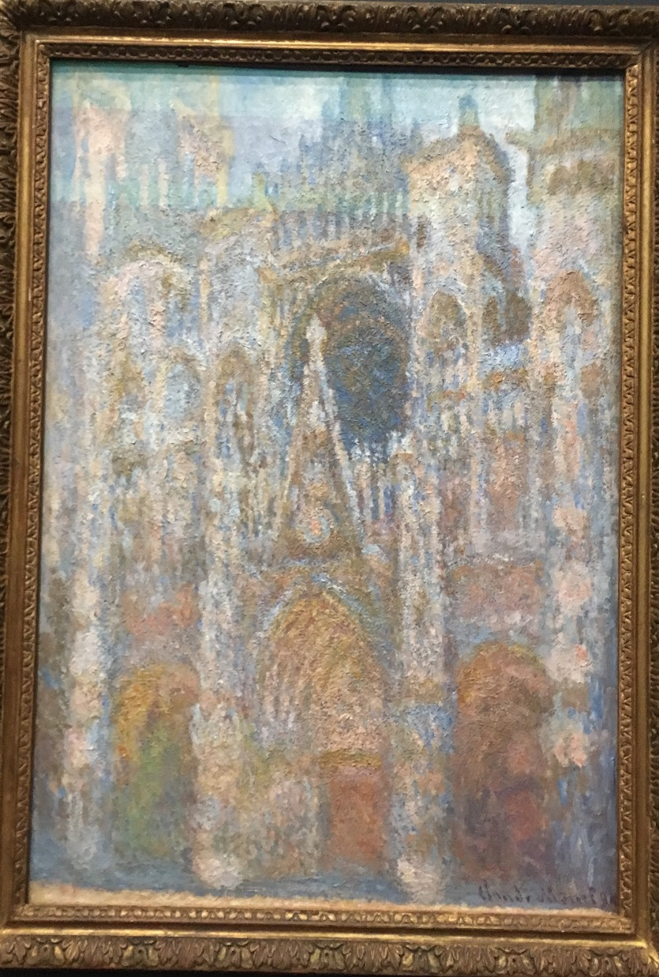
Rouen Cathedral, Blue Morning Harmony, Morning Sunlight
Photo taken by: Caroline Mc Corriston
Photo taken by: Caroline Mc Corriston

Slide 13
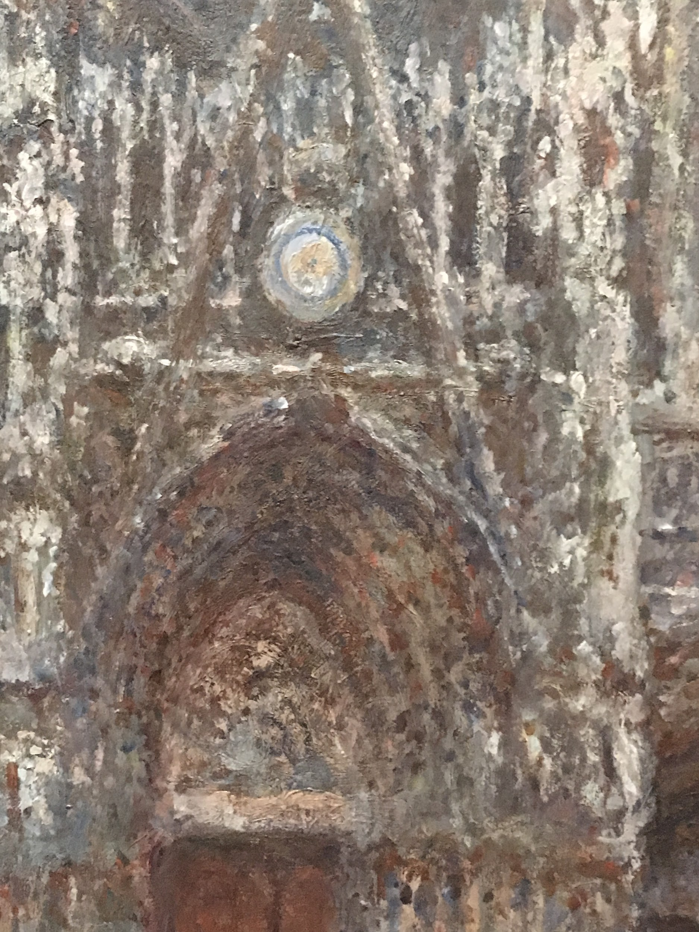
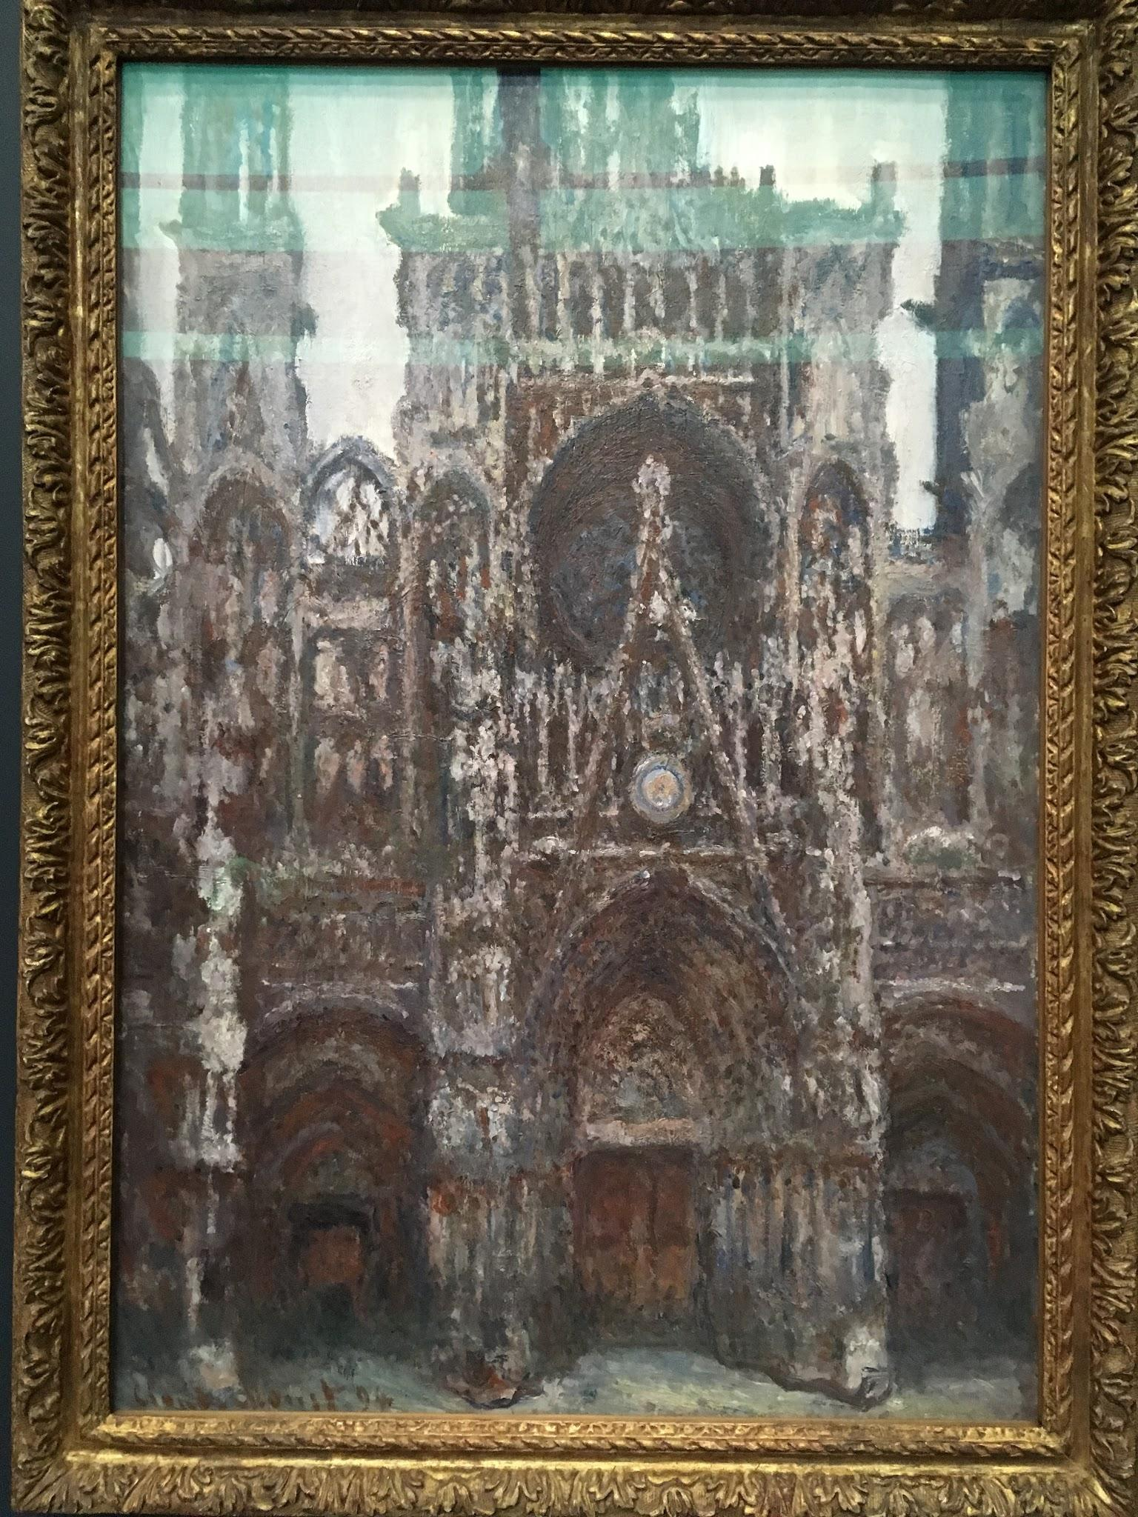
Rouen Cathedral, Portal in Front View, Harmony in Brown
Photo taken by: Caroline Mc Corriston
Photo taken by: Caroline Mc Corriston

Slide 14
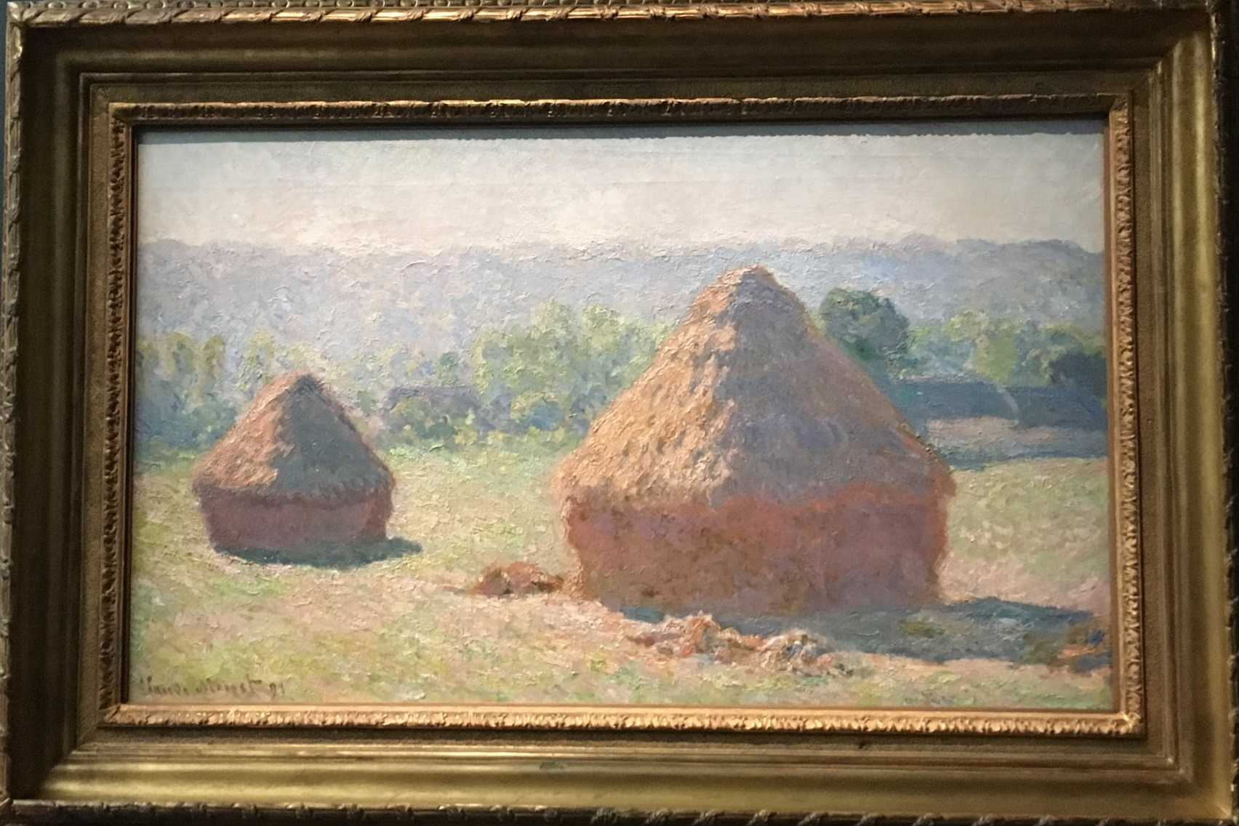
‘The End of Summer’
From Monet’s Haystack Series
Photo taken by: Caroline Mc Corriston

Slide 15
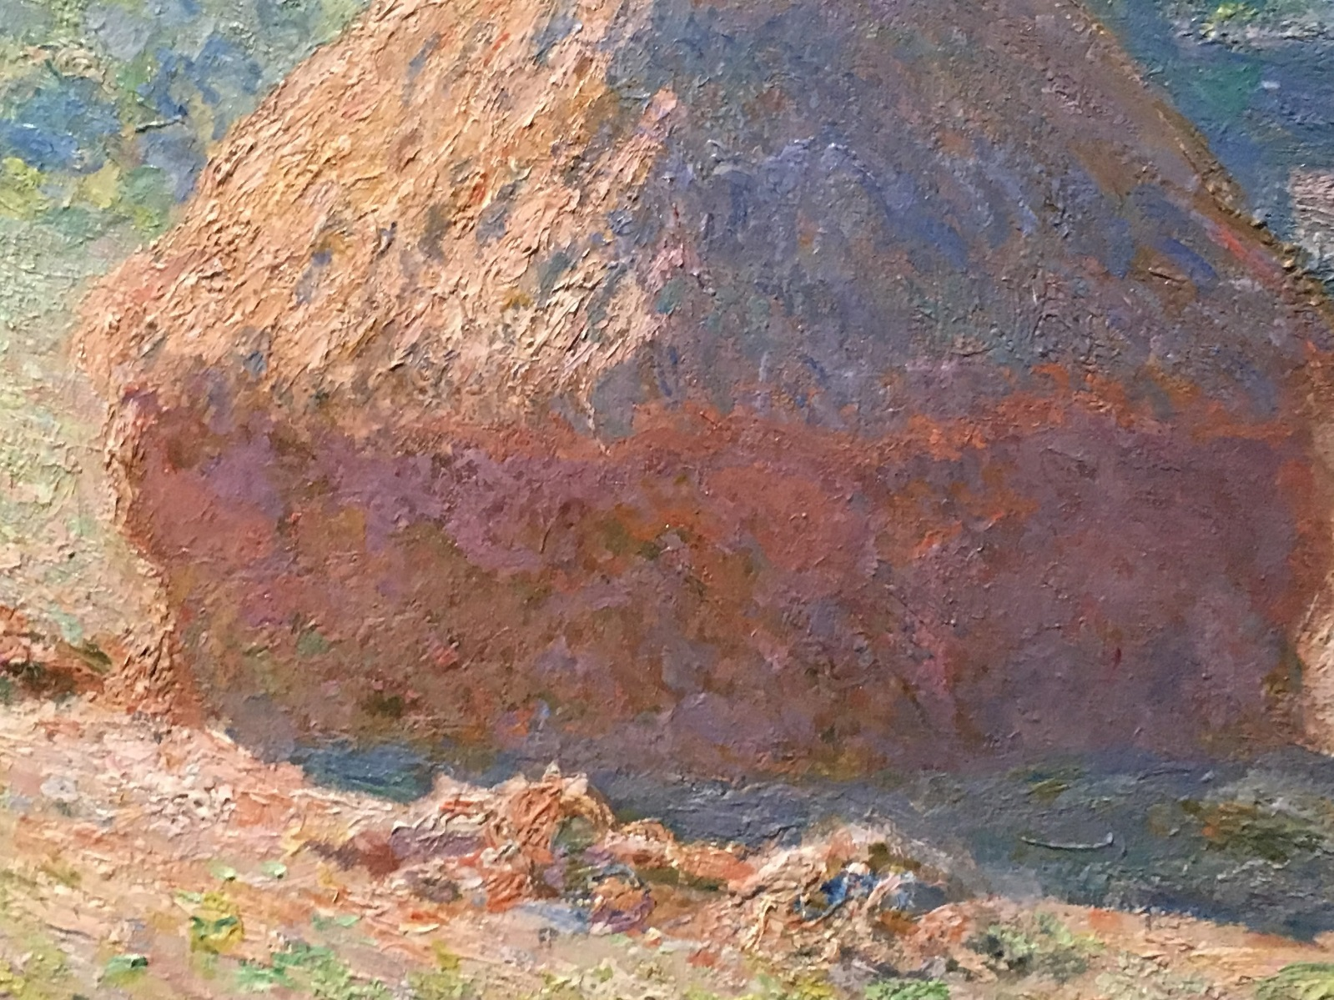
Photo taken by: Caroline Mc Corriston

Slide 16
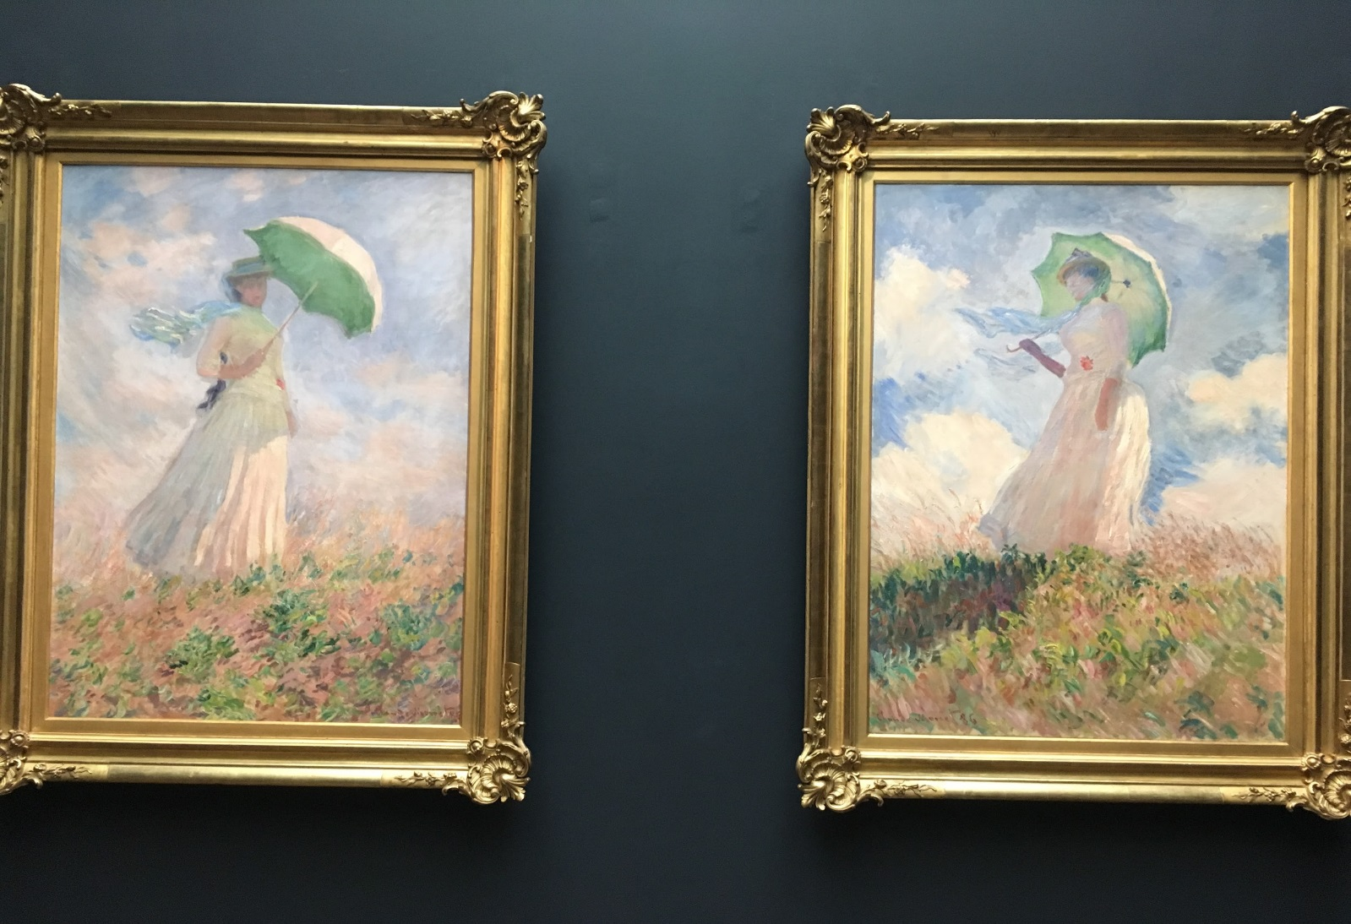
Women with Parasols
Photo taken by: Caroline Mc Corriston

Slide 17
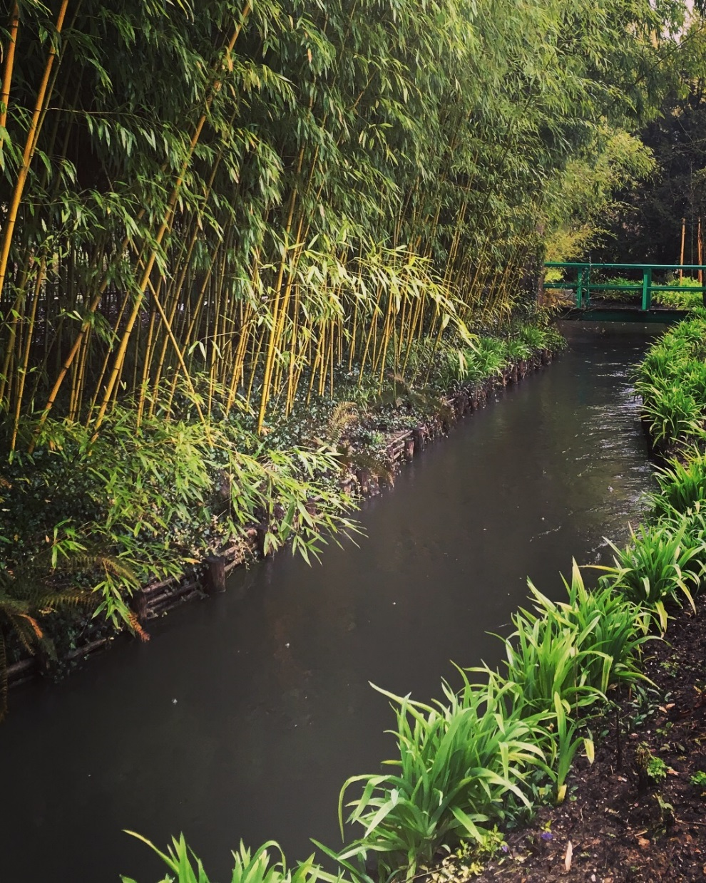
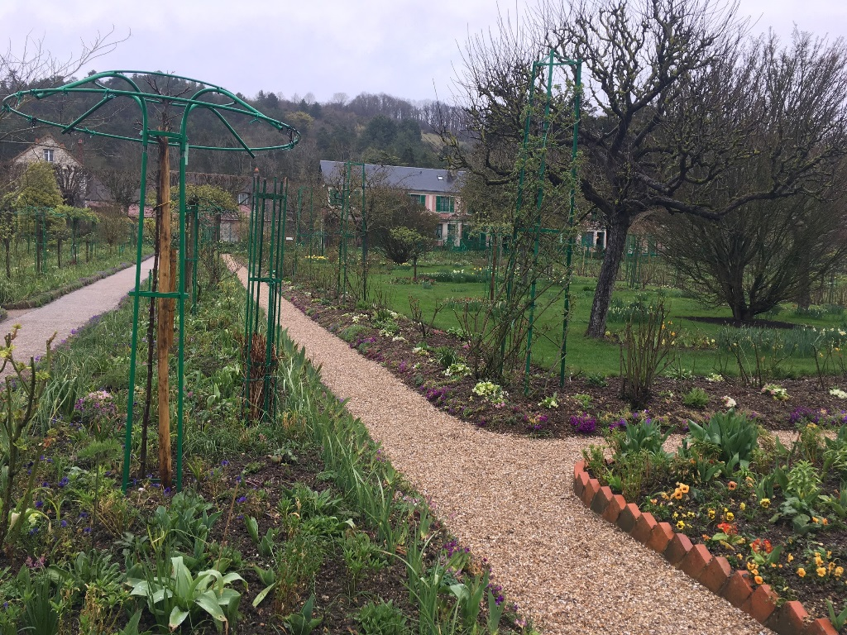
Monet’s Gardens In Giverny
Credit: Caroline Mc Corriston
Credit: Caroline Mc Corriston

Slide 18
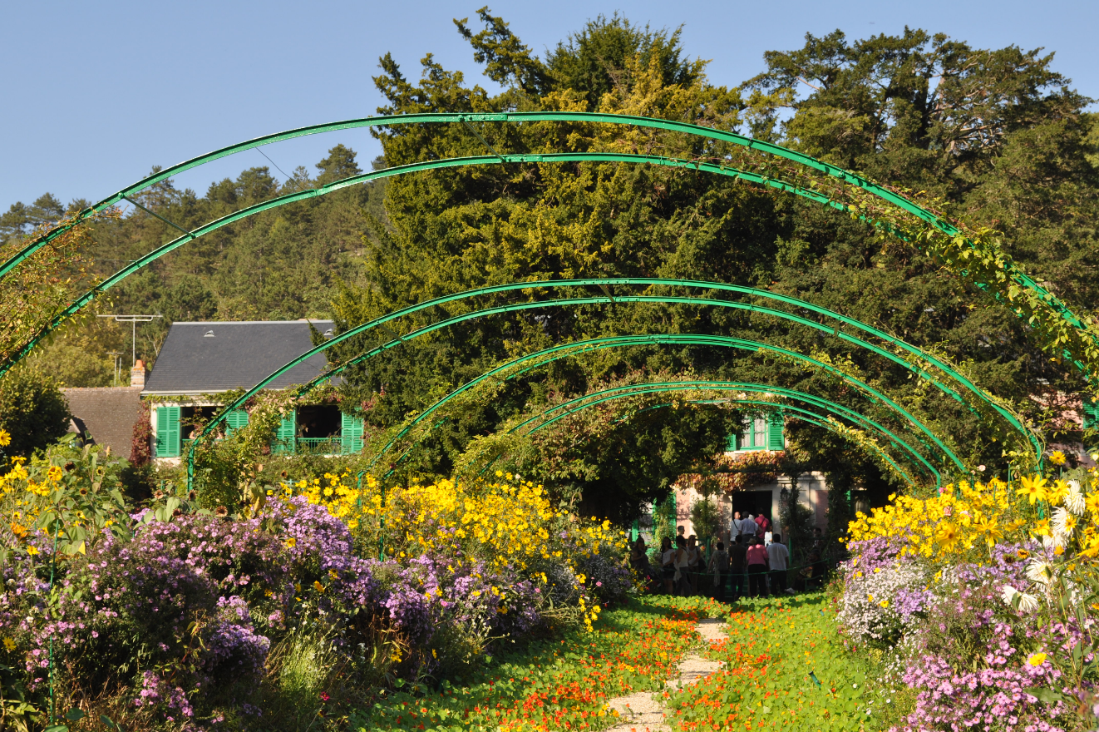
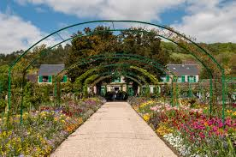

Slide 19
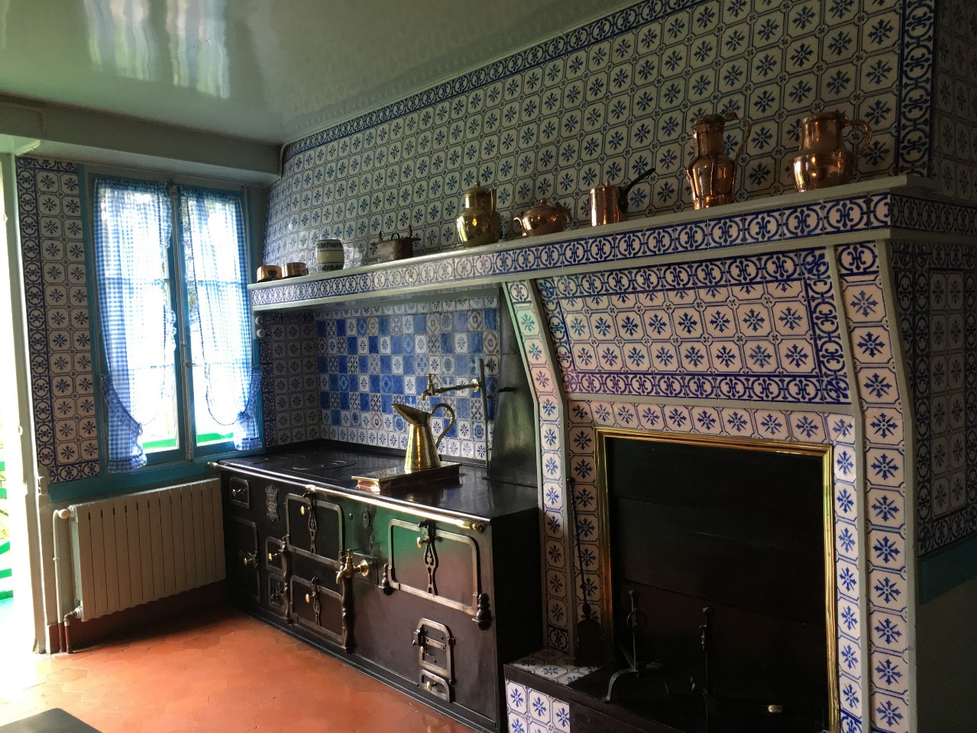
Monet’s House
Credit: Caroline Mc Corriston

Slide 20
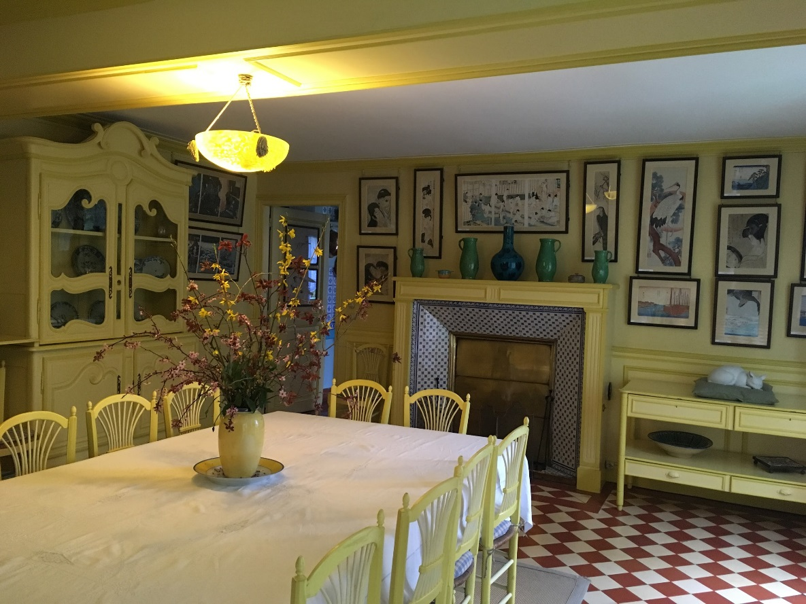
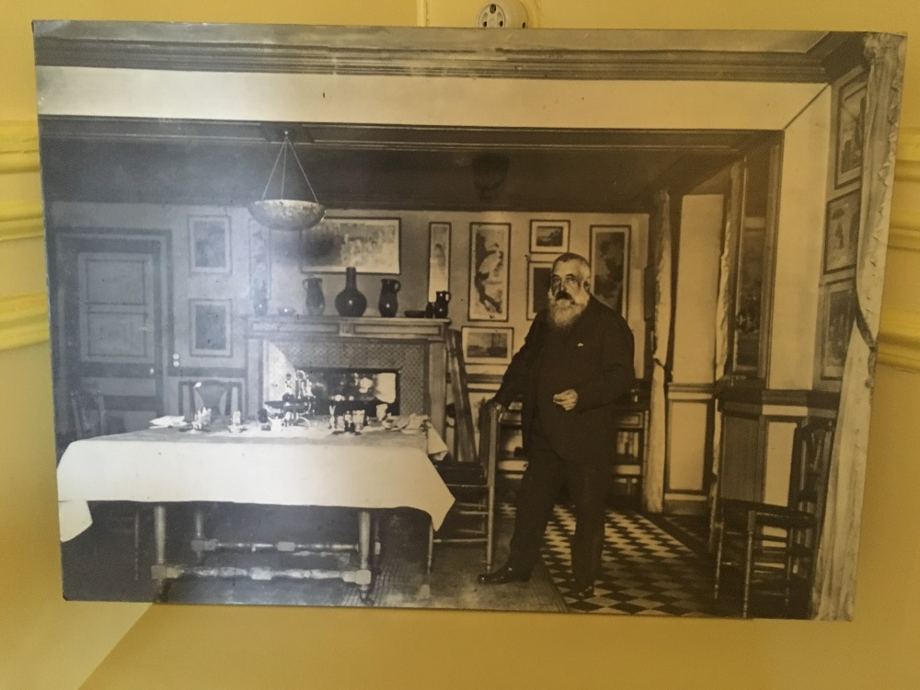
Credit: Caroline Mc Corriston
Credit: Caroline Mc Corriston

Slide 21
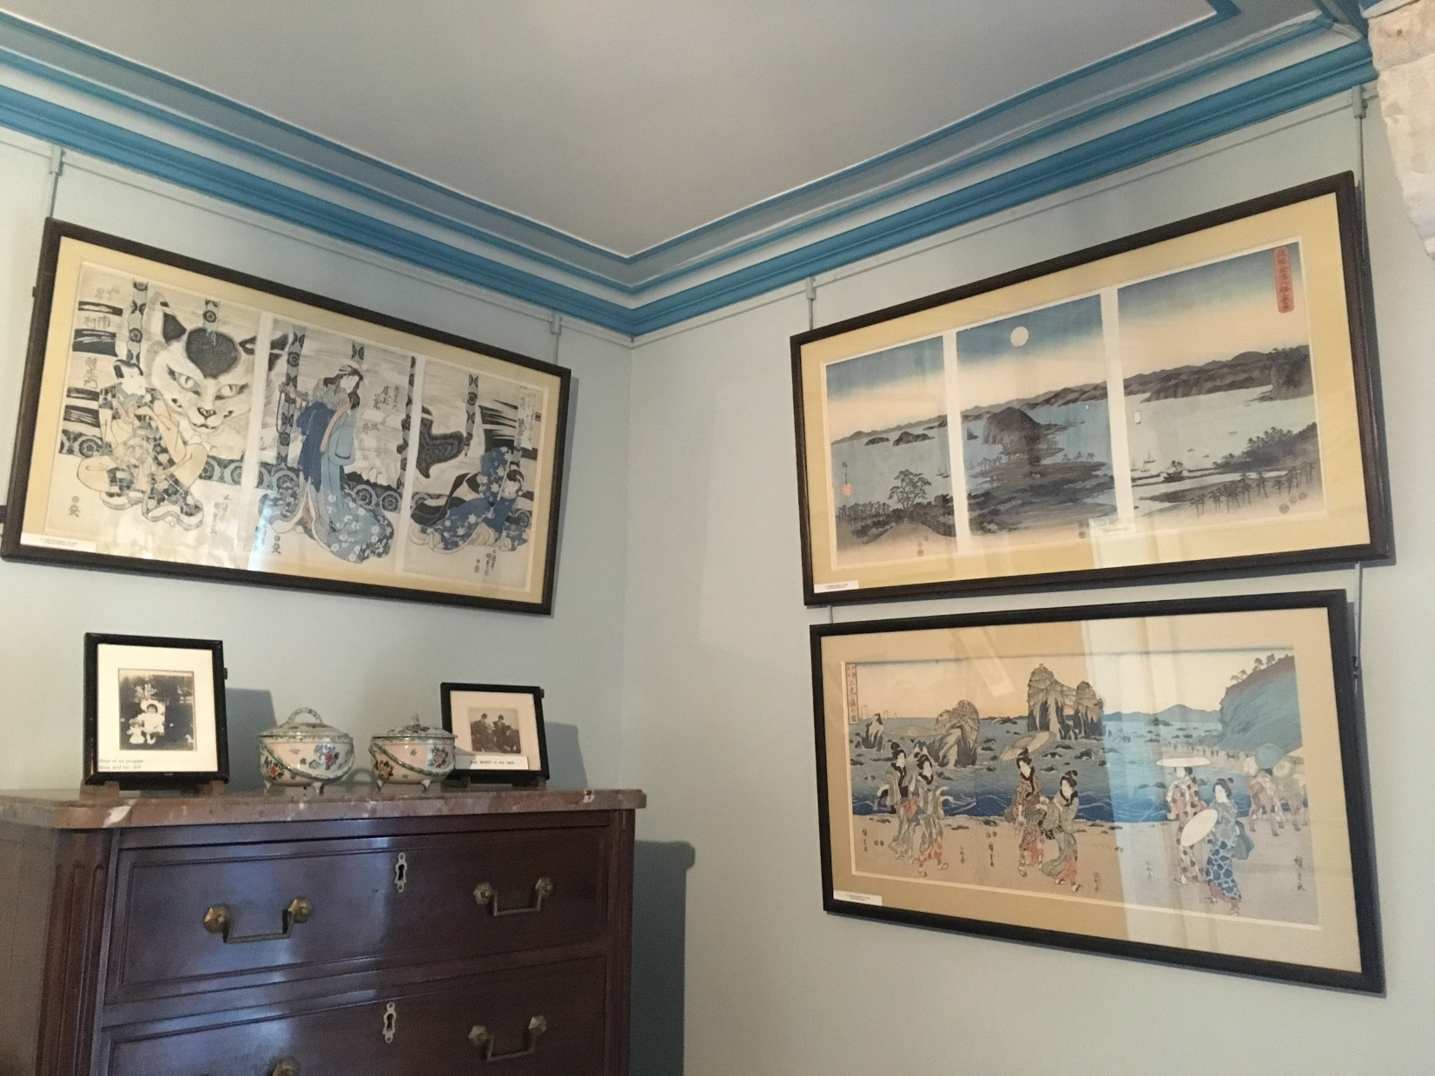
His house was full of Japanese prints
Credit: Caroline Mc Corriston
Credit: Caroline Mc Corriston

Slide 22
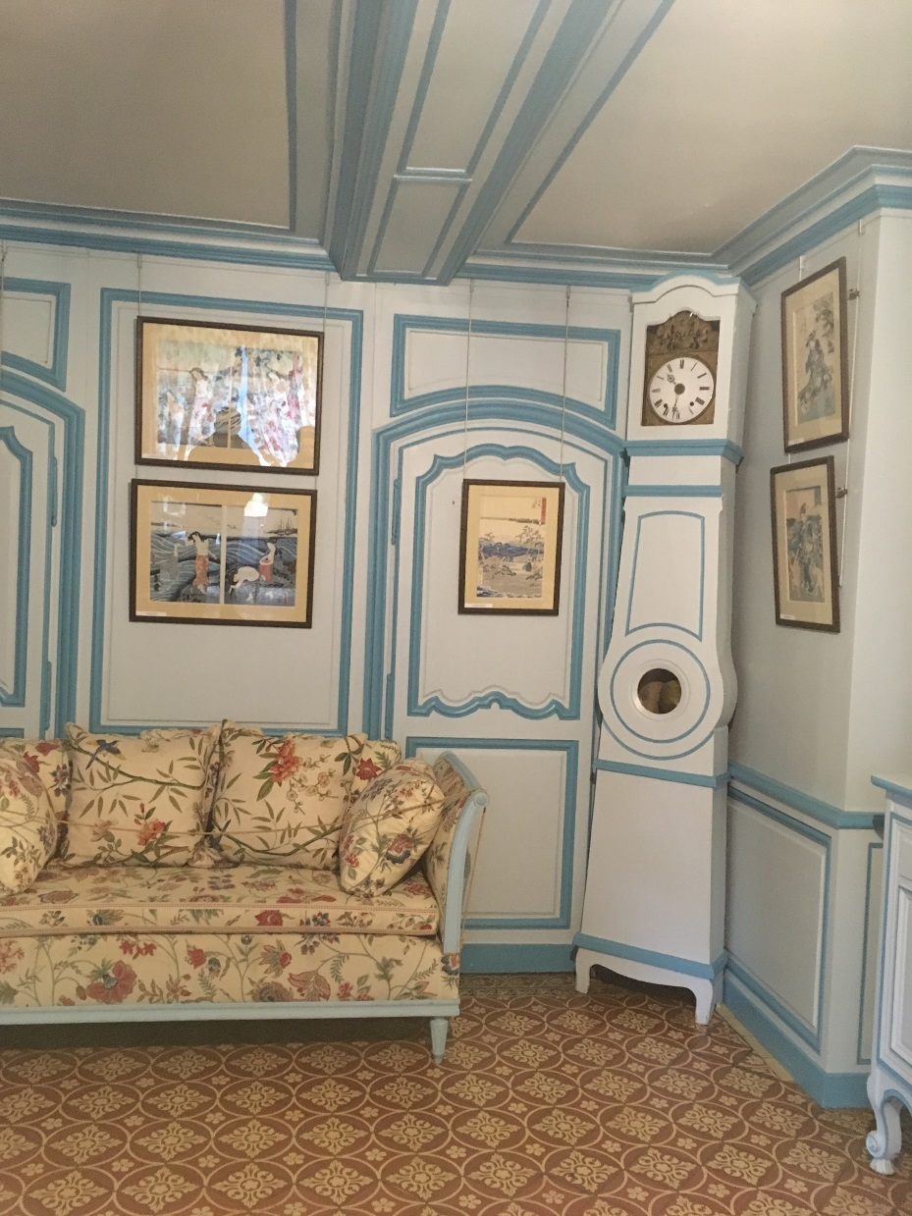
Credit: Caroline Mc Corriston

Slide 23
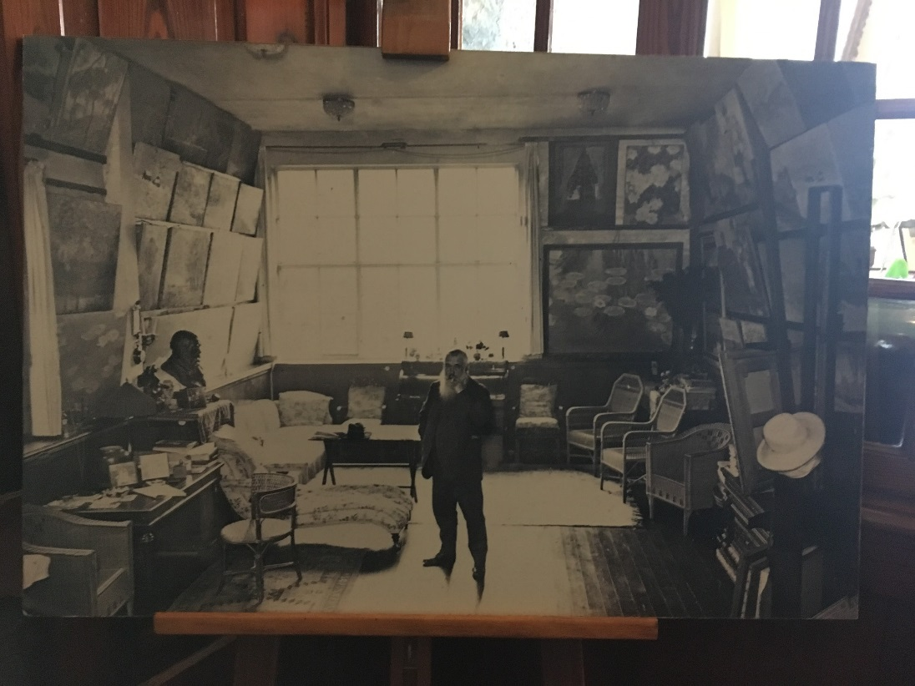
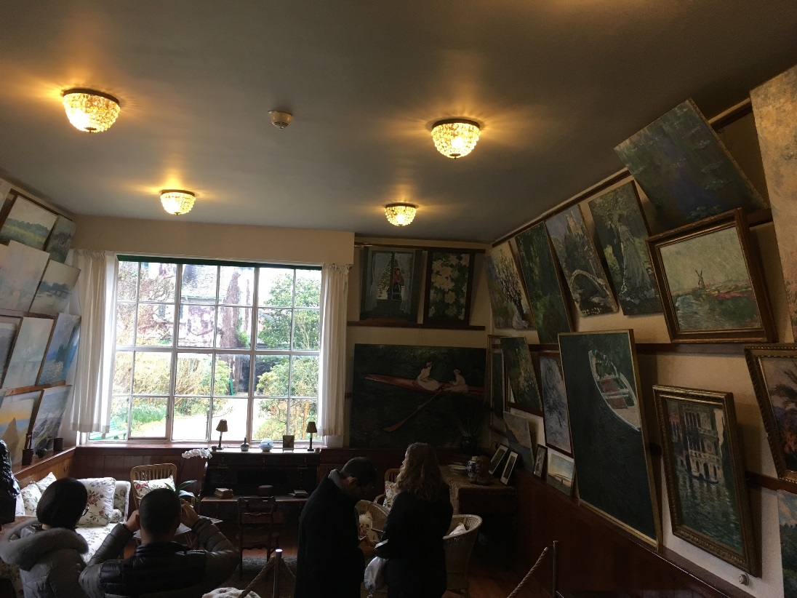
Living room with his paintings hanging on the walls
Credit: Caroline Mc Corriston
Credit: Caroline Mc Corriston

Slide 24
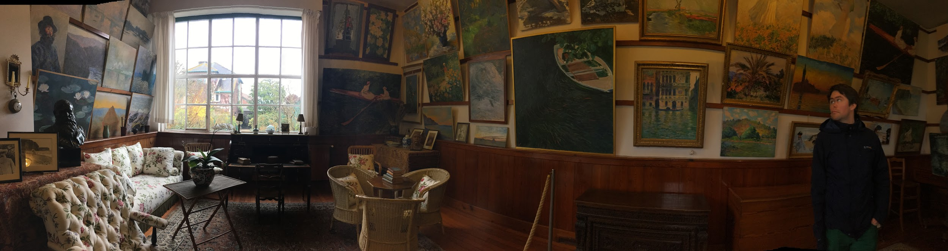
Credit: Caroline Mc Corriston

Slide 25
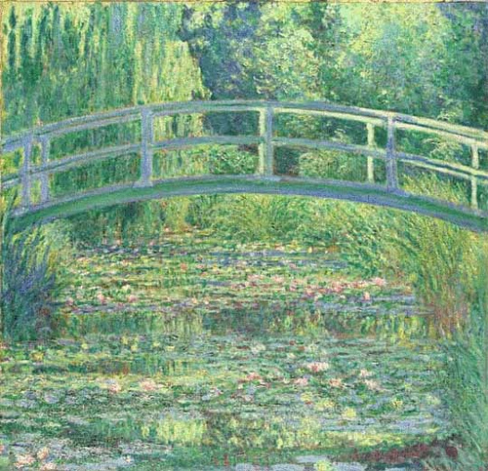
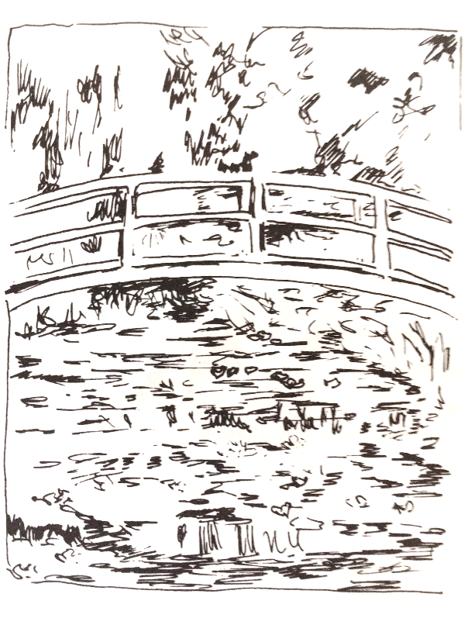
‘Waterlily Pond: Green Harmony’

Slide 26
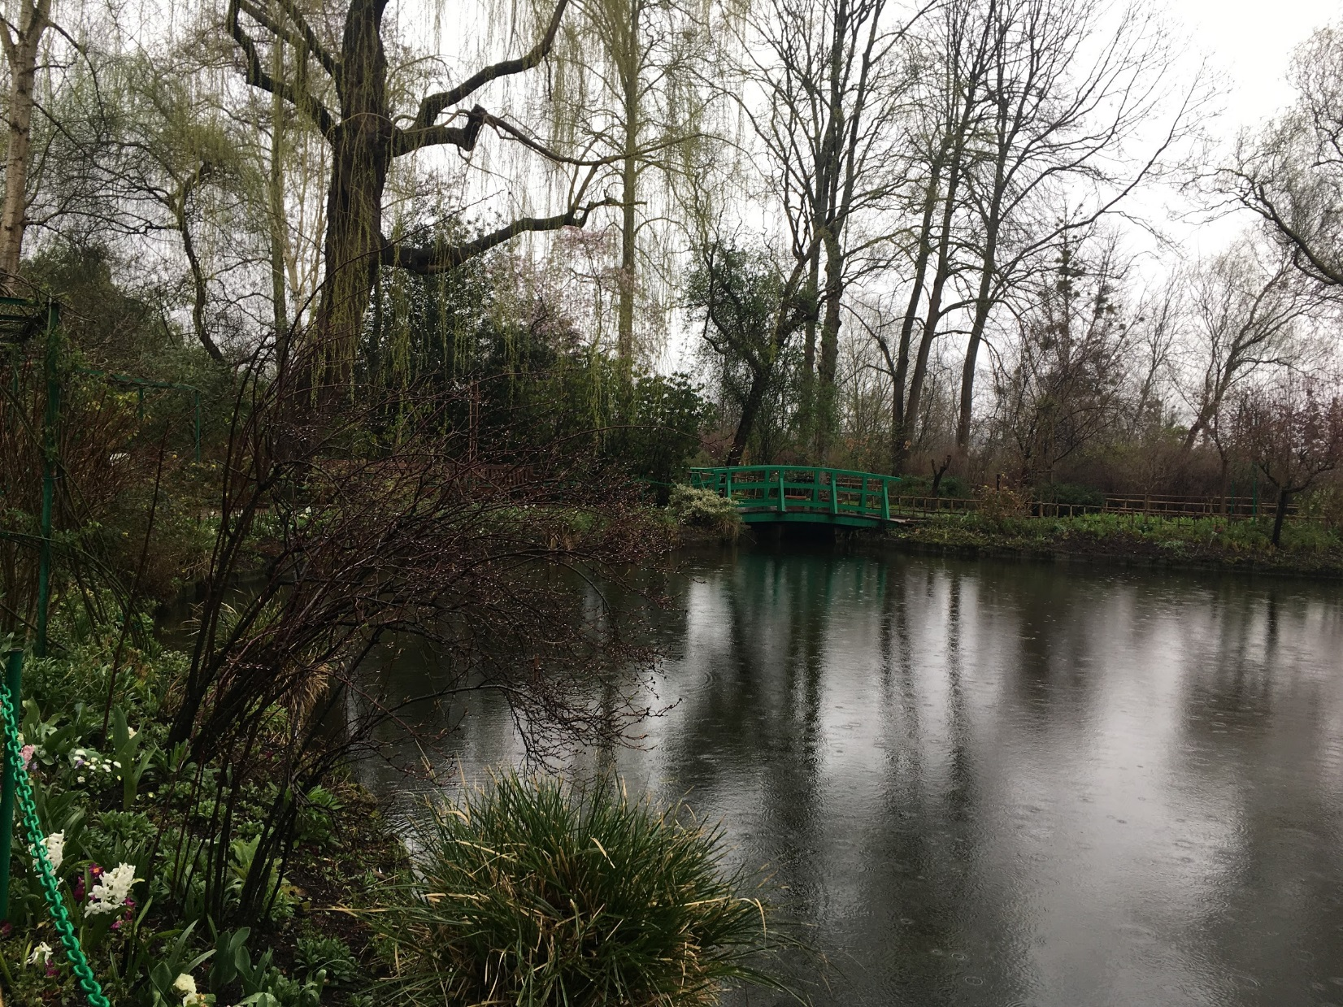
2018
Credit: Caroline Mc Corriston

Slide 27
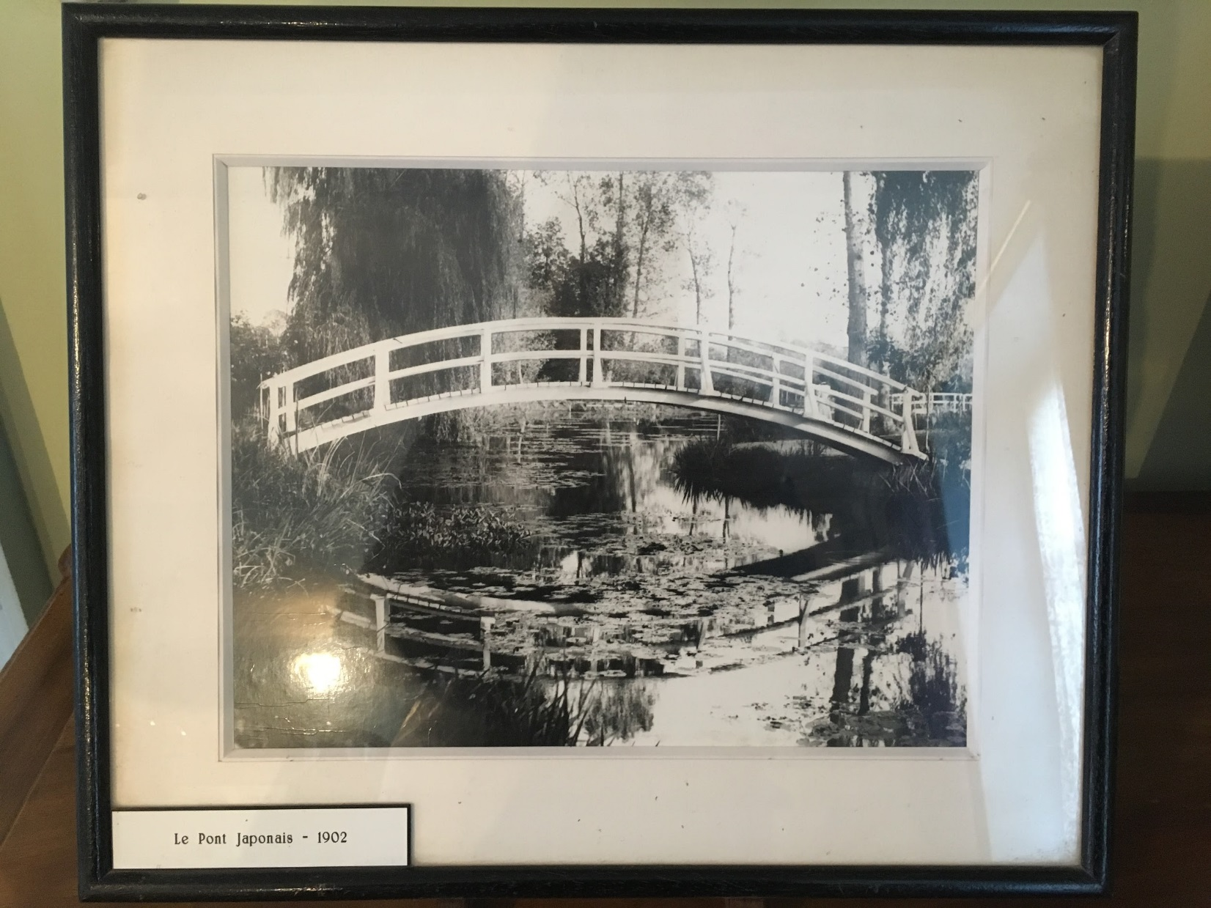
1902
Credit: Caroline Mc Corriston

Slide 28
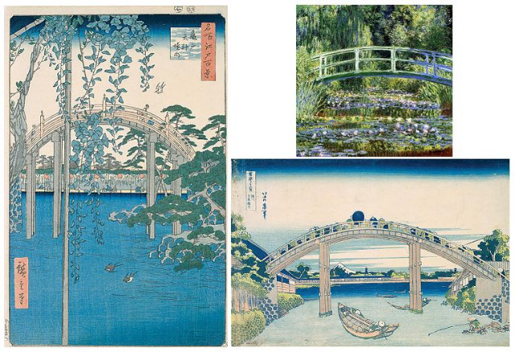
‘The Bridge with Wisteria’ by Utagawa Hiroshige

Slide 29
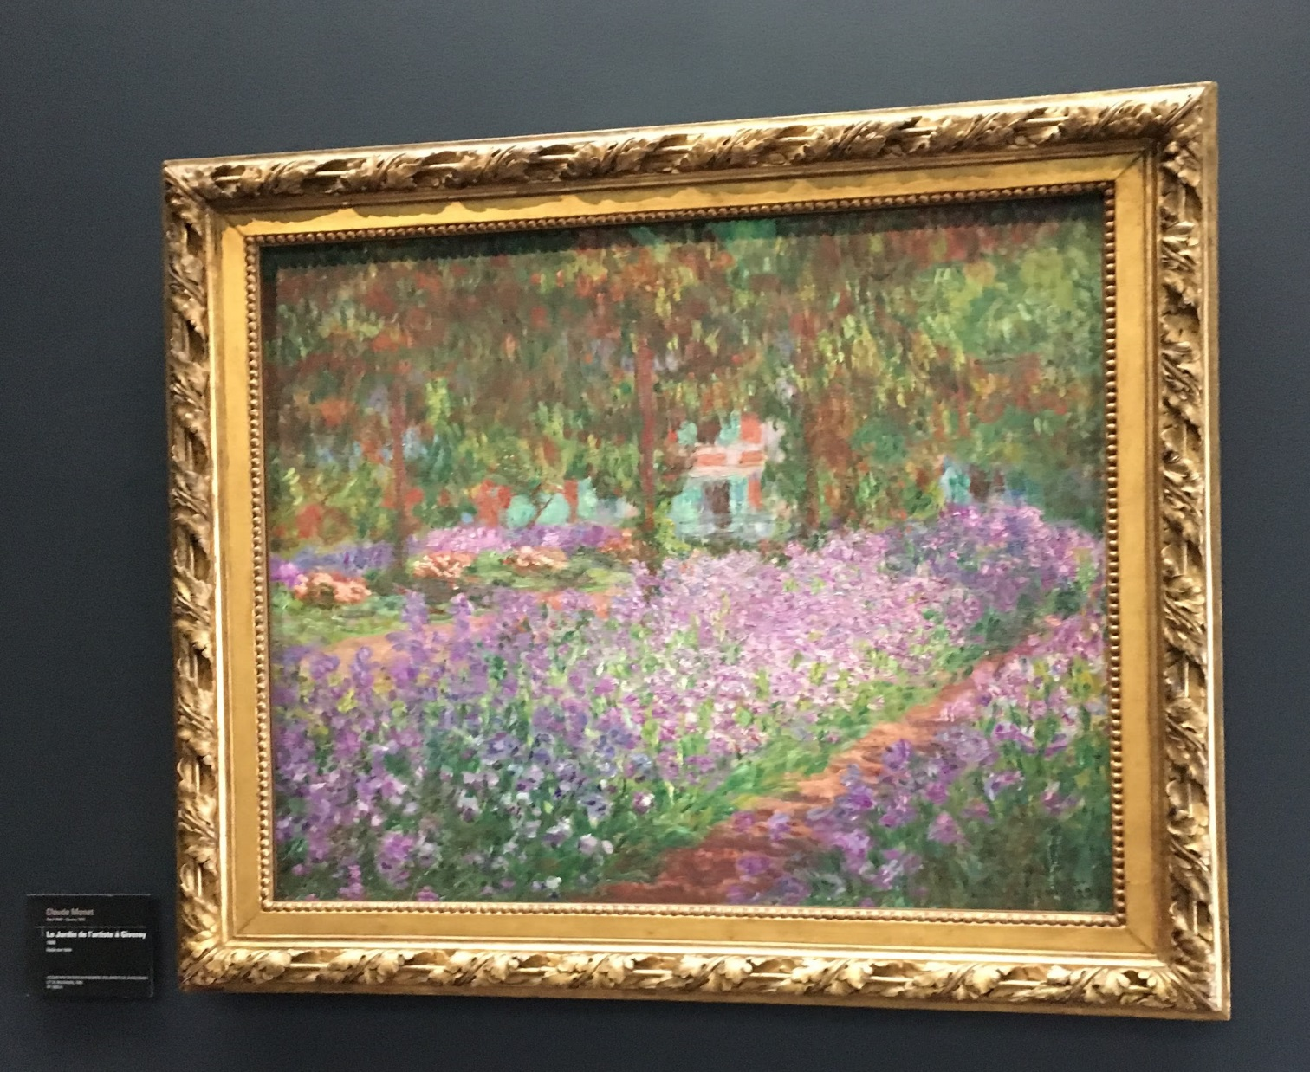
Garden at Giverny
Photo taken by: Caroline Mc Corriston

Slide 30
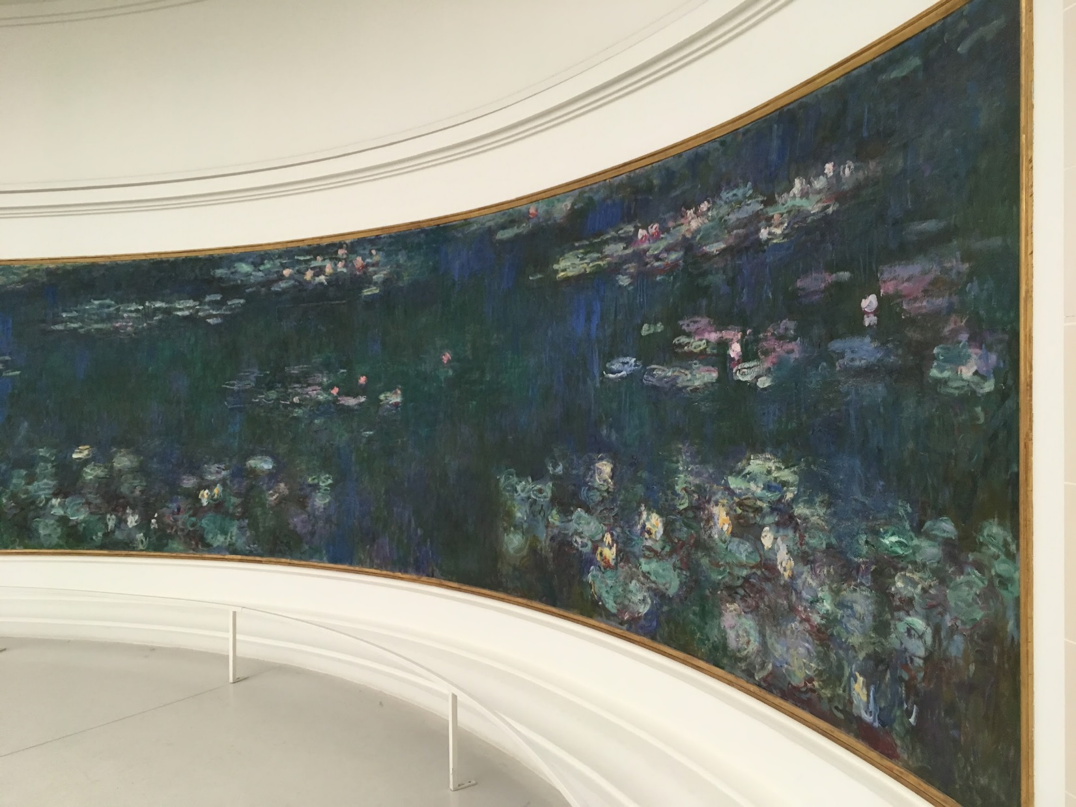
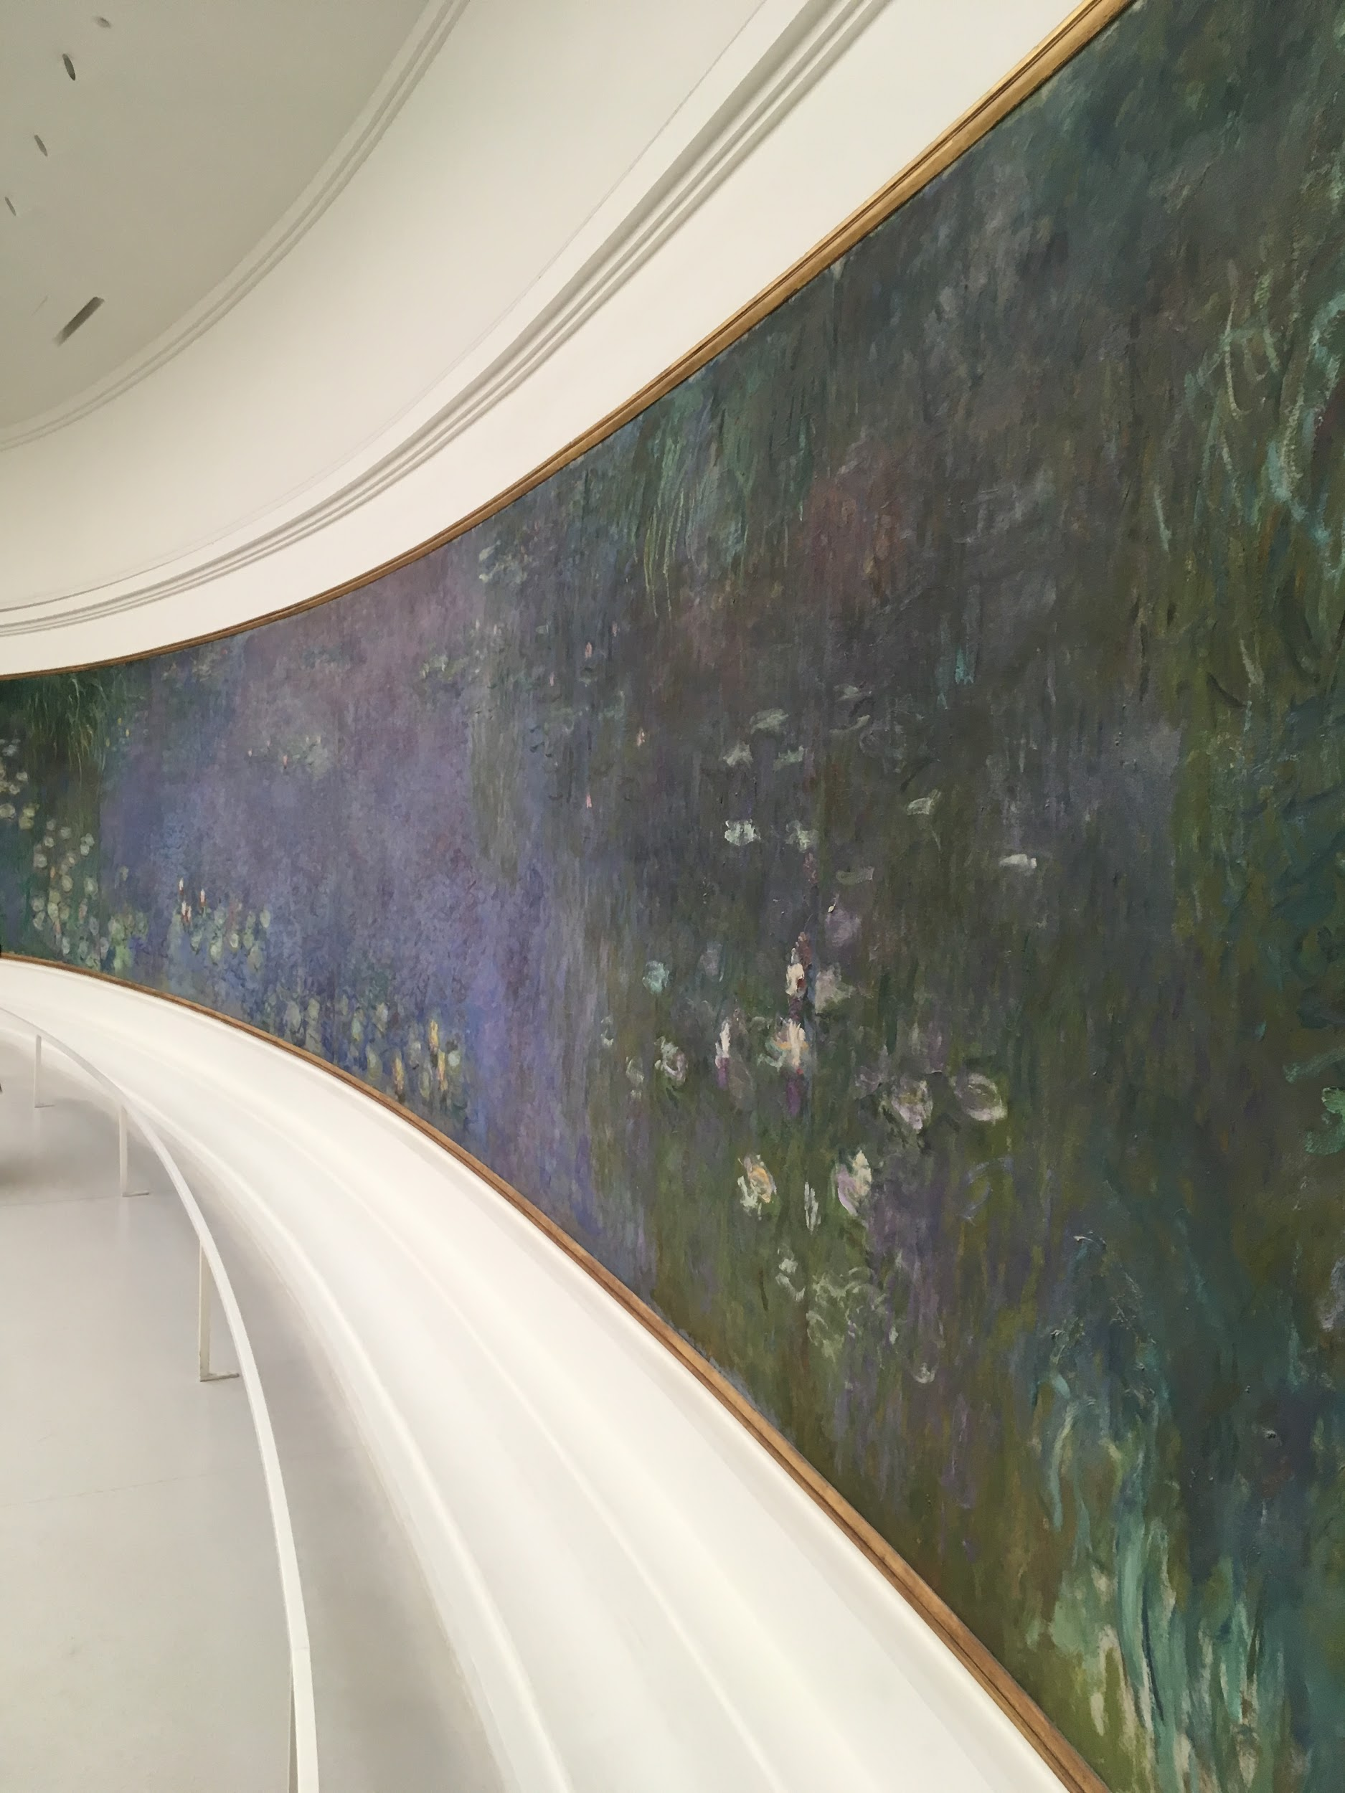
Musée de l’Orangerie, Paris
Credit: Caroline Mc Corriston

Slide 31
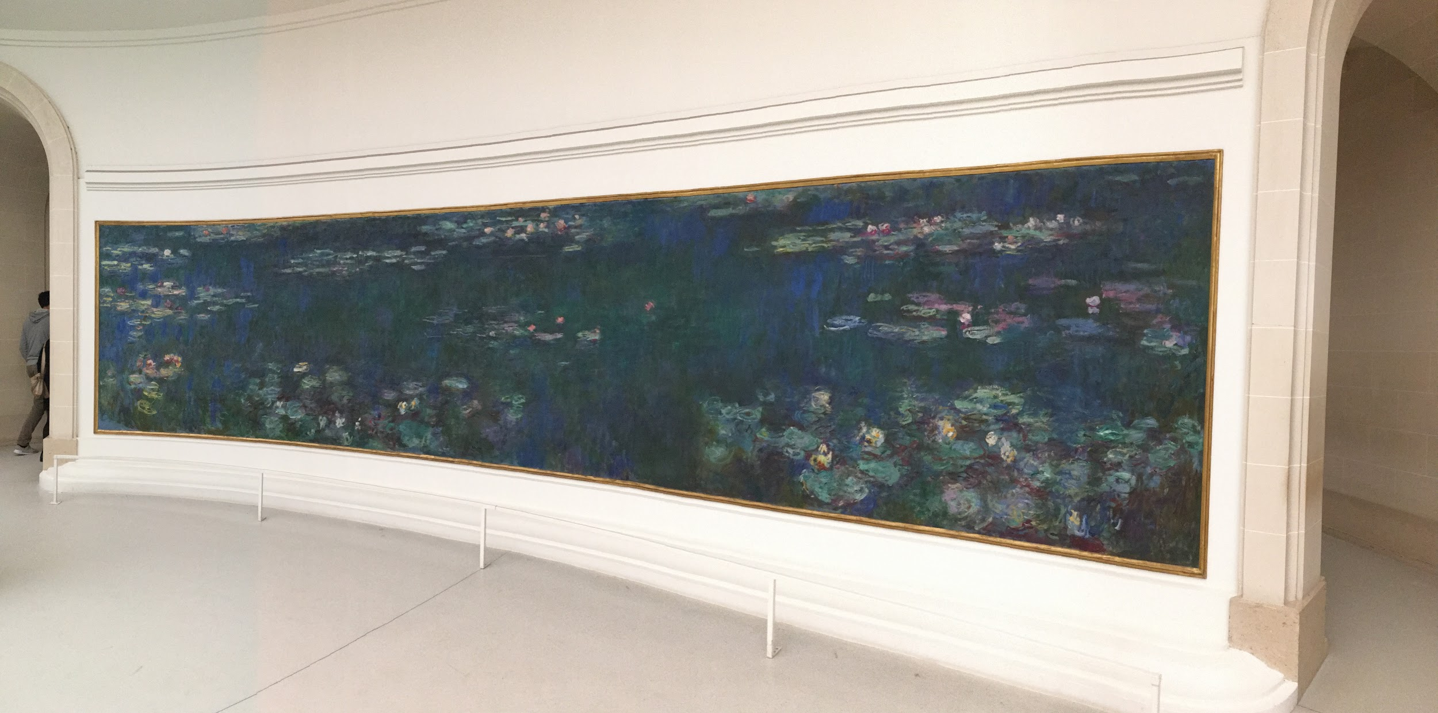
Photo taken by: Caroline Mc Corriston

Slide 32
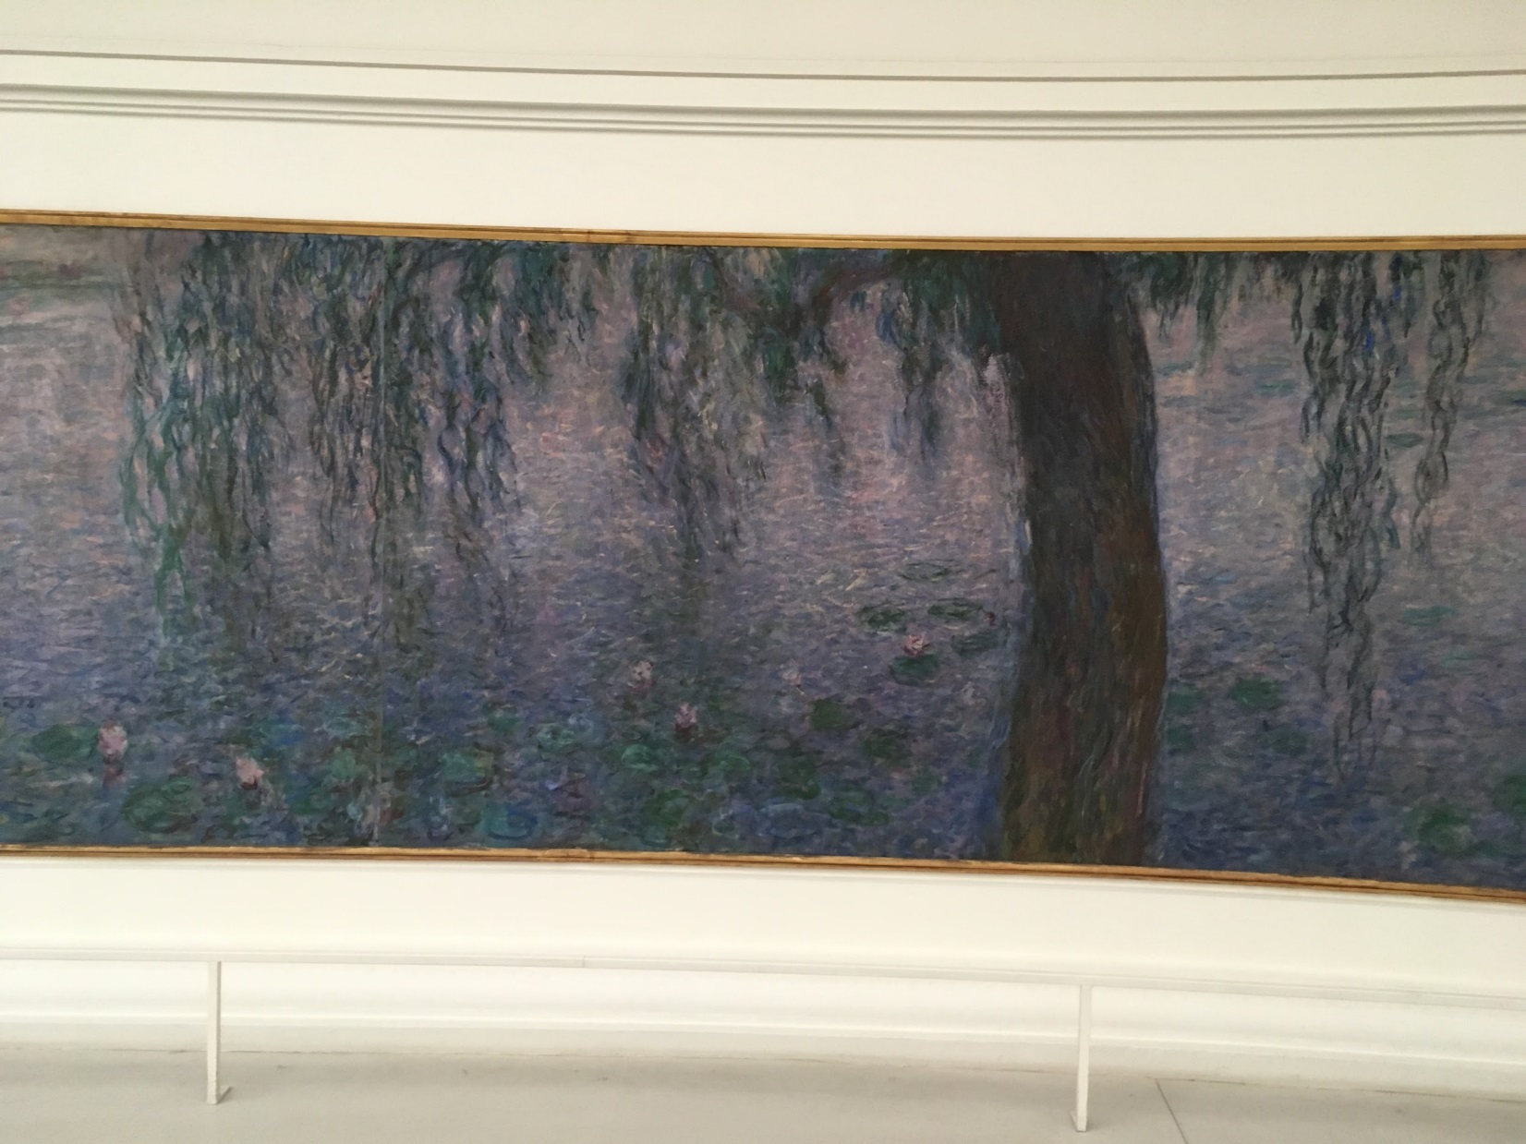
Photo taken by: Caroline Mc Corriston

Slide 33
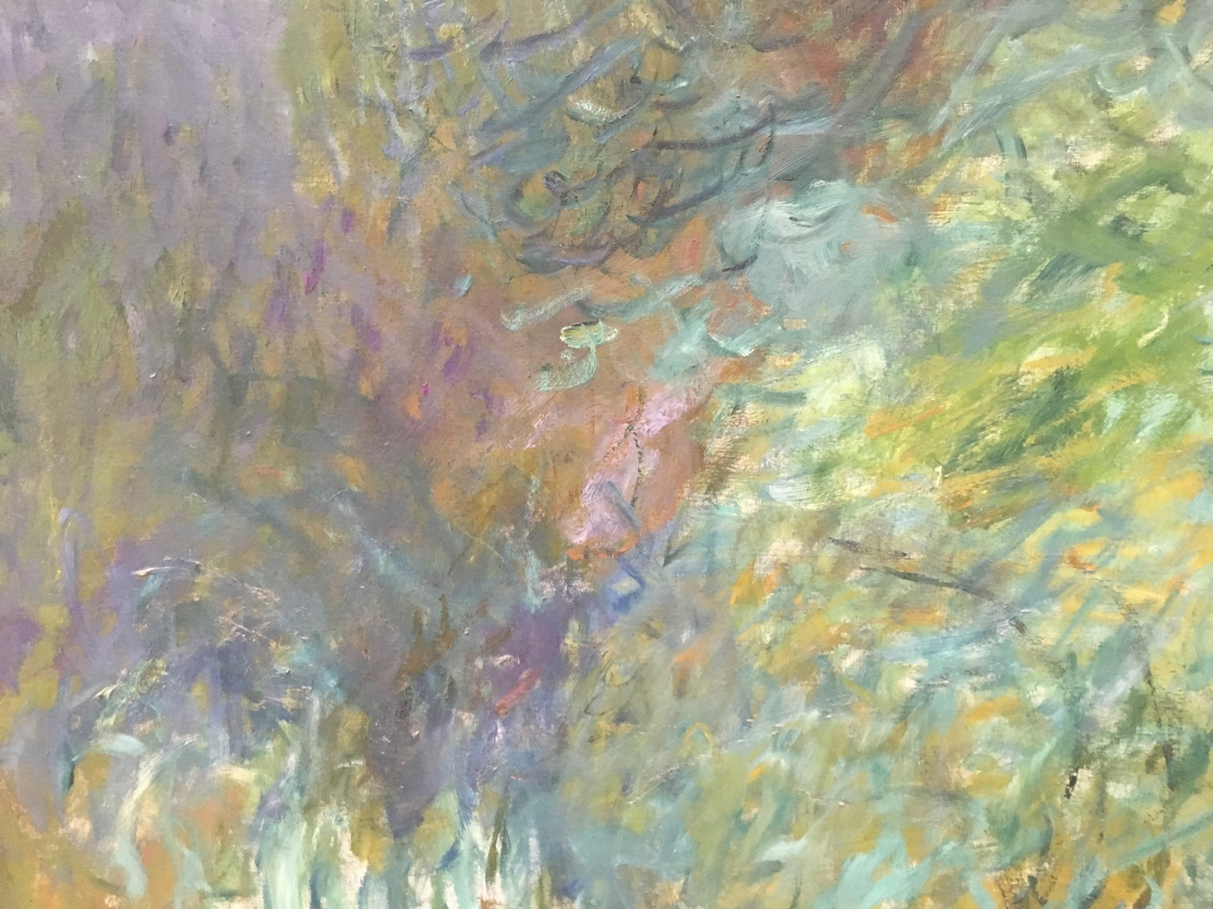
Photo taken by: Caroline Mc Corriston

Slide 34
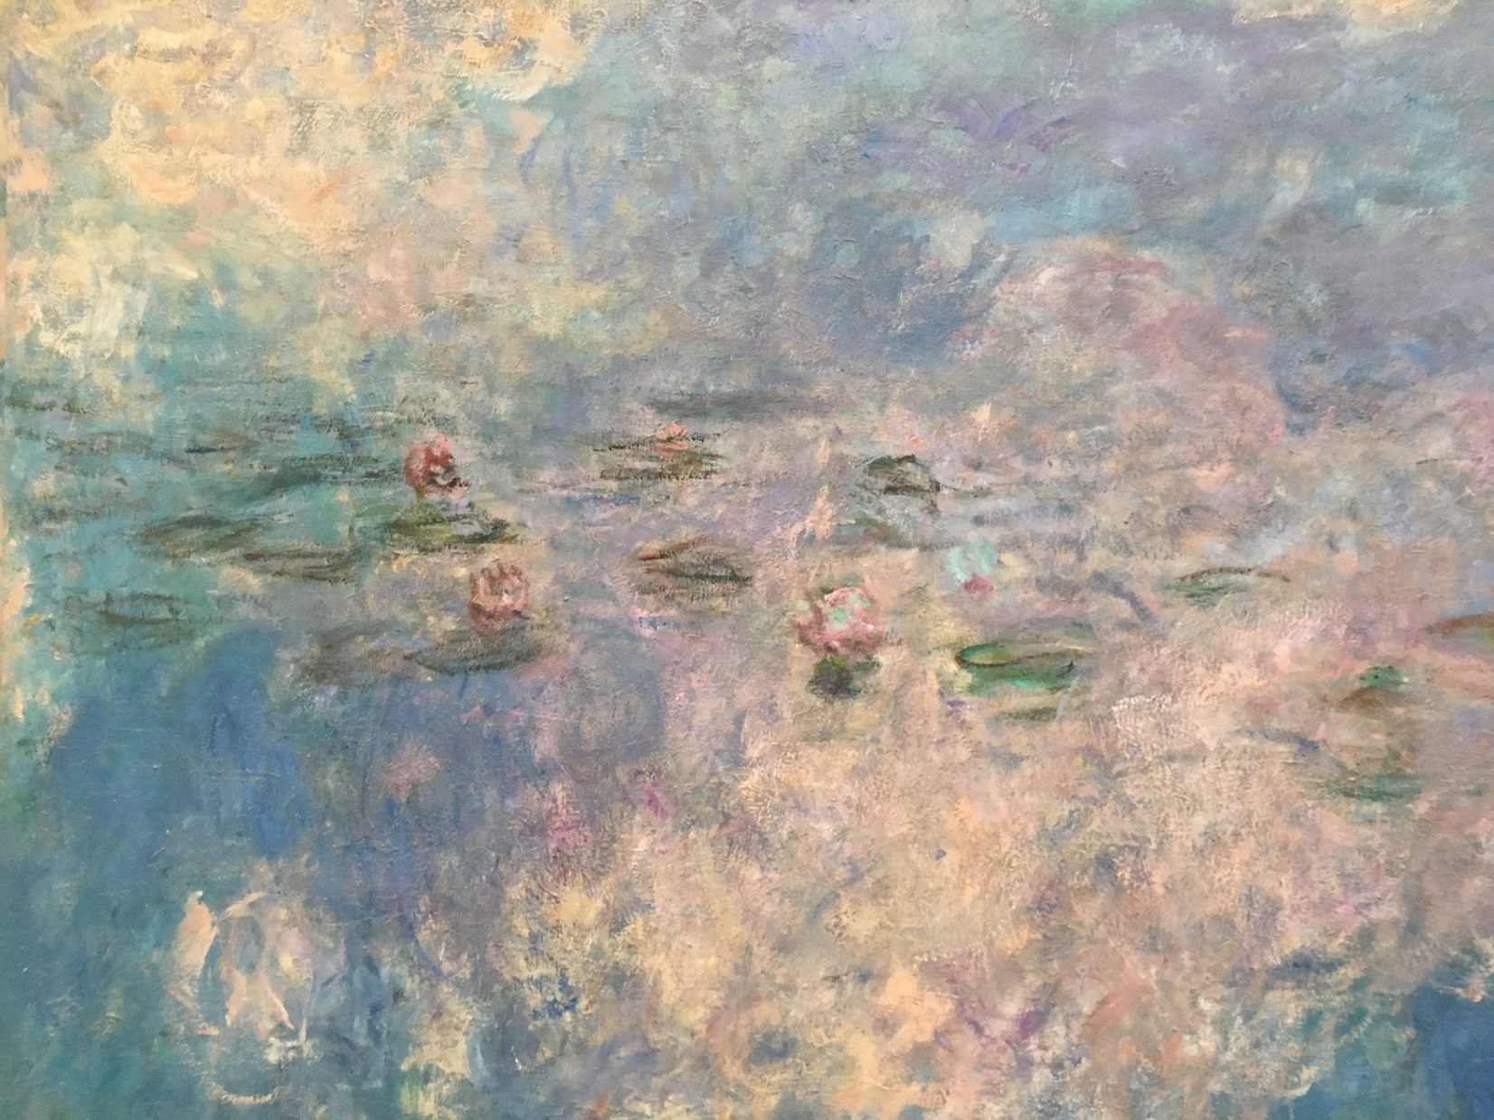
Photo taken by: Caroline Mc Corriston

