Slide 1
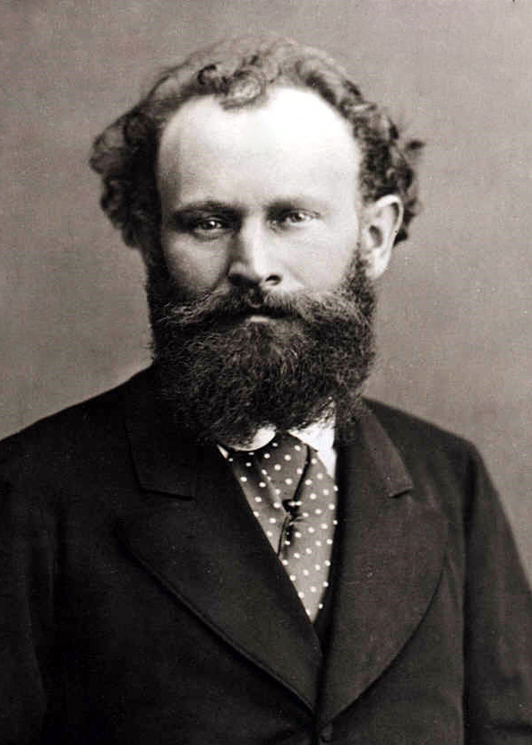

Édouard Manet,1832- 1883
Caroline Mc Corriston

Slide 2
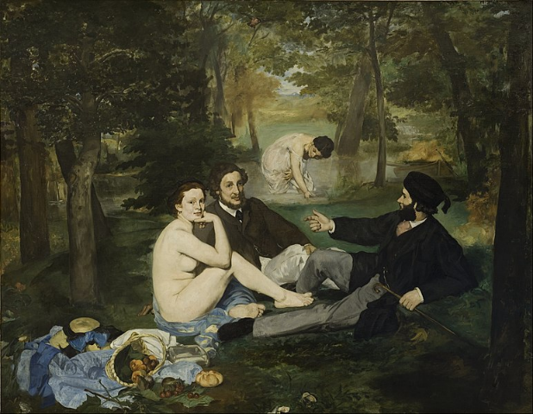
Déjeuner sur l’Herbe, oil on canvas, 1863

Slide 3
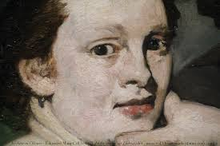
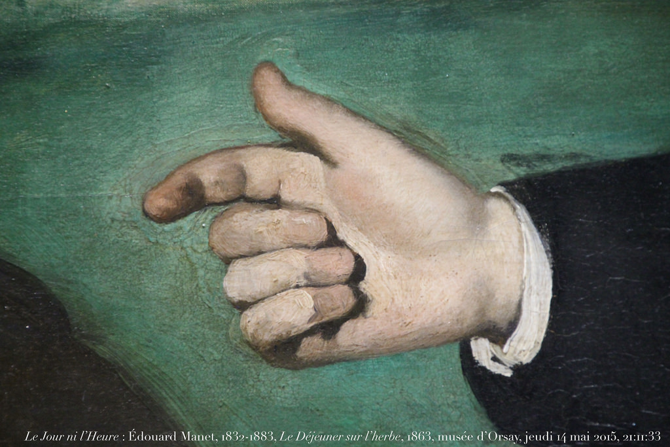
Eyes looking out at the viewer

Slide 4
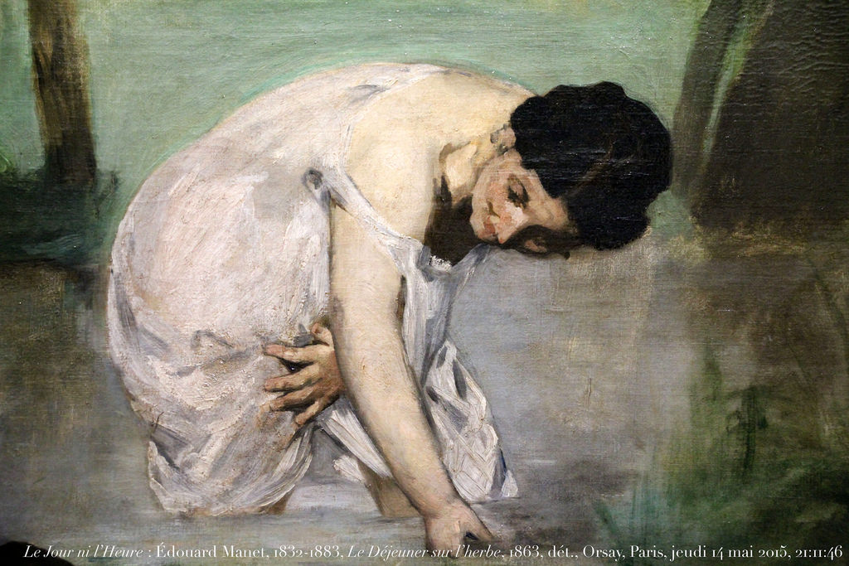
Woman blurred in the background

Slide 5
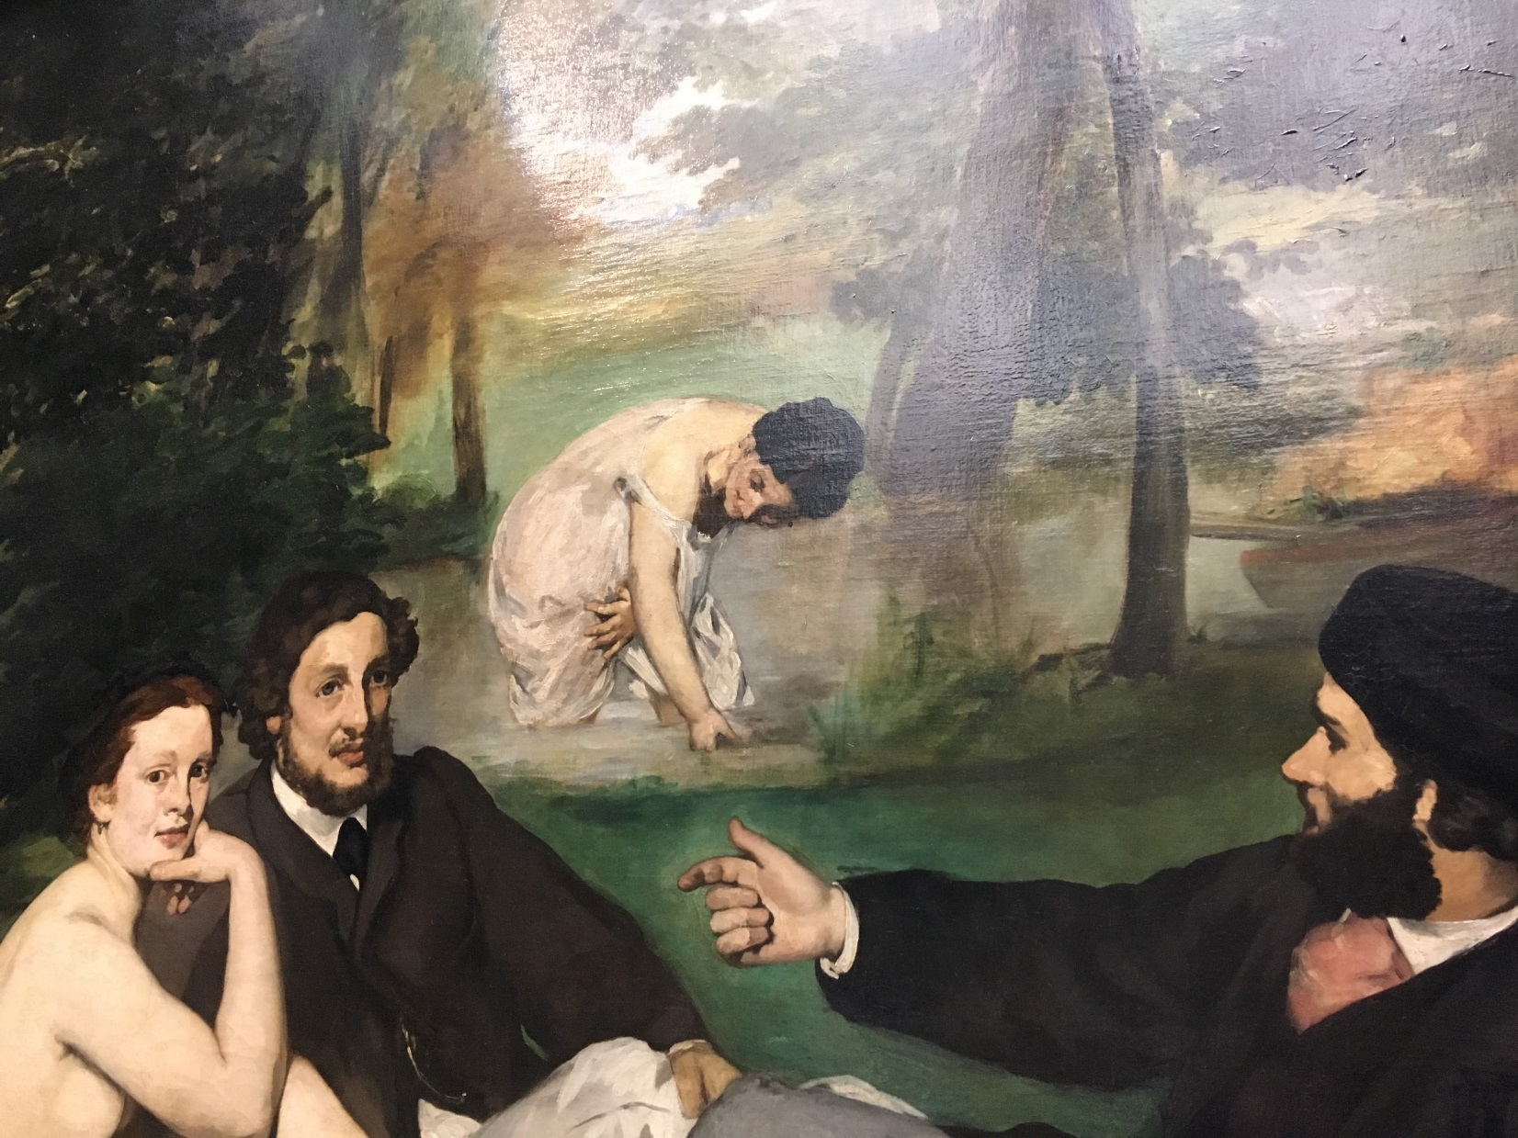
Photo taken by: Caroline Mc Corriston

Slide 6
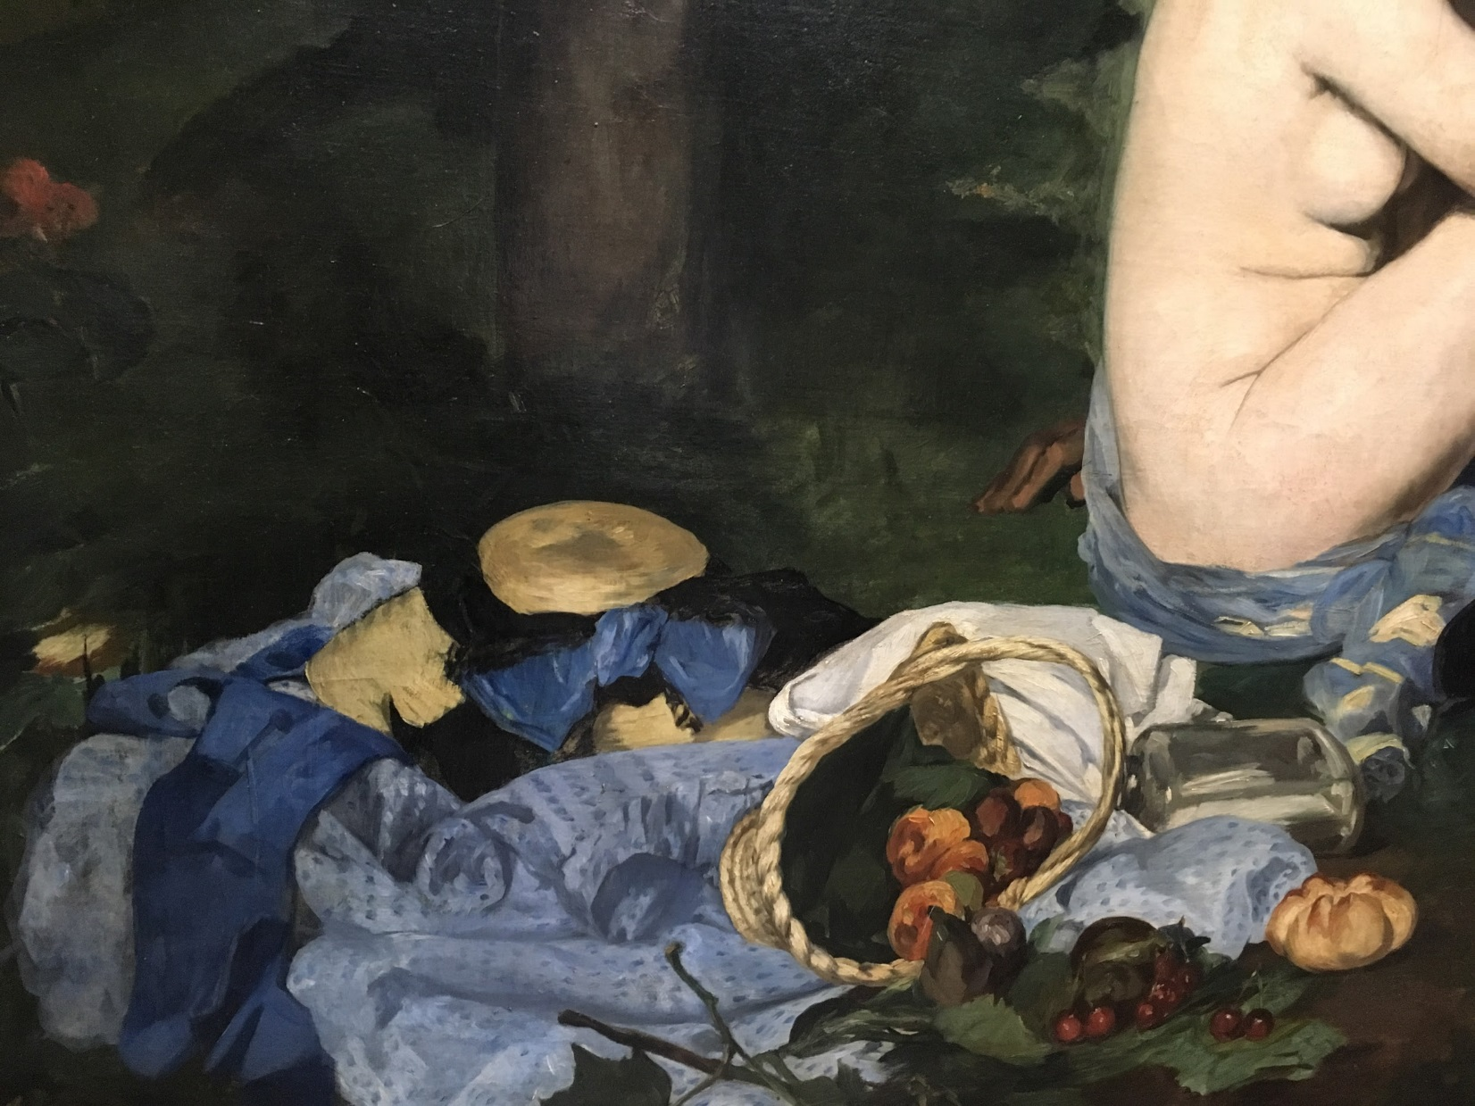
Photo taken by: Caroline Mc Corriston

Slide 7
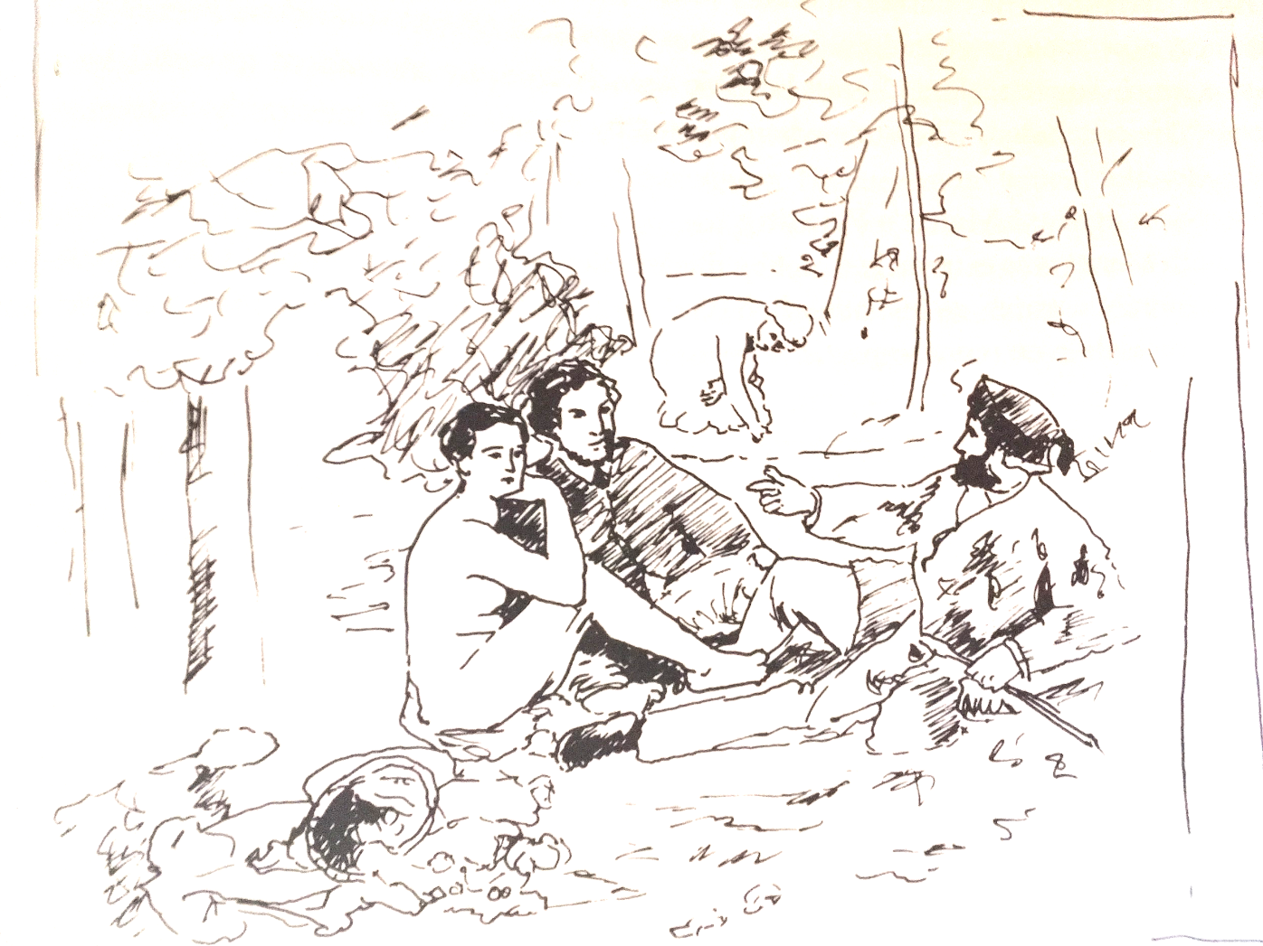

Slide 8
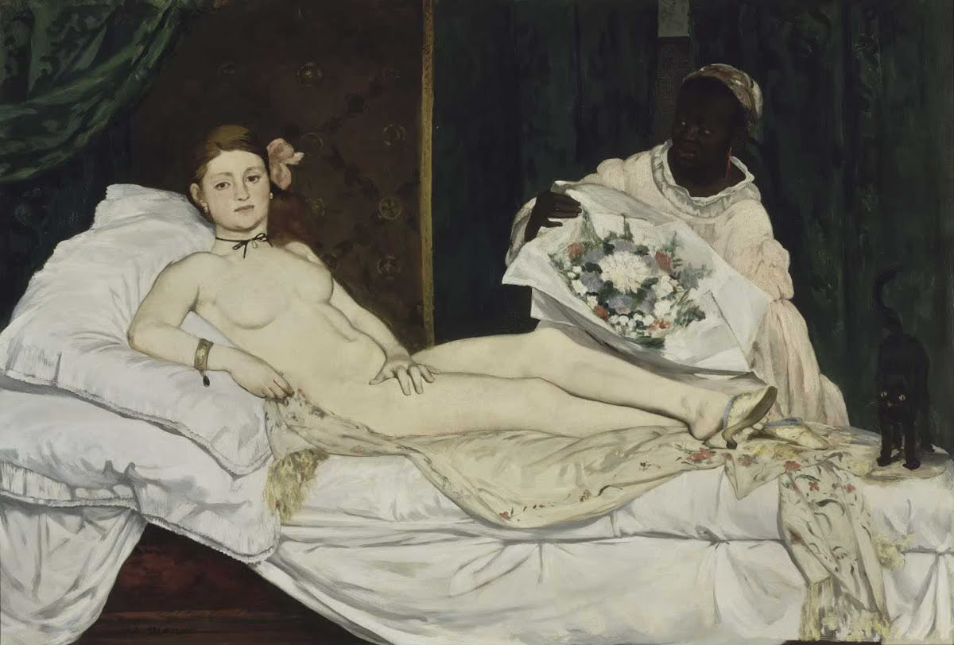
‘Olympia’, oil on canvas, 1865

Slide 9
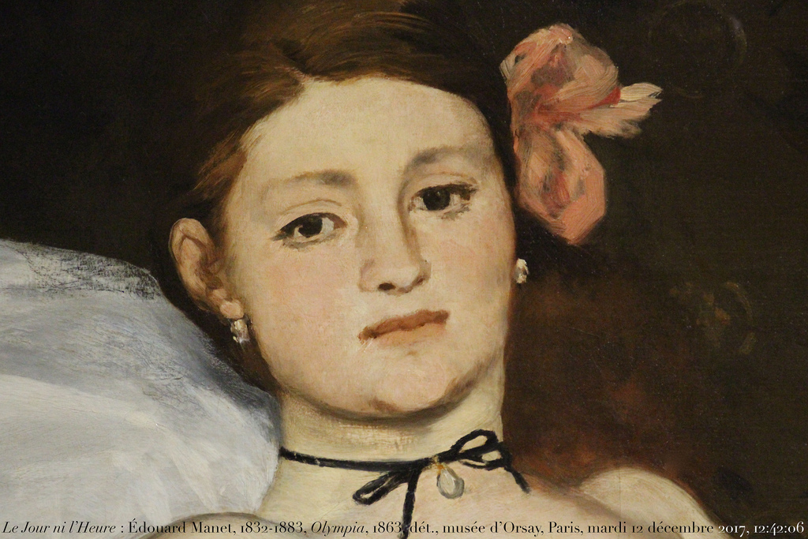
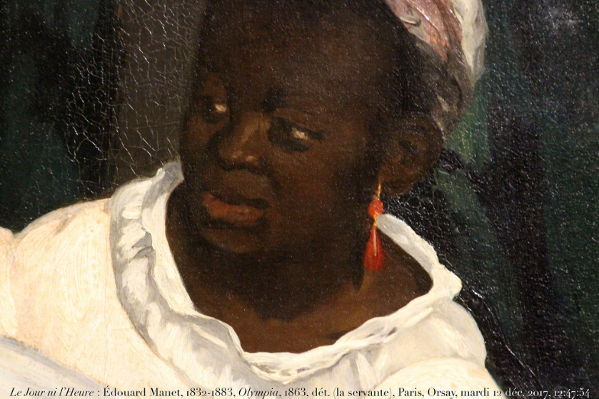

Slide 10
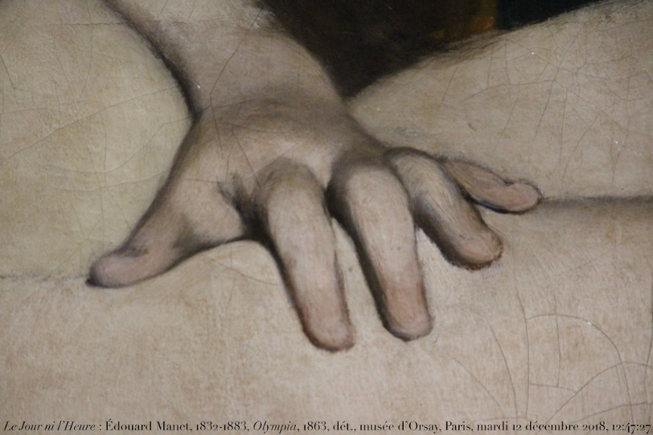

Slide 11
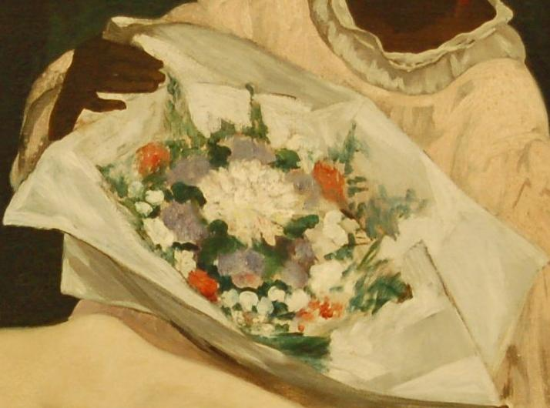

Slide 12
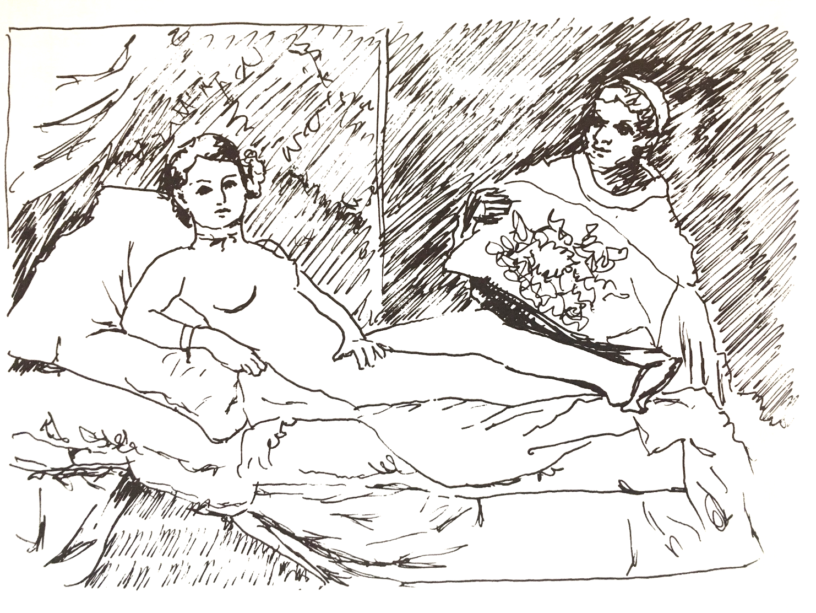

Slide 13
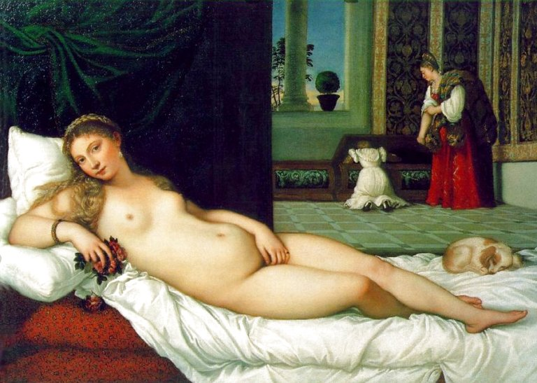
The Venus of Urbino, Titian, 1538

Slide 14
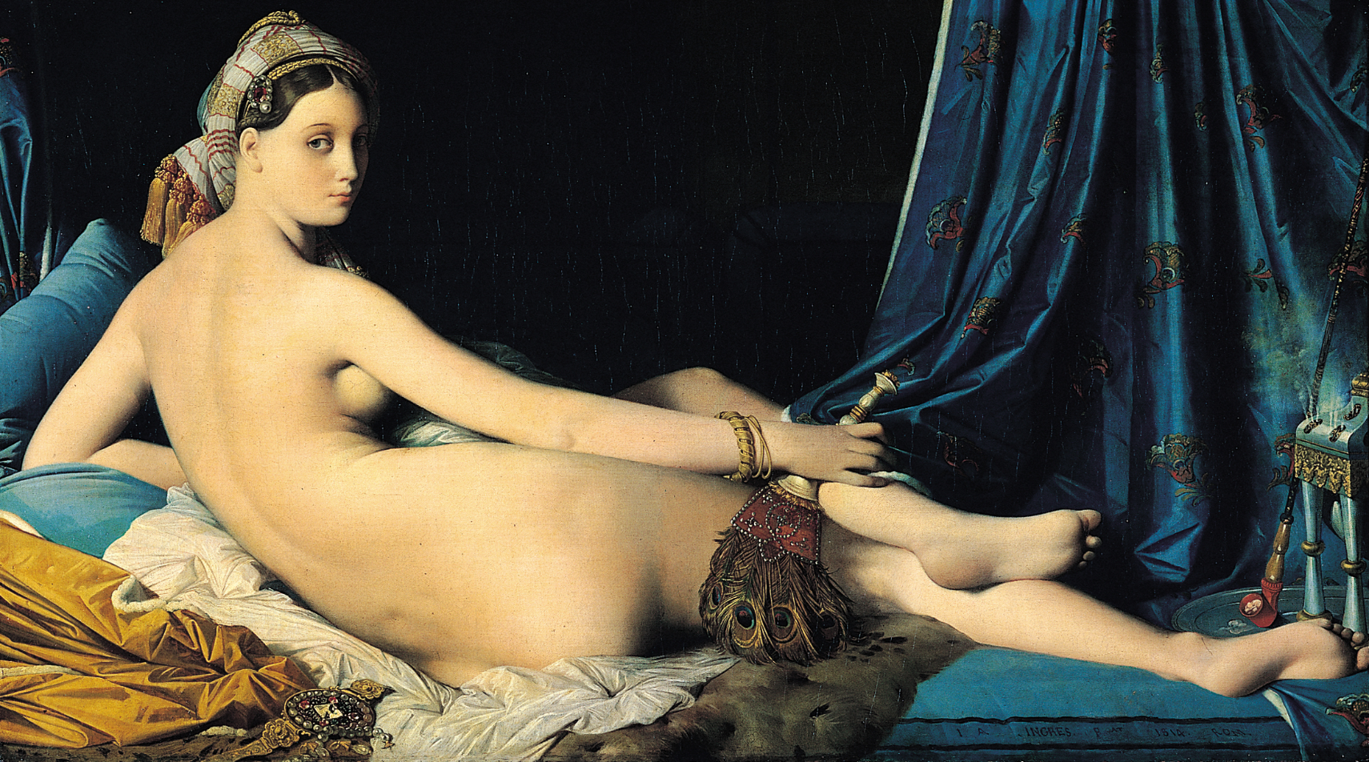
La Grande Odalisque, Jean Auguste Dominique Ingres, 1814

Slide 15
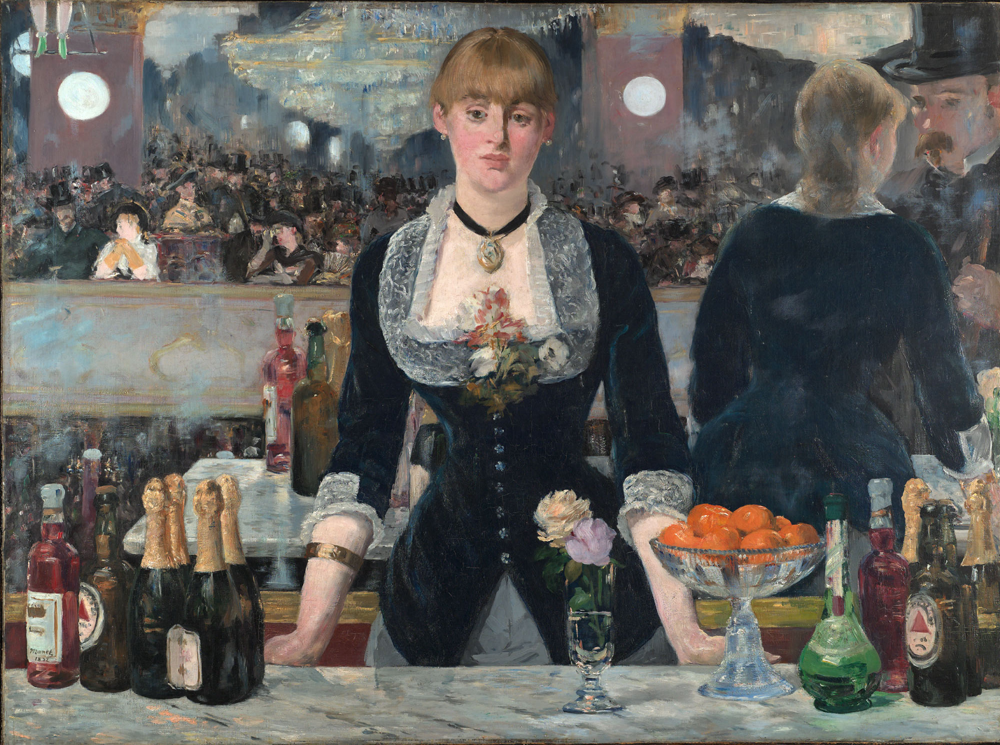
A Bar at the Folies- Bergere, oil on canvas, 1882

Slide 16
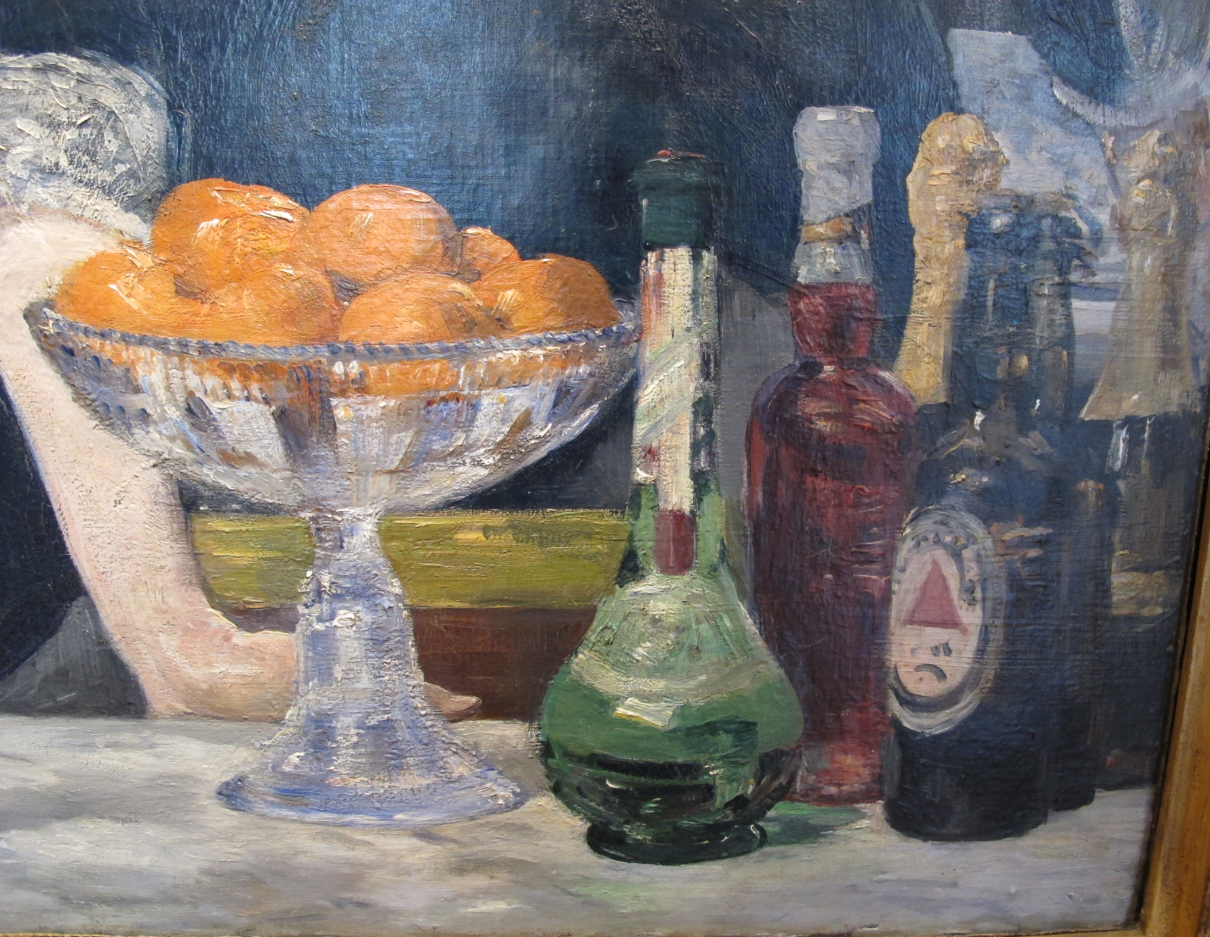

Slide 17
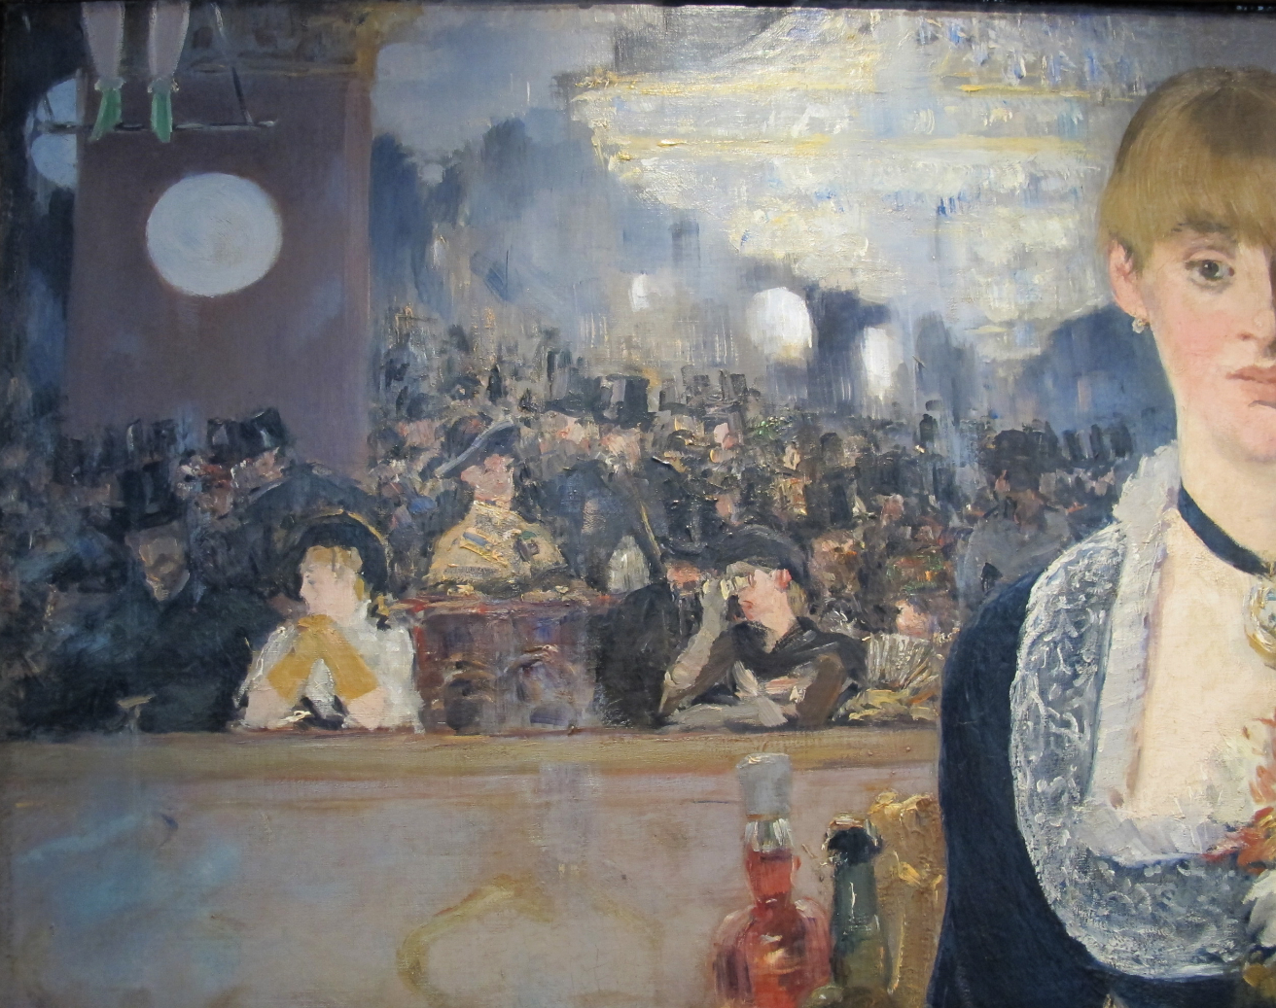
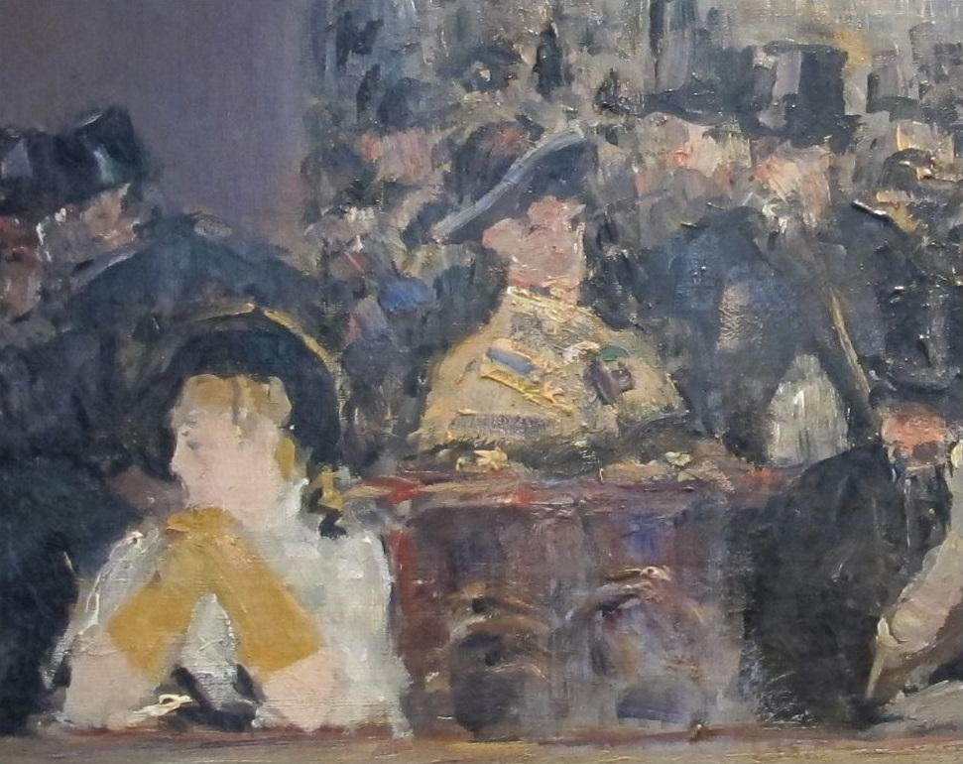
Thick brushstrokes

Slide 18
