Slide 1


Designed & created by Melanie McInerney for
Dogs need Shelter!
Answer the questions, and see how many you get right.
Teacher notes:
2:15 Different types of dog shelters.
Start a discussion about ‘Shelter’
What does it mean?
What type of shelter do you see here?
What are they made of?
Look at expanding or consolidating vocabulary – shelter, kennel, etc

Slide 2
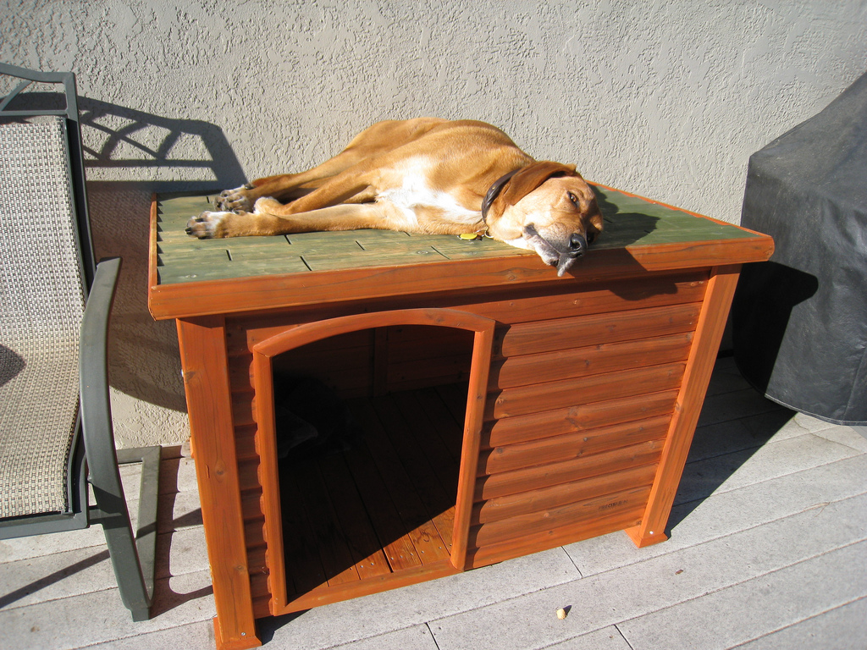
Designed & created by Melanie McInerney for
What type of shelter is this?
This is an outdoor dog kennel,
what is it made of?
It is made of wood mostly.

Slide 3
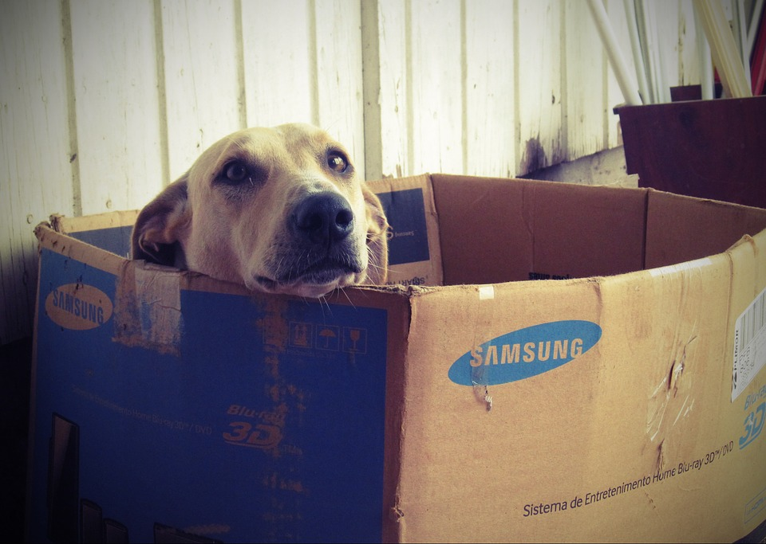
What type of shelter is this?
Designed & created by Melanie McInerney for
This is an indoor box bed,
What is it made of?
It is made of cardboard.

Slide 4
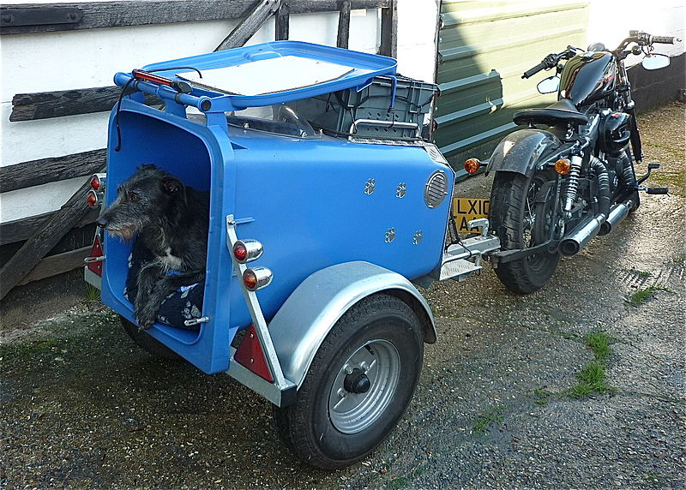
Designed & created by Melanie McInerney for
What type of shelter is this?
This is a mobile dog trailer. What is it made from?
It is made from plastic. It is an old bin.

Slide 5
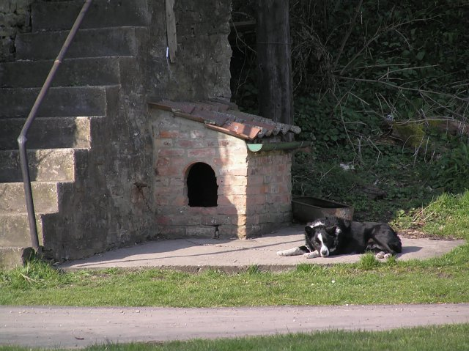
Designed & created by Melanie McInerney for
What type of shelter is this?
This is an out door dog kennel. What is it made of?
It is made of stone

Slide 6
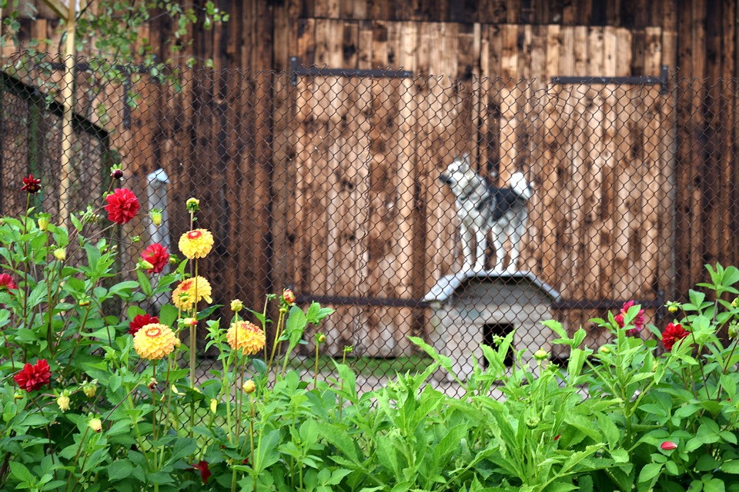
Designed & created by Melanie McInerney for
What type of shelter is this?
This is a dog kennel in a garden.
What is different about this shelter?
This is an outdoor dog kennel with a fence.

Slide 7
Links to the copyright free images.
https://www.flickr.com/photos/dharrels/3008666361
https://pixabay.com/en/dog-box-doghouse-dogface-660505/
https://commons.wikimedia.org/wiki/File:Hank_in_his_new_mobile_Dog_House_2014-04-26_08-27.jpg
https://commons.wikimedia.org/wiki/File:Brick-built_dog_kennel_at_Ashberry_Farm_-_geograph.org.uk_-_377253.jpg
https://pixabay.com/en/dog-kennel-village-rural-fence-2755486/

