Slide 1

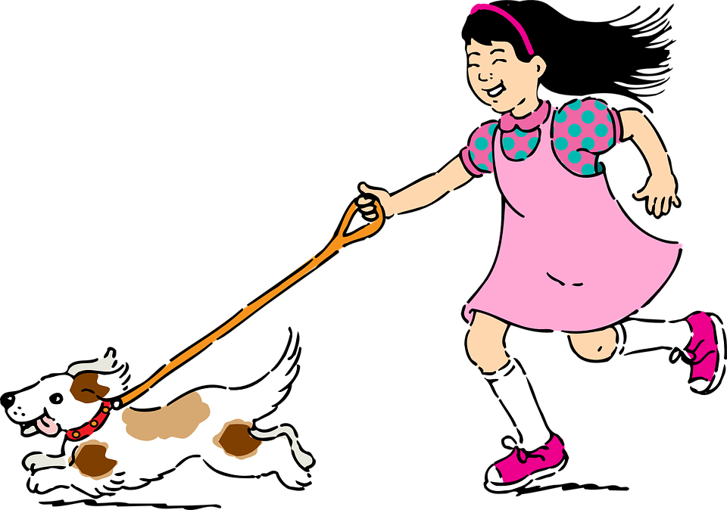
Teacher Notes:
2:10 Make comparisons with healthy exercise for humans
‘Exercise’
What is it?
Why should we exercise?
Linkage to PLU personal care – C1, C2.
See notes in Powerpoint.
Designed & created by Melanie McInerney for
Dogs need exercise every day.
Humans need exercise every day too!
Lets compare the benefits
of exercise!
https://pixabay.com/en/pet-pets-girl-dog-puppy-running-312041/
Notes:
Use this sheet to expand students understanding of how exercise ‘Benefits’ humans and animals.
This selection is not exhaustive and students could look online for more ideas:
role play a conversation about why it is good to be healthy. PLU Comm & Lit
Make a poster highlighting the benefits of exercise PLU Comm & Lit

Slide 2
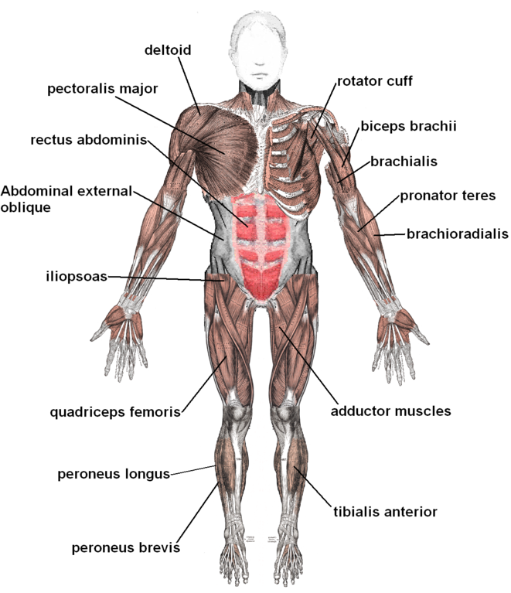
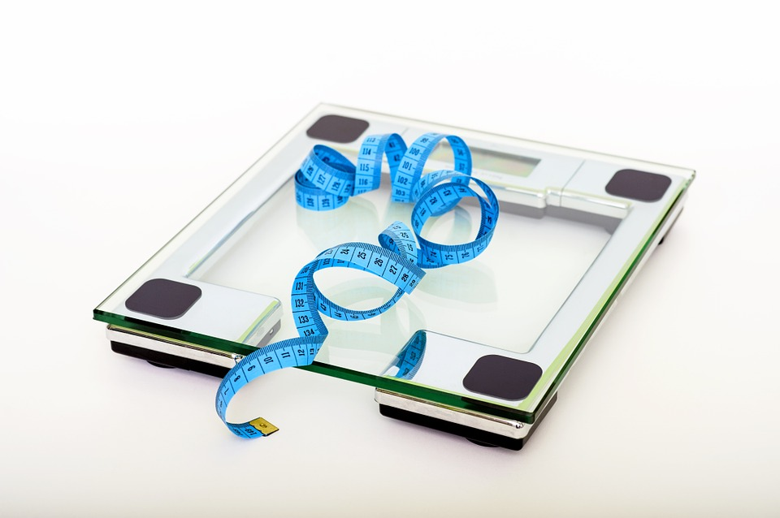
Lets look at the different benefits of exercise!
Look the pictures, what are the benefits of exercise?
Are the benefits the same for dogs?
Designed & created by Melanie McInerney for
Exercise builds strong bones and muscles
Exercise helps us to get to a healthy weight and stay at it.
https://commons.wikimedia.org/wiki/File:Muscles_anterior_labeled.png
https://cdn.pixabay.com/photo/2014/07/28/11/18/scale-403585_960_720.jpg
JC L2 Short Course animals – 2:10

Slide 3
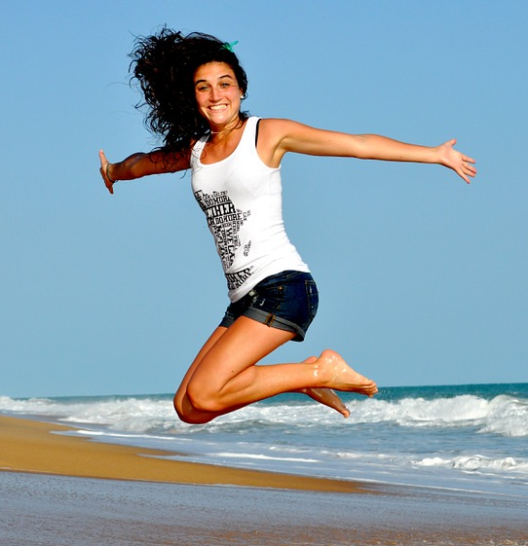
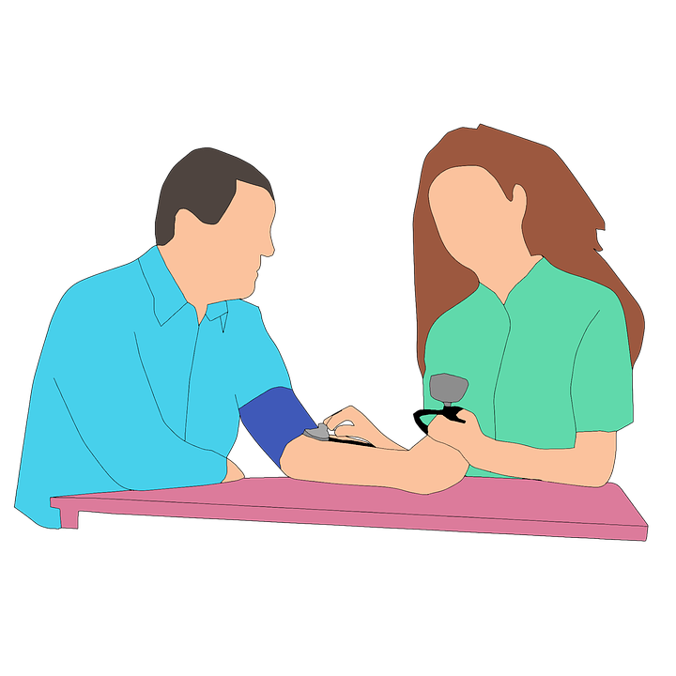
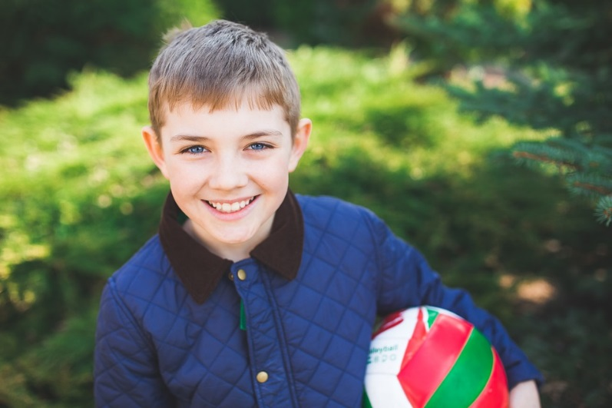
Designed & created by Melanie McInerney for
Exercise makes you happy!
Lets look at the different benefits of exercise!
Look the pictures, what are the benefits of exercise?
Are the benefits the same for dogs?
Exercise reduces your chances of getting sick
https://cdn.pixabay.com/photo/2014/04/26/04/25/fitness-332278_960_720.jpg
https://cdn.pixabay.com/photo/2017/09/14/17/38/blood-pressure-2749822_960_720.png
https://cdn.pixabay.com/photo/2014/04/26/04/25/fitness-332278_960_720.jpg
JC L2 Short Course animals – 2:10

Slide 4

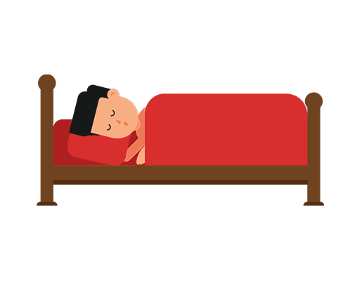
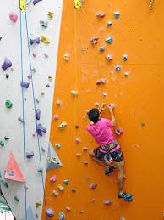
Designed & created by Melanie McInerney for
Exercise helps your Brain to think and move your body faster!
Lets look at different benefits of exercise!
Look the pictures, what are the benefits of exercise?
Are the benefits the same for dogs?
If you’re not sure,
why not ask a vet.
This links to 3:10 & 4:3
https://cdn.pixabay.com/photo/2017/01/24/00/21/question-2004314_960_720.jpg
You sleep better too!
https://upload.wikimedia.org/wikipedia/commons/0/01/Man_Sleeping_in_Bed_GIF_Animation_Loop.gif
https://encrypted-tbn0.gstatic.com/images?q=tbn:ANd9GcQ_ZRqf_y3MSfDLGGYWEzwcQNBwpx4eUa2E1Mn7POhpNgICI8gW
JC L2 Short Course animals – 2:10

