Slide 1

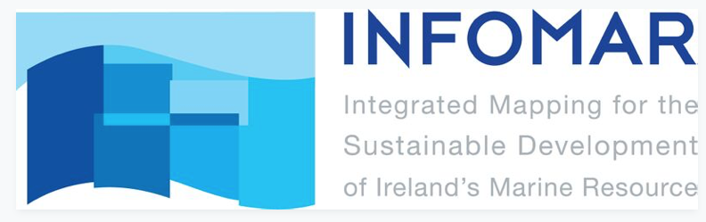
The Atlantic Transect
Created by Tara Fitzharris

Slide 2
Here is an overview of the Atlantic Transect. This is what the seafloor of the Atlantic ocean between Ireland and Canada looks like:
Newfoundland, Canada
Galway Bay, Ireland

Slide 3
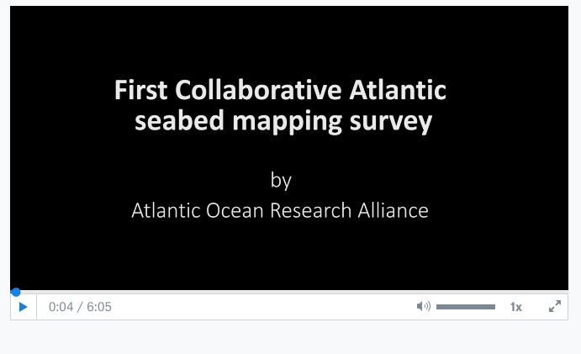
Watch the following video clip (6.05mins) to see how the data was collected:
https://www.dropbox.com/sh/f72x3eofs4va7mr/AAC3bpjlhFKa3VUzSCePiRYSa/Transatlantic/Atlantic%20Seabed%20Mapping%20Initiative.mp4?dl=0

Slide 4
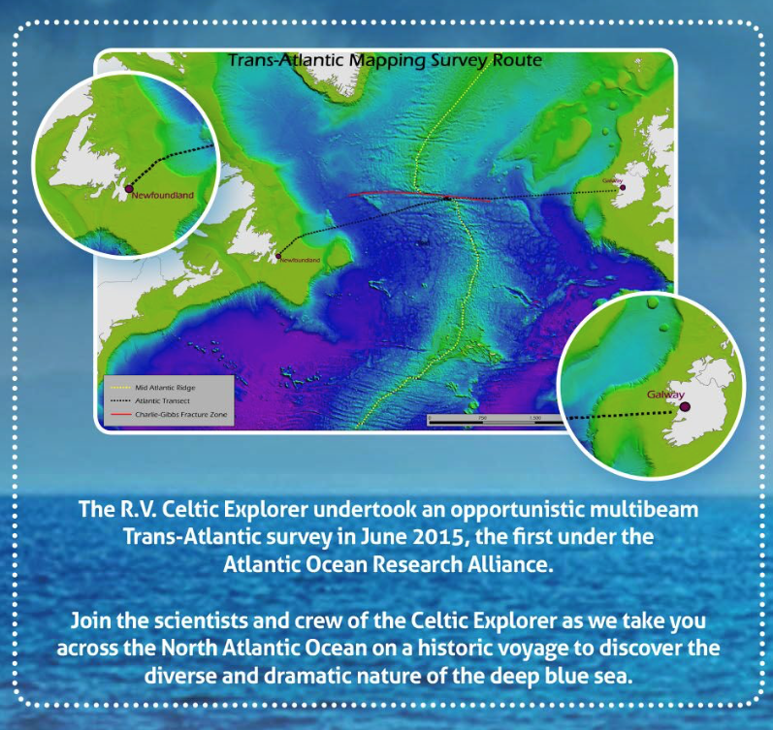
The Atlantic Transect was a mapping expedition that examined the features of the seabed of the North Atlantic Ocean from Newfoundland, Canada to Galway Bay, Ireland.

Slide 5
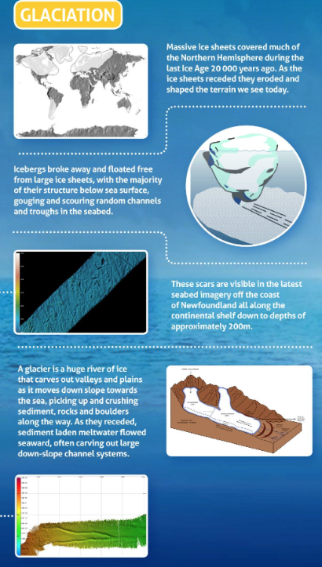
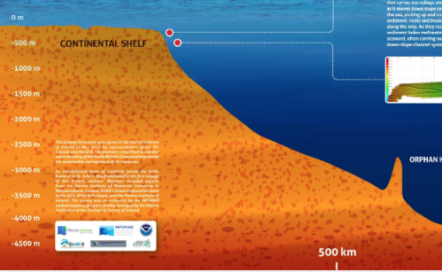
Firstly they examined the seabed as far as Orphan Knoll and found the following effects of glaciation on the Canadian continental shelf:

Slide 6
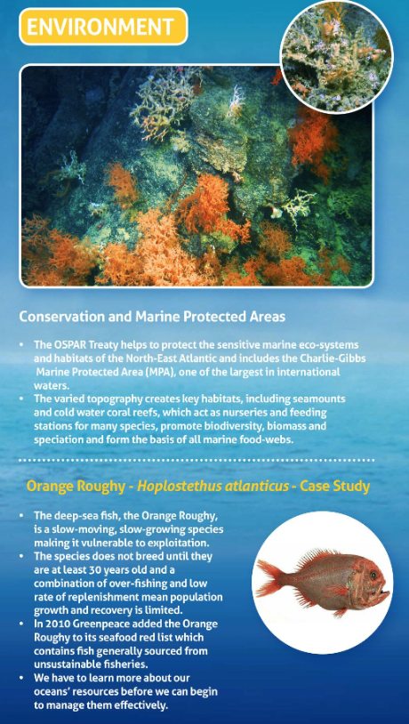
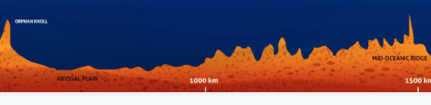
The next section examined was between Orphan Knoll across the Abyssal Plain to the Mid-Oceanic Ridge or Mid-Atlantic Ridge. Here many key habitats were found. The survey collected valuable information about the regions biological diversity.

Slide 7
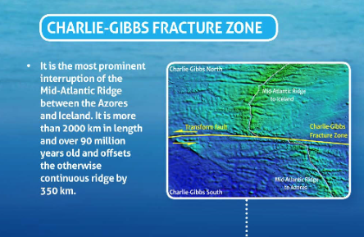
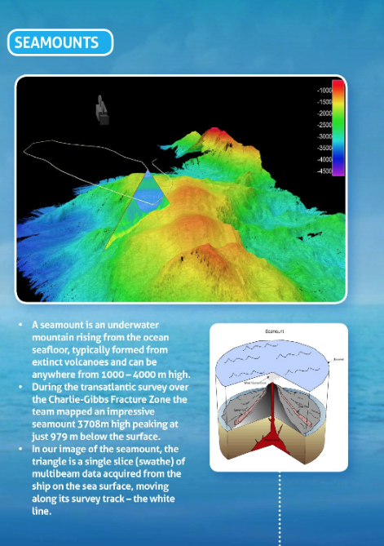
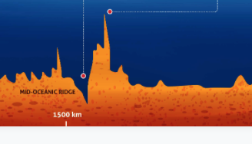
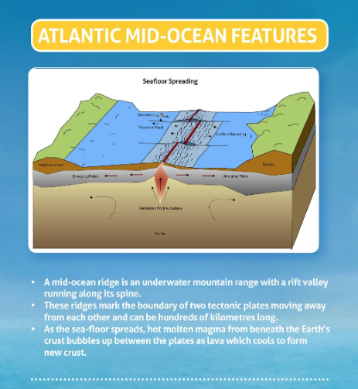
The Mid-Atlantic Ridge
This is a mid-oceanic ridge that is found almost halfway between the two landmasses. It is a physical features of a constructive plate boundary, where two oceanic plates are pulling apart.

Slide 8
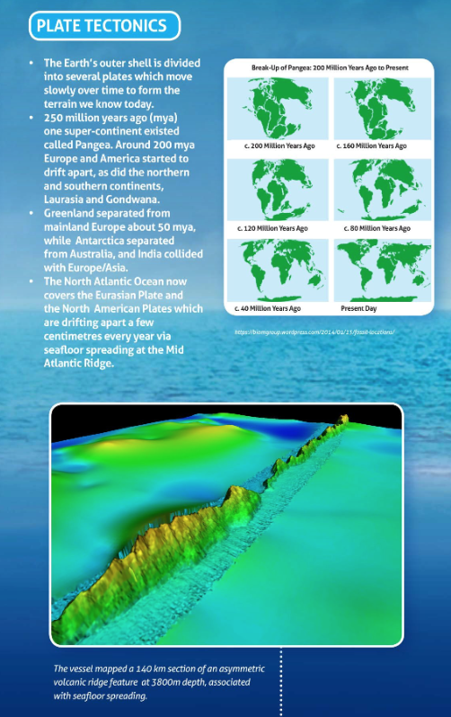
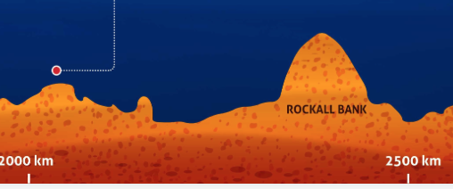
The next section of the Atlantic Transect as far as Rockall Bank. Here evidence of plate tectonics was found.

Slide 9
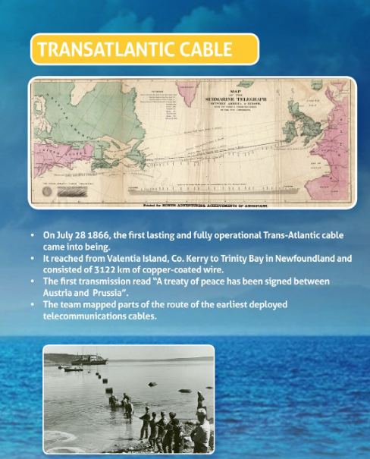
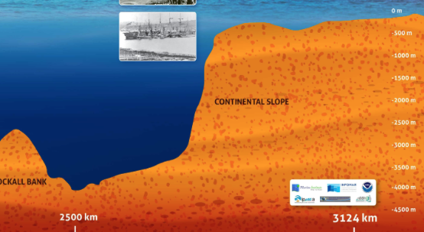
The final section of the Atlantic Transect from Rockall Bank to the Irish Continental Shelf. The social and economic impacts of the area are examined with the laying of the Trans- Atlantic Cable.

Slide 10
Here students can interact with an INFOMAR Story Map of the Atlantic Transect. They can click into each numbered point on the map of the transect. At the bottom of the screen if they click the information that pops up they can find out more facts about the journey, watch video clips and animations about the exploration and its discoveries.
http://www.infomar.ie/StoryMaps/Atlantic/index.html

