Slide 1
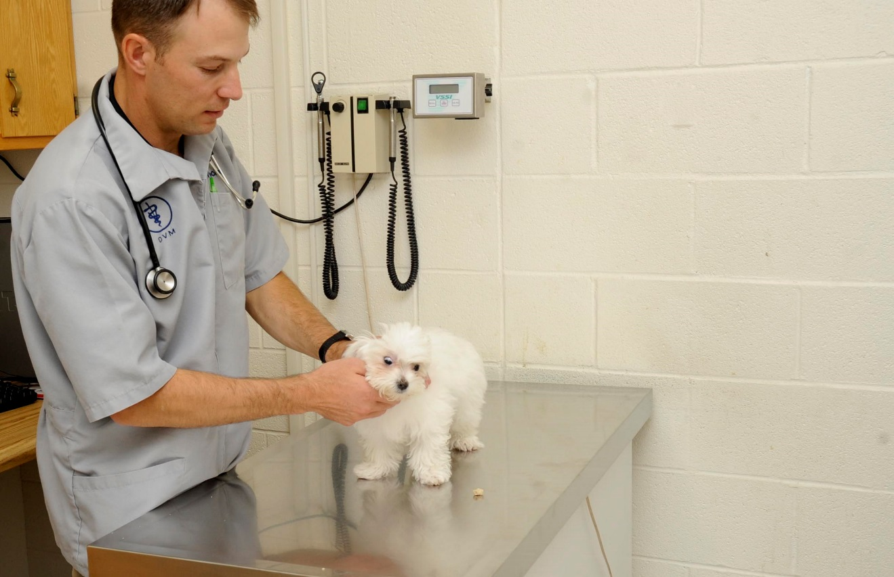

4.6 identify places and events associated specifically with dogs
Can you guess where this is?
It is a vets surgery.
Designed & created by Melanie McInerney for

Slide 2
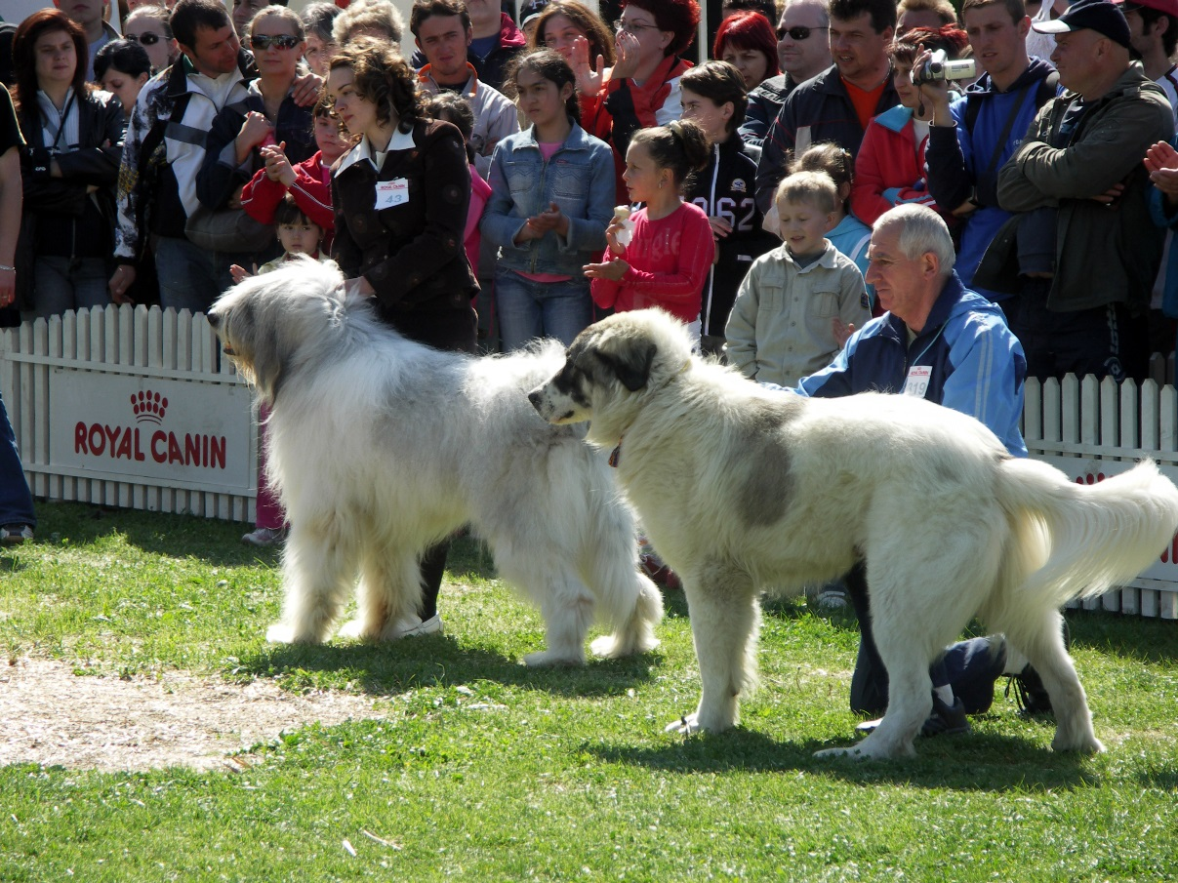
4.6 identify places and events associated specifically with dogs
It is a dog show
Can you guess where this is?
https://upload.wikimedia.org/wikipedia/commons/0/0c/Dog_Shows_2007.jpg
Designed & created by Melanie McInerney for

Slide 3
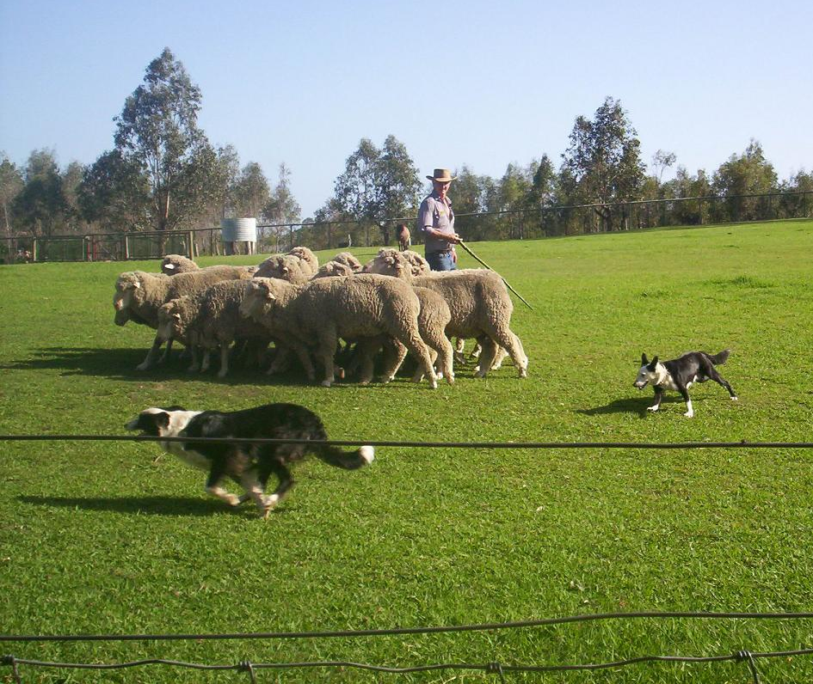
4.6 identify places and events associated specifically with dogs
Can you guess where this is?
It is a farm.
https://upload.wikimedia.org/wikipedia/commons/4/46/Sheep-Dog-Show.JPG
Designed & created by Melanie McInerney for

Slide 4
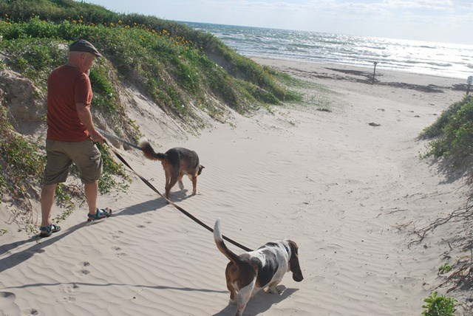
4.6 identify places and events associated specifically with dogs
Can you guess where this is?
It is a beach.
https://www.nps.gov/pais/planyourvisit/images/DSC_0067-large-web-size.jpg?maxwidth=650&autorotate=false
Designed & created by Melanie McInerney for

Slide 5
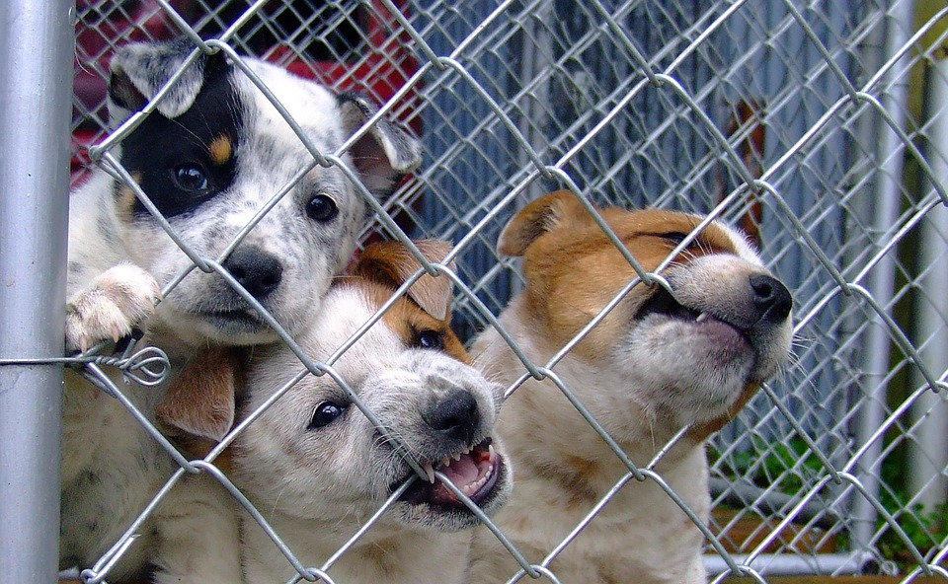
4.6 identify places and events associated specifically with dogs
Can you guess where this is?
It is a dog shelter.
https://cdn.pixabay.com/photo/2016/06/07/10/40/dog-1441396_960_720.jpg
Designed & created by Melanie McInerney for

Slide 6
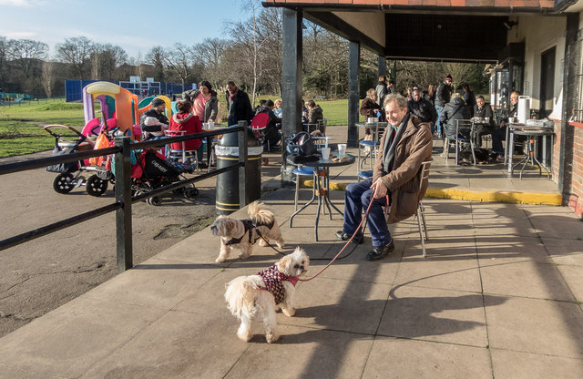
4.6 identify places and events associated specifically with dogs
Can you guess where this is?
It is a dog cafe.
https://upload.wikimedia.orghttp://s0.geograph.org.uk/geophotos/04/29/07/4290754_c9d62d76.jpg/wikipedia/commons/0/0c/Dog_Shows_2007.jpg
Designed & created by Melanie McInerney for

