Slide 1
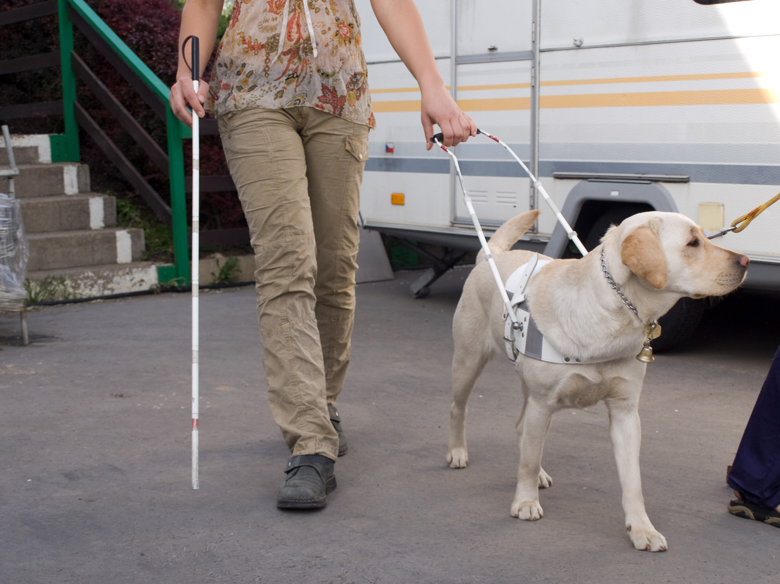

4.8 name the ways that dogs can help us in the community
It is helping her to not bump into things.
How is the Dog helping the lady?
https://upload.wikimedia.org/wikipedia/commons/0/0c/Dog_Shows_2007.jpg
Designed & created by Melanie McInerney for

Slide 2
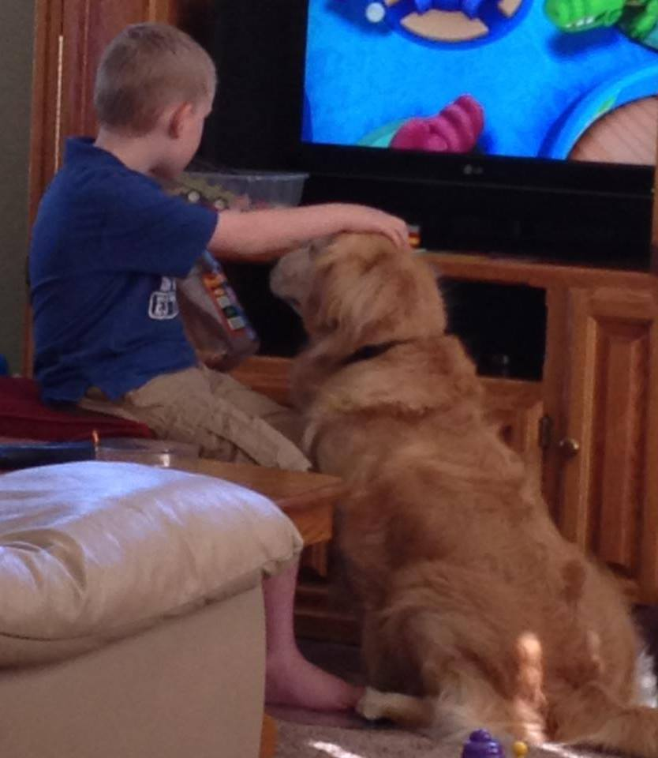
4.8 name the ways that dogs can help us in the community
How is the Dog helping the boy?
It is being a friend to a boy with special needs.
https://upload.wikimedia.org/wikipedia/commons/0/0c/Dog_Shows_2007.jpg
Designed & created by Melanie McInerney for

Slide 3
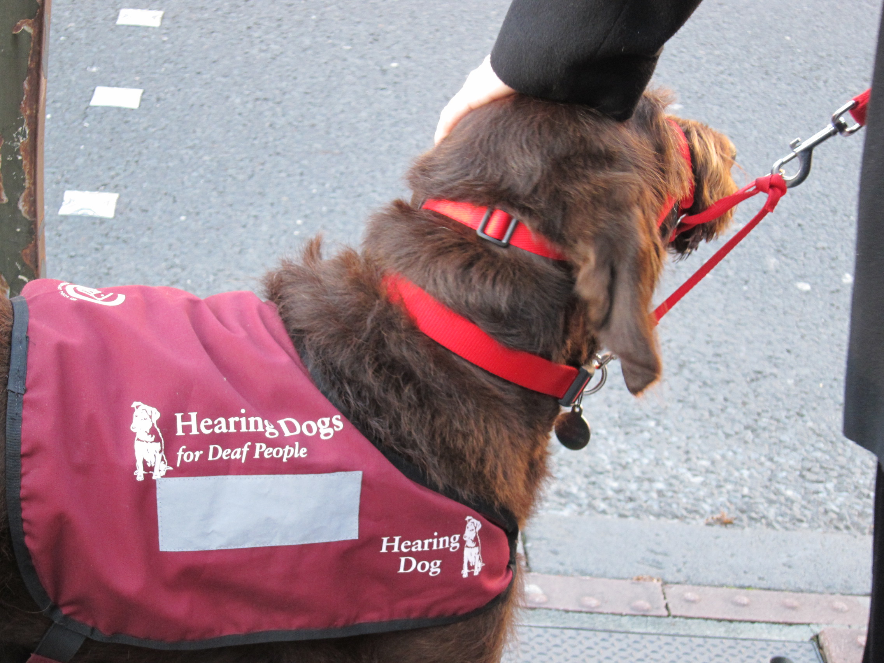
4.8 name the ways that dogs can help us in the community
It is helping someone who is deaf to stay safe crossing the road.
How is the Dog helping the man?
https://upload.wikimedia.org/wikipedia/commons/0/0c/Dog_Shows_2007.jpg
Designed & created by Melanie McInerney for

Slide 4
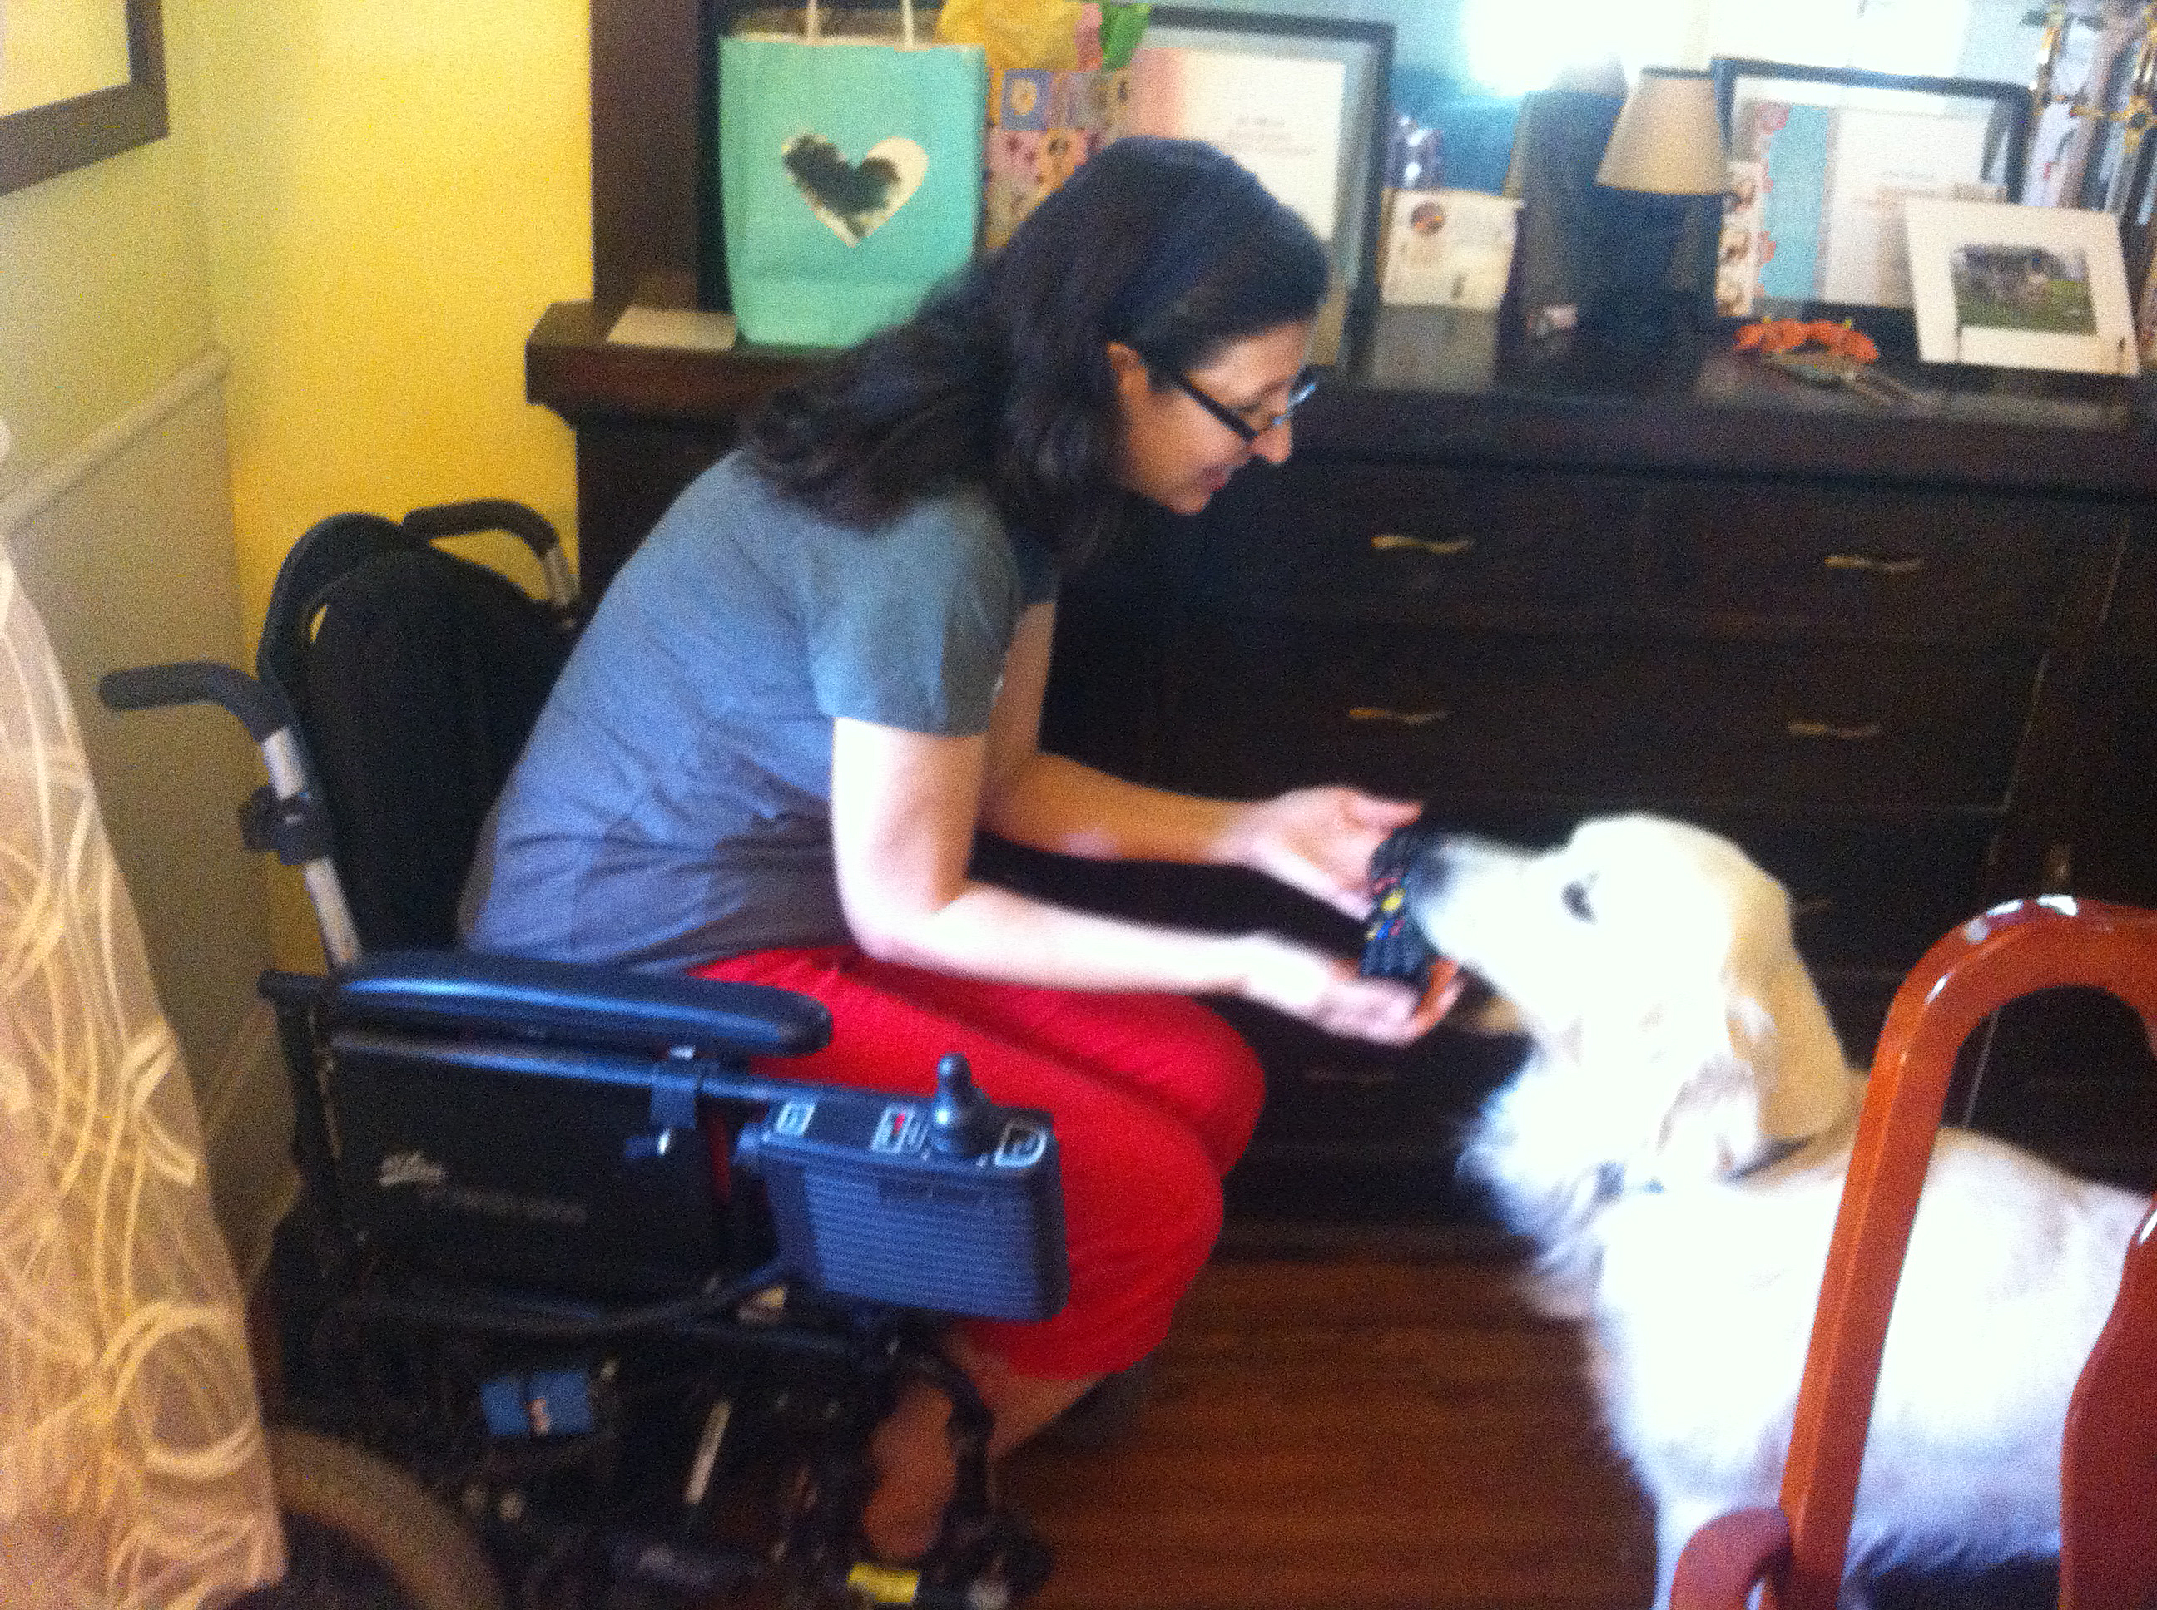
4.8 name the ways that dogs can help us in the community
It is helping by fetching things for her.
How is the Dog helping the lady?
https://upload.wikimedia.org/wikipedia/commons/0/0c/Dog_Shows_2007.jpg
Designed & created by Melanie McInerney for

Slide 5
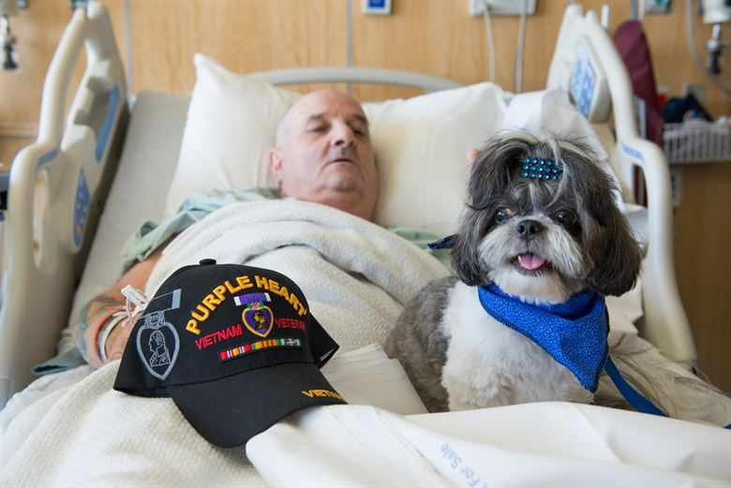
4.8 name the ways that dogs can help us in the community
It is helping by being friendly and making him happy.
How is the Dog helping the old man?
https://upload.wikimedia.org/wikipedia/commons/0/0c/Dog_Shows_2007.jpg
Designed & created by Melanie McInerney for

