Slide 1

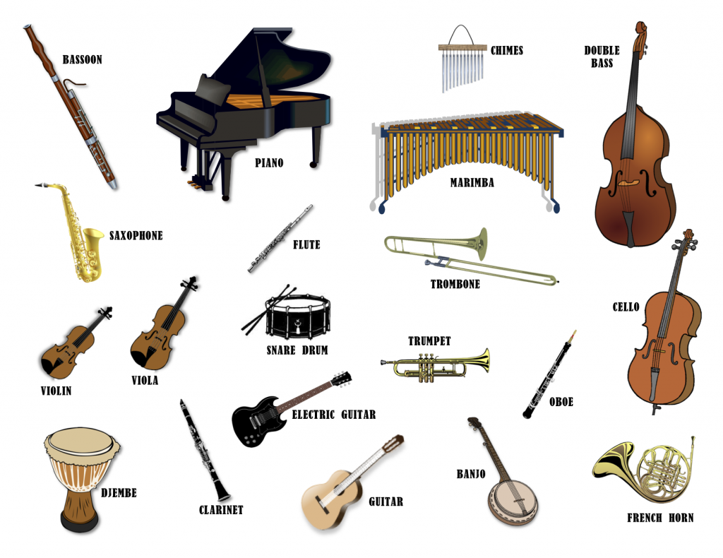
Musical Instruments
This Photo by Unknown Author is licensed under CC BY-NC-SA

Slide 2
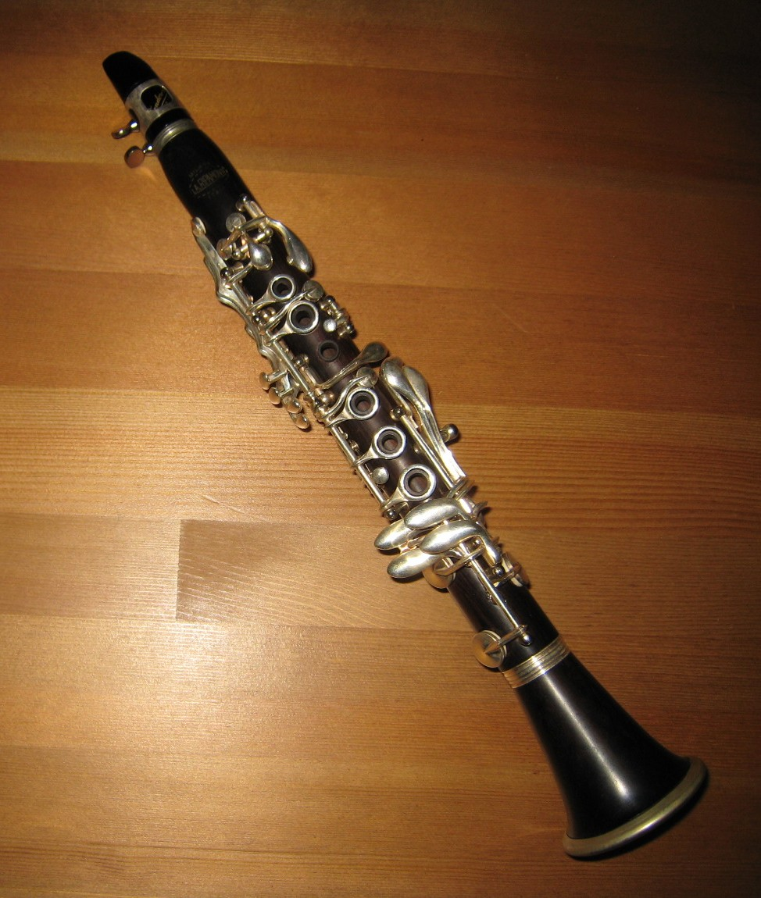
What is this instrument?
French Horn
Cello
Violin
Harp
Oboe
Trumpet
Clarinet
Trombone
Flute
Bassoon
Tuba
This Photo by Unknown Author is licensed under CC BY-SA

Slide 3
Correct !
Next

Slide 4
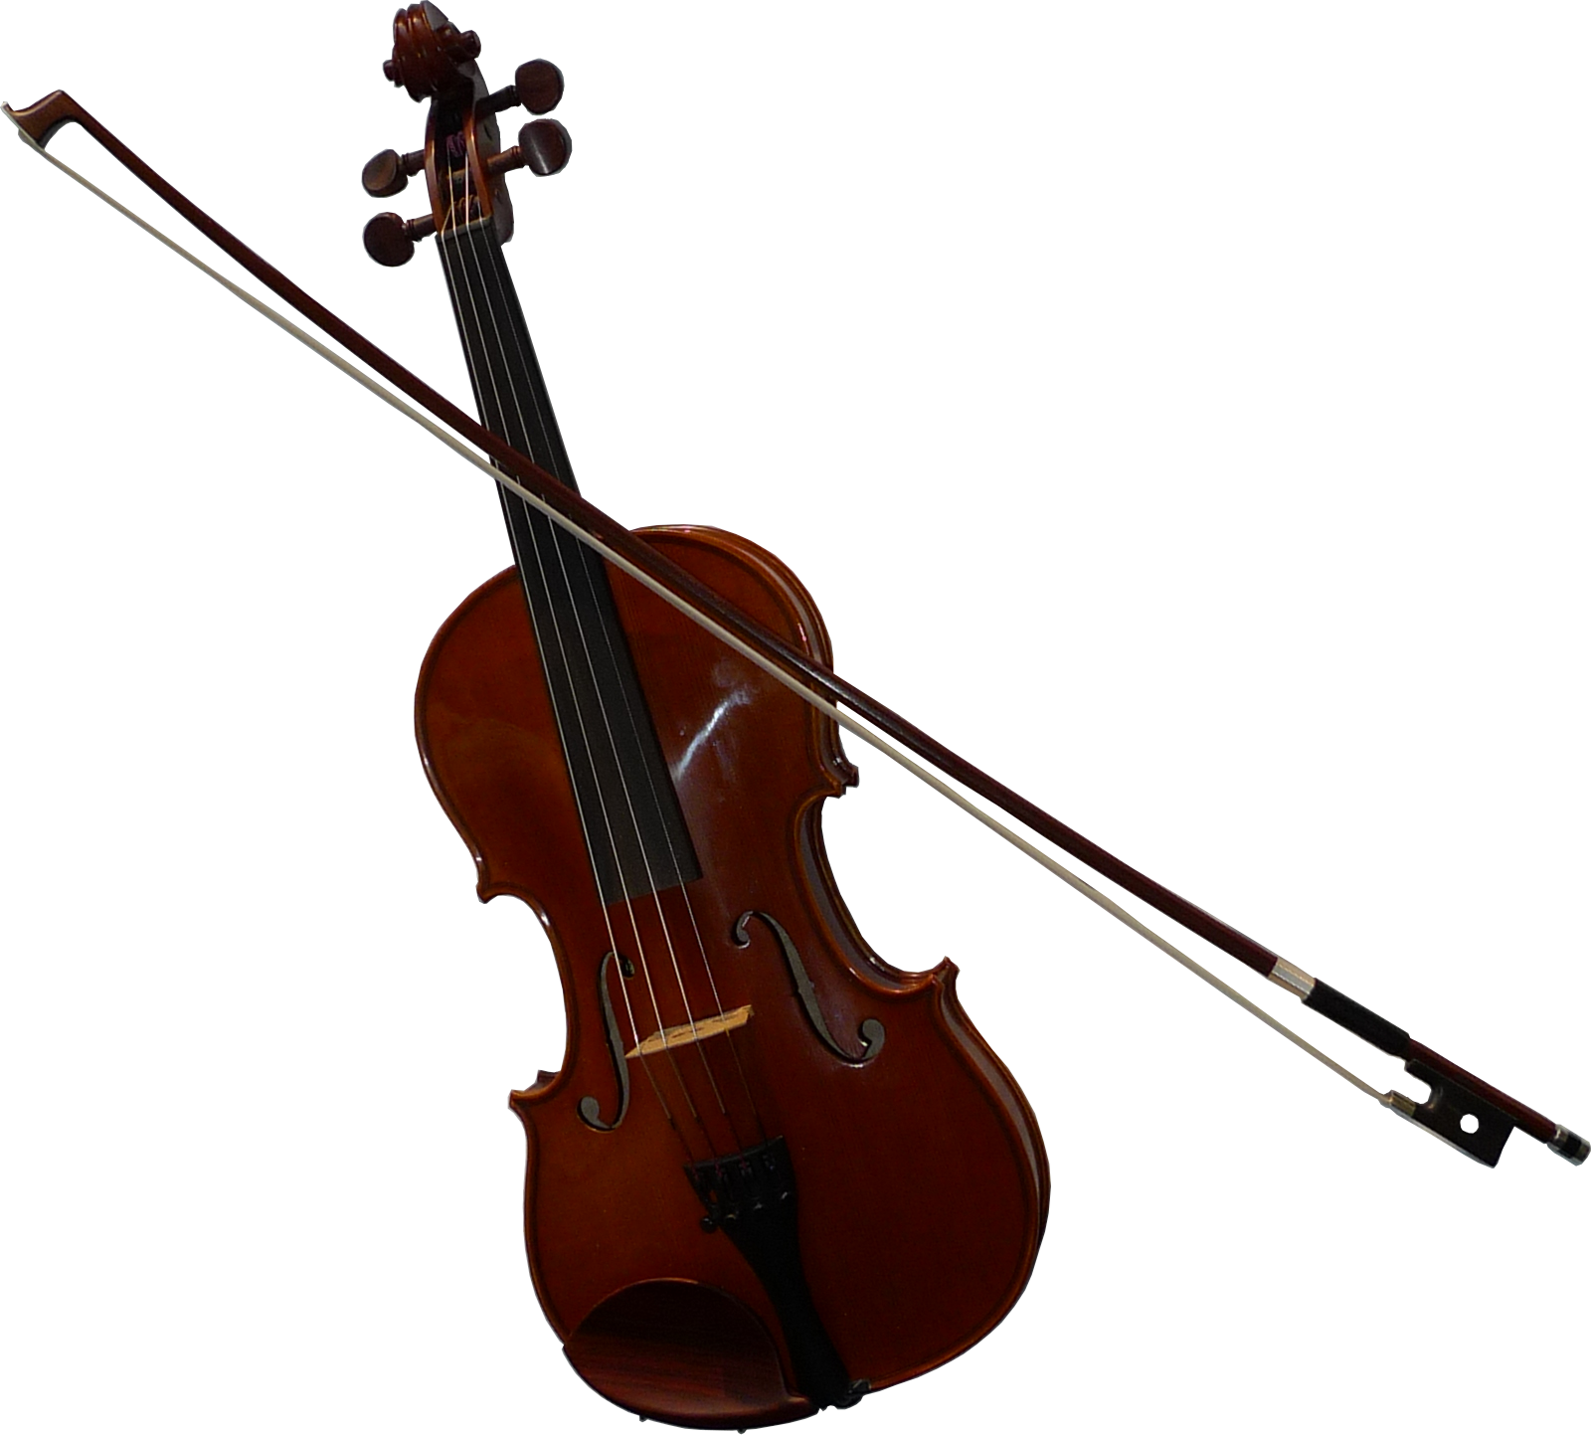
What is this instrument?
Flute
French Horn
Trumpet
Trombone
Harp
Tuba
Bassoon
Violin
Clarinet
Oboe
Cello
This Photo by Unknown Author is licensed under CC BY-SA

Slide 5
Correct !
Next

Slide 6
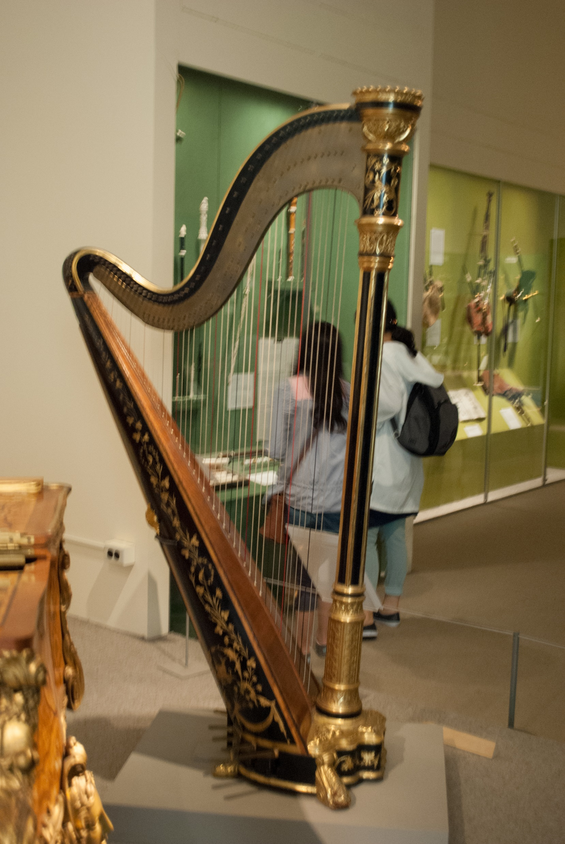
What is this instrument?
Tuba
French Horn
Trumpet
Harp
Trombone
Flute
Cello
Oboe
Clarinet
Violin
This Photo by Unknown Author is licensed under CC BY-SA
Bassoon

Slide 7
Correct !
Next

Slide 8
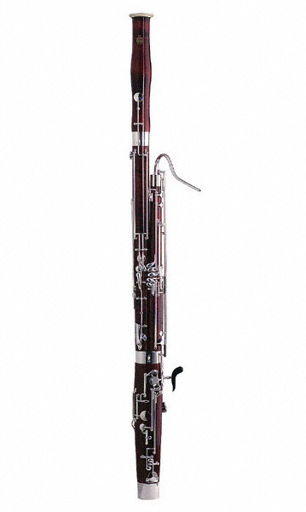
What is this instrument?
Oboe
Cello
Trumpet
Tuba
Trombone
Flute
Harp
French Horn
Clarinet
Bassoon
This Photo by Unknown Author is licensed under CC BY-SA
Violin

Slide 9
Correct !
Next

Slide 10
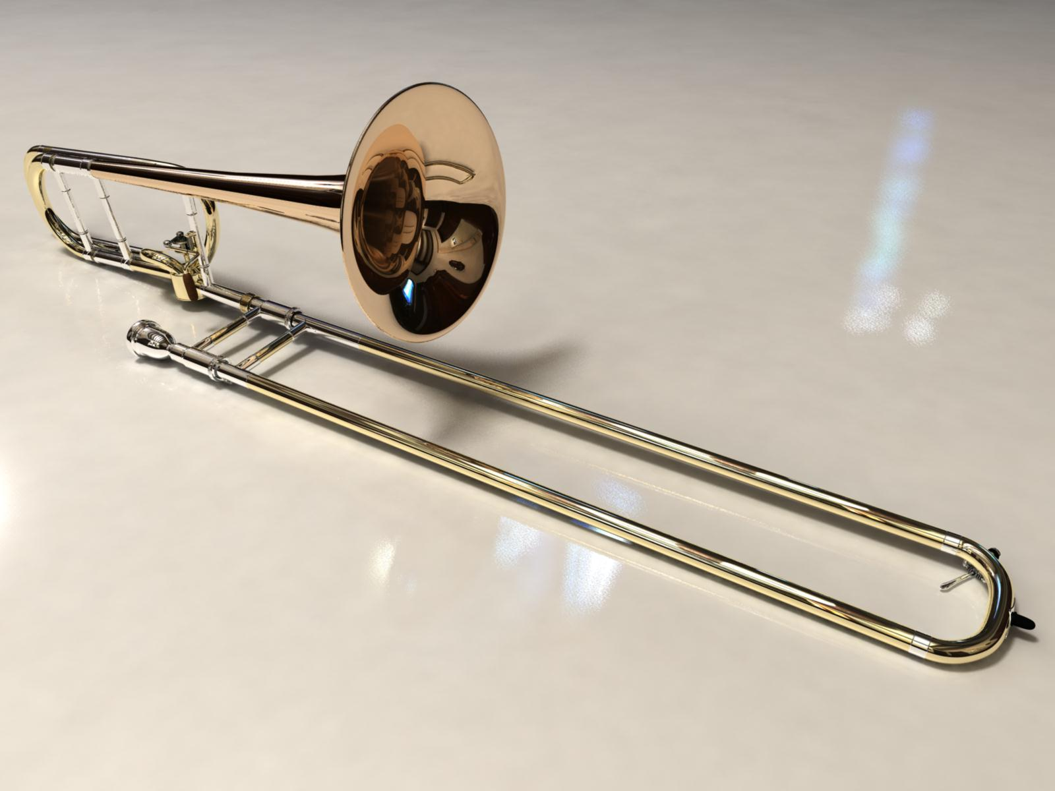
What is this instrument?
Tuba
Trumpet
Trombone
Oboe
Harp
Cello
Clarinet
Bassoon
Violin
French Horn
This Photo by Unknown Author is licensed under CC BY-SA

Slide 11
Correct !
Next

Slide 12
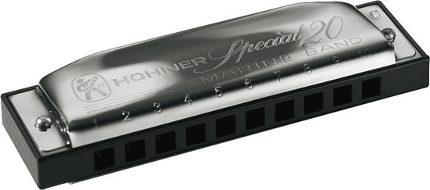
What is this instrument?
Flute
Balalaika
Bagpipe
Harmonica
Cor Anglais
Jew’s Harp
Harpsichord
Ukelele
Cello
This Photo by Unknown Author is licensed under CC BY-SA

Slide 13
Correct !
Next

Slide 14
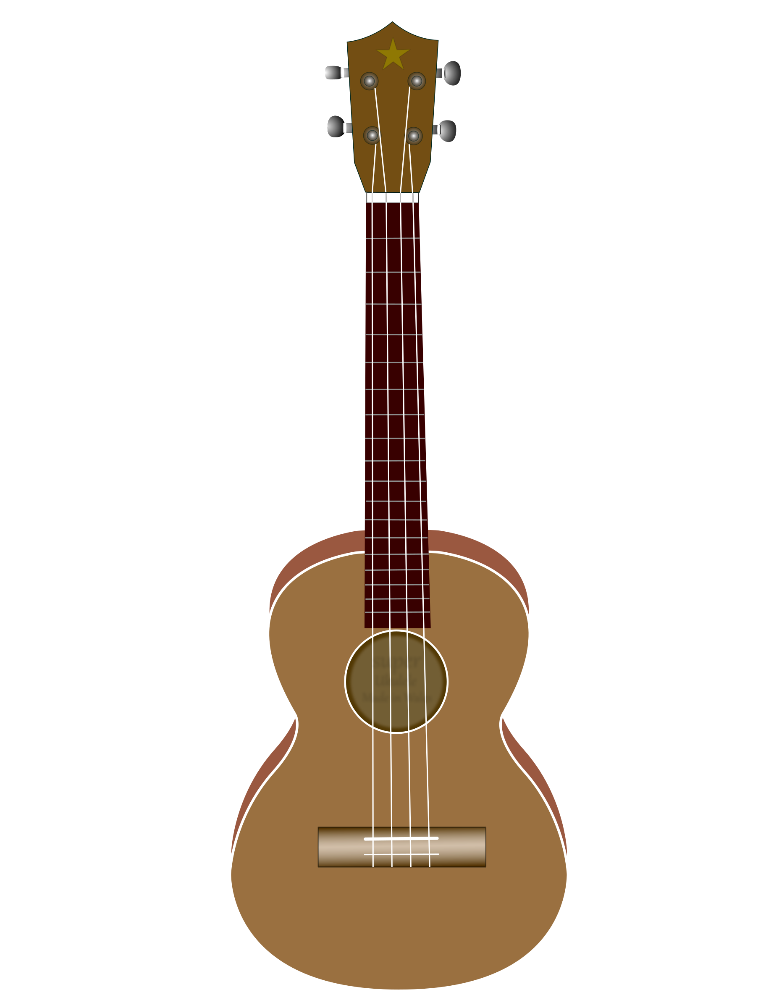
What is this instrument?
Flute
Jew’s Harp
Balalaika
Bagpipe
Harmonica
French Horn
Ukelele
Harpsichord
Banjo
Cello
Cor Anglais

Slide 15
Correct !
Next

Slide 16
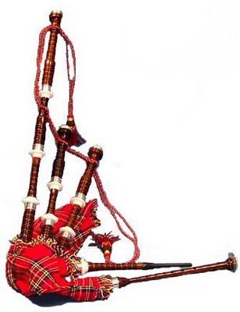
What is this instrument?
Bagpipe
Cor Anglais
Balalaika
Harpsichord
Harmonica
Cello
Ukelele
Jew’s Harp
Banjo
French Horn
This Photo by Unknown Author is licensed under CC BY-ND

Slide 17
Correct !
Next

Slide 18
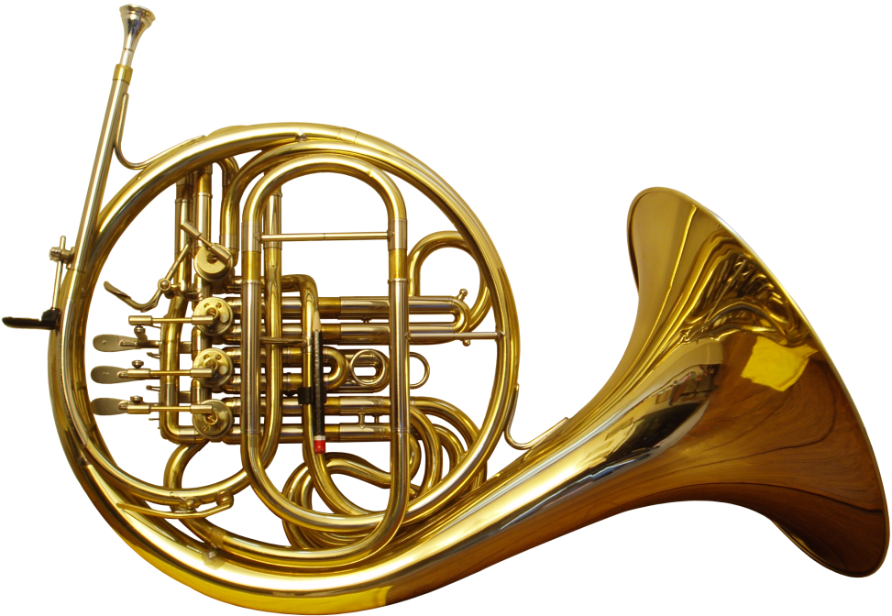
What is this instrument?
Cor Anglais
Bagpipe
Balalaika
Harpsichord
Harmonica
Cello
Ukelele
Jew’s Harp
Banjo
Flute
This Photo by Unknown Author is licensed under CC BY-SA
French Horn

Slide 19
Correct !
Next

Slide 20
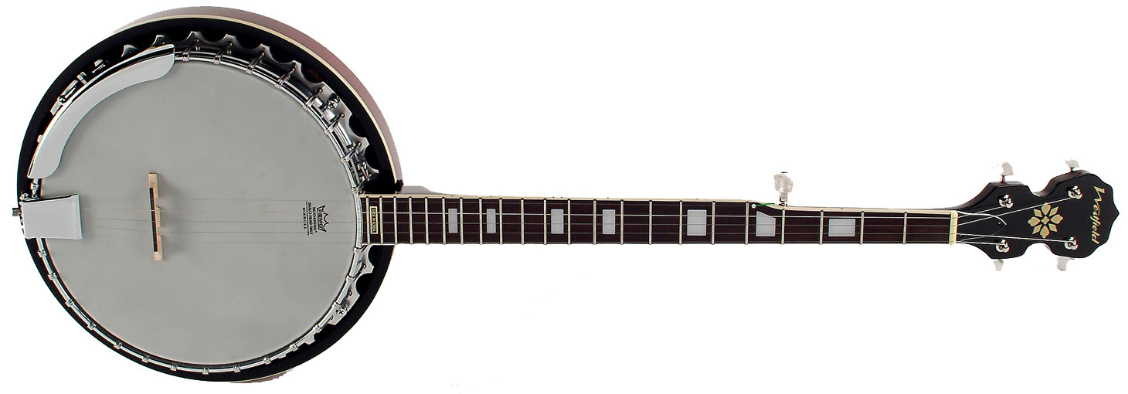
What is this instrument?
Cor Anglais
Bagpipe
Harmonica
Harpsichord
Ukelele
French Horn
Banjo
Jew’s Harp
Flute
Balalaika
Cello
This Photo by Unknown Author is licensed under CC BY-SA

Slide 21
Correct !
The End

