Slide 1


Slide 2

LC Chemistry Syllabus Links:
Content: 7.1 Tetrahedral Carbon - Alcohols
Social and Applied Aspects: Fermentation as a source of ethanol; use of fermentation in the brewing and distilling industries. Methanol as a denaturing agent. Ethanol as a solvent.
Alcohols: Structure and nomenclature up to C-4 (primary and secondary alcohols only). Physical properties.
Additional
Students should understand how chemistry relates to everyday life.
Students should have a knowledge of social, historical, environmental, technological and economic aspects of chemistry.
Students should appreciate that the understanding of chemistry contributes to the social and economic development of society.
Students should appreciate the range of vocational opportunities that use chemistry, and how chemists work.
Students should be able to translate scientific information in verbal and graphical form.

Slide 3
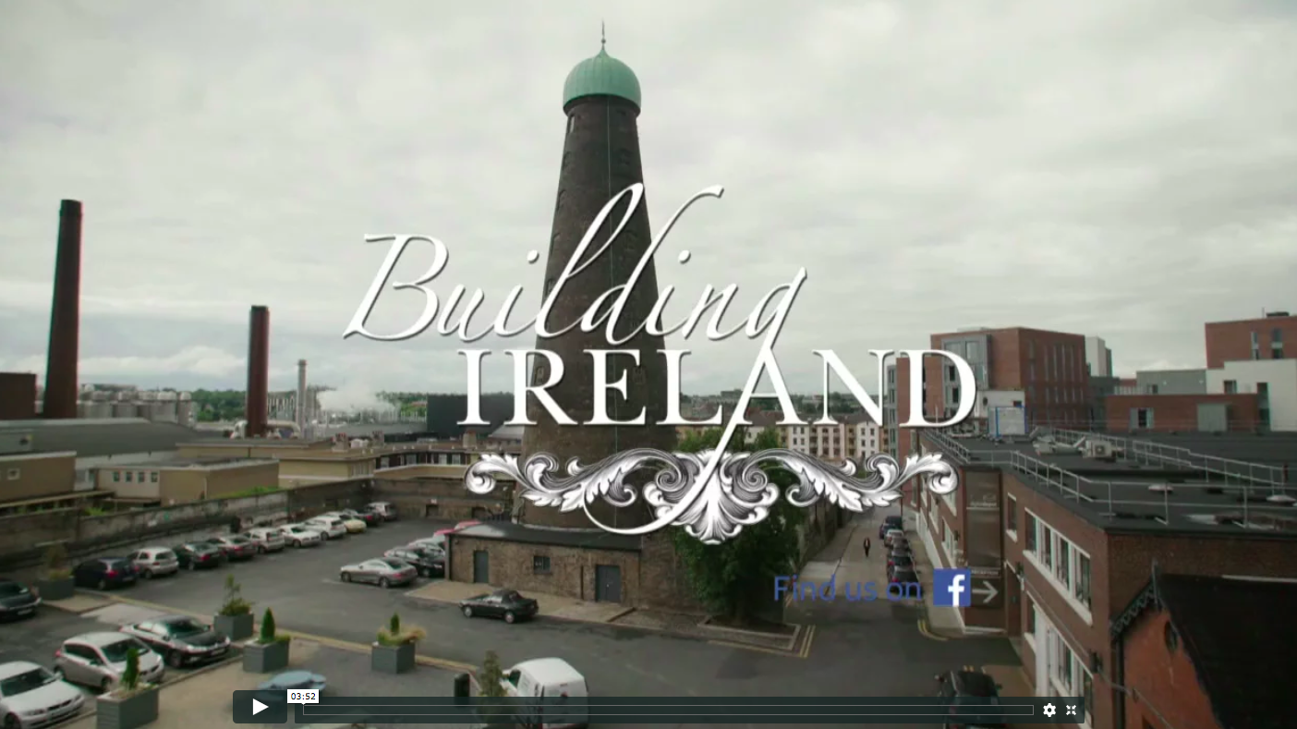
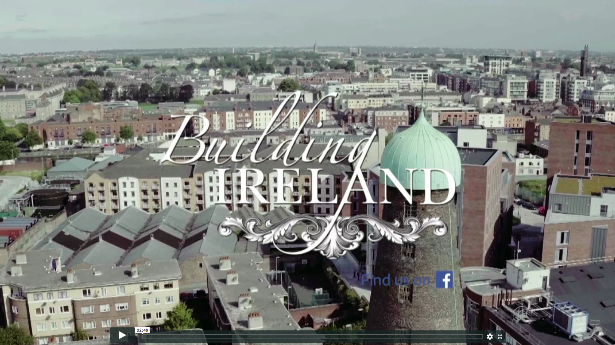
Watch the Videos:
Compare the social, environmental, technological and economic aspects involved in the distilleries of 19th century to present day.
19th Century
Roe Distillery in Thomas Street.
Present
Teelings Distillery in Newmarket.

Slide 4
Complete the Table Below in Groups:
Compare the social, environmental, technological and economic aspects involved in the distilleries of 19th century to present day.
Distillery | Social | Environmental | Technological | Economic
19th Century: Roe Distillery
Present: Teeling Distillery

Slide 5
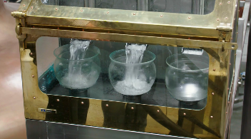
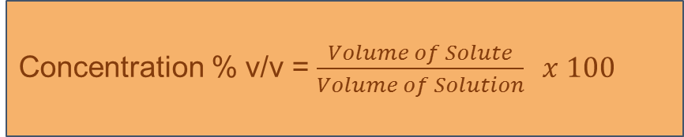
Concentration of Various Alcoholic Drinks
The concentration of a solution is the amount of solute that is dissolved in a given volume of solution.
Alcoholic drinks express the concentration of their solution using volume per volume. (% v/v). The alcohol in alcoholic drinks is called ethanol. Whiskey typically has a concentration of 40 % v/v.
A cubic centimetre is exactly the same quantity as a millilitre.
1 cm³ = 1 ml
A solution of 40 % v/v is made by measuring 40 cm³ of ethanol and adding 60 cm³ of another liquid to get a solution of 100 cm³ .
The formula for concentration is:
Alcoholic Drink | % v/v | Complete the table…
Alcopops | 4
Cider | 5
Beer | 8
Wine | 12
Spirits | 40 | 40 cm³ ethanol per 100 cm³ solution
40 cm³ ethanol per 100 cm³ solution
Concentration % v/v = $\frac{Volume of Solute}{Volume of Solution} x 100$
* % v/v are given as an approximate value. Adults who drink should always look at the label on the alcoholic drink.

Slide 6
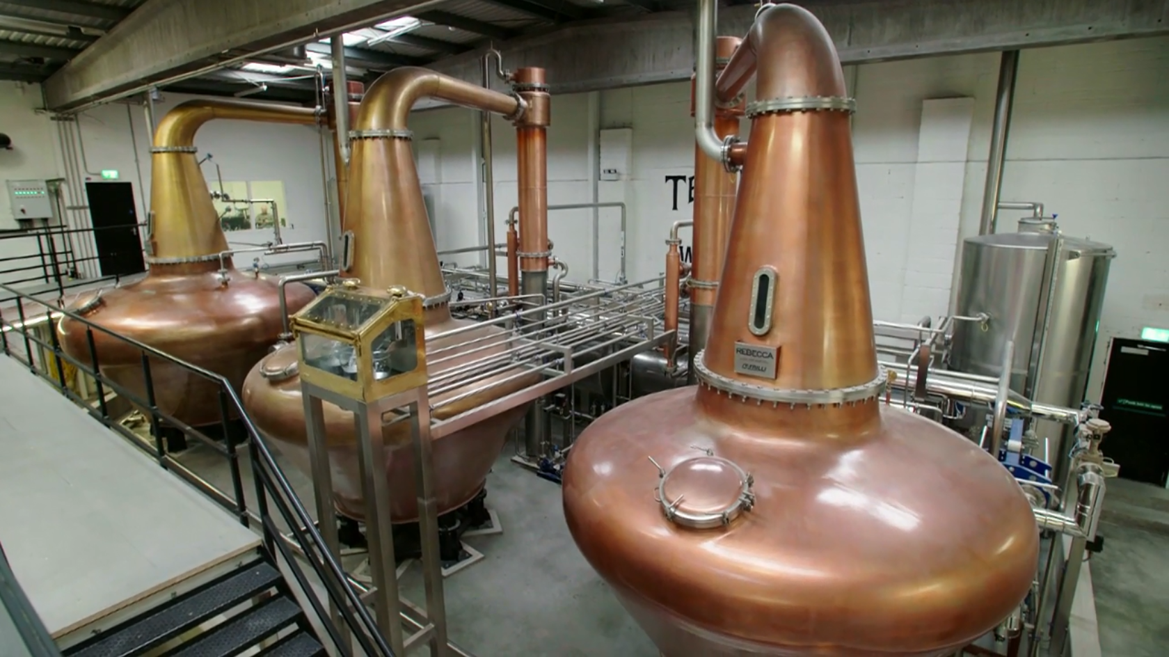

Video Two
Concentration % v/v = $\frac{Volume of Solute}{Volume of Solution} x 100$
How is Whiskey Produced?

Slide 7
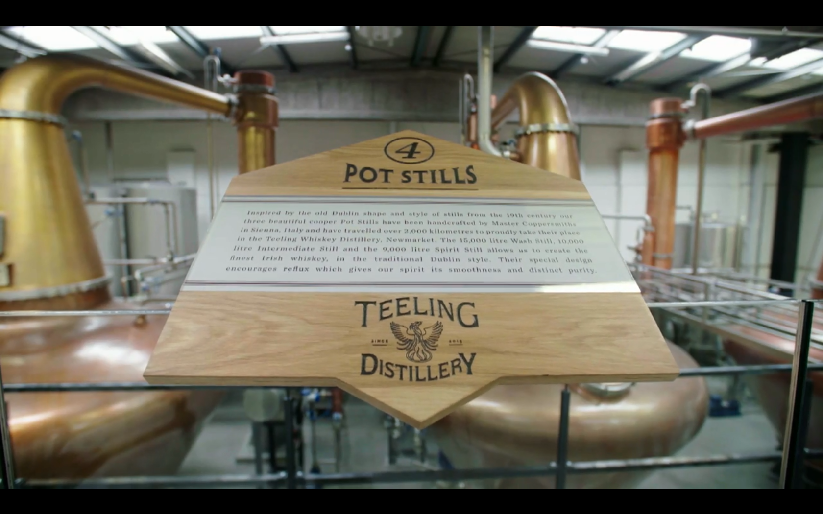
There are two processes needed to produce Whiskey.
Click on each process to learn more about it…
Fermentation
Distillation

Slide 8
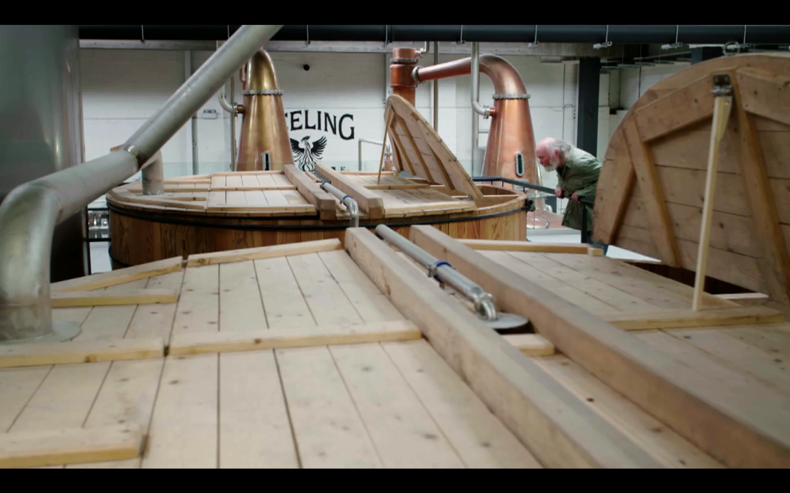
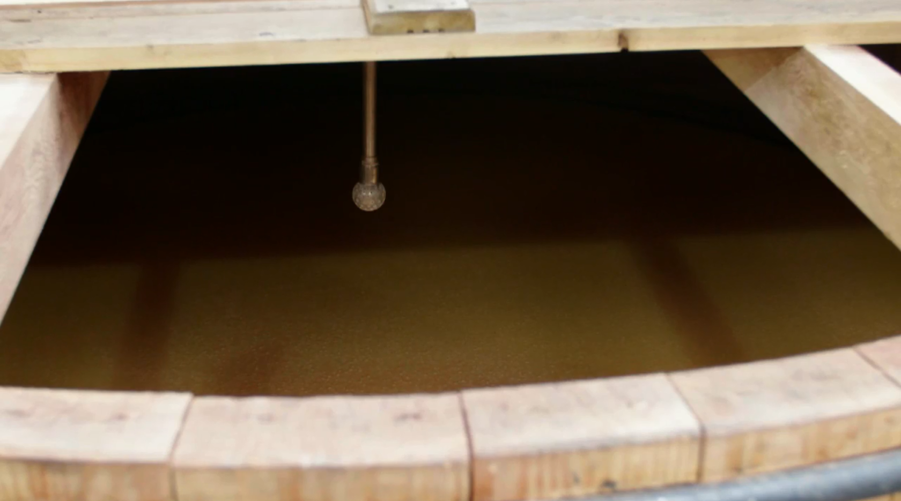

Is the chemical breakdown of organic material in the absence of oxygen. (anaerobically)
Fermentation is used in the brewing industry to manufacture beer and cider.
Fermentation is carried out by microbes such as yeast. The yeast catalyses the reaction to produce ethanol and carbon dioxide.
The word equation is:
The chemical equation is:
Beer and Cider is about 8% v/v. It is impossible to produce alcoholic drinks of 40% v/v by fermentation alone. In order to produce a concentration of 40 % v/v, the fermented liquid must be distilled.
Alcoholic Drink | Organic Material Used
Beer | Malted Grains
Wine | Grapes
Cider | Apples
Fermentation
Glucose → Ethanol + Carbon Dioxide
$$C_{6}H_{12}O_{6} → 2C_{2}H_{5}OH + 2CO_{2}$$

Slide 9
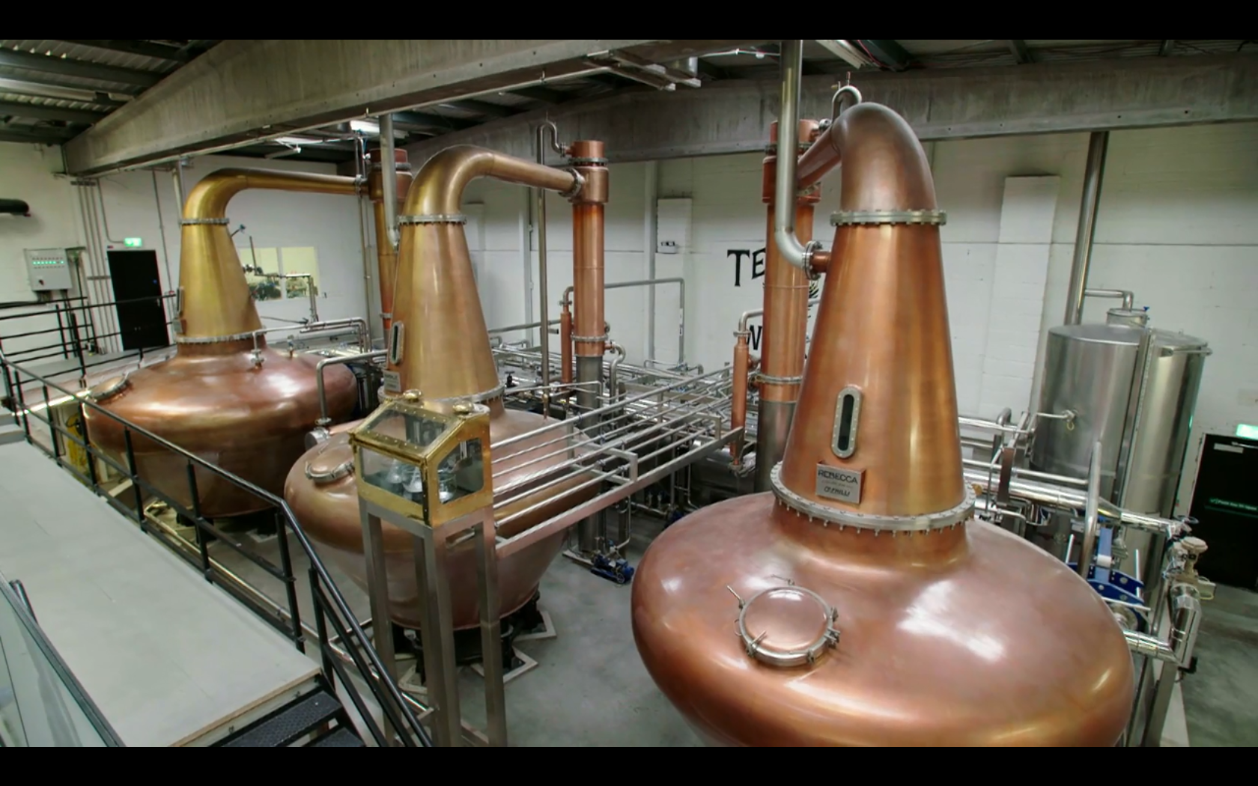
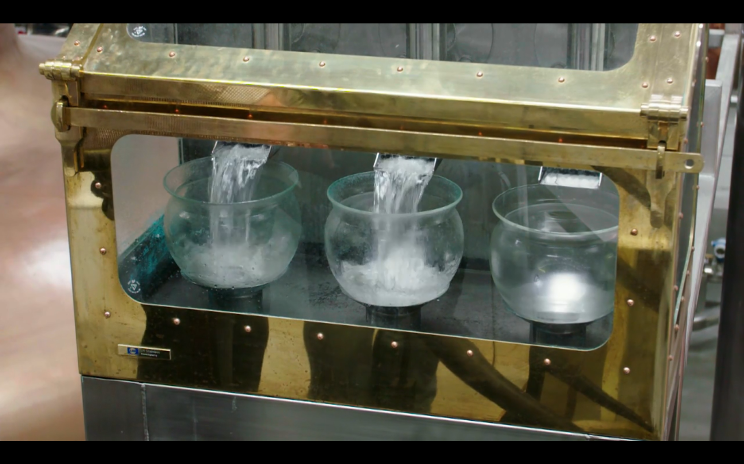
Is the process of separating two miscible liquids based on their boiling points.
Distillation is used in the distillery industry to produce alcoholic drinks of higher concentration such as spirits like whiskey.
In the distillation process, fermented liquids are distilled. Distillation begins when the fermented mixture is heated, turning the ethanol into vapours. The vapours are collected and cooled back into a liquid to produce a more concentrated liquid. The distilled liquid is called the distillate.
Distillers in the Teeling Distillery distil the fermented mixture in a pot still. A pot still distils one batch of liquid at a time.
Distillation

Slide 10
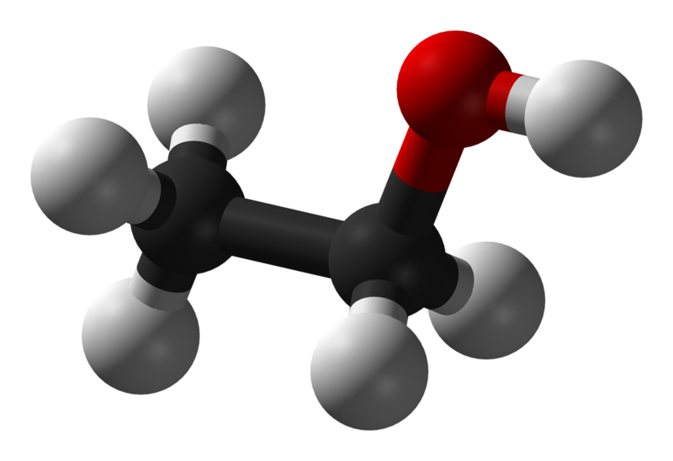
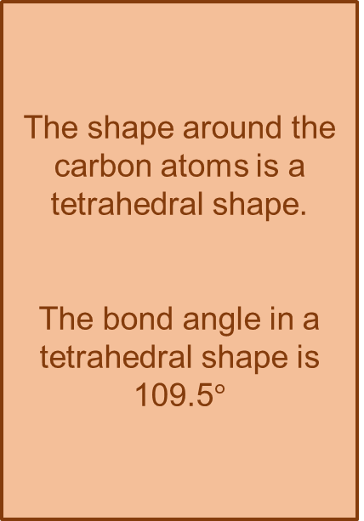
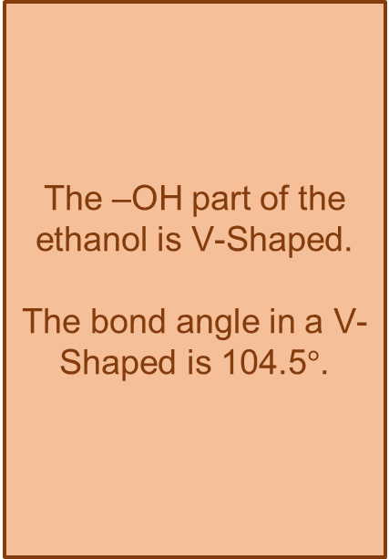
Ethanol is the alcohol in alcoholic drinks.
Let’s have a deeper look at the ethanol compound.
The shape around the carbon atoms is a tetrahedral shape.
The bond angle in a tetrahedral shape is 109.5$°$
The –OH part of the ethanol is V-Shaped.
The bond angle in a V-Shaped is 104.5$°$.
Demonstrate the shape of the ethanol compound using molecular models.
Notes:
Image sourced from: Public Domain (https://en.wikipedia.org/wiki/File:Ethanol-3D-balls.png)

Slide 11
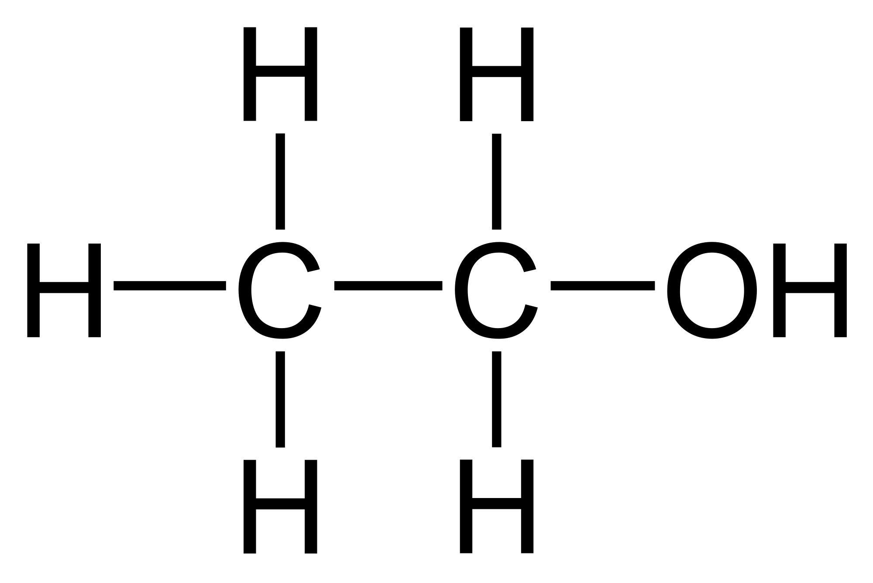
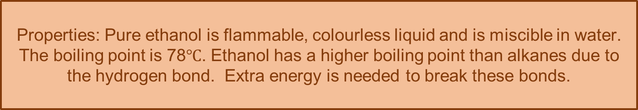
Ethanol is the alcohol in alcoholic drinks.
Explore the properties and other uses for ethanol.
Uses: Ethanol is valuable to chemical manufacturers as a solvent. For example, it is used in varnishes, perfumes and anti-freeze products. It is also used as a fuel, gasohol.
-OH (hydroxyl group) is the functional group of alcohols.
A functional group is an atom or group of atoms responsible for the common properties of certain compounds, especially organic compounds.
Properties: Pure ethanol is flammable, colourless liquid and is miscible in water. The boiling point is 78$℃$. Ethanol has a higher boiling point than alkanes due to the hydrogen bond. Extra energy is needed to break these bonds.
Notes:
Image source: Public Domain (https://commons.wikimedia.org/wiki/File:Ethanol_Lewis.svg)

Slide 12
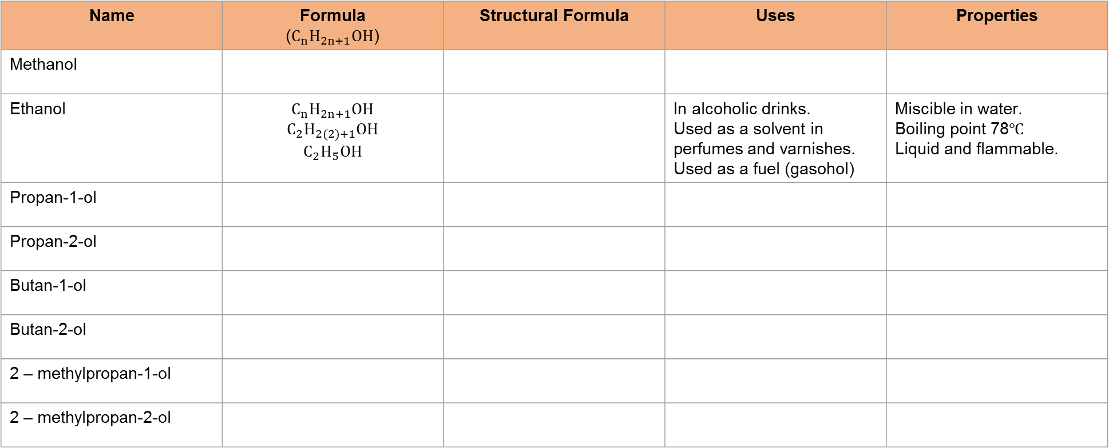
Ethanol is only one example of an alcohol.
The structure and nomenclature of alcohols up to C-4 are required.
(primary and secondary alcohols only).
Complete research on the following alcohols using the table below.
Name | Formula ($C_{n}H_{2n+1}OH$) | Structural Formula | Uses | Properties
Methanol
Ethanol | $$C_{n}H_{2n+1}OH \\ C_{2}H_{2(2)+1}OH \\ C_{2}H_{5}OH$$ |  | In alcoholic drinks. Used as a solvent in perfumes and varnishes. Used as a fuel (gasohol) | Miscible in water. Boiling point 78$℃$ Liquid and flammable.
Propan-1-ol
Propan-2-ol
Butan-1-ol
Butan-2-ol
2 – methylpropan-1-ol
2 – methylpropan-2-ol

