Slide 1


Introduction to the Co-Ordinate Plane (GT. 5)
What you will learn…
1.What is the Co-Ordinate Plane
2. Name points on a co-ordinate Plane
3. Plot Points on a Co-Ordinate Plane
4. Recognise the connection between co-ordinates and other subjects such as map reading in Geography.
Anne Gilleran

Slide 2
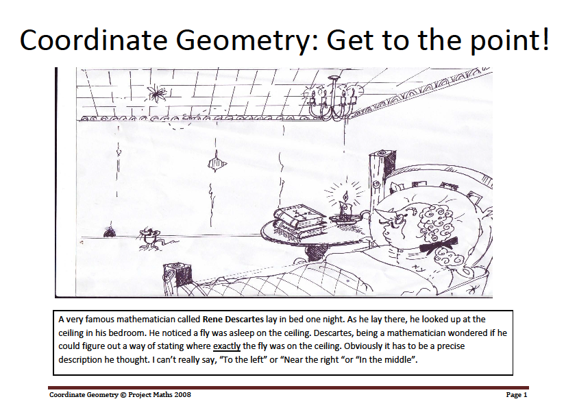
What is the Cartesian Plane
A very famous mathematician called Rene Descartes lay in bed one night. As he lay there, he looked up at the ceiling in his bedroom. He noticed a fly was asleep on the ceiling. Descartes, being a mathematician wondered if he could figure out a way of stating where exactly the fly was on the ceiling. Obviously it has to be a precise description he thought. I can’t really say, “To the left” or “Near the right “or “In the middle”.
Anne Gilleran

Slide 3
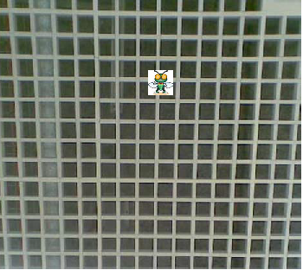
When Descartes looked up at his ceiling, this is what he saw. A fly resting there. He began to think about how he might be able to describe the exact position of the fly.
Anne Gilleran

Slide 4
Descartes decided that if he drew two lines at right angles to each other, then he might be able to come up with a way of describing the exact position of the fly.
How do you think this would have helped him?
Anne Gilleran

Slide 5
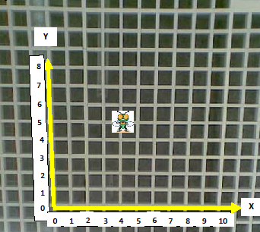
Anne Gilleran
Descartes decided to place numbers on the bottom (horizontal) row and on the side (vertical) row. He could now state accurately where exactly the fly was on the ceiling.
But there was a problem, should he give the vertical number of tiles followed by horizontal? i.e. go up 5 squares and move across 4 squares, or should he give the horizontal number first, then the vertical? i.e. go across 4 squares then move up 5?

Slide 6
He decided to put the Horizontal Number first and the Vertical Number second.
To help people remember this, he called the horizontal line X and the Vertical line Y. (X comes before Y in the Alphabet).
So, in this diagram, the position of the fly can be found by moving 4 units across, then 5 units up. These are known as X, Y values and are written like this
Position of fly = (4, 5)
X value , Y value
(First) (Second)
In honour of Rene Descartes, the graph showing the coordinates of the fly is known as the Cartesian Plane (or X Y Plane).
Anne Gilleran

Slide 7
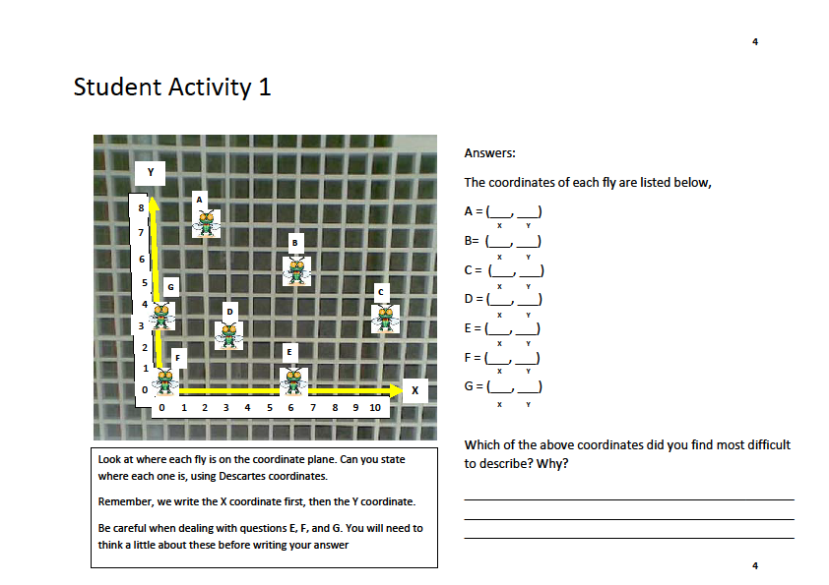

Task: Student Activity 1
State where each fly is on the co-ordinate plane using x, y co-ordianates
Anne Gilleran

Slide 8
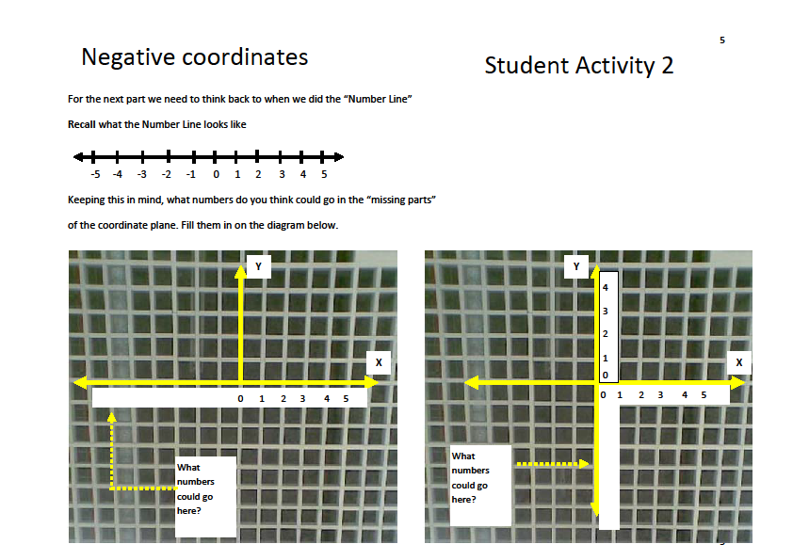
Task: Student Activity 2
What numbers do you think go in the missing parts below?
Anne Gilleran

Slide 9
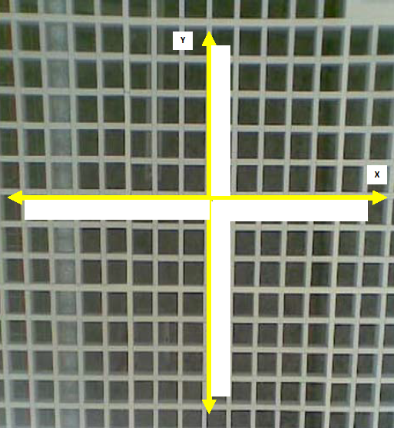
Task: Student Activity 3
Fill in the numbers which should go in on each axis
Anne Gilleran

Slide 10
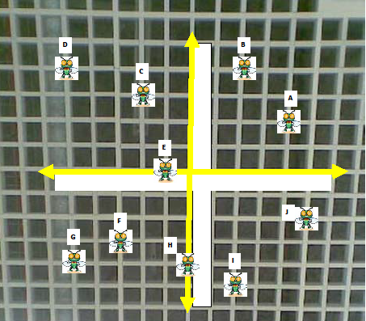
Task: Student Activity 4
Fill in the missing numbers. Then write the coordinates of each fly
A | = | ( ____ , ____ )
B | = | ( ____ , ____ )
C | = | ( ____ , ____ )
D | = | ( ____ , ____ )
E | = | ( ____ , ____ )
F | = | ( ____ , ____ )
G | = | ( ____ , ____ )
H | = | ( ____ , ____ )
I | = | ( ____ , ____ )
J | = | ( ____ , ____ )
Anne Gilleran

Slide 11
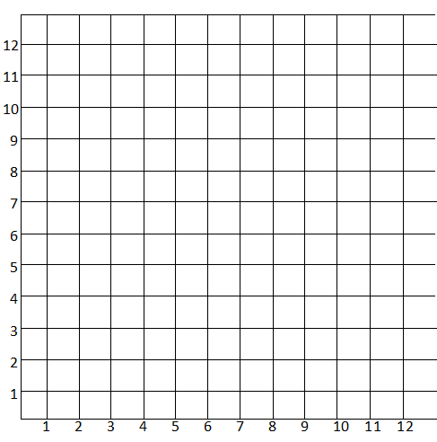
Task: Student Activity 5
Plot the following points on the x,y axis. Then draw a straight line to connect
1. | (8 , 6) | to | (4, 10)
2. | (4 , 2) | to | (8 , 2)
3. | (4 , 4) | to | (10 , 4)
4. | (2 , 4) | to | (4 , 4)
5. | (4 , 6) | to | (4 , 10)
6. | (8 , 6) | to | (4 , 6)
7. | (4 , 2) | to | (2 , 4)
8. | (8 , 2) | to | (10 , 4)
9. | (4 , 4) | to | (4 , 6)
Anne Gilleran

Slide 12
Co-Ordinate Geometry and Geography
We use a very similar way to read places on Ordnance survey maps.
Anne Gilleran

Slide 13
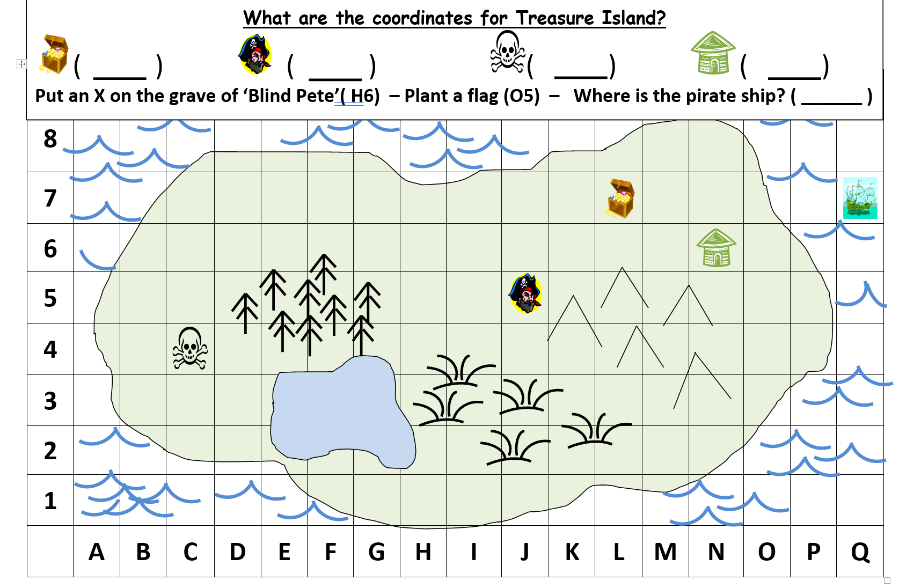
Anne Gilleran

Slide 14
Reflect on your learning:
Anne Gilleran
Confident
Need more practice
Not yet there
I can plot points on a co-ordinate diagram
I can name points on a co-ordinate plane
I know how I would use these skills in helping me in other subjects such as map reading in Geography.
Skills I have used:
Working with others
Managing Information & Thinking
Managing Myself
Staying Well
Communicating
Being Creative

