Slide 1


Title: Slope of A Line
What you will learn…
To learn what slope is
To learn what a line looks like when it is has positive, negative, zero or undefined slope
To learn how to find the slope of a graph
To learn how to find the slope when given two points
Anne Gilleran

Slide 2
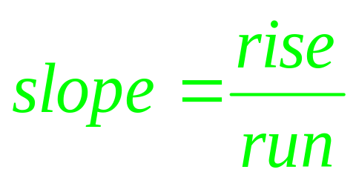
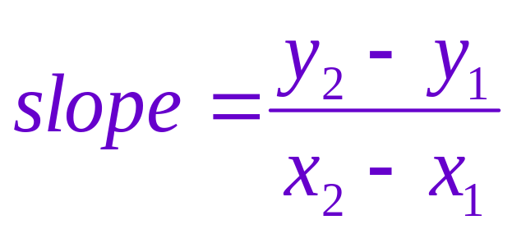
What is slope?
Slope is the rate of change of a line
Anne Gilleran

Slide 3

What does the line look like when…
You have positive slope?
You have negative slope?
You have zero slope?
0
0
You have NO slope?
Anne Gilleran

Slide 4

Negative slope,
- work
NO slope.
Oh No!!!!
Positive slope,
+ work
Zero slope is zero fun!
Slope Mountain
Anne Gilleran

Slide 5
What Type of Slope is Shown?
Positive Slope
Negative Slope
Zero Slope
No Slope/Undefined
Anne Gilleran

Slide 6

Slope of a Graph
When slope is positive or negative we need to find the actual value of the slope or rate of change
When given a graph, we can find the slope from the formula:
How far up or down it changes
How far left or right it changes
Anne Gilleran

Slide 7
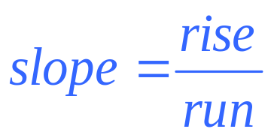
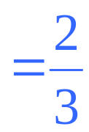
Slope of a Graph
First pick two points on the line
The points need to be where the lines cross so they are integers/whole numbers
(Tip: try to form a triangle)
2. Find the rise and run
3. Determine if the slope of the line is positive or negative
Rise = 2
Run = 3
Anne Gilleran

Slide 8
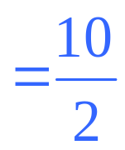

Slope of a Graph
First pick two points on the line
The points need to be where the lines cross so they are integers
2. Then find the rise and run
3. Determine if the slope of the line is positive or negative
Rise = 10
Run = 2
Anne Gilleran

Slide 9

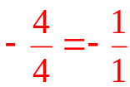

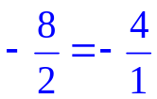


Slope of a Graphed Line
Find the slope of each line below
y
Slopes:
x
4
4
Anne Gilleran

Slide 10
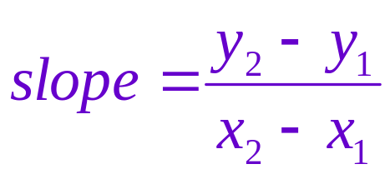
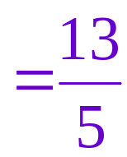
Slope of line through 2 points
To find the slope of a line through 2 given points we use the formula
For example, Find the slope of a line that goes through (-3, 5) and (2, 18)
-3
5
2
18
X₁
y₁
X₂
y₂
Anne Gilleran

Slide 11
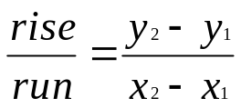
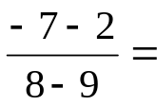


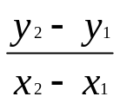

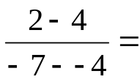
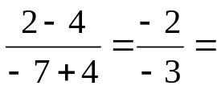
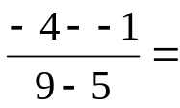
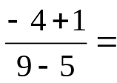

Given two points on a line, find the slope:
1. (9, 2), (8, -7)
X₁
y₁
X₂
y₂
2. (-4, 4), (-7, 2)
X₁
y₁
X₂
y₂
3. (5, -1), (9, -4)
X₁
y₁
X₂
y₂
Anne Gilleran

Slide 12
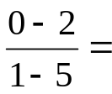


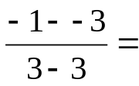
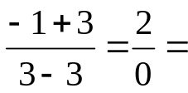
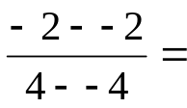
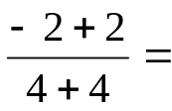
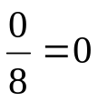
Given two points on a line, find the slope:
4. (5, 2), (1, 0)
X₁
y₁
X₂
y₂
5. (3, -3), (3, -1)
X₁
y₁
X₂
y₂
Undefined, NO slope
6. (-4, -2), (4, -2)
X₁
y₁
X₂
y₂
Anne Gilleran

Slide 13
Task: Homework
Further instructions...
Complete the worksheet – Slope Activity Worksheet 1
Anne Gilleran

Slide 14
Reflect on your learning:
Anne Gilleran
Confident
Need more practice
Not yet there
I know what slope is
I know what a positive, negative, zero and undefined slope looks like
I know how to find the slope of a graph
I know how to find the slope when given 2 points
Skills I have used:
Working with others
Managing Information & Thinking
Managing Myself
Staying Well
Communicating
Being Creative

