Slide 1

Expanding Brackets
Lesson Objective:
To expand
and simplify brackets.
2(b + 3)
Learning Outcome:
Algebra Functions 3 (AF.3 (a) (i) (ii) (iii): Multiply Expressions of the Form a (bx + c)
Anne Gilleran

Slide 2
Lesson Objectives
I will understand what expanding brackets means
I will be able to expand brackets involving an expression with addition and subtraction
I will be able to expand and simplify brackets
Anne Gilleran

Slide 3

Think – Pair - Share
Anne Gilleran
Any ideas how we get the following answer?
2(b + 3) = 2b + 6
This Photo by Unknown Author is licensed under CC BY-NC-SA

Slide 4
Expanding Brackets
To expand brackets, multiply everything inside the brackets by what is outside them
x
4(a + 6)
4a
+ 24
x
Anne Gilleran

Slide 5
Expanding Brackets
To expand brackets, multiply everything inside the brackets by what is outside them
Expand: 4(a + 6)
x | a | +6
4
4a
+24
4(a + 6) = 4a + 24
Anne Gilleran

Slide 6
Expanding Brackets
To expand brackets, multiply everything inside the brackets by what is outside them
x
2(2t + 4)
4t
+ 8
x
Anne Gilleran

Slide 7
Expanding Brackets
Team
To expand brackets, multiply everything inside the brackets by what is outside them
x
9(c + 3)
9c
+ 27
x
Anne Gilleran

Slide 8
Expanding Brackets
Pair
To expand brackets, multiply everything inside the brackets by what is outside them
x
5(a – 7)
5a
- 35
x
Anne Gilleran

Slide 9
Expanding Brackets
Solo
To expand brackets, multiply everything inside the brackets by what is outside them
x
3(p – 10)
3p
- 30
x
Anne Gilleran

Slide 10
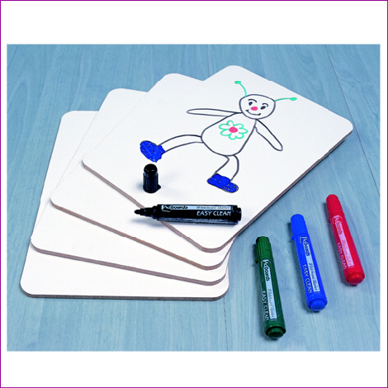
On your Mini Whiteboards
p(p - 5)
p² - 5p
2(r + 6)
2r + 12
5(n + 5)
5n + 25
8(p - 3)
8p – 24
6(n - 2)
6n - 12
3t(t + 7)
3t² + 21t
This Photo by Unknown Author is licensed under CC BY-NC-SA
Anne Gilleran

Slide 11
SPOT THE MISTAKE
Find the mistakes:
1) 3(q + 6) = 3q + 6
2) 9(p + 4) = p + 36
3) 6(y - 5) = 6y – 11
4) 8(w - 3) = w + 24
5) c(c + 4) = c² + 4 + c
Anne Gilleran
Notes:
11

Slide 12
Questions
3(y + 6)
4(y + 2)
9(y + 6)
3(y – 2)
5(y – 2)
3(y + 13)
5(y – 8)
8(y – 9)
3(3y + 5)
5(4y + 7)
8(6y – 3)
-7(y – 3)
4(3y + 2)
8(6y + 4)
-9(2y – 3)
3y(y + 5)
5y(y² – 7)
7y(2y + 3m)
Anne Gilleran

Slide 13
Answers
Red
3y + 18
4y + 8
9y + 54
3y - 6
5y - 10
3y + 39
Amber
5y - 40
8y - 72
9y + 15
20y + 35
48y - 24
-7y + 21
Green
12y + 8
48y + 32
-18y + 27
3y² + 15y
5y³ - 35y
14y² + 21ym
Anne Gilleran

Slide 14
When you have the following questions
Answered, go the corner of the room
Which matches your answer. These
Questions can also be answered on kahoot
(https://play.kahoot.it/#/?quizId=317ed28b-ac87-4058-8f5b-b35cfb8f3a70
B
C
A
FRONT
D
Anne Gilleran

Slide 15
Corners
B
C
4(y + 2)
A
FRONT
D
A) 4y + 2
B) y + 8
C) 4y + 8
D) 6y
Anne Gilleran

Slide 16
Corners
4(y – 5)
A) 4y - 5
B) 4y - 9
C) 4y + 20
D) 4y - 20
Anne Gilleran

Slide 17
Corners
7(y - 9)
A) 7y - 9
B) 7y - 63
C) 7y - 54
D) 7y - 16
Anne Gilleran

Slide 18
Corners
3(4 – y)
A) 3y - 12
B) 12 – 3y
C) 12 - y
D) 7 - y

Slide 19
Corners
3(2y + 2)
A) 6y + 6
B) 6y - 6
C) 5y + 6
D) 6y + 2
Anne Gilleran

Slide 20
Corners
6(3y – 5)
A) 6y - 30
B) 18y + 30
C) 6y + 30
D) 18y - 30
Anne Gilleran

Slide 21
Corners
4y(3y – 5m)
A) 12y - 5m
B) 12y² - 20ym
C) 12y – 20m
D) 12y² - 20m
Anne Gilleran

Slide 22

Activity
Get into groups of three.
Number each person 1-3.
This Photo by Unknown Author is licensed under CC BY-SA
Using your mini whiteboards:
Number 1 must teach the rest of the group how to do Q1
Then, Number 2 must teach the rest of the group how to do Q2
Lastly, Number 3 must teach the rest of the group how to do Q3.
Anne Gilleran

Slide 23
Question 1
3(y + 2)
Question 2
5(y - 11)
Question 3
6y(y - 8)
Anne Gilleran

Slide 24
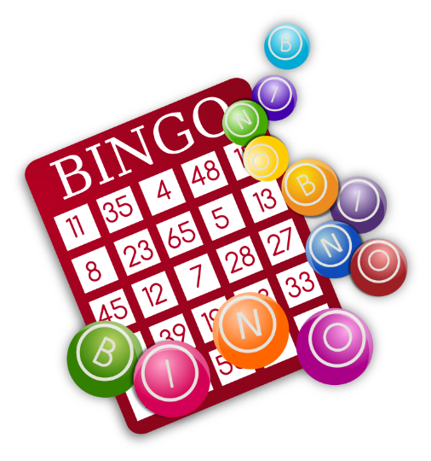
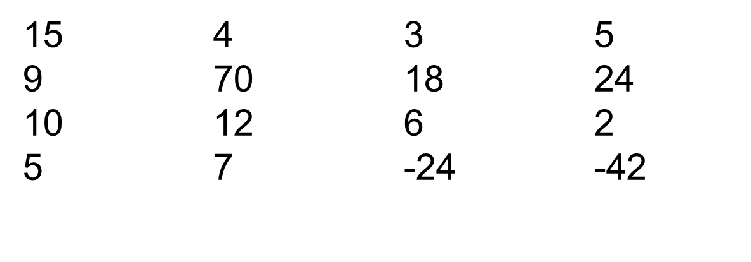
Bingo
Draw a 3 x 3 grid as shown below:
Place any 9 numbers below into the grid (no repeats)
Anne Gilleran

Slide 25
Bingo
3(n + 1) = 3n + ?
3
Anne Gilleran

Slide 26
Bingo
5(n + 2) = ?n + 10
5
Anne Gilleran

Slide 27
Bingo
10(n + 7) = 10n + ?
70
Anne Gilleran

Slide 28
Bingo
3(n + 6) = 3n + ?
18
Anne Gilleran

Slide 29
Bingo
6(-7 + n) = ? + 6n
-42
Anne Gilleran

Slide 30
Bingo
5(2n + 11) = ?n + 55
10
Anne Gilleran

Slide 31
Bingo
?(n + 2) = 6n + 12
6
Anne Gilleran

Slide 32
Bingo
?(4n + 1) = 8n + 2
2
Anne Gilleran

Slide 33
Bingo
-2(12 + n) = ? – 2n
-24
Anne Gilleran

Slide 34
Bingo
2(2n + ½) = ?n + 1
4
Anne Gilleran

Slide 35
Bingo
5n(n + 3) = 5n² + ?n
15
Anne Gilleran

Slide 36
Bingo
10(n + ½) = 10n + ?
5
Anne Gilleran

Slide 37
Bingo
7(n - 3) = ?n - 21
7
Anne Gilleran

Slide 38
Bingo
?(2n + 4) = 18n + 36
9
Anne Gilleran

Slide 39
Bingo
8(n + 3) = 8n + ?
24
Anne Gilleran

Slide 40

Reflect on your learning:
Confident
Need more practice
Not yet there
I understand what expanding brackets mean
I am able to expand brackets involving an expression with addition and subtraction
I can expand and simplify brackets
Working with others
Managing Information & Thinking
Managing Myself
Skills I have used:
Staying Well
Communicating
Being Creative
Anne Gilleran

