Slide 1



Title: Substitution in Algebra
AF2.
Lesson Objectives
.
To know what it means to substitute
To understand the rule of BIMDAS
To be able to substitute and calculate values for expressions
This Photo by Unknown Author is licensed under CC BY-SA
Anne Gilleran

Slide 2
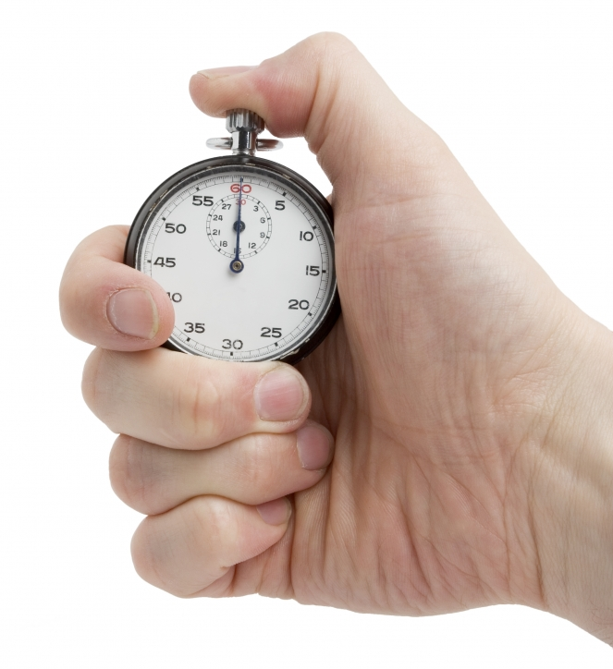
Starter Exercise
Add text here.
5 Quick Questions
1. Solve 2³ =
2. Simplify m x m =
3. Simplify t + b + t + 2b =
4. When a = 2, find the value of a + 3 =
5. Calculate the following: 2 + 3 x 3 =
8
m²
3b + 2t
5
4 minutes
11
Anne Gilleran
This Photo by Unknown Author is licensed under CC BY-SA

Slide 3
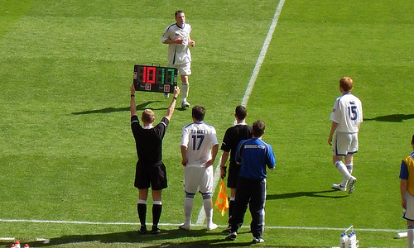
Substitution
OFF
a, b, c,
d, e, f …
ON
-2, -1, 0, 1, 2 …
This Photo by Unknown Author is licensed under CC BY
Anne Gilleran

Slide 4

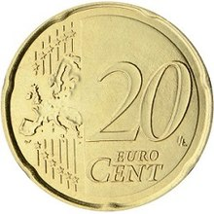
1
a
b
a = 10
b = 20
Find the value of 2a + 3b
= 2x10c + 3x20c
= 20 + 60
= 80
This Photo by Unknown Author is licensed under CC BY-SA
a
a
b
b
b
Anne Gilleran

Slide 5
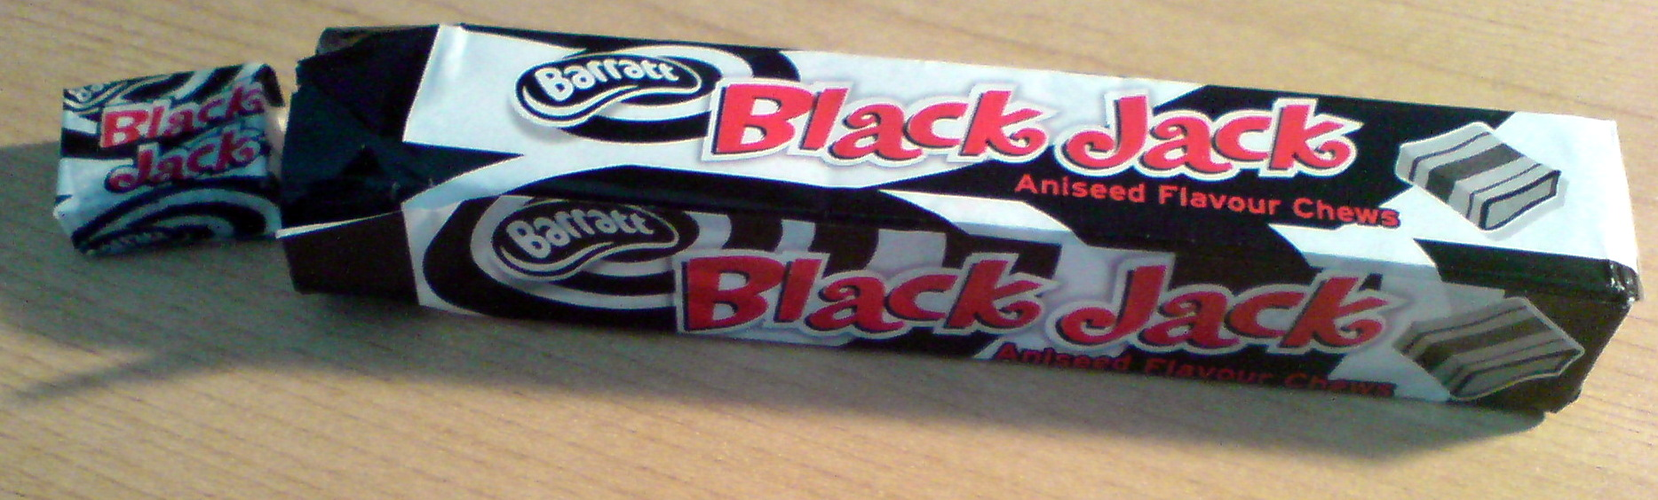
Black Jacks are 5cent each.
= 5b
Find the price if I buy 10
= 5 x10
= 50
This Photo by Unknown Author is licensed under CC BY-SA
Anne Gilleran

Slide 6

3
a = 2
Find the value of 3a²
= 3 x2²
= 3 x 4
= 12
BIMDAS
Power 1st
Multiplying 2nd
Anne Gilleran

Slide 7
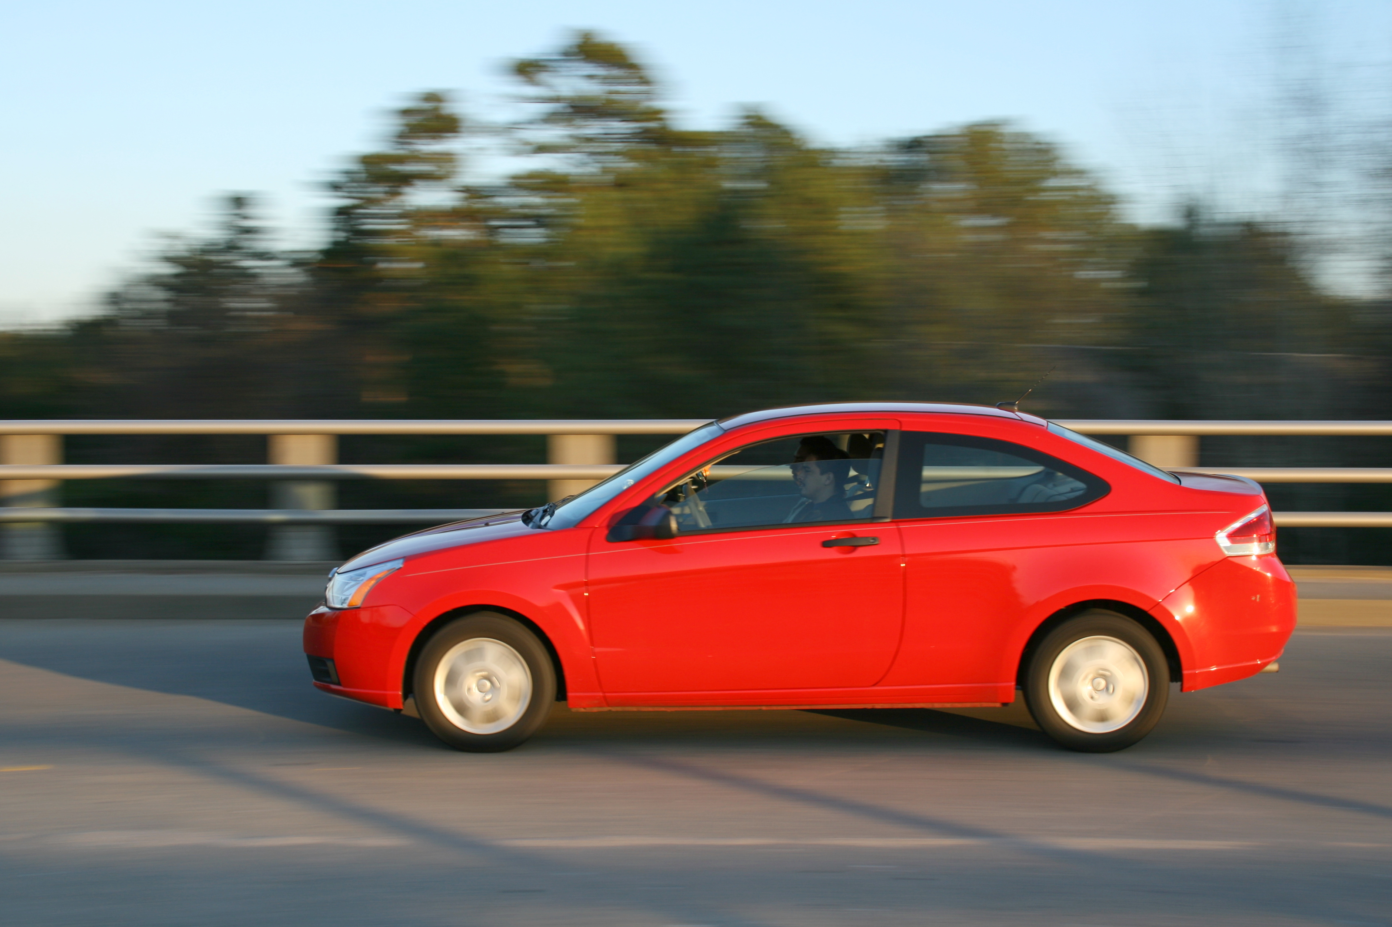
V = u + at
u = 12, a = 5, t = 10
V = 12 + 5 x 10
This Photo by Unknown Author is licensed under CC BY-SA
V = 12 + 50
V = 62
Anne Gilleran

Slide 8
Substitution
Area of Triangle:
A = ½ b x h
b = 15 cm h = 8cm
A = ½ (15 cm x 8 cm)
A = ½ (120 cm ²)
A = 60 cm ²
h cm
b cm
Anne Gilleran

Slide 9

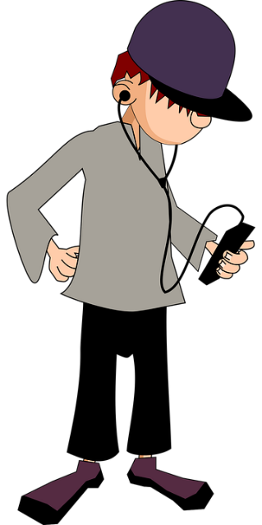
Find the Value of Y
a = 3
b = 4
c = 5
d = 10
y = 2a
Question 1.
Click for Answer
Anne Gilleran

Slide 10
Find the Value of Y
a = 3
b = 4
c = 5
d = 10
y = 3c
Question 2.
Click for Answer
Anne Gilleran

Slide 11
Find the Value of y
a = 3
b = 4
c = 5
d = 10
y = 5d
Question 3.
Click for Answer
Anne Gilleran

Slide 12
Find the Value of y
a = 3
b = 4
c = 5
d = 10
y = 3c + 2
Question 4.
Click for Answer
Anne Gilleran

Slide 13
Find the Value of y
a = 3
b = 4
c = 5
d = 10
y = 4b + 5
Question 5.
Click for Answer
Anne Gilleran

Slide 14
Find the Value of y
a = 3
b = 4
c = 5
d = 10
y = 2c + 3a
Question 6.
Click for Answer
Anne Gilleran

Slide 15
Find the Value of y
a = 3
b = 4
c = 5
d = 10
y = 3ab
Question 7.
Click for Answer
Anne Gilleran

Slide 16
Find the Value of y
a = 3
b = 4
c = 5
d = 10
y = 2bd
Question 8.
Click for Answer
Anne Gilleran

Slide 17
Find the Value of y
a = 3
b = 4
c = 5
d = 10
y = d / c
Question 9.
Click for Answer
Anne Gilleran

Slide 18
Find the Value of y
a = 3
b = 4
c = 5
d = 10
y = c / d
Question 10.
Click for Answer
Anne Gilleran

Slide 19
Question 1
Answer: y = 6
Return to Quiz
Anne Gilleran

Slide 20
Question 2
Answer: y = 15
Return to Quiz
Anne Gilleran

Slide 21
Question 3
Answer: y = 50
Return to Quiz
Anne Gilleran

Slide 22
Question 4
Answer: y = 17
Return to Quiz
Anne Gilleran

Slide 23
Question 5
Answer: y = 21
Return to Quiz
Anne Gilleran

Slide 24
Question 6
Answer: y = 19
Return to Quiz
Anne Gilleran

Slide 25
Question 7
Answer: y = 36
Return to Quiz
Anne Gilleran

Slide 26
Question 8
Answer: y = 80
Return to Quiz
Anne Gilleran

Slide 27
Question 9
Answer: y = 2
Return to Quiz
Anne Gilleran

Slide 28
Question 10
Answer: y = 0.5
Return to Quiz
Anne Gilleran

Slide 29
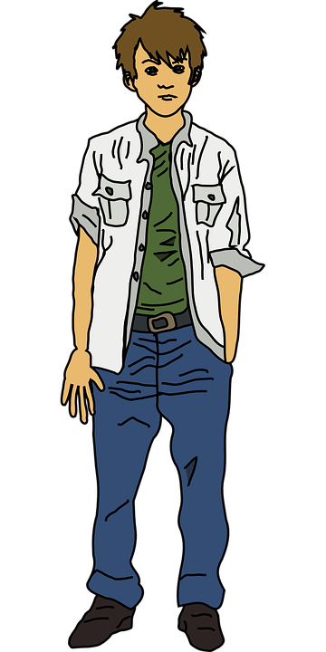

Game Time
https://www.scoilnet.ie/uploads/resources/26958/26694.pdf
Add text.
This Photo by Unknown Author is licensed under CC BY-SA
Anne Gilleran

Slide 30

Reflect on your learning:
Anne Gilleran
Confident
Need more practice
Not yet there
I know what it means to substitute in Algebra
I understand the rules of BIMDAS
I am able to substitute values into an expression and evaluate
Skills I have used:
Working with others
Managing Information & Thinking
Managing Myself
Staying Well
Communicating
Being Creative

