Slide 1
Energy Sources
Supply and Demand

Slide 2
Learning Intentions:
By the end of this lesson you will be able to:
Discuss the supply and demand trends for the future.
Conduct research on the different types of energy sources.
Debate your informed view on how current and future energy needs on Earth can be met.
Links to LO: 2.6, 1.6

Slide 3
Earth
Overshoot Day
What date does Earth Overshoot Day land on this year?
The day marks the point when humanity’s demand for resources and services in a given year exceeds what Earth can regenerate in that year.
Is Irelands biocapacity in a deficient or reserve?
Use the Global Footprint Network to check.
More Information
Suggested video

Slide 4
The History of Earth Overshoot Day:
These are the dates of past Earth Overshoot Days, as calculated with the National Footprint Accounts 2018 Edition.
Based on the data, predict an approximate date for Earth Overshoot Day in 2010, 2020 and 2030.
Year | Date
2001 | September 22
2002 | September 19
2003 | September 9
2004 | September 1
2005 | August 26
2006 | August 20
2007 | August 14
2008 | August 15
2009 | August 19
2010 | August 8
2011 | August 4
2012 | August 4
2013 | August 4
2014 | August 5
2015 | August 6
2016 | August 5
2017 | August 3
2018 | August 1
Year | Date
1970 | December 29
1980 | November 3
1990 | October 11
2000 | September 23
2010 | ?
2020 | ?
2030 | ?
We’d need the equivalent of 1.7 Earths to support our level of consumption.
More Information
Notes:
Video Link: https://www.youtube.com/watch?v=7GjLa5kfDfA

Slide 5
Scenario Planning Activity:
There are many uncertainties associated with the future demand for natural resources and the future technologies used to generate electricity. For example, historical data shows that a strong economy may even be linked with higher consumption. Developing scenarios is important as it enables mankind to consider their impact and plan for the future as it unfolds.
In this activity, you must brainstorm reasons for an increase in future demand and reasons for a decrease in future demand on natural resources.
Reasons for future demands to increase…
Reasons for future demands to decrease…

Slide 6
Scenario Planning Activity: Sample Reasons
In this activity, you must brainstorm reasons for an increase in future demand and reasons for a decrease in future demand on natural resources in Ireland.
Reasons for future demands to increase…
Reasons for future demands to decrease…
Sample
Population decline
Warmer weather conditions
Breakthrough in server technology
Advancement in renewable and low carbon technologies.
New policies and targets
Incentives or fines.
Population growth
Colder weather conditions
More data centres
Increase in smart devices
Electrification of transport and heat.
Economic development
‘Our scenarios see the total electricity demand increasing by between 22% and 53% by 2030 compared to today’ EirGrid, 2017, Tomorrow’s Energy Scenarios 2017

Slide 7
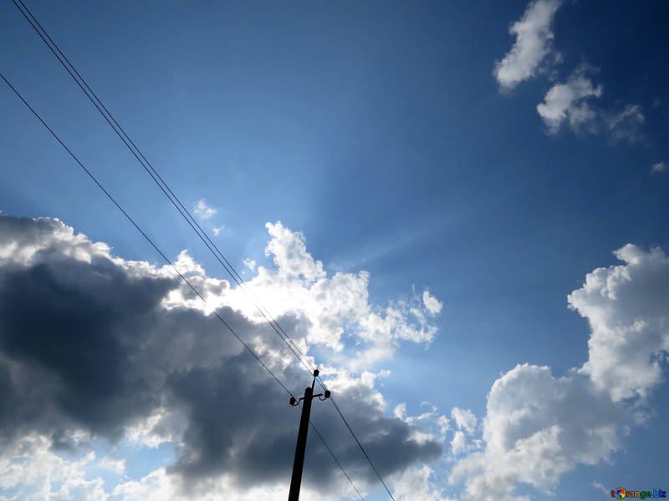
Where does our electrical energy come from?
Where does Ireland
get its energy from?
Visit the ESB Interactive Map

Slide 8
Sources of Energy
There are many different types of energy such as light, heat, sound, electric, chemical, kinetic, potential and nuclear. The source of these energies can vary. We can group the sources of these energies into two categories as follows; renewable and non-renewable sources of energy.
Non – Renewable Source of Energy
Renewable Source of Energy
Non-renewable sources are limited and will run out
Renewable sources of energy are those that will not run out in the short term.
Examples include coal, oil, gas and peat.
Examples include wind, solar, hydroelectric, tidal, wave, biomass, Geothermal

Slide 9
Research
Task
Energy Source | Is it sustainable? (Will it get used up or is it renewable) | It’s advantages (Easy to build, no pollution, etc..) | It’s problems (Too dangerous, Too expensive)
Fossil fuels
Solar
Hydroelectric
Biomass
Geothermal
Nuclear
Wind
Wave
Tidal
Complete research on the different sources of energy by completing the table.
How reliable do you think your source of information are?

Slide 10
Energy Source | Is it sustainable? (Will it get used up or is it renewable) | It’s advantages (Easy to build, no pollution, etc..) | It’s problems (Too dangerous, Too expensive)
Fossil fuels |  | Fossil fuels can be transported easily. Fossil fuels are currently accessible. Fossil fuels have a high energy density. | Produces acid rain and greenhouse gases
Solar |  | No harmful polluting gases are produced. Large scale solar photovoltaic is becoming more economically viable due to decreasing capital costs | Household solar photovoltaic are still very expensive. Need to locate in an area of high sunlight exposure.
Hydroelectric |  | No harmful polluting gases are produced. Cost effective way to produce | Building dams can cause flooding in valleys.
Biomass |  | Reduces need for fossil fuels. It’s carbon neutral. Biofuels can be transported and stored, and allow for heat and power generation on demand, | Burning Biomass releases greenhouse gases. Uncontrolled biomass production could result in deforestation. Land is needed to plant energy crops.
Geothermal |  | Renewable energy – Uses the heat beneath the ground to heat water. The earth’s internal heat is available around the world | Construction of geothermal power plants can affect the stability of land. Electricity is still needed to operate heat pumps.
Nuclear |  | Less uranium is needed to produce the same amount of energy as coal or oil. | Uranium is an unstable element. Precautions must be taken when mining, transporting and storing it. Expensive to decommission a nuclear power plant.
Wind |  | No harmful polluting gases are produced. Livestock can still be grazed on wind farms. Local communities around wind farms could derive income/benefits from the renewable energy. Migratory and local bird population patterns could be assessed prior to construction to avoid birds being killed. (Job creation) | Offshore wind energy is more costly than onshore wind energy. Wind farms kill birds and bats. Wind farms are noisy and may spoil the view for people living near them
Wave |  | No harmful by-products such as gas, waste, and pollution | Technology for wave energy is still in infancy and very expensive
Tidal |  | Tidal currents are predictable. No harmful by-products such as gas, waste, and pollution | Technology for tidal energy is still in infancy and very expensive
Sample

Slide 11

Debating Scenarios: Think – Pair – Share Activity
Students should stand in a line in the middle of the room.
Draw students attention to the ‘Agree’ side of the classroom and the ‘Disagree’ side of the classroom.
If students ‘Agree’ with a statement, they must move to the agree side.
If students ‘Disagree’ with a statement, they must move to the disagree side of the classroom.
If students are ‘undecided’, they must stay in the middle of the room.
Students must be ready to give an informed view to their decision.
Other students can move from ‘agree’ to ‘disagree’ if they are convinced to do so.
Note: Statements for the Debate have been provided by DevelopmentEducation.ie. Access viewpoints here.

Slide 12
Debating Scenarios: Think – Pair – Share Activity
Show whether you agree or disagree with each statement.
Be ready to give an informed explanation to your decision.
Switching to renewable energy is not as simple as it is being made out to be.
Quite the opposite.
Read the following viewpoint

Slide 13
Debating Scenarios: Think – Pair – Share Activity
Show whether you agree or disagree with each statement.
Be ready to give an informed explanation to your decision.
Leaving fossil fuels in the ground is good for everyone.
Read the following viewpoint

Slide 14
Debating Scenarios: Think – Pair – Share Activity
Show whether you agree or disagree with each statement.
Be ready to give an informed explanation to your decision.
Renewables cannot provide the required amount of energy to supply demand.
Read the following viewpoint

Slide 15
Debating Scenarios: Think – Pair – Share Activity
Show whether you agree or disagree with each statement.
Be ready to give an informed explanation to your decision.
Renewable energy can meet energy needs in a safe and reliable way.
Read the following viewpoint

Slide 16
Debating Scenarios: Think – Pair – Share Activity
Show whether you agree or disagree with each statement.
Be ready to give an informed explanation to your decision.
Renewable energy is not cost effective.
Read the following viewpoint

Slide 17
Debating Scenarios: Think – Pair – Share Activity
Show whether you agree or disagree with each statement.
Be ready to give an informed explanation to your decision.
Fossil fuel energy costs do not factor in all the ‘hidden’ costs.
Read the following viewpoint

Slide 18
Debating Scenarios: Think – Pair – Share Activity
Show whether you agree or disagree with each statement.
Be ready to give an informed explanation to your decision.
Renewable energy utilises too much land, meaning problems in scalability and storage.
Read the following viewpoint

Slide 19
Debating Scenarios: Think – Pair – Share Activity
Show whether you agree or disagree with each statement.
Be ready to give an informed explanation to your decision.
Many renewable technologies are scalable, and perceived problems regarding land, noise and animal welfare can be overcome.
Read the following viewpoint

Slide 20
Debating Scenario Summary
Document your findings using the following template.
Debating Statement | Findings from your Class Debate | Findings from the DevelopmentEducation Article
1. Switching to renewable energy is not as simple as it is being made out to be. Quite the opposite.
2. Leaving fossil fuels in the ground is good for everyone.
3. Renewables cannot provide the required amount of energy to supply demand.
4. Renewable energy can meet energy needs in a safe and reliable way.
5. Renewable energy is not cost effective.
6. Fossil fuel energy costs do not factor in all the ‘hidden’ costs.
7. Renewable energy utilises too much land, meaning problems in scalability and storage.
8. Many renewable technologies are scalable, and perceived problems regarding land, noise and animal welfare can be overcome.

Slide 21
Debating Statement | Findings from your Class Debate | Findings from the DevelopmentEducation Article
1. Switching to renewable energy is not as simple as it is being made out to be. Quite the opposite. |  | Capturing renewable resources can be expensive and many are intermittent. It takes time and money to change distribution and consumption Bringing new renewable technologies to the market can be costly and inconvenient.
2. Leaving fossil fuels in the ground is good for everyone. |  | Is leaving fossil fuels in the ground enough? Is man destroying the Earth? We are currently on track of a temperature rise of 5 degrees. Is leaving fossil fuels in the ground enough to protect Earth?
3. Renewables cannot provide the required amount of energy to supply demand. |  | Solar and wind are weather dependent and thus unpredictable and unreliable. Energy storage is required to supplement and meet demand. Full dependence on renewable energy can only be done if we move lifestyles and systems. (We would need to change the ‘present’ energy demand.)
4. Renewable energy can meet energy needs in a safe and reliable way. |  | The focus should be on using a mix of renewable sources rather than over-relying on one renewable technology. Continued research will keep reducing the cost associated with renewable energy as seen by current trends. Countries are setting targets and economies are investing in renewable energy. Developing smarter grids and better storage options would support this statement.
5. Renewable energy is not cost effective. |  | How many solar plants or wind farms are needed to produce the same amount of electricity over time as a similar sized coal fired plant? Renewable energy has the issue of intermittency. Can it meet demand? Is renewable energy more expensive in terms of capital cost and operating cost? Renewable energies are not cost effective without heavy government subsidies.
6. Fossil fuel energy costs do not factor in all the ‘hidden’ costs. |  | Environmental cost - Climate change is causing droughts that drive up food prices. Ireland imports a lot of fossil fuels. What if international prices for fossil fuels rise? Ireland will need to pay fines if they cannot meet the EU 2020/2030/2050 targets.
7. Renewable energy utilises too much land, meaning problems in scalability and storage. |  | How many solar plants or wind farms are needed to produce the same amount of electricity over time as a similar sized coal fired plant? Land is needed for this. No cost effective form of energy storage currently exists. Large scale solar PV farms would be located in favourable regions. This will involve long distance transmission and disturbance on land.
8. Many renewable technologies are scalable, and perceived problems regarding land, noise and animal welfare can be overcome. |  | All the scalability problems are surmountable but there is a need for a more sustainable energy system with demand-side management. Land - Livestock can graze on land used for renewable energy. Noise - More complaints from aesthetics. Noise complaints could reduce if local communities derived income from the renewable energy source. Animal welfare - Migratory and local bird population patterns could be assessed before construction to avoid wildlife deaths from wind farms.
Sample

Slide 22
Homework
Examine the following sample projects on
‘Meeting Current and Future Energy Needs’.
Project One – Above Expectation
Project Two – In Line With Expectation
Project Three – In Line With Expectation
Task: For each project, record five ‘What Went Well’ and five ‘Even Better If’ comments.

Slide 23

THANK YOU!
Lesson activities by:
Inspired by:
PPT Template by:
Alexander Martensson
Email
martensson@example.com

