Slide 1
Climate Change
Why should we care about sustainable development?

Slide 2
Learning Intentions:
By the end of this lesson you will be able to:
Describe climate change, global warming and the greenhouse effect.
Examine evidence to make judgements on the effects of climate change.
Appreciate the role of science in society and its global importance.
Links to Science LO: 2.7, 4.8, 1.10

Slide 3
Starter Activity:
Significant Weather Events
Weather describes the day to day conditions of the atmosphere.
Recall the significant weather events that happened this year in Ireland, Europe and globally using the graphic organiser.

Slide 4
Japan July 18’:
Experienced the worst flooding and landslides in decades. Heatwave with temperatures above 40 ℃.
Typhoon Jongdari
Sample
Globally, June was the second warmest on record.
Greece July 18’:
Deadly fires and extremely high winds
Storm Ophelia
October 17’ - National Red Warning
Ex-hurricane - Strong wings & gusts
Beast from East & Storm Emma
March 18’ - National Red Warning
Snow, blizzard like conditions & gale force wind
Heatwave- 5 consecutive days over 25 ℃
July 18’ - High temperatures & dry spell
Near drought conditions
Bog fires & hose ban

Slide 5
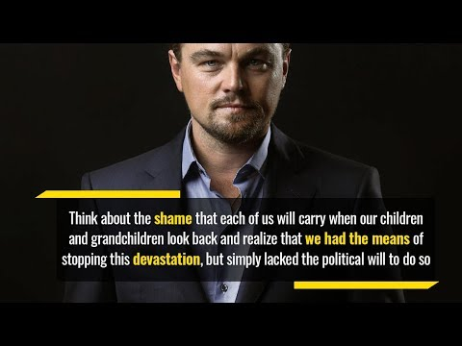
Climate Change - What is it?
In this video, Leonardo Di Caprio speaks about climate change.
Watch the video and complete the following task:
1. Record your understanding of the word ‘Climate Change’.
2. What evidence is there that climate change is happening?

Slide 6
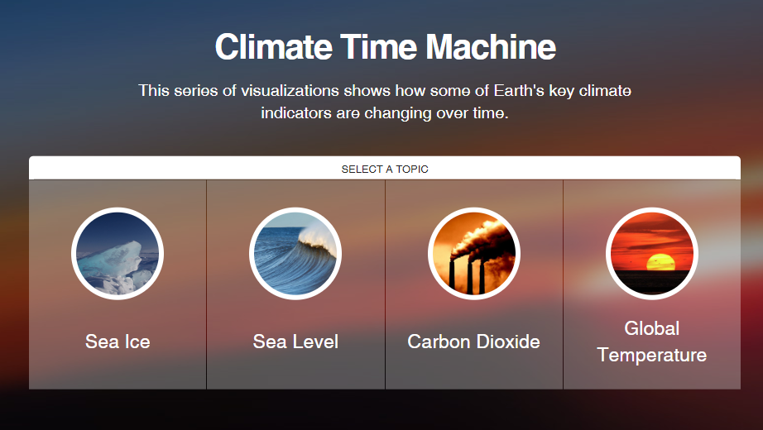
Climate Change - What is it?
Climate change is a significant change in the weather (e.g. temperature, rainfall or wind) lasting for an extended period - decades or longer. Have a look at NASA’s Climate Time Machine to visually see climate indicators changing over time.
Climate change has already had observable effects on the environment:
Global temperature rise
Warming oceans
Shrinking ice sheets
Glacial retreat
Decreased snow cover
Sea level rise
Extreme events
Ocean acidification
Image Source: Nasa

Slide 7
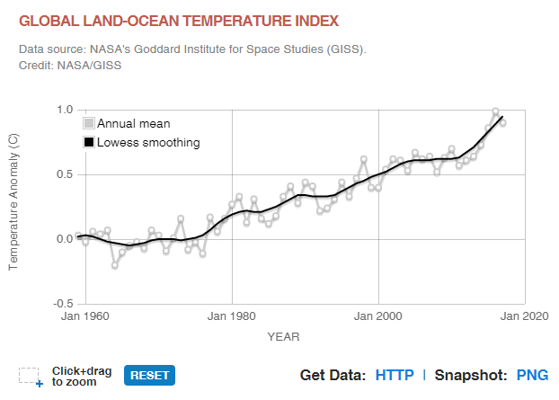
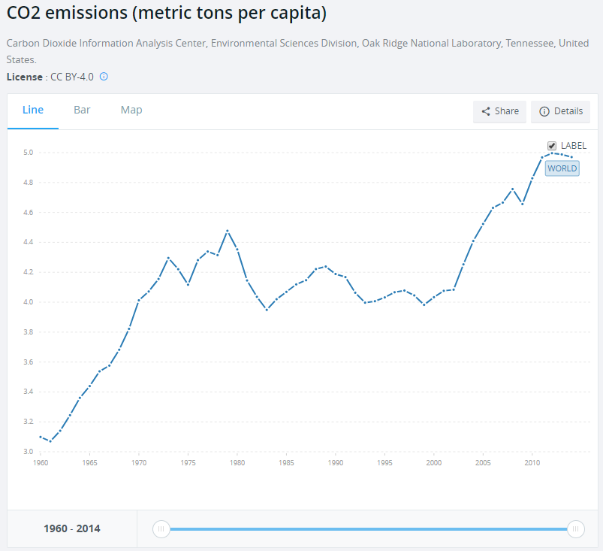
Global Warming - What is causing it?
Global warming is the increase in the Earth’s average surface temperature.
The cause of global warming is often debated, however, 97 % of actively publishing climate scientists agree
that climate-warming trends over the past century are extremely likely due to human activities. Carbon dioxide (CO₂) is an important heat-trapping gas, which is released through human activities such as deforestation and burning fossil fuels, as well as natural processes such as respiration and volcanic eruptions. Click on the graphs below to compare the global temperature against the global CO₂ emissions.
The latest IPCC assessment report predicts that global temperature increases by 2100 could range between 1.1℃ and 6.4℃.
Image Source: Nasa
Image Source: World Bank Data, CC BY-4.0

Slide 8
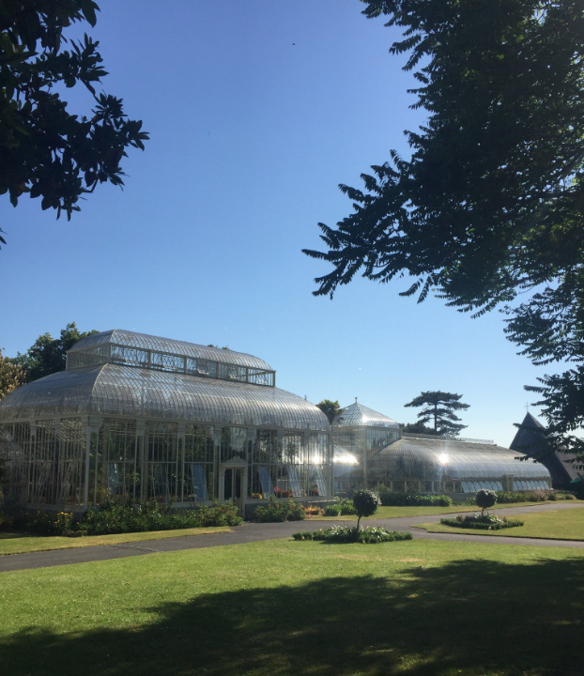
The Greenhouse Effect
Drawing Task:
Listen to your teacher’s description of the greenhouse effect and draw a labeled diagram to model your teacher’s description.
Your teacher has two descriptions to choose from:
Easy
Difficult

Slide 9
The Greenhouse Effect
Task: Easy
Draw a labeled diagram to model your teacher’s description of the greenhouse effect.
Sunlight passes through the Earth’s atmosphere and warms the Earth’s surface.
The heat is radiated back towards space.
Most of the outgoing heat is absorbed/trapped by greenhouse gas molecules in the Earth’s atmosphere.
The absorbed heat is re-emitted in all directions, warming the Earth.
This causes the temperature of the Earth to rise, which results in global warming.

Slide 10
The Greenhouse Effect
Task: Difficult
Draw a labeled diagram to model your teacher’s description of the greenhouse effect.
Our Earth receives energy from the sun in the form of radiation (E.g. Visible light or ultraviolet).
The solar radiation with shorter wavelengths passes through the atmosphere.
Most of the solar radiation is absorbed by the Earth’s surface and warms the Earth’s surface.
The Earth’s surface then radiates the heat back towards space as thermal radiation of longer wavelengths.
Some of the thermal radiation is absorbed and trapped by the greenhouse gases in the Earth’s atmosphere.
The main greenhouse gases are carbon dioxide, methane, nitrous oxide and water vapour.

Slide 11
The Debate
Not everyone agrees that climate change is happening.
Activity - You will be presented with a list of for and against statements. You must decide whether you side with the agree or disagree arguments. Your decision can only be made based on the arguments in front of you.
Complete the table to record your position in each case.
Statement | For | Against | Undecided
Climate Change - Fact or Fiction?
Is climate change a priority?
Is global warming caused by human actions?
Who should we listen to?
Are future projections accurate?
Is preventative action a priority?
Click Here for Argument Cards.

Slide 12
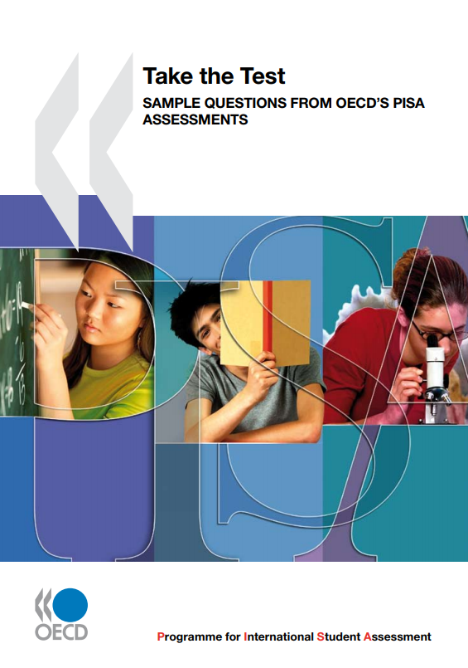
Final Task
Take the OECD’s PISA Assessment on the Greenhouse Effect. (Page 199)
The teacher solutions are page 262.

Slide 13

Climate Change - Fact or Fiction?
FOR There is consensus among the world’s top scientists that global warming is happening. The Intergovernmental Panel on Climate Change (IPCC) is the leading international body for the assessment of climate change. Scientists from over 190 countries contribute to the work of the IPCC. This statement from the IPCC’s assessment report in 2007 is accepted as confirmation that climate change is real, and cannot be denied on scientific grounds: Warming of the climate system is unequivocal, as is now evident from observations of increases in global average air and ocean temperatures, widespread melting of snow and ice, and rising global mean sea level. | AGAINST There are those who believe that climate change is a conspiracy and that politicians and scientists are exaggerating the consequences of global warming and climate change to create fear among the public and greater publicity and funding for themselves. Scientists who want to attract attention to themselves, who want to attract great funding to themselves, have to find a way to scare the public…and this you can achieve only by making things bigger and more dangerous than they really are. Petr Chylek, Professor of Physics and Atmospheric Science, Dalhousie University

Slide 14
Is climate change a priority?
FOR The increasing number of climate related disasters and the rate at which global temperatures are rising is a growing concern. In the last 100 years the earth’s global surface temperature has risen by an average of 0.74°C. The IPCC predict that global temperatures could rise by between 1.1°C and 6.4°C by 2100 – that’s more than double, and possibly over eight times, the increase in the last century. According to the UNDP 326 climate-related disasters, affecting over 262 million people occurred each year between 2000 and 2004. If global warming were to reach the temperatures predicted by the IPCC between now and 2100, the number of climate-related disasters, and people affected, would rise considerably. Future climate change is expected to put almost 50 million people at risk of hunger by 2020. Shrinking freshwater supplies for drinking as well as agriculture will affect billions of people. UNDP | AGAINST There is an argument that calls for current humanitarian issues (poverty, human rights, HIV and AIDS, etc.) to be addressed as a higher priority ahead of climate change. Everyday 30,000 people on this planet die of the diseases of poverty… a third of the planet doesn’t have electricity. We have a billion people with no clean water. We have half a billion people going to bed hungry every night. Do we care about this? It seems that we don’t. It seems that we would rather look a hundred years into the future than pay attention to what’s going on now. I think that’s unacceptable. I think that’s really a disgrace. Michael Crichton, Novelist

Slide 15
Is global warming caused by human actions?
FOR Human activities do contribute substantially to climate change. Scientific data published by the IPCC, and other official bodies, shows significant rises in greenhouse gas (GHG) concentrations and global temperatures since the beginning of the industrial era. There is an argument that GHG emission increases are above those that would be expected from natural causes. Most of the observed increase in global average temperatures since the mid-20th century is very likely due to the observed increase in anthropogenic GHG concentrations. It is likely that there has been significant anthropogenic warming over the past 50 years averaged over each continent (except Antartica). IPCC Global GHG emissions due to human activities have grown since pre-industrial times, with an increase of 70% between 1970 and 2004. IPCC | AGAINST There are some who believe that human activity is not contributing significantly to climate change. They argue that natural factors are the cause of the increase in greenhouse gas concentrations in the atmosphere and that climate change is part of the earth’s natural cycle. The earth has a history of temperature changing cycles, and there are some who believe that the global warming we are experiencing is part of that natural cycle. The small (+0.7 deg C) increase in the average global temperature over the last hundred years is entirely consistent with well-established, long-term, natural climate trends. Jim McConalogue, The European Journal It is no secret that increased solar irradiance warms Earth’s oceans, which then triggers the emission of large amounts of carbon dioxide into the atmosphere. So the common view that man’s industrial activity is a deciding factor in global warming has emerged from a misinterpretation of cause and effect relations. Dr Habibullo Abdussamatov, Head of Space Research, Pulkovo Observatory

Slide 16
Who should we listen to?
FOR Many leading climate change sceptics do not have a background in science. There is an argument that their lack of scientific experience undermines the issues they raise in the climate change debate. It has also been pointed out that sceptics gain support for their campaigns using media directed towards the public rather than through scientific or academic forums. Official supporters of climate change (IPCC, UNDP, academic research reports, etc.) publish their findings in formal journals and reports that are mainly read by academics and other scientists. As a result the public are left with an unbalanced overview of the climate change debate and often believe that there is more support for the sceptics than is the actual case. It is difficult for members of the public to access the scientific arguments supporting climate change. A larger group of economists, political scientists and intellectuals… remain unconvinced. This community are strong on economics but they are not scientists and rarely understand the reliability (and limitations) of experimental measurements – another fact that is rarely highlighted in the media. Cormac O’Raifeartaigh | AGAINST Climate change sceptics draw attention to the vague language used in scientific reports. They also claim climate change scientists manipulate data to form conclusions that will support climate change theories. There is no scientific consensus on how much the world has warmed or will warm; how much of the warming is natural; how much impact greenhouse gases have had or will have on temperature; how sea level, storms, droughts, floods, flora, and fauna will respond to warmer temperature; what mitigative steps – if any – we should take; whether (if at all) such steps would have sufficient (or any) climatic effect; or even whether we should take any steps at all. Christopher Monkton

Slide 17
Are future projections accurate?
FOR Climate change projections are based on long-term averages and conservative models. A broad range of data, over a long time period is analysed. This allows scientists to identify trends and averages and project these results into future timescales. There are a number of scientists who believe that the parameters chosen in climate change models may be too conservative and underestimate the magnitude of future global warming. They believe the situation is going to be even worse than expected. | AGAINST There are some who claim that climate change analysis is inaccurate. The measurement tools and models used for analysis are questioned. Some argue that there is too much dependence on information from weather stations as changes in their surroundings can affect the data and lead to incorrect readings. Some sceptics argue that there are too many variable factors involved in computer modelling to effectively monitor global climate patterns and predict future events.

Slide 18
Is preventative action a priority?
FOR There are claims that the climate change debate is over and it’s time now for action to reduce greenhouse gas emissions. It is argued that whether or not the future projections of climate change are absolutely accurate, the fact that climate change has been shown to have a negative effect on humanity and the environment, and is predicted to become an even greater problem, is reason enough to act now. Many believe that to ignore climate change and write off estimated projections would be an unfair, immoral and a short- sighted gamble when there is so much at risk. | AGAINST Climate change has already begun and greenhouse gases that are already in the atmosphere will remain there for decades, or longer. It is argued that human intervention at this stage will neither worsen nor improve the situation, as a portion of the warming associated with past human activity has not yet been realised. It is also argued that many societies depend on fossil fuels and it is not feasible to alter this dependence without dramatic changes to current social and economic structures.

Slide 19


THANK YOU!
Lesson activities by:
Inspired by:
PPT Template by:
Alexander Martensson
Email
martensson@example.com

