Slide 1
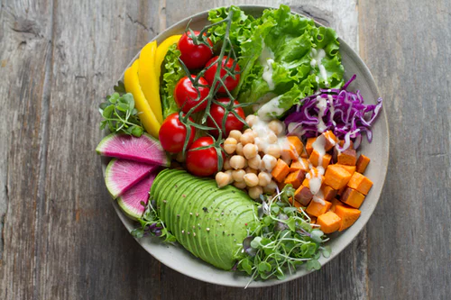

Macronutrients
@annapelzer//unsplash.org

Slide 2

Learning Outcomes
1.9 Recognise the importance of nutrition and diet in contributing to health and wellbeing
1.10 Explain the role of the nutrients in contributing to a healthy balanced diet.
@RG104/creativecommons.org

Slide 3
What will I learn
To explain the term nutrient
To identify the 6 nutrients
To differentiate between macronutrients and macronutrients
To state sources of each nutrient
To describe the composition of each nutrient
To classify each nutrient
@RG104/creativecommons.org

Slide 4
What will I learn
To explain the function of each nutrient
To state the effects of deficiency diseases
To describe the effects of overconsumption of certain nutrients of the body.
@RG104/creativecommons.org

Slide 5



Key Skills
Staying well- Being healthy by having a good understanding of nutrition
@technatrually@creativecommons.org
Communicating- Discussing the impact of healthy and less healthy f
Communicating- Discussing the impact of healthy and less healthy food choices on wellbeing.
@mazeo/creativecommons.org
Managing Information and Thinking- gathering and evaluating information relating to different nutrients.
@rejon/creativecommons.org

Slide 6
Key Words
Nutrition
Food
Well being
Nutrient
Element
Balanced Diet
Anaemia
Rickets
Osteoporosis
Vitamins
Minerals
Water

Slide 7
Function
is?
Classify
means?
Balanced
diet
is?
Recap
Deficiency
is?
Source is?

Slide 8
MicroNutrient
Needed in small amounts
Vitamins
Minerals
Measured
in mg or μg

Slide 9
Vitamins
@annapelzer//unsplash.org

Slide 10
Key Words
Fat-Soluble
Water-Soluble
Deficiency
Night Blindness
Carotene
Rickets
Beri-Beri
Scurvy
Absorbic Acid

Slide 11
CLASSIFICATION OF VITAMINS
WATER SOLUBLE
FAT SOLUBLE
A
D
B
C
E
K
Notes:
‹#›

Slide 12
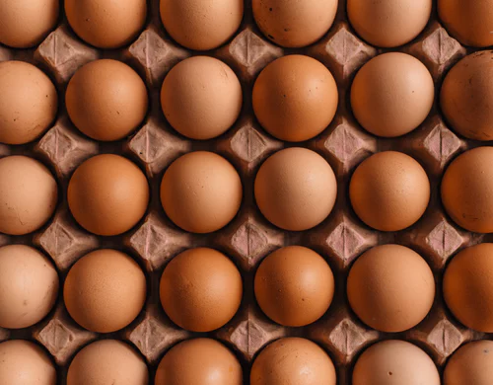
VITAMIN B
SOURCES: Meat, Fish, Cheese, Eggs
FUNCTIONS:
Energy, for a healthy nervous system and growth.
DEFICIENCY DISEASE:
Beri-beri & pellagra
@erolahmed/unsplash.org
Notes:
‹#›

Slide 13
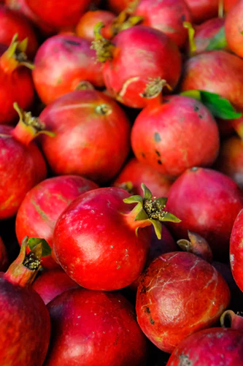
VITAMIN C
SOURCES: Fresh fruit and vegetables
@siamand/unsplash.org
Notes:
‹#›

Slide 14
VITAMIN C
FUNCTIONS:
Needed for good general health, for healthy skin and gums.
Needed to help absorb iron.
It helps make connective tissue, which can help the healing of wounds.
@siamand/unsplash.org
Notes:
‹#›

Slide 15

Deficiency Diseases
Scurvy
Anaemia
Delayed healing of wounds
@antares/creativecommons.org

Slide 16

VITAMIN A
SOURCES:
Fish liver oil
Oily fish
Eggs
Milk
Carrots
@GDR/creativecommons.org
Notes:
‹#›

Slide 17
VITAMIN A
FUNCTIONS: Growth, Healthy Eyes, Healthy Skin, Healthy lining tissue in the nose and throat etc..
DEFICIENCY DISEASES
Slowed growth.
Lining of nose and throat
become dry and irritated.
Night Blindness.
Notes:
‹#›

Slide 18

VITAMIN D
SOURCES:
Sunshine
Oily fish
Eggs
Cheese
Cod liver oil
@sunking2/creativecommons.org

Slide 19
VITAMIN D
FUNCTIONS: To make strong bones and teeth
DEFICIENCY DISEASE:
Rickets
Osteoporosis
Tooth decay
@sunking2/creativecommons.org
Notes:
‹#›

Slide 20
RICKETS
Child with rickets will have soft, badly formed bones and teeth that are prone to tooth decay
Notes:
‹#›

Slide 21
OSTEOPOROSIS
Commonly known as “brittle bone disease” bones are fragile and break easily
Notes:
‹#›

Slide 22

VITAMIN
Sources: Eggs, Nuts, Cereals, Sunflower seeds
Functions: Acts as an antioxidant
Deficiency Disease: Rare
Notes:
‹#›

Slide 23

VITAMIN
Sources: Cod liver oil, cabbage, spinach, cauliflower
FUNCTIONS: Helps the blood to clot
Deficiency Disease:
Blood clots slowly or in severe deficiencies not at all

Slide 24

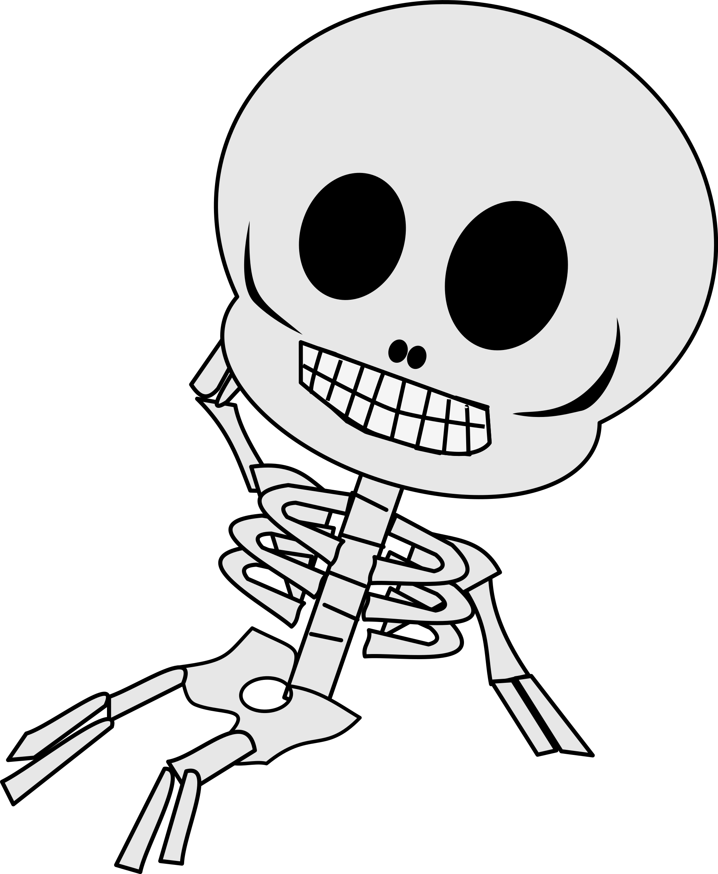
MINERALS
@tawm1972/creativecommons.org
@dear_theophilus/creativecommons.org
Notes:
‹#›

Slide 25
PHOSPHOROUS
SODIUM
CALCIUM
MINERALS
FLOURINE
IRON
IODINE

Slide 26
SOURCES OF IRON
HAEM: Good sources
Non Haem: need Vitamin C
Red Meat and offal
Whole meal Bread, green vegetables, cereals, eggs, oily fish
Notes:
‹#›

Slide 27
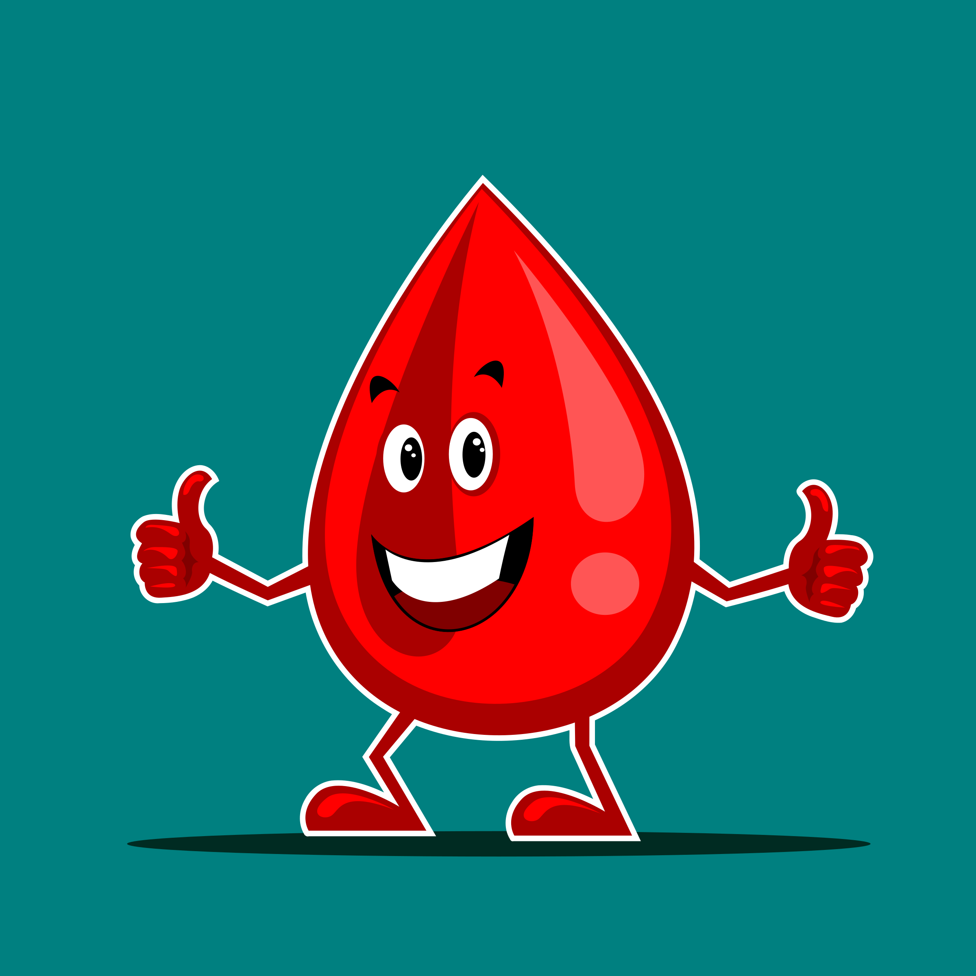
IRON
FUNCTION:
Needed to make haemoglobin.
Haemoglobin is found in red blood cells and is needed to bring oxygen around the body to give us energy.
@nugroho/creativecommons.org
Notes:
‹#›

Slide 28
Deficiency disease
Paleness
Faint
Heart palpitations
Shortness of breath
Muscular pain
Low blood pressure
Notes:
‹#›

Slide 29
CALCIUM
Sources: Milk, Cheese, yoghurt, tinned fish
FUNCTION: To build strong bones and teeth
Deficiency Disease:
Rickets, Osteoporosis, Tooth decay
@tawm1972/creativecommons.org
Notes:
‹#›

Slide 30
FLOURINE
Sources: Drinking Water, Toothpaste and Fish
FUNCTION: Healthy Teeth
Deficiency: Tooth Decay
@tawm1972/creativecommons.org
Notes:
‹#›

Slide 31
IODINE
FUNCTION : Needed for healthy thyroid gland
Sources: Seaweed, Cereals, Milk, Sea fish
Deficiency: Goitre
Notes:
‹#›

Slide 32
PHOSPHORUS
SOURCES: Milk, fish, cheese, eggs
FUNCTION:Works with calcium for strong bones and teeth
DEFICIENCY: Rare
Notes:
‹#›

Slide 33
SODIUM
SOURCES: Table salt, bacon, cheese, crisps, tuc biscuits
FUNCTION: Controls water balance in the body
DEFICIENCY: Muscular cramps
Notes:
Symptoms of dry beriberi include:
Difficulty walking
Loss of feeling (sensation) in hands and feet
Loss of muscle function or paralysis of the lower legs
Mental confusion/speech difficulties
Pain
Strange eye movements (nystagmus)
Tingling
Vomiting
Symptoms of wet beriberi include:
Awakening at night short of breath
Increased heart rate
Shortness of breath with activity
Swelling of the lower legs
Pellagra: tongue and skin become sore, as the condition progresses the symptoms get worse, diarrhea, dermatitis, depression, dementia and death.
‹#›

Slide 34
Quiz Time
Try our kahoot quiz on macronutrients!
(Teacher will have to log into their account to give students code!)
https://play.kahoot.it/#/k/cdb0de6e-c73d-4431-ad1c-65574c235045

