Slide 1
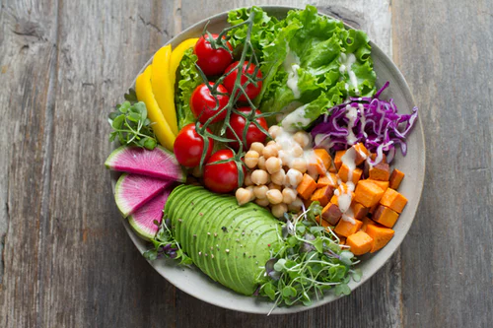

Macronutrients
@annapelzer//unsplash.org

Slide 2

Learning Outcomes
1.9 Recognise the importance of nutrition and diet in contributing to health and wellbeing
1.10 Explain the role of the nutrients in contributing to a healthy balanced diet.
@RG104/creativecommons.org

Slide 3
What will I learn
To explain the term nutrient
To identify the 6 nutrients
To differentiate between macronutrients and macronutrients
To state sources of each nutrient
To describe the composition of each nutrient
To classify each nutrient
@RG104/creativecommons.org

Slide 4



Key Skills
Being Literate- demonstrating the importance of effective communication by composing a letter or email of complaint regarding a consumer issue
@technatrually@creativecommons.org
Communicating- Discussing the impact of healthy and less healthy food choices on wellbeing.
@mazeo/creativecommons.org
Managing Myself- developing the skills needed to be a discerning consumer.
@rejon/creativecommons.org

Slide 5
What I will learn:
Classification of macronutrients and micronutrients.
The classes of protein.
The sources of protein
The functions of protein
@RG104/creativecommons.org
@RG104/creativecommons.org

Slide 6
PROTEIN
FAT
WATER
NUTRIENTS
MINERALS
CARBOHYDRATE
VITAMINS

Slide 7
MacroNutrient
Proteins
Fats
Carbohydrates
Needed in large amounts

Slide 8
MicroNutrient
Needed in small amounts
Vitamins
Minerals
Measured
in mg or μg

Slide 9
Nutrients
Macro Nutrients
Micro Nutrients
Our bodies need these in large amounts
They are too big to be absorbed by the body so they must be broken down
Our bodies need these in small amounts
They are small enough to be absorbed by the body once eaten
Minerals and vitamins

Slide 10
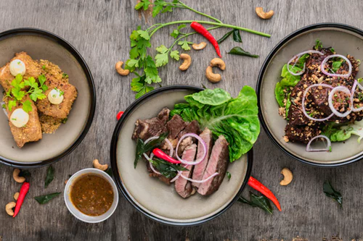
PROTEIN
@lilybanze/unsplash.org

Slide 11
Key Words
Carbon
Hydrogen
Oxygen
Nitrogen
Amino Acids
Peptide Link
Enzymes
Hormones
Antibodies

Slide 12
PROTEIN STRUCTURE
Proteins are made up of amino acids
Amino acids are joined together with peptide links

Slide 13
CLASSIFY
FUNCTIONS
SOURCES
PROTEIN
STRUCTURE

Slide 14

Classification
Grouping things according to their similarities
Example: pigeons and hawks are birds.
@Arvin61r58/creativecommons.org

Slide 15

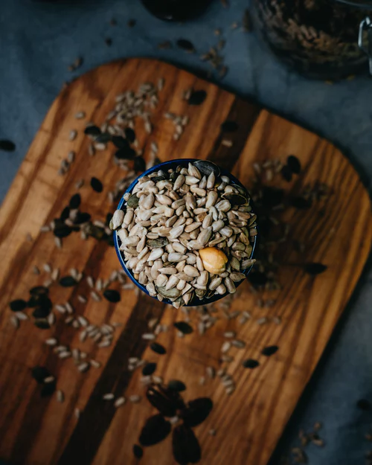
CLASSIFICATION OF PROTEIN
HIGH BIOLOGICAL VALUE PROTEIN
LOW BIOLOGICAL
VALUE PROTEIN
Meat
Fish
Eggs
MILK
Cheese
Peas
Beans
Lentils
Nuts
Cereals
S
O
U
R
C
E
S
S
O
U
R
C
E
S
@j4p4n/creativecommons.org
@cathalmacanbheatha/unsplash.org

Slide 16

Function
How something works.
@dominquechappard/creativecommons.org

Slide 17


BIOLOGICAL FUNCTIONS OF PROTEIN
Growth & Repair of worn out or damaged cells
Production of hormones, enzymes and antibodies.
Gives us energy and heats our body
@wildchief/creativecommons.org
@sharonmccutcheon/creativecommons.org

Slide 18
More Fibre
@cathalmacanbheatha/unsplash.org
Less saturated fat
Cheaper to produce
Advantages of plant foods as a source of Protein
Less lad needed to produce plant foods than to raise animals

Slide 19

Protein Deficiency
Slow Growth
Delay healing of wounds
Lack of energy
@arvin61r58/creativecommons.org

Slide 20
CLASSIFY
FUNCTIONS
SOURCES
LIPIDS
STRUCTURE

Slide 21
Key Words
Carbon
Hydrogen
Oxygen
Lipids
Glycerol
Omega 3 fatty acids
Fatty Acids
Obesity
Saturated
Unsaturated

Slide 22

STRUCTURE OF FATS
Lipids / Fats are made up of 1 glycerol unit joined to 3 fatty acid units- Triglyceride!
3
FATTY
ACIDS
G
L
Y
C
E
R
O
L

Slide 23
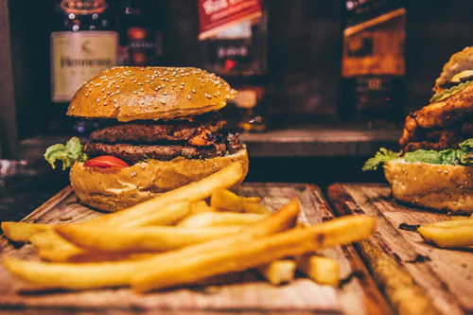
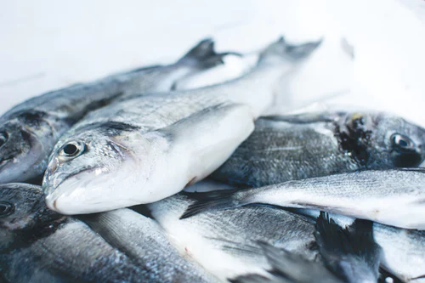
CLASSIFICATION & SOURCES OF FATS
SATURATED FATS
UNSATURATED FATS
Milk, Cheese, Meat, Butter, Fried foods
Oil, Oily Fish, Nuts, Seeds
@armadoascorvemorales/unsplash.org
@jakubkapusnak/unsplash.org

Slide 24
BIOLOGICAL FUNCTIONS OF FATS
Gives our bodies heat and energy
A layer of fat in the skin insulates our body keeping us warm
Delicate organs in the body like the heart and kidneys are protected by a layer of fat around them
We get fat soluble vitamins A,D,E,K from fats

Slide 25


Too much fat =
Weight Gain
Overweight
Obesity
Heart Attacks
Strokes
@amicalmant/unsplash.org
@moini/creativecommons.org

Slide 26
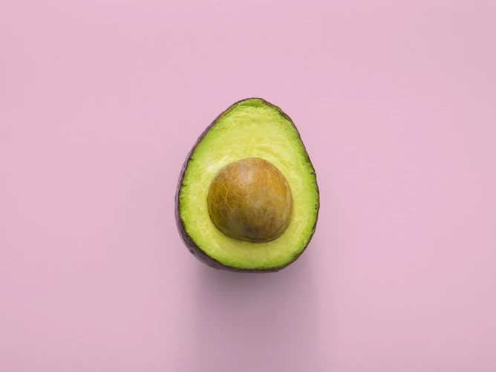

Reduce blood cholesterol
Omega 3 improves brain function and concentration
Omega 3 reduce risk of heart disease
Benefits of unsaturated fat in the diet
@thoughtcatalog/unsplash.org
@philipbarrington/creativecommons.org

Slide 27
CLASSIFY
FUNCTIONS
SOURCES
CARBOHYDRATE
STRUCTURE

Slide 28
Key Words
Carbon
Glucose
Peristalysis
Photosynthesis
Starch
Empty calories
Fatty Acids
Cellulose
Hidden Sugars

Slide 29
CARBOHYDRATES
Carbohydrates are made up of two or more simple sugars joined together. Glucose is a simple sugar unit
Carbohydrates created by glucose joining up!
Glucose

Slide 30
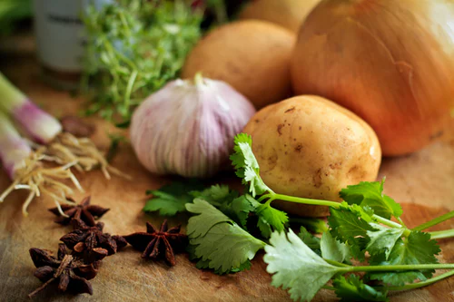

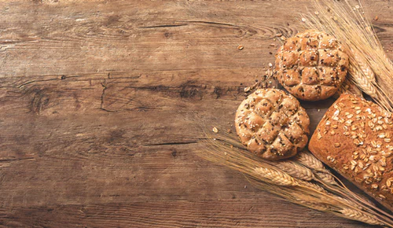
CLASSIFICATION & SOURCES OF CARBOHYDRATES
SUGAR
STARCH
FIBRE
Honey, Fruit,
Ice cream
Potatoes, Pasta, Rice, bread
Brown Bread, Whole meal pasta / rice, nuts seeds, fruit and vegetable skins
@evilestmark/creativecommons.org
@sydwachs/unsplash.org
@aleskrivec/unspash.org

Slide 31
BIOLOGICAL FUNCTIONS OF CARBOHYDRATES
Sugar and Starch provides heat and energy
Fibre rich foods fill you up
Fibre helps prevent constipation and other bowel problems

Slide 32
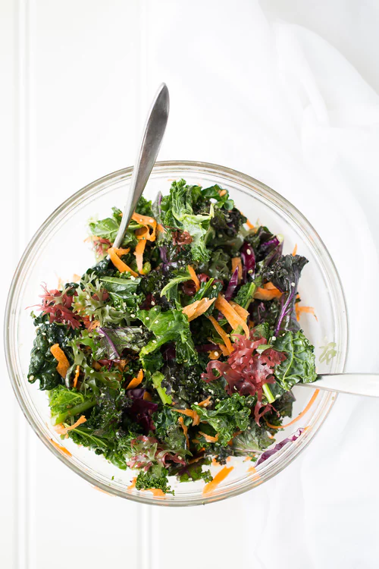
HOW TO INCREASE FIBRE INTAKE?
Brainstorm ways of increasing fibre intake in the diet
@anatavares/unsplash.org
Notes:
‹#›

Slide 33
RDA of Fibre
25g-35g per day!
@anatavares/unsplash.org
Notes:
‹#›

Slide 34
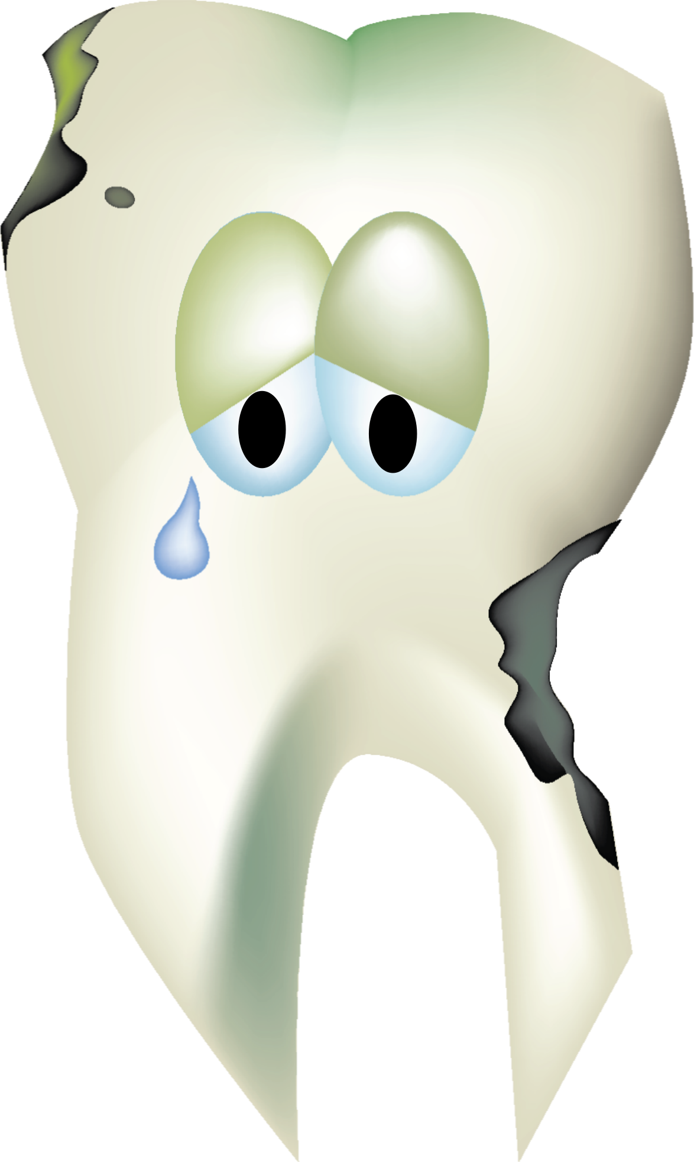
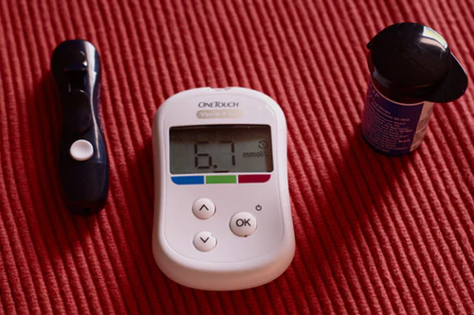
Too much sugar =
@snoppingasusual/creativecommons.org
@kateredfern/unsplash.org
@amicalmant/creativecommons.org

Slide 35
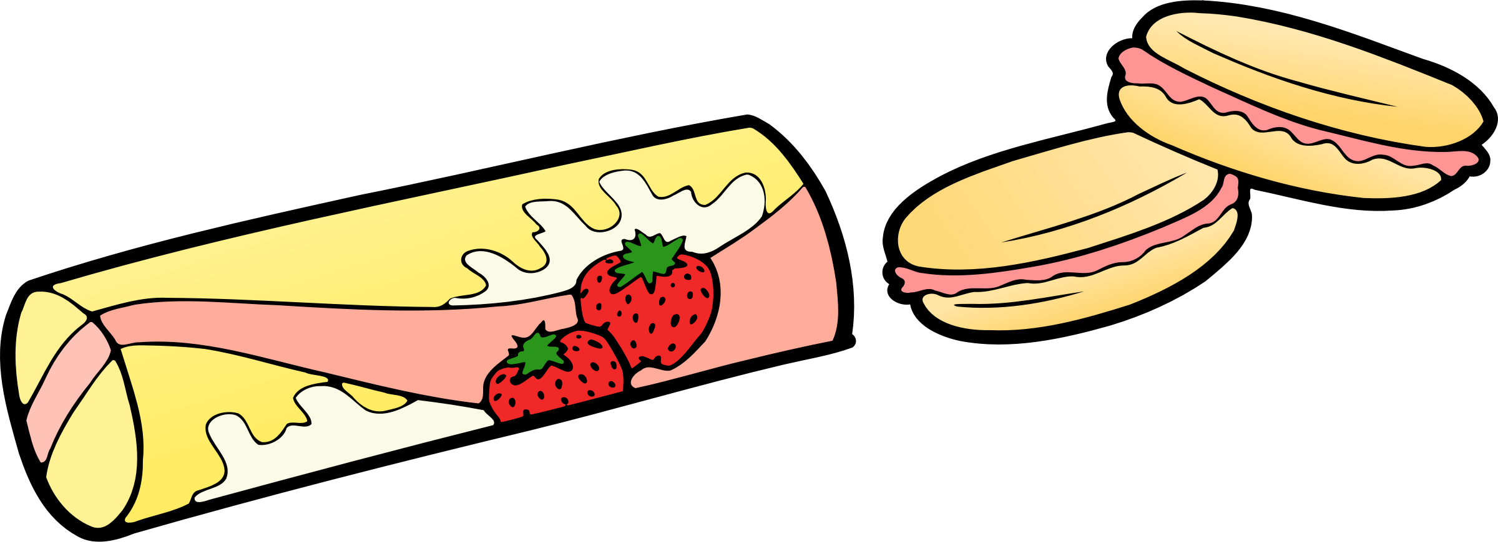
Empty Kilocalories
Hidden Sugars
@j4p4n/creativecommons.org
Contain sugar only and lack other nutrients
Foods that do not taste sweet but contain sugar i.e. savoury sauces. Watch for sugars called ‘’ glucose’’ or ‘’dextrose’’

Slide 36
HOW TO REDUCE SUGAR INTAKE
Eat non-sugary breakfast cereals
Choose reduced sugar jams and jellies
Use sweeteners in tea / coffee instead of sugar
If eating canned fruit make sure it’s in its own juice not in syrup
Reduce intake of soft/fizzy drinks-choose diet/sugar free option
Reduce intake of high sugar foods eg. sweets, cakes, biscuits etc.
Check labels for sugar content eg yogurts can be high in sugar
Notes:
‹#›

Slide 37
Quiz Time
Try our kahoot quiz on macronutrients!
(Teacher will have to log into their account to give students code!)
https://play.kahoot.it/#/k/01965187-4c73-4879-84b8-d766413a1319

