Slide 1
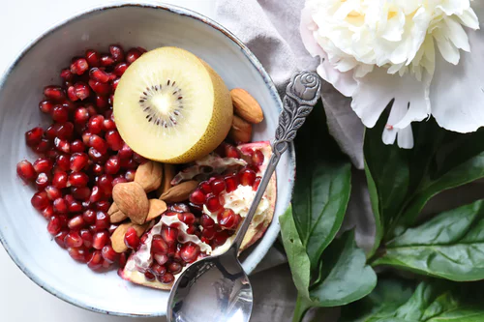

Balanced Eating
@magaliedepreux/unsplash.org

Slide 2

Learning Outcomes
1.9 Recognise the importance of nutrition and diet in contributing to health and wellbeing
1.10 Explain the role of the nutrients in contributing to a healthy balanced diet.
@RG104/creativecommons.org

Slide 3
What will I learn
To define energy and energy balance
How energy is measured
The difference between metabolic rate and basal metabolic rate
The functions of energy
The factors that affect energy requirements
To plan healthy balanced diets using the food pyramid and the healthy eating guidelines.
Points to follow when planning meals throughout the life cycle during pregnancy and convalescence
To discuss elements of a healthy lifestyle.
@RG104/creativecommons.org

Slide 4


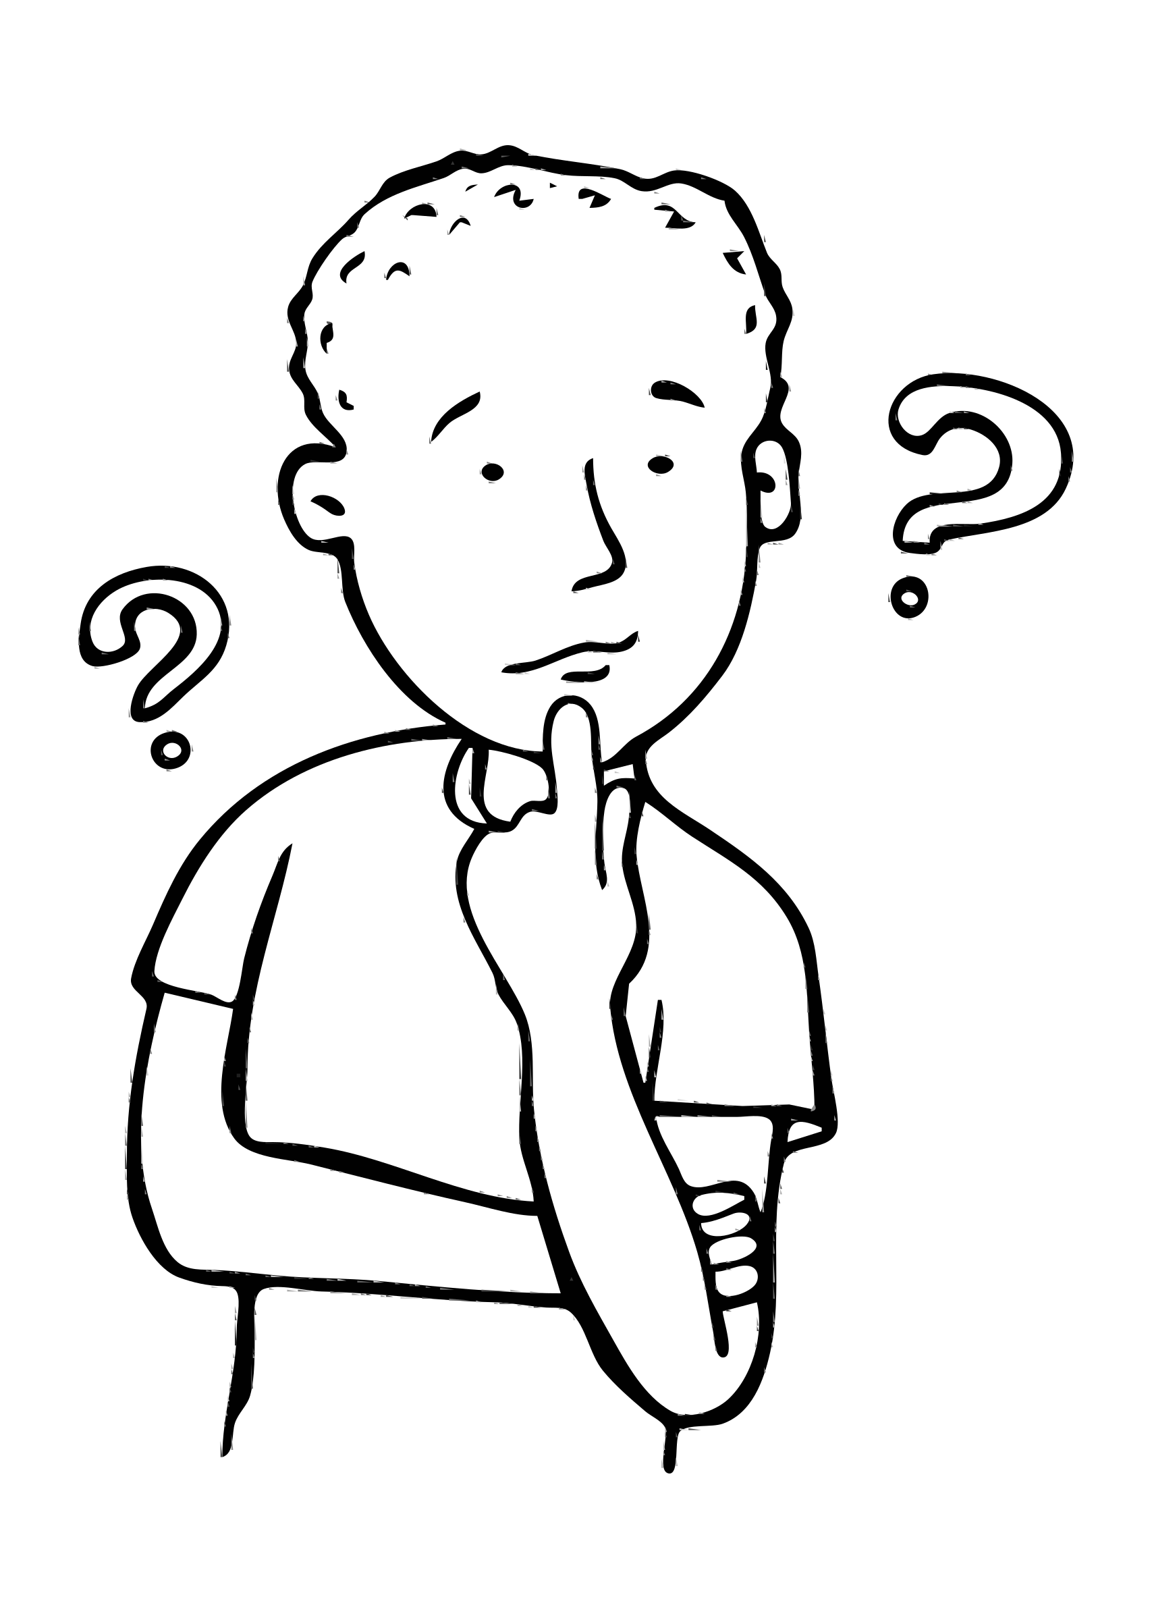
Key Skills
Staying well- Being healthy by having a good understanding of nutrition
@technatrually@creativecommons.org
Communicating- Discussing the impact of healthy and less healthy f
Communicating- Discussing the impact of healthy and less healthy food choices on wellbeing.
@mazeo/creativecommons.org
Managing Information and Thinking- gathering and evaluating information relating to different nutrients.
@rejon/creativecommons.org

Slide 5
Key Words
Energy
Energy Balance
Portions
Kilocalories
Weaning
Balanced Diet
Kilojoules
Sedentary
Metabolic Rate
Food Pyramid
Dehydration

Slide 6

Energy is
@deluge/creativecommons.org
The ability to perform any task!
Ex: swimming, walking, running.

Slide 7

Measuring Energy
@lyo/creativecommons.org
Kilocalories or Kilojoules!
1 Kilocalorie = 4.2 kilojoules

Slide 8
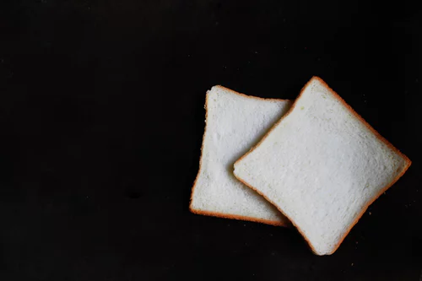
Numeracy Moment
@graphyco/unsplash.org
There are 256 kilojoules in 1 slice of white bread. Work out how many kilocalories are in the bread?

Slide 9
Factors that determine energy requirements
Age: adult needs more energy than a child. Teen needs more than the elderly
Gender-males need more than females
Size: bigger people need more energy than smaller
Energy
Pregnant & breastfeeding women need more energy
Jobs- active jobs i.e. builders need lots of energy

Slide 10

Balanced Diet
Consuming nutrients in the correct amounts to meet the needs of the body.
@enhy/creativecommons.org

Slide 11
Un-Balanced Diet
Over-eating or under-eating nutrients needed for the needs of the body.
Over-eating= GAIN WEIGHT
Under eating – LOSE WEIGHT.
@enhy/creativecommons.org

Slide 12
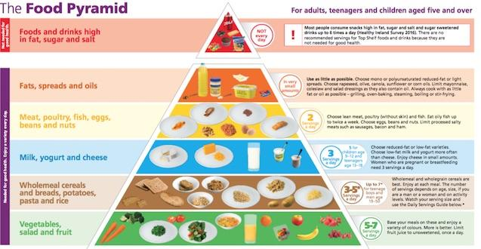
@safefood.eu
Foods high in fat, sugar and salt
Eat on occasion! No more than 1 a day!
Fats, Spreads and Oils
In very small amounts!
Meat, poultry, fish, eggs, beans & nuts
2 servings per day
Milk, yoghurt and cheese
3 servings per
day
Wholemeal cereals & breads,potatoes, pasta & rice
3-5 servings per day
Vegetables, Salads & Fruits
5-7 servings
per day

Slide 13
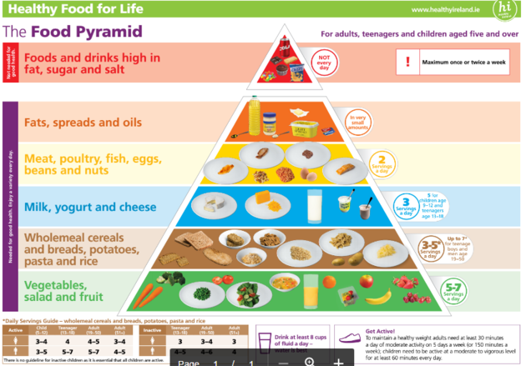
Servings
@safefood.eu
1 or less a day
1
2
3
5
6
Rhyme: Top to the floor except four

Slide 14
Balanced Meal Contains
@safefood.eu
1 or less a day
1
2
3
5
6
3 out of 4 of the main food Groups

Slide 15

Eat well plate
Activity: Use a paper plate
Design a balanced breakfast meal for an active teen.
@oksmith/creativecommons.org

Slide 16

Eat well plate
DESIGN A BALANCED LUNCH FOR AN ACTIVE TEENAGER
@liftarn/creativecommons.org

Slide 17

Eat well plate
DESIGN A BALANCED Dinner FOR AN ACTIVE TEENAGER
@algotruneman/creativecommons.org

Slide 18
Portion Size Guidelines
https://www.safefood.eu/Healthy-Eating/Food,-Diet-and-Health/Eating-In/Serving-sizes.aspx

Slide 19
Quiz Time
Try our kahoot quiz on macronutrients!
(Teacher will have to log into their account to give students code!)
https://play.kahoot.it/#/k/0fced22d-96e8-403f-a250-742298ee2c16

