Slide 1
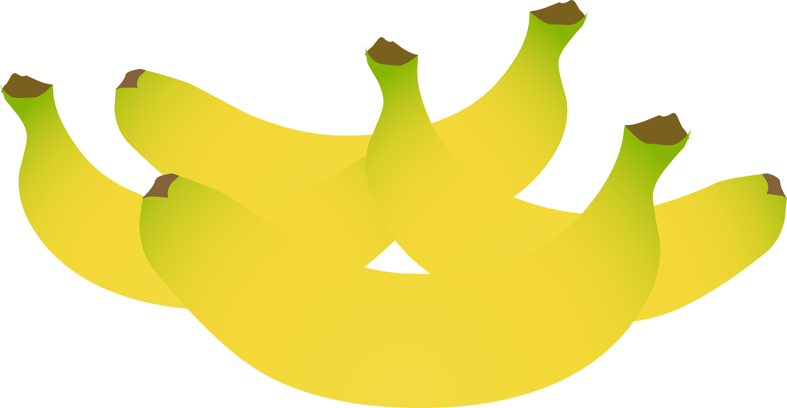

Food Sustainability
World Food Day~ 16/10/2018!
@glitch/creativecommons.org

Slide 2



What is World Food Day??
Celebrated internationally on the 16th of October each year
@glitch/creativecommons.org
A key international day of awareness and action dedicated to tackling food hunger.
WFD arose as a point of interest and activity on world hunger and poverty issues as a result of the work of Food and Agriculture Organisation of the UN and has been championed by many actors over recent decades.
@glitch/creativecommons.org
Celebrated internationally on the 16th of October each year
For more info
Check out
@glitch/creativecommons.org

Slide 3

Learning Outcomes
1.15 Investigate the impact of food choices from an ecological and ethical perspective.
1.16 Apply sustainable practices to the selection and management of food and material resources.
@RG104/creativecommons.org

Slide 4
What will I learn
What is meant by food sustainability
To apply sustainable practices in the choice and use of foods
Prevention of food waste
Define ethical consumption
The ethical benefits of Fairtrade products.
@RG104/creativecommons.org

Slide 5



Key Skills
Managing myself- learning to make informed ethical decisions when buying and using foods.
@oksmith@creativecommons.org
Communicating- Discussing the impact of healthy and less healthy food choices on wellbeing.
Communicating- Discussing the impact of healthy and less healthy .
@mazeo/creativecommons.org
Working with others- contributing to making the world a better place by shopping locally, preventing food waste and buying Fairtrade goods.
@j_iglar/creativecommons.org

Slide 6
Key Words
Sustainability
Preservation
Ecological
Preservative
Ethical
Fairtrade

Slide 7
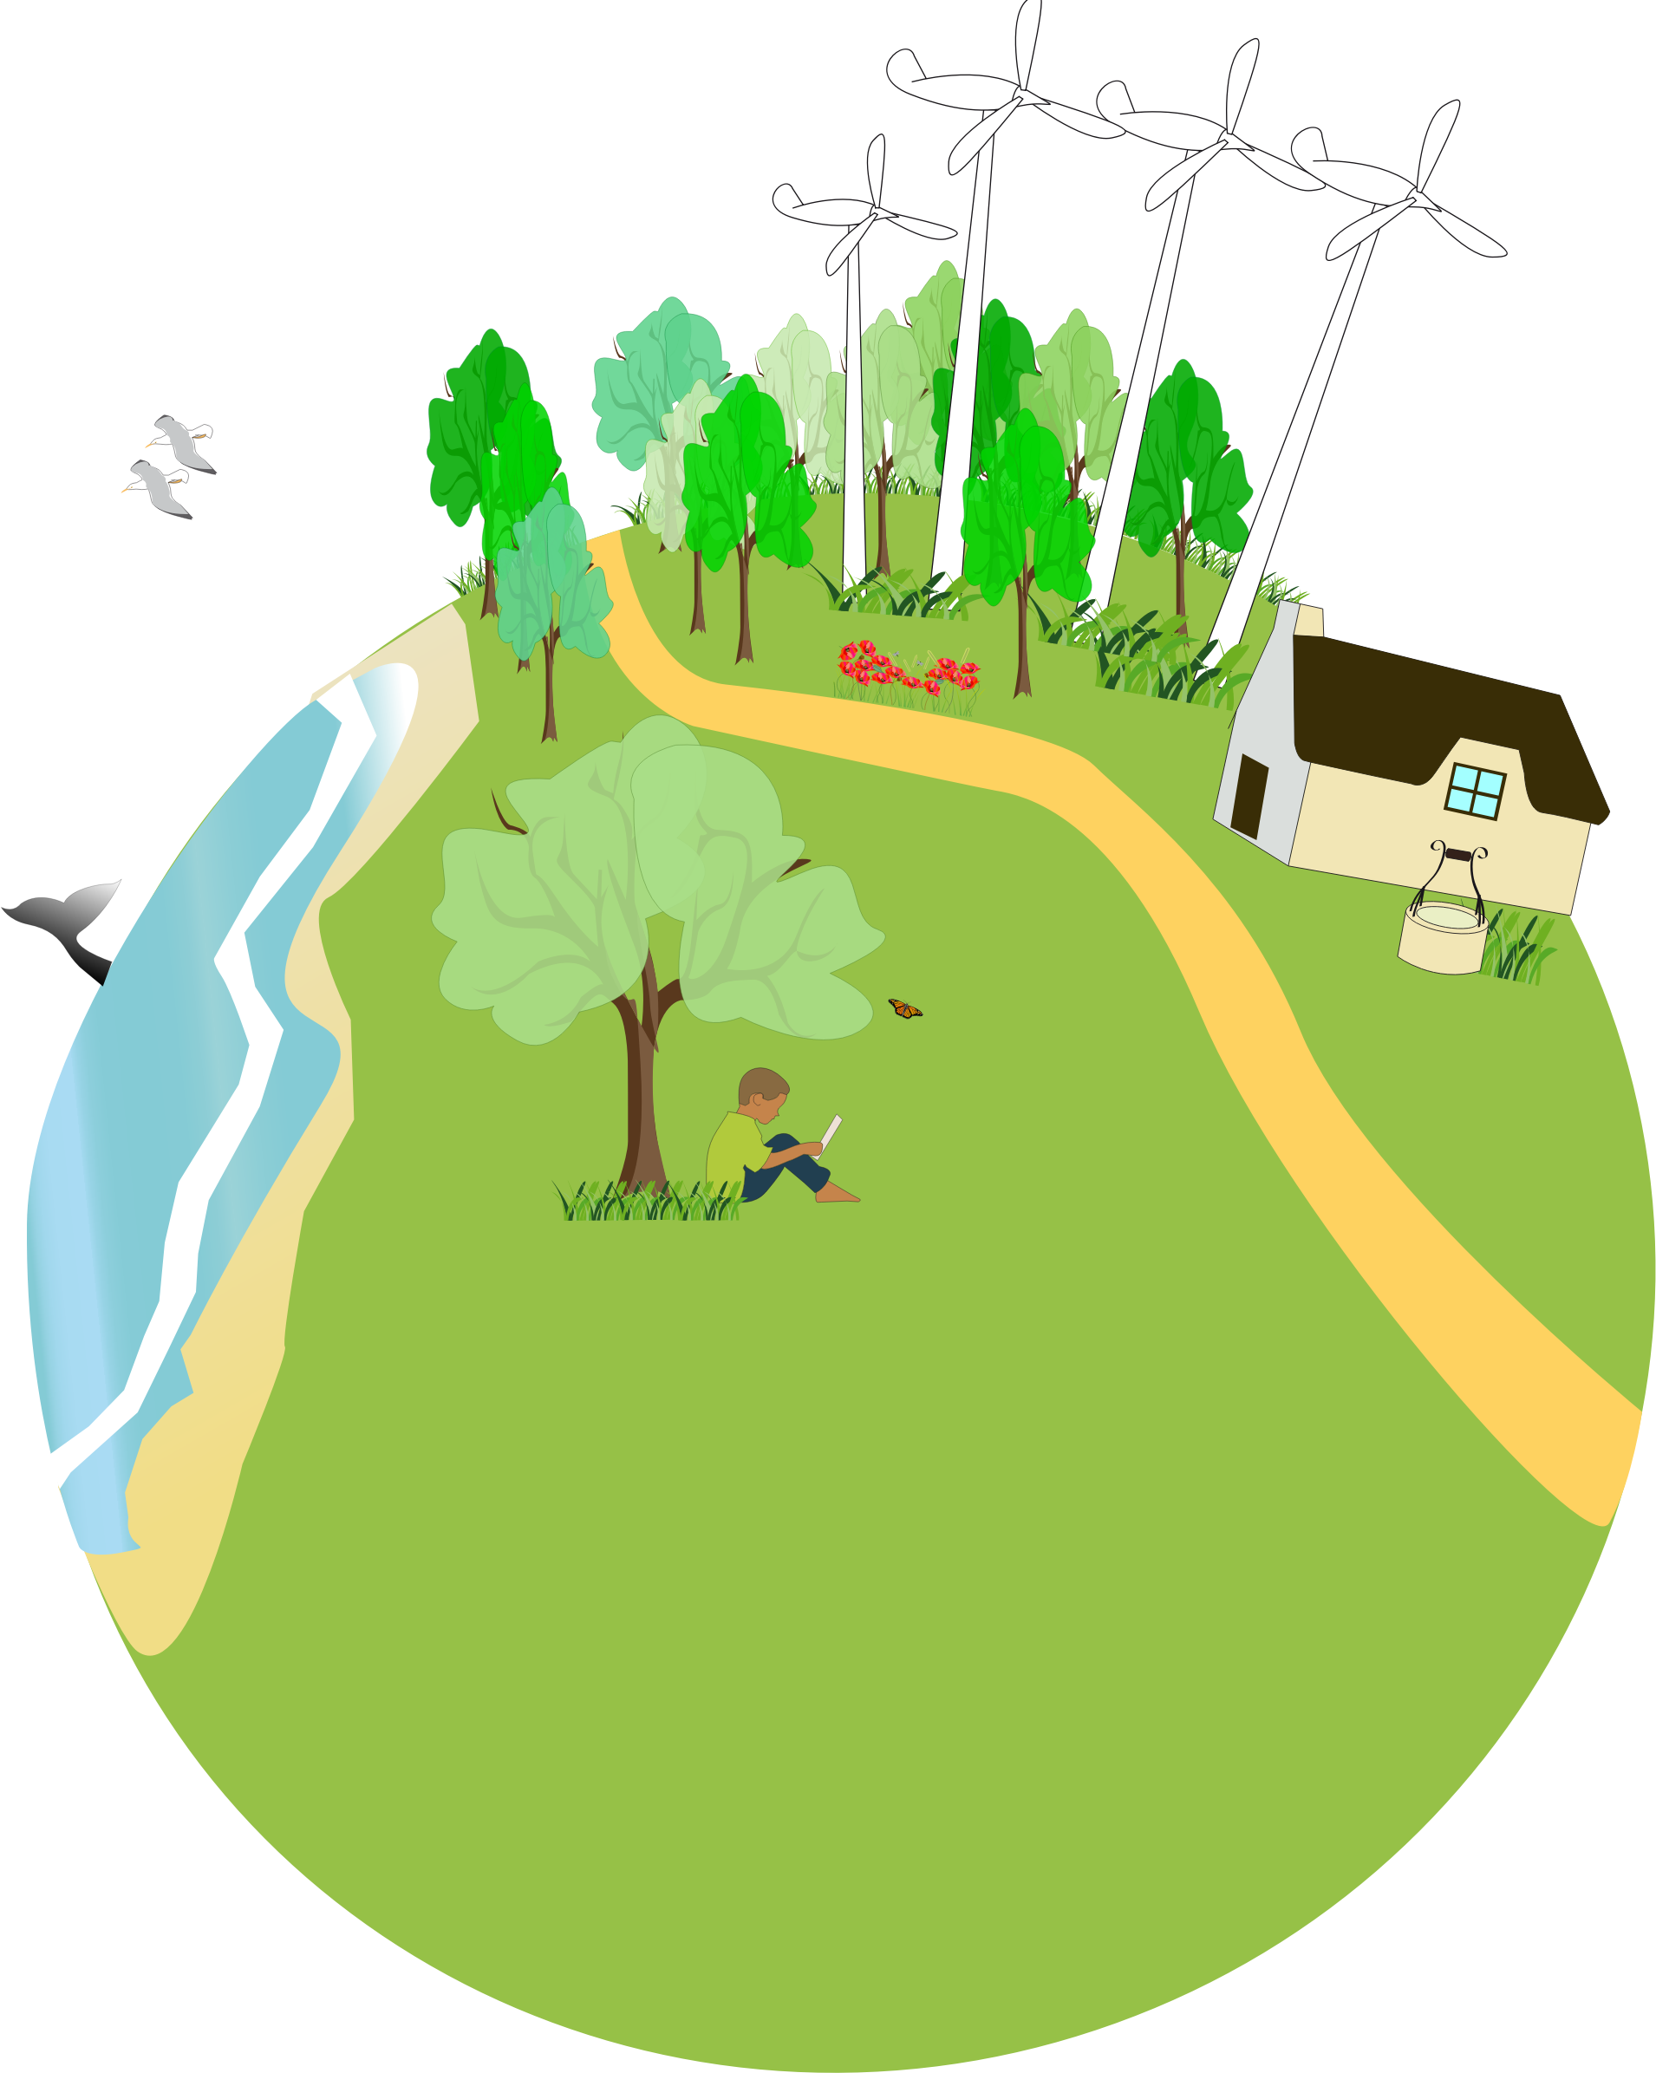
Sustainability means
Maintaining the world we live in for future generations
@presquesage/creativecommons.org

Slide 8

Activity: 2 minute Manic Brainstorm
In pairs, write down key words that you think define food sustainability
@glitch/creativecommons.org
@presquesage/creativecommons.org

Slide 9
Food Sustainability
Choosing and using food that is healthy for consumers and that does not harm the environment, animals or the workers who were involved in producing the foods.
@presquesage/creativecommons.org

Slide 10
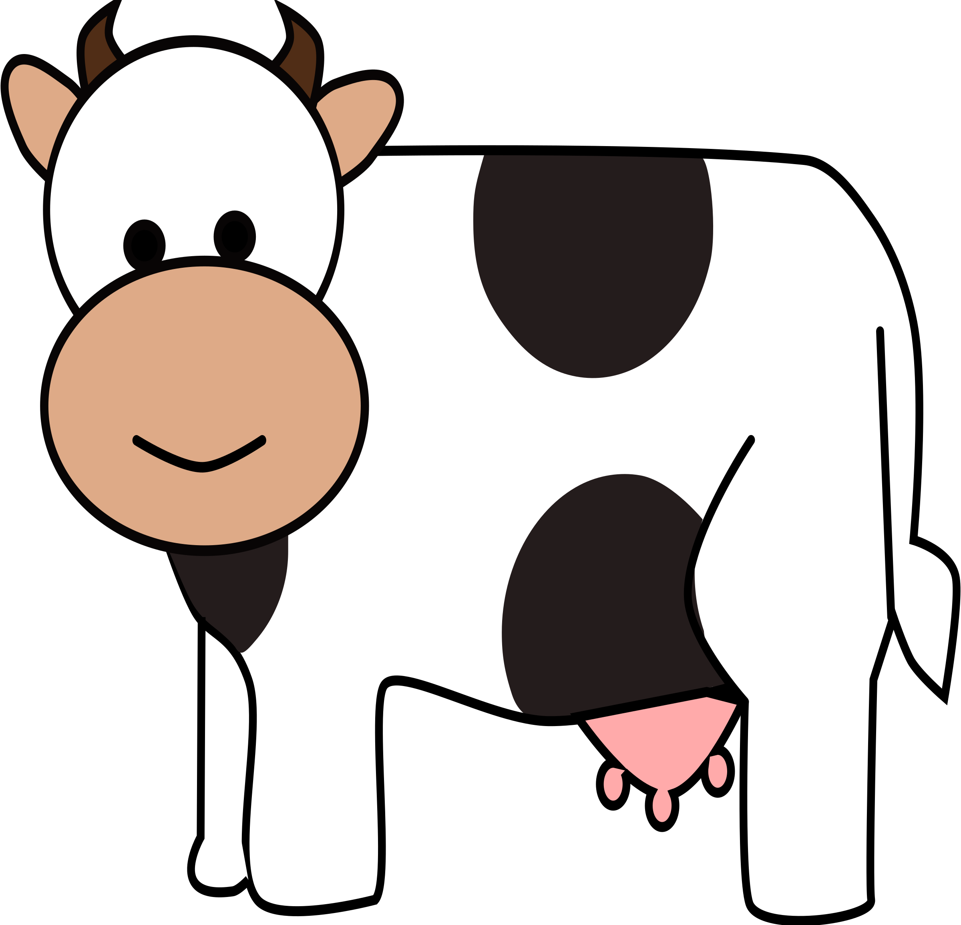
Activity: How can consumers support animal welfare when buying goods?
Opt for organic farming and free range foods as they prioritise animal welfare and environmental sustainability.
@j4p4n/creativecommons.org

Slide 11

Food Sustainability.
Meat Production requires more energy, land & water than the production of plant foods.
Where possible, chose locally produced foods- this benefits you, your environment and the local economy.
@glitch/creativecommons.org
@fjcanals/creative commons.org

Slide 12

Activity: Think-Pair-Share
In pairs,brainstorm the benefits of locally produced foods.
@Issi/creativecommons.org

Slide 13

Less environmental impact- less energy needed for transport, refrigerate, package & store food.
Locally produced, seasonal food is usually fresher, tastes better & is more nutritious
Less transport time= less chance of food spoilage and waste
Benefits of local produce
Supports local Irish farmers and communities.
@bingenberg/creativecommons.org

Slide 14
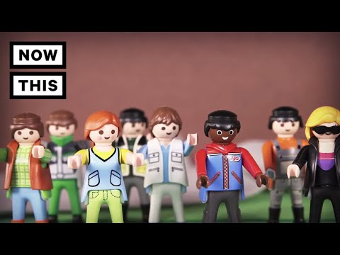
Being an ethical consumer!
@fineas_anton/unsplash.org

Slide 15
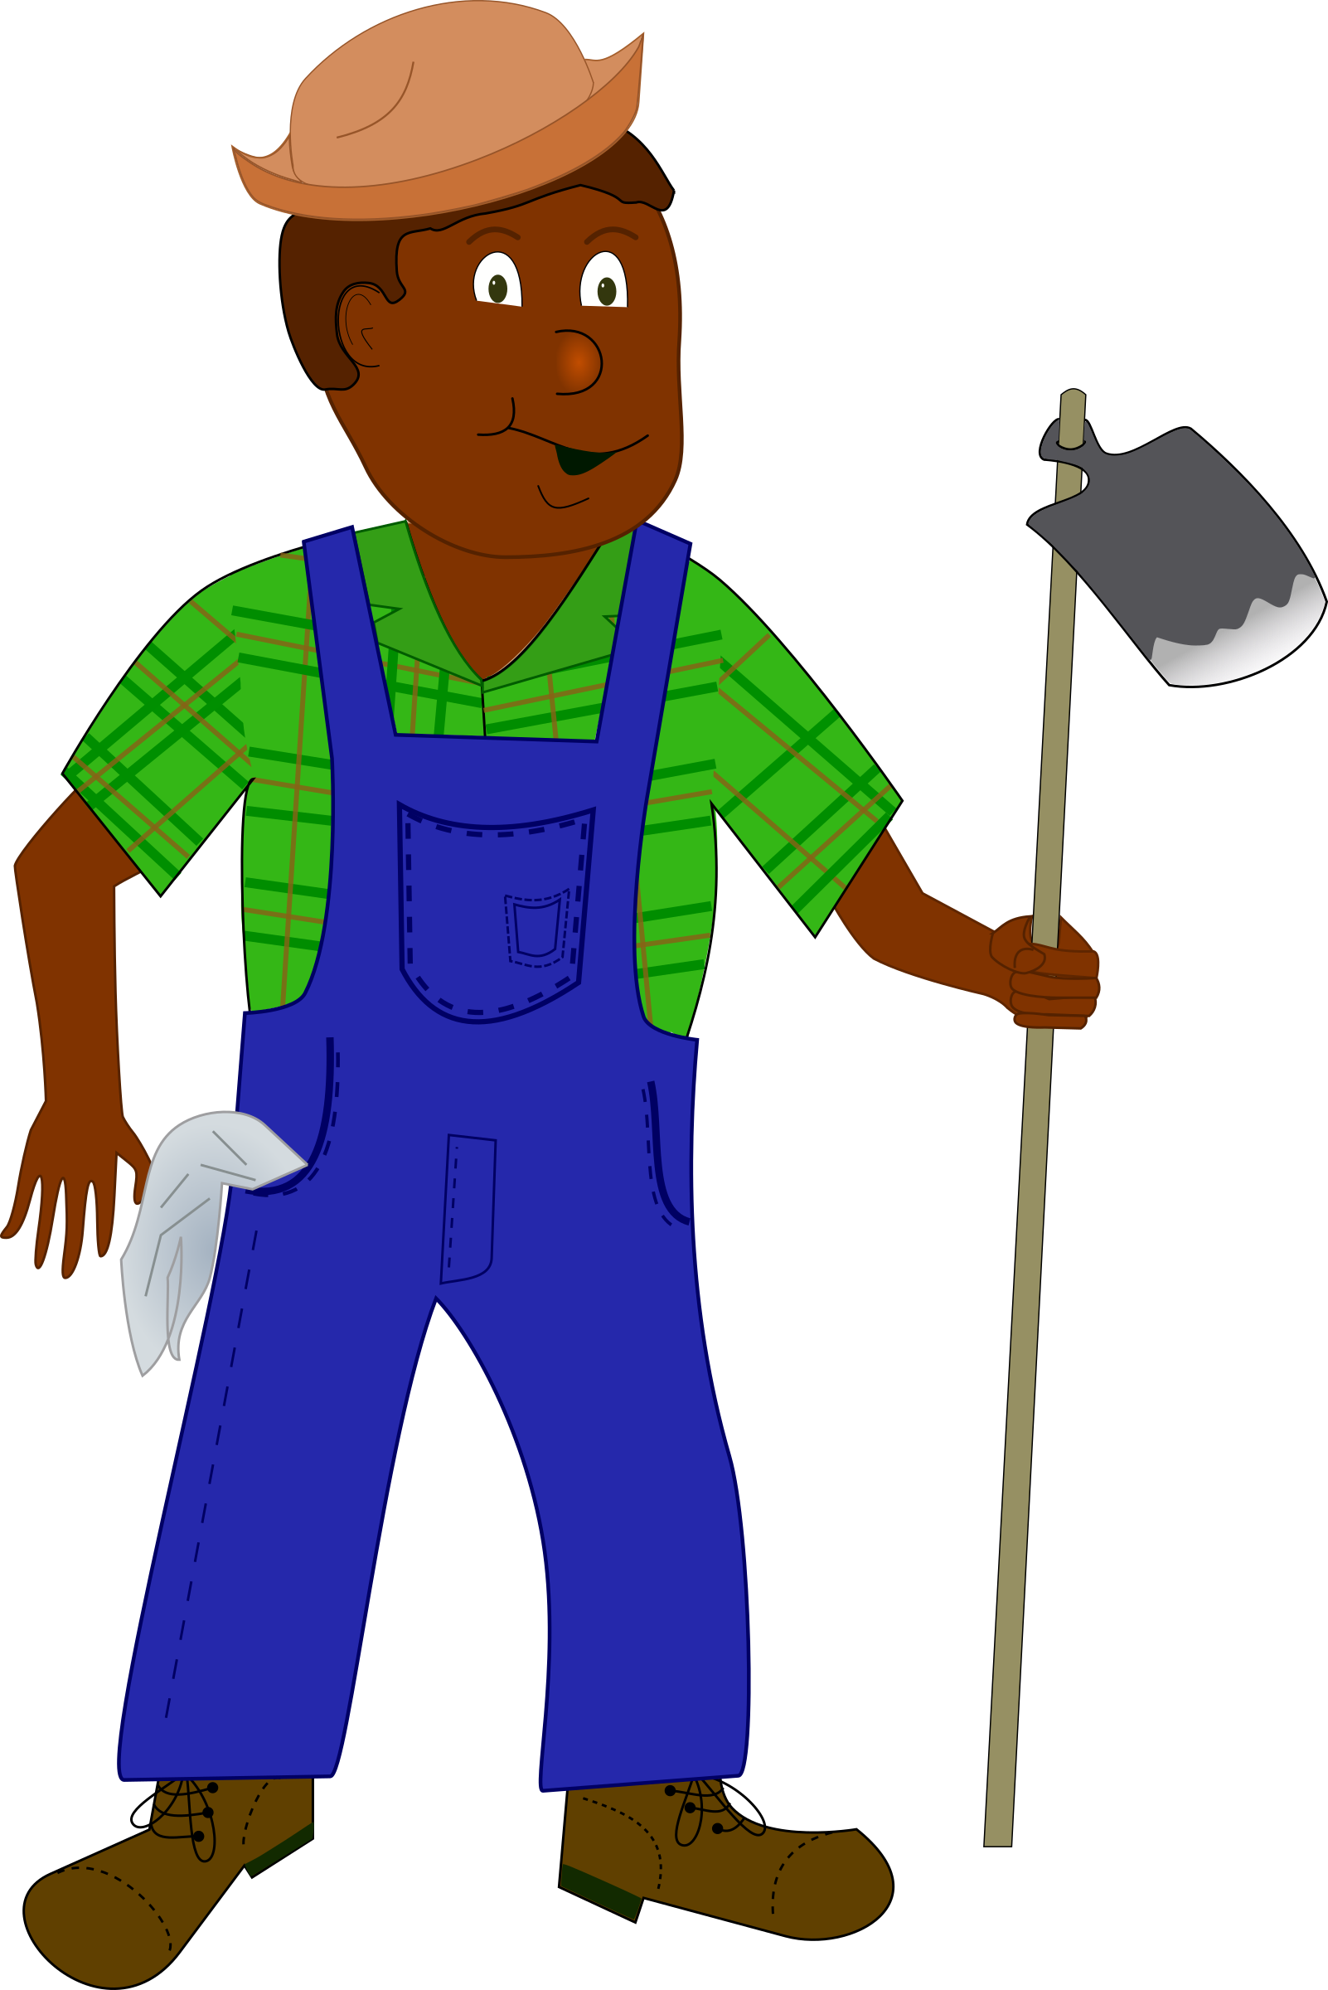
Ethical Consumption means
Requires you to make the connections between a product, where that product originated and in what context it has been produced.
@themartin/creativecommons.org
Examples
To purchase Fairtrade products
deciding whether or not to buy locally-produced products versus imported ones
whether to drive to work or use public transport

Slide 16

Fairtrade
Often, these workers cannot afford education for their children and their children may end up working!
Why? Workers receive low wages and often have poor standards of living.
To give people who produce the food you buy a fair price for their produce.
@wikimediacommons/googleimages.org

Slide 17
Fairtrade
Fairtrade aims to ensure people work in suitable conditions & children are educated in schools!
Fairtrade encourages farming & production practices that are environmentally sustainable i.e. organic farming
The Fairtrade logo tells you that a fair amount of money is going towards helping the community it is coming from
Protect human rights by promoting social justice, sound environmental practices and economic security
@wikimediacommons/googleimages.org

Slide 18
Fairtrade Products
Tea
Chocolate
Fruit
Coffee
Sugar
Honey
Fruits i.e. bananas, mangos & pineapples
@wikimediacommons/googleimages.org

Slide 19
Guessing game
What is the cost of the amount of food Ireland’s average house throws away yearly??

Slide 20
Guessing game
€400-€1000 a year!!!
(Source EPA website)

Slide 21

Food Waste Youtube
Circulate worksheet. Questions to be answered during video!

Slide 22
Activity: 2 minute Manic Brainstorm
In pairs, list reasons for food waste!

Slide 23

We do not check the use by dates of food in our cupboards/fridges
We buy too much food
Breads and leftovers are not used up in time.
Reasons for food waste
Our portion sizes are way too big! This leads to waste.
@publicdomainsymbols/creativecommons.org

Slide 24
Activity:
What are the main types of food wasted in the home?

Slide 25
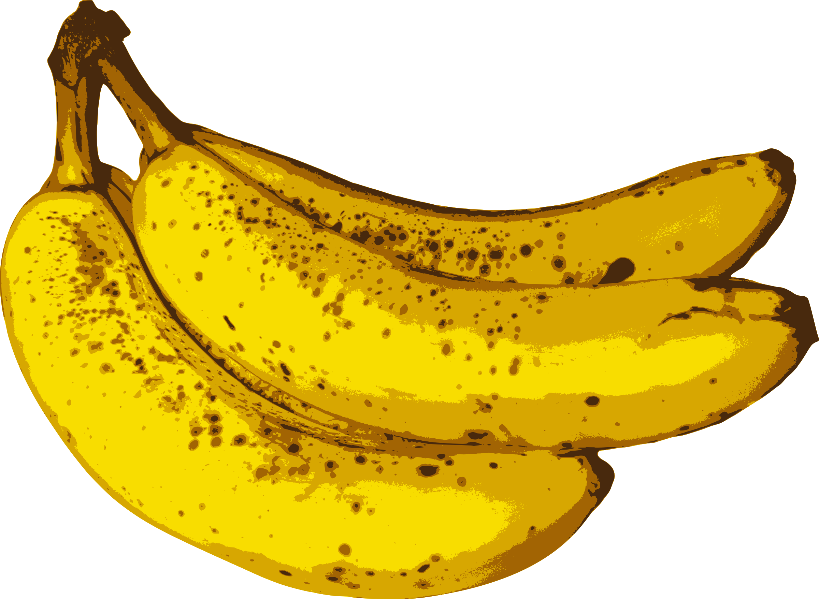

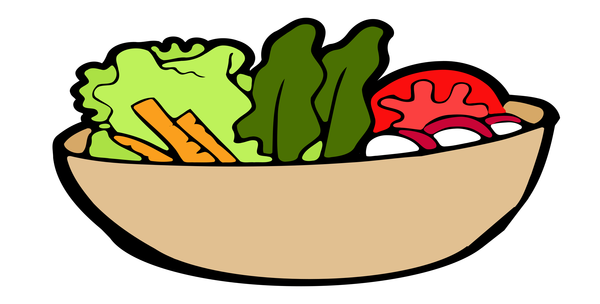
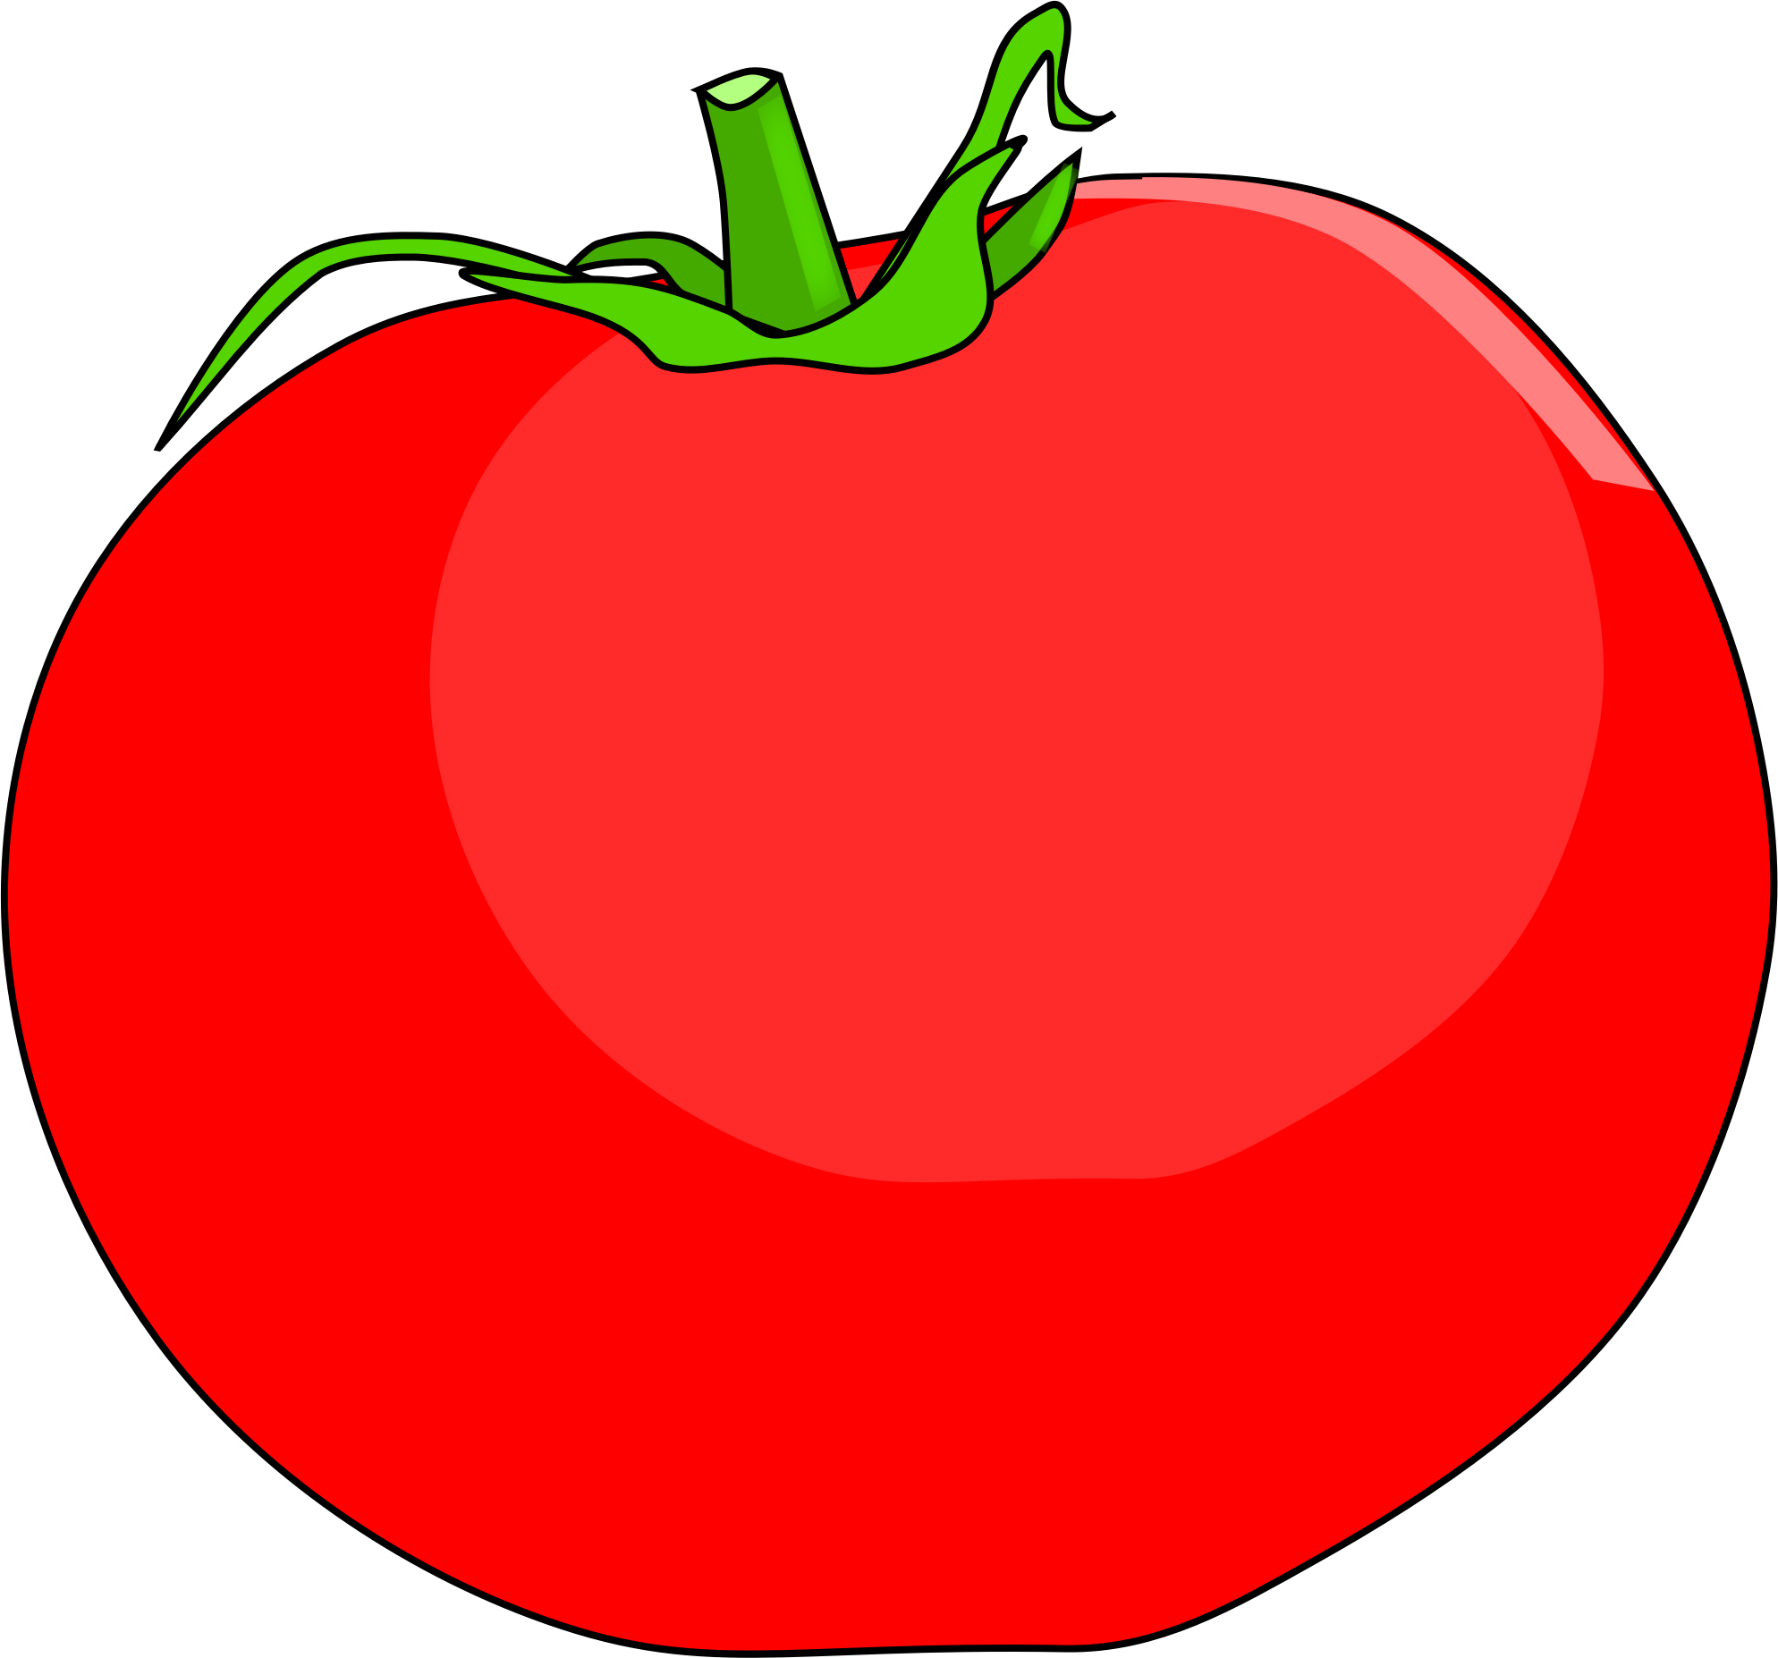


Major food felonies for wastage!
@j4p4n/creativecommons.org
@jack7/creativecommons.org
@j4p4n/creativecommons.org
@glitch/creativecommons.org
@budwhite72/creativecommons.org
@glitch/creativecommons.org

Slide 26
Activity: Jigsaw
In pairs, list reasons for food waste!

Slide 27
Plan your meals and stick to a shopping list.
Don’t overbuy the main type of food you are throwing up
Store leftover food correctly and use up ASAP.
Ways to prevent food waste
Serve correct portion especially for children..
@publicdomainsymbols/creativecommons.org

Slide 28
Using leftover food
Advantages | Disadvantages
Avoids food waste Saves Fuel Useful in emergencies Adds variety- Interesting dishes can be made using leftovers | Loss of food value from reheating/freezing/drying. Time required to prepared. Can lack flavour, colour & moisture. Danger of food poisoning if not treated carefully.

Slide 29
Food Preservation
‘’Prevents food going bad/spoiling’’.
Causes:
M
icroorganisms
A
ir
E
nzymes

Slide 30

Microorganisms need
T
ime
W
armth
O
xygen
F
ood
@J_Alves/creativecommons.org
M
oisture

Slide 31
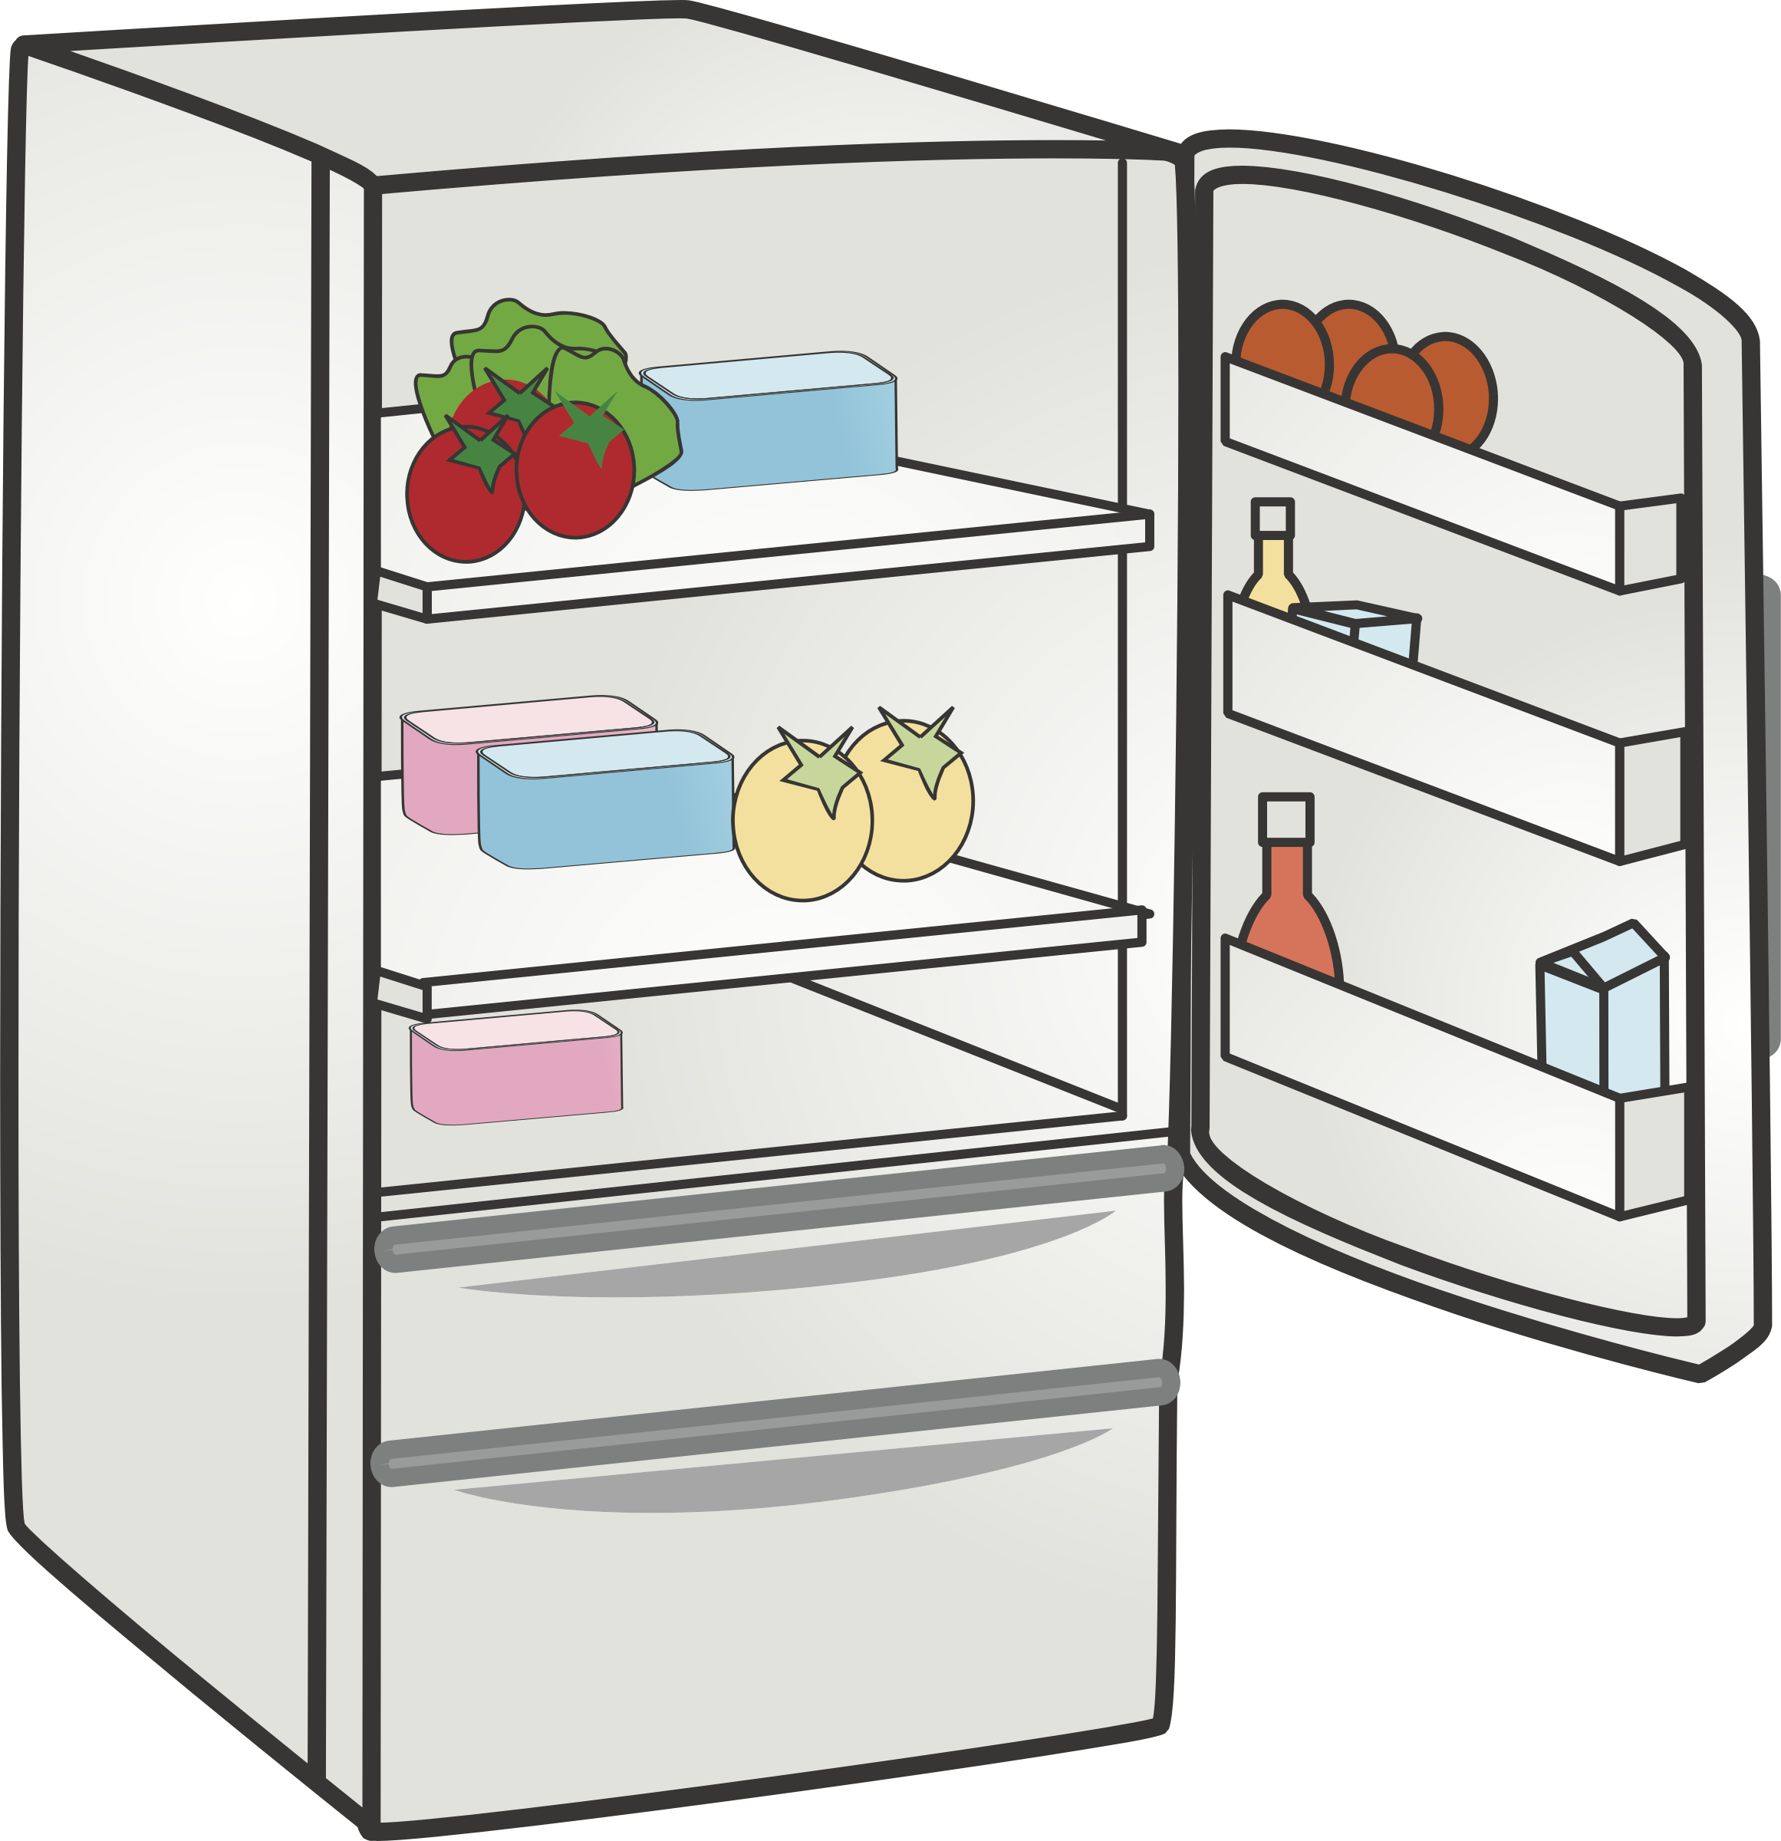
Saves time & energy as preserved foods need little preparation
Prevents waste- saving money and it is better for the environment
Adds variety to the diet
Advantages of preserving
Seasonal food i.e. strawberries are available out of season.
@oksmith/creativecommons.org

Slide 32
Preservation means
Removing or more of the growth conditions so that microorganisms cannot grow & enzymes are inactivated.
Removing warmth | Refrigeration, Freezing
Removing moisture | Drying
Removing oxygen | Canning, Bottling
Changing pH | Using vinegar as a preservative
@fineas_anton/unsplash.org

Slide 33
Methods of Preservation
Method | How it works | Examples
Freezing | Low temperatures Water changed to ice Food is wrapped & sealed | Vegetable, meat
Canning | High temperatures Airtight sterile cans | Fruit Fish
Drying | Moisture removed Airtight packaging | Pasta, milk
Freeze-drying | Food is frozen, moisture then removed. Airtight packaging Better retention of texture colour and flavour. | Coffee granules, vegetables in dried soups
Jam making | Boiling of fruit, high sugar content. Airtight sterile jars | Strawberries, blackberries
Pasteurisation | Milk is heated, cooled & stored in sterile containers. | Chutney, bacon, jam
Irradiation. | Energy waves passed through the food kill microorganisms. | Herbs, spices

