Slide 1
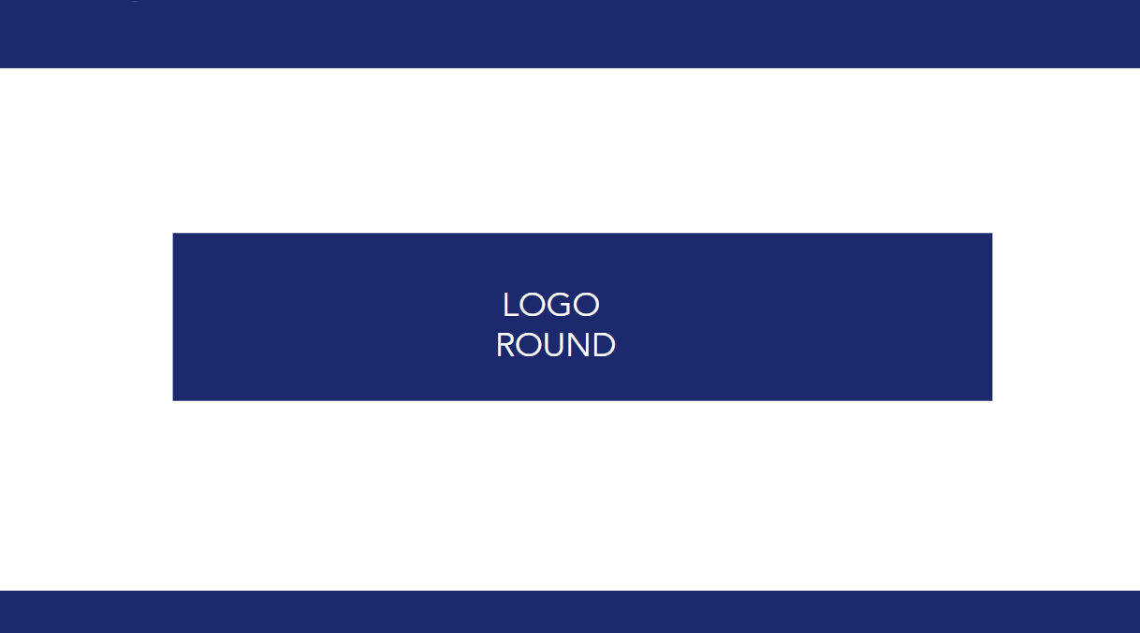

LOGO
ROUND

Slide 2



QUESTION 1
A
NWS ROUND
Which logo is the
real Twitter logo?
B

Slide 3
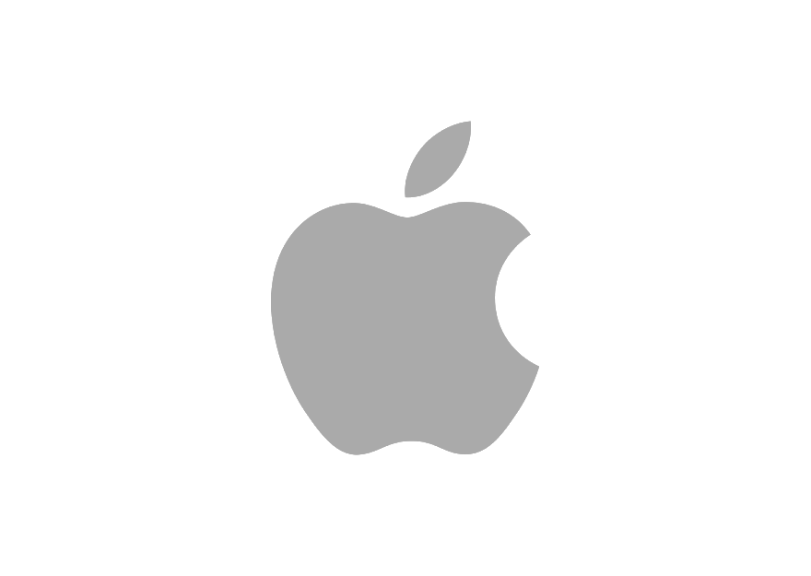
QUESTION 2
A
NWS ROUND
Which logo is the
real Twitter logo?
B

Slide 4


QUESTION 3
A
NWS ROUND
Which logo is the
real Microsoft logo?
B

Slide 5

QUESTION 4
NWS ROUND
What organisation does this logo represent?

Slide 6

QUESTION 5
NWS ROUND
What car does this logo represent?

Slide 7

QUESTION 6
NWS ROUND
What political party does this logo represent?

Slide 8

QUESTION 7
NWS ROUND
What does this logo represent?

Slide 9
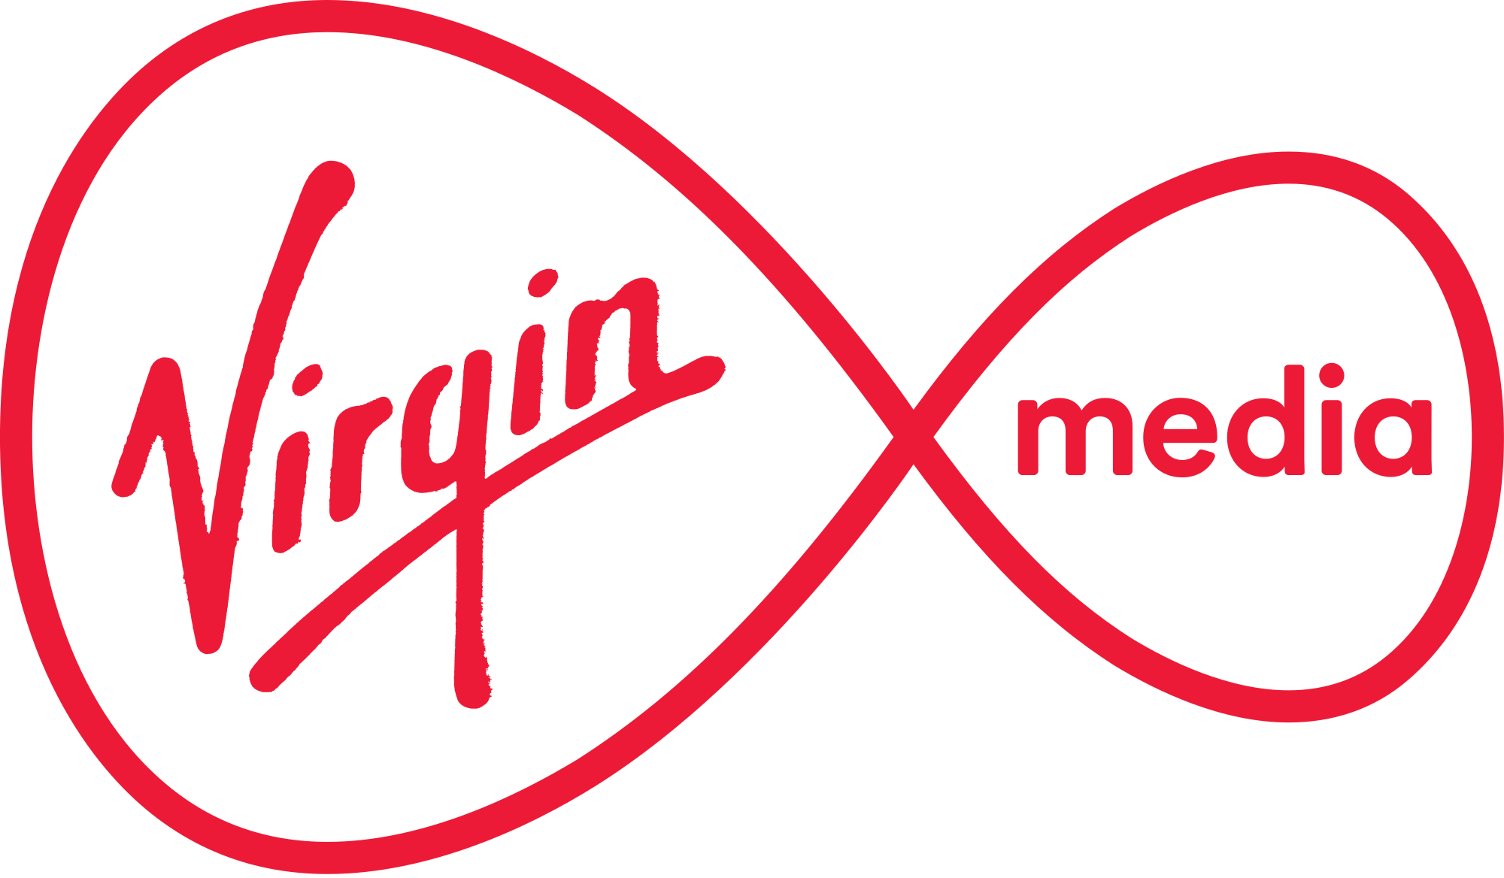
QUESTION 9
NWS ROUND
What does this logo represent?

Slide 10
1. A
6. Fine Gael
2. A
7. Bord Gáis
3. A
8. National Lottery
3.
4. United Nations
9. Virgin Media
5. Chevrolet
10. Irish Ferries

