Slide 1

Global Food Production
How will we produce more food using less resources?

Slide 2
Learning Intentions:
By the end of this lesson you will be able to:
Distinguish between food security and food insecurity.
Describe factors that influence the global food production system.
Evaluate the ways in which our food production system can become more sustainable.
Links to Science LO: 5.10, 1.10

Slide 3


New Terminology
Food Insecurity
The Food Gap
Food Security
Food Insecurity is the physical or uncertain availability of food or inability to acquire safe and nutritious food.
The Food Gap refers to the difference between the amount of food produced and the amount of food needed worldwide.
Food Security is the assured access to enough nutritious food to sustain an active and healthy life.

Slide 4
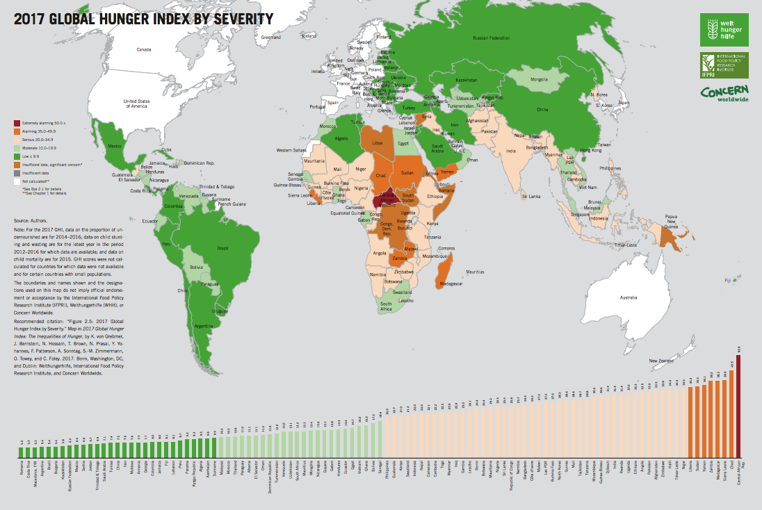
Starter Task:
Visit the Global Hunger Index tool by
clicking on the above image.
Note which countries have a low GHI
and a high GHI.
Global Hunger Index
The GHI is a tool designed to measure and track hunger at a global, regional and national level.
The GHI scale ranges from 0 to 100, where 0 is the best score (no hunger) and 100 is the worst score.
List 3 countries with a low GHI: _______________________________________
List 3 countries with a high GHI: _______________________________________
Image Source: This Photo by Unknown Author is licensed under Creative Commons

Slide 5
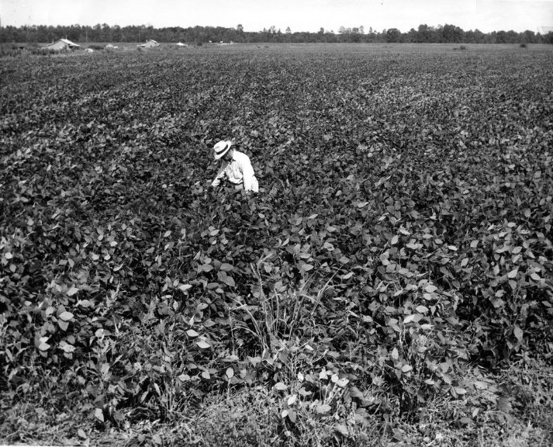

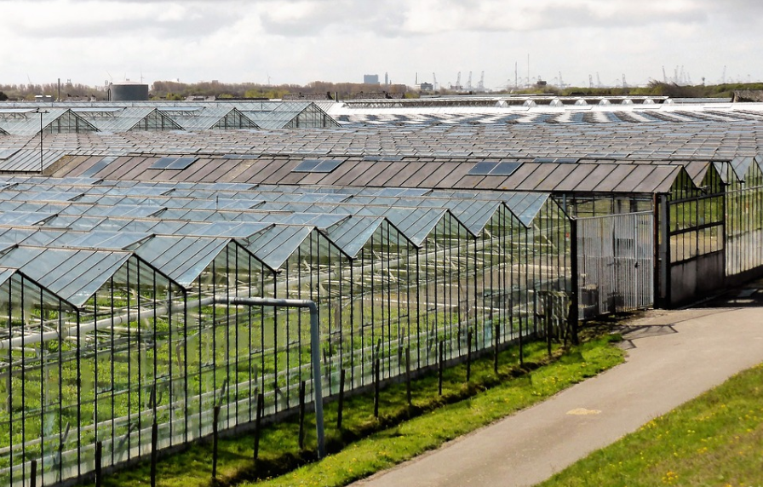
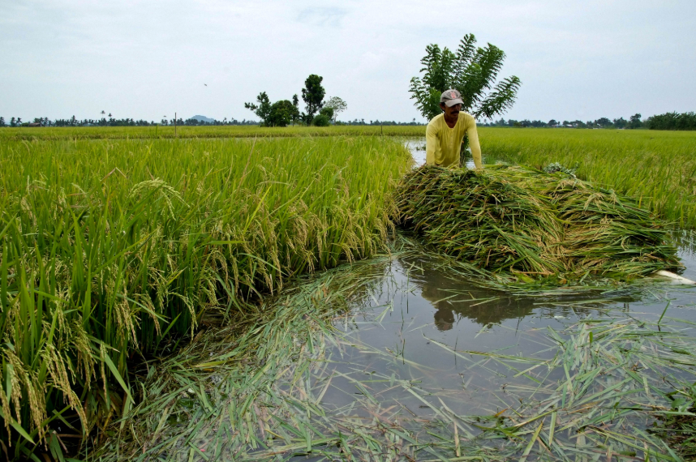
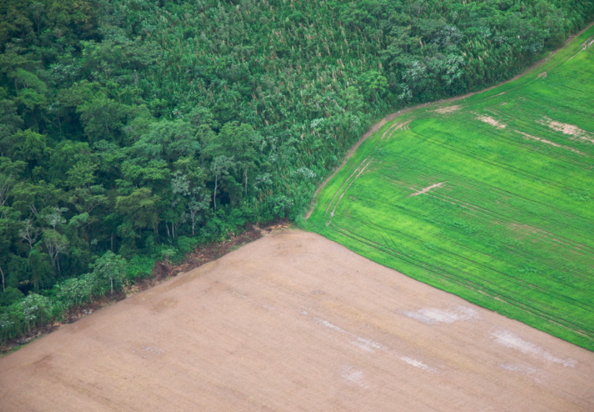
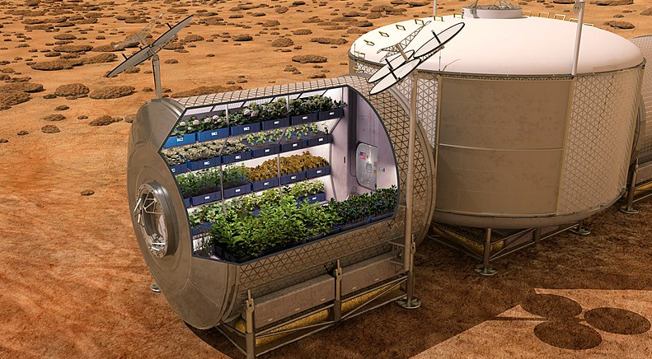
Task:
Responding to Photographs.
Look at the following images.
What do you see in the picture?
What key message is the picture illustrating?
What are they key questions they give rise to?
Teachers: Read about how you can use photographs in your lesson. Click HERE

Slide 6
https://www.flickr.com/photos/missouristatearchives/13974172874
The current world population of 7.6 billion is expected to reach 8.6 billion in 2030, 9.8 billion in 2050 and 11.2 billion in 2100’
United Nations Report, 2017.
Image Source: This Photo by Unknown Author is in the Public Domain
Notes:
Food security/insurity, more people to feed, more food is needed.

Slide 7
Image Source: This Photo by S. Beebe is in the CC BY
‘The planet must produce more food in the next 4 decades than all farmers in history have harvested over the past 8,000 years’
- Ernest von den Ende, managing director WUR’s Plant Science Group
Image Source: This Photo by Unknown Author is licensed under Creative Commons
Notes:
Food security/Insurity, more food needed, new farming techniques needed, benefits of greenhouses,

Slide 8
“I’m sitting right now looking at a soybean field, it’s probably 90 or 100 acres and there’s not a single weed in this whole field, there’s nothing else growing but soybeans. This is all desert land as far as the bees go.”
- Tim Tucker
Image Source: This Photo by MSA located on Flickr
Notes:
Food security/insurity, use of pesticides/chemicals, genetically modified food, loss of biodiversity,

Slide 9
‘A one metre sea level rise could flood 17% of Bangladesh, one of the world’s poorest countries, displacing tens of millions of people & reducing its rice-farming land by 50%’
- The Royal Society
Image Source: This Photo by IRRI is in the CC BY 2.0
Notes:
Food security/insecurity, less farmland due to flooding, more people in less area, hydroponics, aeroponics

Slide 10
‘Agriculture is estimated to be the proximate driver for around 80% of deforestation worldwide’
Kissignger et al, 2012, Synthesis Report for REDD+
Image Source: This Photo by S. Beebe is in the CC BY
Notes:
Food security/insecurity, need for more farmland to produce food, deforestation contributing to the greenhouse effect,

Slide 11
‘If massive increases in agricultural yield are not achieved, matched by massive decreases in the use of water and fossil fuels, a billion or more people may face starvation.’
Ernest von den Ende, managing director WUR’s Plant Science Group
Image Source: This Photo by NASA is in the Public Domain
Notes:
Food security/insecurity, need more food, need to use less natural resources when producing food, new technology needed to produce food more efficiently, how does NASA plant food in Mars?

Slide 12
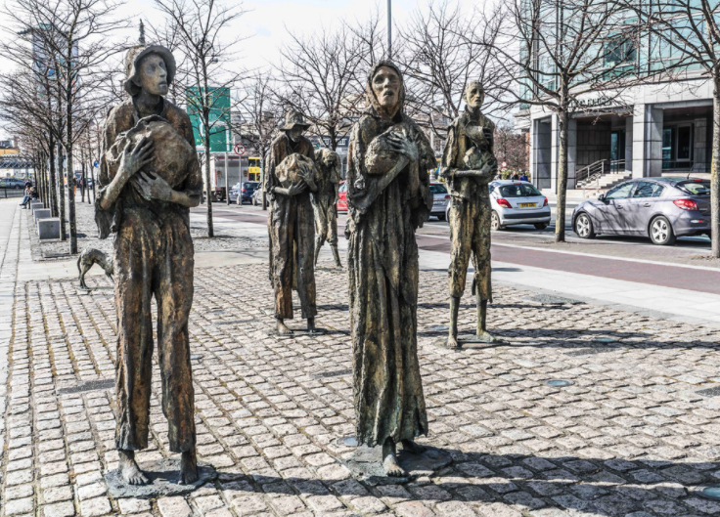
‘We are dangerously reliant on a few crops. Only 12 plants provide 80% of the World’s food - wheat, maize, rice, barley, sorghum, soybean, potato, yam, sweet potato, sugarcane, sugar beet, banana.’
- Professor Sue Hartley, Director of the York Environmental Sustainability Institute at the University of York.’
Image Source: This Photo by W.Murphy is licensed under CC BY-SA
Notes:
Food security/insecurity, famine, danger associated with over relying on certain crops,

Slide 13
Climate Change:
Resources:
Population Growth:
What factors influence global food production?
Farming Techniques:
Diets/ Food Consumption:
Food Waste:
Research each factor mentioned above and write a paragraph for each factor. Your paragraph should provide details on how the factor influences global food production.

Slide 14
Climate Change: Climate change is likely to impact negatively on global food production. As climate change progresses, extreme events, such as droughts and floods, are forecast as well as a rise in sea levels. The amount of land available for agriculture could reduce and there could be a risk of a diminished food supply due to weather damage. The timing and length of the growing season will change and this could impact on the quality of land and yield of crops.
Resources: Food production crucially depend on natural resources: land, soil, water, biodiversity and fossil fuels. If we want to ensure all people have safe and nutritious food, in appropriate amounts, these resources need to be managed sustainably and used efficiently, while reducing environmental impact. Over-fishing, intensive farming and over exploitation of natural resources impact negatively on global food production and food security. We need to investigate ways to produce more food using less resources.
What factors influence global food production?
Population Growth: The world population is expected to reach 8.6 billion in 2030 and 9.8 billion in 2050. This increase in population will put pressure on the environment, global food supplies, and energy resources. Solutions for feeding the extra billions in the future are being studied. At the moment, one in every seven people go to sleep hungry.
Farming Techniques: In the early 1960s, India was on the brink of mass famine because of a rapidly growing population, so they put in place the ‘Green Revolution’. The term Green Revolution refers to the changes in agriculture practices that happened between 1940-1960s. The aim of the Green Revolution was to increase farming output and productivity. The techniques used to increase the food production included the use of fertilisers, pesticides, irrigation schemes, machinery and selectively breeding plants. These practices replaced the traditional farming practices. Is it time to investigate new farming practices that can meet the needs of the future?
Diets/ Food Consumption: More people on our planet consume greater amounts of meat, more land is required to support this diet. Some people think it would be more sustainable if we were all vegetarians. The reason being is that vegetarians have a shorter food chain than meat eaters. Energy is lost along food chains. If we reduce the number of steps in the food chain when we produce the food, the efficiency of food production could increase.
Meat Eaters: Grass -> Cattle -> Humans
Vegetarians: Cabbage -> Humans
Food Waste: Each year we throw away approximately one-third of the food we buy. All that food that never gets consumed requires water and energy to grow, harvest, transport, prepare, package and store. Households could reduce their food waste by making a few changes and this, in turn, would reduce the demand for food production.
Have a look at these SAMPLE paragraphs.
Compare the sample paragraphs to paragraphs you wrote.
Did you mention different points in your paragraphs?

Slide 15

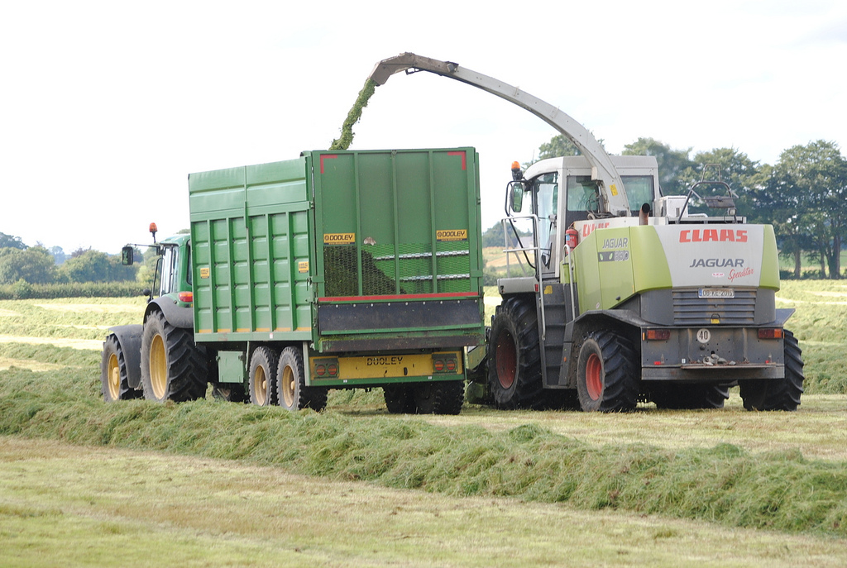
We have looked at factors that influence
global food production.
Now, we will look at
What ‘sustainable food production’ means?
Why ‘sustainable food production’ is important?
Why Ireland is so well suited to sustainable food production?
Sustainable Food Production
Task: Watch the Origin Green video and answer the above questions on sustainable food production.
Image Source: This Photo by P. Moloney is in the CC BY-SA 2.0
Solutions to questions available here...
Notes:
What is Origin Green >>> https://vimeo.com/246459914

Slide 16
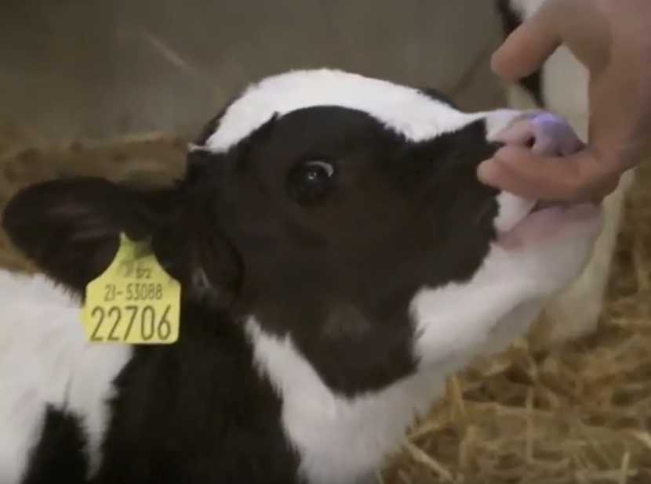
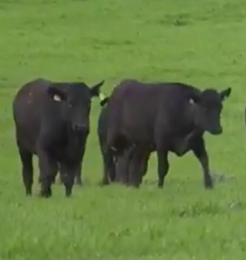
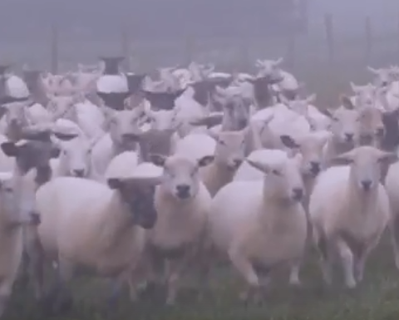
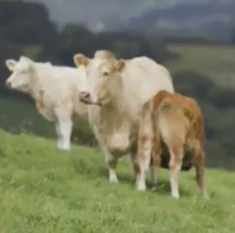
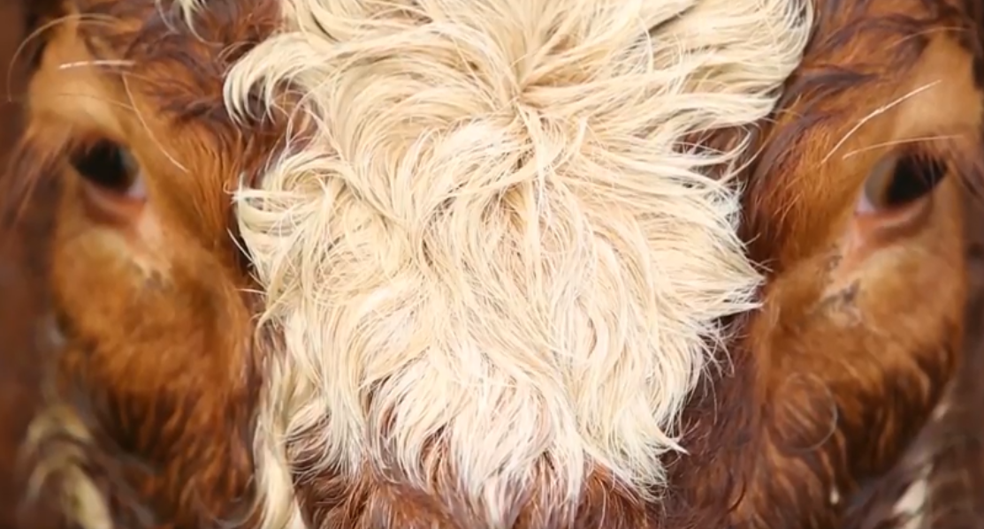
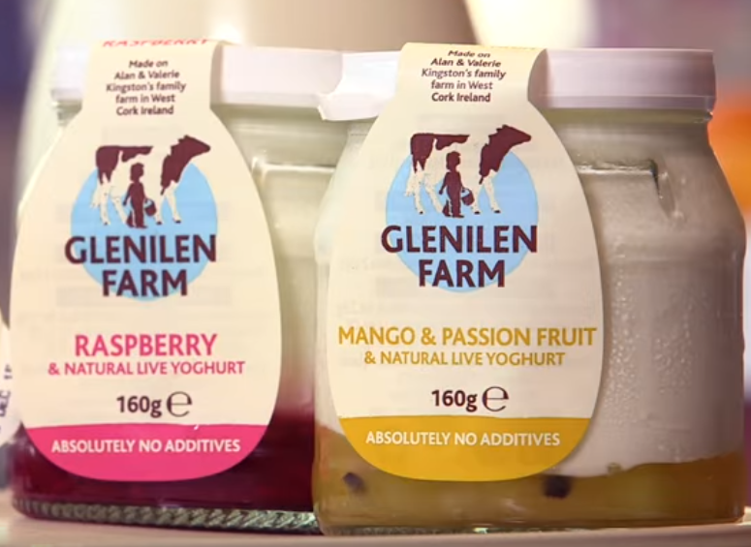
Origin Green is Ireland’s food and drink sustainability programme.
For farmers, Origin Green is about managing farms responsibly. Farms are inspected every 18 months. Factors measured include traceability, animal health and welfare, also greenhouse gas emissions, biodiversity, energy efficiency, soil management and water conservation.
Task: Each group is to watch one of the below case studies and report back to the class.
Joe Hayden
Paddy Redmond
Richard Hogg
David Johnson
David Kinsella
Genilen Farm
Notes:
Additional video explaining Origin Green with Saoirse Ronan >> https://www.youtube.com/watch?v=ydP2SG8pANA

Slide 17
Farm | Type of Farm | How the Farmer is Farming Sustainably | The Benefits of Farming Sustainably
Joe Hayden
Paddy Redmond
Richard Hogg
David Johnson
David Kinsella
Genilen

Slide 18
Farm | Type of Farm | How the Farmer is Farming Sustainably | The Benefits of Farming Sustainably
Joe Hayden | Dairy Farm with Holstein Friesian cows | Has set realistic targets Follows objectives set by carbon navigator Performs farm sustainability assessments Protects trees, hedgerows and wetlands (flora and fauna). | Increases the protein and fat content in milk Reduces the carbon emissions using a carbon navigator. Boosts a business approach to the diary enterprise. Helps drive profitability
Paddy Redmond | Beef farm in Wexford with 900 angus cattle | Participates in farm sustainability assessments Has inspections on animal welfare & medicines Has set grass utilisation targets Reseeds new fields every year More efficient in getting cattle slaughtered off the farm. Grows hedgerows and trees. | Sustainable: Meets the needs of future without compromising future needs. Increases the quality of beef Reduces the carbon footprint of the farm.
Richard Hogg | Mixed farm with suckler cows and sheep. | Identifies areas of weakness. Sets targets to improve and progress the farm. | Enhances environment Increases days that cows are grazing Helps drive profitability Ireland has chance to be market leaders on environmental protection.
David Johnson | Beef and tillage farming in Wicklow | Sets targets and aims to meet them. | Eradicates inefficiency Ensures we get the most out of our money Origin green helps people work together for a common goal.
David Kinsella | Beef farm in Wexford | Monitor the average daily gain of calves. Get the calf ready for the factory in as short a period of time. Grow as much grass as possible and utilise it. Avoid having animals that are not calving or producing bad calves. | Get tips on how to improve Produce food more efficiently Lower carbon footprint More high quality yields of beef produced from a set amount of inputs.
Genilen | Use milk from nearby farm to produce yoghurts and dairy products West Cork | Has solar panels on the roof. It heats 65% of water in the year. Harvests rainwater on the roof of their dairy farm. | Making the best use of natural resources Keeps life in a rural area Protects what we currently have.
Sample

Slide 19
Final Task/ Homework:
To what extent do you agree with this statement?
‘Humans can successfully contribute to global food production’
Success Criteria
In Line With Expectations | Above Expectations | Exceptional
Can provide evidence on whether there is enough food in the world to feed everyone. Can list the factors that affect food production. Can identify ways in which humans can improve food security locally. | Can use appropriate evidence to support judgement. Can describe the factors that affect food production. Can describe ways in which humans can improve food security nationally. | Can use a variety of reliable sources to appropriately support their judgement. Can demonstrate a detailed understanding on the factors that affect global food production. Can provide solutions to some of the factors the impact negatively on global food production. Can describe ways in which humans can improve food security globally.

Slide 20

THANK YOU!
Lesson activities by:
Inspired by:
PPT Template by:
Alexander Martensson
Email
martensson@example.com

