Slide 1
Soil Profiles
Leaving Cert. Agricultural Science

Slide 2
Classification
Soil profiles are a useful method of classifying soils.
Soil profiles are determined by examining
  the proportions of each ‘horizon’ and
  The colour of each horizon
For your leaving cert exam there are 3 main profiles to know:
  Brown Earth
  Podzol
  Gley
Students are expected to draw each profile for the exam

Slide 3
Drawing a soil profile
As for any diagram in the exam, give yourself at least half a page
Use pencil
You can use colour but this isn’t a good idea if you are against time
The examiner is looking for correct proportions, and correct labels to indicate colours.

Slide 4
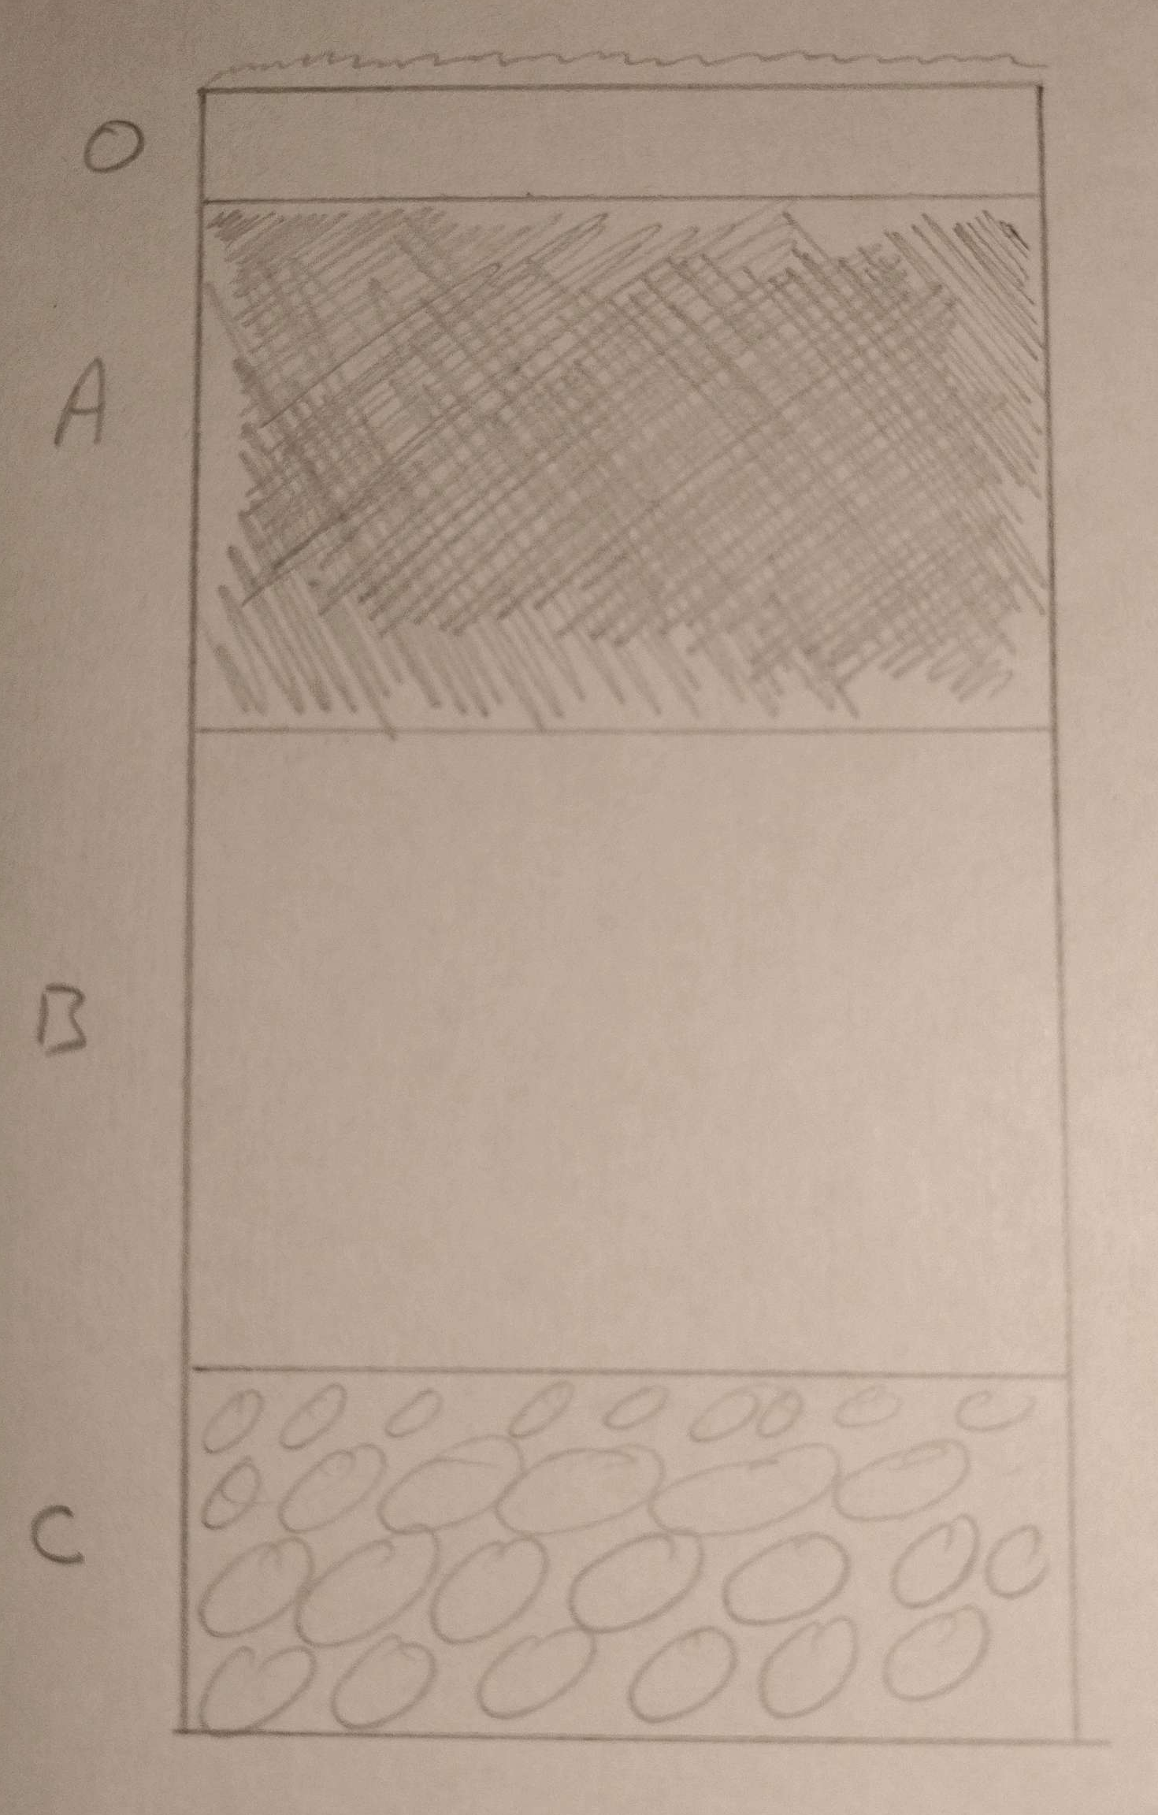
Horizons
O – Organic horizon
  This is topmost layer, made of vegetation, humus, etc.
A – Top soil
  A horizon is a mixture of mineral and organic particles
  Most important layer
  Size of A determines the quality of a soil
B – Sub soil
  Mineral matter mostly: sand, silt, and clay
C – Bedrock / Broken rock

Slide 5
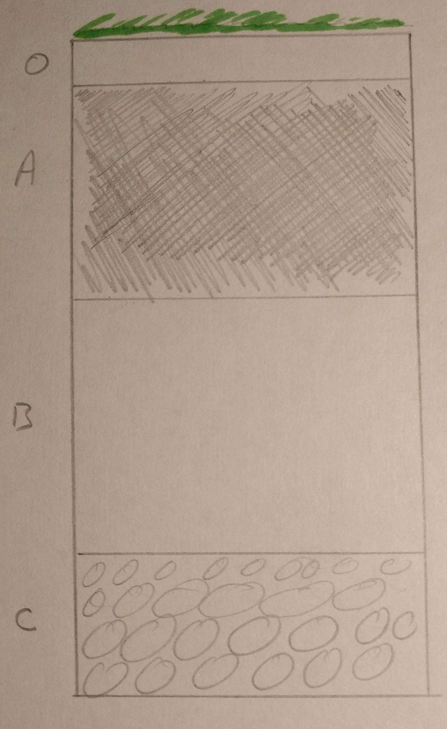
Brown Earth
Thick O horizon, i.e. plenty of humus in soil
Brown earths have an even distribution of organic
And mineral particles, this leads to the uniform
brown colour in each horizon

Slide 6
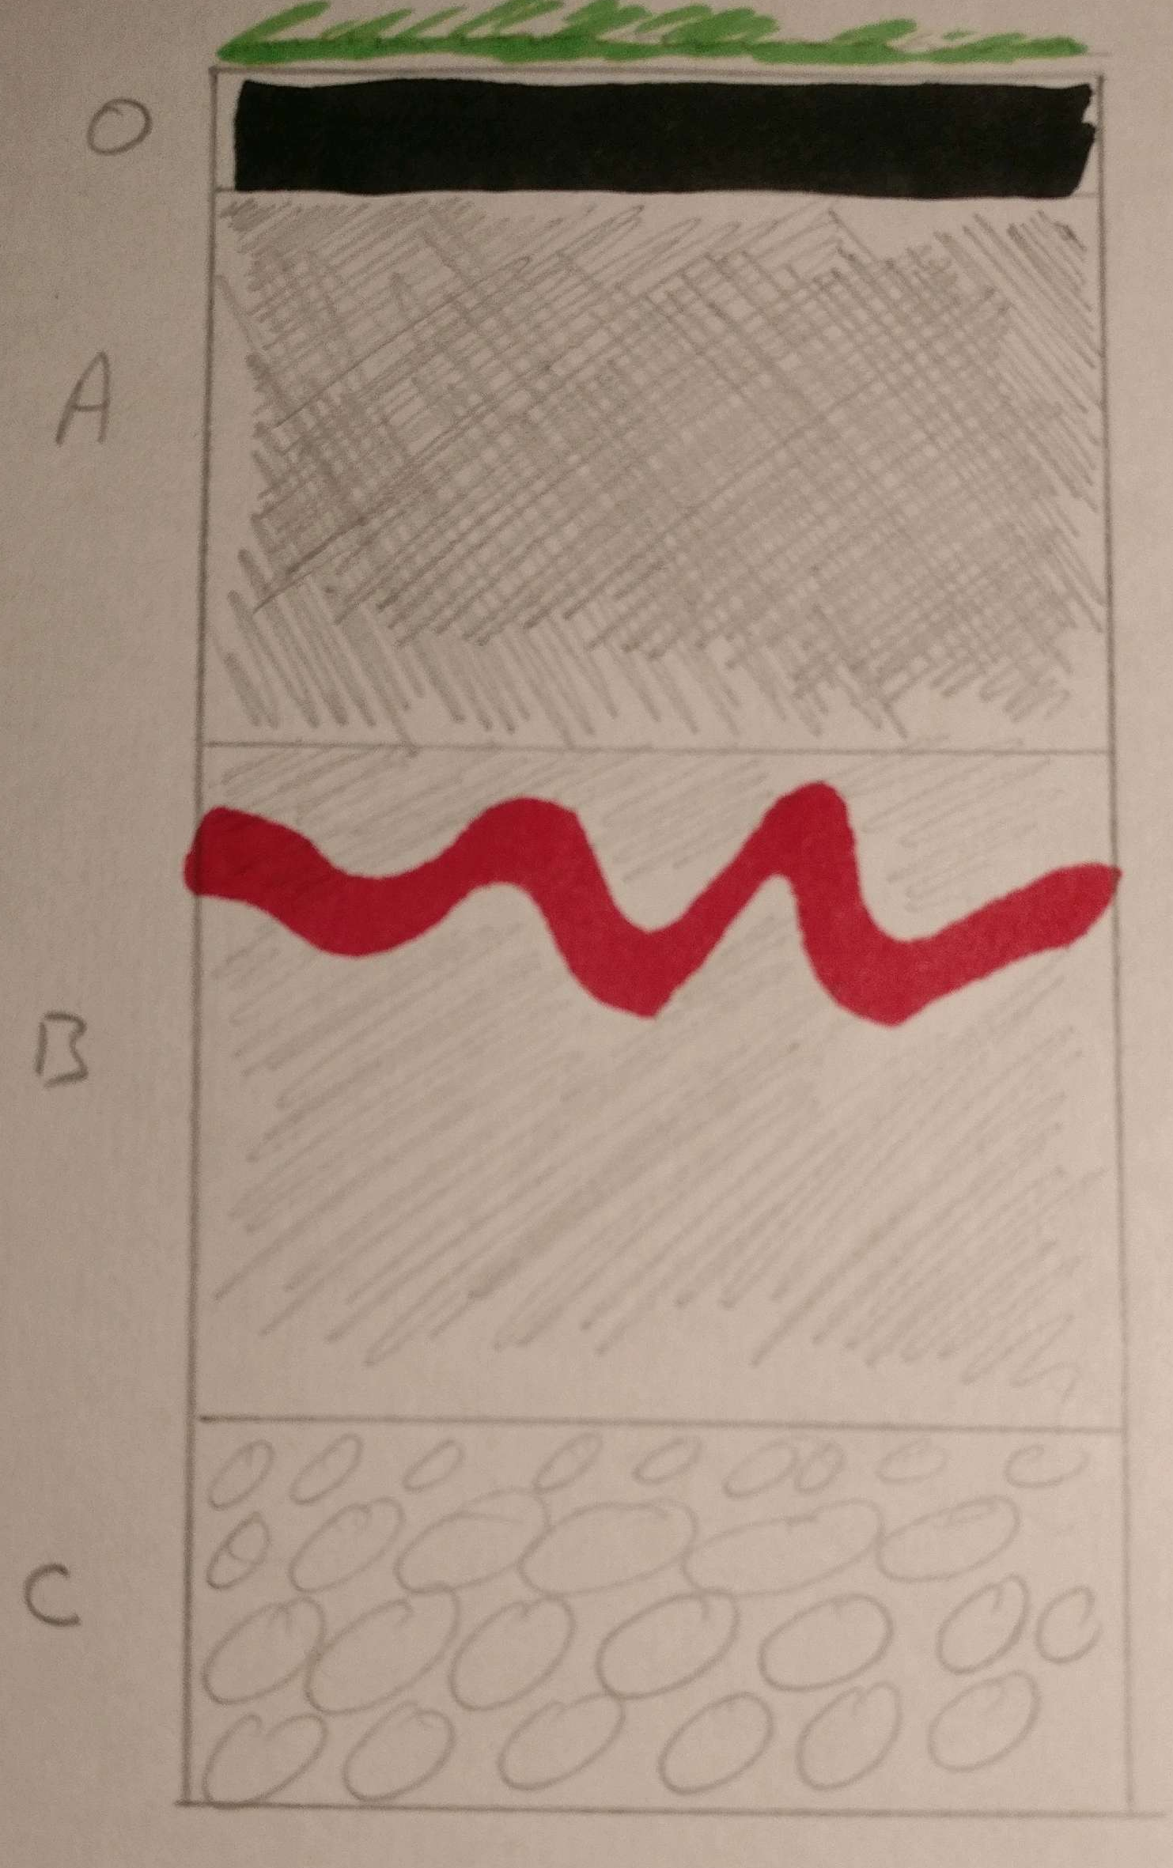
Podzol
Black O Horizon due to acidic leaf litter
Bleached (not as brown) A Horizon due to leaching of minerals
Iron pan formed between A + B horizons. Due to the accumulation of Iron and Aluminium from top soil. Impermeable to water and plant roots
Note that the proportions for Brown Earth and Podzol soils are the same,
when drawing them in the exam it’s easy to remember the only structural
Difference is the iron pan

Slide 7
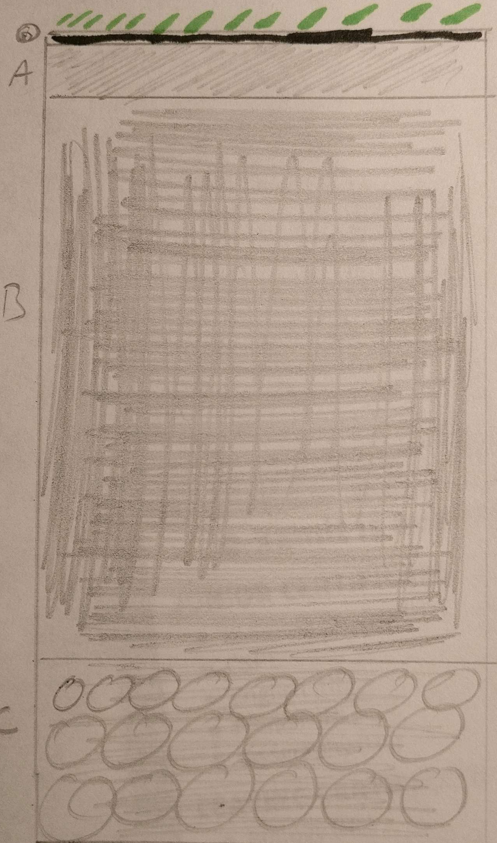
Gley Soils
Very narrow O horizon – key difference in the formation of gley vs. bog (a lot of organic matter)
A Horizon very thin – little to no organic matter, bleached/grey in colour
B Horizon is incredibly large by comparison to Brown Earth and Podzol. It has a mottled blue/green appearance due to anaerobic bacteria. This will turn orange/red if exposed to oxygen

Slide 8
Study advice
Go back through exam papers and practice drawing each of the three soil profiles.
Check the marking scheme to see how many marks are awarded in each case.
Remember when drawing, use at least half a page and make notes/labels very clear
Use pencil in case you make a mistake
Watch your time in the exam

