Slide 1
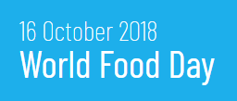
Farm to Refrigerator
How can our food choices become more sustainable?

Slide 2
Learning Intentions:
By the end of this lesson you will be able to:
Describe the life cycle of food and plastics.
Evaluate sustainable living strategies people can employ to reduce the environmental impact of their choices.
Links to: Science C3.10
Cross curricular links:
Home Ec 1.1 and 1.15 and CSPE 2.4

Slide 3
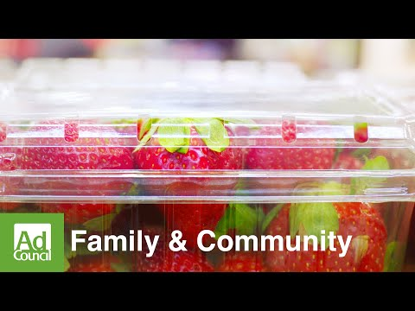
Life Cycle of a Strawberry
Starter Task:
Watch the video clip and create a flowchart documenting the life cycle of food.
Play video with no sound

Slide 4
PRODUCTION:
Cultivation/Purchase of seeds/fertilizer
Planting and growing plants
Harvesting plants
DISPOSAL:
Disposal of food scraps in a compost
Reuse food and its packaging
Recycle packaging
Non Recyclable packaging goes to landfill site.
Vestibulum congue
PRODUCTION
DISPOSAL
Life Cycle of Food
Vestibulum congue
Vestibulum congue
DISTRIBUTION
DISTRIBUTION
CONSUMPTION
Purchase the food
Transport the food home
Prepare the food
Consume the food
DISTRIBUTION:
Transportation
Processing
Packaging
Distribution to retailer/ consumer
Vestibulum congue
CONSUMPTION
Notes:
The next few slides will focus on some issues associated with Distribution - Transportation.

Slide 5

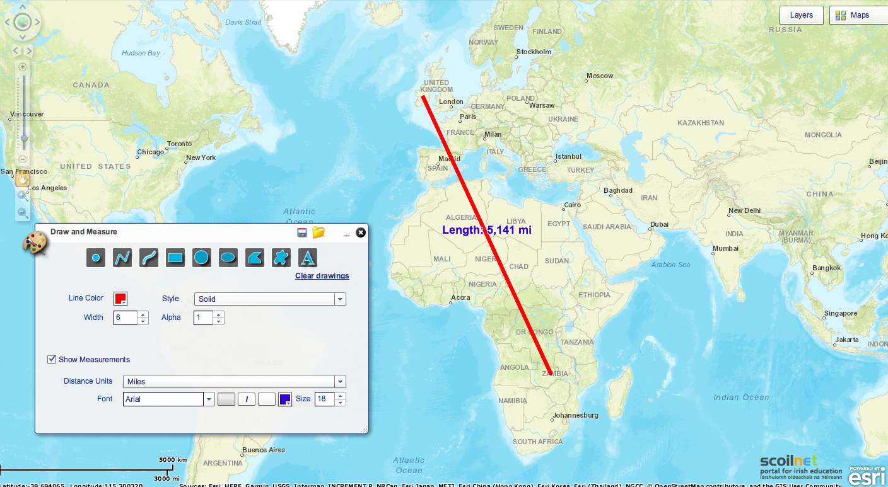
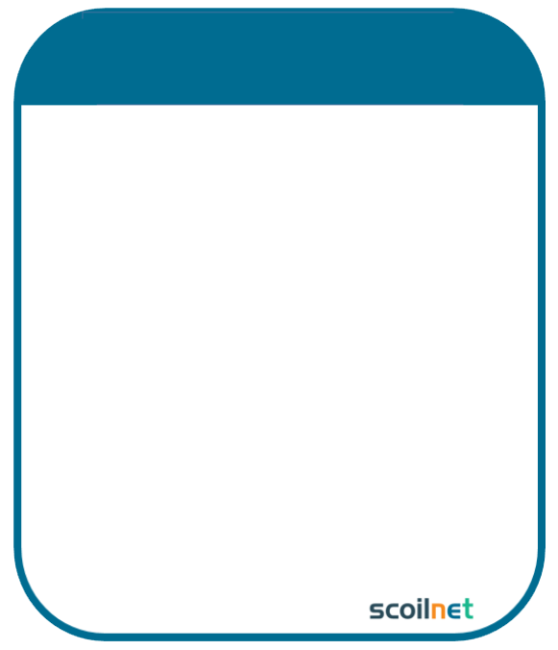
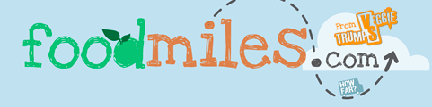

Food Miles
Food Miles
Food Miles is a term which refers to the distance food is transported from the time of production until it reaches the consumer.
Food production has become globalised and with this, our food is traveling a further distance. Calculate the food miles for a selection of food using the World Maps on Scoilnet Maps or Foodmiles.com

Slide 6
Task:
Calculate the Food Miles.
Food | Food Miles
Bananas
Peppers
Tomatoes
Carrots
Avocados
Mangetouts
Total Food Miles
Calculate the total food miles for shopping using the table to record your findings.
You could visit your local store to find the origin of some food. Alternatively, use the photographs of food on the next slides to identify the origin of some food.

Slide 7
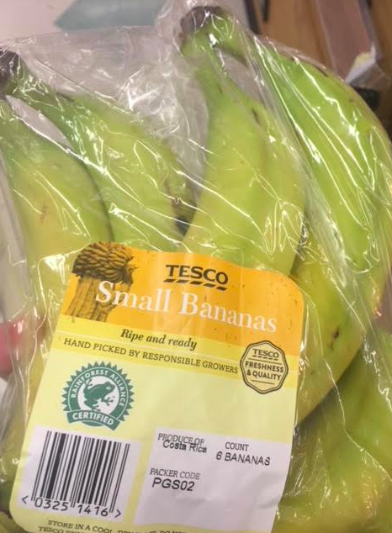
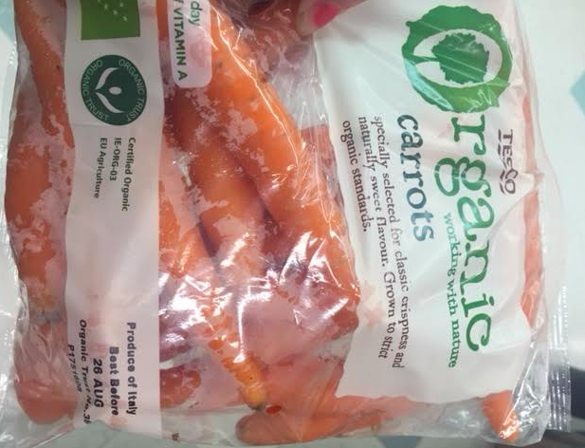

Slide 8
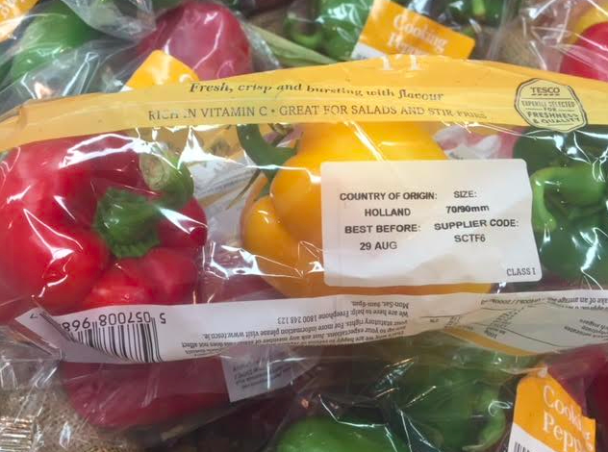
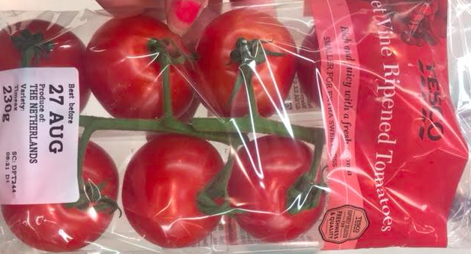

Slide 9
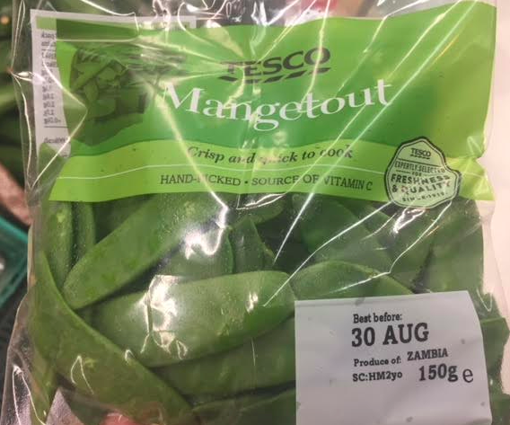
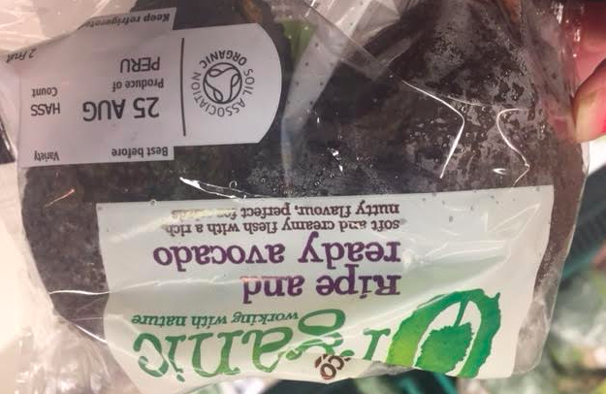

Slide 10
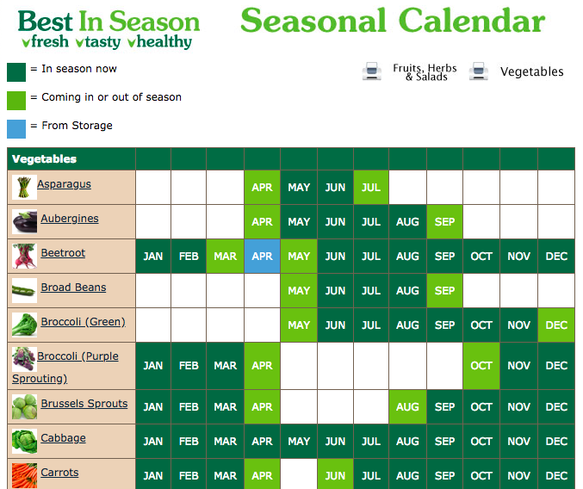
Food | Food Miles (approx)
Bananas | 5,167
Peppers | 470
Tomatoes | 470
Carrots | 1,170
Avocados | 6,121
Mangetouts | 5,173
Total Food Miles = 18,571
What can we do to reduce food miles?
Have a look at the seasonal calendar by Bord Bia. Should we always buy locally grown food over imported food? Explain your reasoning...
Notes:
Compare the price of food produced in Ireland to food imported to Ireland.
Students should consider the resources used in producing the food to the resources used in transporting the food. For example, some foods grow better in warmer climates and would require heated greenhouses to grow in Ireland.

Slide 11
PRODUCTION:
Cultivation/Purchase of seeds/fertilizer
Planting and growing plants
Harvesting plants
DISPOSAL:
Disposal of food scraps in a compost
Reuse food and its packaging
Recycle packaging
Non Recyclable packaging goes to landfill site.
Vestibulum congue
PRODUCTION
Life Cycle of Food
DISPOSAL
Vestibulum congue
DISPOSAL
Vestibulum congue
DISTRIBUTION
CONSUMPTION:
Purchase the:food
Transport the food home
Prepare the food
Consume the food
DISTRIBUTION:
Transportation
Processing
Packaging
Distribution to retailer/ consumer
Vestibulum congue
CONSUMPTION

Slide 12
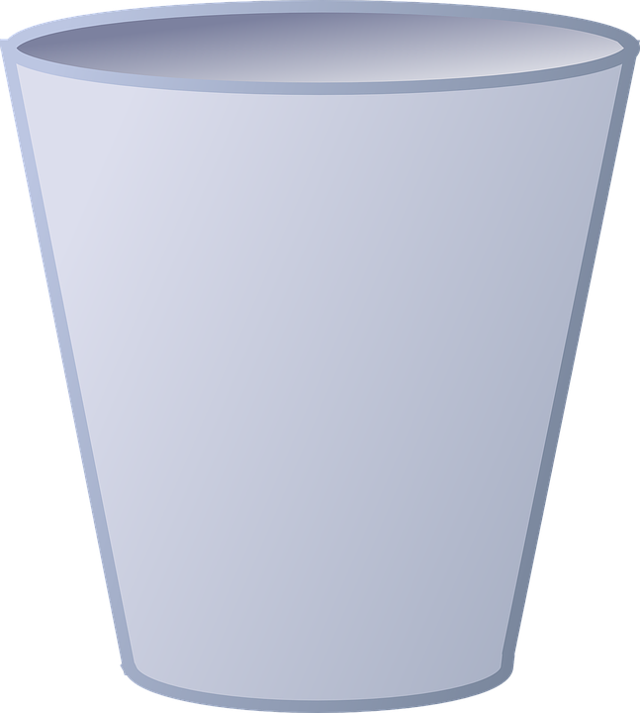
Composting
Composting is the natural process of decomposition that turns organic materials like garden waste and vegetable food scraps into material called compost.
Compost provides nutrients to the soil.
Task: Read the World Book Online article about how to make compost. Represent the stages of making compost by filling the compost bin with creative illustrations.
Image Source: This Photo by Unknown is in the Creative Commons CCO
Notes:
Image source:
https://pixabay.com/en/trashcan-bin-container-recycling-23286/

Slide 13
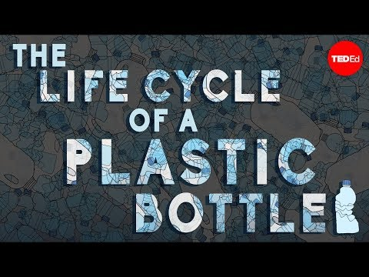
2. Life Cycle of Plastics
Starter Task:
Plastics have many uses but one example is for packaging food.
Watch the video clip and create a flowchart documenting the life cycle of plastic

Slide 14
EXTRACTION OF RAW MATERIALS
Life Cycle of Plastic
MANUFACTURING
DISPOSAL
MANUFACTURING
USAGE
DISTRIBUTION
Read about each stage using World Book Online article HERE
Notes:
The next few slides will focus on some issues associated with Distribution - Packaging.

Slide 15
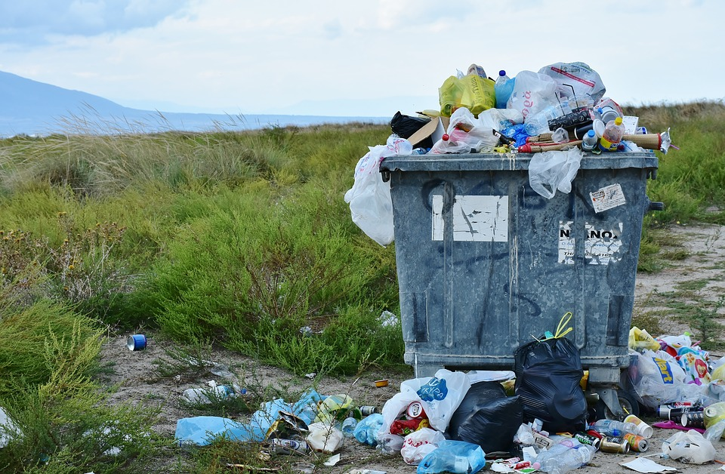

Manufacturing Plastics
As more and more plastic packaging materials are used by consumers, more plastic is generated.
Plastics consist of long chains of molecules called polymers. Polymers are made of smaller molecules called monomers.
Monomers
Polymer
The properties of plastics depend on the types of monomers in their polymer chains, the length of the chain, and the arrangement of the chains.
Image Source: This Photo by RitaE is in the Creative Commons CCO

Slide 16

Become a Polymer Engineer
Engineers have created hundreds of different plastics, each with their own properties. Evaluate the properties of the following plastics using the keywords strength, stiffness, hardness, density, melting point, stiffness, and conductivity.
Check your properties here.
Plastic | Sample Products | Properties
Polyvinylidene chloride | Used for packages for meat and other foods
Polyethylene | Used for bottles, packaging, electrical insulation
Nylon Plastic | Used for fabrics, gears, brush bristles, electrical appliances, carpeting.
Polystyrene | Used for housewares, toys, electrical insulation.
Unsaturated polyester | Used for automobile parts, boats, bowling balls.
Notes:
Image Source: This Photo by GraphicMama team is in the Creative Commons CCO Read the World Book Online Article for help, available here https://www.worldbookonline.com/student-new/#/media/ta434080-t02/type/table

Slide 17
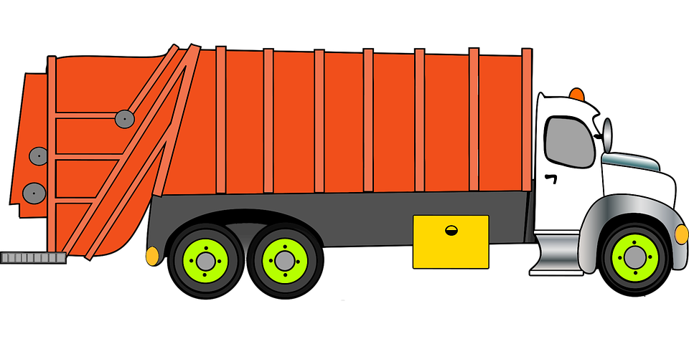
EXTRACTION OF RAW MATERIALS
DISPOSAL
Life Cycle of Plastic
MANUFACTURING
DISPOSAL
USAGE
DISTRIBUTION
Read about each stage using World Book Online article HERE
Notes:
The next few slides will focus on some issues associated with Distribution - Packaging.
Image soure: https://pixabay.com/en/photos/entsorgung/

Slide 18
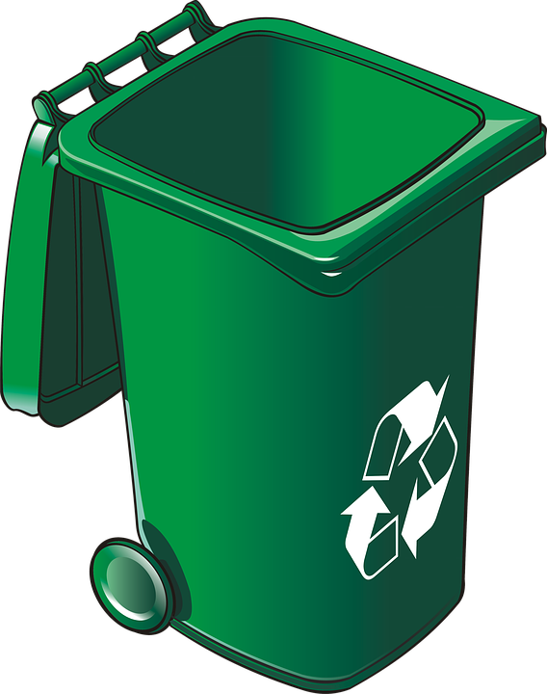
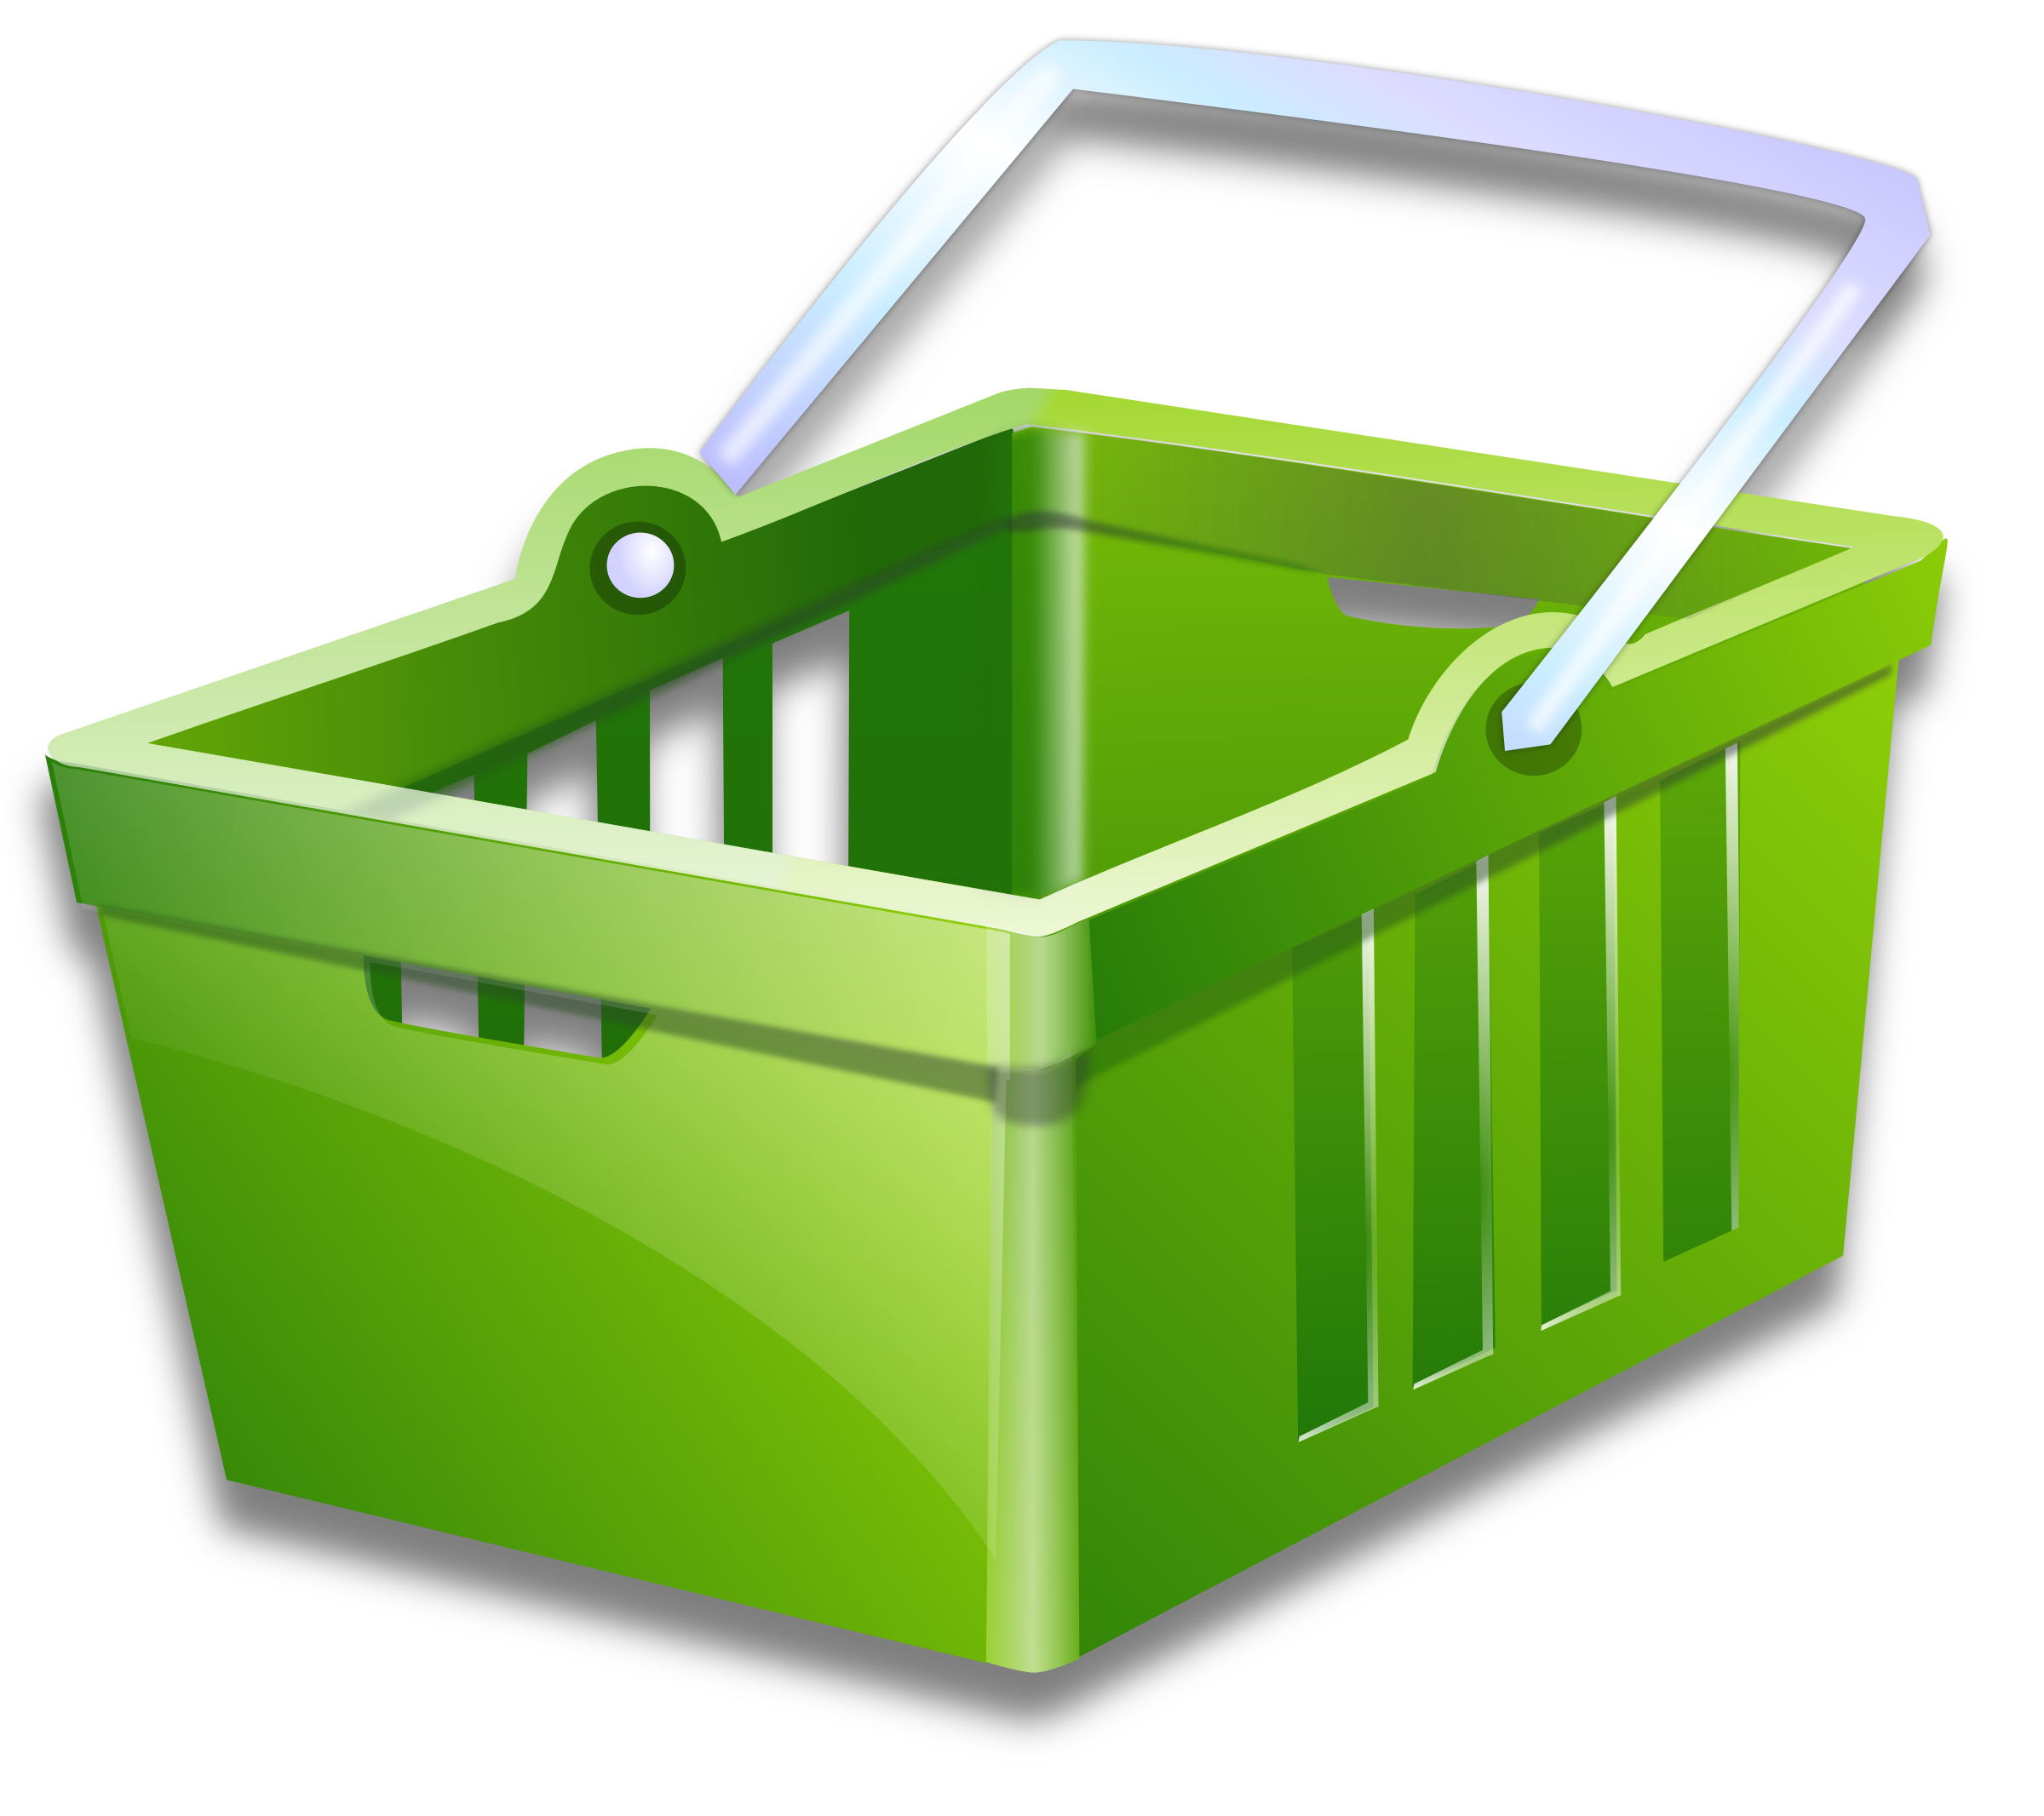
Disposing of Plastics
As a consumer, how do you dispose of your plastic waste? Research the different ways in which plastic waste can be disposed of. Use the table to guide your research. Students can use World Book Online to access reliable sources of information. Remember to reference your sources used.
Method of Waste Disposal | Description of How the Waste is Disposed | Advantages of Using this Method | Disadvantages of Using this Method
Landfills
Incineration
Recycling
Other methods of disposal….
Notes:
Image source: This Photo by Painter06 team is in the Creative Commons CCO
2nd photo >>http://pngimg.com/download/28858

Slide 19
Method of Waste Disposal | Description of How the Waste is Disposed | Advantages of Using this Method | Disadvantages of Using this Method
Landfills | Waste collectors collect the black bin which contains household waste (plastic bags/food wrapping). The household waste is brought to the landfill, a place where rubbish is deposited. | Most plastics are not biodegradable This means that microorganisms cannot break them down. Some plastics cannot be recycled yet. This is an easy disposal method for consumers. | Disposing plastics in landfills takes up space. Microplastics could be eaten by small microorganisms at the base of our food chain and eventually end up in products that humans eat. Microplastics could enter the waterways. Marine animals often mistake microplastics for food which can lead to reduced feeding rates resulting in starvation and interference with reproductive cycles.
Incineration | Destruction of waste products by fire in furnaces. | Polymers burn easily. Modern incinerators are designed to burn waste very efficiently. The heat released could be used to generate electricity. | Carbon dioxide is released when polymers are burnt. CO₂ is a greenhouse gas that contributes to global warming. Incineration plants must properly handle the ash they produce.
Recycling | Plastic bottles and containers are placed in the green bin. Waste collectors collect the waste and bring it to the recycling centre, where the waste is separated by plastic type. | Recycling avoids the problems caused by landfill disposal and incinerating plastics. Recycled plastic can be used in producing new products which reduces the consumption of fresh raw materials. | It can be time consuming to sort the plastics. Recycled waste can be easily contaminated by food residues. Soft plastic (plastic bags/food wrapping) is currently not widely accepted in the recycling bin.
Design plastics that can be broken down by nature. | Photodegradable or biodegradable. | In photodegradable plastics, the plastic breaks down when exposed to sunlight | Once a photodegradable plastic is exposed to light it begins to break down – whether you want it to or Not. Plastic waste is best recycled.
Sample
Notes:
Reference:
1. Marine.ie. (2018). Marine Institute supports Ireland’s commitment to ban microbeads | Marine Institute. [online] Available at: https://www.marine.ie/Home/site-area/news-events/news/marine-institute-supports-ireland%E2%80%99s-commitment-ban-microbeads [Accessed 19 Sep. 2018].
2. Dit.ie. (2018). Microplastics - School of Physics & Clinical & Optometric Sciences. [online] Available at: http://www.dit.ie/physics/research/microplastics/ [Accessed 19 Sep. 2018].
3. Repak. (2018). What Can I Recycle? - Repak. [online] Available at: https://www.repak.ie/for-home/what-can-i-recycle-2/ [Accessed 19 Sep. 2018].

Slide 20
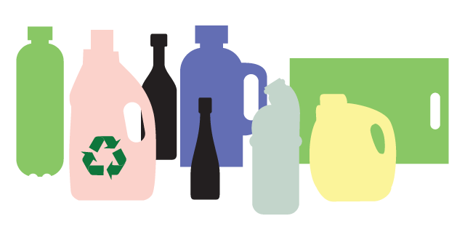
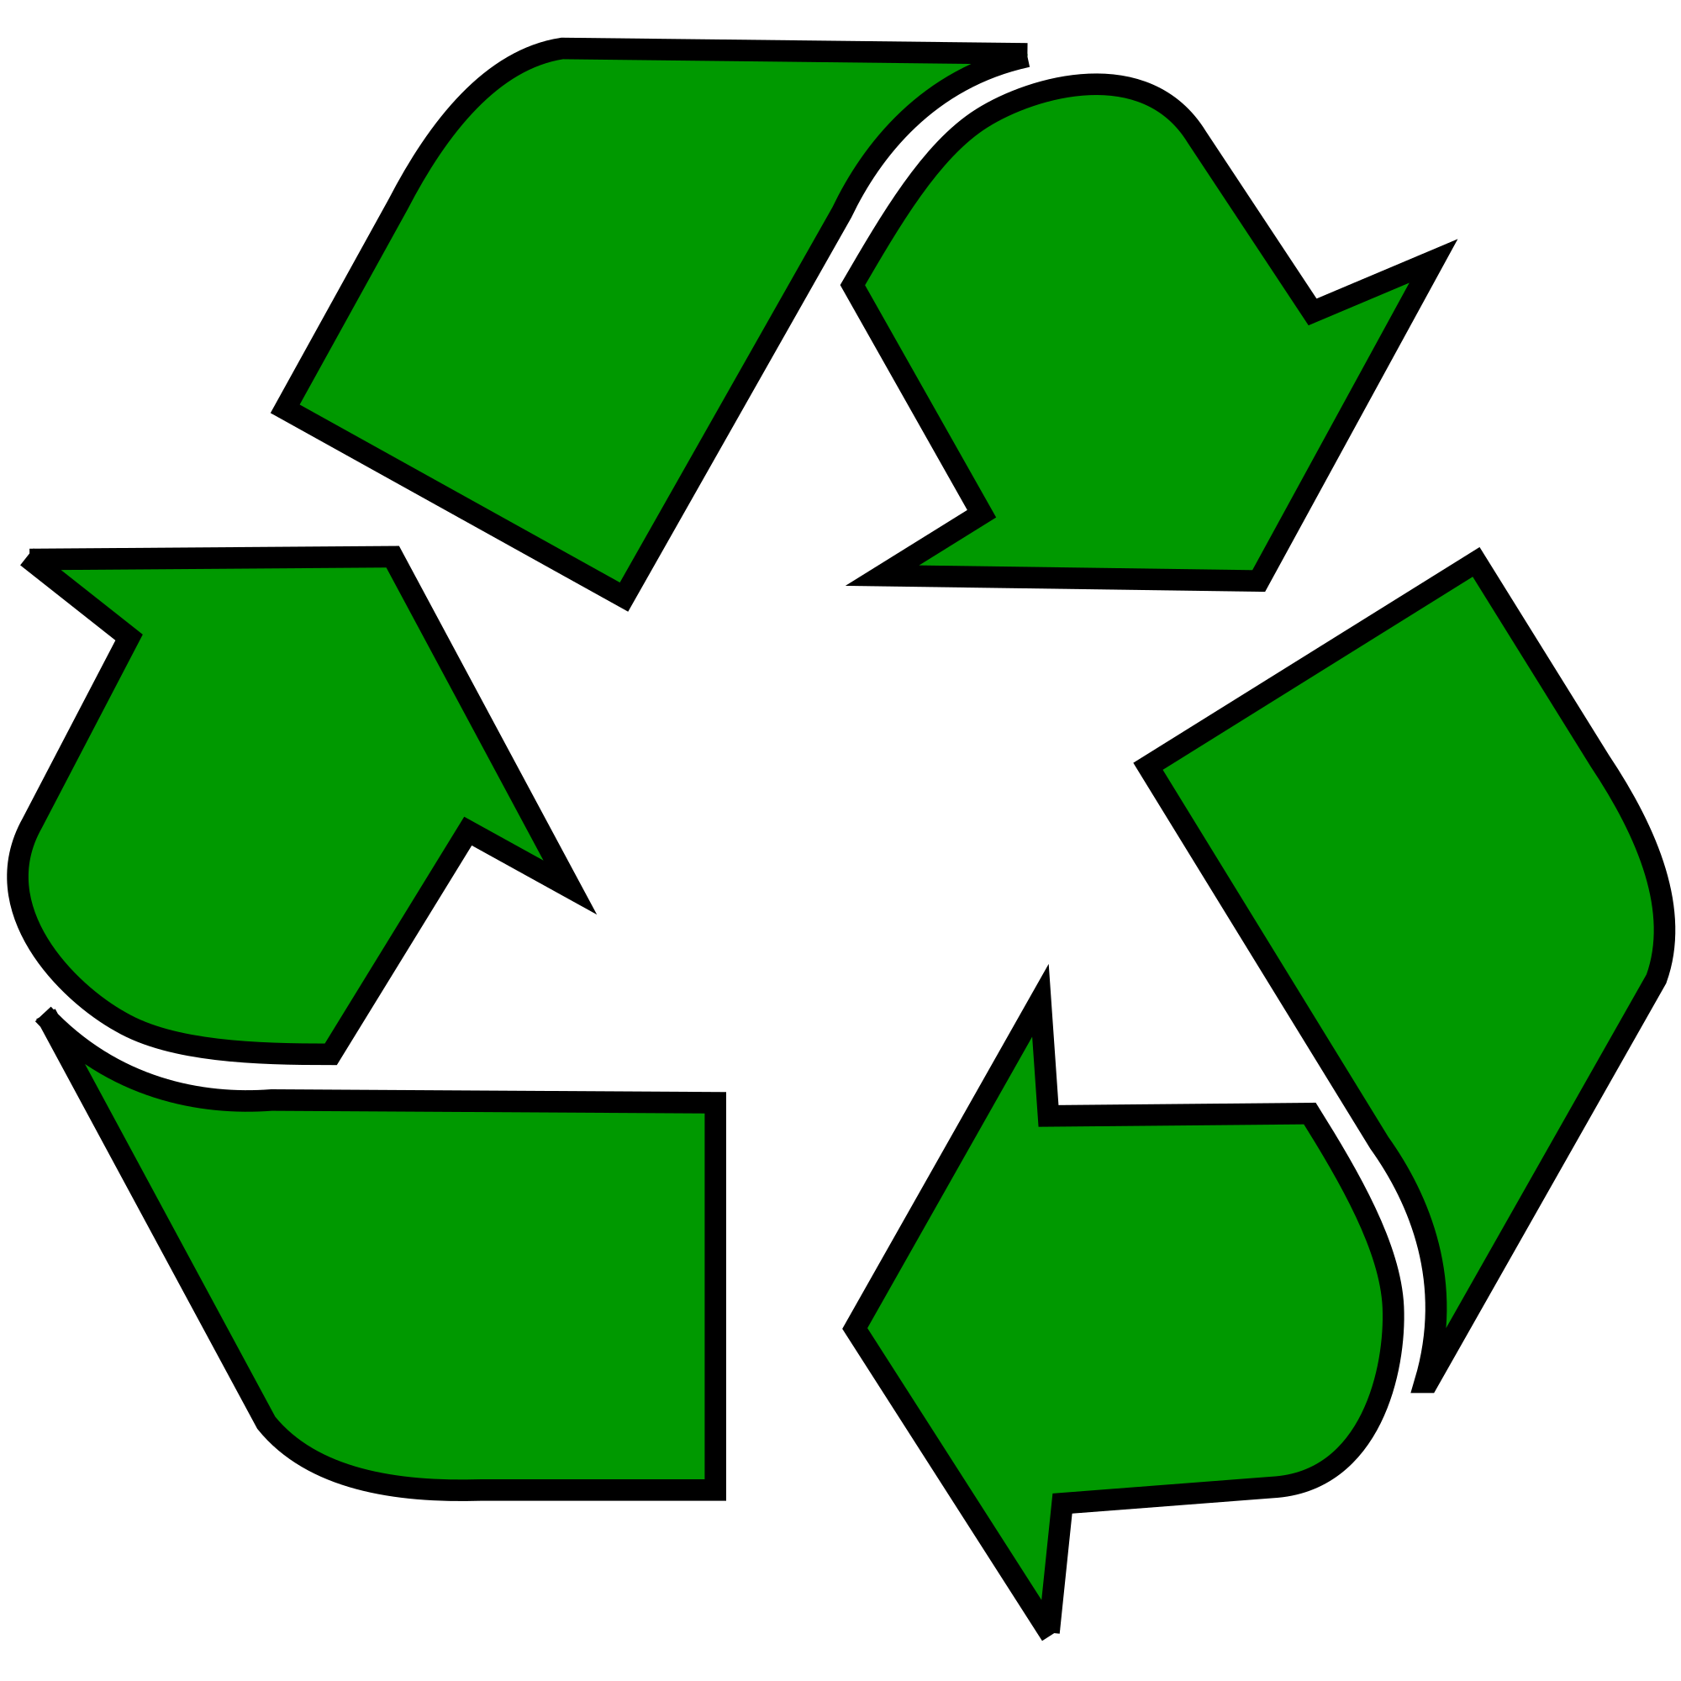
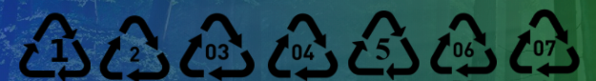
Recycling Plastics
The below Plastic Identification codes (PIC) are used for sorting plastics when recycling. Each label represents a different type of plastic. Manufacturers of the plastic products put these labels on the plastic products. Consumers can identify the plastic types based on the PIC labels.
Task: According to Repak, there are three labels which represent plastic types that can be recycled in Ireland, identify these three labels with the circles AND list four examples of the plastic products.
Image Source: This Photo by GRACE Communication Foundation
Notes:
Text: Adamson, DH 2018, 'Plastics' , World Book Student, World Book, Chicago, viewed 19 September 2018,
<https://www.worldbookonline.com/student-new/#/article/home/434080>

Slide 21
Recycling Plastics
The below Plastic Identification codes (PIC) are used for sorting plastics when recycling. Each label represents a different type of plastic. Manufacturers of the plastic products put these labels on the plastic products. Consumers can identify the plastic types based on the PIC labels.
Water bottles
Biscuit trays
Salad bowls
Meat trays
2. Milk bottles
Shampoo bottles
Detergent bottles
Household cleaning bottles
5. Yoghurt containers
Margarine tubs
Liquid soap containers
Rigid food packaging
Visit the Repak website for more information HERE

Slide 22
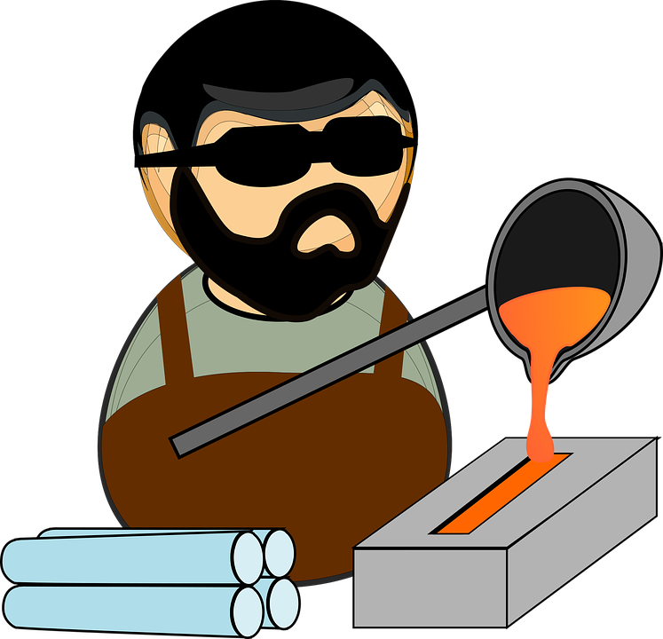
What Happens to the Recycled Plastics?
Most recycled plastics are re-melted and reformed into new products.
Plastics that cannot be remelted are ground into fine powders or shredded. The powders are used as fillers. The shreds can be used in such products as sleeping bags.
Image Source: This Photo by Unknowns in the Creative Commons CCO
Notes:
Adamson, DH 2018, 'Plastics' , World Book Student, World Book, Chicago, viewed 19 September 2018,
<https://www.worldbookonline.com/student-new/#/article/home/ar434080>

Slide 23
Final Task/ Homework:
Waste plastic is a worldwide
problem requiring worldwide solutions.
Task: Take action on waste..
Create an information booklet/video for your parents/school/local supermarket/local factory/county council visually explaining the life cycle of a plastic product. Outline ways in which the plastic industry can become more sustainable in each step of the life cycle. You must also provide an assessment chart for the reader to assess their own plastic dependency.
As a class, decide on the success criteria for the booklet. (In-line with Expectations, above expectations and Exceptional)

