Slide 1



Starter Challenge:
Who is the Minister for Finance in Ireland?
Paschal Donohoe

Slide 2
Learning Intentions:
Describe the National Budget.
Identify different types of government revenue and expenditures.
Analyse government expenditure in terms of current and capital expenditure.
#LO3.4, 3.10

Slide 3

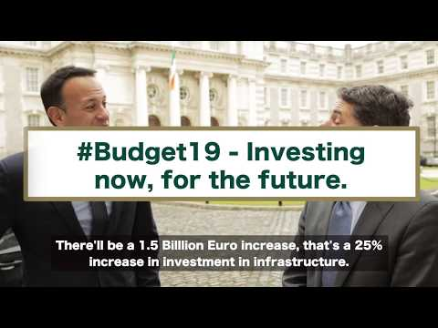


National Budget
The National Budget is a plan of future government income and expenditure for the country.
Activity:
Watch the video to identify whether the 2019 Budget is a balanced budget, surplus budget or a deficit budget.
Answer: A balanced budget. The planned revenue equals the planned expenditure.
*Budget Day was the 9th October 2018
Notes:
Balanced budget is when planned revenue = planned expenditure.
Surplus budget is when planned revenue > planned expenditure.
Deficit budget is when planned revenue < planned expenditure.

Slide 4
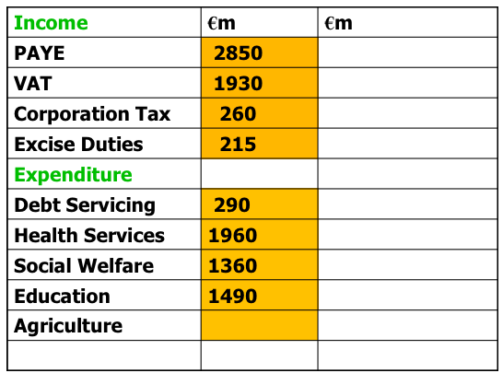
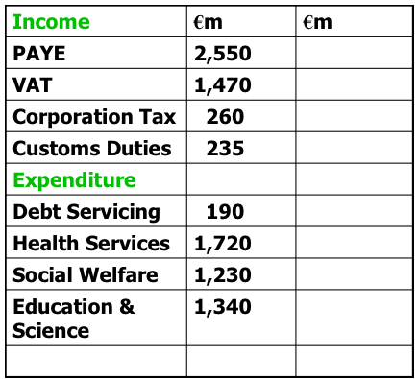
Types of Budgets
Task:
1. One of the below budgets is a deficit budget and the other is a surplus budget.
Identify which budget is which by illustrating your workings.
2. What can the government do with a surplus budget?
3. How can the government fix a deficit budget?
Notes:
2. Pay off debts, reduce taxes, invest in capital projects.
3. Raise Taxes, Borrow money, Privatise state companies, Sell State Assets

Slide 5
Government Revenue and Expenditure
Task: In groups discuss and record ways in which governments obtain revenue and reasons for expenditure.
Revenue (Government Income) | Expenditure (Government Spending)

Slide 6
Government Revenue and Expenditure
Task: In groups discuss and record ways in which governments obtain revenue and reasons for expenditure.
Revenue (Government Income) | Expenditure (Government Spending)
Taxation such as: - PRSI - USC - PAYE - VAT - Corporation tax - Excise duty - Stamp duty - Property tax - Customs tax Non Tax such as - Fees, Fines, Licenses, privatising... | Current Expenditure Day to day expenses such as: Salaries, maintenance, social welfare... Capital Expenditure Once-off expenses that has a long term value such as: Building new transport links, building hospitals/schools/prisons

Slide 7
Imagine that
you are the Minister for Finance...
Decide in groups of four, how you will spread out the spending for the budget.
Consider the following areas of spending.
Education
Health
Defence
Social Protection
Justice
Agriculture
Debt Servicing, EU payments
Transport
Other

Slide 8
Most Spending
Least Spending

Slide 9
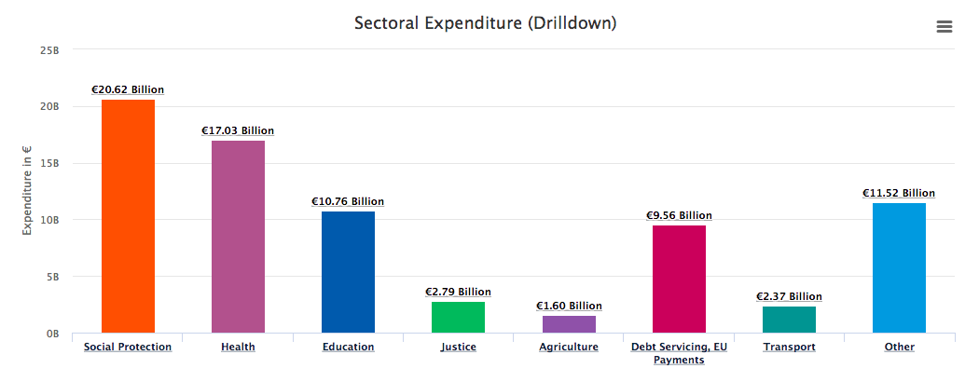
2019 Total Expenditure
Task: Calculate the total expenditure.
Has the total expenditure increased or decreased from last year's budget? Visit this interactive website to compare the data.
= €76.2 Billion
Image Source:The Irish Governments Expenditure Data

Slide 10
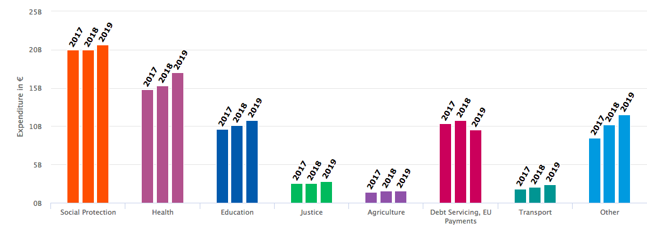
Three Year Comparison
Task: Compare the expenditure trends over the last three years by examining the below graph. Write a short paragraph to brief your parents on the budget.
Image Source:The Irish Governments Expenditure Data

Slide 11

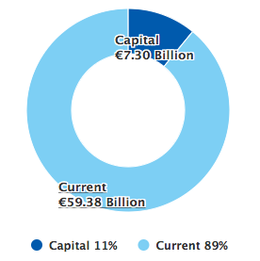
Capital Expenditure
Money spent on once-off expenses that have a long term value
Current Expenditure
Current Expenditure
Money spent on day to day activities
Image Source:The Irish Governments Expenditure Data, 2019

Slide 12
Task: Use the ‘Where Your Money Goes’ website to analyse the breakdown in current expenditure and capital expenditure for each sectoral expenditure given in the below table. Which areas have the most expenditure for long-term projects? Give examples of current and capital expenditure.
Sectoral Expenditure | Current Expenditure | Capital Expenditure
Social Protection
Health
Education
Justice
Agriculture
Debt Servicing, EU payments
Transport
Other

Slide 13
Homework:
Design a three-fold information leaflet, aimed at a particular group of people, which will help them understand the budget.
Your leaflet should be directed at one of the following groups:
• Single worker
• Pensioner
• Families
As a class, decide on the success criteria for this homework task...
Success Criteria
Yet to Met Expectations
In Line with Expectations
Above Expectations
Exceptional

Slide 14
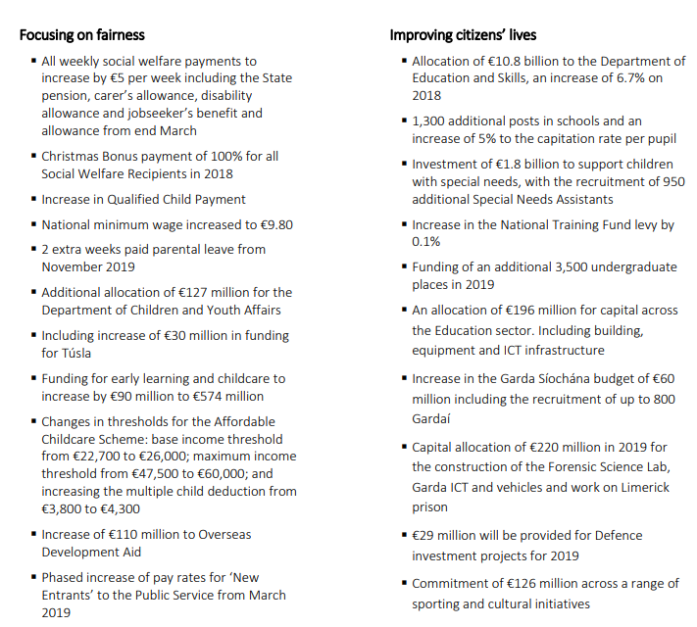
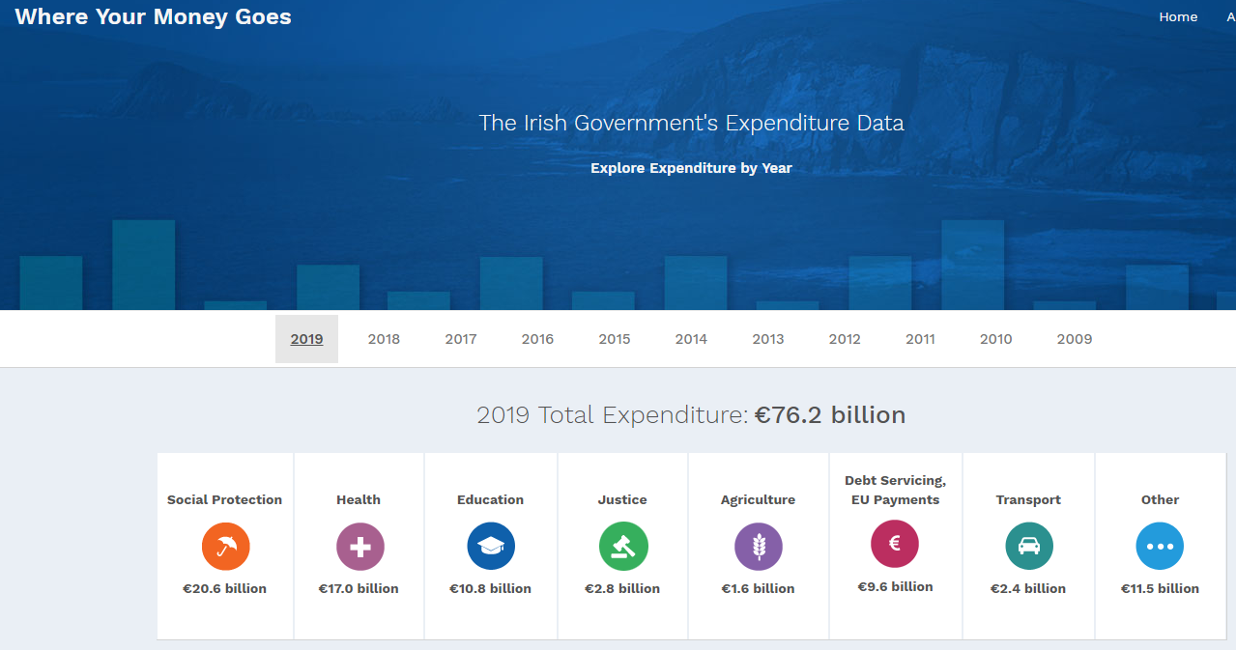
Guide for Students on Budget 2019
Students could read the Budget 2019 Leaflet.
Students could examine the date from the Irish Government’s Expenditure Data

Slide 15
Budget 2019 - Some Points
Task: Complete the following table. Students could read the Budget 2019 Leaflet here.
Revenue (Government Income) | Expenditure (Government Spending)
Higher rate of income tax increasing by €750 to €35,300 USC to be cut from 4.75% to 4.5% Excise duty on a packet of 20 cigarettes will rise by 50 cents Corporation tax remains at 12.5% Increase in rate of VAT in the tourism sector to 13.5% from January 2019 Tax Relief for Start-up Companies Reduction in the rate for electronic publications from 23% to 9%. 9% rate to be retained for newspapers Retaining 9% VAT rate for sporting facilities | €5 a week increase in all social welfare payments from next March Two extra weeks’ leave to every parent of a child in their first year Child Payment of €2.20 per week in respect of under 12s and €5.20 per week in respect of over 12s €60m extra increase in funding for emergency accommodation. An increase of €1.05bn in Health funding for 2019 Additional €196m for capital in Education in 2019 Budget for An Garda Síochána to increase by €60 million.

