Slide 1



A Year in Review
CURRENT AFFAIRS ROUND
2018
January → December

Slide 2

QUESTION 1
NWS ROUND
Who was crowned the Dancing with the Stars
winner in January of 2018?

Slide 3

QUESTION 2
NWS ROUND
What was the Chinese New Year animal for 2018?

Slide 4
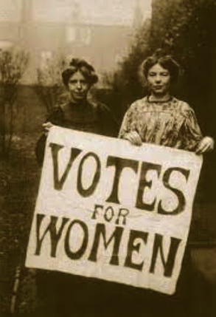
QUESTION 3
NWS ROUND
6th February 2018 marked 100 years since women were first granted the vote under the Representation of the People Act but who was the first female MP to be elected in Ireland?

Slide 5
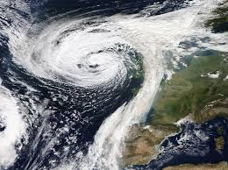
QUESTION 4
NWS ROUND
What was the name of the storm which brought massive amounts of snow with it in March?

Slide 6



QUESTION 5
NWS ROUND
Ireland finished 16th in the Eurovision song contest but who won the Eurovision?

Slide 7
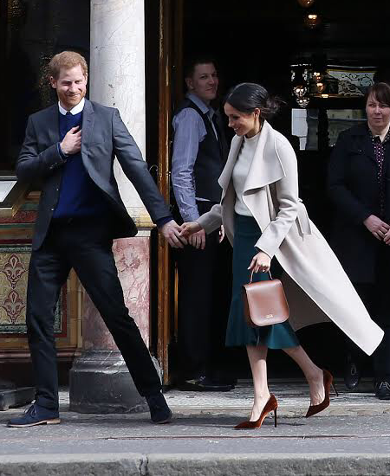
QUESTION 6
NWS ROUND
Megan Merkel tied the knot with Prince Harry on the 19th May in Windsor Castle. What is the Royals surname?

Slide 8
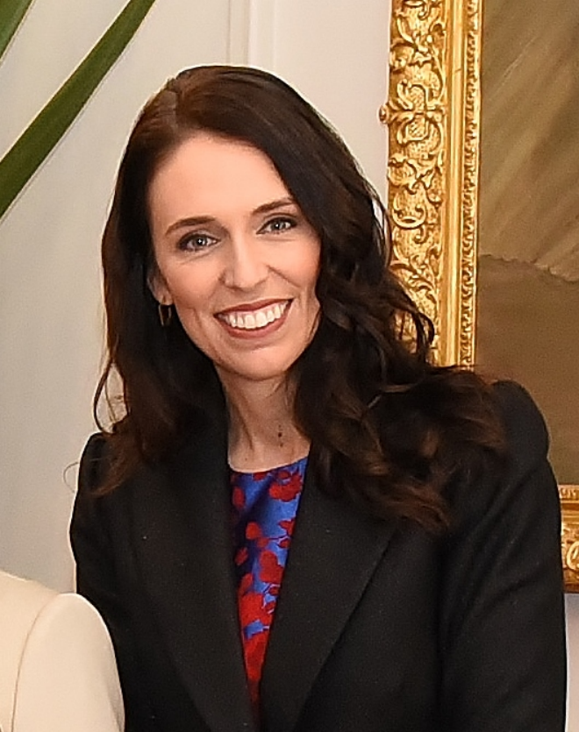
QUESTION 7
NWS ROUND
Jacinda Ardern is the first world leader in almost three decades to give birth while in office in June, what country is she a leader of?

Slide 9
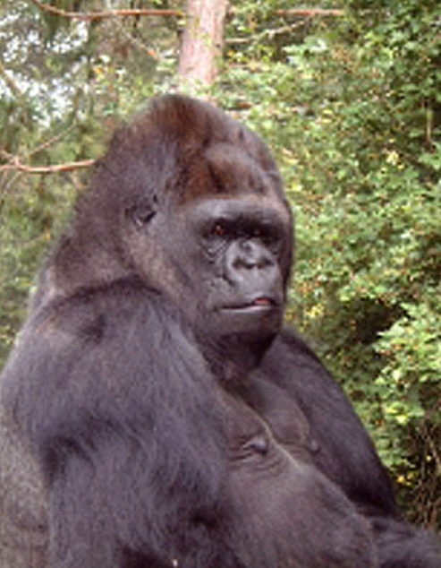
QUESTION 8
NWS ROUND
The famous gorilla who mastered sign language died in her sleep during the morning of June 19, 2018, at the Gorilla Foundation preserve in California, at the age of 46, what was the name of this gorilla?

Slide 10

QUESTION 9
NWS ROUND
The 2018 FIFA World Cup took place in Russia on the 15th July. What three countries will host the 2026 FIFA World Cup?

Slide 11
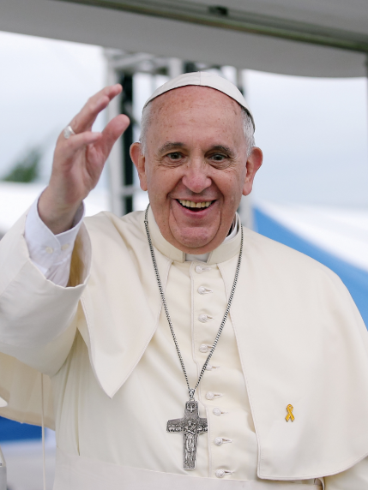
QUESTION 10
NWS ROUND
What was the name of the pope who visited Ireland during the World Meeting of Families in August?

Slide 12

QUESTION 11
NWS ROUND
Kirsten Mate Maher was crowned the Rose of Tralee 2018, what county did she represent?

Slide 13
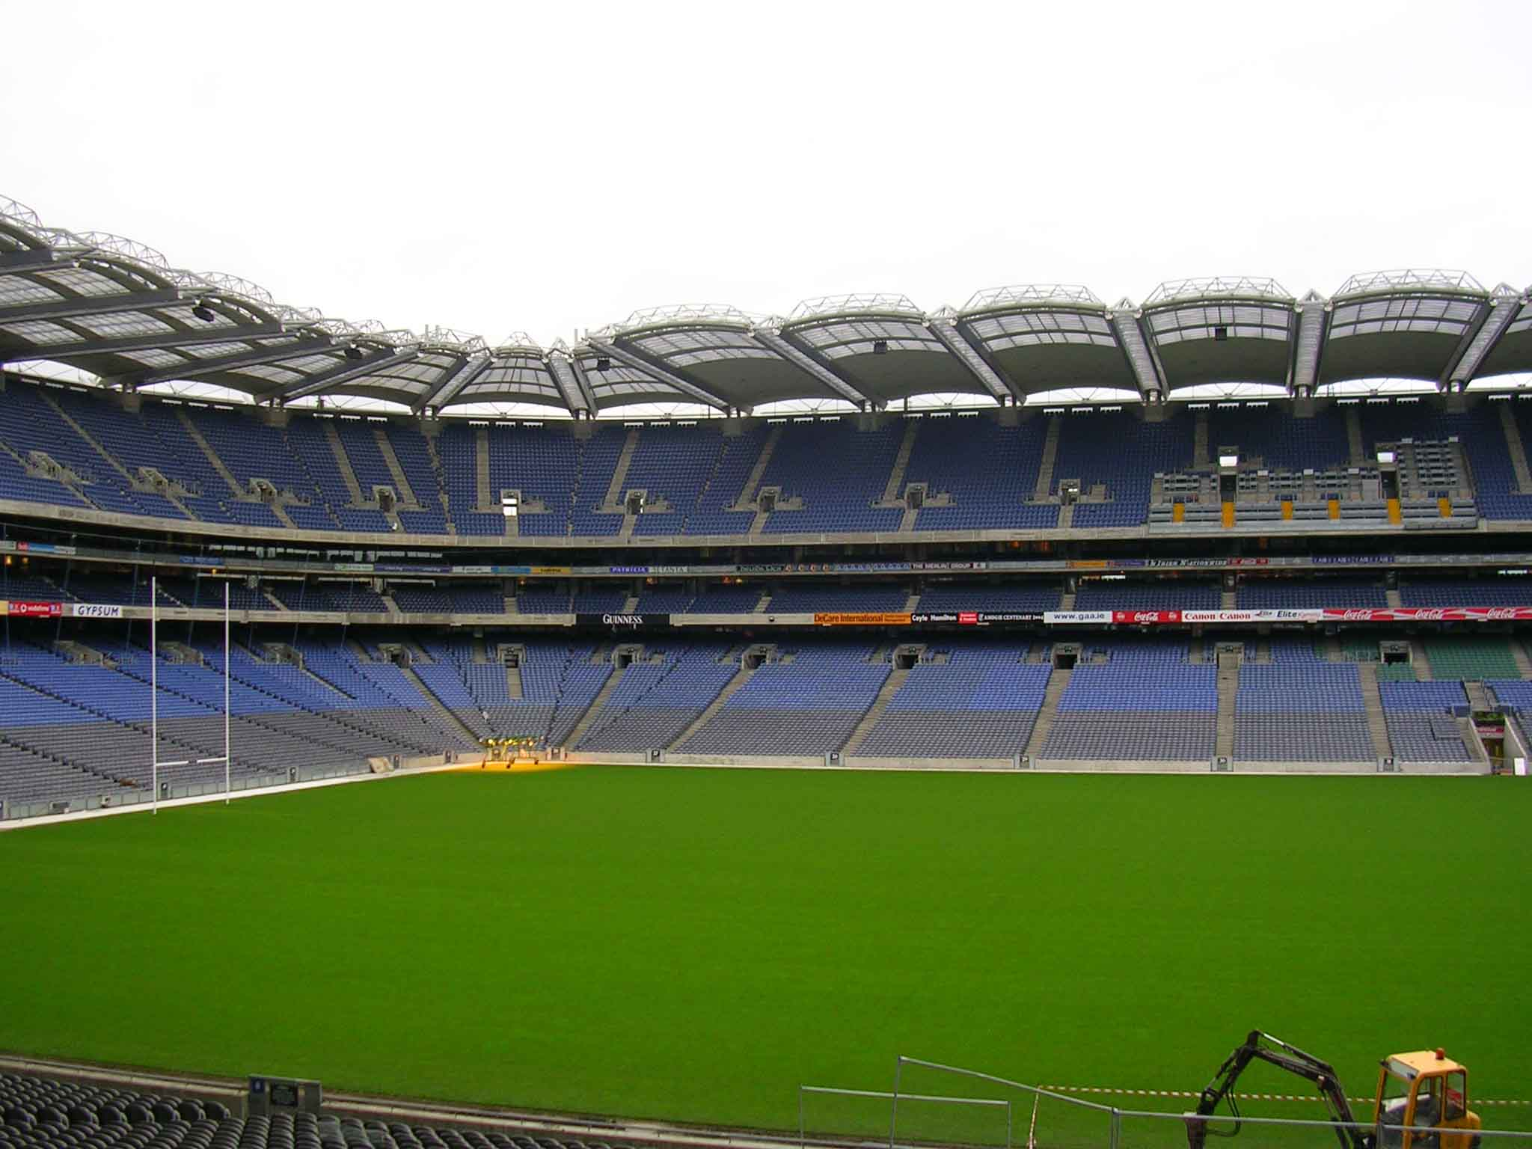
Question 12
NWS ROUND
The All Ireland Hurling champions waited 45 years to bring the Liam MacCarthy Cup back to their county.
Who won the All Ireland Hurling in August 2018?

Slide 14
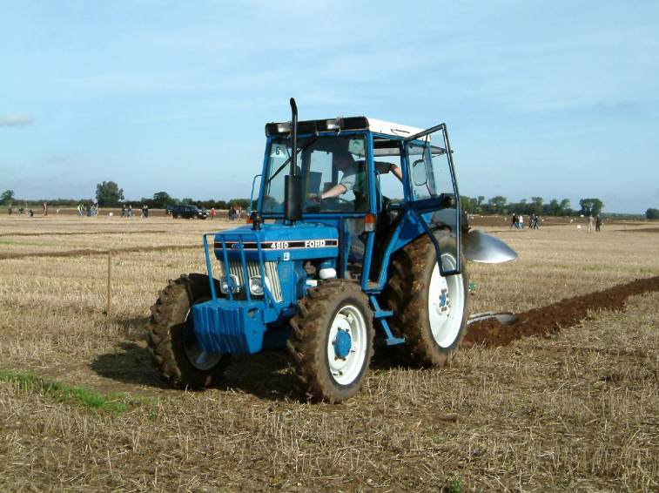
Question 13
NWS ROUND
September:
Day two of the Ploughing Championships in Offaly was cancelled due to a storm, what was the name of this storm?

Slide 15

Question 14
NWS ROUND
Budget day took place on the 9th October 2018. Who is the Minister of Finance that announced the budget?

Slide 16
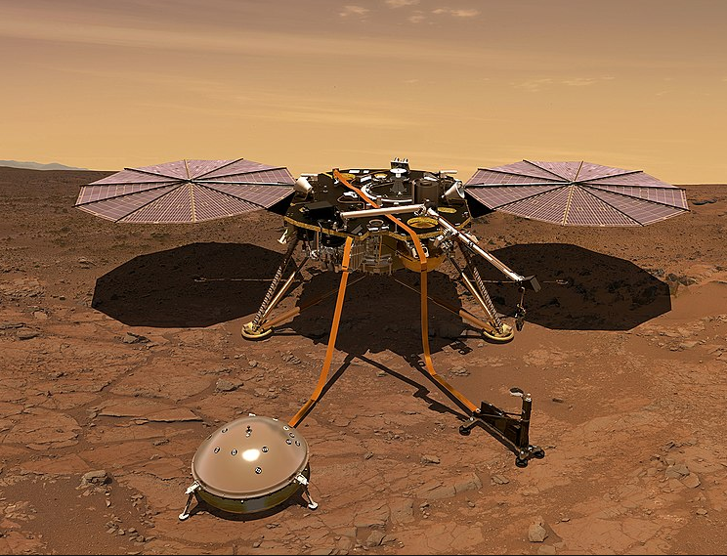
QUESTION 15
NWS ROUND
On the 26th November, Mars received its newest robotic resident, what is the name of this spacecraft?
Data Source: NASA

Slide 17

QUESTION 16
NWS ROUND
On the 26 October, the Irish electorate voted in a referendum to remove a word from Article 40 of the constitution.
What word was removed?

Slide 18
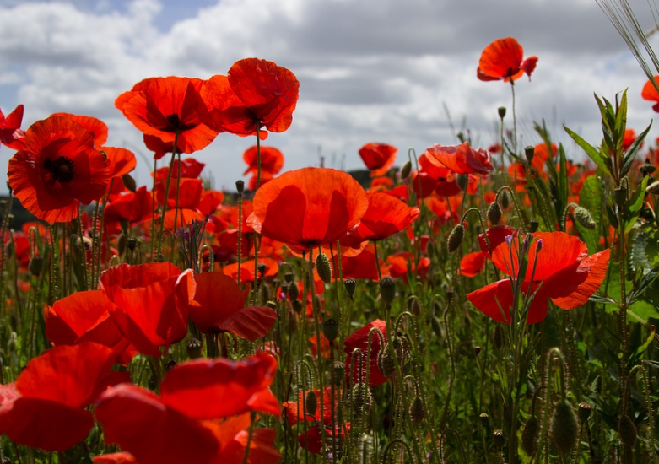
QUESTION 17
President Michael D. Higgins was elected president of Ireland. The inauguration took place on the 11th November.
What important commemoration also took place on this day?
NWS ROUND

Slide 19
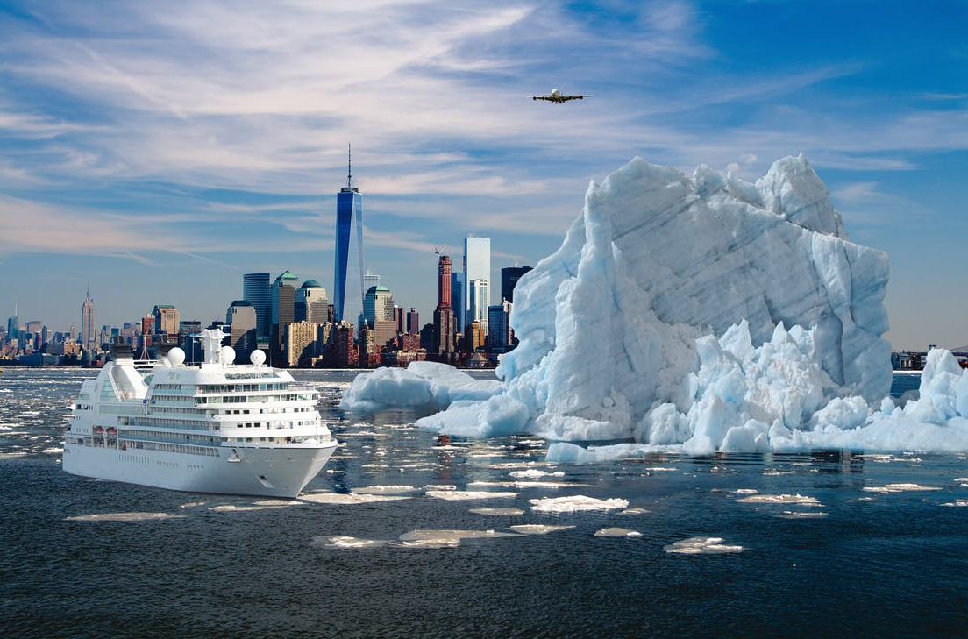
QUESTION 18
The collapse of civilisation and extinction of much of the natural world is “on the horizon” due to climate change.
Who declared this to the World Leaders at the COP24 conference in Poland in December of this year?
NWS ROUND

Slide 20
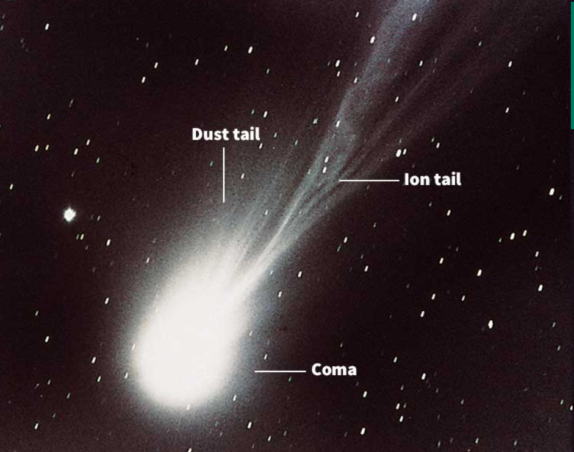
QUESTION 19
NWS ROUND
Christmas 2018 had its very own comet. It’s closest approach to Earth in 70 years happened on the 16th December 2018.
What is the name of this comet?

Slide 21

QUESTION 20
NWS ROUND
What team was crowned the RTÉ Sport Team of the Year 2018 by public vote?

Slide 22
1. Jake Carter
6. Windsor (Mountbatten Windsor)
2. Year of the Dog
7. New Zealand
3. Constance Markievicz
8. Canada, the USA and Mexico
3.
4. Storm Emma (Beast from East)
9. Koko the gorilla
5. Israel
10. Pope Francis

Slide 23
11. Waterford
16. Blasphemous / Blasphemy
12. Limerick
17. Armistice Day
13. Storm Ali
18. David Attenborough
3.
14. Paschal Donohoe
19. Comet 46P/Wirtanen
15. Insight
20. Irish women's hockey team

Slide 24
Tie-Breaker Questions
The United Nations General Assembly has declared 2019 as the International Year of ____________________. Fill in the blank.
Answer: Indigenous Languages/the periodic table of chemical elements
The United Nations has designated 2019 as the international year of the periodic table of chemical elements. The year will coincide with the 150th anniversary of the table's creation. Who created the first Periodic Table?
Answer: Dmitri Mendeleev
2019 marks the centenary of the meeting of the First Dáil. Where did the First Dáil meet?
Answer: Mansion House, Dublin in 2019.
What is the Chinese New Year animal for 2019?
Answer: Year of the Pig. Chinese New Year happens on Tuesday, 5th February.

