Slide 1


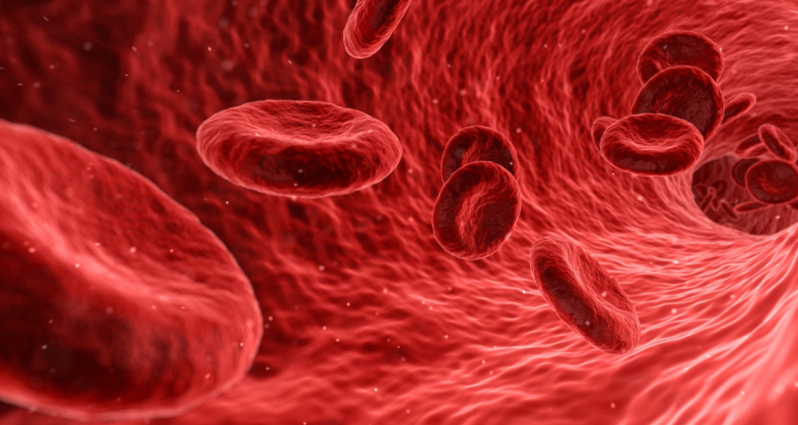
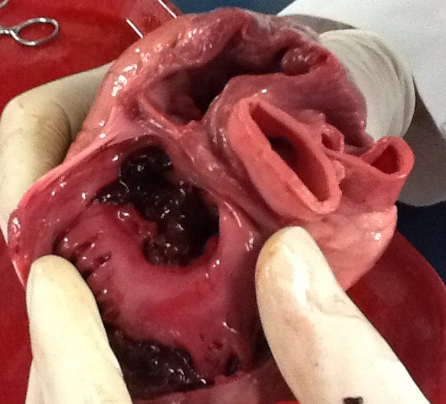
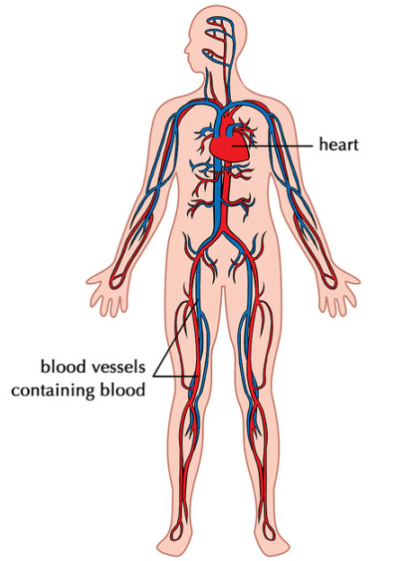



Notes:
Image Source/ Attribution: Heart diseccion, Wikipedia, Creative Commons Attribution-Share Alike 3.0 Unported, 5th Feb 2019
Red Blood Cells, Pexel, https://www.pexels.com/photo/analysis-anatomy-artery-bacteriology-236044/, 5th Feb 2019
Circulatory System, Flickr, Attribution 2.0 Generic, 5th Feb 2019, Access https://www.flickr.com/photos/121935927@N06/13579205034
Heart Signal, Pixabay, https://pixabay.com/en/stethoscope-curve-pulse-frequency-66885/, 5th Feb 2019
Child at doctors, Wellness GM, https://www.flickr.com/photos/130100316@N04/16162536809, 5th Feb 2019

Slide 2


Describe the structure and function of the heart.
Explain the role of the heart and blood vessels in the circulatory system.
Appreciate the role of science in society and how society influences scientific research.

Slide 3

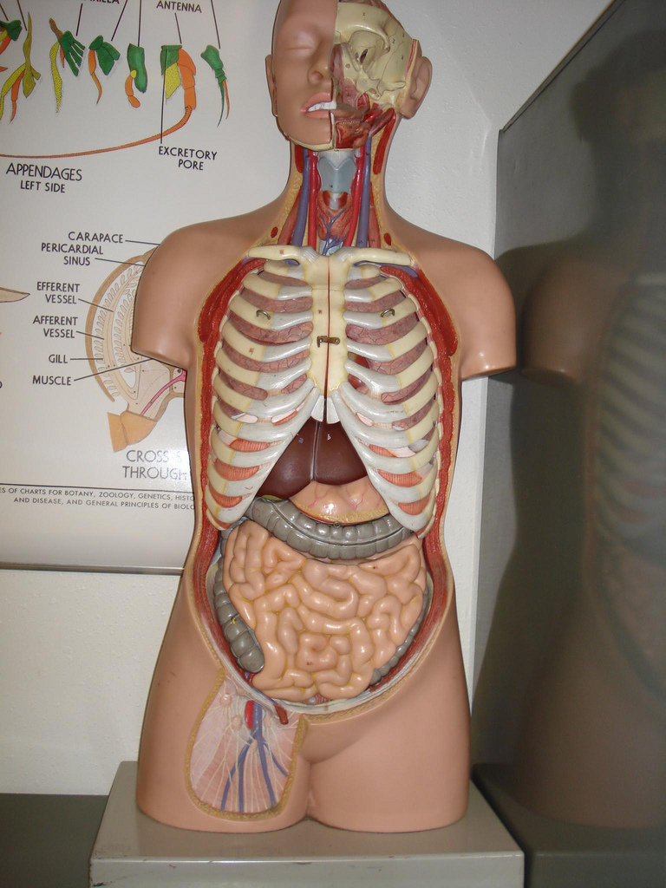
Starter Questions:
Using the human model, describe the location of the heart.
What protects the heart?
If you listen to a heart using a stethoscope, what does it sound like?
When does the rhythmic beating of the heart begin?
When does the rhythmic beating of the heart stop?
What do you think the job of the heart is?
Note: If you do not have a human model, you could use this online tool. Click here
Notes:
Image Souce: Flickr, Attribution-NonCommercial 2.0 Generic, Access https://www.flickr.com/photos/biologycorner/3998418432, Feb 2019
Answers:
It is located in the upper chest between the lungs.
It is protected by the ribcage and the sternum.
lub-DUB, lub-DUB, lub-DUB
Begins about seven months before birth.

Slide 4



Compare 19 grams to 250 grams by weighing out.
Your heart pumps blood all over the body. Each person’s heart is a little larger than the size of the person’s fist. A newborn baby’s heart weighs about 19 grams and an adult’s heart weighs about 250-315 grams.
The heart is made of a strong cardiac muscle that continuously contracts and relaxes.
Every time that your heart contracts, blood is forced out of your heart and into your arteries.
This force pushes blood through your arteries in spurts.
With each spurt, a beat can be felt. This beat is called a pulse.
Model the action of the heart with your fist.
Locate the best places to take your pulse.
Extend activity with this animation.

Slide 5



Use the videos below as a guide…
How fast does your heart beat?
To check your pulse at your wrist, place two fingers between the bone and the tendon over your radial artery — which is located on the thumb side of your wrist. When you feel your pulse, count the number of beats in 15 seconds. Multiply this number by four to calculate your beats per minute. Take three measurements and calculate the average. Repeat the procedure after 2 minutes of running on the spot.
Activity | Measurement 1 B.P.M | Measurement 2 B.P.M | Measurement 3 B.P.M | Average B.P.M
Resting
After 2 minutes running on spot
Note: Teachers could project an online timer onto the board. Try this one…
Extend the activity using this graph.
Notes:
Follow up questions:
Is your pulse the same as your heart rate?
Why do we need to pump blood around the body faster during exercise?
Explain why it is important that you use two fingers to feel the pulse and not your thumb when checking your pulse.
Why did you take several measurements?
What is the average adult heart rate? What is the average heart rate for a teenager?
Note – Heart rate can speed up when a person exercises, is frightened, or needs to fight or run. If a student’s resting heart rate is high and they are alarmed, ask students to repeat the procedure at home with parents when they are truly resting. Ask the student to let you know how they get on. If it is still higher/lower than normal, ask them to get a diary of their resting heart rate and that they could visit their doctor for a check-up. Explain that a person’s age, gender, physical fitness, diet and stress levels affect the heart rate.
What is the medical term used for a heart rate less than 60 beats per minute?
Why is a baby's heart rate faster than an adults?
When an elephant is standing, there heart rate is approximately 30 beats per minute. A mouse can have a heart rate of approximately 310-840 beats per minute. Why do you think animals have different pulse rates?

Slide 6

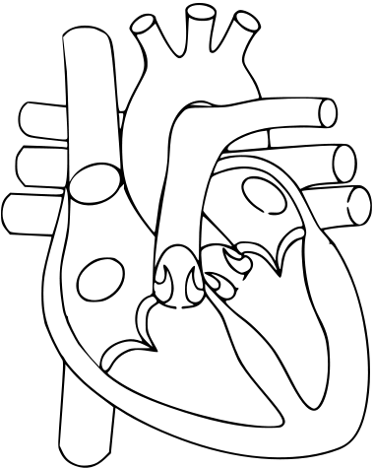
Left
Side
Watch the following clip and label the parts of the heart in the given diagram?
Septum
Right Atrium
Left Atrium
Right Ventricle
Left Ventricle
Aorta
Pulmonary Artery
Vena Cava
Pulmonary Vein
Valve
Right
Side
Video Link: http://columbiasurgery.org/heart/about-heart or demonstrate the structure using a dissection of a cow or sheep heart.
Notes:
Image Source: WikiMedia, Creative Commons Attribution-Share Alike 3.0 Unported, 5th Feb 19 Access here https://commons.wikimedia.org/wiki/File:Heart.svg
Note: All heart diagrams are shown as if you were looking at the front of a person. The right side of the heart appears on the left side of the drawing. The left side of the heart appears on the right.

Slide 7
The heart is separated into the left side and the right side by a muscular wall called the
septum.

Slide 8
There are four chambers in the heart.
Left Atrium
Right Atrium
Pumps blood down to the left ventricle.
Pumps blood down to the right ventricle.
Left Ventricle
Right Ventricle
Pumps blood out the Aorta
to all around the body.
Pumps blood out of the pulmonary artery to the lungs.
Draw arrows to direct the blood flow within the heart.
Notes:
Question: Why are the walls of the left ventricle thicker than the walls of the right ventricle?
Why are the walls of the atria thinner than the walls of the ventricle?

Slide 9
Aorta
Blood is pumped away from the heart to all around the body. Blood is oxygenated.
Vena Cava
Pulmonary Vein
Blood enters the heart from the arms, legs and other parts of the body.
Blood is deoxygenated.
Blood from the lungs is pumped to the heart. Blood is oxygenated.
Pulmonary Artery
Discuss the location of the values.
Blood is pumped Away from the heart to the lungs. Blood is deoxygenated.
Recap the function of the valve with this animation.
Notes:
Note: Arteries usually carry oxygenated blood. Veins usually carry deoxygenated blood. Can your students see an exception to this rule from the above diagram?
What would happen if the valves were damaged?

Slide 10
Colour the deoxygenated blood blue and the oxygenated blood red.
Note: Blood vessels transport blood from the heart and to the heart. There are three types of blood vessels…
Arteries | Carry blood Away from the heart. The blood is oxygenated. *Trick - Any exemption? The artery has thick walls. The blood is pumped by the heart under high pressure.
Veins | Carry blood to the heart. The blood is deoxygenated. *Trick - Any exemption? The veins have thinner walls than the arteries. The blood pressure is lower than in arteries. Veins have valves to prevent the backwards flow of blood.
Capillaries | Transport blood from arteries to veins. The capillaries have extremely thin walls. The thin walls allow diffusion of substances such as nutrients/oxygen/ waste products to pass into and out of capillaries.
Recap with this animation.
Notes:
Image Source: WikiMedia, Creative Commons Attribution-Share Alike 3.0 Unported, 5th Feb 19 Access here https://commons.wikimedia.org/wiki/File:Heart.svg
Remember: In a normal heart, both upper chambers (atria) fill with blood at the same time. Both lower chambers (ventricles) pump blood out at the same time.

Slide 11

Lungs
The steady pumping of the heart supports life by moving blood through the body. Both sides of the heart pump blood at the same time.
As the right ventricle contracts and sends blood to the lungs, the left ventricle also contracts and squeezes blood out to the body.
Activity – Record the pathway of the blood using the illustration on the right.
Body
Note: There is a nice activity here on page 30 and 32.
Notes:
Image Source: WikiMedia, Creative Commons Attribution-Share Alike 3.0 Unported, 5th Feb 19 Access here https://commons.wikimedia.org/wiki/File:Heart.svg

Slide 12

Blood pressure is the force with which the blood pushes against the walls of the arteries as it circulates the body.
Blood pressure is measured using a piece of equipment called a sphygmomanometer or digital blood pressure meters
Doctors always give blood pressure as two readings.
1. The first number is the higher pressure caused as the left ventricle contracts to push blood out of the heart. This is the systolic blood pressure.
2. The lower value measures the force your heart exerts on the walls of your arteries in between beats. This is the diastolic blood pressure.
Notes:
Image Source: Pixabay, Access https://pixabay.com/en/doctor-blood-pressure-stethoscope-3295045/, Feb 2019

Slide 13

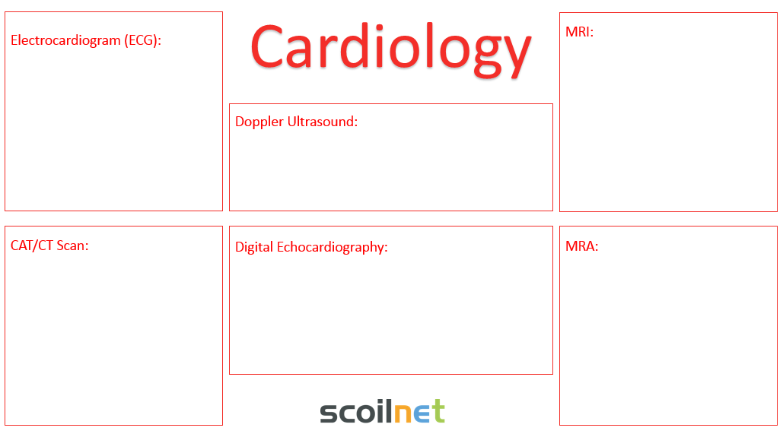
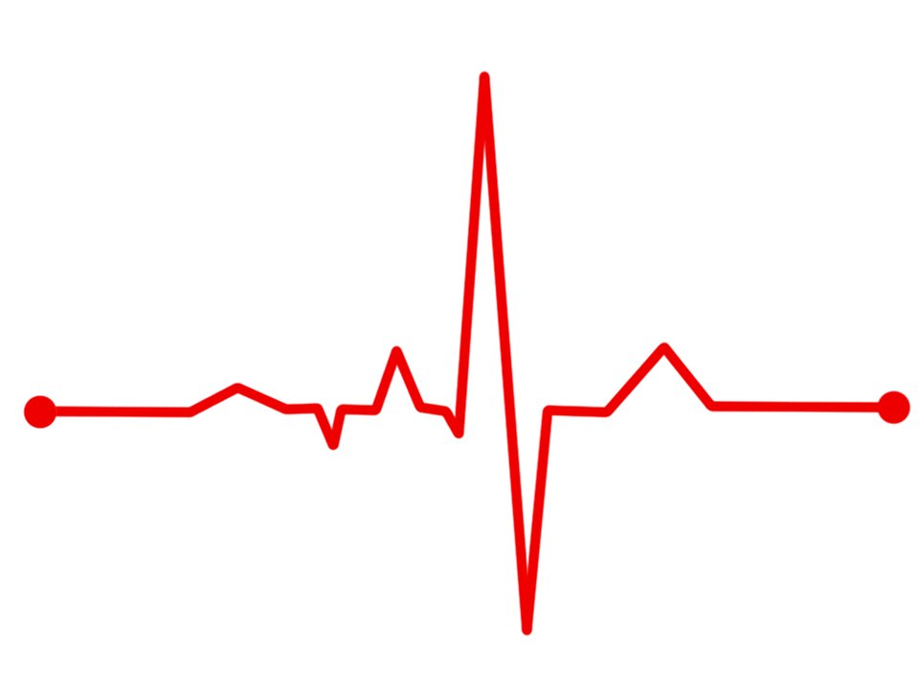
Complete research on the variety of diagnostic tools that exist to help diagnose heart conditions.
Medicine has made some of its most exciting advances in cardiology. Cardiology is the branch of medicine that deals with diseases of the heart and blood vessels. In the 1900’s, doctors learned to diagnose and treat many heart conditions.
Notes:
Useful links:
http://columbiasurgery.org/heart/about-heart
https://www.worldbookonline.com/advanced/article?id=ar249920&st=heart#tab=homepage
https://www.mayoclinic.org/diseases-conditions/heart-disease/diagnosis-treatment/drc-20353124

Slide 14

Cardiology
Electrocardiogram (ECG):
MRI:
Doppler Ultrasound:
CAT/CT Scan:
Digital Echocardiography:
MRA:

Slide 15
Cardiology
Electrocardiograph:
Twelve electrodes are placed on the skin to pick up the electrical pattern of the blood.
A record called an electrocardiogram (ECG) is produced, which displays the electrical activity of the heart muscle. (Source: World Book Online)
MRI:
A diagnostic technique that is used to assess anatomy and heart muscle function, as well as to identify the presence of any scar tissue.
(Source: Columbia Surgery)
Digital Echocardiography:
This technique uses sound waves to produce a video image of your heart. This test can help doctors see the size and shape of your heart along with any abnormalities. It can tell how well your heart is pumping. (Source: Mayo Clinic)
Sample Research
CAT Scan/ Computed Tomography Scan:
This diagnostic technique is used to detect coronary artery disease by highlighting areas of increased density.
(Source: Columbia Surgery)
Coronary Angiography:
This technique is usually performed only if diagnosis is difficult. In this test, doctors insert a long, flexible tube called a catheter through a large blood vessel, usually an artery in the area where the thigh and abdomen meet. They push the catheter up to the beginning of the coronary arteries, then inject special dye. The dye shows the condition of the arteries as it travels through them. An image of the arteries is recorded on an X-Ray film called an angiogram. (Source: World Book Online)
MRA:
A diagnostic technique used to detect coronary artery disease, identifying plaque in the arterial system and determining degrees of narrowing.
(Source: Columbia Surgery)

Slide 16
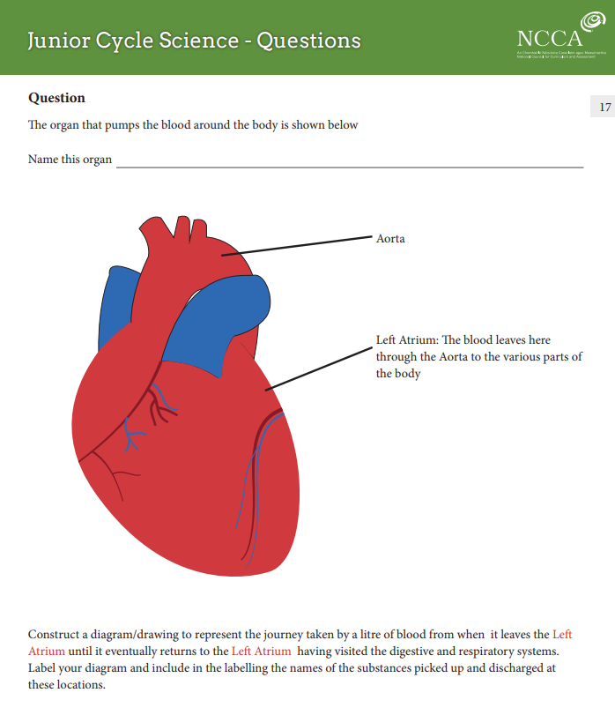

Complete the NCCA Sample Question.
Link to the Question is available here.
The question is located on page 17.

