Slide 1

Title:
Election 2019
Learning Intentions:
1. Describe the constitution.
2. Examine the proposals to amend the Irish constitution in the upcoming referendum.
3. Outline how people can vote in the upcoming referendum.

Slide 2

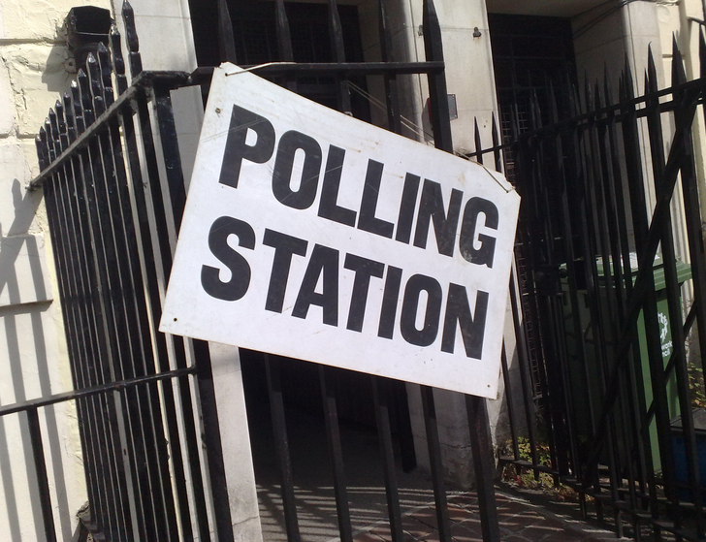
Upcoming Events:
People will be voting in the Local and European Elections on 24thMay 2019.
The election will be held on the same date as a referendum on divorce arrangements
Voters in Cork City, Limerick and Waterford will be asked their views on directly elected mayors.
Notes:
Answer: The centenary of Armistice Day - It marks the day World War One ended, at 11am on the 11th day of the 11th month, in 1918.

Slide 3
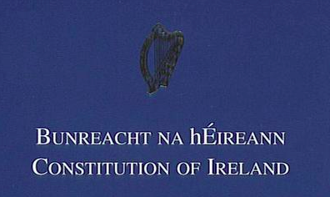
The Irish Constitution
The constitution (Bunreacht na hÉireann) is a legal document which sets out how Ireland should be governed and the rights of the people.
The constitution is divided up into articles. Each article sets out an important rule or law. There are 50 articles in total.
You can read the Constitution of Ireland online here...
Notes:
Image Source: Wikipedia, Fair Use

Slide 4

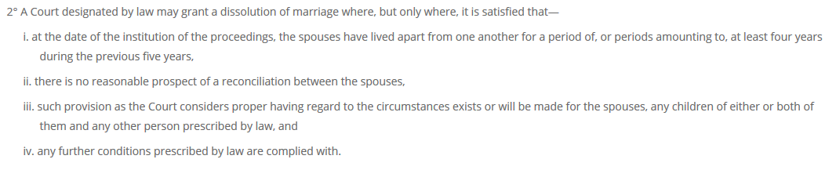
The Referendum on Divorce Arrangements
The constitution can only be changed by a referendum.
On Friday 24th May, the Irish electorate will vote on a proposal to change the Constitution of Ireland in relation to divorce.
The proposal is about two issues relating to divorce, namely how long people must be living apart before applying for a divorce, and the recognition of foreign divorces.
Article 41.3
More Information: Referendum Commission Guide (Pg 5)
Notes:
Note: Students may talk about Stephen Fry’s comments on ‘The Meaning of Life’, hosted by Gay Byrne.

Slide 5
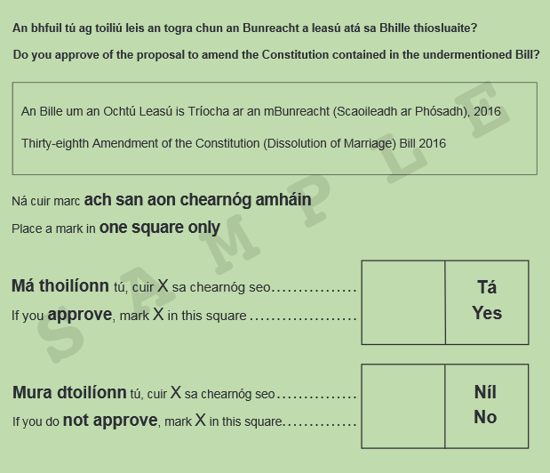
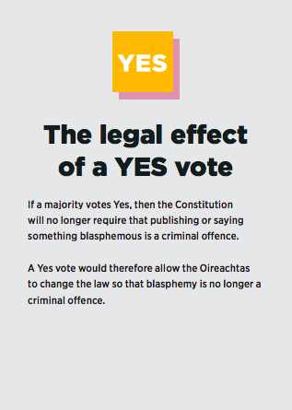
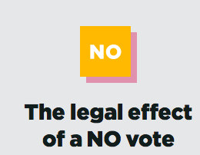
On polling day, voters will be given a green ballot paper for the referendum. Voters will mark ‘X’ in the YES box or ‘X’ in the NO box, depending on how they want to vote.
Task: Click on the above YES and No to examine the legal effect of both votes. Independently, decide whether you would vote yes or no. Indicate your decision on a mock ballot paper .
Image source: Referendum Commission website

Slide 6
Class Vote:
Do you approve of the proposal to amend the Constitution contained in the undermentioned Bill?
Thirty-eighth Amendment of the Constitution (Dissolution of Marriage) Bill 2016
Categories | Tally | Frequency
YES
NO
Click here to read a leaflet about this Referendum.
*Ensure votes are private and valid. What does this mean?

Slide 7
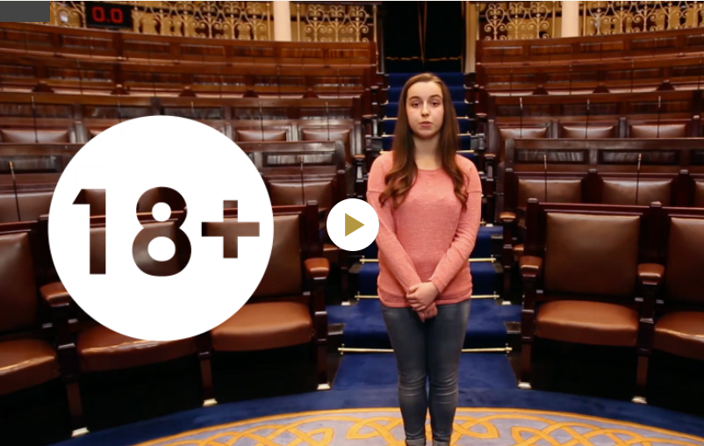
Click on the image to watch the House of the Oireachtas video.
Questions:
Who can vote on the 24th of May?
How can people cast their vote?
Why is it important for people to vote?
Notes:
https://www.oireachtas.ie/en/visit-and-learn/teachers-and-students/cspe-videos/

Slide 8
Homework:
Create a three-sided leaflet illustrating how people can vote in the upcoming referendum on the 24th of May.
Include all the keywords listed on the next slide in your leaflet.
Try to cater for people who struggle with reading by using visual illustrations to convey how people can vote.

Slide 9
Keywords:
A referendum is a special type of an election where citizens get to vote on proposals to make changes to the constitution.
The constitution (Bunreacht na hÉireann) is a legal document which sets out how Ireland should be governed and the rights of the people.
The electorate are all the people in a country who are eligible to vote.
Register of Electors a list of residents who are registered to vote at an Election or Referendum
Ballot paper is the slip of paper used to register a vote.
Polling card is the card that tells you when and where to vote.

