Slide 1


Sun and Skin
Debunk the myths about skin care, sun protection and sunbeds using:
1. A walking debate
2. The Irish Cancer Society SunSmart myth busting videos.
Learning Intentions:
Listen actively and speak with confidence about their viewpoints on UV rays.
Bust some serious myths around skin care, sun protection and sunbeds.
Evaluate how human health is affected by lifestyle choices.
(LO: 5.6, 1.6, 1.7)

Slide 2
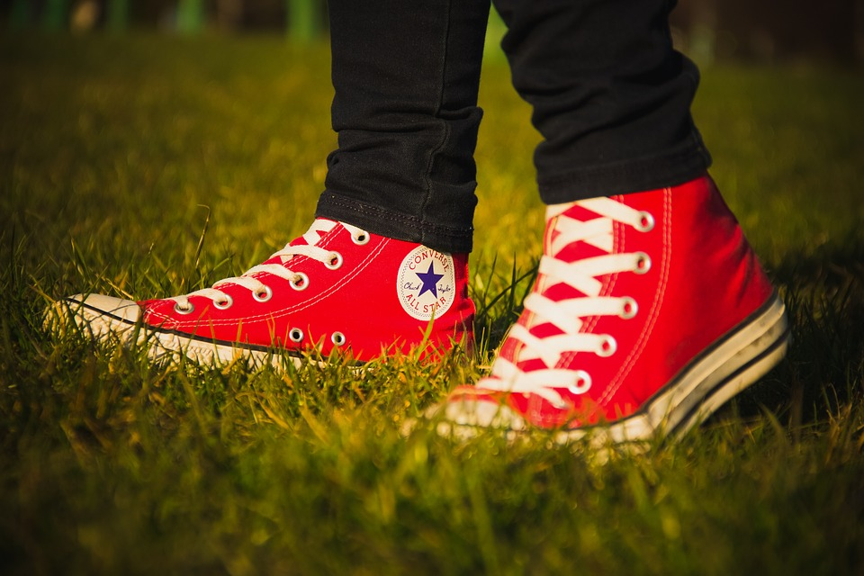


Walking Debate – Set Up
Key Skills: Communicating, Managing Myself, Staying Well, Managing Information and Thinking.
Try these guidelines when setting up your classroom to facilitate a walking debate.
1
Create an ”I agree” and an ”I disagree” and an ”I’m not sure” corner in the classroom.
2
Emphasis the importance of mutual respect and sensitivity to the different values and attitudes held by others. Negotiate debating standards.
3
The teacher calls out the motion for a debate using the statements provided on the next slide.
In the best walking debates you will see a lot of movement as students’ minds are changed by powerful arguments made by their peers. Source: JCT
4
Students must move to the sign that corresponds with their opinions. Students are then called upon to explain/justify their position.

Slide 3
Statement 1 – Demonstrate the Walking Debate…
Agree
UV rays are invisible and you can’t feel them.
Not Sure
Disagree

Slide 4
Statement 2
Agree
I don't need sunscreen - my skin never burns!
Disagree
Notes:
https://www.youtube.com/watch?v=E9-MK__cE34 DISAGREE

Slide 5

Hear what Jennifer Rock, aka The Skin Nerd, has to say…

Slide 6
Statement 3
Agree
Irish weather doesn't cause skin damage.
Disagree
Notes:
https://www.youtube.com/watch?v=E9-MK__Ce34 DISAGREE

Slide 7
Hear what Jennifer Rock, aka The Skin Nerd, has to say…
Notes:
https://www.youtube.com/watch?v=KEuoexUd9ow

Slide 8
Statement 4
Agree
Skin cancer is the most common cancer in Ireland.
Disagree
Notes:
AGREE

Slide 9
Watch what the Irish Cancer Society has to say… (Nov 2018)

Slide 10
Statement 5
Agree
Tanned skin is a sign that I'm healthy!
Disagree
Notes:
DISGREE

Slide 11
Hear what Jennifer Rock, aka The Skin Nerd, has to say…
Notes:
https://www.youtube.com/watch?v=X-VhIc2STTc

Slide 12
Statement 6
Agree
I need to sunbathe to get vitamin D!
Disagree
Notes:
DISGREE

Slide 13
Hear what Jennifer Rock, aka The Skin Nerd, has to say…

Slide 14
Statement 7
You can get sunburnt on a cloudy day, under the water, and even when skiing!
Agree
Disagree
Notes:
AGREE

Slide 15
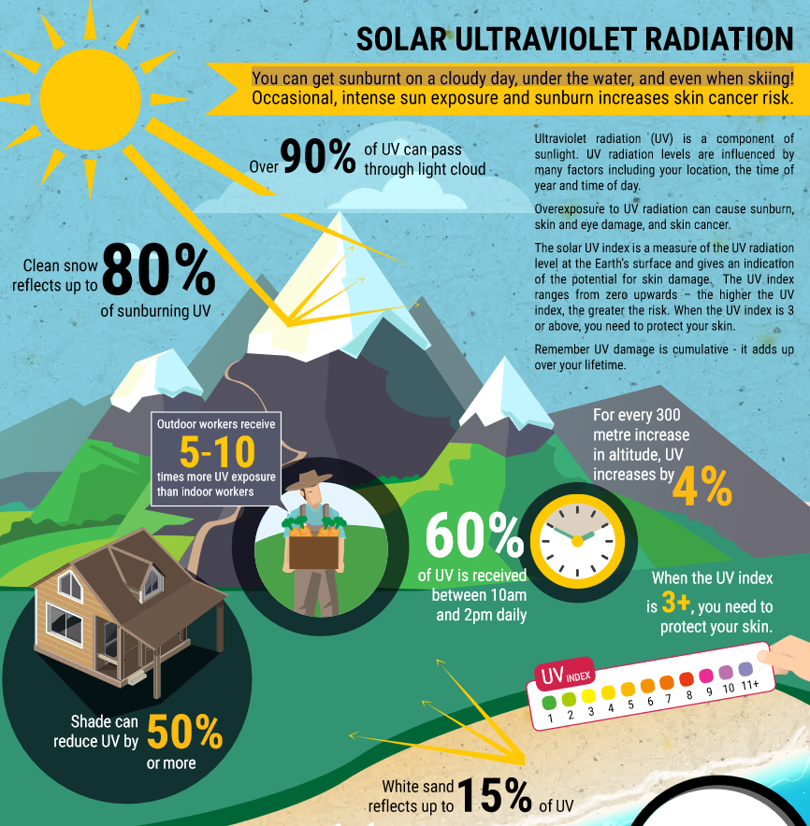
Look at this poster by the Irish Skin Foundation

Slide 16
Statement 8
Agree
A tan on a child is healthy!
Disagree
Notes:
https://www.youtube.com/watch?v=XsUO7Hi651Y DISAGREE

Slide 17
Hear what Jennifer Rock, aka The Skin Nerd, has to say…
Notes:
https://www.youtube.com/embed/XsUO7Hi651Y

Slide 18
Statement 9
Agree
Only women who sunbathe all the time get skin cancer.
Disagree

Slide 19
Hear what Jennifer Rock, aka The Skin Nerd, has to say…
Notes:
https://www.youtube.com/watch?v=PMQS4jTeizc

Slide 20
Statement 10
Agree
A sunburn is the same as a burn from a hot object.
Disagree

Slide 21
Watch this animation from Cancer Research UK…
Notes:
https://www.youtube.com/watch?v=o9oSJpomee8

Slide 22
Statement 7
Agree
Sunbeds give a good base tan before holidays.
Disagree

Slide 23
Hear what Jennifer Rock, aka The Skin Nerd, has to say…
Notes:
https://www.youtube.com/watch?v=cSAW2HOP1ig

Slide 24
Statement 8
Agree
Sunbeds are good for skin problems.
Disagree

Slide 25
Hear what Jennifer Rock, aka The Skin Nerd, has to say…
Notes:
https://www.youtube.com/watch?v=mVW2Ntu237s

Slide 26
Statement 9
Agree
Using sunbeds is safer than tanning.
Disagree

Slide 27
Hear what Jennifer Rock, aka The Skin Nerd, has to say…
Notes:
https://www.youtube.com/watch?v=wTVXOifqits

Slide 28








More questions about UV rays and your skin?
Visit the following websites to find out more information.
Notes:
In Slide Show mode, select the arrows to visit links.

