Slide 1



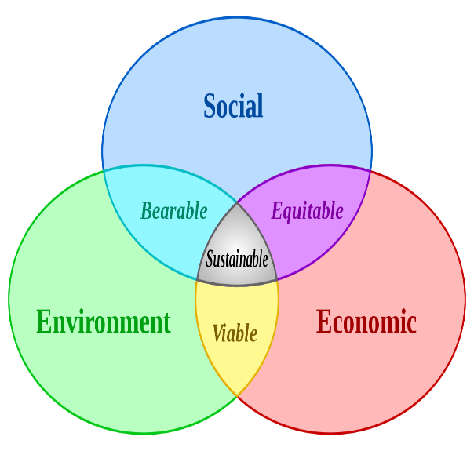
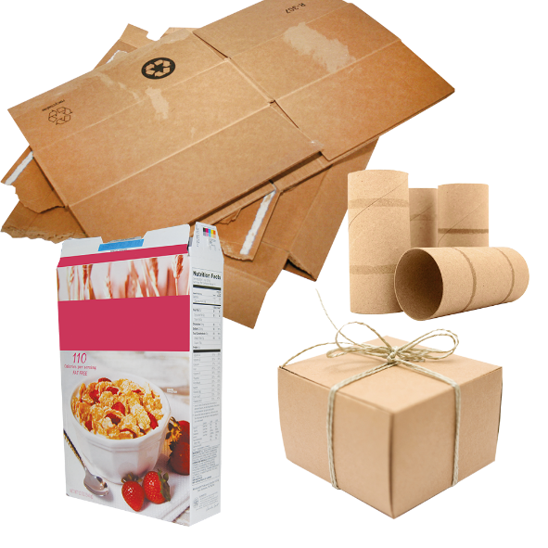
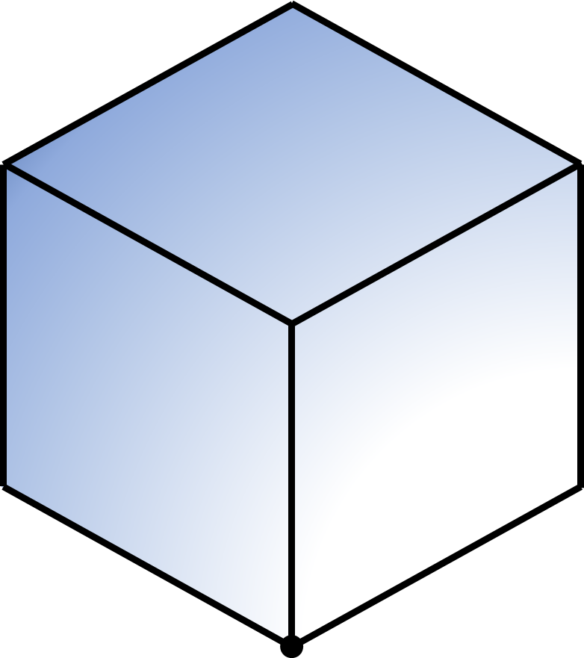
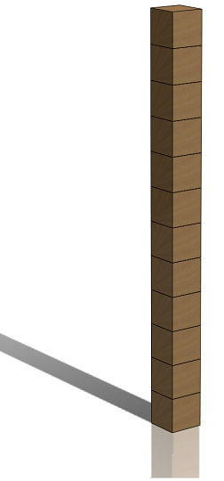
RESOURCE 19: ISOMETRIC PROJECTION 3 & SURFACE DEVELOPMENT 1
2D GRAPHICS & 3D Graphics
SUSTAINABLE DEVELOPMENT LINK
Spatial Reasoning, Design Thinking, Communicating, Geometric Principles & Constructions
1.1, 1.2, 1.3, 1.9, 1.12, 2.2, 2.3, 2.7, 2.8, 2.10 & 2.13
Packaging of products is an industry that uses a large volume and variety of materials. In recent decades greater efforts have been made to ensure the recyclability and reusability of packaging.
Time to Develop!
The Cube Development Tower Challenge
Equipment
Drawing Board, T-Square, 2H/5H
Pencil, Set-Squares, Scissors & Masking tape
Efficient use of packaging material is aided by an understanding and application of surface developments.
Step 1: Set up and line out page as per specification
Step 2: Draw the isometric Cube at desired dimension using a 30° Set-Square as shown
LEARNING TRACKER
JC KEY SKILLS | BEING CREATIVE, BEING LITERATE, BEING NUMERATE, COMMUNICATING, MANAGING INFORMATION & THINKING
KEY SKILL ELEMENTS | EXPLORING OPTIONS & ALTERNATIVES, EXPRESSING IDEAS CLEARLY & ACCURATELY, EXPRESSING IDEAS MATHEMATICALLY, USING LANGUAGE AND SETTING & ACHIEVING PERSONAL GOALS
STATEMENTS OF LEARNING | SOL15, SOL21 AND SOL23
LEARNING OUTCOMES | 1.1, 1.2, 1.3, 1.9, 1.12, 2.2, 2.3, 2.7, 2.8, 2.10 & 2.13
ACTION VERBS | VISUALISE, INTERPRET, ILLUSTRATE, DEMONSTRATE, RECOGNISE, APPRECIATE, CREATE, DEVELOP & COMMUNICATE
KEY QUESTIONS | WHAT IS THE PURPOSE OF BEING ABLE TO DEVELOP THE SURFACES OF AN OBJECT?
 | HOW MANY SURFACES ARE THERE WHEN DEVELOPING A CUBE?
 | WHY ARE DEVELOPMENTS SO IMPORTANT REGARDING THE PACKAGING AND RECYCLING INDUSTRIES?
3-2-1 STUDENT REFLECTION | 3 THINGS I LEARNED – WRITE IT ON THE PAGE
 | 2 THINGS I WANT TO KNOW MORE ABOUT – WRITE IT ON THE PAGE
 | 1 QUESTION I STILL HAVE – WRITE IT ON THE PAGE
Step 3: The Development of the cube involves unfolding all six of its surfaces as shown in the 3D graphic.
Step 4: To Develop the cube in 2D begin by drawing the first square surface as per the dimensions used in the initial isometric projection of the cube. Note that we use dashed lines when drawing this square to represent ‘fold/hinge’ lines which other surfaces are developed from.
MATHS LINK
Mathematically we can calculate the volume of a cube as follows:
Length x Width x Thickness
100mm x 100mm x 100mm = 1,000,000mm³
Surface area of a cube can be calculated as follows:
Length x Width
100mm x 100mm = 10,000mm²
10,000mm² x 6 = 60,000mm²
Step 5: Using projection lines, extend the initial dashed line square in all directions.
Step 6: Using the same dimensions, add each of the remaining 5 square surfaces to complete the development of the cube as follows:
One to the top, one to either side and two to the bottom with a ‘fold/hinge’ line separating each of these squares. Render/Colour to complete the projection

