Slide 1
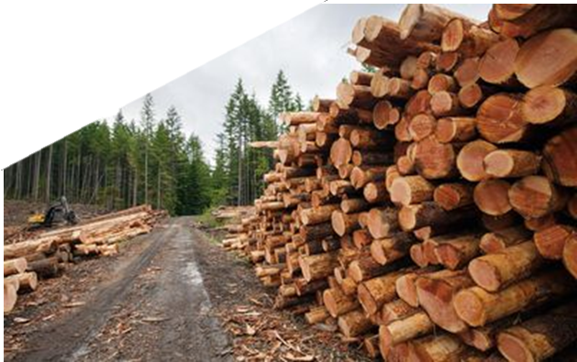


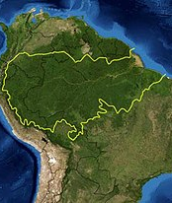
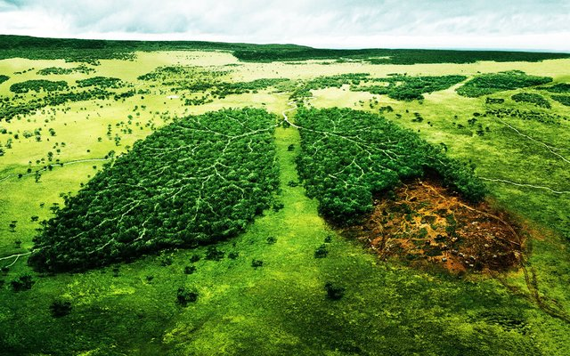
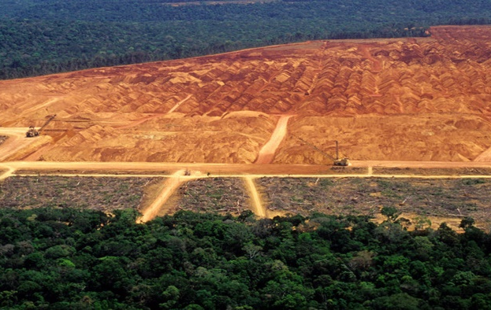
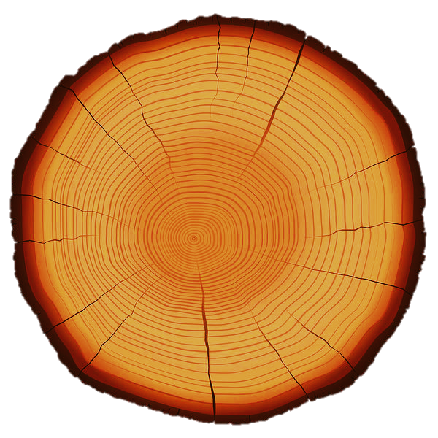
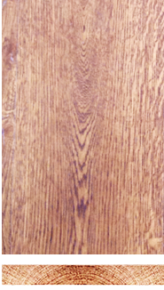
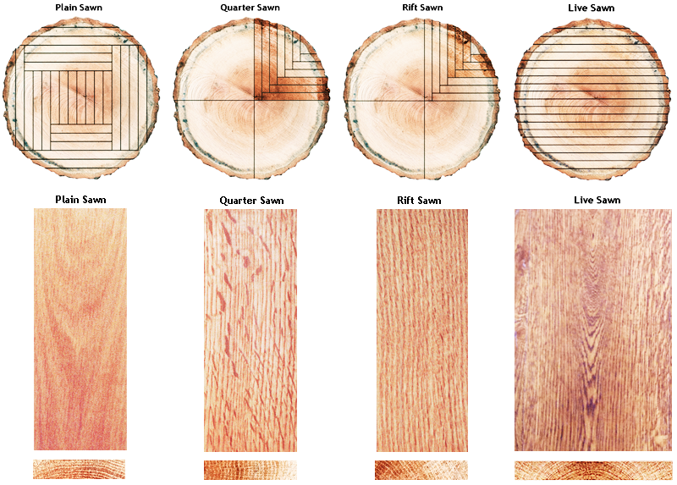
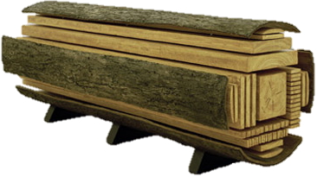
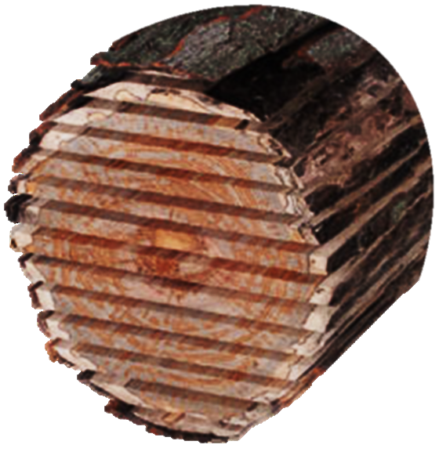
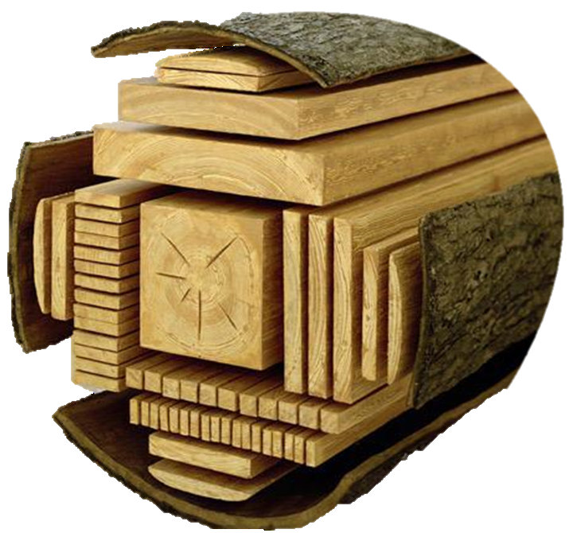
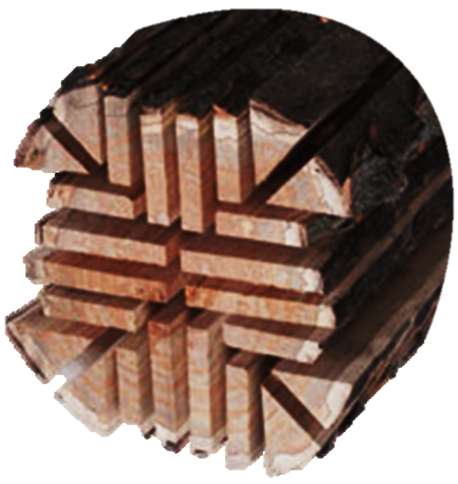
RESOURCE 13: THREE METHODS FOR THE CONVERSION OF TIMBER LOGS
Wood Science & Materials
Forests cover 30% of the Earth! If the current rate of deforestation continues, it will take less than 100 years to destroy all the rainforests on the earth. 20% of the world’s oxygen is produced in the Amazon forest.
Planning & Management, Communication and Environment & Sustainability
SUSTAINABILITY
LINK
3.2, 3.3, 3.5 & 3.11
LET’S CONVERT!
‘Three Methods of Timber Conversion’
Forests are an essential component of the Earth’s ecosystem and plays a vital role in sustaining all life.
Timber conversion is the process by where tree logs are processed into planks that can be seasoned and used in a variety of ways.
There are three common methods of timber conversion as follows:
Through & Through Sawing
Tangential Sawing
Quarter Sawing
Each of the methods produce timber planks with different structural and aesthetic properties depending on the need.
Up to 20% of a tree log is wasted during the timber conversion process, depending on the method used.
Waste material can be reused for other wood based products, for example manufactured boards, mulch, saw dust etc.
As timber remains to be a popular choice of material in industry it is important that processes are sustainable.
Amazon
LEARNING TRACKER
JC KEY SKILLS | BEING LITERATE, BEING NUMERATE, STAYING WELL, MANAGING INFORMATION & THINKING, COMMUNICATING, MANAGING MYSELF AND WORKING WITH OTHERS
KEY SKILL ELEMENTS | EXPRESSING IDEAS CLEARLY & ACCURATELY, EXPRESSING IDEAS MATHEMATICALLY, THINKING CRITICALLY & CREATIVELY, USING LANGUAGE, BEING RESPONSIBLE/SAFE/ETHICAL AND SETTING/ACHIEVING PERSONAL GOALS AND CO-OPERATING
STATEMENTS OF LEARNING | SOL15
LEARNING OUTCOMES | 3.2, 3.3, 3.5 & 3.11
ACTION VERBS | EVALUATE, UNDERSTAND, EXPLAIN AND INVESTIGATE
KEY QUESTIONS | WHAT ARE THE DISADVANTAGES OF THROUGH AND THROUGH CONVERSION?
 | HOW MIGHT WASTE TIMBER AS A RESULT OF CONVERSION BE RE-USED?
 | WHY ARE THERE DIFFERENT METHODS OF TIMBER CONVERSION AS OPPOSED TO JUST ONE?
3-2-1 STUDENT REFLECTION | 3 THINGS I LEARNED – WRITE IT ON THE PAGE
 | 2 THINGS I WANT TO KNOW MORE ABOUT – WRITE IT ON THE PAGE
 | 1 QUESTION I STILL HAVE – WRITE IT ON THE PAGE
Through & Through Sawing
Tangential Sawing
Quarter Sawing
Through and through produces mostly tangentially sawn timber and some quarter sawn stuff. Tangential timber is the most economical to produce because of the relatively less repetitive production methods. It is used extensively in the building industry.
Tangential boards are used extensively for beams and joists. They are stronger when placed correctly edge up with the load in the tangential axis. These type of boards suffer from 'cupping' if not carefully converted, seasoned, and stored properly. Annual growth rings form an angle less than 45 degrees.
Quarter sawn boards are radial cut from the centre of the tree. It produces the distinctive silver ribbon effect (in oak) across the whole board. Annual growth rings form an angle greater than 45 degrees. True quartered boards producing the best features will have the angle on or very much closer to 90 degrees.

