Slide 1
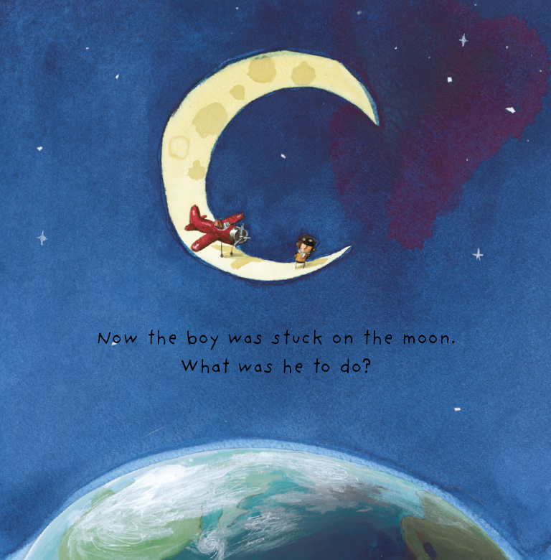
Hello boys and girls,
I hope you liked the letter I sent. Your teacher has told me that you really liked my story and have put actions to it. I would LOVE to see that!
The moon was a surreal experience, so peaceful and quiet, yet beautiful. Do you have any questions for me about my journey to the moon? Or how I felt on my journey up and down? Write them down and your teacher will send them to me. I cannot wait to answer them.
From, The Boy

Slide 2


Over to you ……..
(Insert picture of class)
Prior to this we learnt actions to the story and had been retelling it daily following Pie Corbett’s Talk for Writing programme.

Slide 3
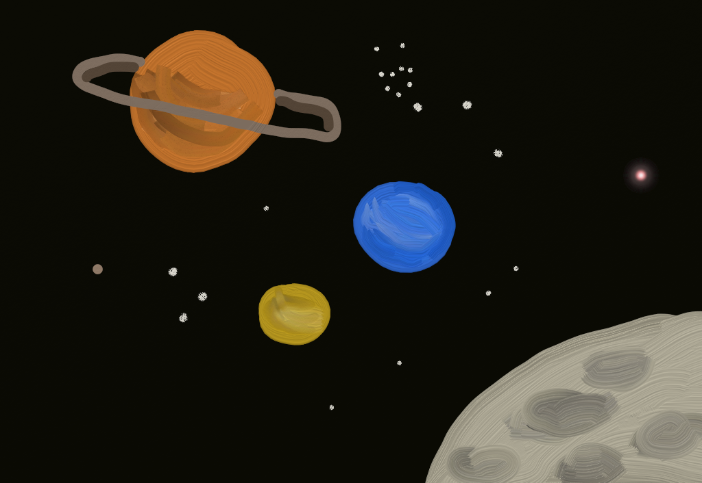
What questions could we ask the boy?
What do you want to know about his journey to space?
Who?
Where?
Why?
What?
When?

Slide 4
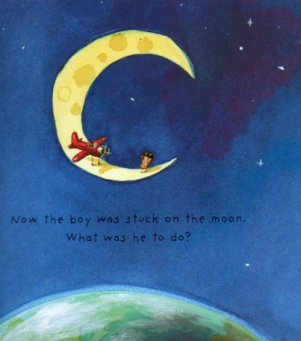
What questions would you want to ask him here?

Slide 5


Slide 6
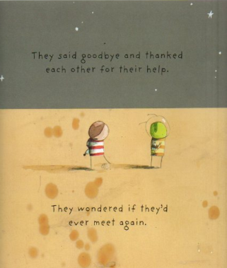

Slide 7
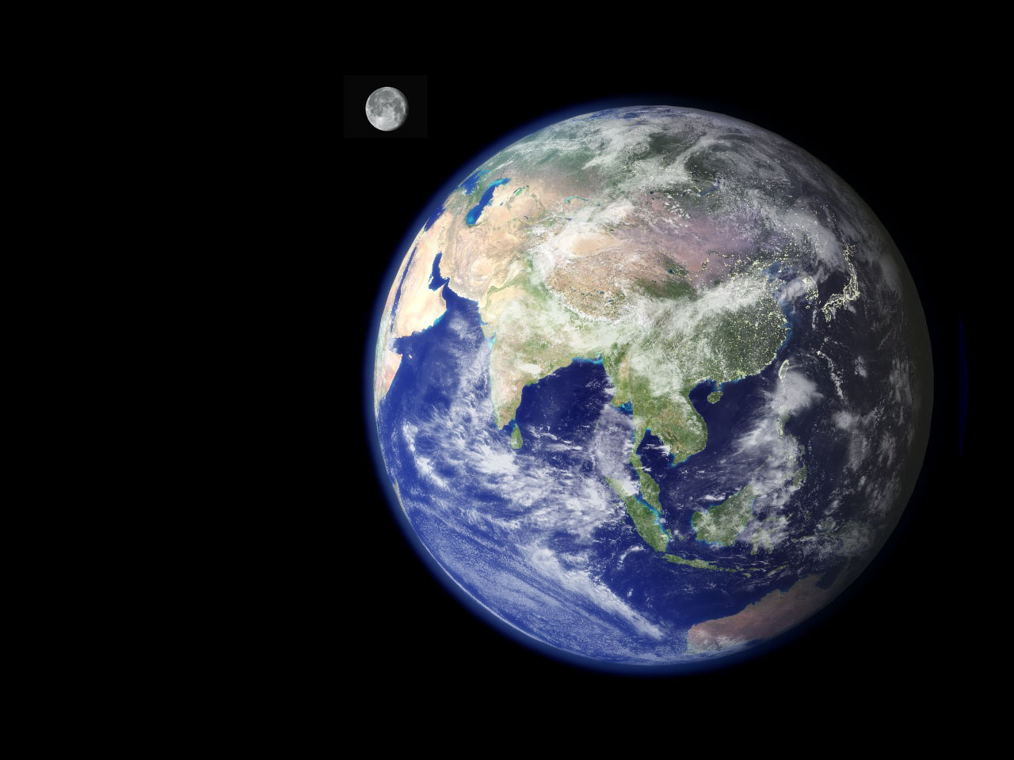
Who did you tell about your trip?
What did you miss the most when you were on the moon?
How did you feel travelling through space?
What did you see?
How did you feel
Were you scared when you were stuck on the moon?
Where will your next adventure be?

Slide 8
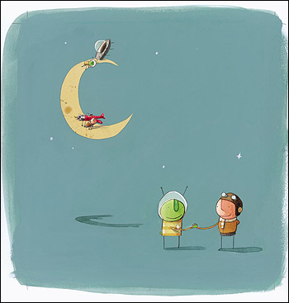
Name:
LO: Gather questions to ask the boy from the story.
How?
Where?
What?

