Slide 1
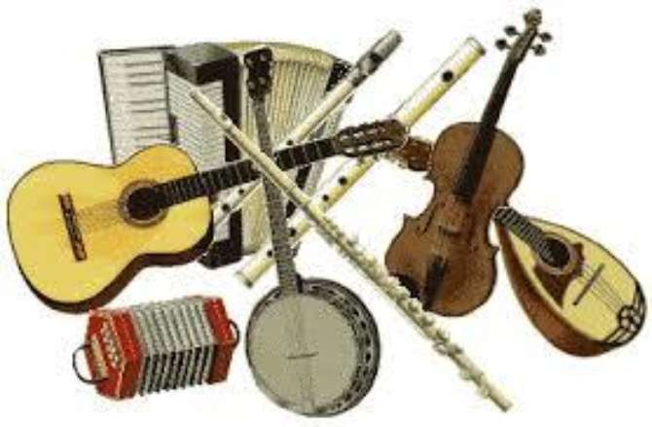
Guide to Irish Traditional Music
History and Dance Styles

Slide 2
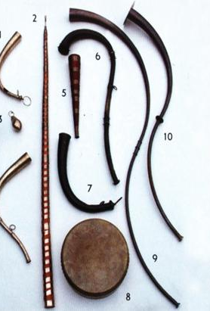
Origins
Music has been in Ireland for thousands of years. The first inhabitants of the island used very primitive forms of musical instruments, mostly pipes and horns. Rather than being used to make melodies or as a form of art, instead they were most likely used as signallers, to warn others of danger or to summon people from an area for whatever reason. Over time as these people became more skilled, the instruments became more complex as well as more durable; although whether they became more tuneful or not is anyone’s guess. Among other instruments, a set of six hand-carved cylindrical wooden pipes dating from around 2000 BC have been found in Wicklow. Made from yew wood and resembling a larger set of pan pipes, they are said to resemble similar objects found in Scandinavia around the same time period. Two other prime examples are the Dord Iseal and the Dord Ard. Both are cast bronze horns that are around 3000 years old, from the west and north of Ireland respectively.

Slide 3
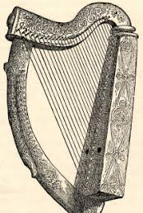
Origins
Like most other aspects of Irish culture and traditions, the beginning of Irish music as we know it today can be traced back to the arrival of the Celts. Having spread from central Europe all the way to the shores of the Atlantic, they picked up a few skills along the way, and using musical instruments was one of them.
In particular, they had one significant instrument; the harp. This was the most dominant sound in Ireland long after the Celts had made way to the Vikings. The harp is often featured throughout Irish mythology, for example when the harper Corann, a musician to the Dagda at Newgrange, puts the rampaging sow Cail Cheis to sleep with his enchanting music the magical musical energy spills out from the caves in the mountain of Kesh Corann in County Sligo.
While not a whole lot is known about how exactly the Celts used music, we do know that it had already become an important part of life by the Middle Ages. Anyone proficient in the harp could earn themselves a very nice living playing in the courts of the chieftains, and the harp and harpists were held in very high regard.

Slide 4
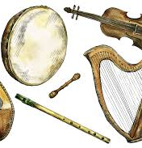
Instruments
In addition to the harp, other instruments joined the fray over the last few hundred years, most of which are earlier versions of present-day traditional instruments, including the Fiddle, Uileann Pipes, Bodhran, Irish Flute, Low Whistle, Tin Whistle, Accordion, Concertina.
These were joined in the 20th century by the piano, bouzouki, guitar, banjo and other instruments that have been incorporated into the traditional music scene.

Slide 5
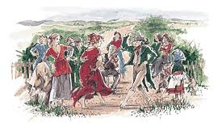
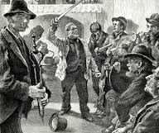
19th & 20th Century
In earlier centuries, music and storytelling were often the only forms of entertainment on an island that had no electricity and where only a small minority of the population were literate.
On cold, dark evenings, villages would crowd together into houses and in warmer months, at crossroads, to share a warm fire, hear stories and dance to music played by the local musicians. It started a tradition that has been kept alive since then.

Slide 6
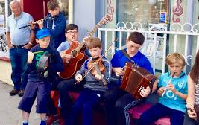

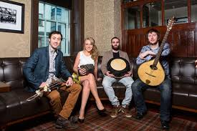
Modern Day
Many changes have taken place in Irish traditional music over the last 60 years or so. In the past, the Irish music culture was largely rural,
enjoyed by amateur musicians, it was passed on orally and was largely confined to the rural regions. It was also music for dancing to, not generally for listening to.
The changes in traditional music in the last century were largely a product of the general modernisation of Irish. Urbanisation, development of technology, greater reach of the media, transport better instruments and a general change in attitude towards traditional music, dance and language, have all been important factors in the process.
The formation of organisations like ITMA, Ceomhaltas, Gaeil Linn and Píobáirí Éireann, have allowed for the preservation, recording and promoting of Irish traditional music amongst a new generation.

Slide 7

The mission of Comhaltas Ceoltóirí Éireann
To promote Irish Traditional Music in all its forms;
To restore the playing of the Harp and Uilleann Pipes in the National life of Ireland;
To promote Irish Traditional Dancing;
To foster and promote Traditional singing in both Irish and English;
To foster and promote the Irish language at all times;
To create a closer bond among all lovers of Irish music;
To co-operate with all bodies working for the restoration or Irish Culture;
To establish Branches throughout the country and abroad to achieve the foregoing aims and objects.

Slide 8
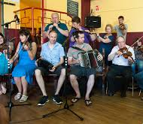
Céilí Bands
The first Céilí bands were probably a response to the Gaelic League's creation of the céilí dance in the early years of the 20th Century.
A Céilí band consisted of a Piano, snare drum and an accordion. As venues became larger so the bands grew, so today fiddles, flutes, banjos and even saxophones are found in Céilí Bands.
The Céilí Band was often the only type of traditional music played on radio in the 1950s and '60s. Some bands stand out for the quality of the music they perform, with the Kilfenora Céilí band an example of a band that is thriving today. There is also a movement towards 'listening' Céilí Bands with the emphasis on the music alone.

Slide 9
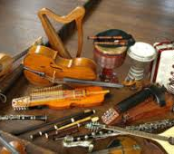
Dance Styles
Much of what we now call Traditional Irish music originated in the Gaelic speaking peasantry of the 18th Century. Dancing was very popular at weddings and other social events. Up until the early 20th Century, the practice of dancing masters travelling from town to town with a fiddler or piper, and giving dance classes was common.
In rural Ireland, dancing at the crossroads was still very popular towards 1950. Today, dance music is often played in a concert situation, to be listened to, rather than to be danced to. This affects the way the music is played. For example, a hornpipe wont necessarily be played at dance speed now.
Modern players particularly in bands or groups often like to play very fast. Modern bands also like to run a slower dance like the slip jig into a faster one like the reel. The tempo change for the Reel gives the music a lift. It's also typical to run several tunes of the same dance type together.

Slide 10
The Jig
The jig is the oldest form of dance. There are 3 types; the Single Jig in 6/8 featuring all quavers, the Double Jig in 6/8 featuring crotchet quaver movement and the Slip (Hop) Jig in 9/8 featuring quaver movement.
The Lark in the Morning, Morrison's Jig are examples of well-known Jigs.
Slipjigs include - The Butterfly and the opening of Riverdance

Slide 11
The Reel
The Reel is of Scottish descent and is often the favourite dance of traditional musicians. Although written in 4/4 it is played in 2/2 with 2 steady beats in each bar.
Drowsy Maggie, The Mason's Apron, the Wind that shakes the Barley and Toss the Feathers are well-known Reels

Slide 12
The Hornpipe
The Hornpipe is the slowest dance leaving room for the most complicated of dance steps. Many set dances are Hornpipes. It is characterised by the dotted rhythm, triplets and 3 strong crotchets in the last bar of each section.
Other dances related to hornpipes include Barndances, Scottishes and Highlands.
The Harvest Home and King of the Fairies are Hornpipes.

Slide 13
The Polka
The Polka is a dance associated with the set dances of the Sliabh Luachra area of West Munster.
It is in 2/4 time and its tempo is very fast.
The Kerry Polka and Britches full of Stiches are Polkas.

Slide 14
End of Slideshow

