Slide 1

Discuss
What do you want your students to understand from calculus?

Slide 2
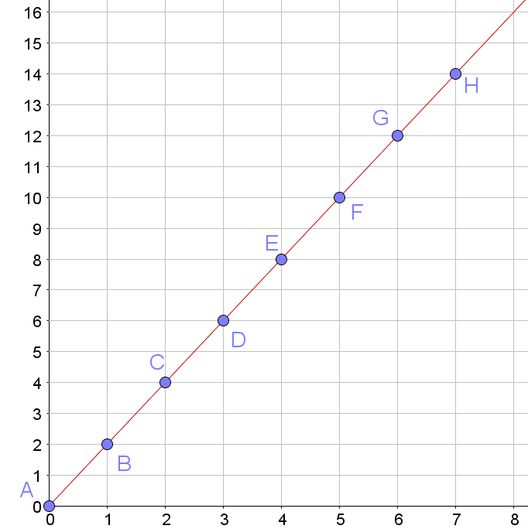
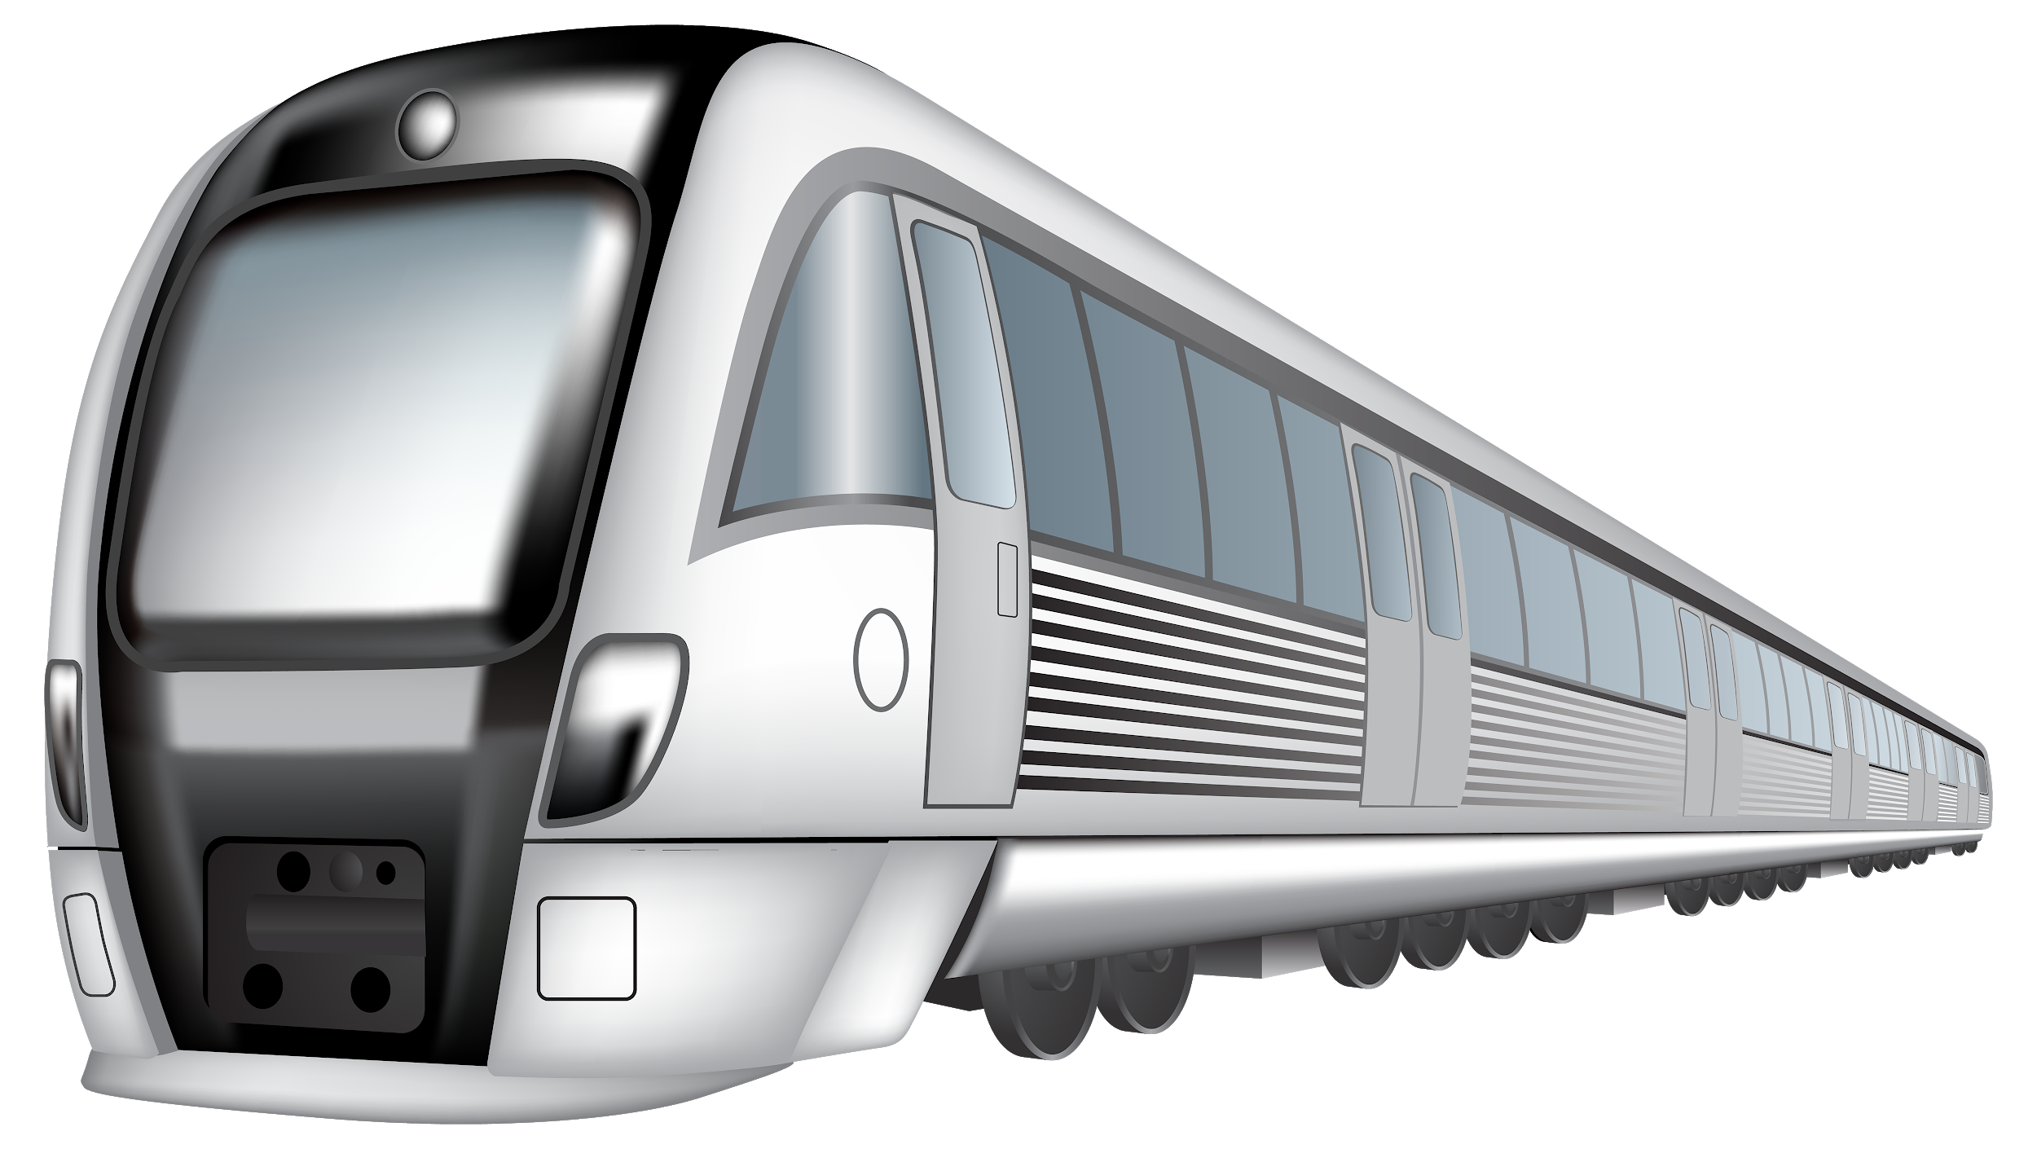
Rates of Change at Junior Cycle
Distance (km)
Time (minutes)

Slide 3


Task 2 – You sayin’ I’m fast?
In 2009 Usain Bolt broke the world record for the 100m sprint with a time of 9.58s.

Slide 4
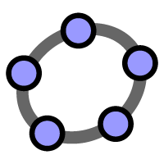
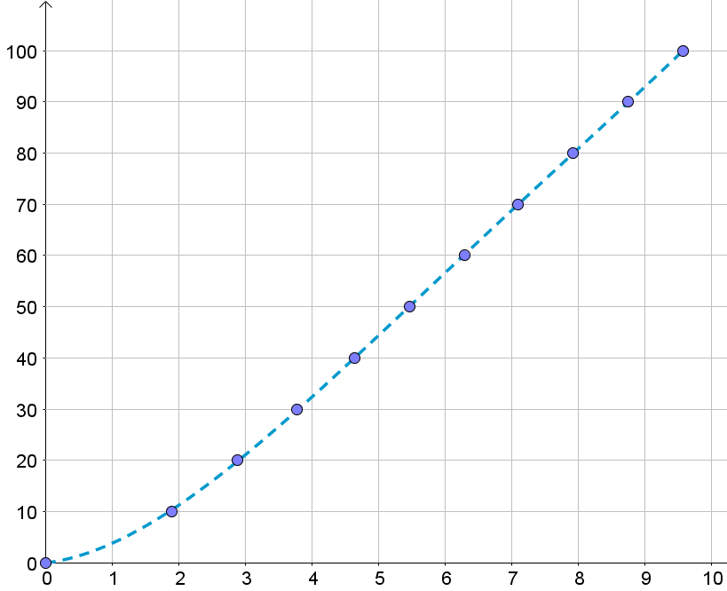
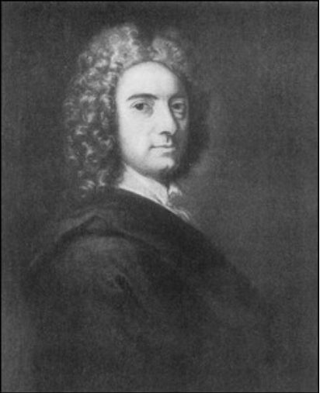
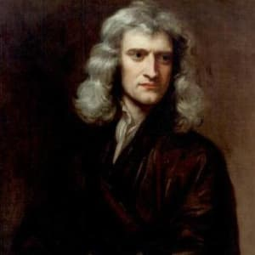
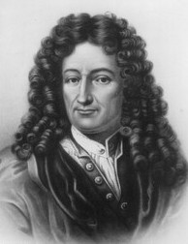
Task 2 - Are you saying I’m fast?
Distance (m)
Time (s)

Slide 5
Origin of Calculus
Newton
Berkeley
Von Leibniz

Slide 6
Task 2 - Introduction to Calculus
Learning Outcomes
During the course of this task we will:
Recognise the importance of building on students’ prior knowledge of rates of change to introduce calculus
Identify the slope of a secant on a curve as the average rate of change
Understand the, origin of, and the need for calculus
Understand the difference between average rate of change and instantaneous rate of change
Identify the slope of a tangent to a curve as the instantaneous rate of change.

Slide 7


Slide 8
Task 3 - Rates of Change
Learning Outcomes
During the course of this task we will:
Investigate the rates of change at different points on a curve as the slope of the tangent to the curve at those points
Explore the relationship between a function and the derivative of that function
Recognise the importance of using a constructivist approach to allow students to discover the rates of change / the slopes of tangents to a curve
See the benefits in using Digital Technologies to further enhance students’ understanding of this concept.

Slide 9
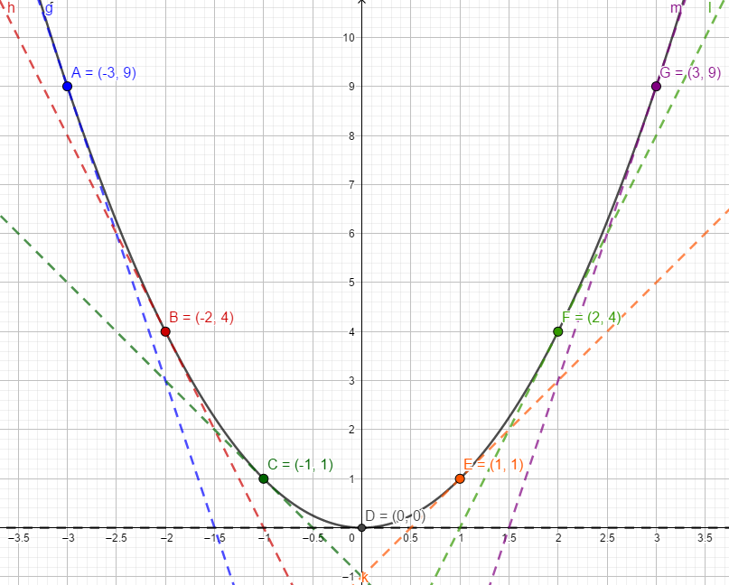
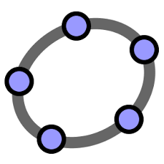
Task 3: Constructing a Lesson

Slide 10





Exploring the derivative of functions

Slide 11


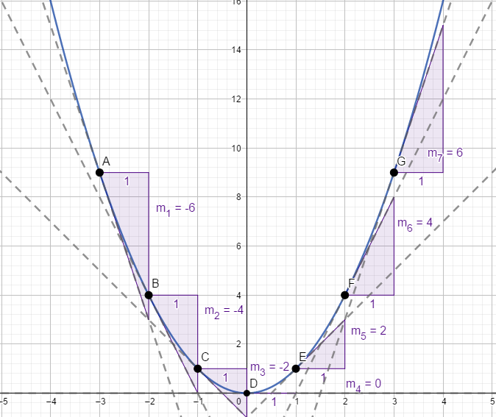
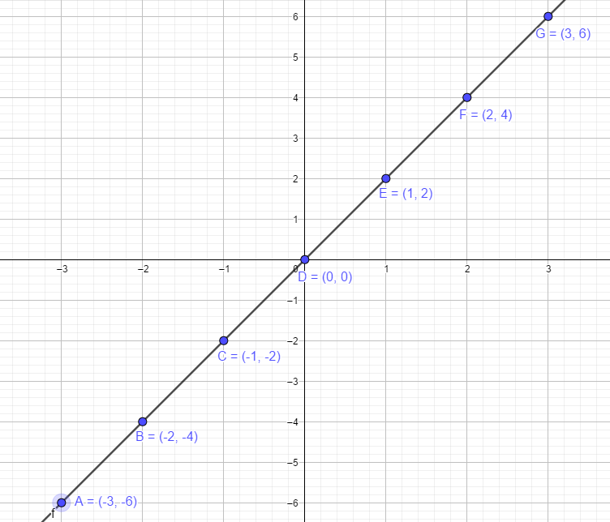
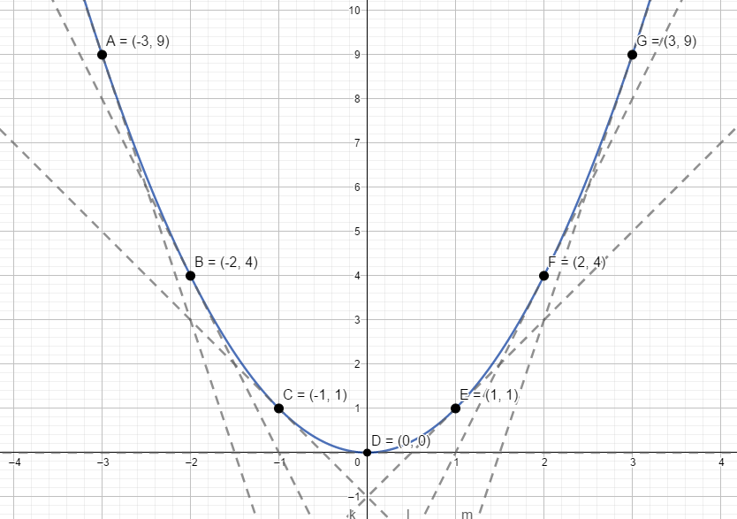
Use the slopes of these tangents to create another function
 | Slope of tangent
-3 | -6
-2 | -4
-1 | -2
0 | 0
1 | 2
2 | 4
3 | 6
Describe the relationship between the x values and the slopes of the tangents to the curve.

Slide 12
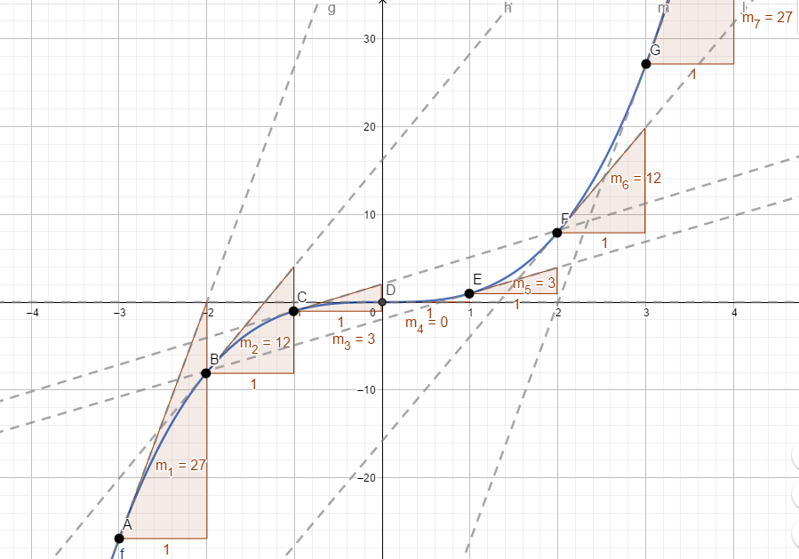
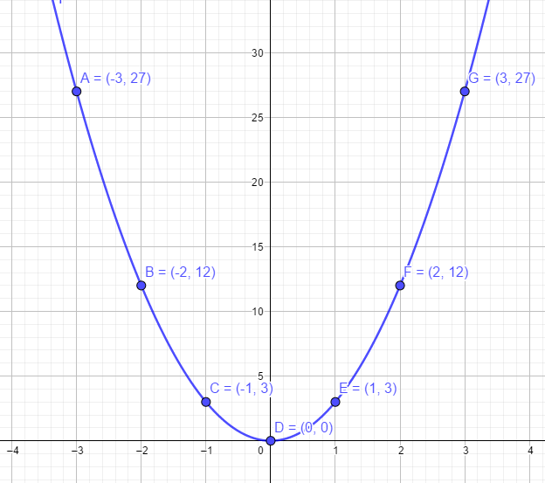
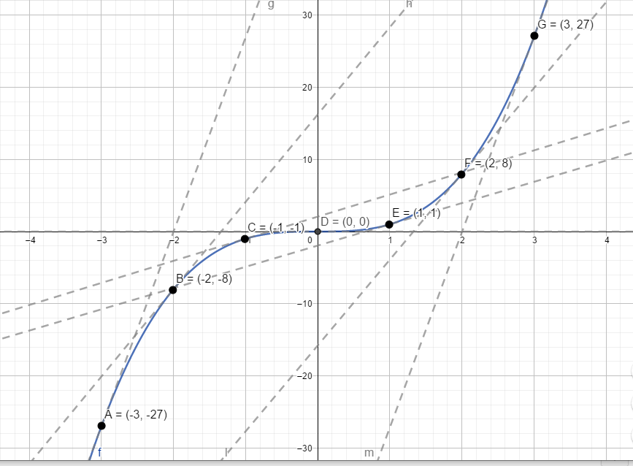

Use the slopes of these tangents to create another function
 | Slope of tangent
-3 | 27
-2 | 12
-1 | 3
0 | 0
1 | 3
2 | 12
3 | 27
Describe the relationship between the x values and the slopes of the tangents to the curve.

Slide 13
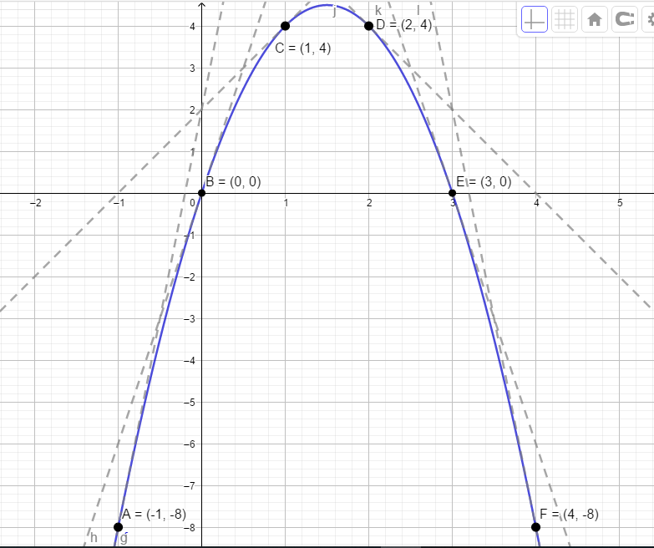
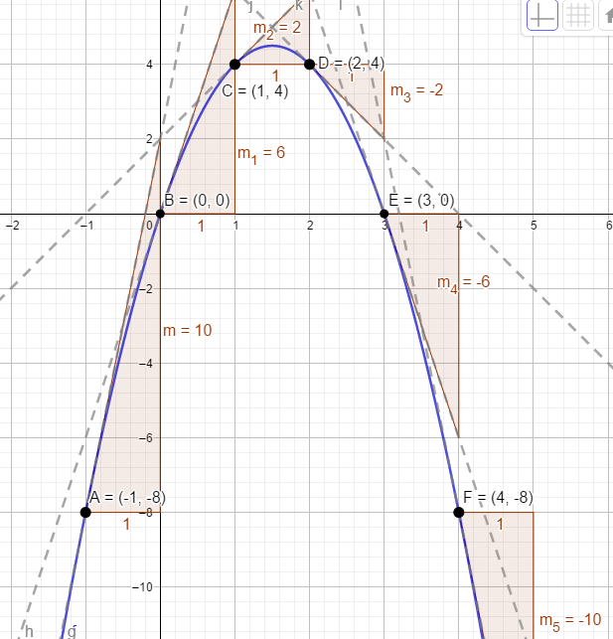
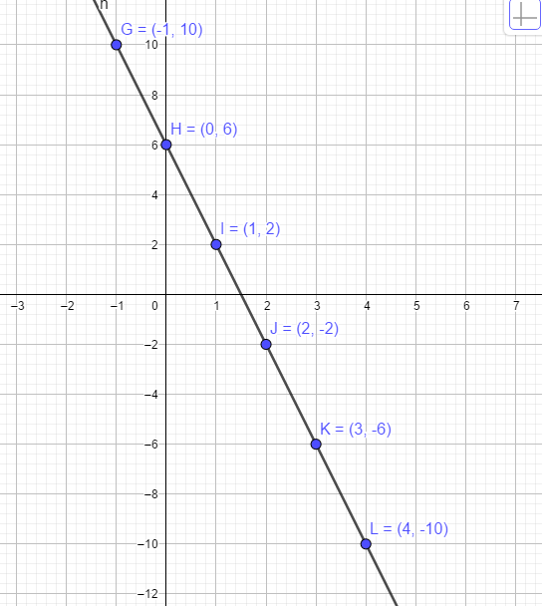

Use the slopes of these tangents to create another function
 | Slope of tangent
-1 | 10
0 | 6
1 | 2
2 | -2
3 | -6
4 | -10
Describe the relationship between the x values and the slopes of the tangents to the curve.

Slide 14
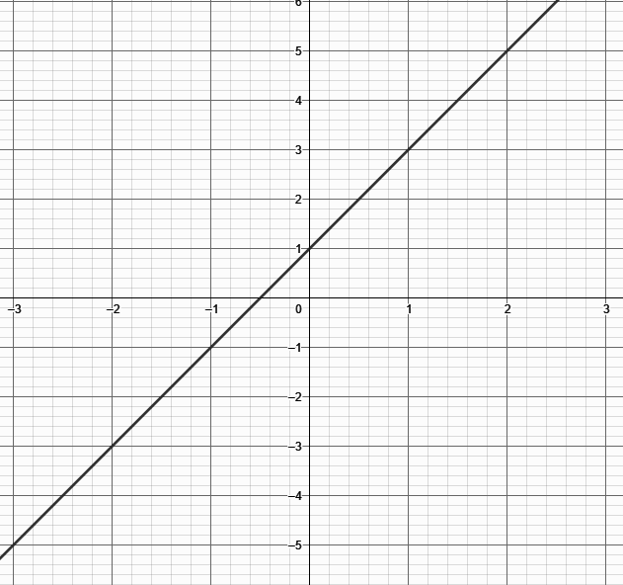
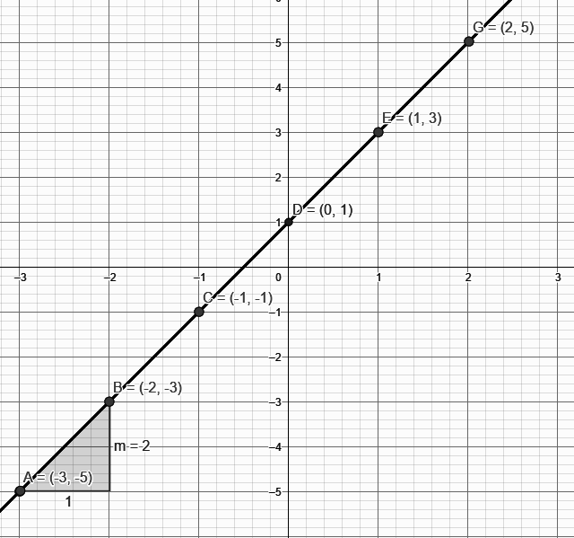
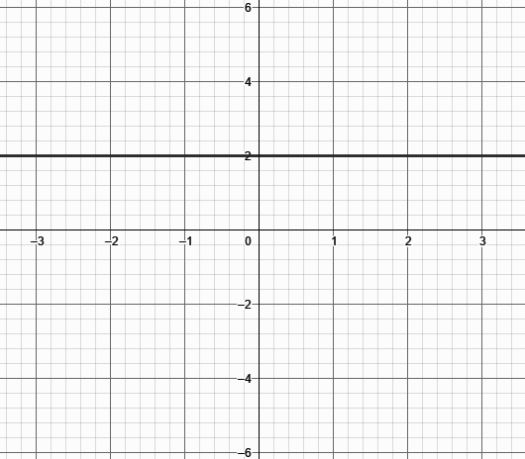

Use the slopes of these tangents to create another function
 | Slope of tangent
-3 | 2
-2 | 2
-1 | 2
0 | 2
1 | 2
2 | 2
Describe the relationship between the x values and the slopes of the tangents to the curve.

Slide 15
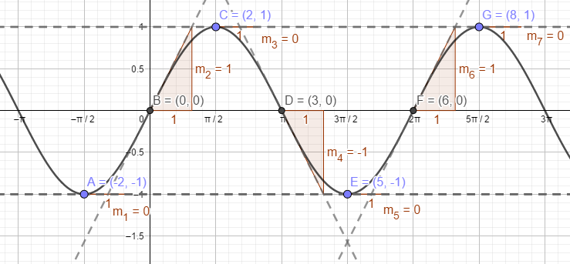
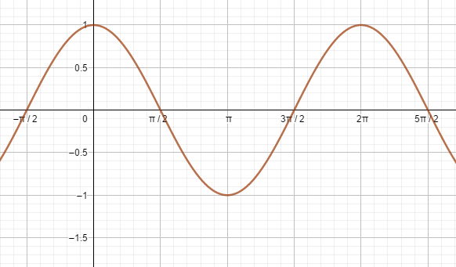

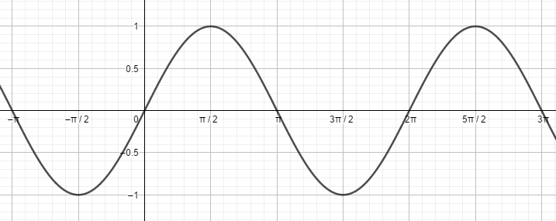
Use the slopes of these tangents to create another function
 | Slope of tangent
-𝝅/2 | 0
0 | 1
𝝅/2 | 0
𝝅 | -1
3𝝅/2 | 0
2𝝅 | 1
5𝝅/2 | 0
Describe the relationship between the x values and the slopes of the tangents to the curve.

Slide 16
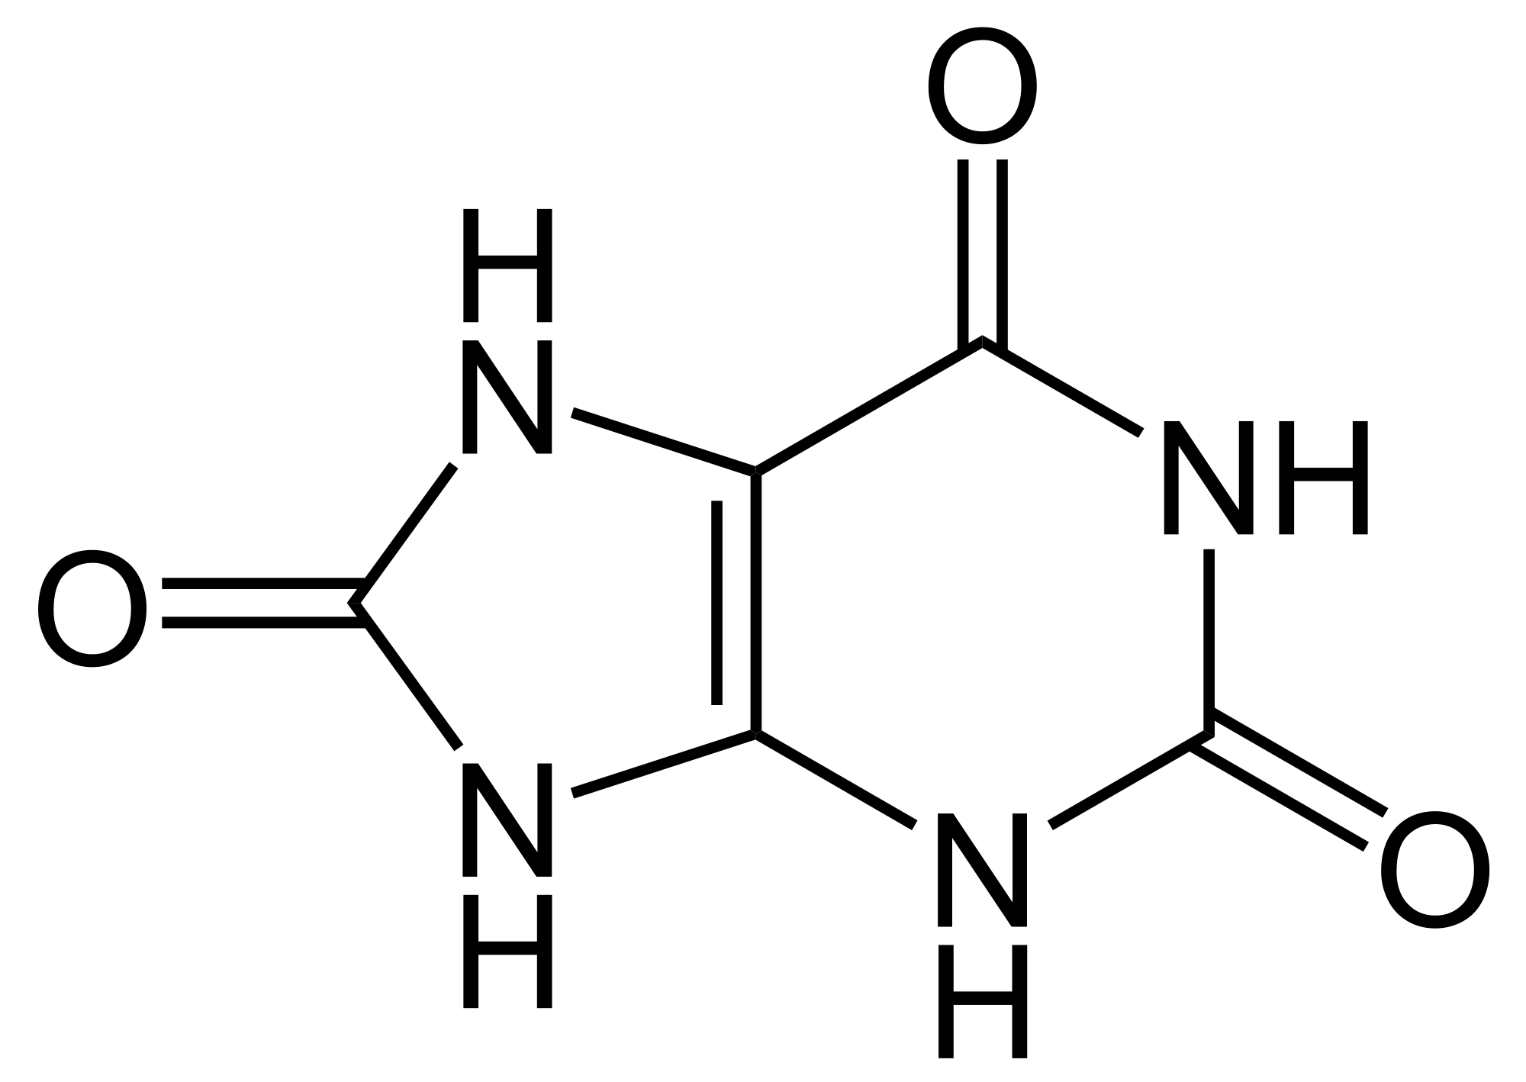

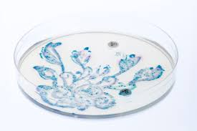
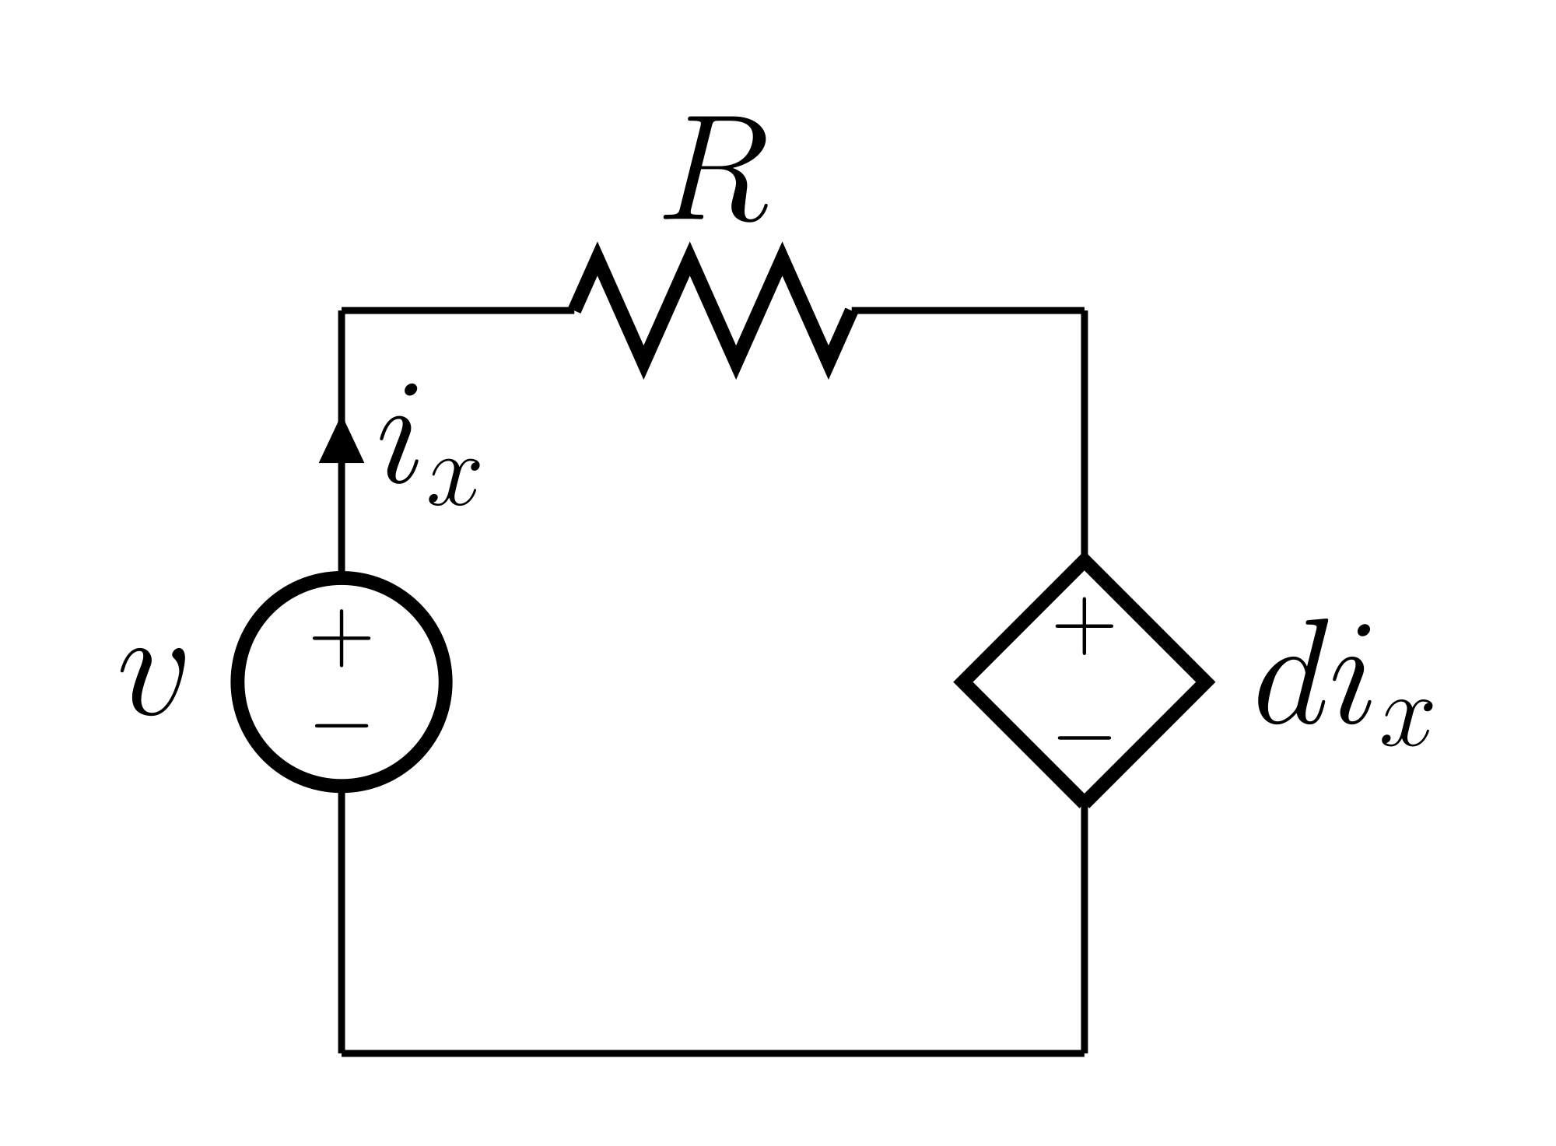

What opportunities exist in other STEM subjects to demonstrate the importance of Calculus?

