Slide 1
The Circle

Slide 2
The Circle
Learning Outcomes
Recognise the importance of Pythagoras’ Theorem in making sense of the equation of a circle.
Understand that often new mathematical knowledge may be developed using knowledge students already have.

Slide 3
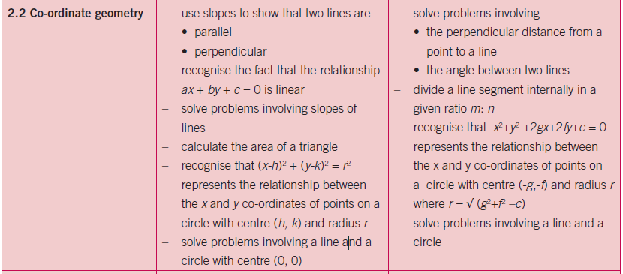
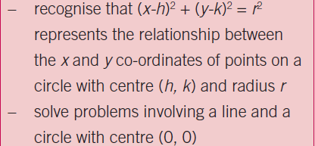
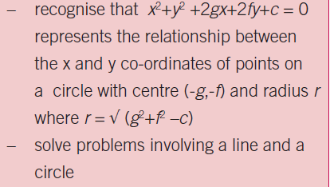
Link to Syllabus

Slide 4
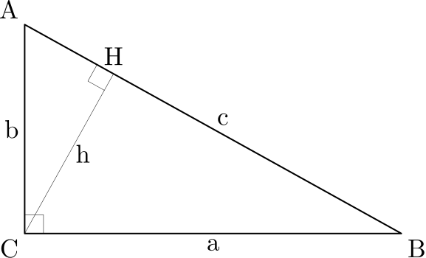
Prior Knowledge
Coordinate Geometry
Pythagoras’ Theorem
Application of Pythagoras’ Theorem
Geometry (Theorems)

Slide 5
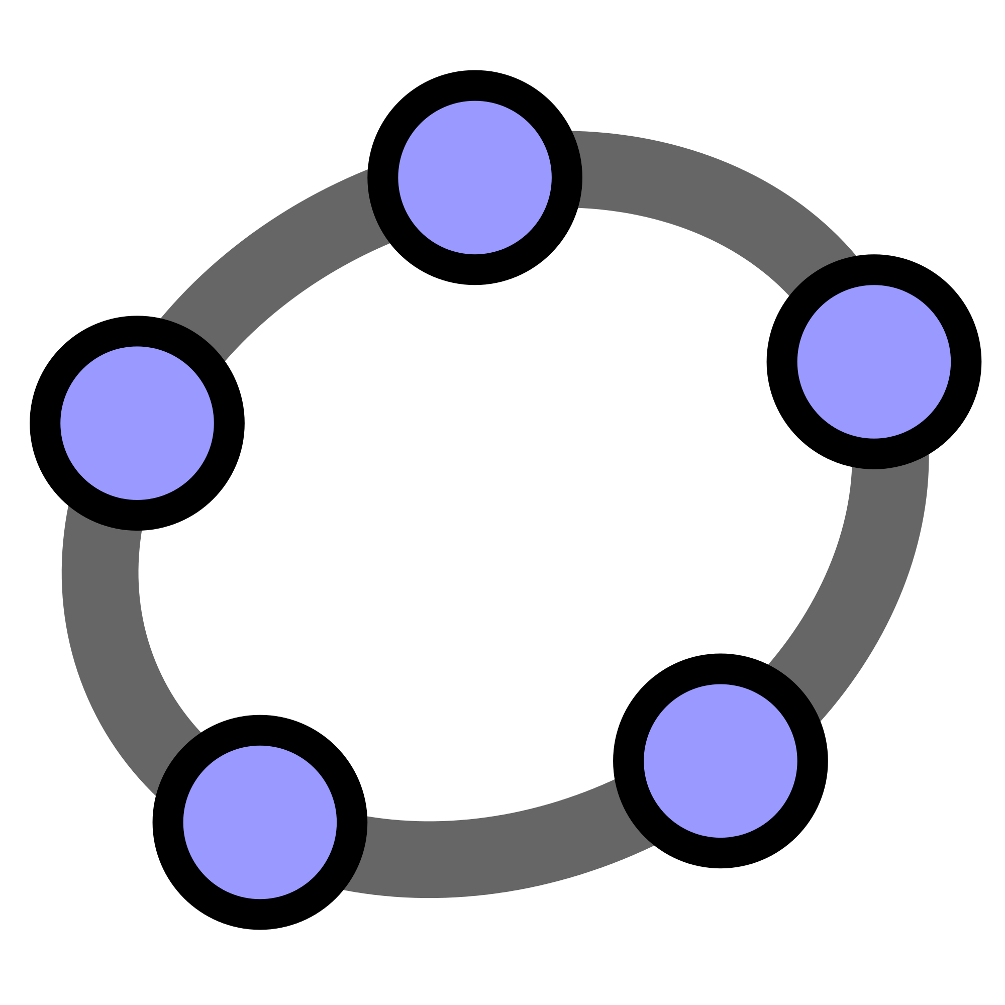
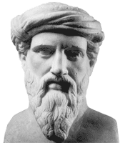
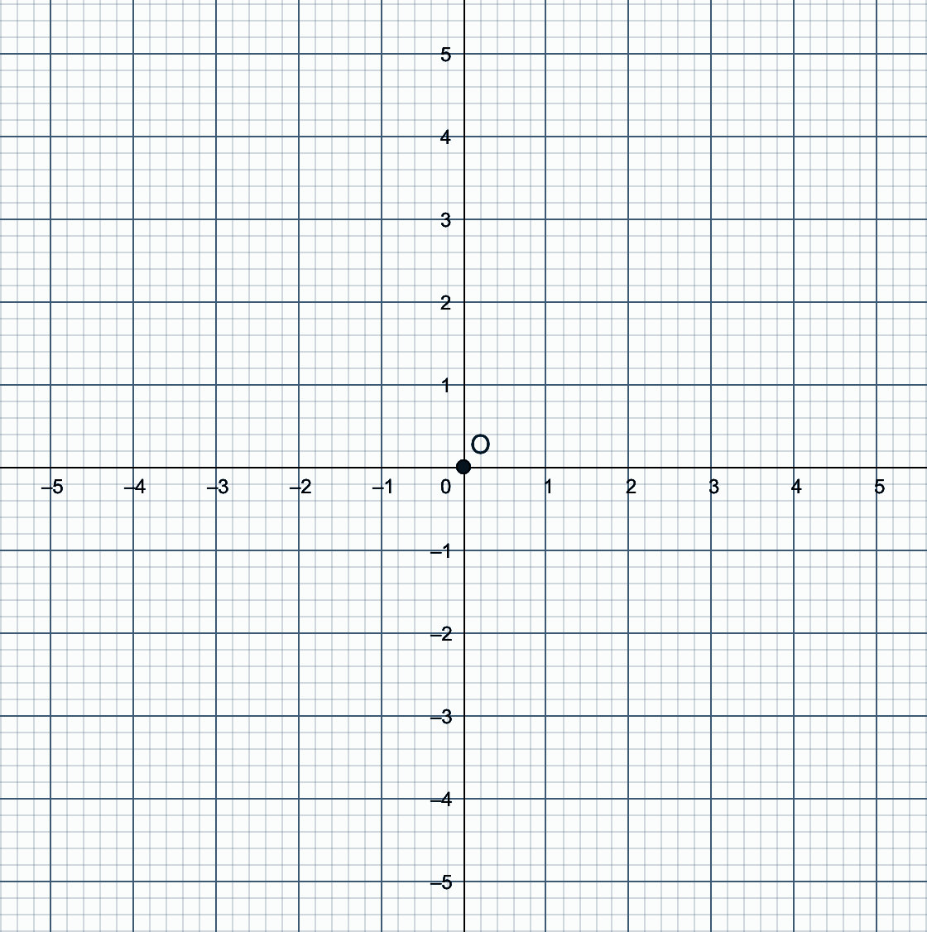
Going in circles with Pythagoras
Write down the coordinates of as many points as possible that are equidistant from the origin?

Slide 6
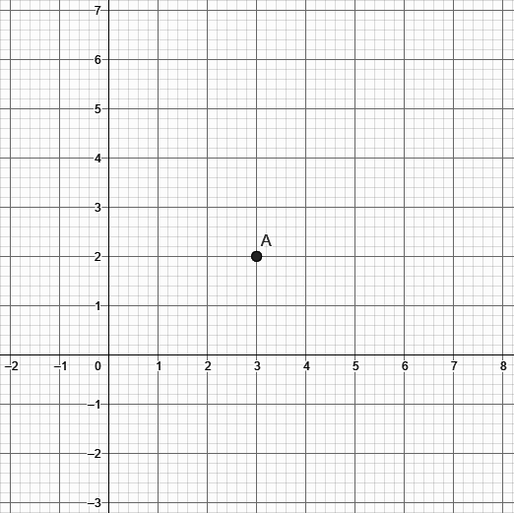
Going in circles with Pythagoras
How would you use this diagram to guide students to the discovery of the equation of a circle when the centre is not at (0, 0)?
Write down the coordinates of as many points as possible that are equidistant from the point (3, 2)?

Slide 7
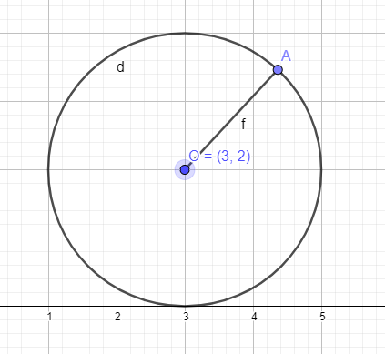
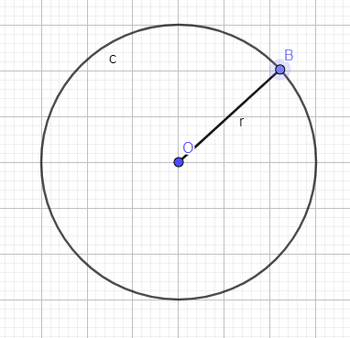
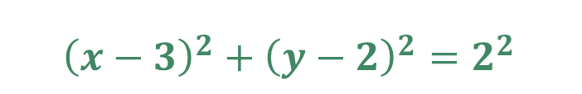
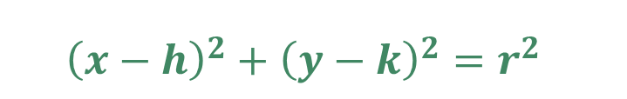
$${\left(x−3\right)}^{2}+{\left(y−2\right)}^{2}=2^{2}$$
$${\left(x−h\right)}^{2}+{\left(y−k\right)}^{2}=r^{2}$$
Co-ordinate Geometry – Equation of a Circle
2
r
y - 2
y - k
x - 3
x - h

Slide 8
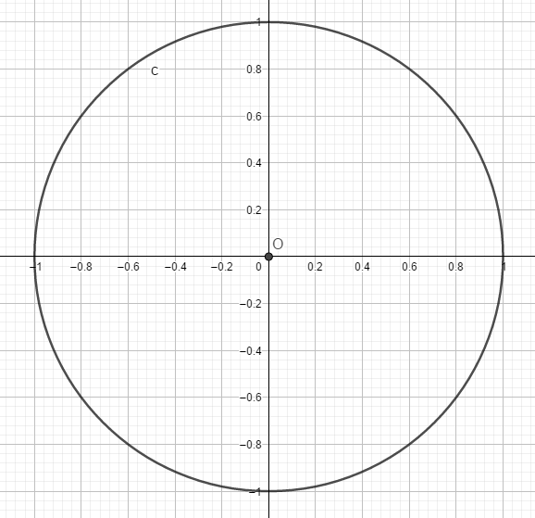

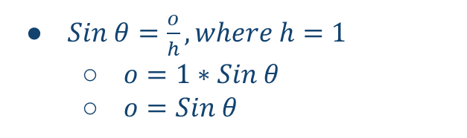
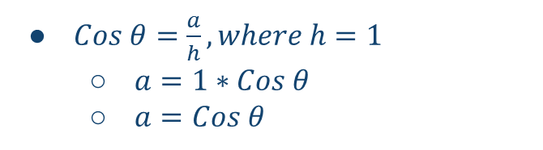
Trigonometry –
Pythagoras, The Unit Circle and Trigonometric Identities
$Cos θ=\frac{a}{h}, where h=1$
  $a=1∗Cos θ$
  $a=Cos θ$
(Cos 𝜭, Sin 𝜭)
h
$Sin θ=\frac{o}{h}, where h=1$
  $o=1∗Sin θ$
  $o=Sin θ$
o
Sin 𝜭
𝜭
a
Cos 𝜭
$Cos^{2}θ+Sin^{2}θ=1$

Slide 9
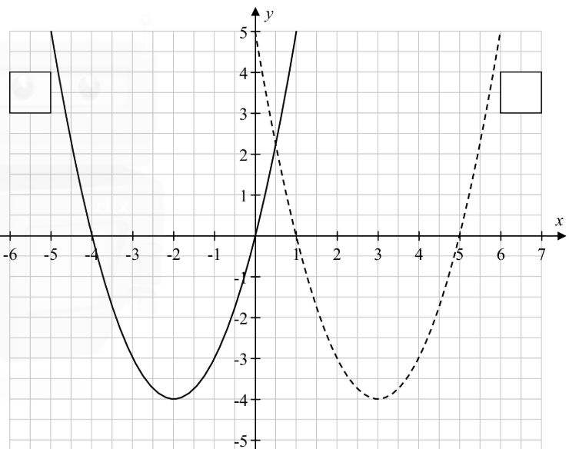
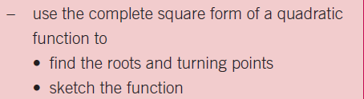

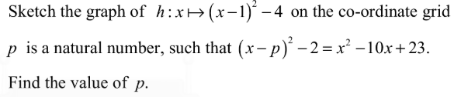
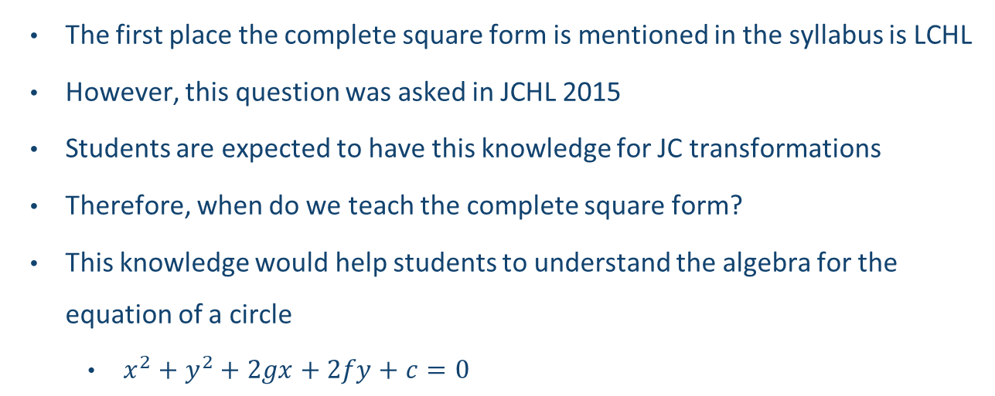
Complete Square Form
The first place the complete square form is mentioned in the syllabus is LCHL
However, this question was asked in JCHL 2015
Students are expected to have this knowledge for JC transformations
Therefore, when do we teach the complete square form?
This knowledge would help students to understand the algebra for the equation of a circle
  $x^{2}+y^{2}+2gx+2fy+c=0$

Slide 10

Explore: ${\left(x−3\right)}^{2}+{\left(y−2\right)}^{2}=5^{2}$

Slide 11
The Circle
Learning Outcomes
Recognise the importance of Pythagoras’ Theorem in making sense of the equation of a circle.
Understand that often new mathematical knowledge may be developed using knowledge students already have.

