Slide 1
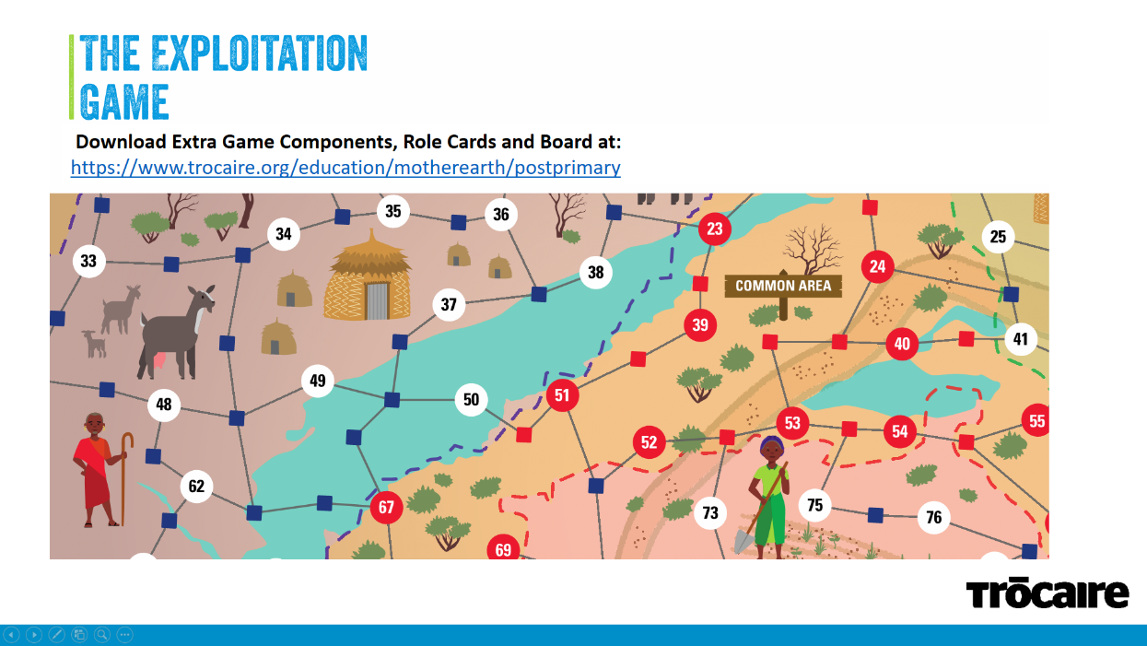

Slide 2
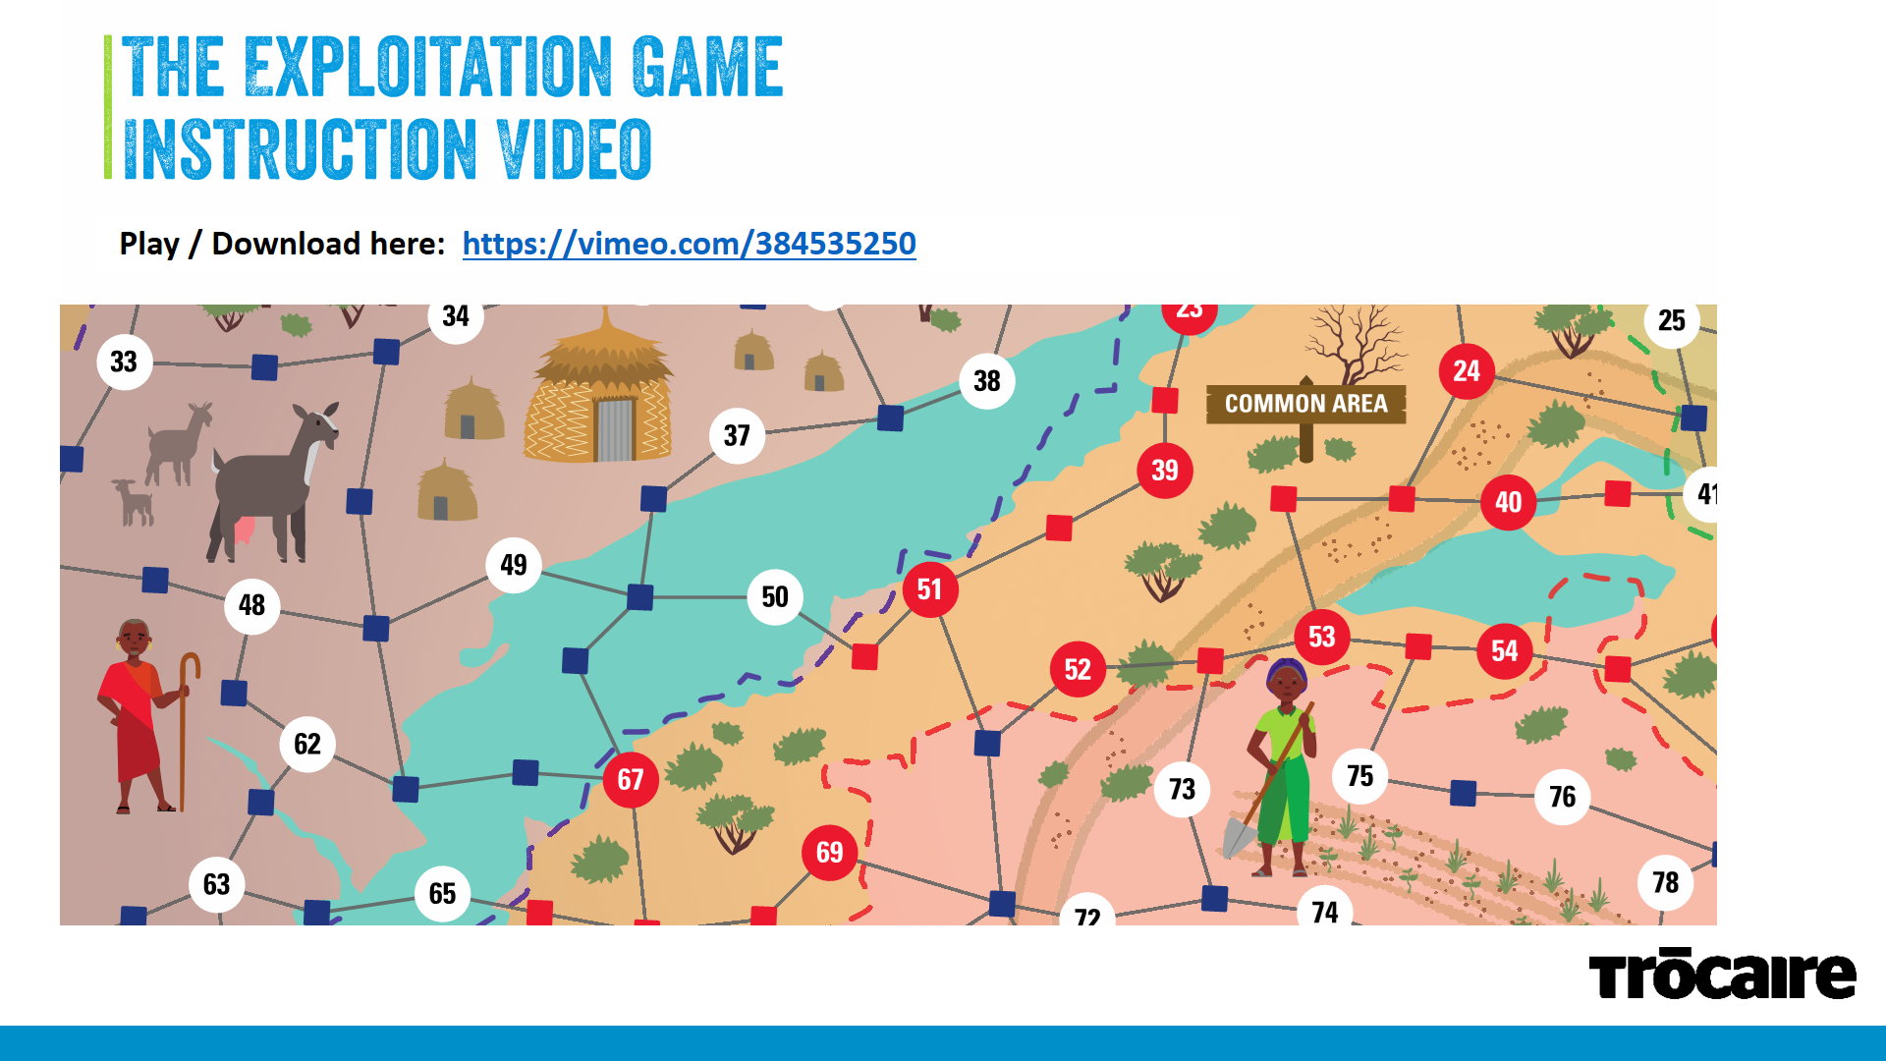

Slide 3
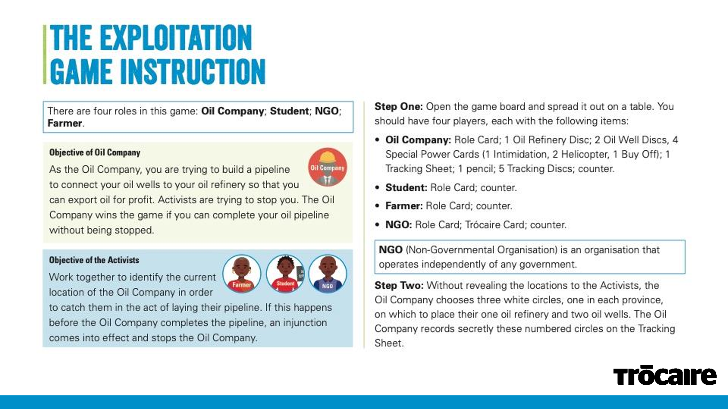

Slide 4
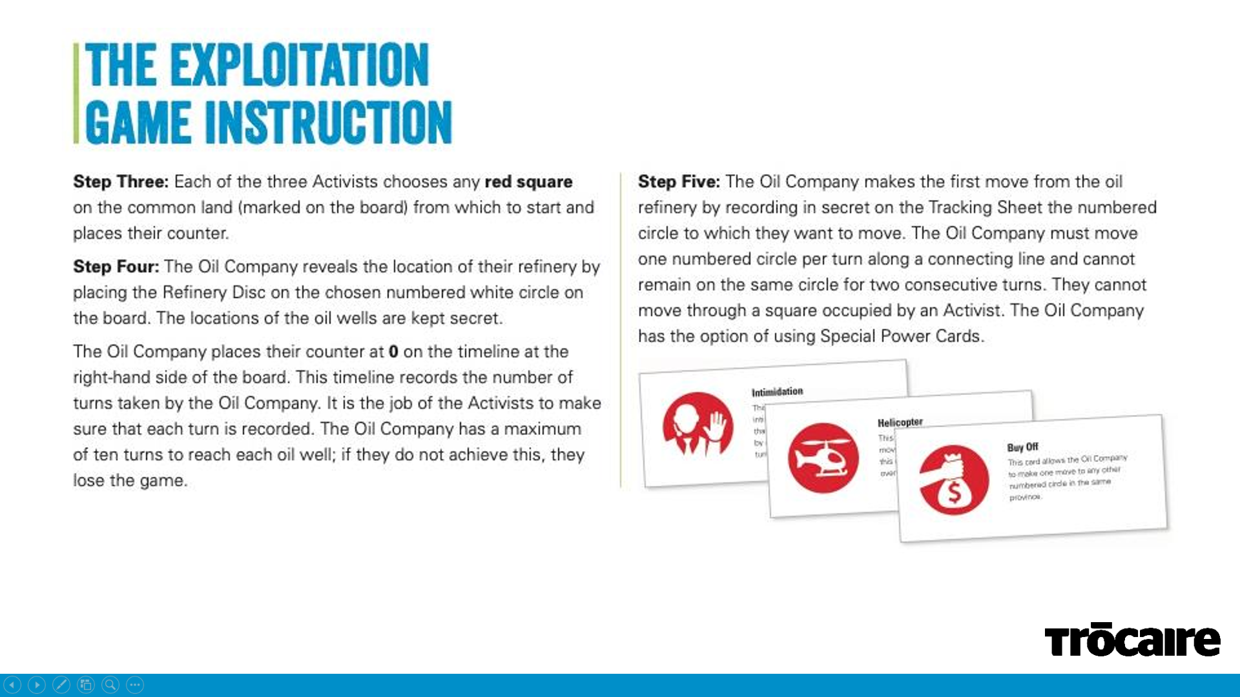

Slide 5
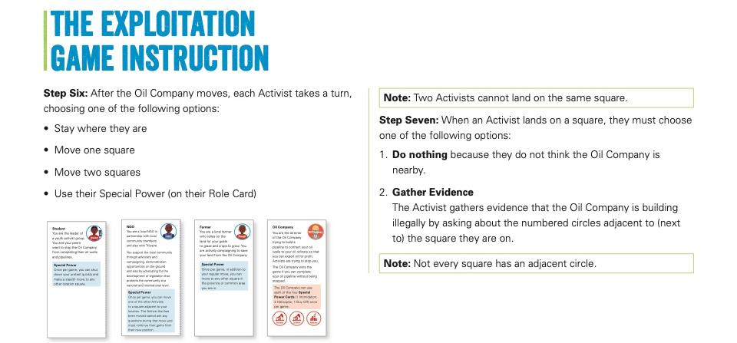

Slide 6


Slide 7
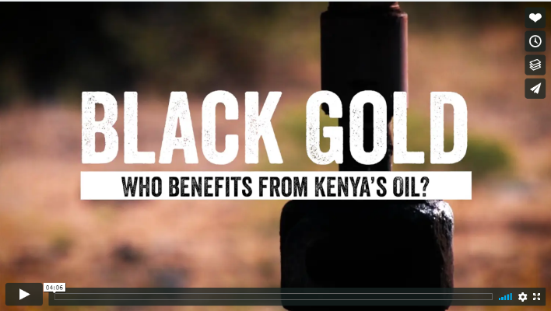
WATCH ‘BLACK GOLD’ WHO BENEFITS FROM Kenya’s oil?
Play / Download here: https://www.trocaire.org/education/motherearth/postprimary

