Slide 1
Human rights defenders game teacher instructions
This is a team game (up to 4 players) where the children work their way through the story to uncover evidence of the 4 human rights violations that are occurring regularly in Honduras. All of these violations are actually happening and several are mentioned in the Teacher Booklet and the Photo Cards in our “mother earth” resource.
The aim is for the children to become aware of the damage that big business, in this case mining and logging companies, can do to indigenous people in countries like Honduras and how, by raising awareness, we can fight to help protect their human rights and their environment.
See link below for more info on how big business is affecting human rights
https://www.trocaire.org/business-and-human-rights/impact-mining
https://www.youtube.com/watch?v=muIzSb84lBQ&feature=youtu.be

Slide 2
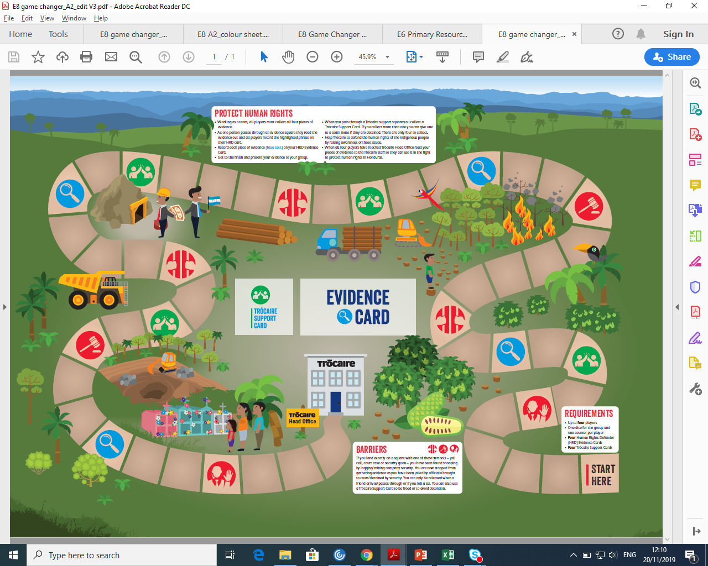
Human rights defenders game
A2 Hard copy – soft copy available online
Colouring activities that can be photocopied on reverse side of A2.
SOFT COPIES that can be printed on a3 can be found at www.trócaire.org/education/motherearth

Slide 3
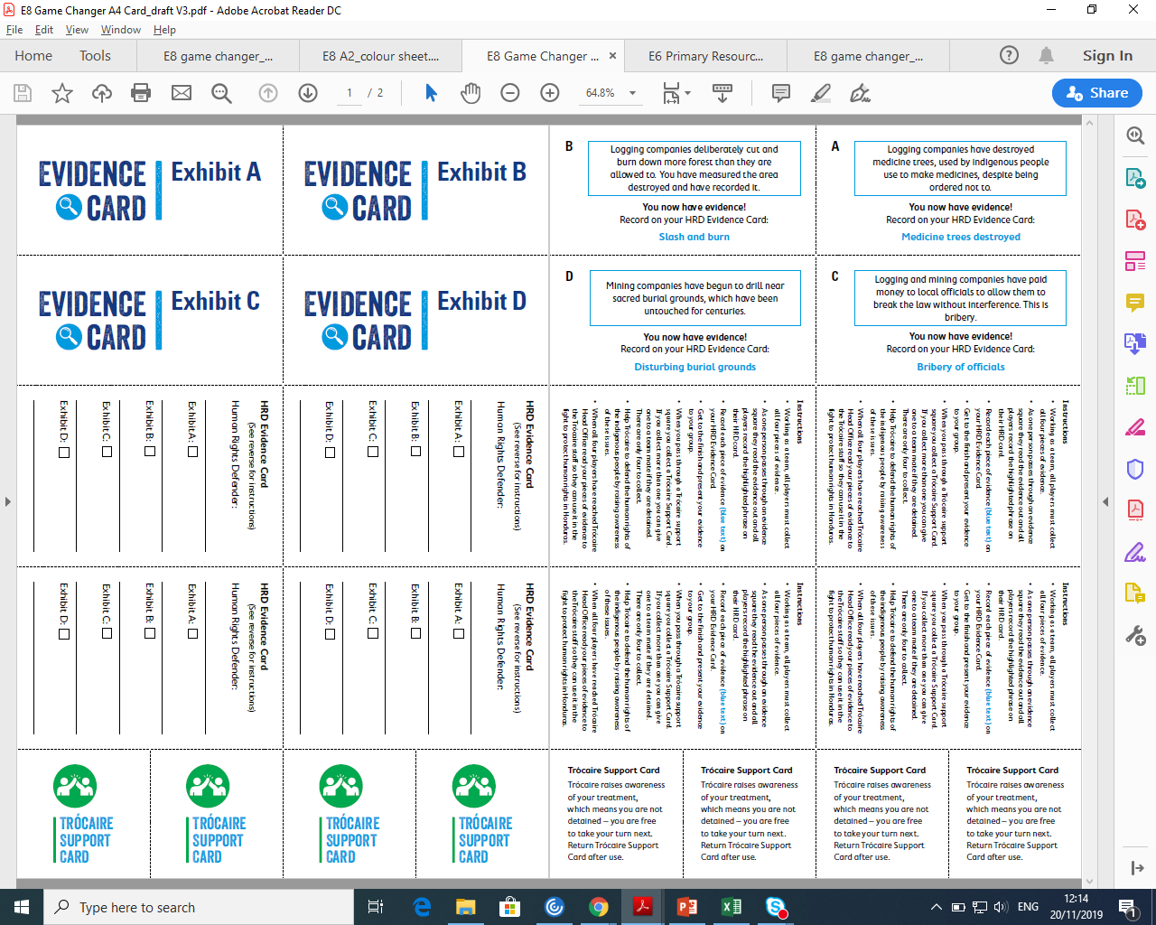
Human rights defenders game
A4 game resource – soft copy available online
4 Evidence Cards
4 Human Rights Defender Cards
4 Trócaire Support Cards
To print more copies a4 soft copies can be found at www.trócaire.org/education/motherearth.
Print on both sides of paper and “flip on long edge”. Simply cut out cards as needed.

Slide 4
Human rights defenders game
GAME instructions
Help Trócaire to defend the human rights of the indigenous people by raising awareness of these issues. ROLL THE DICE AND JUMP THAT NUMBER OF STEPS.
Working as a team, all players must collect all four pieces of evidence.
As one person passes through an evidence square they read the evidence inside the blue box on the back of the evidence card aloud and all players record the highlighted phrase on their HRD card. All players now have that piece of evidence. Record all 4 pieces of evidence as you navigate the game.
When you pass through a Trócaire support square you collect a Trócaire Support Card. If you collect more than one you can give a card to a team mate if they are detained. There are only four to collect.
When all four players have reached Trócaire Office present your evidence to the Trócaire staff so they can use it in the fight to protect human rights in Honduras. (each child in the group should explain one of the crimes to the class/teacher/other group)

Slide 5
Human rights defenders game barriers
If you land exactly on a square with a jail cell/ court case/security goon symbol you have been found snooping by logging/mining company security.
You are now stopped from gathering evidence as you have been jailed by officials/brought to court/detained by security.
You can use a Trócaire Support Card to be released or to avoid detention. The first person to pass through the Trócaire support squares collects the Trócaire Support Cards and there are 4 available. players can give a card to a teammate who is detained if they don’t have ONE TO FREE THEIR FRIENDS.
You can ALSO be released when a friend arrives/passes through or if you roll a six

Slide 6
Game Requirements
Up to four players
One dice
One counter per player
One Human Rights Defender (HRD) Evidence Cards per player
Four Trócaire Support Cards
Four Evidence Cards A-D

