Slide 1
Nets
Prior Knowledge & Rationale
Introducing Nets
Cuboids
Cubes
Cones
Resources

Slide 2
1. Prior Knowledge & Rationale

Slide 3

Prior Knowledge: Juice Box
Rectangular prism
Rectangle
Juice box
Nets
A 2-dimensional representation of a 3-dimensional shape.
Carton
Cuboid

Slide 4
Let’s Define it!

Slide 5
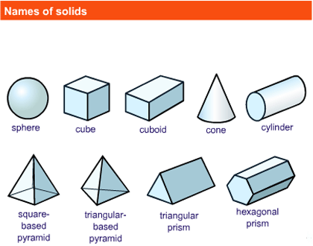
How many 3D shapes can you name?
Cone
Hexagonal prism
Cube
Triangular based pyramid
1
2
3
4
5
Sphere
Cube
Cuboid
Cone
Cylinder
Cuboid
Triangular prism
Sphere
Cylinder
Square based pyramid
6
7
Triangular based pyramid
8
Triangular prism
9
Hexagonal prism
Square based pyramid

Slide 6
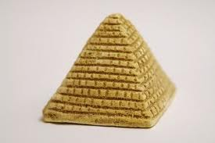
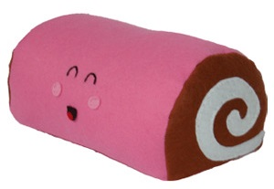
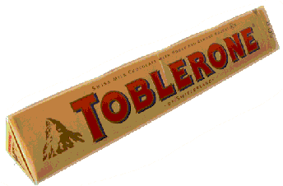
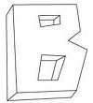
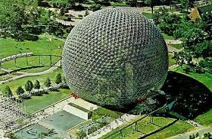

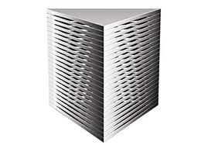
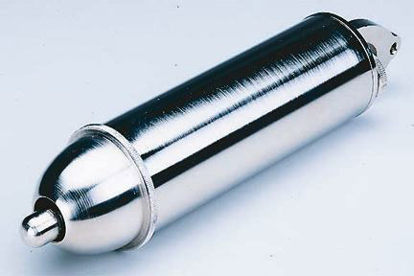
Which of the following are prisms?
A B C
D F
G H
E

Slide 7
Which of the following are prisms?
A solid object that has two identical ends and all flat sides.
The cross section is the same all along its length.
The shape of the ends give the prism a name, such as "triangular prism"

Slide 8
2. Introducing Nets
Introducing nets
&
their development

Slide 9
What is a net?
A 2-dimensional representation of a 3-dimensional shape.

Slide 10

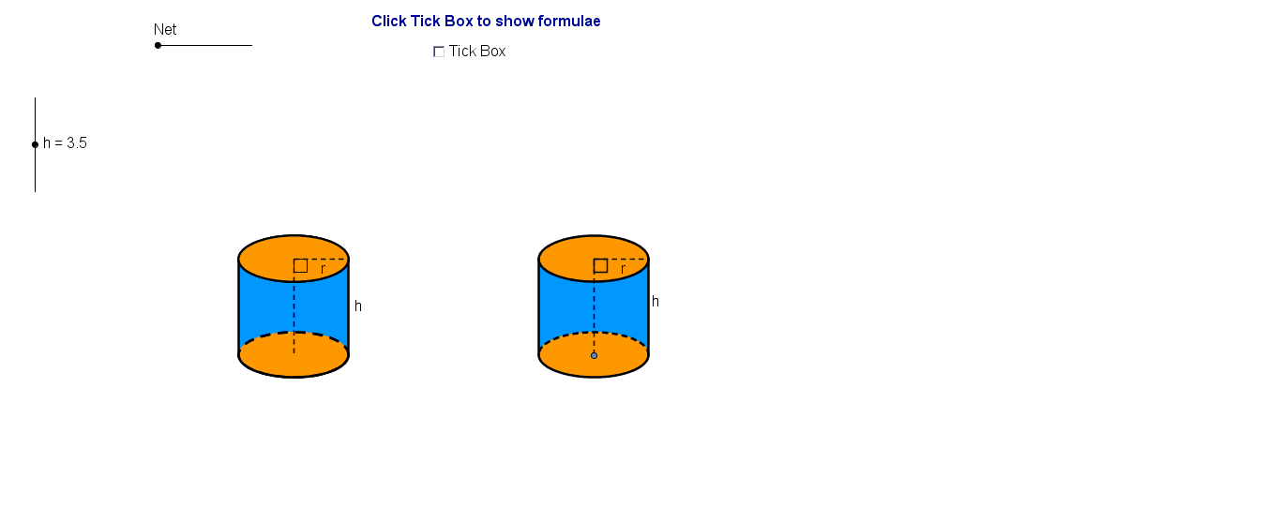
Student’s CD

Slide 11
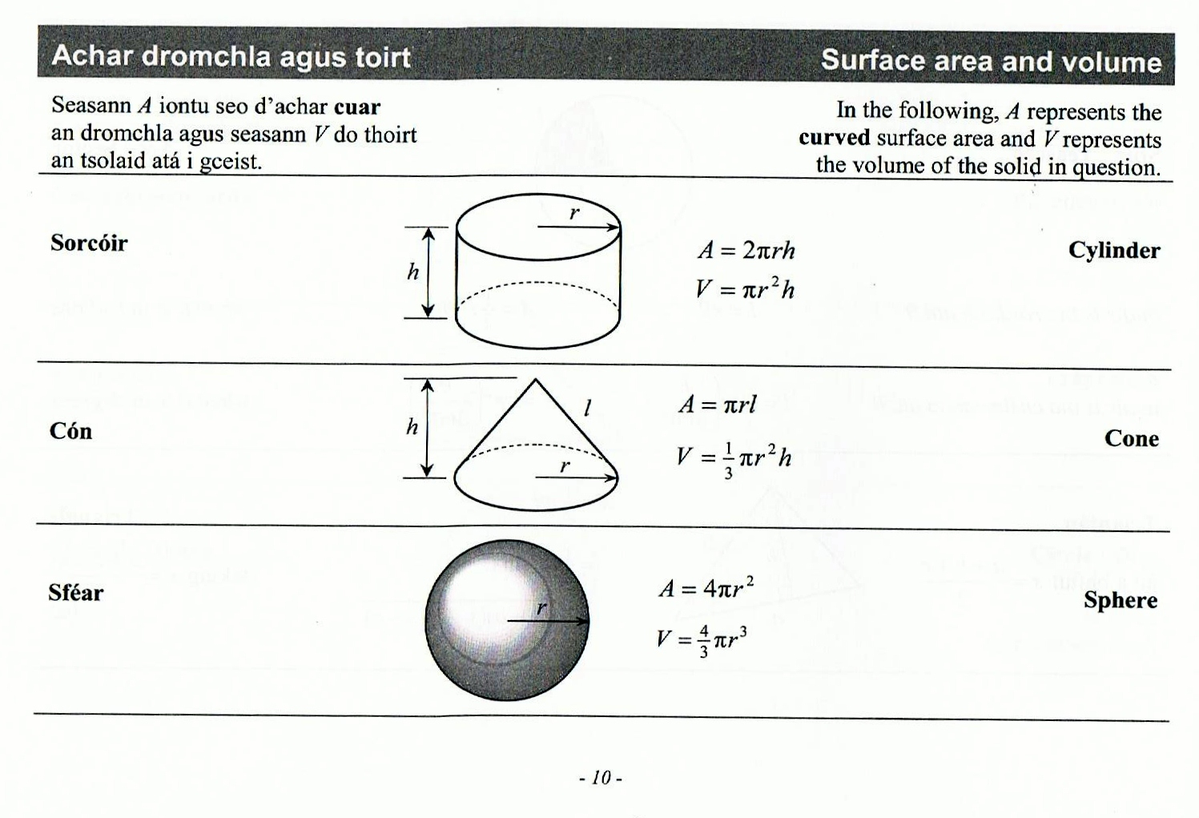




Introducing Formulae
Page 10
$$r$$
$$h$$
$$2πr$$
Surface area = $2πr^{2}+2πrh$

Slide 12
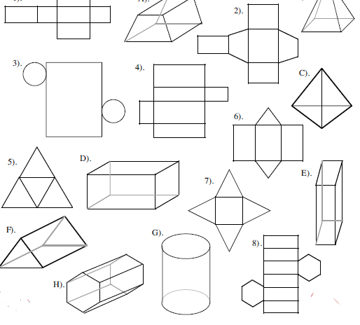
Task: Match nets and their 3D Shape
3D Shape | A | B | C | D | E | F | G | H
Net
3D Shape | A | B | C | D | E | F | G | H
Net | 2 | 7 | 5 | 1 | 4 | 6 | 3 | 8

Slide 13
Spatial Reasoning ??
Spatial Reasoning is not a natural ability
Which is the easiest to go from a Solid to a net
OR
a net to a Solid?
Research says a solid to a net is harder
What do you think? Does it depend on the solid and how familiar you are with it
Link back to previous slide

Slide 14
3. Cuboids

Slide 15
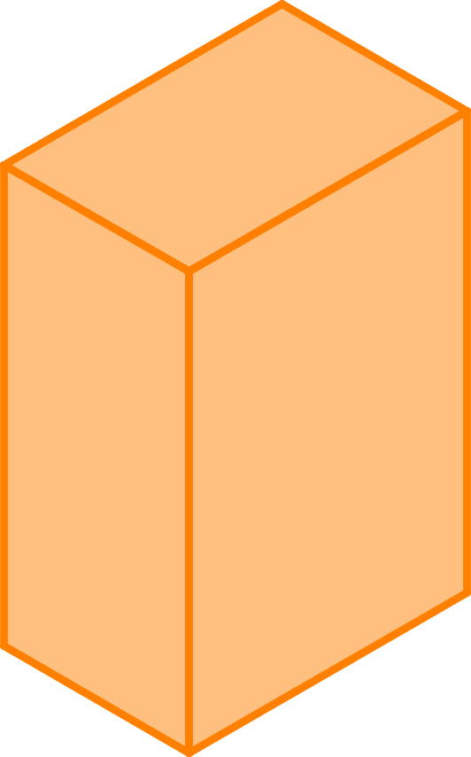
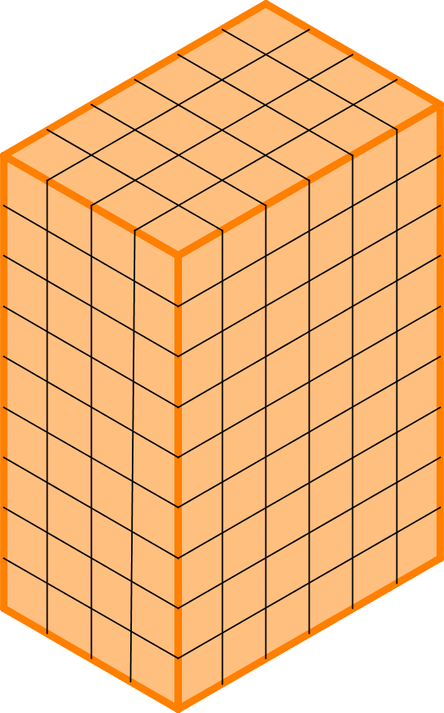
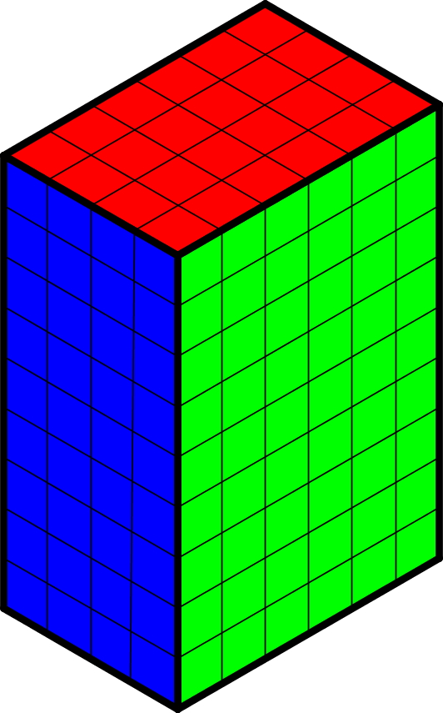
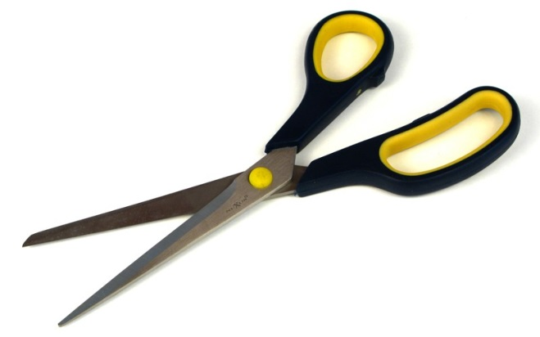
Rectangular prisms (cuboids)
Could you draw an accurate net for this Juice Box?
Juice
Box
9cm
4cm
6cm

Slide 16
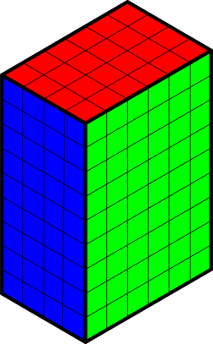
Strategy Used
 |  | C
A | B | A | B
 |  | C
 |  | Top
Back | Side | Front | Side
 |  | Base

Slide 17
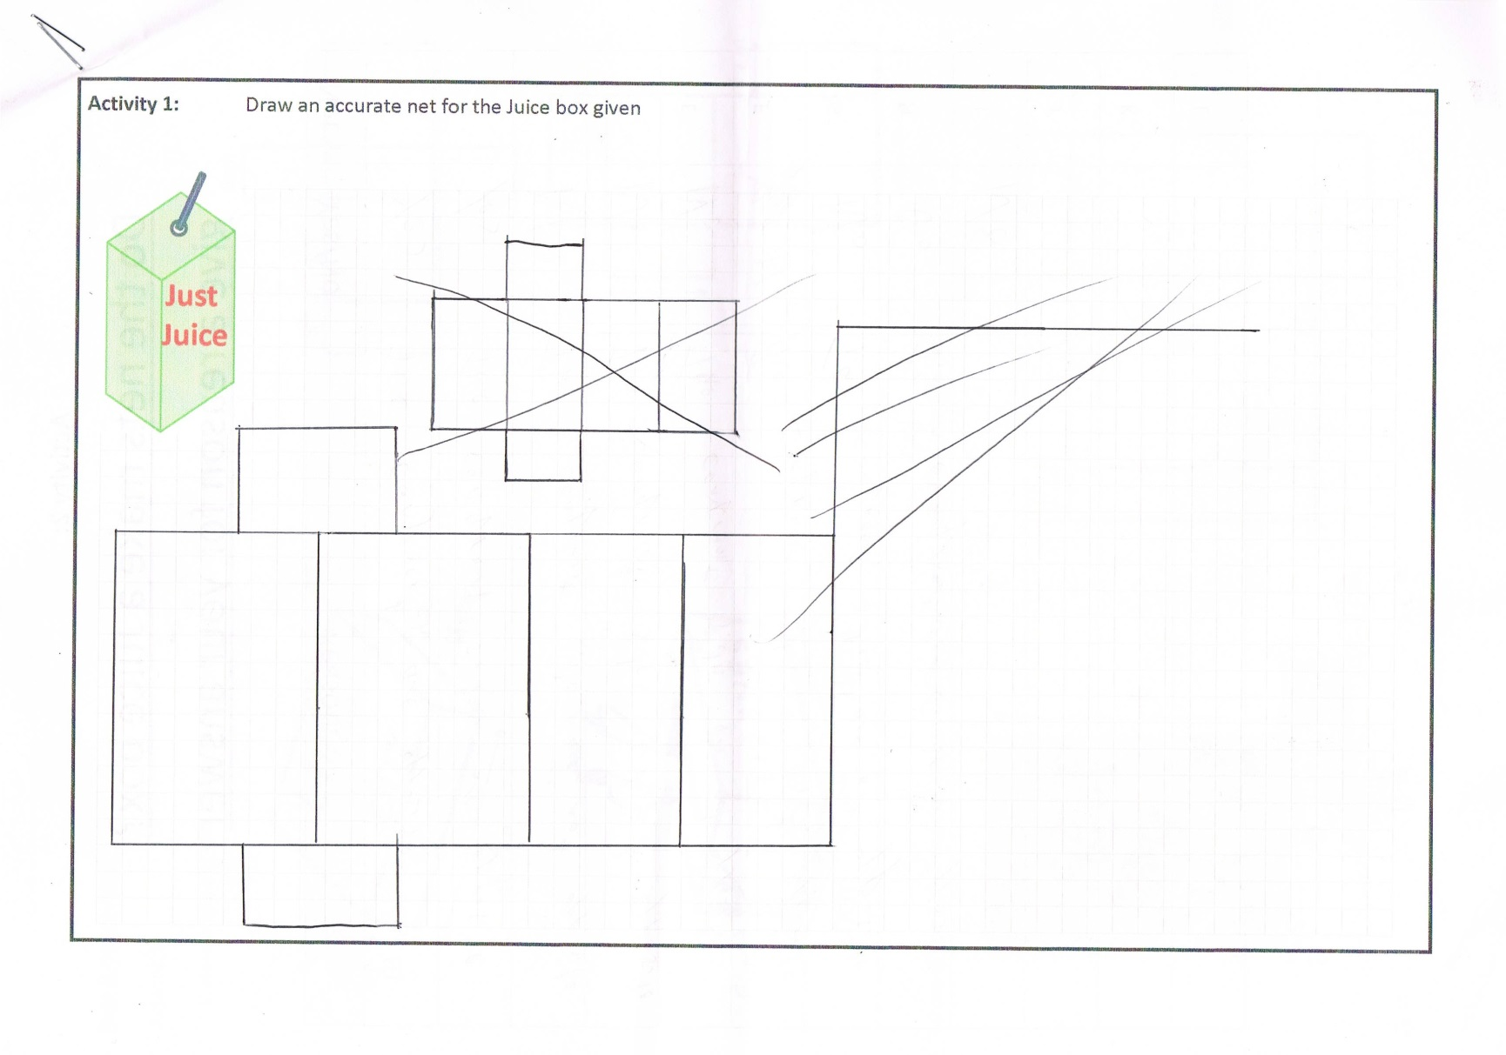
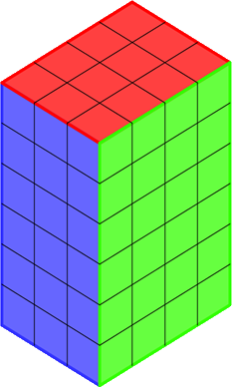
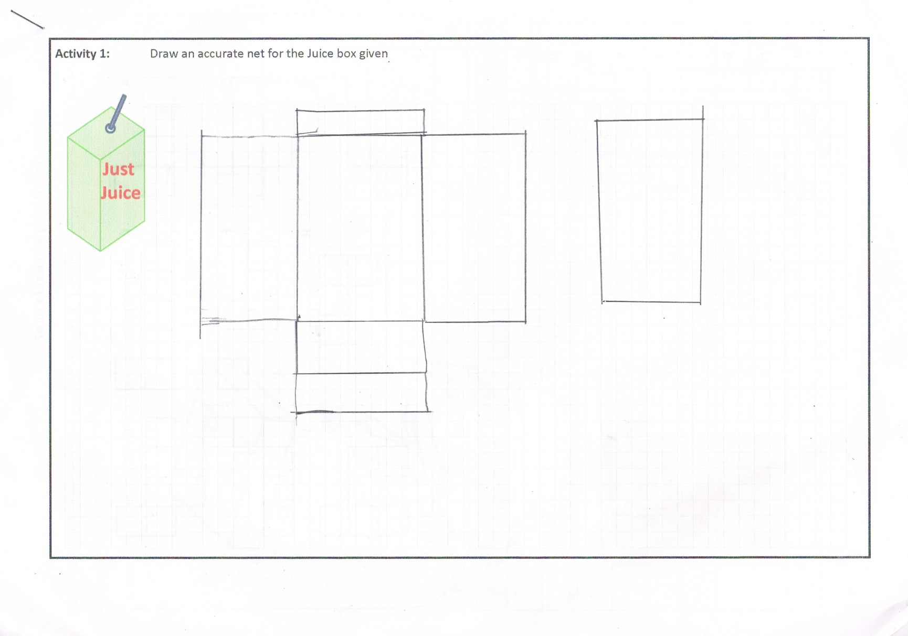
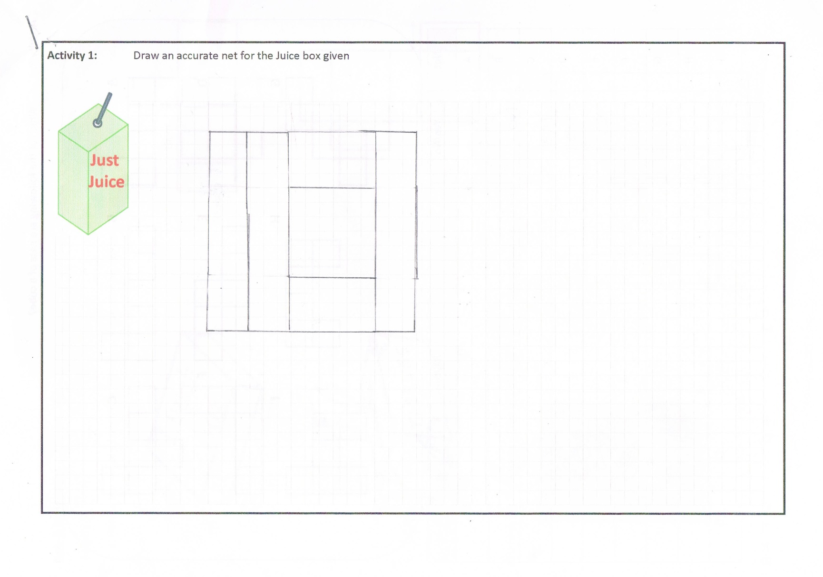
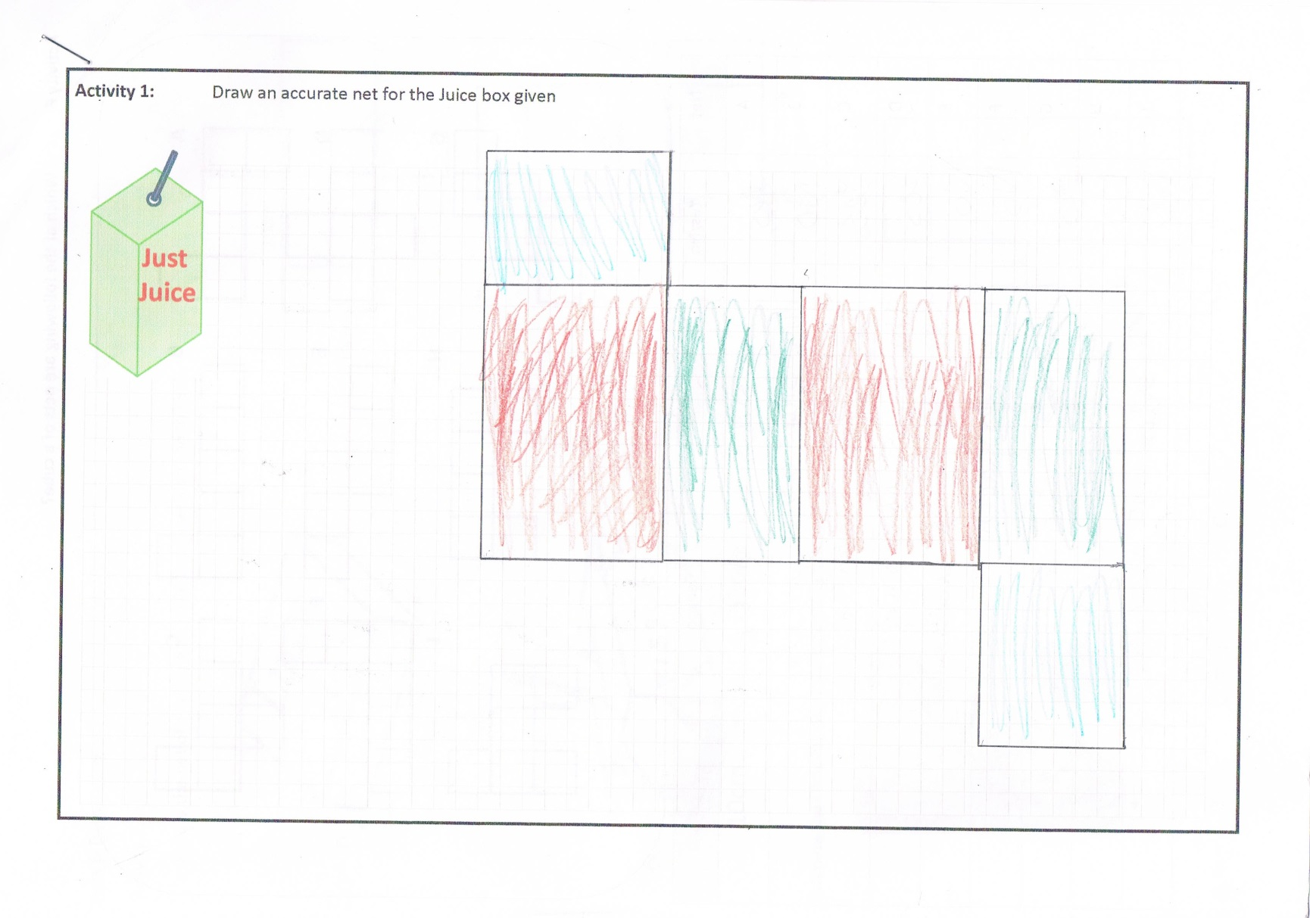
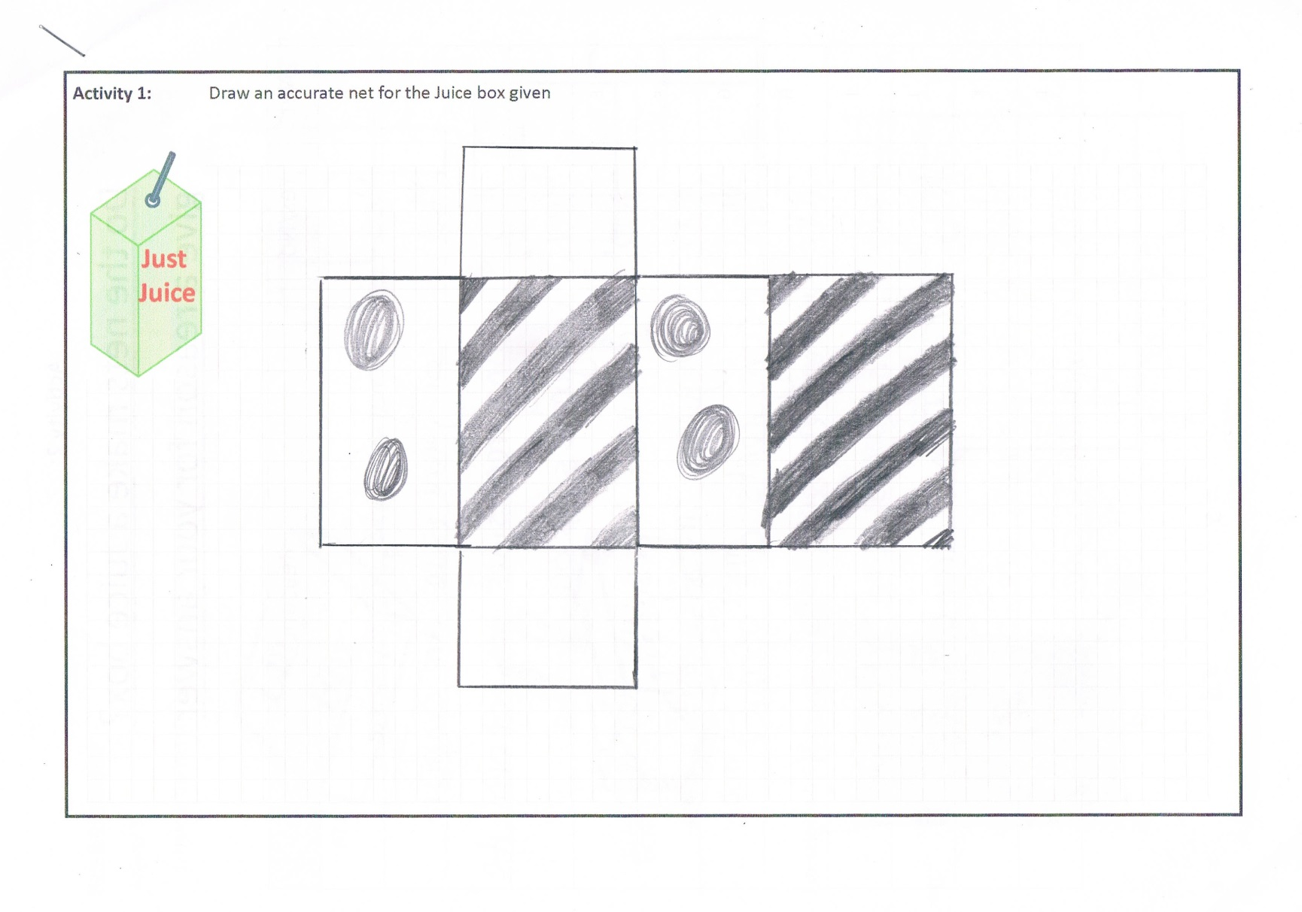
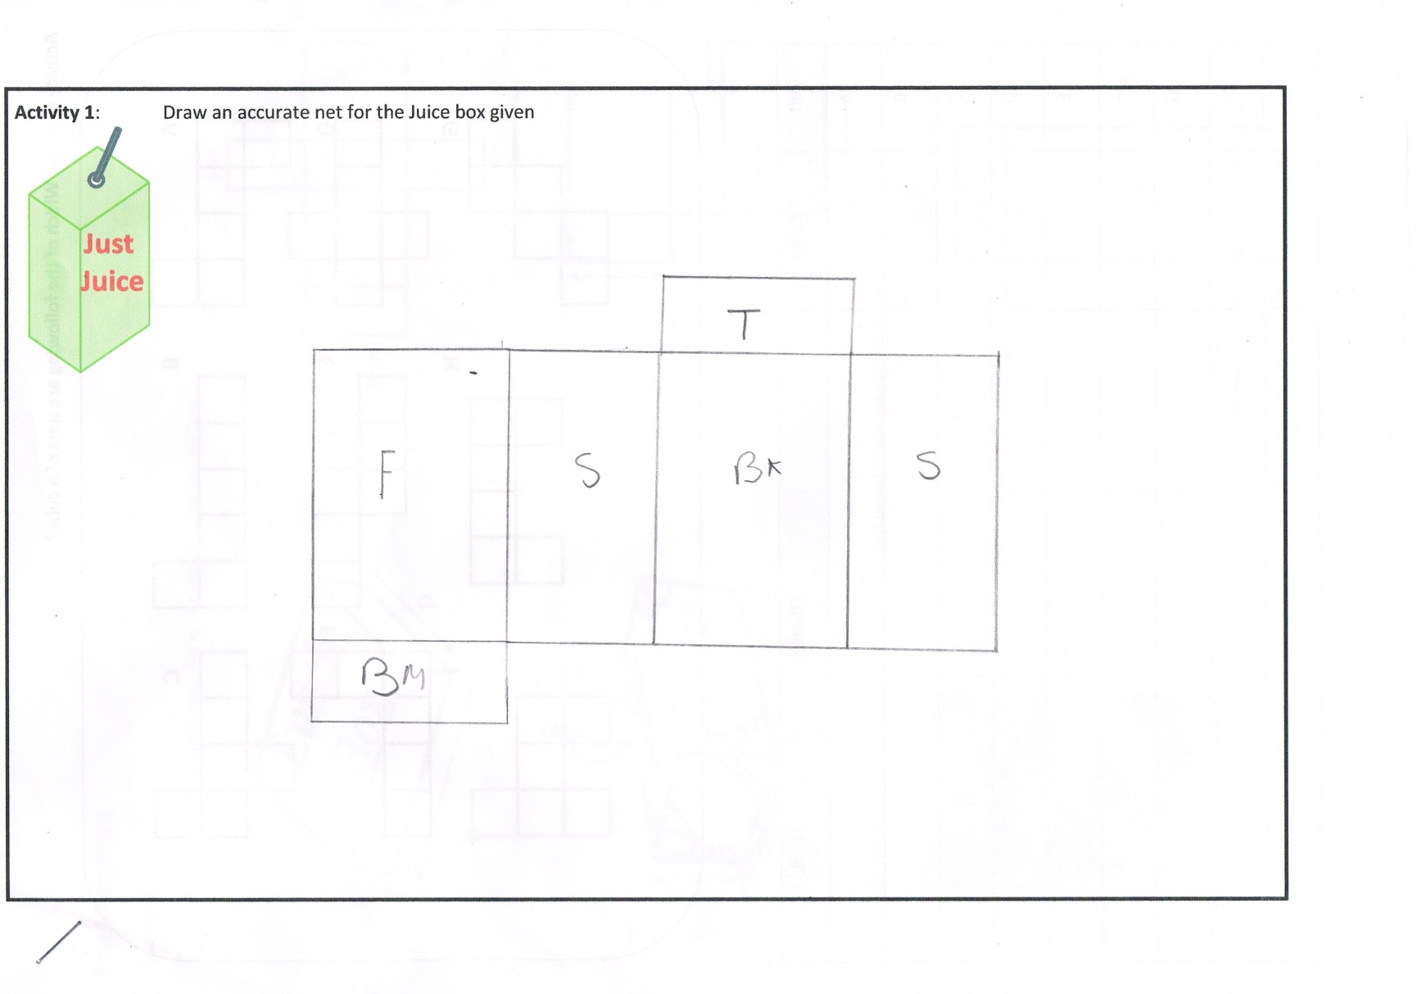
Rectangular prisms (cuboids)
6 cm
3cm
4cm

Slide 18
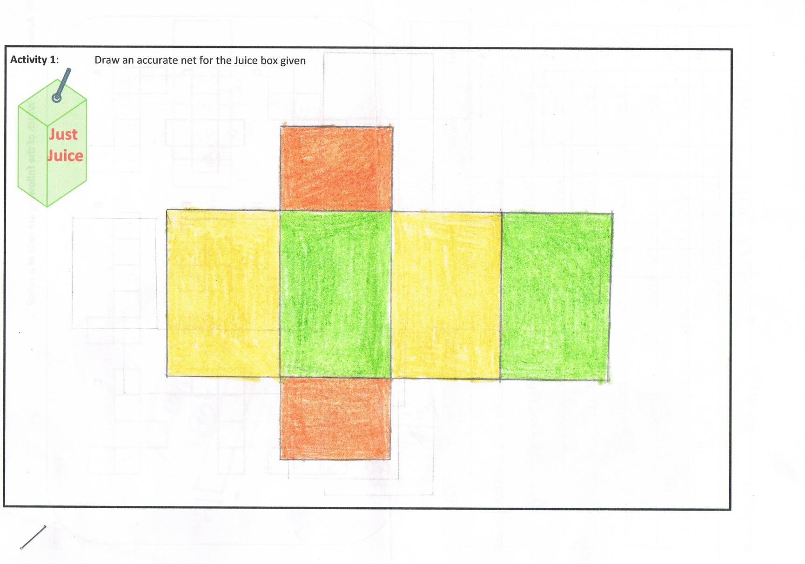
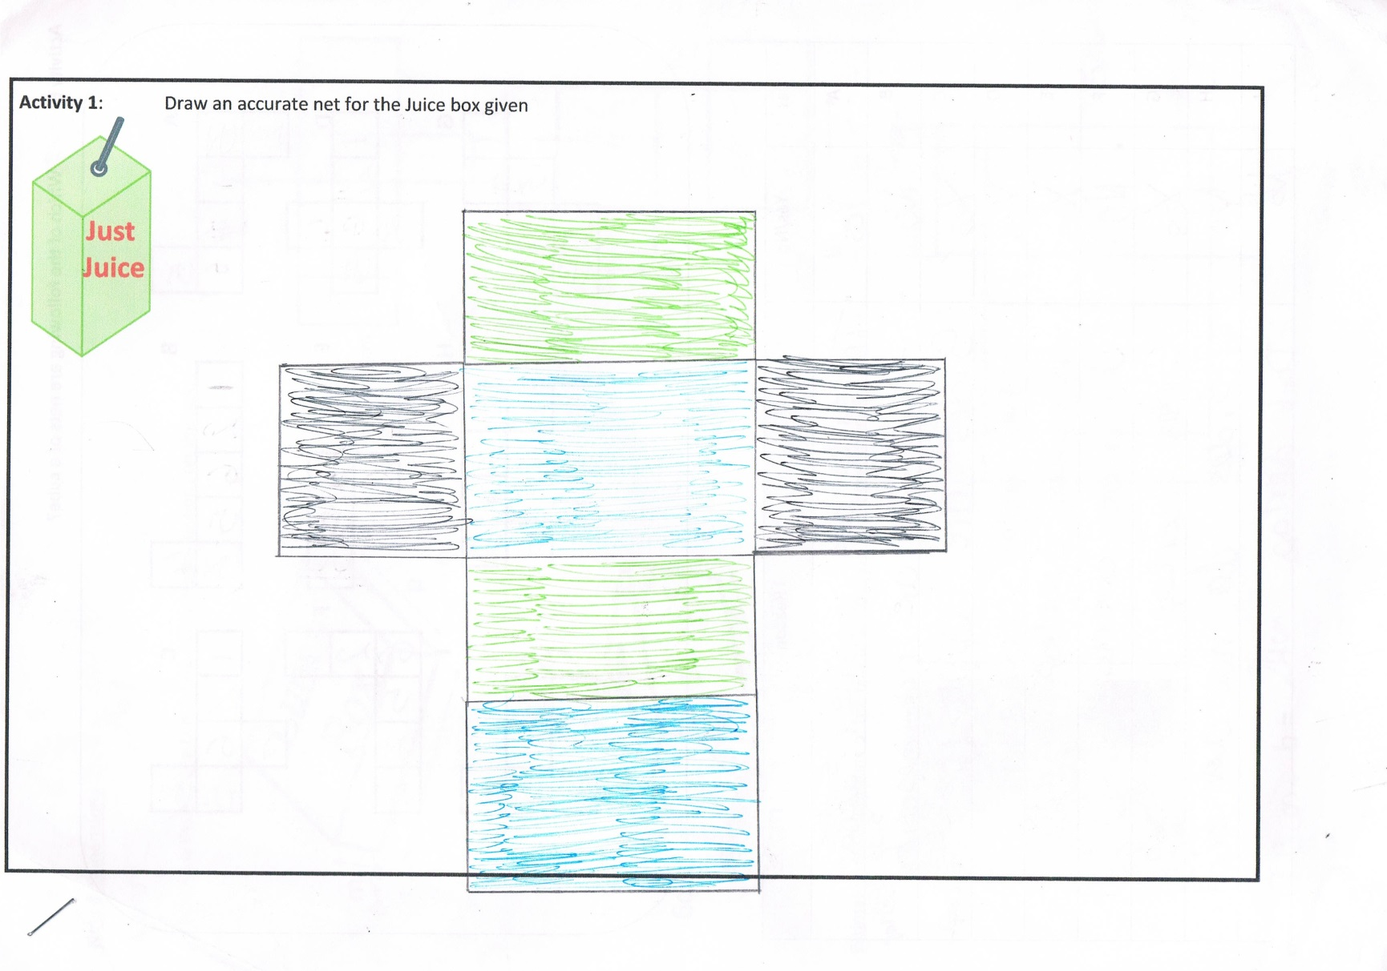
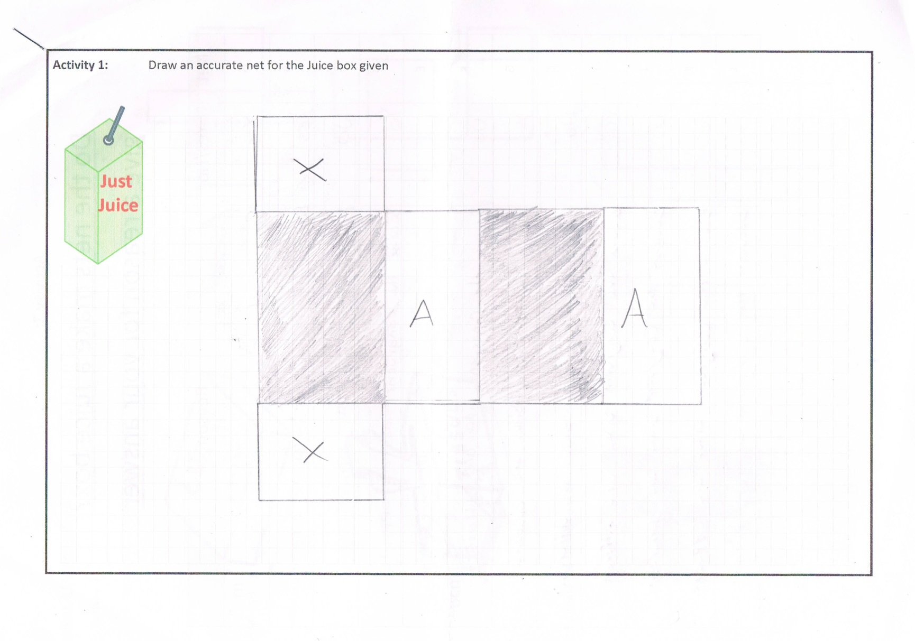
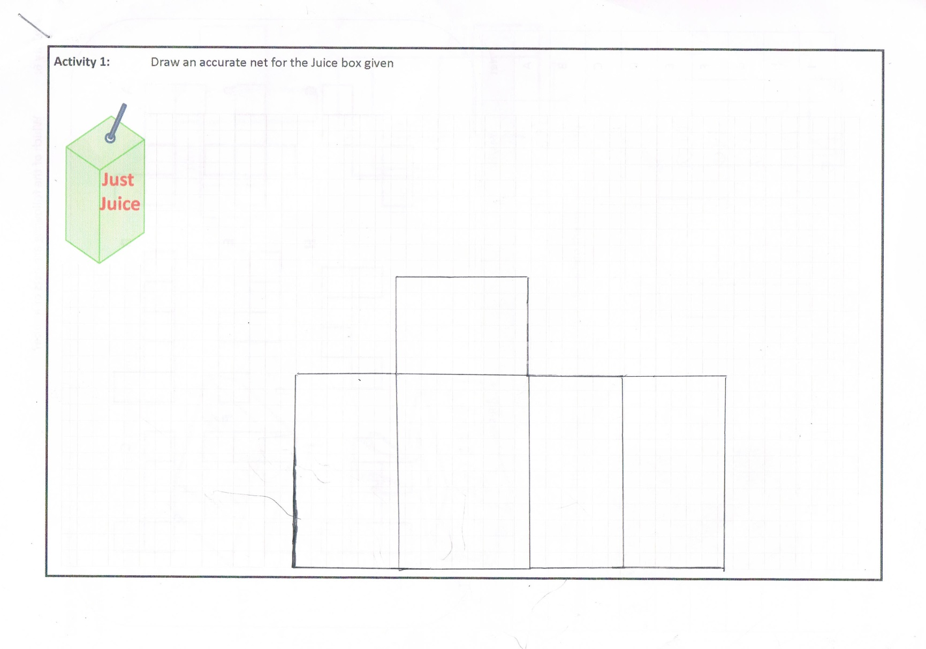
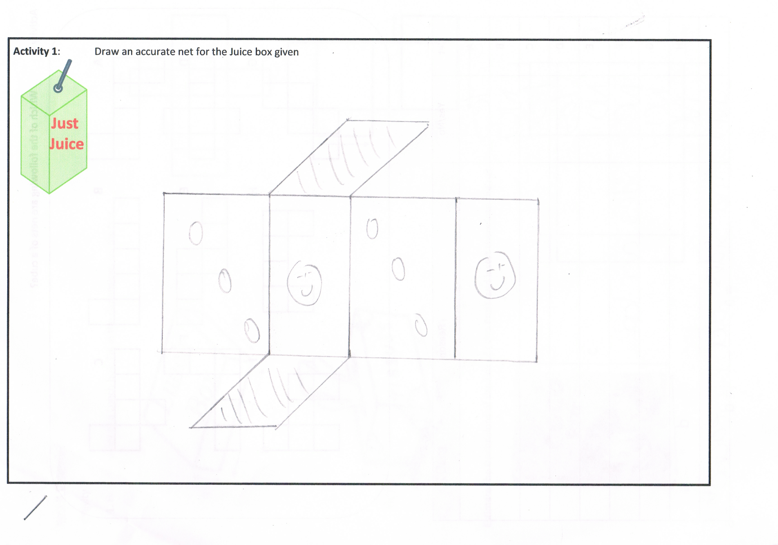
Rectangular prisms (cuboids)
6 cm
3cm
4cm

Slide 19
Rectangular prisms (cuboids)
 |  | Base
 | Side | Base | Side
 |  | Back
 | Side | Base | Side
 |  | Front
 | Strategy | Back
Top | Side | Base | Side
 |  | Front
Draw the base
The sides
The Front and the back
Don’t forget the top!
6 cm
3cm
4cm

Slide 20
Drawing nets
Draw the base
The sides
The Front and the back
Don’t forget the top!
Classroom Activities
Q1
Q2
7cm
2cm
1cm
9cm
2cm
3cm
Q3
5cm
4cm
6cm

Slide 21
Back
7cm
2cm
Side
Base
Side
3cm
Q1
Front
Draw the base
The sides
The Front and the back
Don’t forget the top!
Top

Slide 22
Connections in Mathematics
Within Strands
Curriculum
Subjects
Future
Real
World
Across Strands
Past

Slide 23

Estimating Dimensions
23cm
7.5cm
c cm
34.5cm
565g + 50% Extra Free
a cm
b cm

Slide 24

Estimating Dimensions
D cm
A cm
B cm
C cm

Slide 25
Estimating Dimensions
??cm
???cm
??cm
??cm

Slide 26
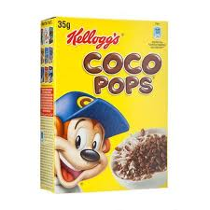
Estimate the dimension of the Coco Pops box
c cm
565g + 50% Extra Free
a cm
b cm

Slide 27
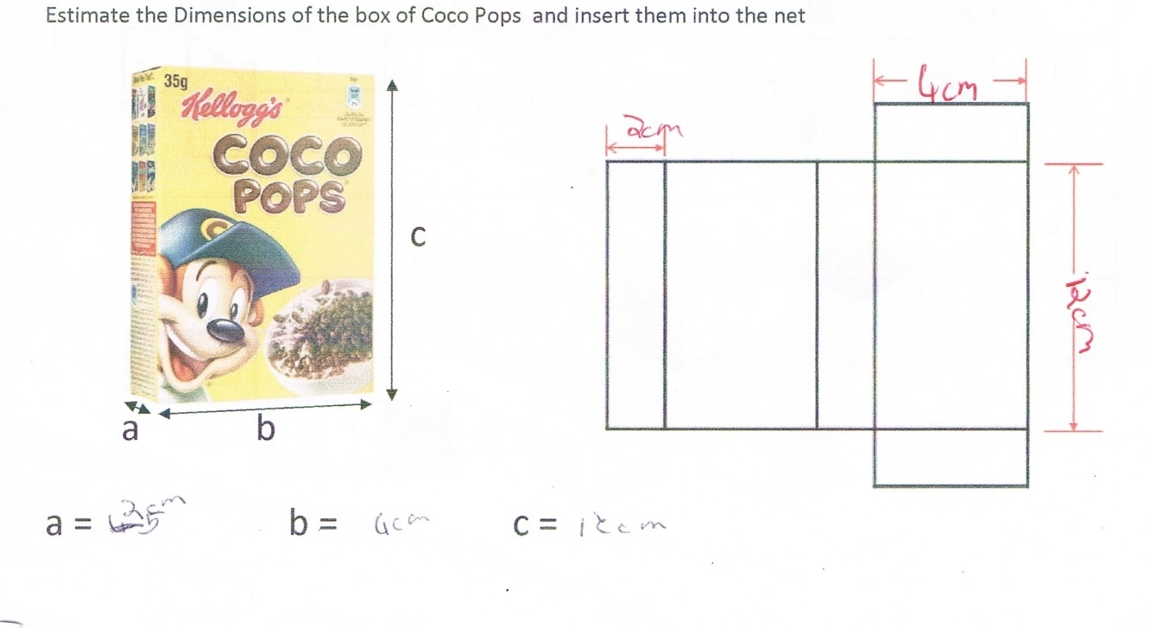
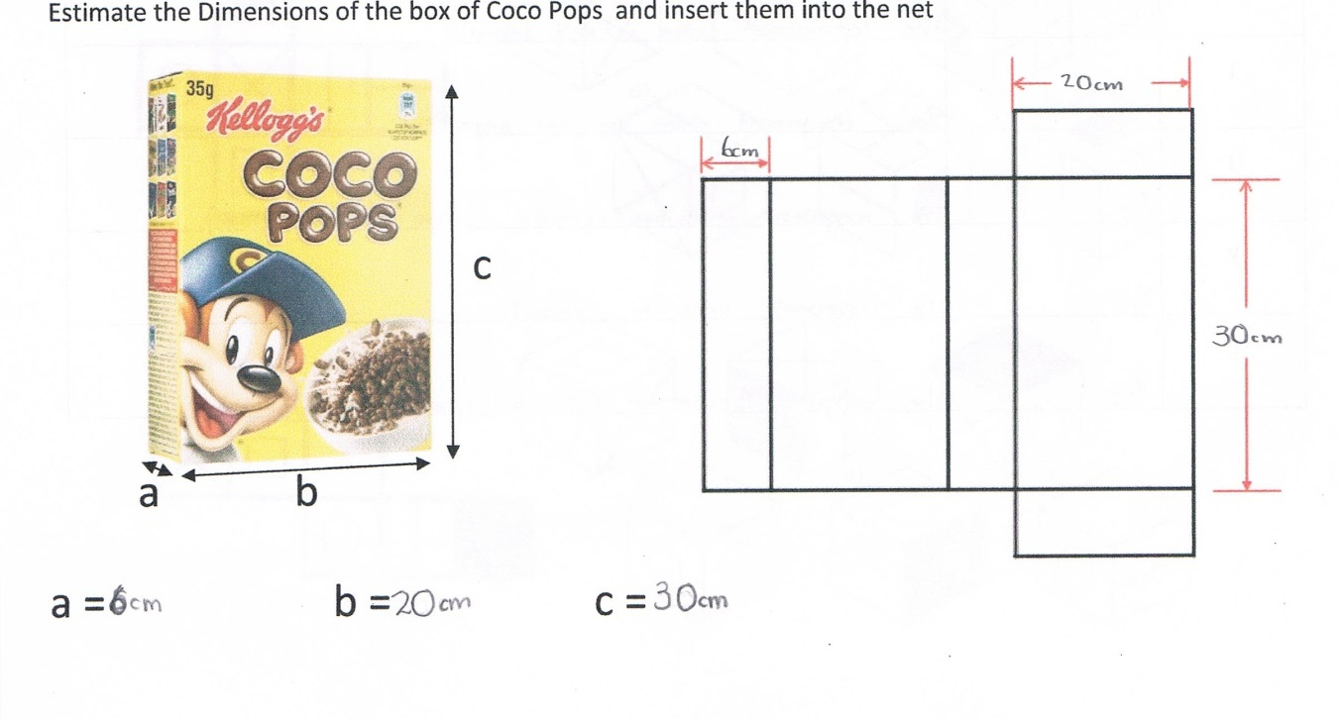
Estimating Dimensions
Jessica
John

Slide 28
Summary
Cuboids
Nets
Students’ Misconceptions
Connections…Estimating Dimensions etc

Slide 29
4. Cubes

Slide 30
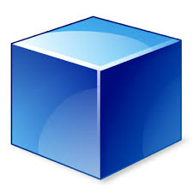
Can you draw the net of a Cube?

Slide 31
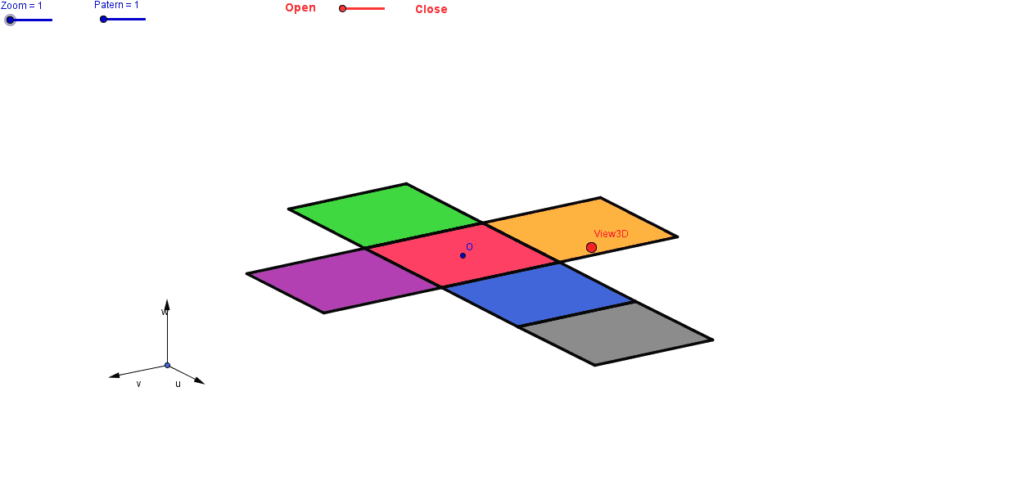


Compare yours to the person next to you

Slide 32
Solids to Nets
Nets to Solids

Slide 33
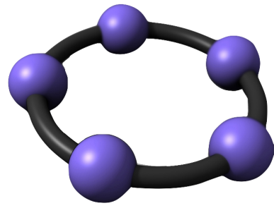
How many nets are there for a cube?

Slide 34


Net mapping
Z
Which shape is on the face opposite the circle?
Which shapes are next to the circle?
Which shape is the arrow pointing to?
Which shape is not next to the square?

Slide 35
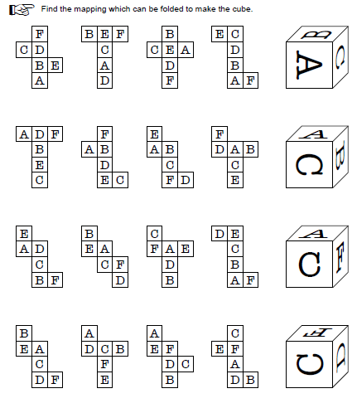
Worksheet
BOOKLET?

Slide 36
Which of the following are nets of a cube?
A B C
D E F
G H I
BOOKLET?

Slide 37
Which of the following are nets of a cube?
A B C
D E F
G H I

Slide 38


Which of the following are nets of a cube?
A B C
D E F
G H I

Slide 39
Connections in Mathematics
Within Strands
Curriculum
Subjects
Future
Real
World
Across Strands
Past

Slide 40
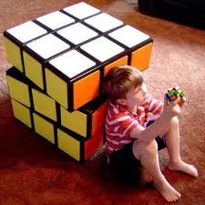

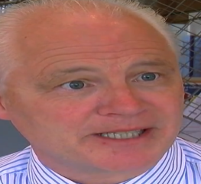
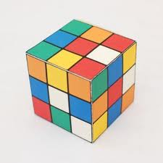
Surface Area of a cube using nets

Slide 41








Surface Area of a cube using nets
Wrapping a rubix cube
Each side is 3cm long
3cm
$Area Square =l^{2}$
3cm
9cm²
$Area Square ={(3)}^{2}$
$Area Square =9{cm}^{2}$
$$Total=$$
$$6(area of one square)$$
$$=6(9)$$
$$=54{cm}^{2}$$

Slide 42
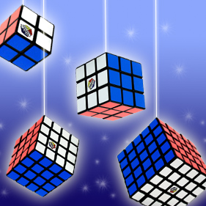
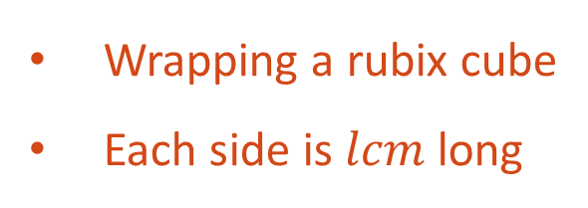





Surface Area of a cube using nets
Wrapping a rubix cube
Each side is $lcm$ long
$$lcm$$
$Area Square =l^{2}$
$$lcm$$
$$l^{2}{cm}^{2}$$
$$Total=$$
$$6(area of one square)$$
$$=6(l^{2})$$
$$={6l}^{2}{cm}^{2}$$

Slide 43
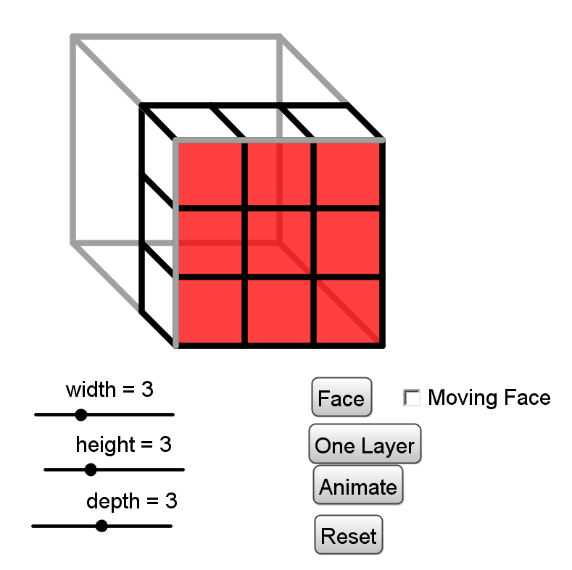
Volume of Prisms

Slide 44
Transformations and Nets
A |  |  |  |  |  | B |  |  |  |  | C
D |  |  |  |  |  | E |  |  |  |  | F
G |  |  |  |  |  | H |  |  |  |  | I
A |  |  |  |  |  | B |  |  |  |  | C
D |  |  |  |  |  | E |  |  |  |  | F
G |  |  |  |  |  | H |  |  |  |  | I
A |  |  |  |  |  | B |  |  |  |  | C
D |  |  |  |  |  | E |  |  |  |  | F
G |  |  |  |  |  | H |  |  |  |  | I
A |  |  |  |  |  | B |  |  |  |  | C
D |  |  |  |  |  | E |  |  |  |  | F
G |  |  |  |  |  | H |  |  |  |  | I

Slide 45
What are some of the properties required to form a cube?
1 |  |  |  |  |  |  |  |  | 2
3 |  |  |  |  |  |  |  |  | 4
5 |  |  |  |  |  |  |  |  | 6

Slide 46
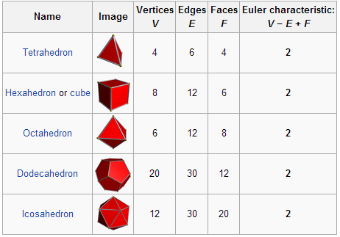
Eulers Formula

Slide 47
Summary
Cubes
Nets
Solids
Surface Area
Volume
Transformations
Euler’s Theorem

Slide 48
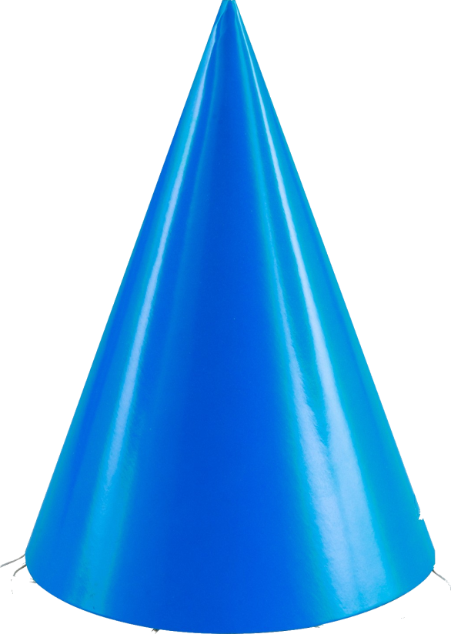
5. Cone Task
Po
st 1st Year
How many times has a student mixed up Perpendicular Height and Slant Height?
How many times have you retaught it over and over again?
NO Longer with one simple question:
Post 1st Year
How many times has a student mixed up Perpendicular Height and Slant Height?
How many times have you retaught it over and over again?
NO Longer with one simple question:
Build a cone of radius 5cm and perpendicular height 12cm

Slide 49
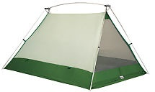
Extension tasks
Estimate the amount of material required to build a 2 person tent

Slide 50
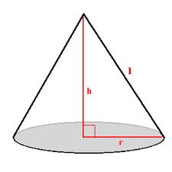
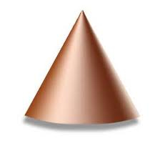





Cone
$$l$$
$$2πr$$
$$2πr$$
$$l$$
$$πr$$

Slide 51


Cone
$$l$$
$$πr$$

Slide 52



Cone
$$l$$
$$Curved SA= πrl$$
$$πr$$

Slide 53
Summary
Cone
Slant Height
Perpendicular Height
Problem Solving
Pythagoras’ Theorem
Curved Surface Area Formula
Angles
Psychomotor skills

