Slide 1
Task 1 - Functions
Learning Outcomes
During the course of this task we will:
Explore the definition of a function and recognise that the set of functions is a subset of the set of relations
Explore the multi-representations of functions and relations and use these to understand the difference between a function and a relation
Explore the concept of inverse and investigate the idea that the inverse of a function is not always a function
Recognise the criteria that apply in order for a function to have an inverse which is also function.

Slide 2
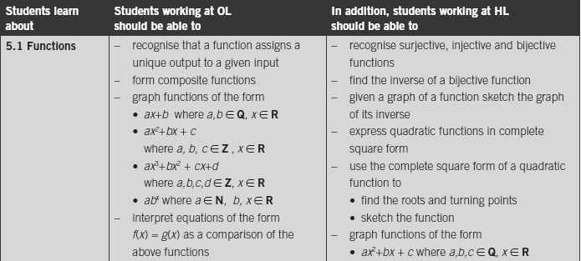

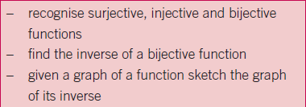
Relationship to Syllabus

Slide 3

Task 1.1: Mapping Representations
Functions and Relations matching activity
Considering each of the mapping diagrams, distinguish which diagram represents a function and which represents a relation only.
Explore the differences between a relation and a function.
Describe the conditions necessary to define a function.

Slide 4
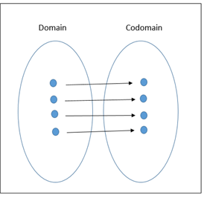
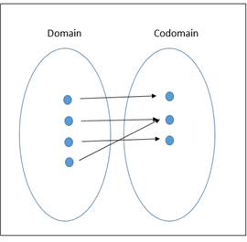
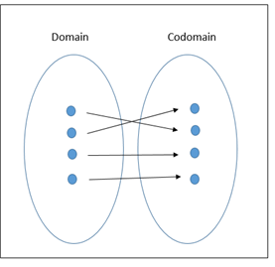
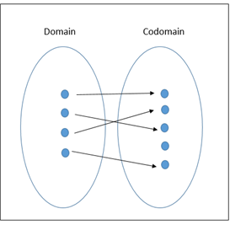
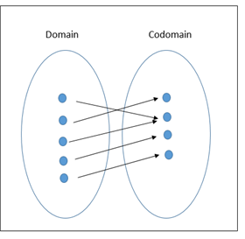
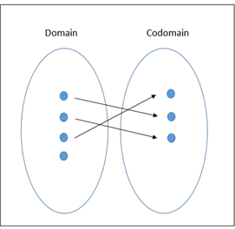
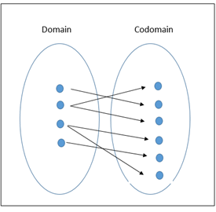
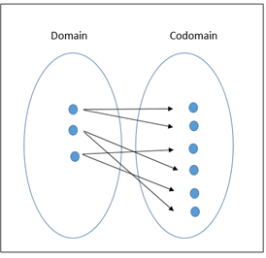
Functions
Relation only

Slide 5
Task 1.2: Matching graphs, couples and algebraic notation
From the set of functions and relations, match the appropriate graph with its algebraic equation and set of couples.
Identify which group of representations are functions and which are relations only. Explain your reasoning.

Slide 6









Solutions

Slide 7
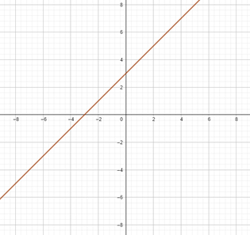
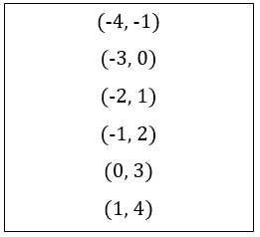
Task 1.2 Solutions - Functions

Slide 8
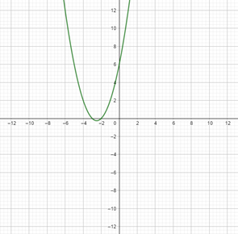
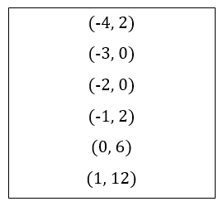

Slide 9
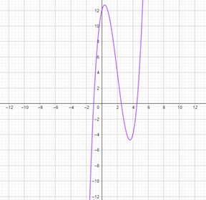
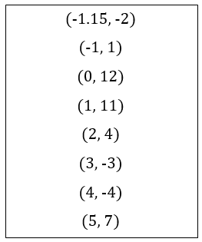

Slide 10
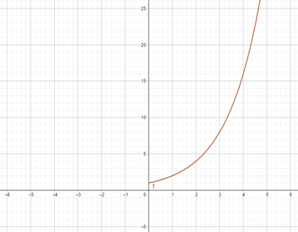
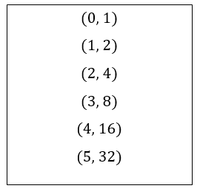

Slide 11
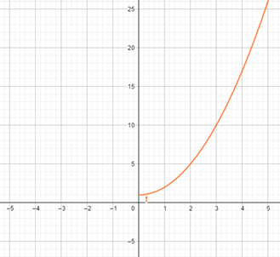
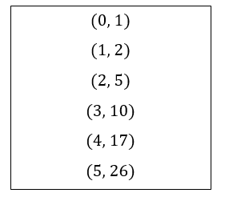

Slide 12
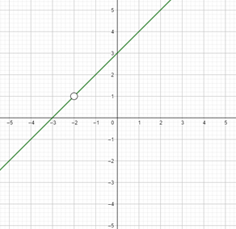
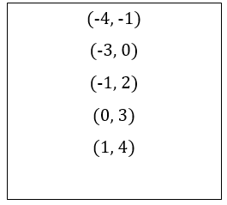

Slide 13
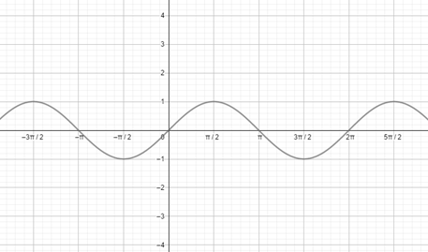
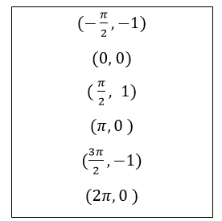

Slide 14
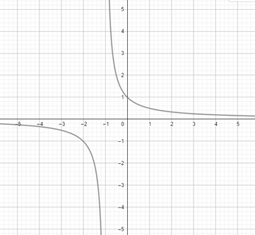
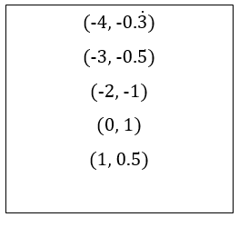

Slide 15
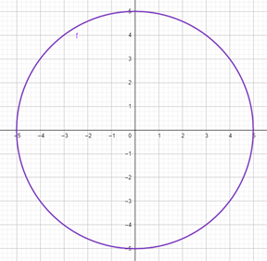
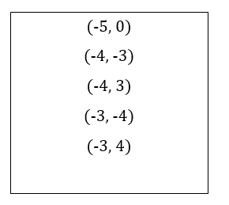
Task 1.2 Solutions - Relations

Slide 16

Discussion
Why do we undo?
Why is it important for us to be able to go backwards?

Slide 17
Task 1.3 Functions and their inverses
Relations

Slide 18
Task 1.3 Functions and their inverses
Which functions in Task 1.2 have inverses that are functions?

Slide 19
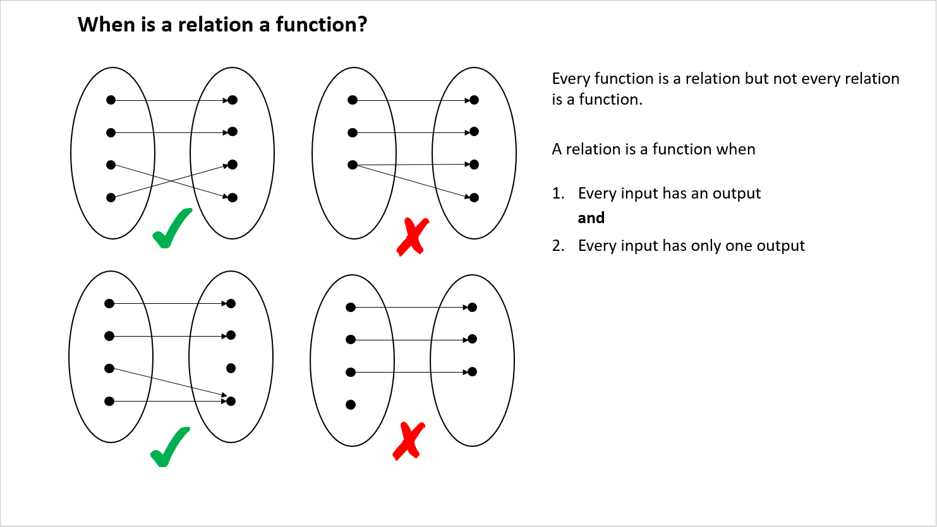
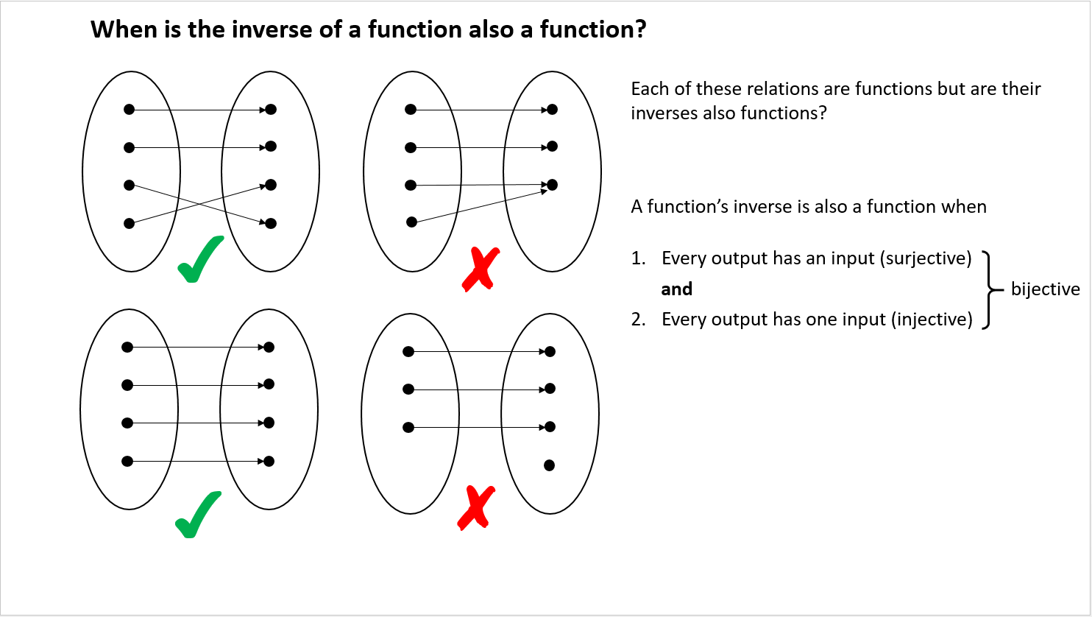
Summary

Slide 20
Task 1 - Functions
Learning Outcomes
During the course of this task we will:
Explore the definition of a function and recognise that the set of functions is a subset of the set of relations
Explore the multi-representations of functions and relations and use these to understand the difference between a function and a relation
Explore the concept of inverse and investigate the idea that the inverse of a function is not always a function
Recognise the criteria that apply in order for a function to have an inverse which is also function.

